Slide 1



http://angular.io/
Part1. Introduction.
Vitaliy Zhyrytskyy
Senior Training and Development Specialist, EPAM
Email: Vitaliy_Zhyrytskyy@epam.com
Skype: v.zhiritskiy

Slide 2
Angular Course Overview
Introduction – 2H
Components – 4H
Services and DI – 2H
Pipes – 1H
Routing (Workshop) – 6.5H
HttpClient (Workshop) – 2.5H
Forms (Workshop) – 5H
Unit Tests – 2.5H
Total: 8 - Topics, 12 - Sessions, 25.5 - Hours

Slide 3

Requirements
Node.js
https://nodejs.org/en/
Git
https://git-scm.com
Angular-CLI
npm install –g @angular/cli
Visual Studio Code
https://code.visualstudio.com

Slide 4

Outline
Angular Features
Angular Architecture
Angular CLI

Slide 5
Angular Features

Slide 6





Angular
Angular 5
Angular 4
Angular 2
AngularJS
2009

Slide 7



Mobile Apps

Slide 8
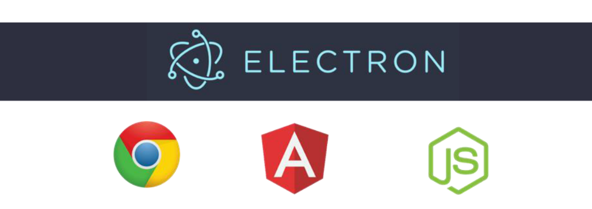
Installed on Desktop
http://electron.atom.io/

Slide 9
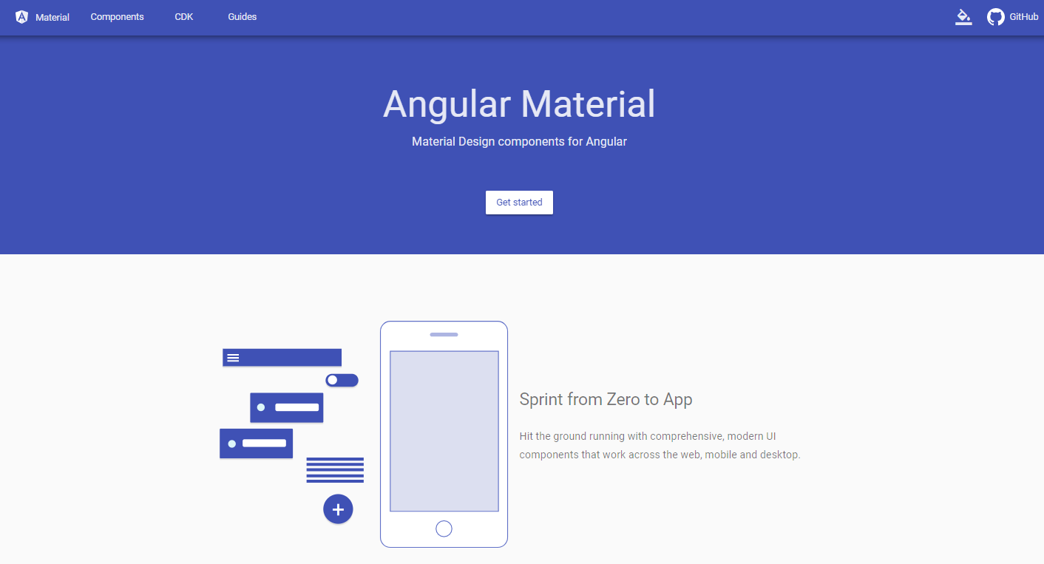
Angular Material – UI Components
http://material.angular.io

Slide 10
Coding Angular
ES5
ES2015+
TypeScript
Dart

Slide 11
Architecture

Slide 12
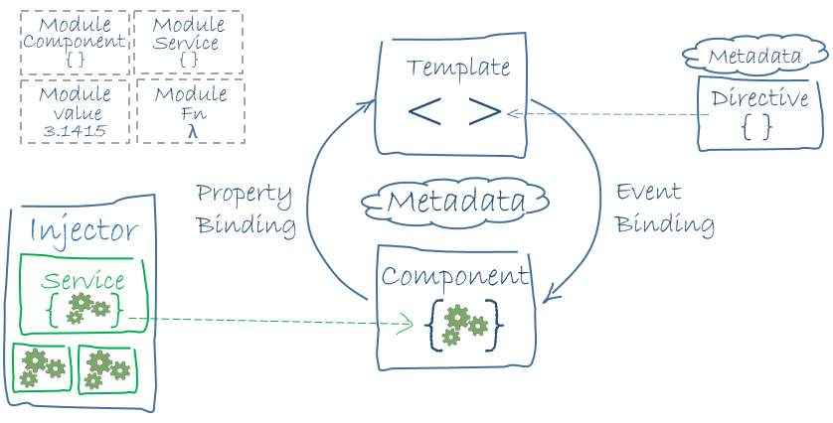
Big Picture
Source: https://angular.io/guide/architecture

Slide 13
1.1. JavaScript Module System
import { Component, OnInit } from '@angular/core';
import { Http, Response } from '@angular/http';
export class AppComponent {}
Import these
Modules
Export these

Slide 14
1.2. Angular Modules
// app.module.ts
import { NgModule } from '@angular/core';
import { BrowserModule } from '@angular/platform-browser';
import { AppComponent } from './app.component';
import { Logger } from './logger.service';
@NgModule({
declarations: [ AppComponent ], // components, directives, pipes
providers: [ Logger ], // services
imports: [ BrowserModule ], // modules
exports: [ ], // public components
bootstrap: [ AppComponent ] // root component
})
export class AppModule { }

Slide 15
2. Bootstraping Angular root module. file: main.ts
import { platformBrowserDynamic } from '@angular/platform-browser-dynamic';
import { AppModule } from './app.module';
platformBrowserDynamic().bootstrapModule(AppModule)
.catch(err => console.log(err));

Slide 16
3.1. Component Class
export class TaskListComponent implements OnInit {
tasks: Array<Task>; // public property
private msg: string; // private property
constructor() {…} // constructor
ngOnInit() {…} // component lifecycle hook
method() {…} // public method
}

Slide 17
3.2. Component Template
<!-- TaskListComponent Template -->
<h2>Task List</h2>
<ul>
<li *ngFor=“let task of tasks; let i = index; let o = odd;”
(click)=“selectTask(task)”>
{{task.action}}
</li>
</ul>
<!-- TaskDetailComponent -->
<task-detail *ngIf=“selectedTask” [task]=“selectedTask”></task-detail>
ngFor properties: index, odd, even, first, last

Slide 18
3.3. Component MetaData
import { Component } from '@angular/core';
@Component({
selector: 'task-list',
templateUrl: './task-list.component.html',
})
export class TaskListComponent implements OnInit {
// …
}

Slide 19
4. Custom Directive
import { Directive } from '@angular/core';
@Directive({
selector: '[validate-email]'
})
export class ValidateEmailDirective {
// …
}

Slide 20
5. Data Binding
Interpolation: {{task.action}}
DOM
Component
One Way Binding: [task]=“selectedTask”
Component
Event Binding: (click)=“selectTask(task)”
Two Way Binding: [(ngModel)]=“task.action”

Slide 21
6. Built-in Directives
Structural Directives
*ngFor
*ngIf
ngSwitch + *ngSwitchCase + *ngSwitchDefault
Attribute Directives
ngModel
ngStyle
ngClass
ngNonBindable

Slide 22
*ngIf Under the Hood
// * Prefix
<task-detail *ngIf=“selectedTask” [task]=“selectedTask”>
</task-detail>
// Step 1
<task-detail template=“ngIf selectedTask” [task]=“selectedTask”>
</task-detail>
// Step 2
<ng-template [ngIf]=“selectedTask”>
<task-details [task]=“selectedTask”></task-details>
</ng-template>

Slide 23
*ngIf Syntax
// Simple Form:
<div *ngIf=“condition”>…</div>
// Form with ‘else’ block:
<div *ngIf=“condition; else elseBlock”>…</div>
<ng-template #elseBlock>…</ng-template>
// Form with a ‘then’ and ‘else’ block:
<div *ngIf=“condition; then thenBlock else elseBlock”></div>
<ng-template #thenBlock>…</ng-template>
<ng-template #elseBlock>…</ng-template>
// Form with storing the value locally:
<div *ngIf=“condition as value; else elseBlock”>{{value}}</div>
<ng-template #elseBlock>…</ng-template>

Slide 24
ngSwitch Syntax
<td [ngSwitch]="task.done">
<span *ngSwitchCase="true">Yes</span>
<span *ngSwitchDefault>No</span>
</td>

Slide 25
7.1. Services
AngularJS 1.X
Factory
Service
Provider
Constant
Value
Angular
Class

Slide 26
7.2. Service shares data or logic
import { Injectable } from '@angular/core';
import { Task } from './task.model';
@Injectable()
export class TaskSevice {
getTasks() {
return [
new Task(1, 'Create', false),
new Task(2, 'Delete', false)
];
}
}

Slide 27
8. Dependency Injection
import { Component } from '@angular/core';
import { TaskService } from './task.service';
@Component({
selector: 'app',
templateUrl: './app.component.html',
providers: [TaskService] // or register it in module
})
export class App {
name = 'Vitaliy';
constructor(private taskService: TaskService) {}
}

Slide 28
9.1. Built-in Pipes
General Syntax (Template)
<p>{{ expression | pipeName : param1 : param 2 }}</p>
Chaining Pipes
<p>{{'Angular' | slice: 3 | uppercase }}</p>
Angular
ular
ULAR

Slide 29
9.2. Custom Pipes
import { Pipe, PipeTransform } from '@angular/core';
@Pipe({
name: 'age'
})
export class AgePipe implements PipeTransform {
transform(value: any, …args?: any): any {
return `${value} years old`;
}
}

Slide 30
Quick Start

Slide 31
Quick Start (2017-11-01)
Name | Star | Commits | Contributors | Issues | Pull Requests
Angular 2 QuickStart | 3008 | 165 | 24 | 0 | 0
Angular2-seed | 4426 | 2039 | 168 | 10 | 2
Angular2-webpack-starter | 9123 | 1746 | 180 | 25 | 6
Angular-CLI | 13397 | 2001 | 299 | 621 | 70

Slide 32
Angular CLI

Slide 33
Tools
Angular CLI Definition
The Angular CLI makes it easy to create an application that works and follows best practices, right out of the box.

Slide 34

Why Angular CLI
Many ways to create an application
Many seed projects
Maintainability becomes difficult
Conventions and style guides help

Slide 35
Installing Angular CLI and Generating new APP
// install angular cli
npm install –g @angular/cli
// check version
ng –v
// generate the app and run npm install, alias ng n my-app
ng new my-app
// Don’t write the files, but report them
ng new my-app --dry-run // -d
// generate the app and skip npm install
ng new my-app --skip-install

Slide 36
Angular CLI Main Commands
ng new
ng generate ng g
ng lint ng l
ng build ng b
ng serve ng s
ng test ng t
ng e2e ng e
ng get/ng set
ng doc
ng eject
ng xi18n
ng help

Slide 37
Angular CLI Generate Command
ng g component cmp ng g c
ng g directive search ng g d
ng g module login ng g m
ng g service data ng g s
ng g pipe init-caps ng g p
ng g guard auth ng g g
ng g class customer ng g cl
ng g interface orders ng g i
ng g enum gender ng g e

Slide 38
Inspect Your Bundles
// Install Source Map Explorer
npm install –g source-map-explorer
// Build with Source Maps
ng build --prod –sm
// Inspect your Bundle
source-map-explorer dist/main*.js

Slide 39
Tools
Angular Style Guide
A living document of conventions to use, consider, and avoid. And more importantly, why.
https://angular.io/guide/styleguide

Slide 40

Tools
Summary
Angular Features
Angular Architecture
Angular CLI

