Slide 1
Concurrent C Programming HPCTF – Hauronen Patronen’s Capture the Flag using ØMQ
ZHAW – School of Engineering
Seminar: Concurrent C Programming
Dozent: Nico Schottelius
Autor: Hauri David
Datum: 28.06.2015
David Hauri 10FS-A, 28. Jun 2015

Slide 2
Inhaltsverzeichnis
Einleitung
ZeroMQ
Spielprinzip
Max Player count
PlayerId vs Printable char field
Request - Reply
Load Balancer
Shared Key Value Map
PlayerId vs FieldOwner
Synchronisation Tasks
Environment
Frage / Demo

Slide 3

Einleitung
GitHub: https://github.com/chubbson/sem_os_hpctf/
ØMQ installation guide by David Hauri https://github.com/chubbson/sem_os_hpctf/blob/master/INSTALLZMQ.md
Stack Overflow strtok HAD: http://stackoverflow.com/questions/2529834/strtok-wont-accept-char-str
ØMQ: http://www.zeromq.org

Slide 4
ZeroMQ, ØMQ
ØMQ (also spelled ZeroMQ, 0MQ or ZMQ)
is a high-performance asynchronous
messaging library aimed at use in scalable distributed or concurrent applications. It provides a message queue, but unlike message-oriented middleware, a ØMQ system can run without a dedicated message broker. The library is designed to have a familiar socket-style API.
http://en.wikipedia.org/wiki/%C3%98MQ

Slide 5
Spielprinzip
Mehrere Spieler
Ein Server
n*n Felder
Capture The Flag
Own all Flags -> Winner
TCP/IP -> ØMQ

Slide 6

Max Player count
1 Terminal character = 1 Field (Owner)
$l$ $=$26 [Letters a..z]
$c$ $=$6 [Colors]
$p_{max }=c+\left(c^{2}∗l∗2\right)$
$p_{max }=6+36∗26∗2$ = 1878

Slide 7
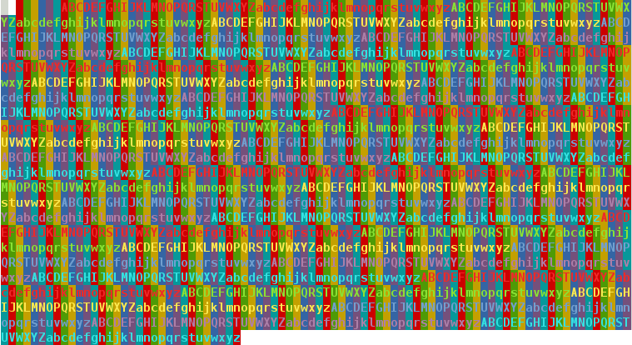
Max Player count

Slide 8
PlayerId => Printable char Field
const int shftidx = 0x41; // lowest ascii tablechar
const int alphcnt = 26; const int lettercnt = (alphcnt*2); // a-z // a-Z
const int coldigcnt = 6; const int fldcolcnt = coldigcnt*coldigcnt; // diferent colors // color combination
const int plrcnt = coldigcnt + (fldcolcnt * lettercnt); // max palyer
idx = idx%plrcnt; int n = 0; int letidx, digbg, digfg; // mod given idx with maxplrcntconst
switch(idx){
case -1: // fill Buffer with ‘Border’
sprintf(buf, "\x1B[%d;3%d;4%dm%c\x1B[0m", 0, 7, 7, ' '); break;
case 0: // fill Buffer with ‘empfy’
sprintf(buf, "\x1B[0m%c", ' '); break;
case 1 ... 6: // fill Buffer with uni color
sprintf(buf, "\x1B[%d;3%d;4%dm%c\x1B[0m", 0, idx, idx, ' '); break;
case 7 ... 1878:
idx -= coldigcnt; idx -= 1; // idx – 1..6 base colors; // idx 2 zero base
letidx = idx % lettercnt; // letidx based to 0..51 -> a..Z
letidx += letidx >= alphcnt ? 6 : 0; // idx > (int)’z’ => skip 6 characters to shift to A..Z range
letidx += shftidx; // shift 0x41 to (int)‘a’ character in ascii table
digfg = (idx/lettercnt)%coldigcnt + 1; // Foreground Color 1 .. 6 => 1Red, 2Green, 3Yellow, 4Blue, 5Magenta, 6Cyan
digbg = (idx - ( idx/(lettercnt*coldigcnt) ) )%coldigcnt + 1;// BgCol 1 .. 6 => 1Red, 2Green, …, 4Blue, 5Magenta, 6Cyan
sprintf(buf, "\x1B[1;3%d;4%dm%c\x1B[0m", digfg, digbg, (char)letidx); // "\x1B[1;31;43mC" =>
break; // 1 Bold on; ForeClr 30-37 Black,Red…Cyan,White; BackClr 40-47 Black,Red…Cyan,White m Character
default: break; }

Slide 9
Request – Reply (Client)
Client Requests Server | Port: 5555
Client -> Lazy Pirate Strategy
Tries 3 Times, with an interval of 1 Second
Server is not available (started)
Server is to busy
Server crashed
If no Response -> Break -> Terminate
ZMQ_REQ -> "tcp://localhost:5555“ (Server:localhost, still hardcoded)

Slide 10
Load Balancer (Server)
Frontend: ZMQ_ROUTER “tcp://*:5555“
Backend: ZMQ_ROUTER “ipc://backend.ipc”
Workerthread: ZMQ_REQ “ipc://backend.ipc”
Workerthread: Sending Worker Ready on “ipc://backend.ipc“
Loop Workerthread: Receive Msg, get last Frame (Commando), Handle cmd, reset frame with answer, send (response) to “ipc://backend.ipc”
Poll On Backend “ipc://backend.ipc” -> handle_Backend
Handle_Backend: Receive Msg from “ipc://Backend.ipc”, unwrap identity from Msg, append identity to workers list. If there is just 1 Worker, poll “tcp://*:5555” -> handle_frontend if there is a Msg.
Hanlde_Backend: If there is a Msg is ‘Worker Ready’ drop it otherwise, forward it to Frontend
Hanlde_Frontend: Receive Msg from “tcp://*:5555”, get a available worker form list and wrap msg with the worker pointer. Send wrapped Msg to Backend “ipc://backend.ipc”. If then no more available workers left, cancel poller which handle_frontend on frontend

Slide 11
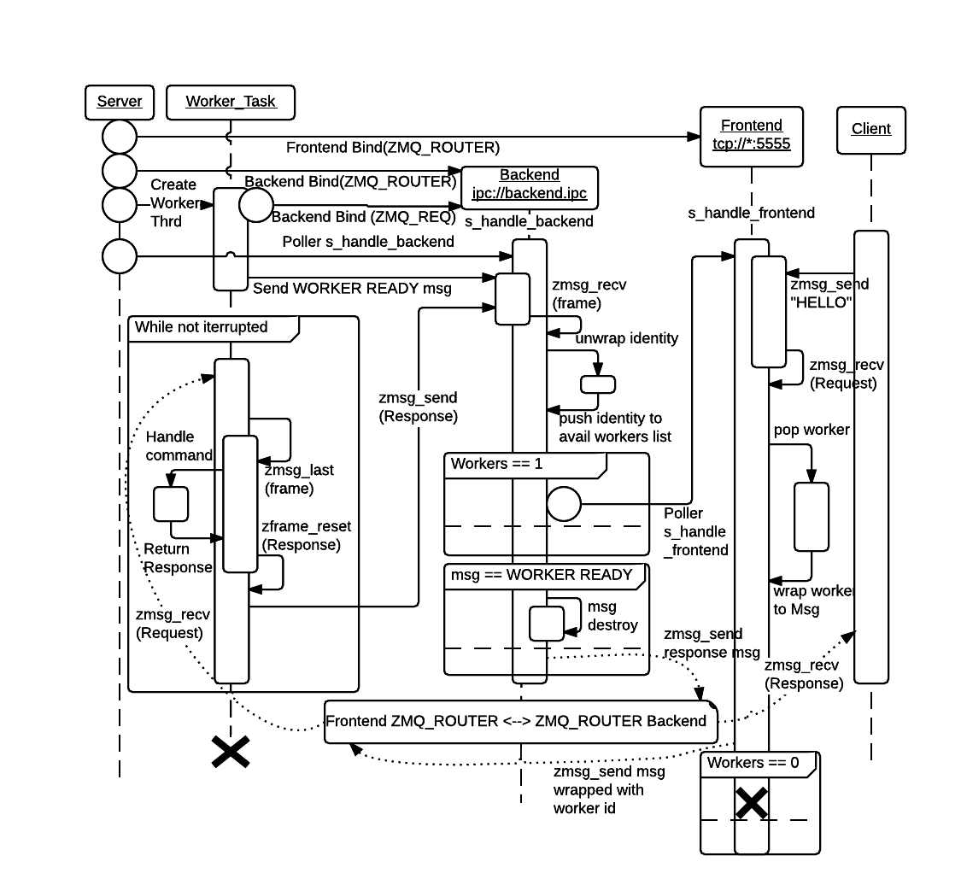
Load Balancer (Sequence)

Slide 12
Shared Key Value Map
Server ZMQ_PUB -> “tcp://*:5556”
Server Sendet asynchron Status updates.
Jeder Client, FieldViewer kann diese Statusmeldungen Subscriben und local in einer KVHash speichern. Diese KVHash kann auf die gewünschten Werde im Programm abgefragt werden.

Slide 13
Shared Key Value Map
Verwendete KV States
[fldlen] int: Size N
[%d][%d] char *: Field Owner
[state] int: Game State FINISHED, RUNNING, WAITING4PLAYERS
[winner] char *: winner Name
{%s} int: PlayerId

Slide 14
PlayerId vs FieldOwner
Req: Name des Spielers steht im Feld.
Owner der Fields als char *
Problem: Mit char * lässt sich in der CMD kein schönes Feld zeichnen.
Server published eindeutige PlayerId pro Spieler.

Slide 15
Synchronisation Task
Server bemerkt keine Disconnects.
Client kann ohne Probleme reconnecten.
Synchronisation tasks (~1s):
Game State
FieldSize
PlayerName:Id
Fieldowner

Slide 16
Environment
Win 7 -> VMWare Fedora 17 x86
Sublime
Terminal
ZeroMQ 4.2.0

Slide 17
Demo

