Slide 1
Syntactic overlapping
Semantic overlapping
State
Constraint
State.eval()
Constraint.eval()
Transition
LogoProgram
Transition.fire()
LogoPro.eval()
StateMachine
Expression
StateMachine.eval()
Expression.eval()
Flowchart
Flowchart.eval()

Slide 2
Size of Commonality
(SoC)
Product Related Reusability
(PRR_{i})
Individualization Ratio
(IR_{i})
Pair-wise Relationship Ratio
(PWRR_{(I,j)})
j
i
i
i

Slide 3
AS
AS
AS
FSM
Logo
Flowchart
Flowchart
arcs *
Arc
StateMachine
LogoProgram
ins *
Primitive
nodes *
kind : PrimitiveKind
Node
states *
transitions *
State
Transition
params *
PrimitiveKind
Expression
Action
Decision
actions *
guard 0..1
Forward
Back
Left
Right
Expression
Constraint
actions *
guard *
Expression
Constraint
WEAVING
WEAVING
WEAVING
Sem
Sem
Sem
@Aspect(Arc)
@Aspect(StateMachine)
execute() : void
step() : void
@Aspect(LogoProgram)
@Aspect(Flowchart)
fire() : void
execute() : void
execute() : void
@Aspect(State)
@Aspect(Transition)
@Aspect(Primitive)
@Aspect(Action)
@Aspect(Decision)
do() : void
fire() : void
eval() : void
do() : void
eval() : void
@Aspect(Expression)
@Aspect(Constraint)
@Aspect(Expression)
@Aspect(Expression)
@Aspect(Constraint)
eval () : void
eval () : bool
eval () : void
eval () : void
eval () : bool

Slide 4


Expressions
Constraints
State, Transition, Trigger, …
FSM
clone
clone
Language designers
Expressions
Backward, Forward, Left …
Logo
clone
Expressions
Constraints
Node, Decision, Arc, …
Flowchart

Slide 5



Syn A
Syn B
Syn
1
Syn
2
Syn
3
Syntactic Break-down
Syntax
Syn
4
Syn
5
Syn
6
Syn
7
Syn C
Sem A
Sem B
Sem
1
Sem
3
Sem
2
Semantic Break-down
Semantics
Sem
4
Sem
5
Sem
6
Sem
7
Sem C
First: Identifying overlapping
Second: Breaking-down the input set
Third: Encapsulating language modules

Slide 6
Identify overlapping
Break-down
Match
Merge
Cut
Encapsulate
Module 1
Module 2
Module 3
Module 4
Module 5
Module 6
Second: Merge
Second: Breaking-down the input set
Third: Encapsulating language modules

Slide 7
 | MM1 | MM2 | MM3
MM1 | - | |MM2 ∩ MM1| | |MM3 ∩ MM1|
MM2 | |MM1 ∩ MM2| | - | |MM3 ∩ MM2|
MM3 | |MM1 ∩ MM3| | |MM2 ∩ MM3| | -
 | AVG(MM1) | AVG(MM2) | AVG(MM3) | AVG(MM)

Slide 8
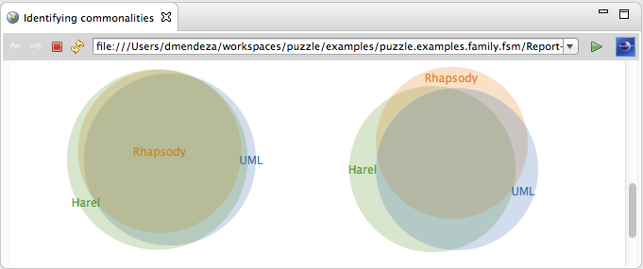
StateMachine.eval()
17
StateMachine.step()
18
22
StateMachine.eval()
20
StateMachine.step()
StateMachine.eval()
StateMachine.step()
19
Syntactic overlapping
(In terms of metaclasses)
Semantic overlapping
(In terms of domain-specific actions)

