Slide 1
Local DB Introduction
Local DB libraries
Realm, Room, ObjectBox
Local DB versioning
What is DB versioning ?
Local DB Migration
What is DB Migration ?
What is challenges ?
Notes:
Realm popular DB
Room is new DB from GG
ObjectBox is DB from GreenBot , After look some comparison on Internet I decide to add it inside this talk
-DB versioning to handle A system where we can defer changes – recording them, and applying them later.
DB migration to handle when we need upgraded the database like add more field, edit type of field ,…
Challenge of migration: data can be loss or corruption , security,..

Slide 2
More information
Realm
began in the end of 2010 by Alexander Stigsen
Room
By Google at 2018
Object Box
By Greenrobot team at 2017
Notes:
TWO THOUSAND TEN, Actually I just known his name a few day ago ☺
TWO THOUSAND EIGHTEEN
TWO THOUSAND SEVENTEEN Ok Let Move, next step about comparison three library

Slide 3
Comparison
Realm
Core C++ NoSQL
RealmModel
>=2.5MB
Migration by hand
1300 method
Room
SQLite
POJO
>=50KB
Migration by hand
300 method
ObjectBox
Fastest NoSQL
POJO
<= 1MB
Auto Migration
2000 method
Notes:
Look the table we can have a Image for comparion
Realm Forced to use RealmModel for implement data class
Create migration file with some code inside
ONE THOUSAND THREE HUNDRED
Object Box -> fastest why? -> I’ll show u later by demo code and image compare
No need migration file ? Wow sound great, we will check it later by code
If you has limitation app size you can choice Room with fitty Kb
If you hate migration manual you can choice ObjectBox
So next we move to detail speed test of three library

Slide 4
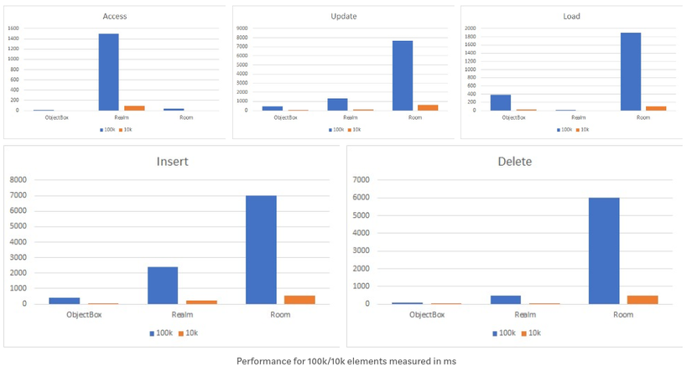

How about speed ?
ObjectBox crushes all competition
Notes:
So interesting Object crushes all competition with 4x faster than Realm and 20x faster than Room WOW. I have all night for add ObjectBox inside this talk because of this comparison. That amazing for speed

Slide 5
What should we choice
Realm
Room
Object Box
Not fastest , not smaller but stable and less bug
Ready to fight with SQL
App size limitation
Need for SPEED and effective
Recommend by Google
Without migration by hand

Slide 6

Show me the code

