Slide 1
CHRONIC DIARRHOEA
BY
DR OGUNTOYE O.O.
MBBS(Ibadan), FWACP(Gastroenterol)

Slide 2
OUTLINE
Definition
Clinical Classification
Causes
Pathophysiology
Evaluation
Management
On going trials

Slide 3
Definition
Diarrhoea is best defined as increased fluidity or decreased consistency
Most experts add increased frequency >3/day
Definition based on stool wt (>200g) or volume (>200mls).
(normal 80g/day in women & 100g/day in men)
Acute Diarrhoea < 2 weeks
Chronic Diarrhoea >4 weeks
Persistent Diarrheoea >2 weeks- <4 weeks
Estimated prevalence of chronic diarrhoea is 3-5%
Often has a non-infectious pathology except in HIV

Slide 4
CLINICAL CLASSIFICATION
Time course: Acute vs Chronic.
Volume: Large vs Small
Stool character: Watery vs Fatty vs Inflammatory
Pathophysiology: Secretory vs Osmotic

Slide 5
Acute Diarrhea: Diarrhea less than 2 weeks.
Usually infectious
Self limited mostly.
Chronic Diarrhea: Diarrhea for more than 4 weeks.
Usually non infectious.

Slide 6
Large Volume Diarrhea:If the source of diarrhea is upstream in the right colon or small bowel and if the rectosigmoid reservoir is intact ,bowel movements are fewer ,but larger.
Small Volume Diarrhea:When the reservoir capacity is compromised by inflammatory or motility disorders involving the left colon ,frequent small volume bowel movements ensue.

Slide 7
Watery diarrhea: Defect primarly in water absorption as a result of increased electrolyte secretion or reduced absorption or ingestion of poorly absorbed substance.
Fatty diarrhea:Defective absorption of fat and perhaps other nutrients in small intestine.
Inflammatory diarrhea:Inflammatory disease invoving the gastrointestinal tract.

Slide 8
Some Pathophysiologic Mechanisms of Diarrhoea
Osmotic Diarrhoea (mal-absorption)
Secretory Diarrhoea
Inflammatory Diarrhoea
Steatorrhoea (fat mal-absorption)
Dysmotility (IBS, Thyrotoxicosis)
Factitious Diarrhoea (laxative abuse)

Slide 9
Osmotic Diarrhoea
High luminal load of non-absorbed hypertonic substances
Non-absorbable substances, generalized malabsorption or specific deficiency
Subsides with fasting
Stool osmolar gap is abnormally elevated >125 mOsm/kg
Stool osmotic gap= 290-2(Na⁺ + K⁺)

Slide 10
Causes of Osmotic Diarrhea
Mg, PO4, SO4 ingestion.
Carbohydrate malabsorption.
Lactose intolerance
Laxative abuse
1. Fine KD, Schiller LR. AGA technical review on the evaluation and management of chronic diarrhea. Gastroenterology. 1999;116(6):1464–1486.
2. Feldman M, Friedman LS, Sleisenger MH, eds. Sleisenger & Fordtran's Gastrointestinal and Liver Disease: Pathophysiology, Diagnosis, and Management. 7th ed. Philadelphia, Pa.: Saunders; 2002: 137

Slide 11
Secretory diarrhoea
Active intestinal secretion and decreased absorption
No change with fasting
No mucus or blood
No leucocyes in stool
Large watery diarrhoea 1-10L/24 hrs with normal osmotic gap
Faecal osmolar gap <50 mOsm/Kg

Slide 12
Causes of Secretory Diarrhea
Laxative abuse (nonosmotic laxatives)
Post-cholecystectomy (from bile salts)
Congenital syndromes (chloridorrhea)
Bacterial toxins
Ileal bile acid malabsorption
Inflammatory bowel disease
Ulcerative colitis
Crohn's disease
Microscopic (lymphocytic) colitis
Collagenous colitis
Diverticulitis
Vasculitis
Drugs and poisons
Disordered motility
Postvagotomy diarrhea
Postsympathectomy diarrhea
Diabetic autonomic neuropathy

Slide 13
Hyperthyroidism
Irritable bowel syndrome
Neuroendocrine tumors
Gastrinoma
VIPoma
Somatostatinoma
Mastocytosis
Carcinoid syndrome
Medullary carcinoma of thyroid
Neoplasia
Colon carcinoma
Lymphoma
Villous adenoma
Epidemic secretory (Brainerd) diarrhea
Idiopathic secretory diarrhea

Slide 14
Steatorrhoea
Osmotic diarrhoea, faecal fat excretion >5g/24 hrs

Slide 15
Causes of Steatorrhoea
Malabsorption syndrome (damage to or loss of absorptive ability)
Amyloidosis
Celiac sprue (gluten enteropathy)–various clinical presentations
Gastric bypass
Lymphatic damage (e.g., congestive heart failure, some lymphomas)
Medications (e.g., orlistat [Xenical; inhibits fat absorption]
Mesenteric ischemia
Noninvasive small bowel parasite (e.g., Giardia)
Postresection diarrhea
Short bowel syndrome
Small bowel bacterial overgrowth (> 105 bacteria per mL)
Tropical sprue
Whipple disease (Tropheryma whippelii infection)
Maldigestion (loss of digestive function)
Hepatobiliary disorders
Inadequate luminal bile acid
Loss of regulated gastric emptying
Pancreatic exocrine insufficiency

Slide 16
Inflammatory diarrhoea
Due to damage to intestinal mucosa – so loss of fluid & blood.
Defective absorption of fluids & electrolytes.

Slide 17
Causes of Inflammatory diarrhea
Inflammatory bowel disease
Ulcerative colitis
Crohn's disease
Diverticulitis
Ulcerative jejunoileitis
Pseudomembranous colitis
Infections
Tuberculosis, yersiniosis, others
Cytomegalovirus
Herpes simplex
Amebiasis/other invasive parasites
Ischemic colitis
Radiation colitis
Neoplasia
Colon cancer
Lymphoma

Slide 18
Altered motility
IBS
Hyperthyroidism
DM
Fecal impaction (overflow diarrhoea)
Enteric fistula
Amyloidosis

Slide 19
Chronic Diarrhoea in the tropics
Tropical sprue- now rare
Giardia intestinalis- may mimic tropical sprue
Strongyloidosis
Enteropathic E. coli
Chronic calcific pancreatitis
Hypolactesia (primary & secondary)
Intestinal flukes
Chronic intestinal Schistosomiasis
HIV Enteropathy

Slide 20
Causes of Chronic Diarrhoea in HIV/AIDS
Parasites
Entamoeba histolytica
Giardia intestinalis
Cryptosporidium
Isospora belli
Microsporidium
Cyclospora cayetanensis
Bacteria:-Salmonella, camphylobacter, Shigella, MAI
Viruses: CMV/HSV, Adenovirus
HIV Enteropathy
Neoplasm- KS, Lymphoma,

Slide 21
Neuroendocrine tumours causing chronic diarrhoea
Gastrinoma
VIPoma (Verner-Morrison syndrome)
Medullary thyroid carcinoma
Phaechromocytoma
Carcinoid
Somatostatinoma
Glucagonoma
Mastocytosis

Slide 22
Systemic disaeses causing chronic diarrhoea
Endocrine: DM, thyrotoxicosis, Addison’s dx, panhypopituitarism
Endocrine tumour syndromes: MEN 1 (Wermer syndrome) & 2a (sipple syndrone), 2b (2a + neuromas & marfanoid phenotype)
Haematologic dxs: Leukaemia, lymphoma, MM
Immune system disorders: AIDS, Amyloidosis, common variable immunodeficiency, IgA deficency
Heavy metal poisoning

Slide 23
Difficult to diagnose chronic diarrhoea
Fecal incompetence
Iatrogenic diarrhoea (drugs, surgery & radiation)
Surreptitious laxative ingestion
Microscopic colitis syndrome
Bile acid-induced diarrhoea
Small bowel bacterial overgrowth
Pancreatic exocrine insufficiency
Carbohydrate malabsorption
Peptide secreting tumour
Chronic idiopathic secretory diarrhoea

Slide 24
HISTORY
A careful history can provide clues to the cause of chronic diarrhea.
The following 14 points should be assessed as part of a comprehensive history in a patient with chronic diarrhea:
The characteristics of the onset of diarrhea should be noted as precisely as possible. Note should be made of whether it was congenital, abrupt, or gradual in onset.

Slide 25
The pattern of diarrhea should be recorded: Are loose stools continuous or intermittent?
The duration of symptoms should be identified clearly.
Epidemiological factors, such as travel before the onset of illness, exposure to potentially contaminated food or water, and illness in other family members should be elicited.

Slide 26
Stool characteristics should be investigated. Specifically, the patient should be queried as to whether stools are watery, bloody, or fatty.
The presence or absence of fecal incontinence should be determined. Some individuals complain of diarrhea when their major difficulty is disordered continence.
The presence or absence of abdominal pain and its characteristics should be evaluated. Pain often is present in patients with inflammatory bowel disease, irritable bowel syndrome, and mesenteric ischemia

Slide 27
The presence of weight loss should be determined if possible by reference to objective measurement of body weight. Substantial weight loss is more likely to be caused by nutrient malabsorption, neoplasm, or ischemia.
Aggravating factors, such as diet and stress, should be recorded.

Slide 28
Mitigating factors, such as alteration of diet and use of both prescription and over-the-counter drugs, should be listed.
Previous evaluations should be reviewed whenever possible. Objective records may be inspected, and radiograms and biopsy specimens should be reexamined before new studies are ordered.
Iatrogenic causes of diarrhea should be investigated by obtaining a detailed medication history and a history of radiation therapy or surgery.

Slide 29
Factitious diarrhea caused by surreptitious laxative ingestion should be considered in every patient with chronic diarrhea.
Markers of factitious diarrhea, such as a history of eating disorders, secondary gain, or a history of malingering, should be sought.
A careful review of systems should be conducted to look for systemic diseases, such as hyperthyroidism, diabetes mellitus, collagen-vascular diseases and other immune problems.

Slide 30
PHYSICAL EXAMINATION
Peripheral neuropathy and orthostatic hypotension may be the only clues to a diagnosis of amyloidosis.
A thyroid nodule with cervical lymphadenopathy may be the only lead to the presence of medullary carcinoma of the thyroid.
Tremor and other systemic signs should lead to consideration of hyperthyroidism

Slide 31
The perineal, anal, and rectal examinations are important. Signs of incontinence include skin changes from chronic irritation, gaping anus, and weak sphincter tone.
Crohn's disease is associated with perianal skin tags, ulcers, fissures, abscesses, fistulas, and stenoses.
Fecal impaction or masses might be noted

Slide 32
Other associated physical findings include
exophthalmos (hyperthyroidism),
aphthous ulcers (IBD and celiac disease),
lymphadenopathy (malignancy, infection or
Whipple's disease),
exophthalmos (hyperthyroidism, medullary
carcinoma of the thyroid),
arthritis (IBD, Whipple's disease),

Slide 33
wheezing and right-sided heart murmurs (carcinoid syndrome) ,
clubbing (liver disease, IBD, laxative abuse,
malignancy),
Dermatitis herpetiformis(celiac disease),
Abdominal bruit (chronic mesenteric ischemia),
Migratory necrotizing erythema(glucagonoma).

Slide 34
Investigation of Chronic diarrhoea
FBC +differentials + ESR
Stool m/c/s (3 samoles for ova and parasites
Stool PH <5.6 suggest CHO malabsorption
Special stains for some parasites
Fecal leucocytes
Stool Osmotic gap
24 hrs faecal fat excretion- >5g/24 hrs = steatorrhoea
Abdominal uss
Small intestinal biopsy + aspirates for quantitative culture
Barium studies
Colonoscopy + biopsy
Exclude pancreatic disease- Secretin test & stool chylomicron activity
Serology
Immunological markers
CT-Scan, MRCP, ERCP, EUS
Hormonal assays (neuroendocrine tumours)
Urinary laxative screening

Slide 35
Routine laboratory tests
Complete blood picture:
Anemia
Leucocytosis
Serum chemistry screening can provide important information about the patient's fluid and electrolyte status, his or her nutritional status, liver problems, and dysproteinemia.

Slide 36
Stool analysis
In most instances, a quantitative stool collection and analysis can yield important objective information about the type of diarrhea and its severity.
When this is impractical, a spot stool collection can yield almost as much information.
In addition to stool weight, six groups of studies should be obtained to classify the diarrhea as watery diarrhea (either secretory or osmotic), inflammatory diarrhea, or fatty diarrhea and to gain insight into specific diagnoses:
› Journals › afp › Vol. 84/No. 10(November 15, 2011)‎

Slide 37
Sodium and potassium concentrations in stool water may be measured, so that the fecal osmotic gap can be calculated.
The fecal osmotic gap is best calculated as 290 −
2([Na+] + [K+]).
Osmotic diarrheas are characterized by osmotic
gap >125 mOsm/kg, whereas secretory diarrheas
typically have osmotic gaps <50 mOsm/kg

Slide 38
Stool pH may be assessed. Values of <5.6 are consistent with carbohydrate malabsorption.
Fecal occult blood testing with any of the available agents should be conducted.
A positive test result suggests the presence of
inflammatory bowel disease, neoplastic diseases, or
celiac sprue or other spruelike syndromes.

Slide 39
The presence of white blood cells in the stool suggests an inflammatory diarrhea.
The presence of excess stool fat should be evaluated by means of a Sudan stain or by direct measurement. The presence of excessively large and numerous fat globules by stain or measured stool fat excretion >14 g/24 h suggests malabsorption or maldigestion. Stool fat concentration of >7% strongly suggests pancreatic exocrine insufficiency.

Slide 40
Laxative screening should be done in any patient with chronic diarrhea that has defied diagnosis

Slide 41
Further evaluation of patients with chronic secretory diarrhea
Patients with chronic watery diarrhea who have little or no osmotic gap as calculated from stool electrolytes should be evaluated with three sets of investigations.
Although bacterial infection rarely causes chronic diarrhea, it can be excluded by stool culture, including culture on special media for Aeromonas and Pleisiomonas.
AGA ;MPS ON EVALUATION AND MANAGEMENT OF CHRONIC DIARRHEA 1999

Slide 42
In addition, the stool should be examined microscopically for ova and parasites, with special tests for Cryptosporidium, Microsporidium, and Giardia. Giardia antigen, measured in stool by enzyme-linked immunosorbent assay, is the most sensitive test for giardiasis.
An aspirate of small bowel contents for quantitative culture or breath tests with glucose or isotopically labeled xylose can be used to establish the presence of small bowel bacterial overgrowth but is likely to be meaningful only in patients with disorders predisposing them to bacterial overgrowth

Slide 43
Structural disease should be excluded by radiography of the small bowel, sigmoidoscopy, or colonoscopy with multiple biopsies of the colonic mucosa, computerized tomography of the abdomen, and endoscopic biopsy of the proximal small bowel mucosa.
A small bowel follow-through examination is preferable to an enteroclysis study for the radiographic evaluation of patients with chronic diarrhea.

Slide 44
Selective testing for plasma peptides such as gastrin, calcitonin, vasoactive intestinal polypeptide, and somatostatin, as well as urine excretion of 5-hydroxyindole acetic acid, metanephrine, or histamine and other tests of endocrine function, such as measurement of thyroid-stimulating hormone and serum thyroxine levels or an adrenocorticotropin-stimulation test for adrenal insufficiency, can be valuable

Slide 45
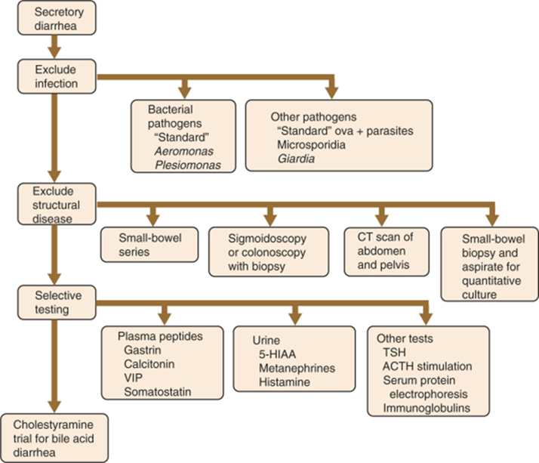

Slide 46
Further evaluation of patients with chronic osmotic diarrhea
A low stool pH suggests carbohydrate malabsorption, and a high stool magnesium concentration or output suggests magnesium ingestion.
If carbohydrate malabsorption is suspected, a careful dietary history and judicious use of breath hydrogen testing with lactose as the test sugar or measurement of lactase in a mucosal biopsy specimen can be diagnostic.
Patients with high stool magnesium outputs should be evaluated for inadvertent ingestion of magnesium in mineral supplements or antacids and for surreptitious laxative abuse.
AGA ;MPS ON EVALUATION AND MANAGEMENT OF CHRONIC DIARRHEA 1999

Slide 47
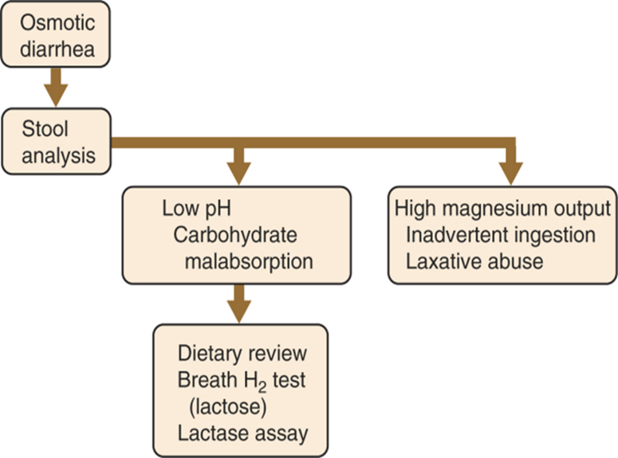

Slide 48
Further evaluation of chronic inflammatory diarrhea
Patients with blood and pus in the stool should undergo radiographic evaluation of the small bowel with barium (small bowel follow-through examination) and sigmoidoscopy or colonoscopy with biopsies of the colonic mucosa.
Stool culture and analysis of stool for Clostridium difficile toxin may identify infectious causes of inflammation.
AGA ;MPS ON EVALUATION AND MANAGEMENT OF CHRONIC DIARRHEA 1999

Slide 49
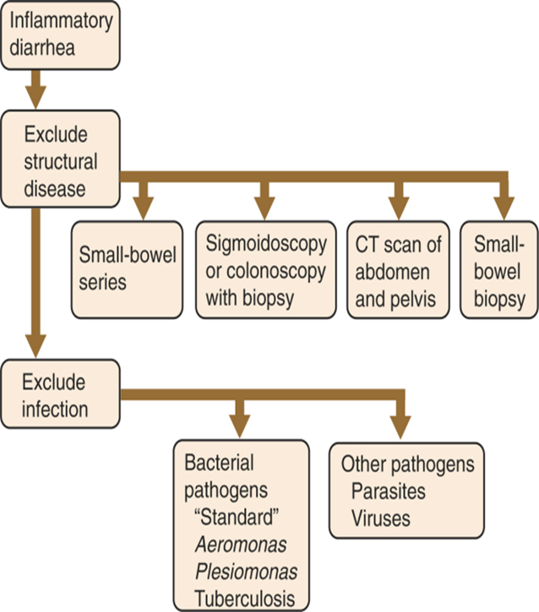

Slide 50
Evaluation of chronic Steatorrhoea
Patients with evidence of steatorrhea should undergo small bowel follow-through radiographic studies to exclude structural problems.
Small bowel biopsy specimens and an aspirate of small bowel contents for quantitative culture should be obtained.
Pancreatic exocrine insufficiency should be assessed by direct tests, such as the secretin test, or by indirect tests, such as measurement of stool chymotrypsin activity or a bentiromide test.
AGA ;MPS ON EVALUATION AND MANAGEMENT OF CHRONIC DIARRHEA 1999

Slide 51
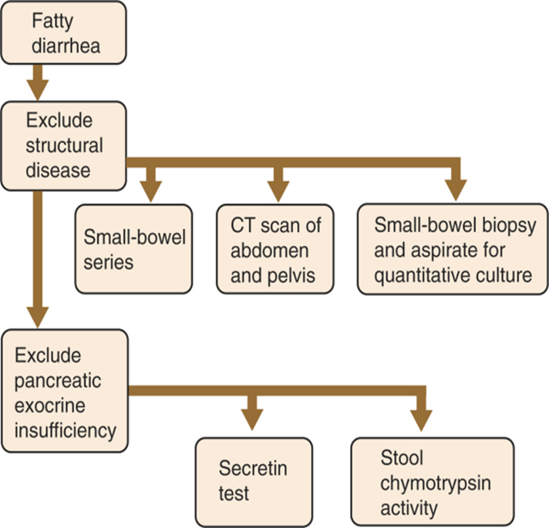

Slide 52
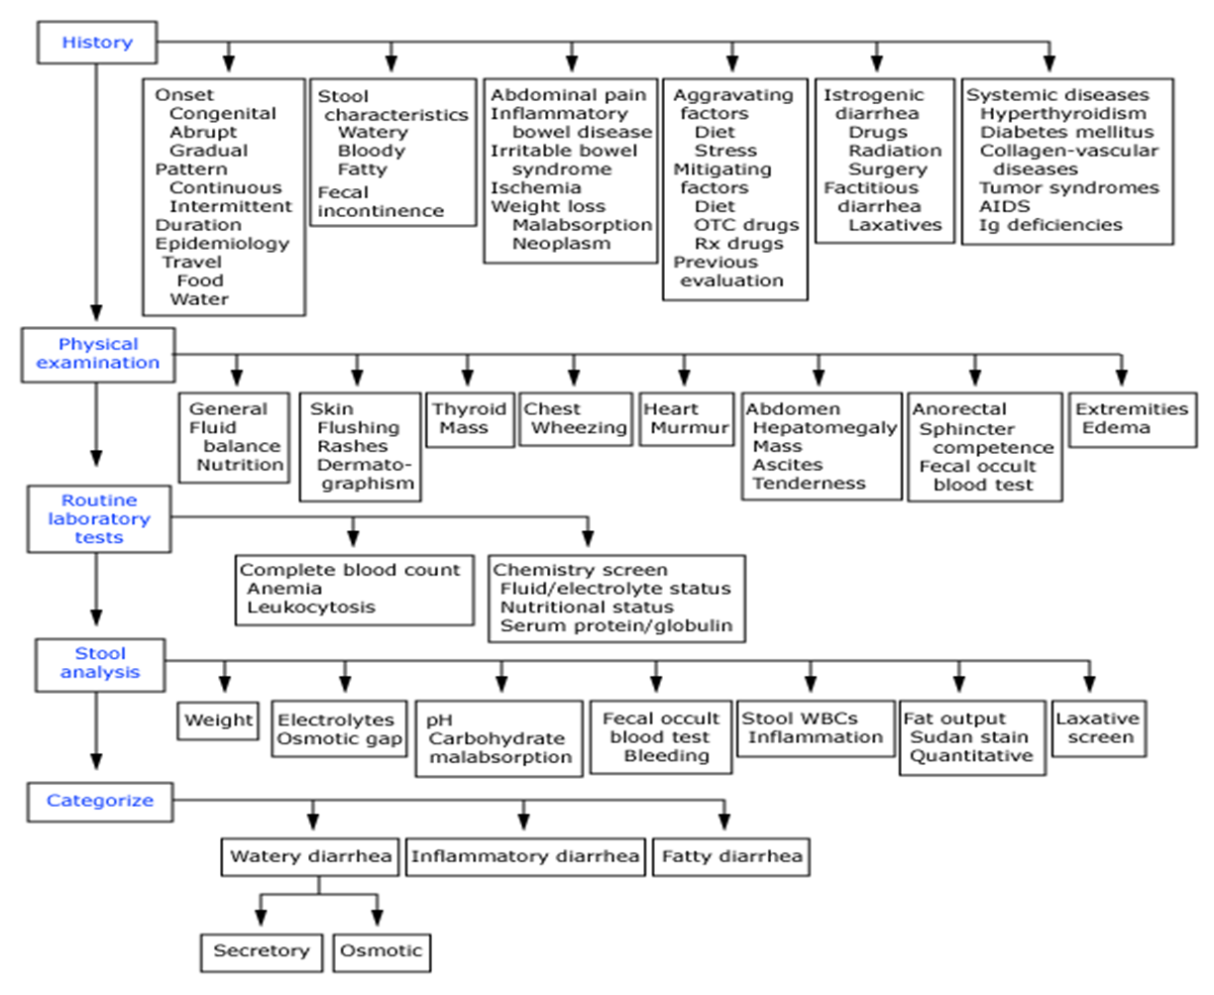

Slide 53
Factitious diarrhea
Factitious diarrhea may be characterized by a true increase in stool volume, which is self-induced, or the creation of an apparent increase in stool volume by the addition of various substances to the stool.
Surreptitious laxative abuse is the most frequent cause of factitious diarrhea.
Laxative abuse often presents as watery diarrhea that is high in frequency and volume.
The diarrhea is often associated with crampy abdominal pain, lethargy and generalized weakness, malnutrition, dehydration, and electrolyte abnormalities may result.

Slide 54
In addition to the history, evaluation of the patient with suspected factitious diarrhea consists of stool analysis and attempted detection of chemical laxatives.
Stool analysis consists of measurement of stool osmolality, and sodium, potassium, and magnesium concentrations.
An osmolal gap indicates the presence of an unmeasured solute which can be due to laxatives containing magnesium, sorbitol, lactose, lactulose, or polyethylene glycol as the active ingredients.

Slide 55
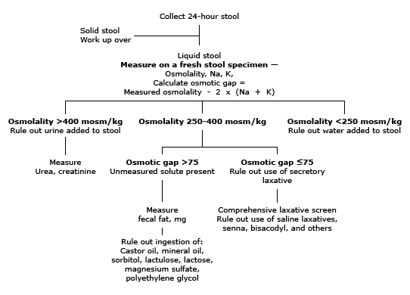
Evaluation of suspected laxative abuse

Slide 56
IDIOPATHIC SECRETORY DIARRHEA
When an exhaustive evaluation fails to reveal a cause of chronic diarrhea and stool analysis suggests a secretory diarrhea,the diagnosis of idiopathic secretory diarrhea should be made.
It occurs in two forms:
1)Epidemic form:Brainerd
2)Sporadic form.
Self limited forms of diarrhea.

Slide 57
Empirical therapy for chronic diarrhea
Empirical therapy is used in three situations:
as a temporizing or initial treatment before diagnostic testing,
after diagnostic testing has failed to confirm a diagnosis,
and when a diagnosis has been made, but no specific treatment is available or specific treatment fails to effect a cure

Slide 58
Empirical trials of antimicrobial therapy may be justified if the prevalence of bacterial or protozoal infection is high in a specific community or situation.
An empirical trial of bile acid–binding resins, such as cholestyramine, may be the least expensive way to diagnose bile acid–induced diarrhea.
Opiates are the most effective nonspecific antidiarrheal agents.
Octreotide should be reserved as a secondary agent.
Enkephalinase inhibitor (delta opiate receptor effect)-Racecadotril .

Slide 59
Adequate hydration is an essential part of the treatment of diarrheal diseases, and oral rehydration solutions may be necessary in some instances.
Some patients, particularly those with postresection diarrhea, may need long-term intravenous fluid administration.
Parenteral nutrition should be reserved for patients who are unable to maintain an adequate nutritional status because of the diarrheal disease.

Slide 60
SUMMARY
A myriad of disorders are associated with chronic diarrhea . The prevalence of specific disorders varies based upon the practice setting.
In developed countries, common causes are irritable bowel syndrome (IBS), inflammatory bowel disease, malabsorption syndromes (such as lactose intolerance and celiac disease), and chronic infections (particularly in patients who are immunocompromised).
Optimal strategies for the evaluation of patients with chronic diarrhea have not been established.
A thorough medical history can guide appropriate evaluation.

Slide 61
SUMMARY
The physical examination rarely provides a specific diagnosis. However, a number of findings can provide clues.
There is no firm rule as to what testing should be done.
The history and physical examination may point toward a specific diagnosis for which testing may be indicated.
The minimum laboratory evaluation in most patients should include a complete blood count and differential, thyroid function tests, serum electrolytes, total protein and albumin, and stool occult blood.
In addition, most patients require some form of endoscopic evaluation (either sigmoidoscopy, colonoscopy, or sometimes upper endoscopy) depending upon the clinical setting.

Slide 62
SUMMARY
Treatment depends on the cause
Address volume status & electrolytes imbalance
Replace vitamin eg Fat soluble vitamins
Cholestyramine if steatorrhoea
Anti-motility agents- loperamide, lomotil

Slide 63
References
Cecil Medicine. 23rd ed. Philadelphia, Pa: Saunders Elsevier; 2007.
Fine KD, Schiller LR. AGA technical review on the evaluation and management of chronic diarrhea. Gastroenterology 1999; 116:1464-1486.
Feldman M, Friedman LS, Sleisenger MH, eds. Sleisenger & Fordtran's Gastrointestinal and Liver Disease: Pathophysiology, Diagnosis, and Management. 7th ed. Philadelphia, Pa.: Saunders; 2002: 137

Slide 64
THANK YOU

