Slide 1
ENDOSCOPY IN OBSTETRICS AND GYNAECOLOGY
DR. A. A. ADENIYI
MBBS(Benin),FWACS;
FMCOG;MSH(Ib.)

Slide 2
Definition of endoscopy
Examination of interior of a hollow organ or cavity using lighted (usually a fibreoptic) instrument called an endoscope for a medical reason or purpose

Slide 3
Types of Endoscopy in OBGYN
Laparoscopy
Hysteroscopy
Colposcopy
Falloposcopy
Cystoscopy
Fetoscopy
Culdoscopy
Sigmoidoscopy
Proctoscopy

Slide 4
History of endoscopy
1805: Philip Bozzini first described endoscopy. He used simple tube and candle light to visualise the interior of the urethra.
1869: Pantaleoni used cystoscope as an hysteroscope to diagnose irregular vaginal bleeding
1910: Jacobaeus introduced the cystoscope into the peritoneal cavity and coined the term laparoscopy
1938: Verres introduced the spring loaded needle for creating haemothorax .
1947: Raoul Palmer introduced pneumoperitoneum (gaseous distention of peritoneum) and Trendelenburg position
Also Fourestier et al introduced cold light and fibreoptics
1970s: Kurt Semm: performed operative laparoscopic procedure of myomectomy
1989: Reich et al performed the laparoscopic hysterectomy

Slide 5
Laparoscopy
Definition
It is a minimally invasive technique of visualisation of the peritoneal cavity by the means of a fibre optic endoscope introduced through the abdominal wall to allow the viewing (diagnostic) or surgical manoeuvre(operative) of abdominal organs.

Slide 6
The Instruments in laparoscopy
The laparoscope ( Telescope)
It is used in visualising the peritoneal cavity.
There are different sizes (5mm, 10mm)

Slide 7

A laparoscope (telescope)

Slide 8
Veress Needle
used to create pneumoperitoneum (inflate air into the peritoneal cavity through the umbilicus where the abdominal wall is thinnest

Slide 9
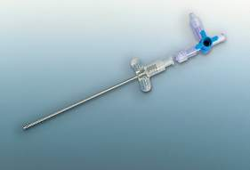
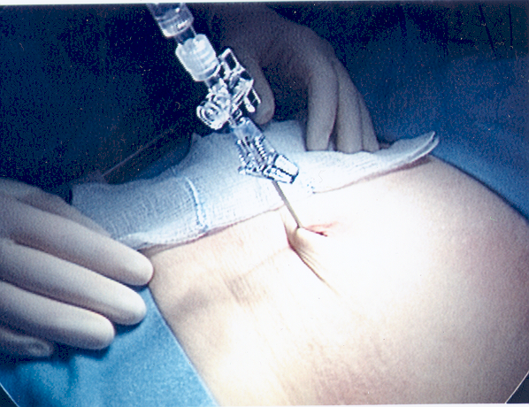
Verres Needle

Slide 10
Insufflator and light source
It introduces gas into the abdominal cavity through the Verres needle.
It also help in maintains constant intra-abdominal pressure during the procedure
The common gas used in laparoscopy is carbon dioxide
The light source provides illumination of the peritoneal cavity.

Slide 11
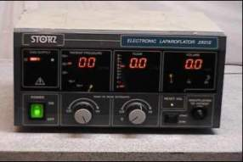
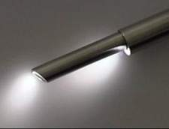
Insufflator

Slide 12
Trocars and cannulae
It create access into the peritoneal cavity through which other instruments can be introduced (laparoscope, scissors)
It comes in different sizes

Slide 13
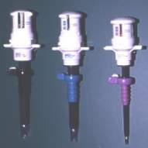
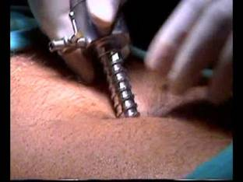
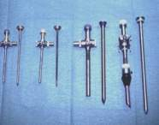
Trocars and cannulae

Slide 14
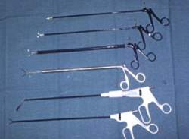
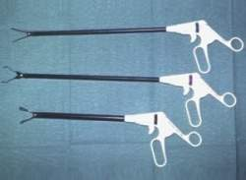
Ancillary instruments
Forceps and scissors

Slide 15
Indications for Laparoscopy
Diagnostic
For pelvic pain
Endometriosis
PID
Adhesions
Pelvic congestion etc.
Infertility
With tubal insufflation
Pelvic Mass
Uterine eg Fibroids
Ovarian – benign or malignant
Ectopic pregnancy

Slide 16
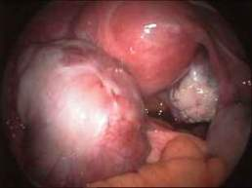
Ovarian cyst

Slide 17
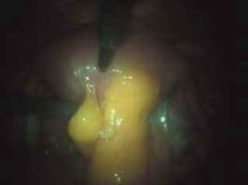
Pelvic adhesions

Slide 18
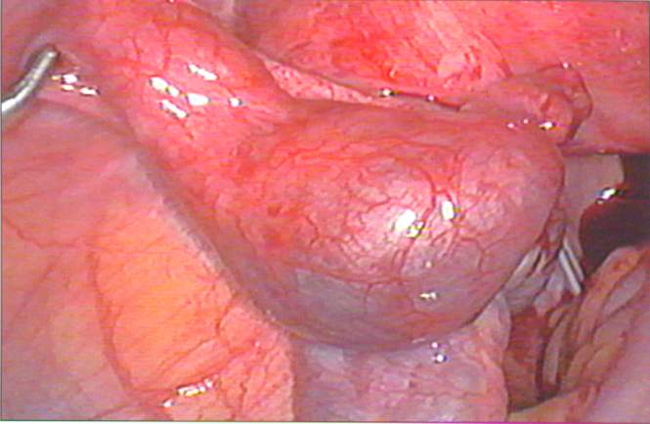
Ectopic pregnancy

Slide 19
Indications for Laparoscopy
Therapeutic Intervention
Assisted conception :ovum pick ups(now mostly performed with TVS), GIFT.
Diathermy to endometriosis
Sterilisation (Clips, Loops or Diathermy)
Biopsy of ovary or tumours
Division of adhesions
Ectopic pregnancy, cysts, oophorectomy
Advanced surgery – (virtually all opreations can be preformed)

Slide 20
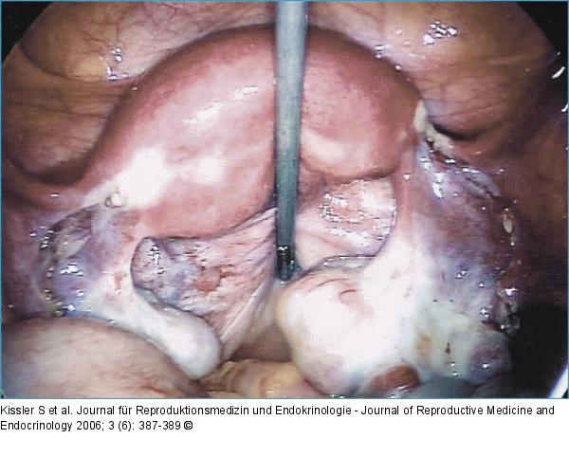
Laparoscopic lysis of endometriosis implants

Slide 21
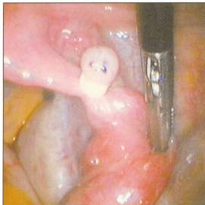
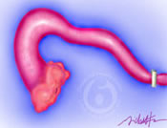
Laparoscopic sterilization

Slide 22
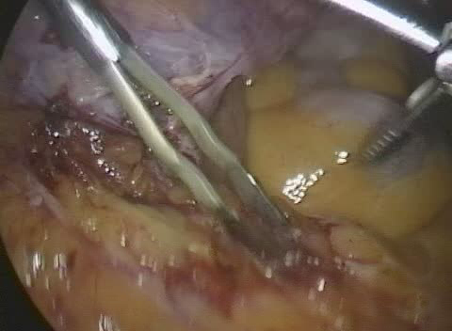
Laparoscopic adhesiolysis

Slide 23
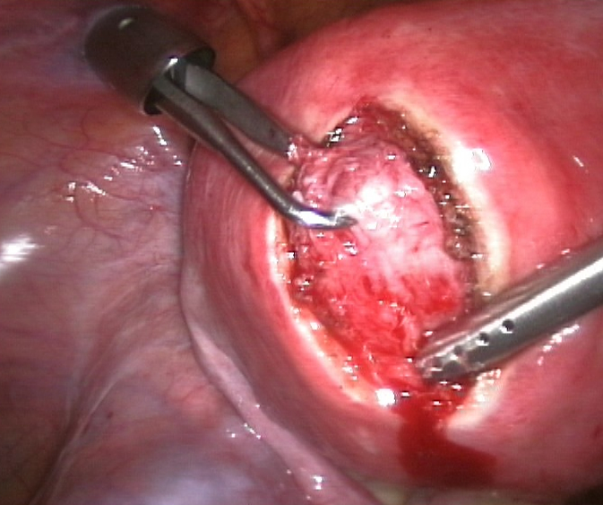
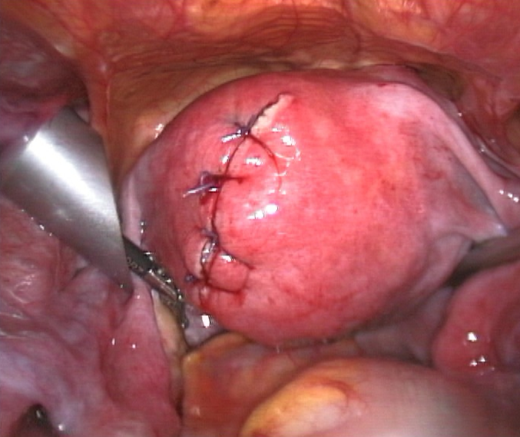
Laparoscopic myomectomy

Slide 24
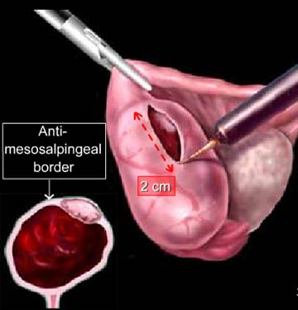
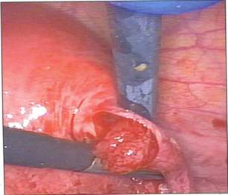
Laparoscopic salpingotomy in ectopic pregnancy

Slide 25
Contraindications of laparoscopy
Generalized peritonitis
Haemoperitoneum
Hypovolemic shock
Severe cardiac disease
Uterine size > 12 wks.
Multiple previous abdominal procedures (adhesions)
Extreme body weight

Slide 26
Steps in laparoscopy
1. Preparation of the patient
Inform the patient about the benefits and potential risks and obtain written informed consent.
Establish valid indication and exclude any contraindication
Place the patient in the dorsal-lithotomy position .
The uterine manipulator is inserted and secured.

Slide 27
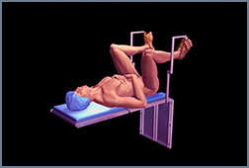
Dorsal- lithotomy position

Slide 28
Steps in laparoscopy
2. Creation of pneumoperitoneum:
The abdominal wall is lifted by hand or by grasping forceps
Pnemoperitoneum is created by verres needle introduced to the umbilical area (less subcutaneous and preperitoneal tissue).
A small incision (1.25cm) is made just below the umbilicus
The needle is inserted in an oblique angle (45°) toward the uterine fundus
The abdominal cavity is inflated with about 1-4 litres of gas(carbon dioxide)
The negative pressure will allow the underlying structures to fall away.
After making sure that the needle is in correct position, air flow can be increased to 1 litre per minute till a pressure of 15mmHg or loss of hepatic dullness.

Slide 29
Steps in laparoscopy
Confirmation of correct placement of the Veress needle.
Hanging drop method: a small amount of normal saline placed on the top of the Veress neddle drops into the peritoneal cavity with negative intraperitoneal pressure.
Syringe barrel test: 10ml of normal saline is attached to the Veress needle, aspiration is done to rule out blood or bowel content. The saline is then pushed into the peritoneal cavity, a repeat aspiration is negative if the needle is properly placed.
Loss of hepatic dullness on percussion
Intra-abdominal pressure: Low pressure <10mmHg and free flow of gas

Slide 30
Creation of Pneumoperitoneum

Slide 31
Creation of Pneumoperitoneum
Gases used in creating haemoperitoneum
Carbon dioxide
Nitrous oxide
Room air
Oxygen

Slide 32
Steps in laparoscopy
3. Introduction of the Trocar and cannula
Once the intra-abdominal pressure reaches 15 mmHg the main trocar is introduced after removal of veress needle.
The position of the trocar must be verified by inserting the laparoscope and viewing the pelvic cavity

Slide 33
Introduction of the trocar and cannula

Slide 34
Steps in laparoscopy
4.Introduction of the laparoscope and visualisation of the peritoneal cavity
The laparoscope is inserted under direct vission and panoramic view of the peritoneal cavity is done to exclude any injury or bleeding by the Veress needle

Slide 35
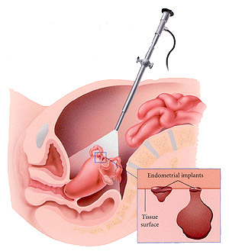
Introduction of the laparoscope

Slide 36
Steps in laparoscopy
For Operative laparoscopy (5 and 6).
5. Creation of accessory ports
6. Surgical procedure
7. Deflation of peritoneal gas
8. Closure of the abdominal wound

Slide 37
Port entry
Primary Port: The commonest port is the umbilicus (sub-umbilicus)
Secondary port: Lateral ports (ancillary ports) one on each side 3-4 cm medial to the anterior superior iliac spine
Palmer’ point: 3cm from the midline and 3cm below the rib cage (useful in patient with possible adhesions)

Slide 38
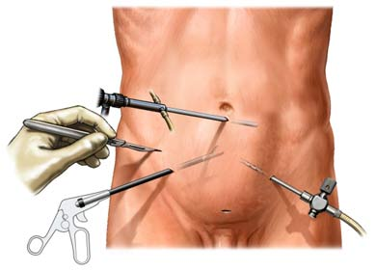
Port entry in laparoscopy

Slide 39
Complications of Laparoscopy
Failure
Anaesthetic complications (hypoventilation, hypercarbia and metabolic acidosis (C0₂₎
Injury to:
Major blood vessels
Ureter, Bladder or Bowel
Uterine perforation from elevator
Need laparotomy 1:500
Wound infection
Gas embolism, surgical emphysema
Surgical misadventure
Inadvertent diathermy perforation
Peritonitis
Death
1:500,000

Slide 40
HYSTEROSCOPY
It is endoscopic visualisation and surgical manipulation of the uterine cavity.
It has both diagnostic and therapeutic (surgical) applications

Slide 41
Basic instruments
Distending medium
Gas: Carbon dioxide
Liquid:
-Normal saline
- Glycine 1.5%
- Manitiol(5%) and glycine (2.2%)
Hysteroscope:

Slide 42
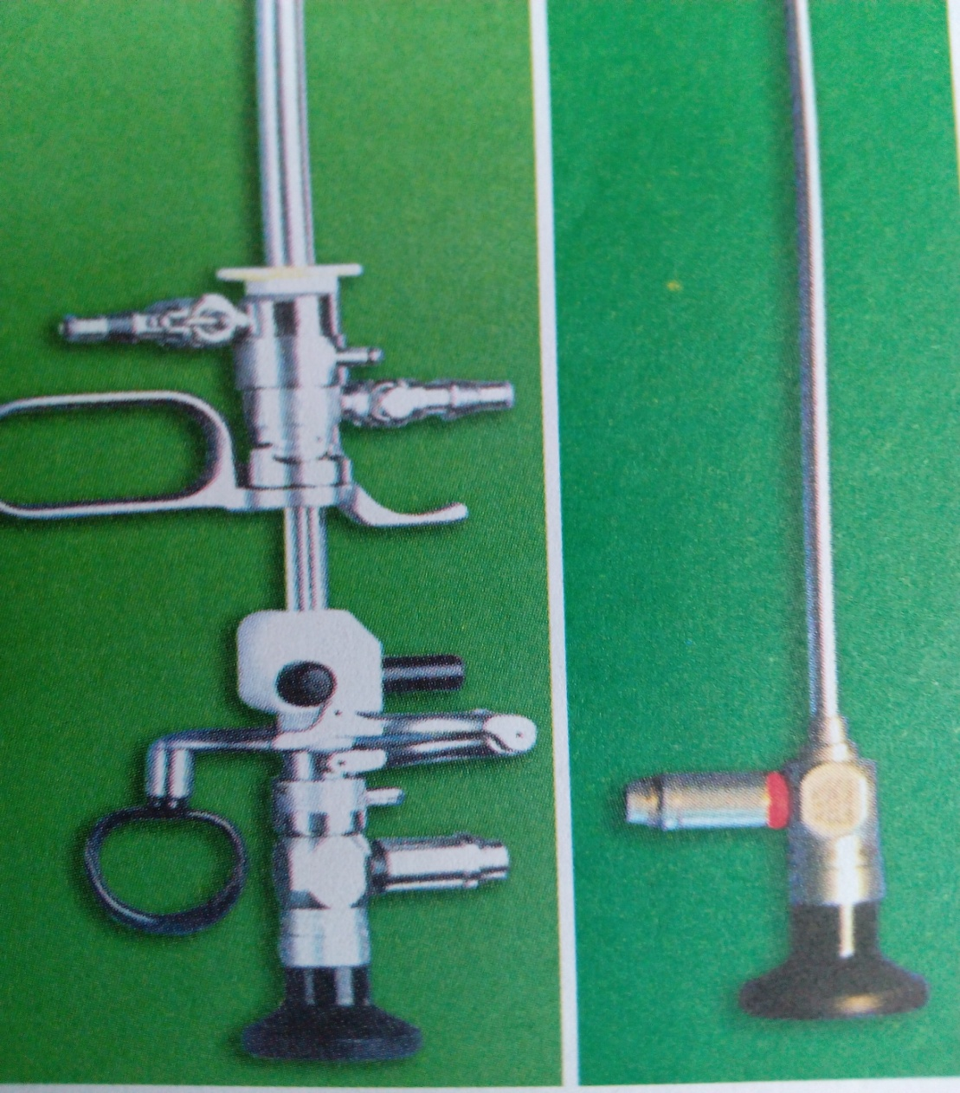
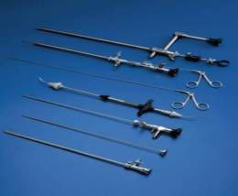
Hysteroscope

Slide 43
Indications for hysteroscopy
Diagnostic
Abnormal uterine bleeding caused by:
- submucous and intramural myoma.
- endometrial polyps.
- endometrial atrophy.
Endometrial tumors.
Infertility related to:
- Intrauterine adhesions (Asherman’s syndrome)
- Submucous fibroids.
- Endometrial polyps.
Uterine malformation

Slide 44
Indications for hysteroscopy
Therapeutic (Surgical) Interventions
Sterilisation (Essure)
Division of adhesions
Removal of benign tumours
Endometrial ablation

Slide 45
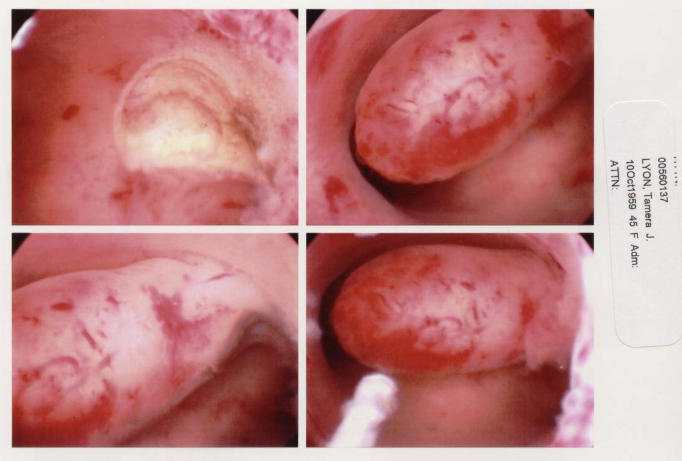
Hysteroscopic Surgeries and Endometrial Polypectomy

Slide 46
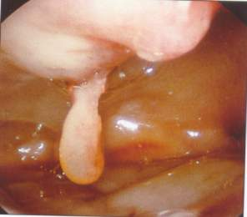
Endometrial polyp

Slide 47
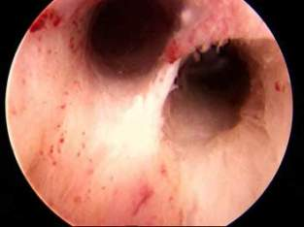
Uterine anomaly (septum)

Slide 48
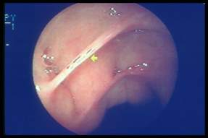
Intrauterine Adhesions

Slide 49
Contraindications of hysteroscopy
Pregnancy.
Current or recent pelvic infection.
Current vaginitis, cervicitis and endometritis.
Recent uterine perforation.
Active Bleeding.
Cervical cancer
Cervical stenosis
Cardiopulmonary disorders

Slide 50
Procedure
Preparation of the patient:
Detailed history and complete physical examination
It is preferable to do the procedure in the first part of the menstrual cycle, because there is less mucus (better viewing) and no chance of encountering early pregnancy
Informed consent
Patient is placed in lithotomy position
Accurate bimanual examination to asses the uterine (position, morphology, volume).

Slide 51
Procedure
2. Technique:
Clean cervix with antiseptics
Cervical forceps is placed on the front labia
Light source & CO2 gas supply are connected to the instrument
Insert hysteroscope into the cervical canal, which dilates from the gas pressure.

Slide 52
Complications of Hysteroscopy
Distension media
Fluid overload
Pulmonary oedema
Procedure
Uterine perforation (<1%)
Hemorrhage either from:
- Perforation
- Tenaculum used to hold the cervix
Infection

Slide 53
Colposcopy
It is an endoscopic technique used in examining the lower genital tract mainly the cervix (sometimes the vulva and the vagina).
It is used in excluding abnormal lesions and premalignant lesions on the cervix
It is usually performed as a follow up to Pap smear (cervical cytology)
It also aid in biopsy and treatment of abnormal lesions on the cervix.

Slide 54
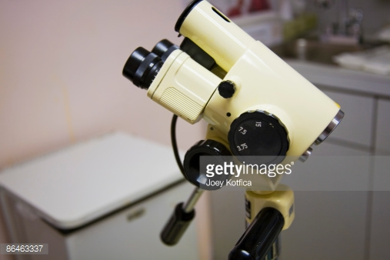
A colposcope

Slide 55
Colposcopy
Indications:
Evaluation of CIN (cervical intraepithelial neoplasia)
Biopsy target
Vaginal and vulval examination
DES exposure
Techniques:
Acetic acid
Schiller’s test (Lugol iodine )
Intervention:
Outpatient treatment of CIN e.g. Laser

Slide 56
Basic Anatomy
Columnar epithelium
Squamus epithelium
Squamus metaplasia
Transformation zone

Slide 57
PRINCIPLE OF COLPOSCOPY
Normal saline ( vascular patterns)
3-5 %)Acetic acid (coagulation of nuclear proteins)
Lugol iodine (Schiller’s test) – iodine uptake by glycogenated columnar cells

Slide 58
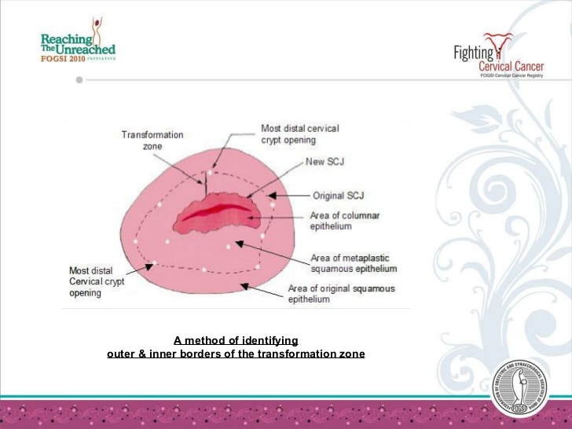
Basic anatomy of colposcopy

Slide 59
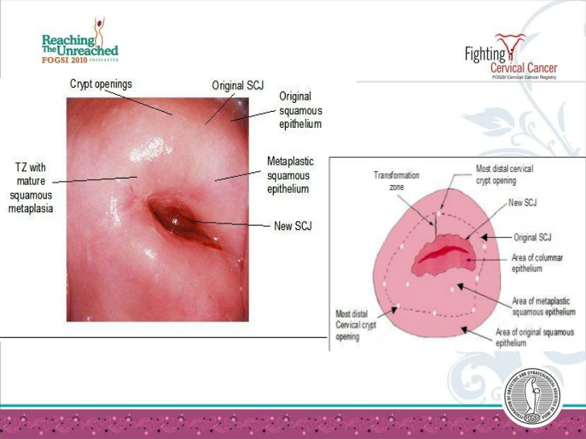
colposcopy

Slide 60
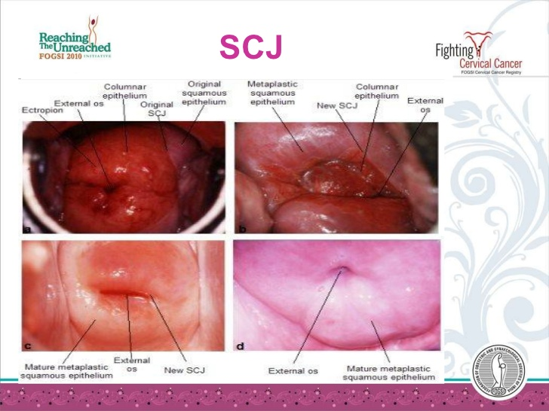
TRANSFORMATION ZONE (TFZ) & SQUAMO-COLUMNAL JUNCTION

Slide 61
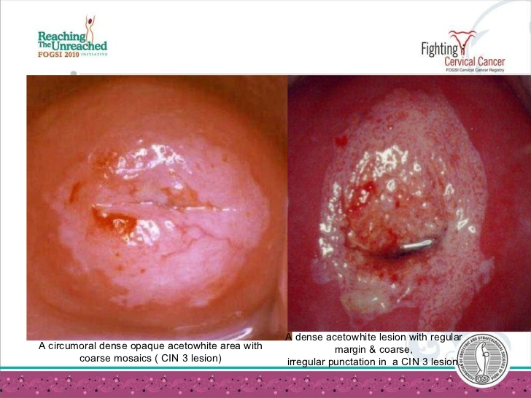
Acetowhite reaction (acetic acid)

Slide 62
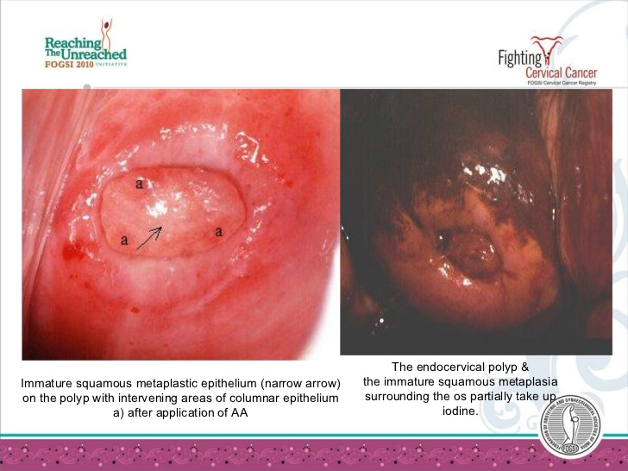
Lugol iodine

Slide 63
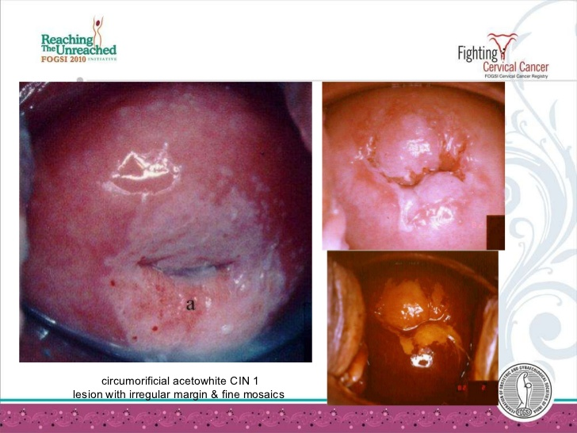
Acetowhite reaction and iodine uptake

Slide 64
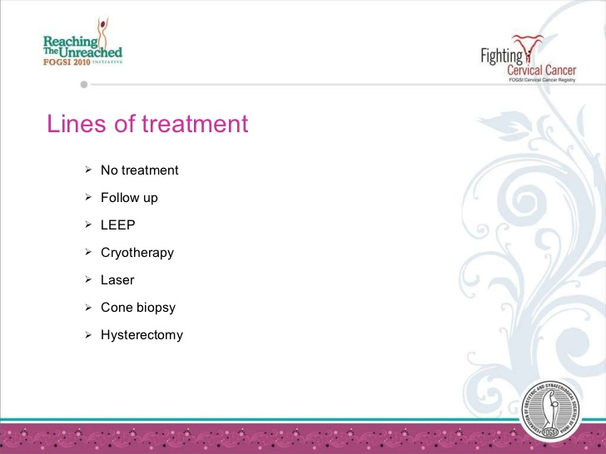
TREATMENT OF LESIONS

Slide 65
Complications of Colposcopy
Bleeding
Infection
Pain
Missing (lack of correlation between Pap smear and subsequent histology)

