Slide 1
GESTATIONAL TROPHOBLASTIC DISEASE
DR O.T ADEYEMO
CONSULTANT OBGYN FETHI/ASS LECT ABUAD

Slide 2
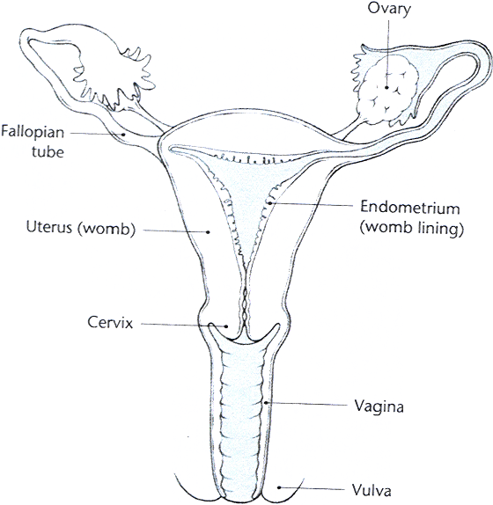
Cancers of the Reproductive Tract
VULVA
VAGINA
CERVIX
CORPUS UTERI
  Endometrium
  Myometrium
FALLOPIAN TUBES
OVARIES
PLACENTA

Slide 3
Introduction.
Gestational trophoblastic disease is an abnormal proliferation of placental- type tissue resulting from a union of egg and sperm with abnormal DNA content.
Histologic findings may include vesicular chorionic villi and proliferative trophoblast.
GTD refers to a variety of diseases including complete and partial molar pregnancy & gestational trophoblastic tumors (GTT ) such as invasive mole, placenta-site trophoblastic tumor and choriocarcinoma
It is a spectrum of interrelated diseases originating from the placental trophoblast.

Slide 4
They arise from fetal tissue within the maternal host and are composed of both syncytitiotrophoblastic and cyto trophoblastic cells except PSTT which is derived from the intermediate trophoblastic cells.

Slide 5
Epidemiology
Incidence rate:- commoner in Asia and Africa than western countries.
Hydatidiform mole - Most common GTD. Incidence varies worldwide from 1 in 125 - 1500 deliveries, incidence is higher in women under 20 and over 40 years of age, patients of low economic status and in those diets are deficient in protein, folic and carotene.

Slide 6
Invasive mole is reported in 10-15% of patients who have had 1⁰ molar pregnancy. It is locally invasive and may produce distant metastasis.
Choriocarcinoma:- reported in 2-5% of all case of gestational trophoblastic diseases. Incidence varies from 1 in 10,000 to 50,000 pregnancies. ½ arising from hydatidiform mole, ¼ from term pregnancy and remainder following abortion.
Maternal age > 40 yrs.
PSTT, is a rare variant of gestational trophoblastic tumour.

Slide 7
RISK FACTORS
Age less than 20 and over 40 years
Previous molar pregnancy,4-5x higher
Increased number of spontaneous abortions
ABO blood group: grp A women with grp O husbands. Poor prognosis in grp AB.
Cosanguinity/ Multiparity
Artificial insemination
Diet – low protein, low fat and vitamin A deficiency,folic acid deficiency
Familial cases have also been observed

Slide 8
Pathophysiology
Hydatidiform mole
An abnormal pregnancy characterized by gross multiple grape like vesicles filling the distending uterus usually in the absence of an intact fetus.
Recognizable on gross examination, but some are small and may seem to be ordinary abortuses.
Microscopically, moles may be identified by the classic findings, edema of the villous stroma; avascular villi and nests of proliferating syncytiotrophoblastic or cytotrophoblastic elements surrounding villi.
Two forms exist complete and partial.

Slide 9
 | Complete | Partial
Karyotype | 46 XX, 46 XY | 69XXY,69XXX
Fetal tissue | Absent | Present
Hydropic villi | Diffuse | Focal
Trophoblastic hyperplasia | Diffuse | Focal
Scalloping of villi | Absent | Present
Trophoblastic stromal inclusions | Absent | Present
β –Hcg | >50,000 | <50,000
Classic symptoms | Common | Rare
Risk of persistence | 20-30% | <5%

Slide 10
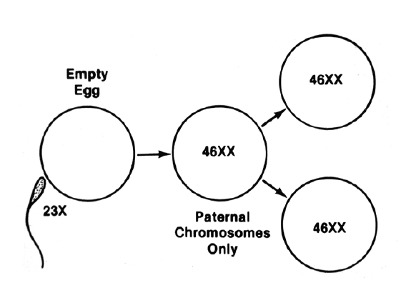
Complete mole:

Slide 11
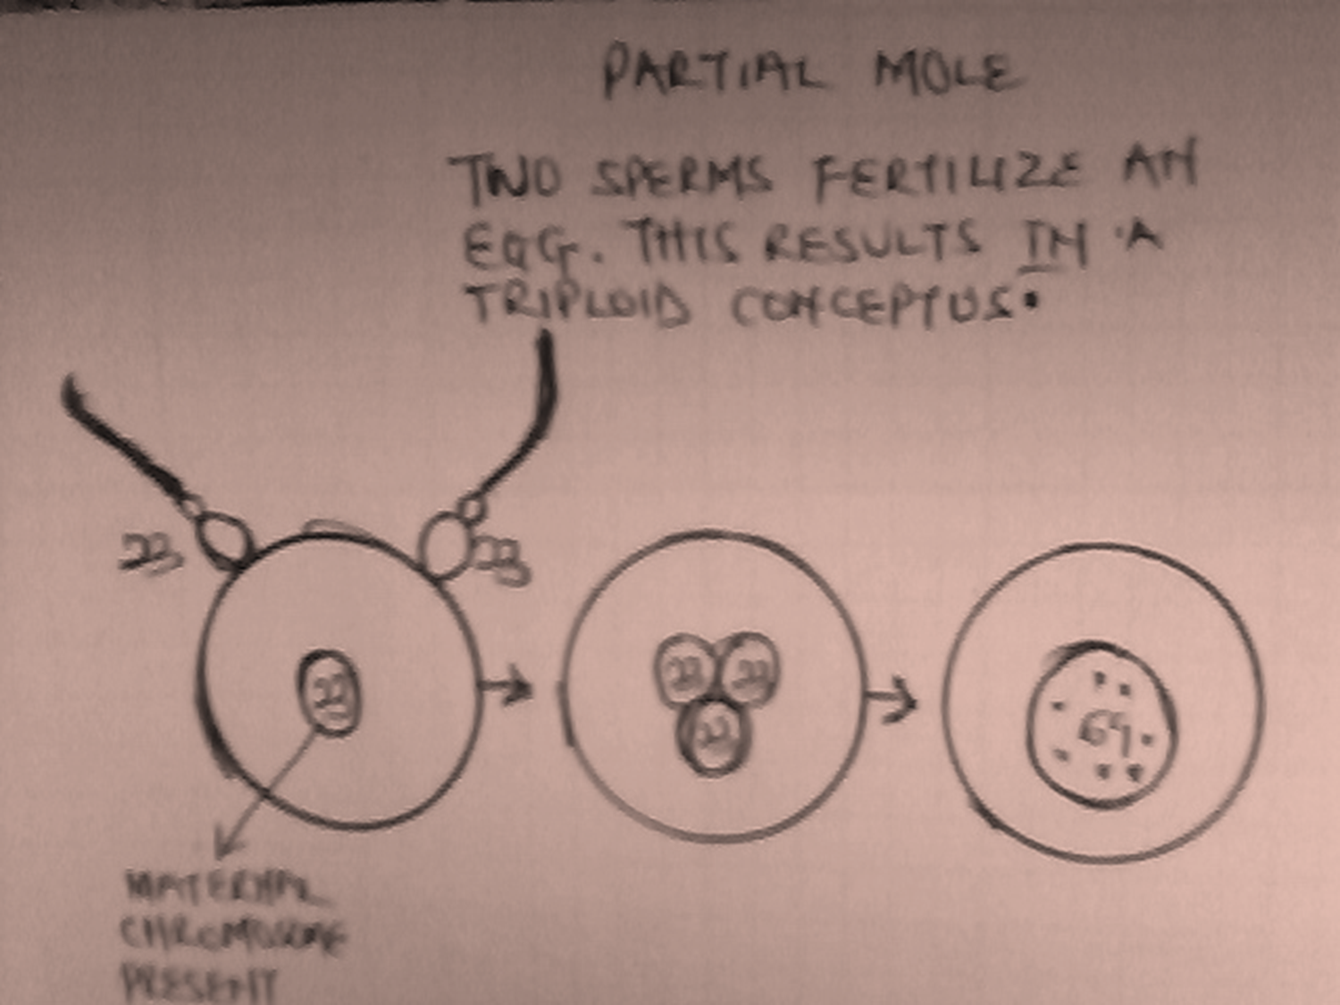

Slide 12
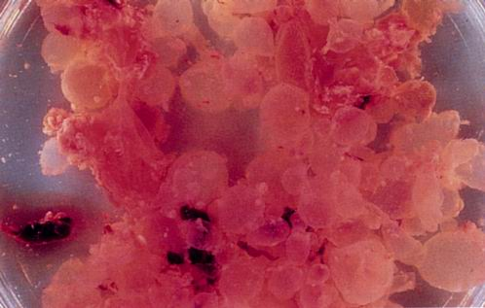
COMPLETE HYDATIDIFOM MOLE DEMONSTRATING ENLARGED VILLI

Slide 13
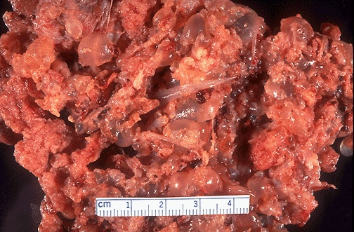
Here is a partial mole in a case of triploidy. Note the scattered grape-like masses with intervening normal-appearing placental tissue.

Slide 14
INVASIVE MOLE
Hydatidiform mole that invades the myometrium adjacent to its site.
Microscopic findings:- same as hydatidiform mole.

Slide 15
Placental Sites trophobalstic tumour (PSTT)
Associated with local invasion, into the myometrium and lymphatics. Vascular invasion is less common.
May occur in any type of pregnancy, 95% follows normal pregnancy.
Lesions – may be low or high grade malignancy
Treatment is surgical
Responds poorly to chemotherapy.

Slide 16
Chorocarcinoma
Composed of syncytiotrophoblastic and cytotrophoblastic cells.
Histologic examination shows no villi but instead sheets of foci trophoblasts on a background of haemorrhage and necrosis microscopically.
May arise from ectopic pregnancy,
25% - molar pregnancy,
25% - normal preg.

Slide 17
Symptoms and Signs of GTD
A. AUB usually during the 1st trimester is the most common symptoms occurring in over 90% of patients with molar pregnancies, ¾ with bleeding have this symptom before the end of 3rd month of pregnancy. Only 1/3 of pts have profuse vaginal bleeding.
Nausea and vomiting often excessive but at times difficult to distinguish from similar complaints seen in normal pregnancy

Slide 18
Disproportionate uterine size:- ½ of patients have excessive uterine size for gestation date, 1/3 uterus is smaller than expected.
Medical Complications seen include
I. Preeclampsia – 1st trimester or early 2nd trimester - An unusual finding in normal preg
II. Hyperthyrodism –10% of pts with HM, manifestation disappear ff evacuation,
may require antithyroid therapy.

Slide 19
III.Uterine perforation or rupture
IV.Coagulopathies
V. Anaemia
VI.Multiple theca lutein Cysts
Increased risk of malignant gestational neoplasm
Occur in 15% - 30% of woman with molar pregnancies
In about 50% of cases – the ovaries are enlarged leading to ovarian torsion or rupture of the cysts.

Slide 20
The 1⁰ symptoms of choriocarcinoma include vaginal bleeding 50 – 60% of cases, others include
- Dyspnoea
- Neurological symptoms
- Abdominal pain
- All within a few weeks or months and sometimes
up to - 10 – 15 years after their last pregnancy
- Some may develop jaundice, renal stone,
pathological fracture, GIT bleeding and
haemoptysis, all arising from metastasis,

Slide 21
REVISED FIGO STAGING SYSTEM FOR GESTATIONAL TROPHOBLASTIC DISEASE
Stage
I. Disease confined to uterus
II. Disease extend outside of the uterus but limited to genital structures (adnexa, vagina, broad ligament).
III. Disease extending to the lungs, ± known genital tract involvement
Disease at other metastasic sites.

Slide 22
Sub-stage (a) No risk factors
(b) One risk factors
(c) Two risk factors
Risk factors – 1) βHCG > 100, 000miu/ml
2) Duration from termination of antecedent pregnancy to diagnosis – 6 months.

Slide 23
CLASSIFICATION/CATEGORY OF MALIGNANT GTD
A)Non metastastic: No evidence of dx outside uterus
B)Metastatic dx: Any dx outside uterus i) Good prognosis
a. Short duration (< 4 months)
b. serum B HCG <40,000 miu/ml.
c. No metastasis to brain or liver
d. No significant prior chemotherapy

Slide 24
ii)Poor Prognosis
a. Long duration (>4 months)
b. Serum HCG > 40,000miu/ml
c. Metastasis to brain/liver
d. Unsuccessful prior chemotherapy
e. Gestational trophoblastic neoplasia following term pregnancy

Slide 25
Modified WHO Prognostic Scoring System(2002)
SCORES 0 1 2 4
Age <40 ≥40
Interval of preg. <4 4-<7 7-<13 ≥13
Type of preg. Mole Abortion Term
β-hCG level <10³ 10³-<10⁴ 10⁴⁻<10⁵ ≥10⁵
Size of tumor - 3-<5cm ≥5cm
Site of metastasis Lung Spleen/kid GI L/B
No of ,, - 1-4 5-8 ≥8
Prior chemotherapy - - single 2 ormore

Slide 26
WHO SCORING SYSTEM(2)
Total score ≤6 = low risk
≥7 = high risk

Slide 27
MANAGEMENT
History, Examination , Investigations &
Treatment
Investigations
- General investigation include
- Full blood count
- Liver fxn tests
- E/u & Cr
- Chest Xray
- Specific investigation.
- BHCG Level:- hormone detected in serum or urine is virtually all pxs with HM or malignant Trophoblast dx

Slide 28
Serial βHCG levels is the gold standard for the diagnosis and monitoring therapeutic response of GTD, careful monitoring is required.
In general HCG level, with value > 100,000 miu/ml
are usual with molar pregnancies in contrast to normal preg <60,000 miu/ml.
Rate/Constancy of decline of in HCG liter is important.
In most instance BHCG values exhibit a progressive decline to normal within 14 weeks following evacuation of a molar pregnancy. The HCG level should be monitored weekly until undetectable following monthly monitoring for 6-24 months.

Slide 29
b. USS – Simple, safe, reliable
- Molar changes can now be detected from the 2nd month of pregnancy which typically reveal in uterine cavity filled with multiple sonolucent areas “(snow storm appearance)” without associated embryonic or fetal structure.
c. Plain x-ray of Abdomen./Pelvis
- Show absent fetal parts after > 16 weeks complete HM

Slide 30
TREATMENT:
A. Hydatiform mole
- Correction of anaemia, dehydration and other medical problems
- Evacuation
Suction curettage is the method of choice, safe & rapid effectiveness nearly in all cases, IV oxytocin should be started after a moderate amount of tissue has been removed, may be continued for 24 hours post evacuation.
Laparotomy or Hysteretomy as indicated.
Hysterectomy:- in older multiparous women.

Slide 31
B Prophlactic Chemotherapy
Indication for chemotherapy
  Very high βHCG value post evacuation
  Rising βHCG value post evacuation
  Detectable βHCG value 6 month post evacuation
  Metastasis to lungs, vagina or vulva
  Heavy bleeding per vagina.
  Tissue diagnosis of choriocarcinoma.

Slide 32
C) Non metastatic gestation trophoblastic disease diagnosis is usually made during follow-up after evacuation of molar pregnancy.
Single agent chemotherapy using methotrexate / dactinomycin or
combined chemotherapy/ surgery as it may be indicated.

Slide 33
Drugs include
Methotrexate
Dacitinomycin D

Slide 34
An average of 3 or 4 courses of single agent therapy is required.
At least one course of drug therapy should be given after the 1st normal βHCG determination.

Slide 35
Metastatic GTD
1.Good Prognosis Patients
Single agent chemotherapy - generally successful
Methotrexate is considered the drug of choice, ideally the 5 days treatment cycle is given every other week.

Slide 36
2 Poor prognosis :
Respond poorly to single agent therapy
A poor response is also seen in patients with revised FIGO stage IIIc, all stages of IV and WHO Scores >7.
Specialized care, life support measures, include Antibiotics,Blood transfusion and good nutrition.
Low risk group:- Single agents as documented above, Methotrexate or Actinomycin D .
High risk group:-
EMA-CO – Etoposide, Methotrexate, Actinomycin D, Cyclophosphamide, Oncovin(vincristine).

Slide 37
Prognosis
Cure rates should approach 100% in nonmetastatic and low-risk metastatic GTD
Intensive multimodality therapy has resulted in cure rates of 80-90% in patients with high-risk metastatic GTD

Slide 38
Placental Site trophoblastic tumour
Hysterectomy.
Partial resection if px desires fertility.
Chemotherapy indicated for cases of metastatic dx.

Slide 39
Other treatment measures
Surgery: Indication
Resistance to chemotherapy
Blood Tx in uncontrollable haemorrhage.
Haemoperitoneum from tumour perforation of uterus
Infected uterus not responding to A/B.
Removal by thoracotomy of solitary lung metastasis which has not responded to chemotherapy.
Excision of bleeding solitary vaginal metastasis
Excision of brain metastasis.

Slide 40
Follow-up.
Serial βhCG
Weekly until undetectable for 3 consecutive wks.
1-2monthly for 6-12month if H-Mole
6monthly for life if malignant
Pelvic examinations & CXR monthly if βhCG ≥ 1000IU/L.
Contraception.

Slide 41
Contraception
Advised for at least 1 yr post hydatidiform mole to monitor dx progression & prevent misdiagnosis of recurrent dx.
Oral contraceptive
IUCD
Barrier methods
Subsequent preg are not at increased risk for complications such as preterm labor, stillbirth or anomalies. However early USS is important.
Risk of recurrent GTD 1-2%.

Slide 42
Conclusion
GTD is a wide and interesting condition. It represents a unique group of human neoplasms because they are derived from fetal tissue.
Note -Sensitivity to chemotherapy.
-Reliable tumour marker.
-Preservation of reproductive function
-Follow-up normal pregnancy in the future.
-Long term follow-up, checking for
Recurrence or
Secondary tumour

Slide 43
THANK YOU

