Slide 1
POSTPARTUM
HEMORRHAGE
Dr O.T Adeyemo.
Consultant Obgyn FETHI & Asso. Lect ABUAD

Slide 2
Outline
Introduction
Epidemiology
Etiology
Clinical Features
Medical management
Surgical management
Prevention
Conclusion

Slide 3
Introduction:
About half a million women die yearly of pregnancy related causes.
Maternal death rates are about 1,000 times the rates quoted for developed countries
Shortage of medical facilities, blood transfusion services, manpower, anaesthesia, transportation and patient’s willingness to seek help early when needed.
Massive postpartum haemorrhage (PPH) tops the list of causes of maternal deaths

Slide 4
Major Causes of Maternal Mortality in Nigeria
Haemorrhage 23%
Sepsis 17%
Eclampsia 13%
Abortion 11%
Anaemia 11%
Malaria 11%
Prolonged obstructed labour 11%
Others 3%

Slide 5
Definition of PPH
A loss of 500mls of blood following vaginal delivery or 1,000mls of blood following caesarean section.
Major PPH requiring urgent attention is defined as a loss of 1,000mls or more postpartum.
ACOG defines PPH as a decrease in haematocrit of more than 10% from antepartum measurements.
Notes:
Absolute measurements present very little clinical relevance because blood losses recorded following deliveries are usually underestimates and unreliable
About 30% to 50% of PPH cases are missed by clinical assessment alone.

Slide 6
Early ( Primary) PPH
Early (primary) PPH is that occurring within the first 24 hours that follows a delivery.
It occurs in 1% to 2% of all deliveries and accounts for more than 75% of serious early postpartum complications

Slide 7
Secondary PPH is defined as abnormal / excessive bleeding from the genital tract 24Hrs after delivery & up to 6 weeks.
OH is defined as blood loss or bleeding during pregnancy; labour and within 42 days of termination of pregnancy.

Slide 8
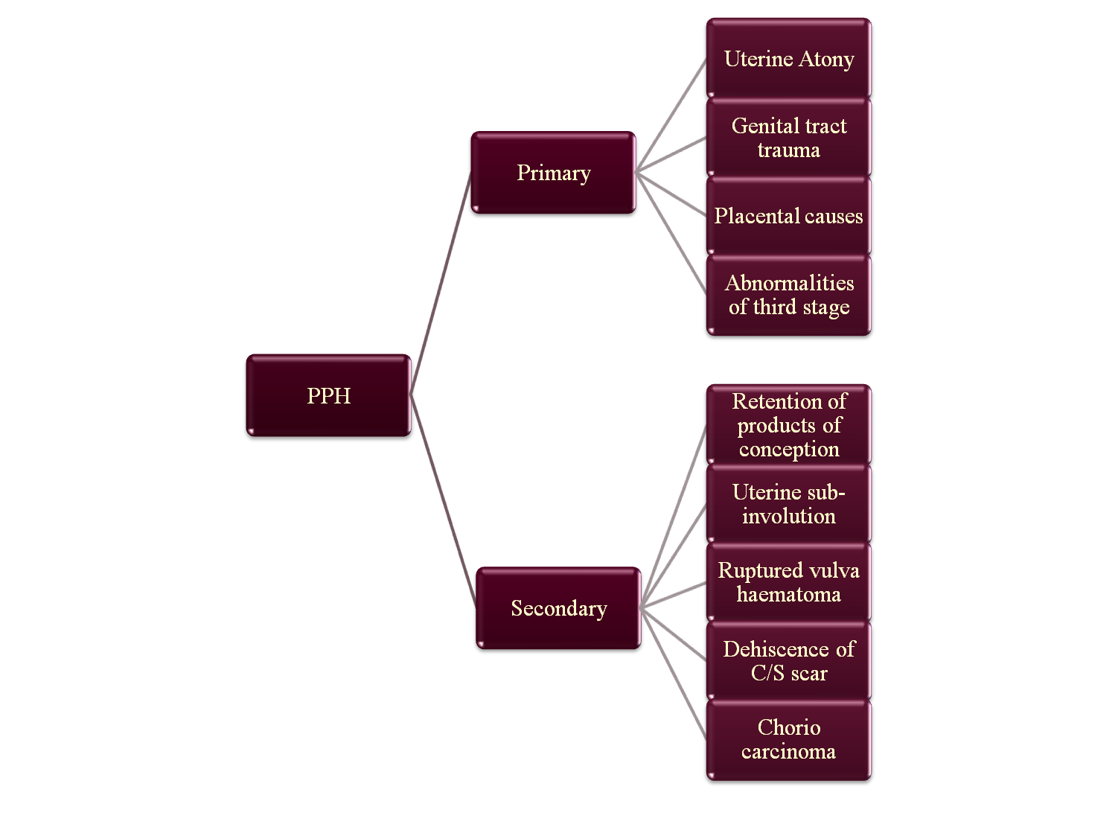

Slide 9
Etiology
    Tone: Uterine atony
    Tissue: Retained placenta
    Trauma: Genital tract lacerations
    Thrombosis: Coagulation disorders
    4 T’s of PPH
    )

Slide 10
Tone: Uterine atony (50% of cases)
 | Etiological process | Clinical risk factors
 | - over distended uterus | - polyhydramnios - multiple gestation - macrosomia
 | - uterine muscle exhaustion | - precipitate labour - prolonged labour - high parity - induction/ augmentation
 | - intra amniotic infection | - prolonged PROM

Slide 11
Tone: Uterine atony…
Etiological process | Clinical risk factors
- functional/anatomic distortion of the uterus | - fibroid uterus - placenta previa - uterine anomalies - Couvelaire uterus - Hypoxia - Hypothemia
- drugs | MgSO4 Anaesthetic agent nitrates

Slide 12
Tissue: Retained placenta (5-10%)
 | Etiological process | Clinical risk factors
 | - retained products retained cotyledon or succenturiate Abnormally adherent placenta | - previous uterine surgery - high parity - abnormal placenta on U/S - incomplete placenta at delivery
 | - retained blood clots | - atonic uterus

Slide 13
Trauma: Genital tract lacerations (20%)
 | Etiological process | Clinical risk factors
 | - lacerations of the lower genital tract | - precipitous delivery - operative delivery
 | - extensions, lacerations at caesarean section | - malposition - deep engagement
 | - uterine rupture | - previous uterine surgery
 | - uterine inversion | - high parity - fundal placenta

Slide 14
Thrombosis: Coagulation disorders
 | Etiological process | Clinical risk factors
 | - pre-existing states - hemophilia A - von Willebrand’s Disease | - hx of hereditary coagulopathies - hx of liver disease
 | - acquired in pregnancy - ITP - thrombocytopenia with pre-eclampsia - DIC - pre-eclampsia - dead fetus in utero - severe infection - abruption - amniotic fluid embolism - dilutional coagulopathy | - bruising - elevated BP - fetal demise - fever, - antepartum haemorrhage - sudden collapse

Slide 15
Clinical Features
Symptoms and Signs
Blood Volume Loss | Blood Pressure (systolic) | Symptoms and Signs | Degree of Shock
500-1000 (10-15%) | Normal | Palpitations, tachycardia, dizziness | Compensated
1000-1500 mL (15-25%) | Slight fall (80-100 mm Hg) | Weakness, tachycardia, sweating | Mild
1500-2000 (25-35%) | Moderate fall (70-80 mm Hg) | Restlessness, pallor, oliguria | Moderate
2000-3000 mL (35-50%) | Marked fall (50-70 mm Hg) | Collapse, air hunger, anuria | Severe

Slide 16
Investigations
Haematological investigations
  Full blood count
  E & U / Cr
  Grouping and cross matching of at least 4 units of blood
  Coagulation studies though not routine
  Bed side clotting time
Imaging studies – Abdominopelvic USS.

Slide 17
General principle in treatment of major primary PPH
Effective management of a major PPH is rapid diagnosis and early intervention.
Resuscitation of the shocked patient.
Uterine exploration and suturing of lacerations.
Managt of coagulopathy.

Slide 18
Initial assessment and resuscitation
Identification of causes/ Rub up contraction.
Secure IV access & take bld sample for tests.
Correction of hypovolemia
Monitoring of urinary output
Give O₂ by facemask and monitor O₂ saturation
Vital signs: BP, PR, RR, CVP.

Slide 19
Medical treatment of major primary PPH
Uterine atony is usually managed with oxytocics e.g.
0.25mg to 0.5mg ergometrine,
Prostaglandin E1 analogue [PGE1 (Misoprostol®)] and PG2 alpha and its anjalogues eg Carboprost & gemeprost, and sulphoprostone.
Notes:
Various brands of ergometrine loose about 90% of their potencies in the tropics after one year of storage exposed to light

Slide 20
Prophylactic management of major primary PPH.
Active management of labour - shortens the third stage by using oxytocics, cord clamping and controlled cord traction.
Intramuscular injections Syntometrine or 10iu oxytocin alone is quite effective in preventing atonic uterus.
Ergometrine has a more drastic effect than oxytocin but it may cause nausea and vomiting in a small number of women.

Slide 21
Surgical treatment
Exploration of the uterus
Uterine tamponade - uterine pack manually or with inflated Surgical gloves
Foley’s catheter – 60-80mls or 110mls (air)
Sengstaken-Blackemore tube –300mls
Rusch urology catheter – 400-500mls
Selective arterial embolisation - Gelfoam

Slide 22
Surgical treatment (cont)
Replacement of uterine inversion – Saline or surgical (Huntington’s procedure) replacement.
- leave placenta attached to the uterus.
- Halothane
- oxytocin infusion
- broad spectrum antibiotics

Slide 23
Surgical treatment (cont)
Surgical compression suture for uterine atony
- B-Lynch suture
- Multiple uterine ‘brace’ haemostatic sutures (does not require hysterotomy)
- Multiple square sutures

Slide 24
Surgical treatment (cont)
Ligation of pelvic arteries.
- uterine vessles – 80% reduction.
- bites into myometrium.
- internal iliac arteries – 85% reduction.
(use absorbable sutures)
Hysterectomy – subtotal or total

Slide 25
Prevention of PPH
Care plans modified when risk factors are present.
Appropriate counselling of our women on the risk factors noted.
Active managt of 3rd stage of labour
Avoid prolonged labour
Detection & treatment of anaemia during pregnancy.
Identification of PP, morbid adherence of placenta

Slide 26
Prevention cont.
Access to blood transfusion facilities
Prophylactic placement of arterial catheter for uterine artery embolisation before delivery in case of placenta previa.

Slide 27
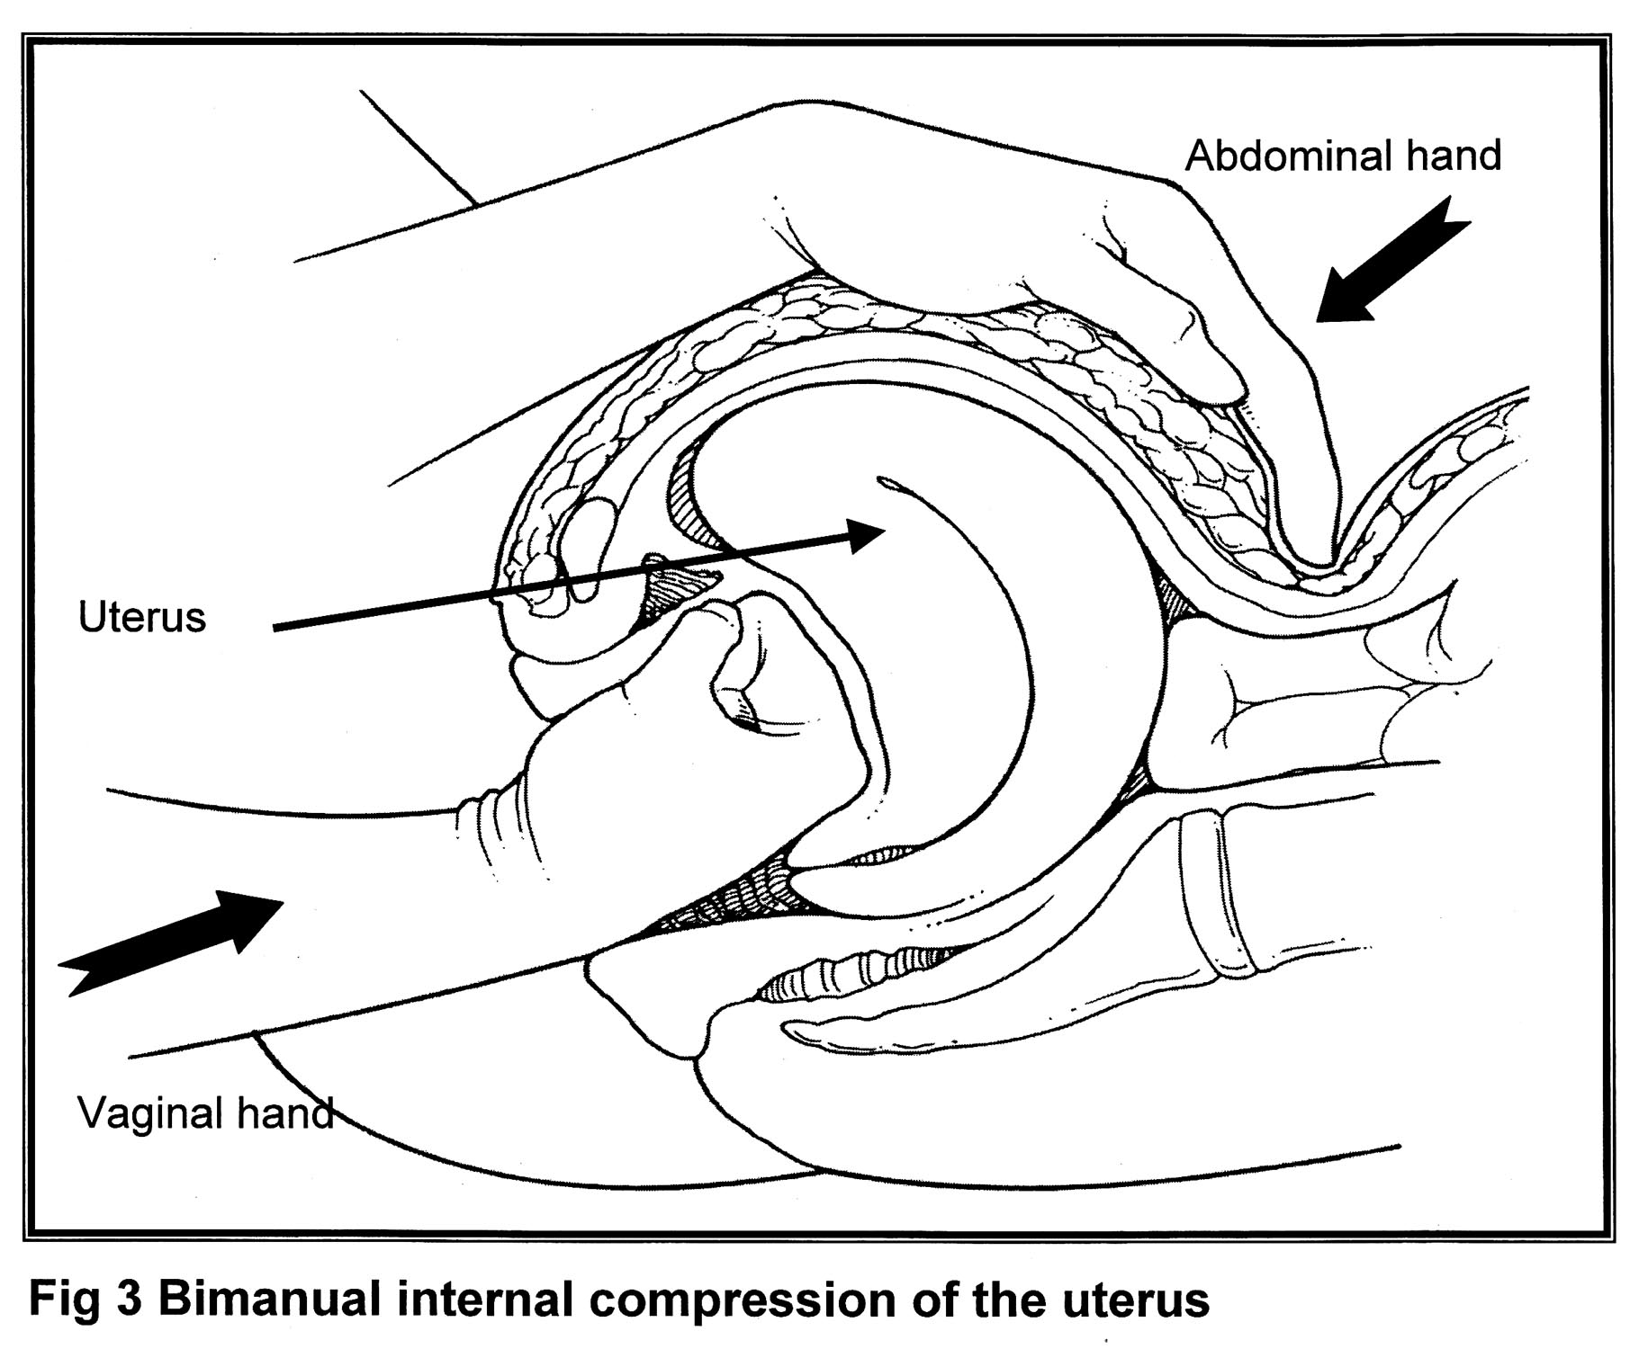

Slide 28
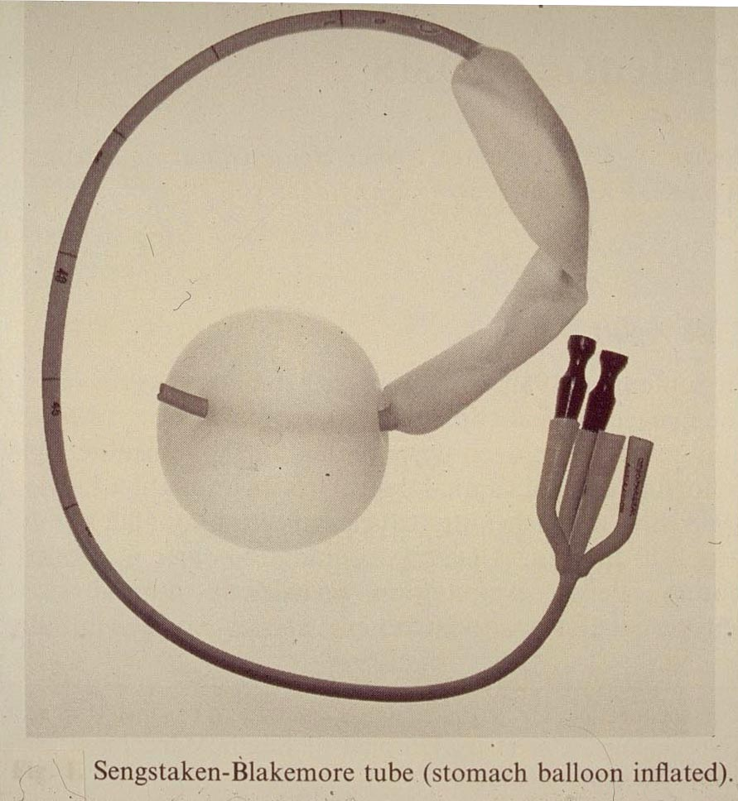
TAMPONADE TEST
Therapeutic & Prognostic
For severe PPH
Stomach balloon
Oesophageal
balloon
Condous G, Arulkumaran S et.al.
Obstetrics & Gynecology. 2003

Slide 29
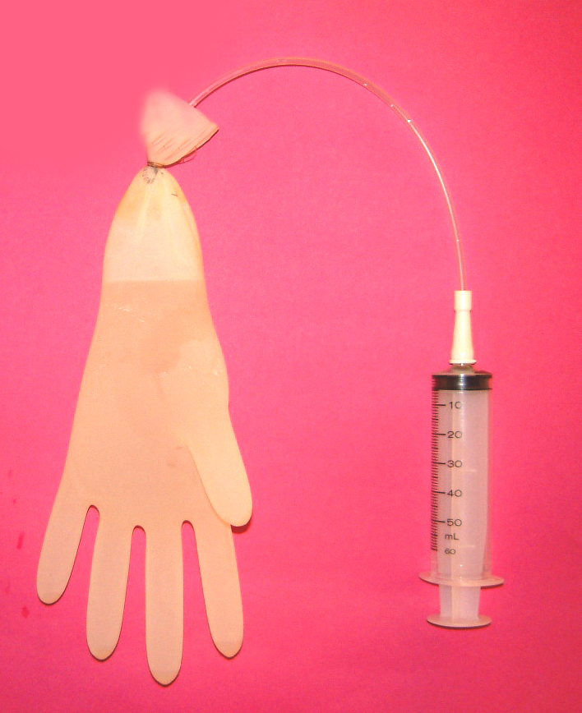
Plastic urinary catheter
Tied by sterile suture material
Glove Size 7
Contains 2 L

Slide 30
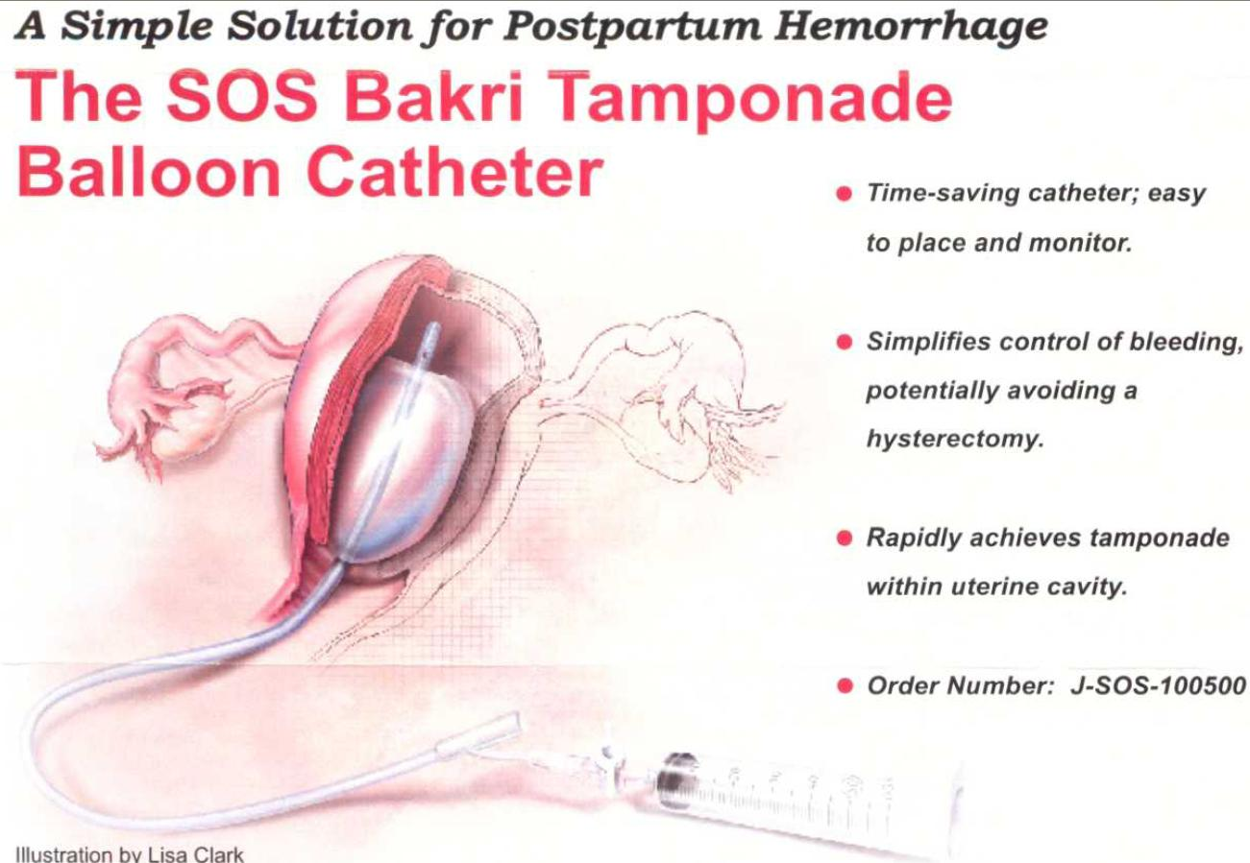

Slide 31
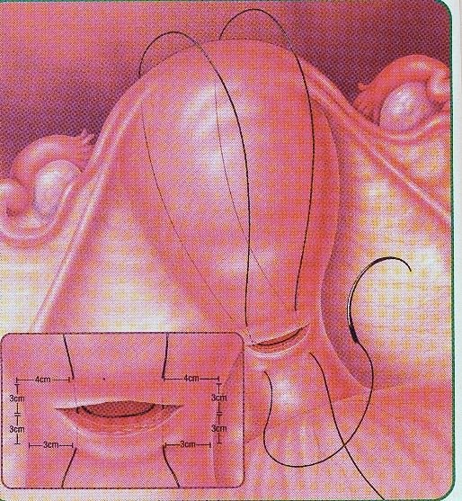
B –Lynch stiches

Slide 32
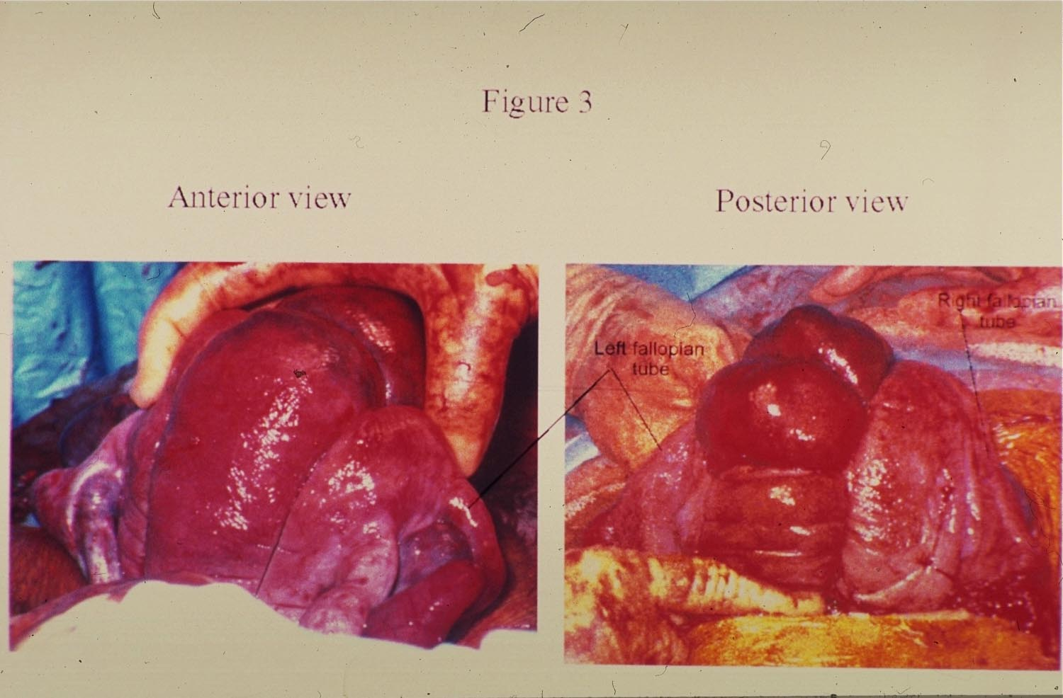
COMPRESSION SUTURES
Cornu
Fallopian tube
Ovary
Hayman R, Arulkumaran S, Steer P
Obstetrics & Gynecology. 2002

Slide 33
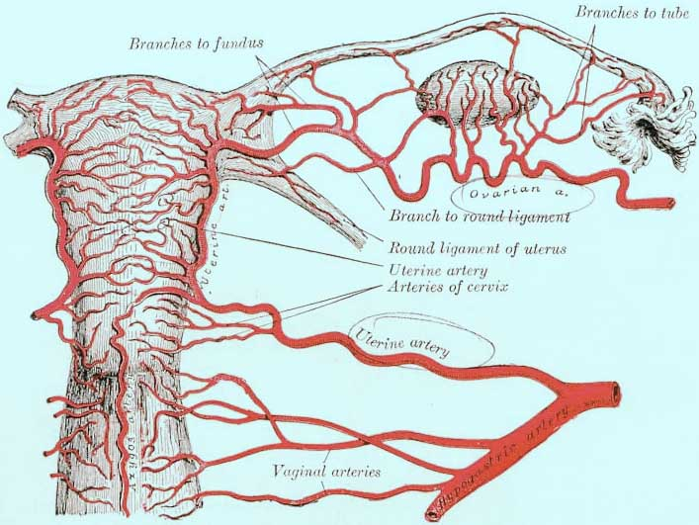
UTERINE & OVARIAN VESSELS LIGATION

Slide 34
HYPOGASTRIC (INTERNAL ILLIAC) ARTERY

Slide 35
NON-PNEUMATIC ANTI SHOCK GARMENT
(NASG)
Efficient, Simple, Safe & Easy to apply

Slide 36
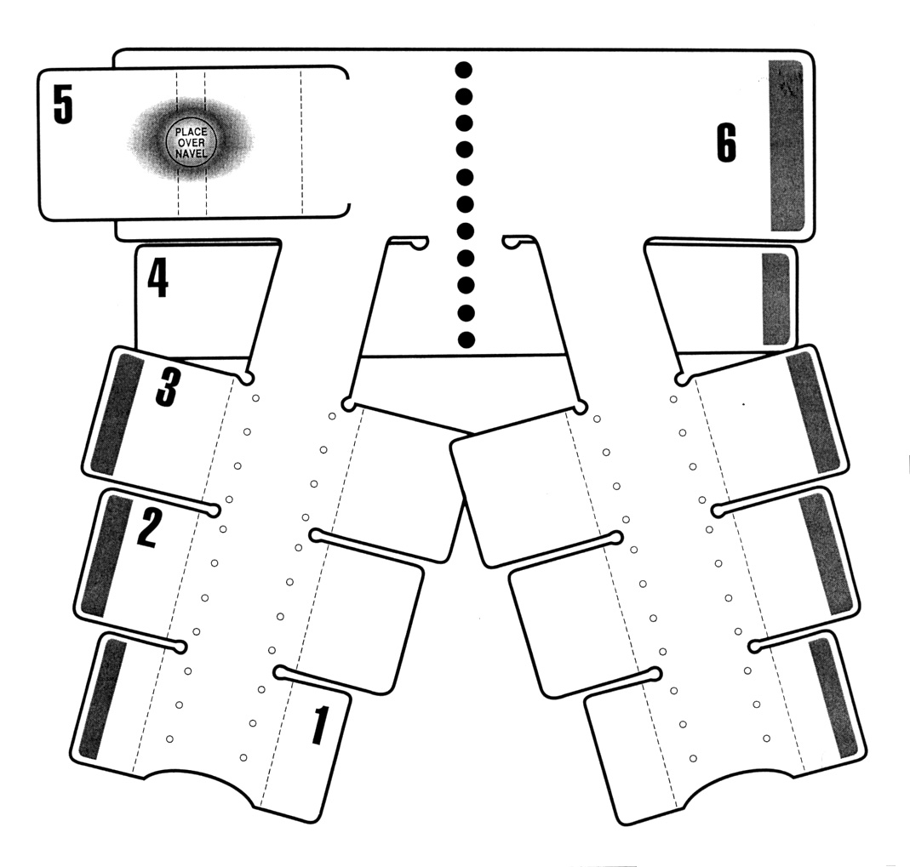

Slide 37
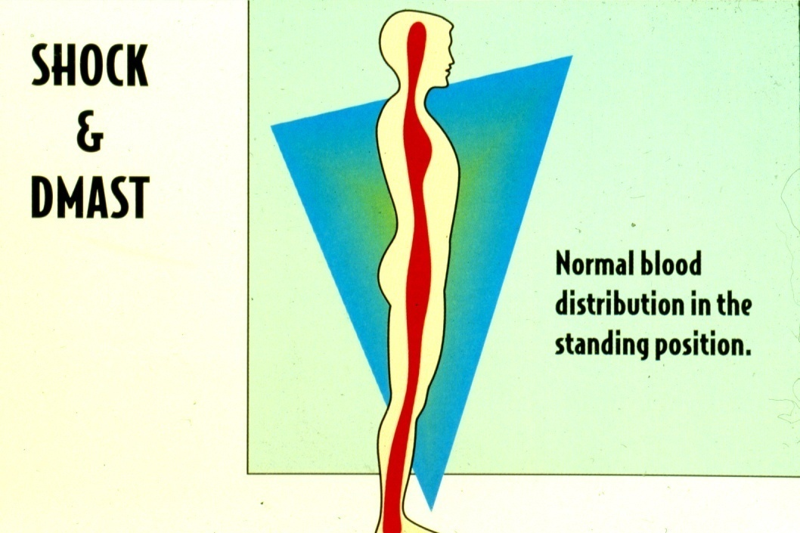
Ojengbede OA
SOGON CONFERENCE 2007

Slide 38
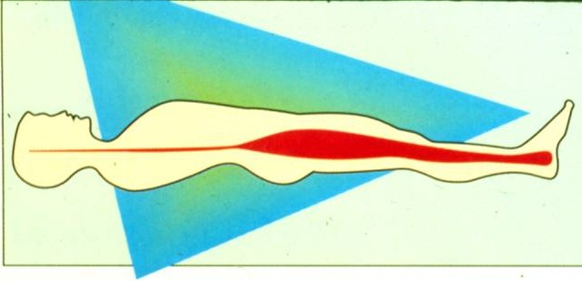
When in shock, the brain, heart, and lungs are deprived of oxygen because blood accumulates in the lower abdomen and legs.

Slide 39
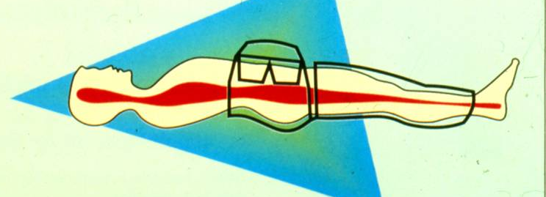
1. Reverses shock by returning blood to the vital organs.
2. This restores consciousness, pulse, and blood pressure.
3. Slows blood flow to lower body and decreases bleeding.

Slide 40
INDICATIONS FOR NASG
Initial control of hemorrhage
SHOCK
  Postpartum hemorrhage - any cause
  Ectopic Pregnancy
  Post cesarean hemorrhage
  Trauma with injury/hemorrhage below the diaphragm

Slide 41
When to remove the ASG??
Intravascular volume re-expanded with blood and saline
Vital signs stable and Systolic >100
Pulse <100
Hb>7.0 or Hct (PCV) >20
Remove one segment every 15 minutes starting below with #1 - check pulse/BP

Slide 42
CONTRAINDICATIONS – NASG use
Viable fetus in-utero
Pulmonary edema
Bleeding above the diaphragm
Congestive heart failure due to mitral stenosis
A major cause of morbidity and mortality when using the NASG is the premature and inappropriate release of external counter pressure.

Slide 43
Conclusion
Major PPH continues to be an important cause of maternal deaths with diverse diagnostic and management problems.
In developing countries, these problems are compounded by several factors that include shortage of manpower, preponderance of substandard medical facilities and delay by the patients to seek medical attention in emergency situations.

Slide 44
Conclusion (cont)
Optimum management depends on identification of women at risk and initiating appropriate prophylactic measures, and timely management of those apparently normal women who present suddenly with massive haemorrhage.

Slide 45
Thank you for listening.

