Slide 1
UTERINE FIBROIDS AND ENDOMETRIOSIS
DR. A. A. ADENIYI
(MBBS(Benin); FWACS, FMCOG, MHSc (Ib.)

Slide 2
INTRODUCTION
Uterine fibroids are benign tumours of uterine smooth muscle composed of varying amount of connective tissues.
Firm, fibrous with high collagen content
One of the common pathologic abnormalities of the female genital tract.
Commonest neoplasia of the uterus
Synonyms: Myomas, Fibromyomas, Leiomyomas.

Slide 3
Incidence
About 20% of women at the age of ≥30 years
Autopsy study revealed an incidence of 50%
50% remain asymptomatic
The prevalence is highest between 35-45 years.
It is more common among the nulliparous women

Slide 4
Origin /Aetiology
The aetiology remains largely unknown
Possible theories:
- Chromosomal abnormality: ( involving xsomes; 3,6,7, and 12.
-From somatic mutations in myometrial cells resulting in loss of growth regulation.
-Polypeptide growth factors:
Epidermal growth factor (EGF), insulin-like growth factor-1 (IGF-1), transforming growth factor (TGF).
They all seem to stimulate grow of the fibroid directly or indirectly

Slide 5
Origin/Aetiology
Genetically abnormal clones of cells
Each myoma is monoclonal
Multiple myomas arise independently
Genetic liability ( family history)
Cytogenetic aberrations
Hormonal sensitivity with estradiol and progestins
?Receptors over expression

Slide 6
Other features
Growth mostly limited to reproductive period
They do not occur before puberty
There is cessation of growth following menopause and no new growth thereafter.

Slide 7
Risk Factors
2-3 times more prevalent in black women
Diet and environmental factors
Onset of menstruation before the age of 12
Over weight/Obesity
Nulliparity
At least 2 full term pregnancies reduces risk by half
Sedentary women with higher risk

Slide 8
General Characteristics
Variable sizes: tiny, huge
Capsule usually separated from the myometrium
Usually one major vessel to each tumour
Cut surface whorled
Small percentage in cervix because of relative sparcity of smooth muscle cells there

Slide 9
Degenerative Changes
Hyaline Degeneration - (65%)
Red (necrobiosis) characteristic but not exclusive to pregnancy)
Calcific (womb stone)- 10%
Cystic
Fatty
Leiomyosarcoma 0.1% – 0.5%

Slide 10
Classification
Cervical
Body (Corporeal)
- Submucous (5%)
- Sessile, pedunculated (polyp)
Intramural (75%)
Subserous ((15%)
-Intraligamentary
- Parasitic (wandering)

Slide 11
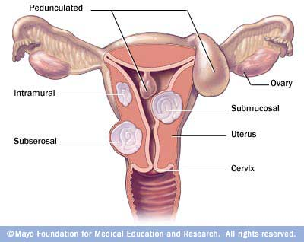
Classification of fibroids

Slide 12
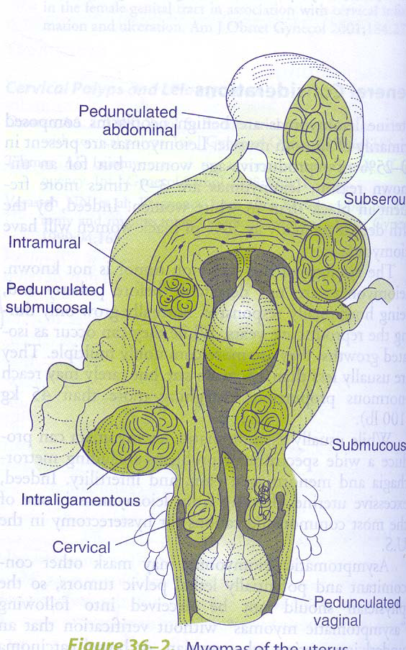

Slide 13
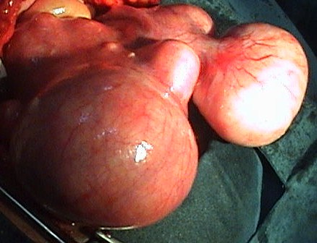
Uterine Fibroids

Slide 14
Symptoms
Asymptomatic in 70 –80% of cases
Most symptoms depend on the anatomical type (SITE) and the size of the fibroid
Menorrhagia (30%)
  Enlargement of surface area of uterine cavity
  Congestion and dilatations of endometrial venous plexuses
    Imbalance in uterine prostaglandins Prostacyclin PGI₂ and Thromboxane TXA₂ and production
  Disturbances in normal myometrial contractility

Slide 15
Symptoms
Chronic pelvic pain
Dysmenorrhoea, Dyspareunia and pelvic pressure
Acute pain
  Torsion, Infarction, Degeneration
Urinary symptoms
Others
  Recto sigmoid compression
  Prolapse of pedunculated sub mucous tumour through the cervix
  Venous stasis

Slide 16
Management
History :Risk factors, symptoms, signs and complications
Pelvic examination: Size, location, other associated findings
Investigations:
-To confirm the diagnosis
- Preoperative treatment

Slide 17
INVESTIGATIONS - Diagnosis
Ultrasonography: Abdominopelvic
Laparoscopy/Hysteroscopy
Magnetic Resonance Imaging (superior to ultrasound)
Hysterosalpingography (HSG)
Saline infusion sonography
Endometrial Biopsy (curettage)

Slide 18
INVESTIGATIONS- Preoperative assessment
Full Blood count
Clotting profile
Electrolytes, urea and creatinine clearance
Chest x-ray
Electrocardiography
Papanicolaou (cervical) Smear
Intravenous urography
Cystoscopy

Slide 19
Differential Diagnosis
Pregnancy
Ovarian Tumour
Full bladder
Adenomyosis
Tubo-ovarian mass

Slide 20
Complications of Fibroid
Persistent menorrhagia
Severe intraperitoneal haemorrhage (rupture of vessels over suserous fibroid
Severe infection
Malignant transformation (rare)

Slide 21
Treatment
Observation
Surgical
  Hysterectomy
  Abdominal myomectomy
  Laparoscopic myomectomy
Non-Surgical
  Medical
  Uterine artery ligation
  Embolization

Slide 22
Treatment- Observation
Symptomless myoma
Less than 12 weeks size
Provided : they do not distort the uterine cavity or are considered a factor in the couples infertility.
they are not situated in the lower part of the uterus or cervix (complicate childbirth)
Have not grown rapidly (?sarcomatous change)

Slide 23
Medical Treatment
It involves the use of drugs for either palliation or as alternative to surgery.
Objectives of medical treatment:
- To reduce menorrhagia and correct anaemia before surgery
- To reduce the size and the vascularity of the fibroid to facilitate surgery
- Alternative to surgery in perimenopausal women
- Postponement of surgery temporarily

Slide 24
Common drugs used to reduce menorrhagia
Gonadotrophin releasing hormone analogue (GnRH analogues)
Antiprogesterones – Mifeprostone
Danazol
Prostaglandin synthetase inhibitors
Levonegestrel intrauterine system (LNG-IUS)

Slide 25
GnRH analogues:
Agonists:(buserelin, leuprolin & goserelin )
Antagonists: (cetrorelix, ganirelix)
Agonists cause initial flare or stimulation before down regulation, while antagonists cause immediate suppression of the pituitary and ovarian function
  Down-regulates pituitary regulation and suppression of ovarian functions.

Slide 26
Advantages of GnRH analogues
  Shrinks fibroid by 30-60%
  Improvement in menorrhagia (it may cause amenorrhoea)
  It reduces the incidence of anaemia
  It reduces pressure symptoms
  Reduction in the vascularity of fibroid
  It reduces blood loss during myomectomy
  It may facilitate laparoscopic or hysteroscopic surgery.

Slide 27
Disadvantages of GnRH analogues
  It produces hypoestrogenic side effects (Osteoporosis, vasomotor symptoms)
  Recurrence rate is high after ceasation of therapy
  It may cause difficulty in myoma enucleation.
  They are expensive

Slide 28
Medical Treatment
Danazol
  Androgen, inhibitor of steroidogenesis.
  ↓ fibroid volume temporarily. vascular effect.
Mifepristone
  Antiprogestogen.
  ↓ volume by 40-50%. Few vasomotor symptoms. No osteoporosis

Slide 29
Treatment- Myomectomy
Definition
Removal (enucleation) of the fibroid mass with the conservation of a potentially functioning uterus.

Slide 30
Indications for Myomectomy
( Women who wish to Maintain Fertility)
Menorrhagia associated with sub-mucous or intramural fibroids despite medical treatments
Infertility associated with uterine cavity distortion after all other avenues have been invested
Recurrent miscarriage associated with sub-mucous fibroids.
Pregnancy complications associated with malpresentations – with other causes excluded.
Pain and Pressure symptoms on bowel or bladder or ureters

Slide 31
Contraindications of myomectomy
Infected fibroid
Post menopause
Suspected malignant change (sarcomatous)
Where hysterectomy is safer and preferable e.g. Parous women with completed family.
Pelvic or endometrial tuberculosis
During pregnancy
During Caesarean section (relative contraindication

Slide 32
Complications of myomectomy
Haemorrhage
Haematoma formation
Infection/ sepsis
Adhesion formation

Slide 33
Prevention of adhesion formation during myomectomy
Adequate surgical exposure
Minimal no of uterine incisions
Antibiotic prophylaxis
Careful surgical technique
Gentle handling of tissues
Anteriorly placed uterine incision
Prevention of tissue desiccation

Slide 34
Surgical Treatment - Hysterectomy
Hysterectomy
Definition: Surgical removal of the uterus
Abdominal
Laposcopic
Vaginal
Indications for Hysterectomy
- Completion of family
- Technically difficult myomectomy
- Uncontrollable hemorrhage
- Coexisting pathology ( cervical , endometrial or ovarian)

Slide 35
Surgical Treatment - Hysterectomy
  Complications of Hysterectomy
  Hemorrhage
  Injury to contiguous structures (ureters, bladder, bowels etc)
  Infection/ sepsis
  Anaesthetic complications
  Advantages of hysterectomy
  No uterine bleeding
  No future cervical cancer
  No other cervical pathology in the future
  Lower future cost of health care
  Adnexal pathology could be treated

Slide 36
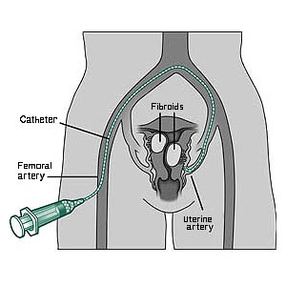
Uterine artery embolization (UAE)

Slide 37
Uterine artery embolization (UAE
It is an interventional radiological procedure
It invoves the selective catheterisation of uterine arteries and,
Injection of embolic agent e.g polyvinyl alcohol (PVA) or Gelfoam embospheres
It leads to blood flow to the fibroids.

Slide 38
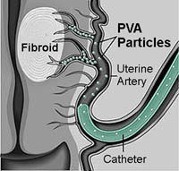
Uterine artery embolization (UAE)

Slide 39
Myomas and Infertility
Role controversial
No clear evidence
Infrequent cause
Submucous cause greatest impairment
  Distortion of endometrial cavity
  Greater distance for sperm travel
  Impairment of blood supply
  Atrophy
  Dysfunctional uterine contractility
  Enhanced androgen environment

Slide 40
Myomas and Reproductive Outcome
78% do not enlarge during pregnancy
Higher rate of miscarriage
Preterm labour
Preterm premature rupture of membranes
Abdominal pain
Abruption of placenta
Placenta praevia
IUGR
Obstructed labour
PPH
Puerperal sepsis

Slide 41
ENDOMETRIOSIS
Definition
The presence of functioning endometrial glands and stroma in sites outside the endometrial mucosa.
These ectopic endometrial tissues respond to cyclical hormonal changes leading to bleeding, inflammation and pain

Slide 42
When the ectopic endometrial tissues are found within the myometrium, it called ADENOMYOSIS (endometriosis interna)
When found outside the uterus- endometriosis externa.

Slide 43
Incidence
The prevalence is about 10%, however prevalence is higher among infertile couples undergoing laparoscopy (30-40%)

Slide 44
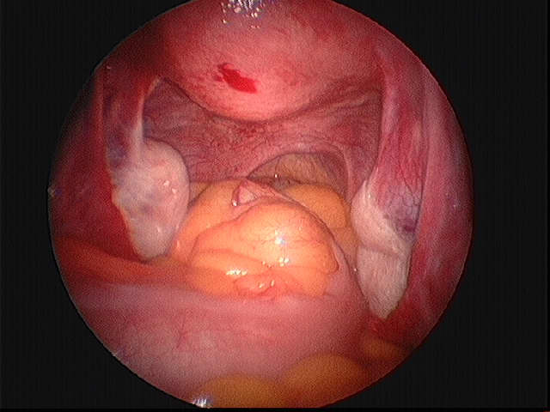

Slide 45
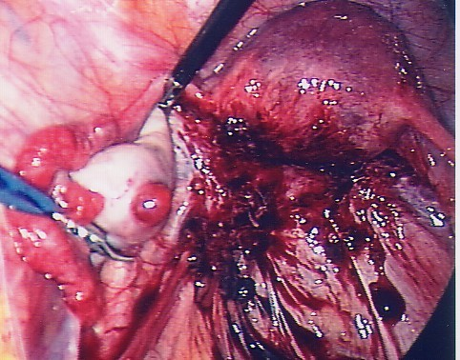

Slide 46
Pathogenesis of endometriosis
Though the exact pathogenesis is not clear, some theories have been proposed. However no single theory is able to explain endometriosis at different sites.
Retrograde menstruation and Implantation:(Sampson’s theory)- pelvic and peritoneal endometriosis
Coelomic metaplasia: (Meyer & Ivanoff theory) De-differentiation of cells originating from the Mullerian duct (uterus, tubes, ovaries and peritoneum) to endometrial cells

Slide 47
Pathogenesis of endometriosis
Lymphatic and vascular theory (Halban theory): Embolization of endometrial tissues along the vascular and lymphatic drainage to distant sites (joints, skin, lung, kidney, lymph nodes
Genetic and immunological factors: This may explain the familial and racial differences in prevalence of endometriosis

Slide 48
Sites of endometriosis
Abdominal
Extra abdominal
Remote

Slide 49
Sites of endometriosis - Abdominal
This is the commonest site and usually limited to the lower abdominal structures (below the umbilicus)
Common sites: ovaries, pelvic peritoneum, Pouch of Douglas, uterosacral ligaments, rectovaginal septum, Sigmoid colon, Fallopian tubes, pelvic lymph nodes, appendix.

Slide 50
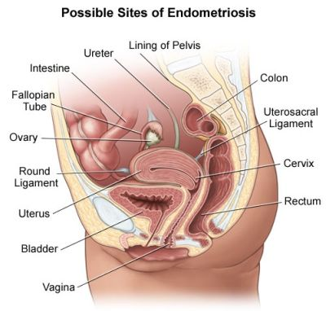

Slide 51
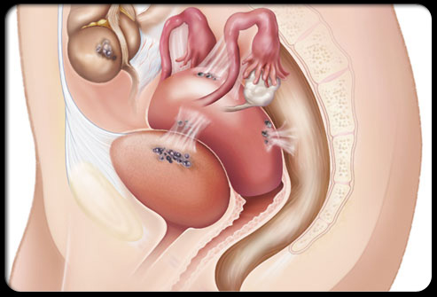

Slide 52
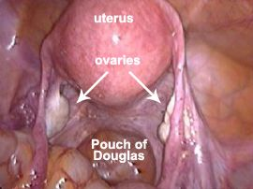

Slide 53
Sites of endometriosis - Abdominal
Uncommon/ remote sites: Umbilicus, abdominal scars, kidneys, ureters, lungs episiotomy scar

Slide 54
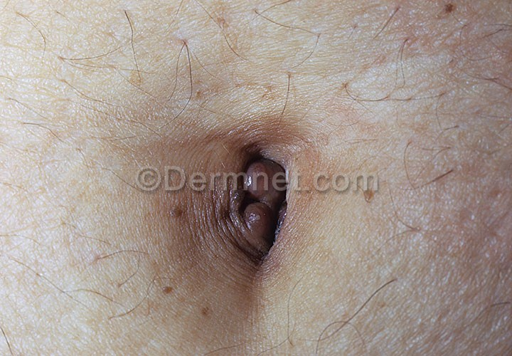
Umbilical endometriosis

Slide 55
Pathology
The endometrial glands at the various sites undergo cyclical changes in response to ovarian hormones which leads to cyclic growth and shedding.
The cyclic shedding may remain encysted or may rupture and appear as free implants.
The shed irritant blood stimulates inflammation and fibrosis leading to formation of adhesion

Slide 56
Pathology
The encysted implants enlarges with cyclical bleeding. The serum gets absorbed in between periods and the contents becomes chocolate coloured called chocolate cyst (endometriomal cysts) usually found in the ovaries (ovarian endometrioma)

Slide 57
Appearance
Macroscopic (naked eye) appearance:
- ‘Powder burns’ are small black dots usually seen in the Pouch of Douglas (POD) and uterosacral ligaments
- Endometriomas (chocolate cysts): varying sizes usually affecting the ovaries bilaterally.

Slide 58
Appearance
Microscopic appearance
-There is presence of both the endometrial glands and stroma.
- The cyst wall is usually composed of fibroid tissues lined with heamosiderin.

Slide 59
Clinical Presentations
The common age is 30-45 years
It commom among nulliparous women
Thee may be a family history
Symptomless (25%)
Symptoms
Dysmenorrhoea (70 %)
Abnormal menses (mostly menorrhagia)
Dyspareunia (20-40%)
Chronic pelvic pains (lower abdominal, backaches
Infertility (40-60%)

Slide 60
Clinical Presentations
Urinary tract : cyclical haematuria, dysuria, frequency, ureteric obstruction
Gastrointestinal tract: dyschezia (painful defecation, constipation, cyclic rectal bleeding.
Lungs: Haemoptysis, haemothorax
Surgical scar/ umbilicus: cyclical bleeding and pain

Slide 61
Endometriosis and infertility
The following may explain the connection of endometriosis with infertility
Ovarian dysfunction
Tubal dysfunction
Coital problem
Abnormal sperm function
Abnormal peritoneal fluids

Slide 62
Staging
The staging is done at laparoscopy
A scoring system by the American Fertility Society is used in staging the degree or severity
Stage I –minimal
Stage II- mild
Stage III – moderate
Stage IV - severe

Slide 63
Diagnosis
Clinical diagnosis : symptoms and signs
Serum markers – Ca- 125 assay ( for diagnosis and monitoring of therapeutic response.
Imaging: Ultrasonography, MRI, CT scan, coloscopy (rectosigmoidoscopy and cystoscopy
Laparoscopy ( the gold standard of diagnosis)

Slide 64
Treatment
Preventive
Suppressive /Curative
The preventive measures include:
- Avoid tubal patency test during menses or soon after curettage (e.g. HSG)
- Avoid forcible pelvic examination during or just after menstruation.
- Women with family history should be encourage to start and complete their family as soon as possible

Slide 65
Treatment- Curative
Objectives of curative treatment
- To abolish or minimize symptoms
- Restore normal anatomy as much as possible
- To improve fertility
- To prevent recurrence.

Slide 66
Treatment-Options
Expectant management (observation)
Medical therapy
Surgical therapy
Combined therapy (medical and surgical)

Slide 67
Determinants of treatment option
Age of patient,
Desire for fertility
Severity of symptoms
Site and extent of the disease
Outcome of previous treatment

Slide 68
Treatment - Expectant
Minimal endometriosis with normal laparoscopic findings
Perimenopausal women
Young unmarried women (relative indication)
Treatment is limited to relief of pain by NSAIDs e.g ibuprofen, mefenamic acid
Patients are encourage to start family early

Slide 69
Treatment – Medical(hormonal)
The aim of hormonal treatment is to induce atrophy of the endometriotic implants
It is mostly temporary as recurrence often follows cessation of therapy.
The mechanisms of action of hormonal drugs: pseudopregnancy, pseudomenopause or medical oophorectomy.

Slide 70
Hormonal drugs
Progestogens- (medroxyprogesterone acetate, dyhydrogesterone) cause decidualisation and thinning of the endometrium.
It may cause amenorrhoea at high doses
Combined oestrogen and progesterone: It causes endometrial decidualisation and atrophy
Danazol/Gestrone: -They suppress ovarian function inducing pseudomenopausal state.
- Patients may experience adrogenic side effects such as acne, weight gain.

Slide 71
Hormonal drugs
Gonadotrophin- releasing hormone analogues ( GnRH) (leuprolide,goserelin)
- When used continously induces hypogonatrophic- hypogonadism or pseudo-menopause (medical oophorectomy) with low circulating oestrogen.
- Side effects include; hot flushes, night sweats, trabecular bone loss.
- They are better tolerated than danazol but more expensive

Slide 72
Treatment- Surgery
Conservative surgery:
- Laparoscopic removal of endometriotic implants.
Definitive surgery:
- It involves hysterectomy and bilateral oophorectomy
- It is usually followed by hormone replacement theraphy.

Slide 73
Prognosis
Endometriosis is recurrent disease despite most treatment.
Overall recurrence rate is about 40% after 5 years of treatment.
It causes a lot of psychological distress.

Slide 74

Endometriosis awareness campaign

