Slide 1
MUSCULOSKELETAL TUBERCULOSIS

Slide 2
CHRONIC GRANULOMATOUS INFECTIOUS DISEASE WITH A COMPLEX NATURAL HISTORY.IT IS CAUSED BY MYCOBACTERIUM TUBERCULOSIS.AN AEROBIC THIN ROD BACT. WITH ROUND ENDS, 0.5µm by 3µm LONG. IT IS NON MOTILE & HAS NO CAPSULE.
IT USUALLY AFFECT THE LUNGS ALTHOUGH ABOUT A THIRD OF CASES, OTHER ORGANS INCLUDING MUSCULOSKELETAL SYSTEM COULD BE AFFECTED.
IT BELONG TO THE FAMILY MYCOBACTERIACEA THE COMPLEX INCLUDE M.TUBERCULOSIS; M.BOVIS; M.AFRICANUM; M.MICROTI; ETC
AFTER EXPOSURE INFECTION MAY BE CLEARED BY THE HOST;IT MAY LEAD TO A PRIMARY INFECTION OR CAN LATER BE REACTIVATED FROM A LATENT INFECTION
DEPRESSION OF IMMUNITY; POVERTY; MALNUTRITION; DRUG ABUSE; HIV; OVERCROWDING; MEASLES; ALCOHOLISM; WAR; NATURAL DISASTERS; POPULATION EXPLOSION; POOR VENTILATION MIGRATION(IDP); PRISONS; OLD PEOPLES HOME; POOR HYGENE; DESTITUTION ARE MAJOR PREDISPOSING FACTORS THAT MAY PRECIPITATE PROGRESSION TO FRANK DISEASE
RESURGENCE HAS BEING ADDUCED TO HIV; COMPLACENCY IN VIGILANCE; HOMELESS POPULATION; IMMIGRATION

Slide 3
TRANSMISION IS MOST COMMON FROM A PATIENT WITH INFECTIOUS PULMONARY TB TO A CLOSE BYSTANDER BY INHALATION OF INFECTED DROPLET NUCLEI (AEROSOLIZED BY COUGHING, SNEEZING,SPEAKING,LAUGHING,SINGING ETC)
INTIMACY; DURATION OF CONTACT AND SHARED ENVIROMENT OF CONTACT (OVERCROWDING IN POORLY VENTILATED ROOMS) AS WELL AS DEGREE OF INFECTIOUSNESS( CAVITATORY/ LARYNGEAL TB) ARE ALL DETERMINANTS OF TRANSMISSION
Consumption of unsterilized infected cow milk or cow milk product
Bacilli are phagocytized by macrophages and are transported by this cells to lymph nodes where they are disseminated widely to many organs and tissues
SPREAD IS BY HEMATOGENEOUS;LYMPHAGENIOUS OR CONTIGUOUS
Infection in the majority of people results in an immune response without any apparent illness; thus primary infection remains dormant, but in response to reduced immunity from any of the predisposing conditions may lead to reactivation.
Dormant bacilli, however, may persist for years before reactivating to produce secondary (or post primary) tuberculosis, which is often infectious.

Slide 4
Inhaled bacilli settles at the middle and lower lung zones. The lesion (Ghon’s focus) is usually peripheral with a transient hilar or paratracheal lymphadenopathy. The Gohn’s focus with or without pleural reaction and regional lymphadenopathy is Ghon’s complex
From the hilar lymph nodes, tubercle bacilli disseminate to tracheal and vertebral lymph nodes. Through the thoracic duct, they reach the blood stream, spreading to the upper areas of the lungs or to different organs, such as kidney, brain, bones e.t.c.
@ this site, they find a favorable atmosphere for adherence that combines a satisfactory oxygen tension & a low local perfusion this is an ideal association that hinders the access of defense cells.
They elicit a chronic inflammatory (granulomatous) reaction. The characteristic microscopic lesion is the tuberculous granuloma(or tubercle); which is a collection of epitheliod & multinucleated giant cell surrounding a central area of necrosis with round cells mainly lymphocytes around the periphery.
The necrotic material present in the center of TB lesions contains high amounts of fat representing the lipids liberated from bacillary catabolism. This material, which has a soft, dry and cottage cheese texture, is known as caseous necrosis (coagulative&liquefactive)

Slide 5
The tissue-damaging response is the result of a delayed-type hypersensitivity (DTH) reaction to various bacillary antigens. This response, mediated by various bacterial products, not only destroys macrophages that contain actively dividing bacilli but also produces early solid necrosis in the center of the tubercle; which may later undergo fibrosis and calcification.
Mononuclear cells then differentiate into epitheloid cells, and a tubercle is formed when lymphocytes form a ring around a group of epitheliod cells. Caseation then develops within the center of the tubercle. Which may later on result in exudation and liquefaction, and a cold abscess is formed (abscess without cardinal signs of inflammation). A cold abscess is composed of serum, leukocytes, caseation, tissue debris, and bacilli.
The macrophage-activating response is a cell-mediated phenomenon which confer partial protection; resulting in the activation of macrophages that are capable of killing and digesting tubercle bacilli.
These activated cells aggregate around the lesion’s center and effectively neutralize tubercle bacilli without causing further tissue destruction. Even when healing takes place, viable bacilli may remain dormant within macrophages or in the necrotic material for years or even throughout the patient’s lifetime.
Aside from macrophages, which directly phagocytize tubercle bacilli. T cells (mainly CD4 lymphocytes), can also induce protection through the production of lymphokines, especially interferon (IFNy) also confer cell mediated immunity

Slide 6
TUBERCULOSIS PREVENTION / CONTROL PROGRAM
CONTACT TRACING / INVESTIGATION
MASS XRAY CAMPAIGN IN THE PAST
SCREENING OF AT RISK GROUP
PASSIVE CASE FINDINGS; EARLY CASE DTECTION
HOLDING PATIENT TO CURE : Obtaining compliance with Rx (D.O.T)
IMMUNISATION / RESPIRATORY Isolation
AVAILABILITY/ affordability OF DRUGS
FAVOURABLE GOVERNMENT POLICIES / SUSTAINED FINANCING
CHEMOTHERAPY SHORT COURSE TO SPUTUM SMEAR AFB POSITIVE PX
AVOID OVERCROWDING & POORLY VENTILATED APARTMENT
ARRIVING AT A DIAGNOSIS IN SOME INSTANCES MAY BE LIMITED TO HIGH INDEX OF SUSPICION WITH POSITIVE CLINICAL FEATURES
ELEVATED ESR; Positive immunologic test; EXPERT MTB/RIF ASSAY
FBC with relative lymphocytosis with or without anaemia
Radiological features suggestive of tuberculosuis
Postive microscopy and culture result
Histopathologic features suggestive of tuberculosis

Slide 7
Diagnosis HIGH INDEX OF SUSPICION is key
Detailed history and thorough examination
Three early morning sputum specimen. Tissue, fluid or aspirate for AAFB (fluorescent microscopy or Z/N stain and MCS)
Gastric washout in children that swallows their sputum; fiberoptic bronchoscopy with bronchial brushings or transbronchial biopsy.
Synovial biopsy and Synovial fluid Aspirate
BIOPSY (commence antiTB. regimen before open biopsy): Histology/culture
CT or ultrasound-guided or fluoroscopy can assist in obtaining appropriate tissue or fluid samples (spinal lesion)
CULTURE IS DEFINITIVE BUT SLOW : Specimens may be inoculated onto egg- or agar-based medium (e.g., Lowenstein-Jensen or Middlebrooks7H10 : incubated at 37⁰C under 5% CO₂).
Nucleic Acid Amplification Technology EXPERT MTB/RIF ASSAY (W.H.O recommended rapid diagnostic test; accepted globally; sensitive and specific)
IMMUNOLOGIC TEST : PPD or Mantoux;
IGRA/ELISA (Interferon gamma release assay) QuantiFERON® TB Gold In-Tube test (QFT-GIT); T-SPOT®.TB test
FBC(relative lymphocytosis +/-anemia); ESR(high);CRP; E/U+Cr, LFT, EYE TEST
Chest X-Ray; X-RAY OF AFFECTED JOINTS OR REGION OR BONES
Drug susceptibility testing to isoniazid; rifampin and ethambutol
MRI/BONE SCAN/CTSCAN

Slide 8
TST /MANTOUX Inject 0.1 mL (5 IU) PPD intradermal on the volar surface of the forearm; mark the area and instruct patient to isolate it; examine after 48-72 hours. A positive reaction is indicated by induration of > 10 mm in size (measure indurated area ONLY transversely) Erythema (redness) is not considered part of the reaction.
TST is a skin test and difficult to administer correctly, as small variations may vary the amount of PPD delivered into the skin and thus, the size of the reaction. Measurement of the reaction is highly subjective.
False-negative reactions are common in malnutrition; immunosuppressed patients; & overwhelming tuberculosis. False Positive reactions are obtained when patients have been infected with tuberculosis but do not have active disease and when persons have been sensitized by nontuberculous mycobacteria or bacille Calmette Gue´rin (BCG) vaccination.
The tuberculin skin test probably measures the response to antigenic stimulation by T cells that resides in the skin (a delayed-type hypersensitivity reaction).These cell release lymphokines induce induration through local vasodilatation, edema, fibrin deposition & recruitment of other inflammatory cells to the area
IGRA IFN y release assay Invitro blood test. This test used an enzyme-linked immunosorbent assay (ELISA) to measure the amount of IFN-γ released in response to PPD compared with controls. It access response to early secretory antigenic target-6 (ESAT-6) and culture filtrate protein 10 (CFP-10). These test measures the response of recirculating memory T-cells. It is a costly test

Slide 9
Although routinely used, the TST has limited sensitivity and specificity. Factors related to the host, test administration and/or reading may diminish TST reactivity resulting in false-negative reactions and decreased TST sensitivity. Important factors associated with reduced TST sensitivity include malnutrition, young age, severe TB disease, HIV-related impaired cellular immunity, and other forms of immune suppression. Several factors are associated with decreased TST specificity and false-positive reactions including antigens shared between M. tuberculosis purified protein derivative (PPD), non-tuberculous mycobacteria (NTM) and BCG vaccine. Additionally, completing the TST requires two health care visits and measurement of reaction size is subjective, with documented poor inter-reader reliability. Nevertheless, the TST is the only test for which the risk of developing active TB in persons with a positive result has been well-defined.

Slide 10
NUCLEIC ACID AMPLIFICATION TEST
EXPERT MTB/RIF ASSAY; GENE EXPERT
The Xpert MTB/RIF assay remains the only fully automated cartridge-based real-time DNA-based test that can detect both TB and resistance to rifampicin in less than 2 hours, and it is the the only mature technology representing a new generation of automated platforms for molecular diagnosis. Xpert MTB/RIF is an automated polymerase chain reaction (PCR) test (that is, a molecular test) utilizing the GeneXpert platform (Cepheid, Sunnyvale, CA, United States). Xpert MTB/RIF is a single test that can detect both Mycobacterium tuberculosis complex and rifampicin resistance within 2 hours after starting the assay, with minimal hands-on technical time (Figure 1). Unlike conventional nucleic acid amplification tests (NAATs), in Xpert MTB/RIF sample processing, PCR amplification and detection are integrated into a single self-enclosed test unit, which is the Xpert MTB/RIF cartridge. Following sample loading, all steps in the assay are automated and contained within the cartridge. In addition, the assay’s sample reagent, used to liquefy sputum, is tuberculocidal (that is, it has the ability to kill TB bacteria), which largely eliminates concerns about biosafety during the test procedure. These features allow the technology to be taken out of a central laboratory or reference laboratory and to be used nearer to patients. However, Xpert MTB/ RIF requires an uninterrupted and stable electrical power supply, temperature control and yearly calibration of the instrument’s modules8.
The test procedure may be used directly on clinical specimens, either fresh sputum samples or sputum pellets (also called sputum sediment), which are obtained after decontaminating and concentrating the sputum. In both cases, the test material is combined with the reagent, mixed by hand or vortex, and incubated at room temperature for 15 minutes. After incubation, 2 ml of the treated sample are transferred to the cartridge, and the run is initiated The number of positive beacons and the timing of their detection (when the fluorescent signal rises above a predetermined baseline cycle threshold), as well as the results of sample processing controls, allow the test to distinguish among the following results: no TB; TB detected, rifampicin resistance detected; TB detected, no rifampicin resistance detected; TB detected, rifampicin resistance indeterminate; and an invalid result.

Slide 11
DIAGNOSIS OF MSK T.B : High index of suspicion; Prolong Hx of pain or swelling; restricted ROM; involvement of only one joint; enlarged and matted lymph nodes;marked synovial thickening; severe muscle wasting;; Positive TST. Periarticular erosions (Periarticular Osteoporosis) observed on X-Rays having an almost lytic appearance with decreased bone mass.( DD:Rheumatoid Arthritis)
Diagnosis is established by Synovial biopsy or Synovial fluid aspirate with positive culture and or isolation of acid fast bacilli; Xpert MTB/RIF assay Histopathological features(non specific).
CLINICAL PRESENTATION Constitutional symptoms include fever (low grade intermittent; evening pyrexia) and chronic cough(dry or productive of purulent sputum and occasionally with hemoptysis),accompanying with pleuritic pain, weight loss, anorexia, malaise, night sweat, positive history of contact, Dyspnea and fatigue. The patient may have acute or chronic symptoms, erythema nodosum, and phlyctenular conjunctivitis. Enlarged lymph nodes.
Musculoskeletal Manifestation could be in form of limp, wasting, stiffness, swelling, discharging sinus, ulcers, scars, deformities; LLD and a joint that has decreased range of motion; fibrous or bony ankylosis; subluxation or joint dislocation. Pains; “night cries” may wake the patient from sleep (the joint splinted by muscle spasm during the day relaxes with sleep at night and inflamed or damaged tissue stretches and compress causing intense pain) and tenderness. Findings in patients with spinal disease include back pain; tenderness; gibbus; incontinence. Neurologic deficit may present with weakness, ankle clonus and in the late stages, paralysis {Spastic or flaccid}; paraesthesia etc.

Slide 12
Anterior vertebral involvement more commonly occurs than central vertebral involvement. Later stages include a focal segmental collapse with anterior wedging and kyphosis (gibbus formation), characteristic of Pott's disease
Tuberculous Arthritis
The disease usually begins with seedling of the synovium by bacilli, but may also result from direct penetration of a metaphyseal focus. An effusion develops, and the synovium hypertrophies. Synovial granulation tissue proliferates at the joint periphery, and leads to marginal erosions. This granulation tissue gradually spreads across the joint from peripheral to central, resulting in loss of articular cartilage, and further bony erosions. If unchecked caseation and infection extend to surrounding soft tissue to produce a “cold abscess”. This may burst through the skin forming a sinus or tuberculous ulcer or it may track along tissue plane. If arrested early there may be healing & resolution +/-Calcification.
There may be progresses to joint destruction, which may be associated with subluxation or dislocation. Ultimately, the joint becomes deformed or ankylosed(majorly fibrous ankylosis but superadded bacteria infection can result in bony ankylosis). Within the fibrocaseous mass mycobacteria may remain imprisoned retaining potential to flare up later in life.
Tuberculosis in a joint markedly decreases its functional use, and even when adequately treated, the disease may reactivate in isolated regions later in life
Children and young adolescent adult are more at risk
A primary lesion may be discovered from the pulmonary, gastrointestinal, skin or urogenital system or from an unknown source.

Slide 13
The two aims of tuberculosis treatment are to interrupt tuberculosis transmission by rendering patients noninfectious and to prevent morbidity and mortality by curing the patient
Treatment of tuberculosis is primarily medical (antimycobacterial agents; multiple drug regimen)
Surgery is at best an adjunct to appropriate antiTB drugs.
Antituberculous treatment regimen is divided into an initial or bactericidal phase and a continuation or sterilizing phase. During the initial phase, the majority of the tubercle bacilli are killed, symptoms resolve, and the patient becomes noninfectious. The continuation phase is required to eliminate persisting mycobacteria and prevent relapse.
The treatment regimen of choice for virtually all forms of tuberculosis in both adults and children consists of a 2-month initial phase of isoniazid, rifampin, pyrazinamide, and ethambutol followed by a 4-7month or more continuation phase of isoniazid and rifampin. Treatment may be given daily throughout the course or intermittently (either three times or twice weekly throughout the course).
In the DOTS(directly observed treatment) with patient support approach; compliance is ensured by employing local health care workers to document the ingestion of each dose of medication. This is accompanied with grants; enablers and incentives.
A full course of treatment is defined accurately by the total no of doses taken than the duration of treatment

Slide 14
The four main drugs used In TB can be found in fixed-dose combination.
There are several combinations containing INH and RIF; INH and EMB; INH, RIF and PZA, and INH, RIF, PZA and EMB. The use of combination preparations is highly recommended.
Fixed dose combination prevent drug resistance due to monotherapy; patient cannot be selective in the choice of drug to ingest, prescription errors are less likely. They facilitate the patient’s compliance
INH is well tolerated at recommended doses, although slow acetylators can accumulate higher INH concentrations and then have a higher risk of developing adverse effects..
Rifamycins have clinically relevant interactions with some antiretroviral drugs, such as zidovudine,non-nucleoside reverse transcriptase inhibitors, and protease inhibitors, whose concentrations may fall to sub-therapeutic levels. Then, rifamycin-free regimens have been suggested. They consist of INH, EMB, PZA, and PAS, daily for two months, followed by INH, PZA, and PAS two or three times weekly subsequently.
The WHO recommends not using SM or thiacetazone in HIV-positive patients in order to prevent the adverse effects of these drugs, often enhanced by antiretroviral drugs; EMB can be used instead
The remaining drugs are reserved for drug intolerance or resistance
Chemoprophylaxis of TB is indicated for asymptomatic patients having a positive tuberculin skin test (TST) but not showing active disease (latent TB infection), especially in the at risk population(e.g HIVpositive patients).

Slide 15
In general, the duration of the continuation phase must be estimated once the first two months of treatment (initial phase) have been completed. If the patient has residual X-ray abnormality on initial radiography and cultures are still positive after two months of treatment, the continuation phase should be extended.
When drug resistance develops, patients should be treated with a new combination containing at least three drugs that they had never received before (or that do not show cross-resistance with those to which resistance is suspected). In these conditions, the treatment is longer, more toxic, more expensive and less effective than regimens containing first-line drugs, and should be directly observed. The treatment of relapse typically involves 5 agents in the first phase, and 3 agents during the second phase. Failure to respond to standard chemotherapeutic protocols, with compliance documented, usually suggests the presence of a resistant organism or an alternate diagnosis.
Multidrug-resistant TB (MDR-TB) is defined as disease caused by a strain of M. tuberculosis that is resistant to both isoniazid and rifampin—the most efficacious of the first-line TB drugs
XDR-TB EXTENSIVELY DRUG RESISTANCE TB ( MDR PLUS RESISTANCE TO ANY OF THE FLOUROQUINOLONE & AT LEAST ONE INJECTABLE SECOND LINE DRUG)
Rifampicin is the most active antimycobacterial agent available, rifampin is the keystone of first-line treatment for TB.
Isoniazid is also a first line drug and is often given together with 25–50 mg of pyridoxine daily to prevent drug-related peripheral neuropathy. It has profound early bactericidal activity against rapidly dividing cells
Prophylaxis : INH P.O 300mg daily for 6-9month
OR INH + RIF for 3MONTHS

Slide 16
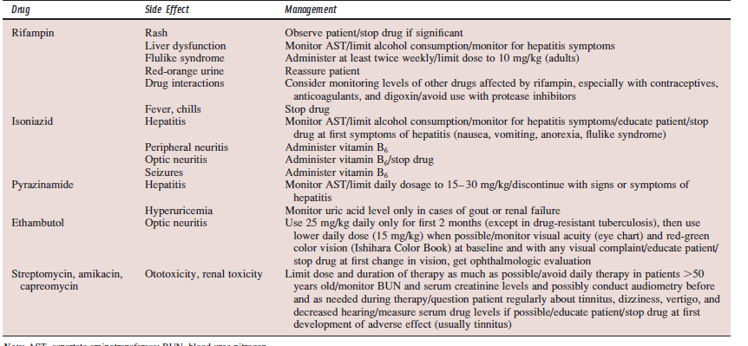

Slide 17
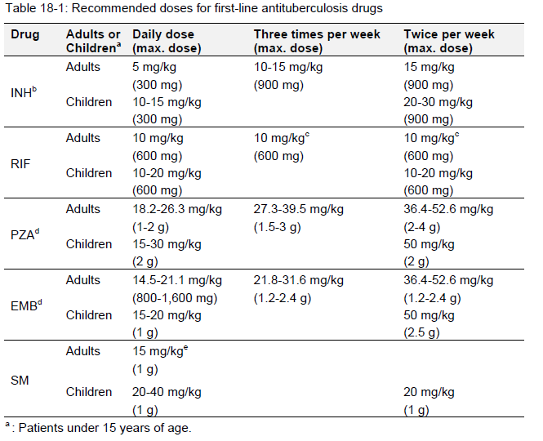
Bactericidal
It Blocks RNA
synthesis
ISONIACID
Inhibits Mycolic
Acid Cell wall
Synthesis
RIFAMPICIN
PYRAZINAMIDE
It Inhibits
Arabinosyl-
transferase
In the cell wall
ETHAMBUTOL
It inhibits Protein
Synthesis. Blocks
Ribosomal function
STREPTOMYCIN

Slide 18
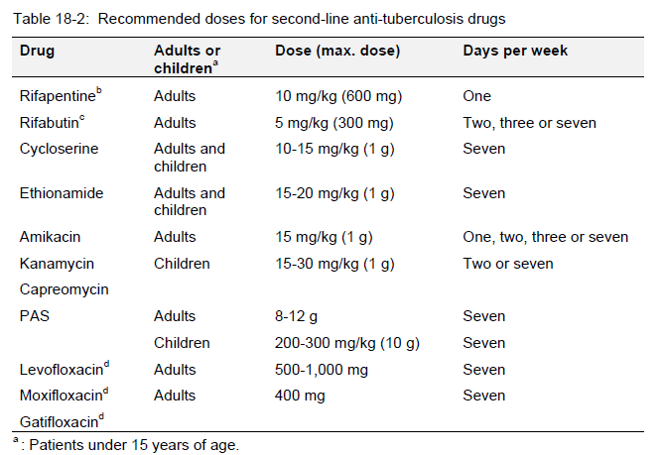

Slide 19
The primary treatment objectives for tuberculosis of bone include curing the infection,limit deformity, maintaining mobility,reduce discomfort & restore fx.
Antimycobacteria drugs is recommended for all patients with active disease as the mainstay of Rx ;
General measures to improve the patient’s physiologic state. Fortunately, most of the patients can be treated conservatively with chemotherapy, relative rest, pain control and guided remobilization. The goal is to obtain or maintain a functionally normal or near normal range of motion of affected joint.
Splinting helps to prevent deformity. Traction or serial casting may be used to restore or improve motion and or alignment before splinting or bracing. Adjunctive splinting (passive, dynamic, functional);bracing and casting techniques are useful for marked or painful and progressive joint involvement.
At times, destructive changes are markedly progressive and eventually may lead to fusion of the joint (e.g. elbow). It is very important to place the extremity in a position of function (e.g. elbow flexion 70 to 90 degrees) for optimal/near optimal range of motion and function.
Treatment duration can extend from 6 to 12 months or 18mths very rarely
Chemoprophylaxis should be considered in family members and other close contacts with positive TST. (INH P.O 300mg daily for 6-9month
OR INH + RIF for 3MONTHS)
Analgeics for pain; Broad spectrum antibiotics for super added infection
Optimal nutrition therapy ;Transfuse if necessary/ Hematinics / multivitamins
Wound care / T.T prophylaxis / HAART/ Psychotherapy/Physiotherapy

Slide 20
TUBERCULOUS SPONDILITIS / OSTEOMYELITIS
Pathogenesis is related to reactivation of latent foci or to spread from adjacent paravertebral lymph nodes or contiguous site.
Spine is the most common site of osseous involvement. Next to this is major weight bearing joints of the lower limbs most commonly the hips & knees; then the foot; elbow & hand. Virtually any other bone or joint can be affected. Metaphyseal & diaphyseal tuberculosis is quite uncommon.
Usually, active spinal lesions involve a particular segment: two vertebral bodies and the corresponding disc : Region of high oxygen tension due to generous arterial and venous supply.
80% is peridiscal in presentation: anterior superior and inferior portion of the vertebral body and spread along anterior longitudinal ligament to involve the adjacent vertebra bodies. The most common presentation involves destruction adjacent to the endplates of two (or more) vertebral bodies.
Less frequent involvement include center of the vertebral body
Posterior elements are rarely the only site involved.
Patients may have intramedullary granulomas, arachnoiditis, anterior segmental collapse with anterior wedging, kyphosis and gibbus formation (Pott's disease)
Perispinal and spinal abscess with sinus extension to the skin may extend to intraperitoneal structures.
While the upper thoracic spine is the most common site of spinal tuberculosis in children, the lower thoracic and upper lumbar vertebrae are usually affected in adults.

Slide 21
Abscesses may track along the anterior and lateral margins, giving rise to vertebral scalloping (“aneurysmal phenomenon) may tract to chest wall in upper spine .Abscesses below the diaphragm typically track along the psoas sheath. Cold abscesses may be palpable in the femoral triangle or the thigh. It may also extend to the hip or sacroiliac joint.
Radiographic features that support the diagnosis of tuberculosis include localized osteopenia, narrowing of the intervertebral disc space; wedge collapse of two adjacent vertebra, paravertebral soft tissue shadows(oedema;sweling or abscess) calcifications, multilevel involvement, and heterogeneous signal with rim enhancement on magnetic resonance imaging. Asymmetry of the psoas shadow
Poor Prognosis : complete paraplegia, flaccid paralysis, spinal infarction, longer duration of symptoms, and late onset of disease
Neurologic Compression : inflammatory edema, extradural compression from posterior extension of an abscess (pus, caseous material, granulation tissue, sequestrae),thrombosis;vertebra collapse or malalignment spinal stenosis,direct compression from a gibbus deformity, and constriction by peridural fibrosis
Spinal tumor syndrome : Tubercular granulomas in an extradural, intradural, or intramedullary location.
Spinal infarction : Sudden and irreversible paraplegia but it is fortunately rare
Pott’s Paraplegia (lower limb weakness; upper motor neuron; incontinence & sensory loss) Early onset paresis has a better prognosis than late onset paresis
Treatment could be by Ambulant Chemotherapy; Continuous bed rest and Chemotherapy;Cast & orthotic brace;Physiotherapy or Operative treatment

Slide 22
Treatment begins with chemotherapy and general measures to improve the patient’s physiologic state.(ADEQUATE NUTRITION; GOOD VENTILATION; ETC)
Indication for surgery neural arch involvement;recurrent paraplegia; persistent or progressive nerologic deficit while on appropriate treatment, painful spasm or nerve root compression, advanced vertebral involvement [severe scoliosis or kyphosis]; extradural compression (circumferential cord compression from granulation tissue on MRI); Symptomatic abscess collection.
Through anterior approach all infected and necrotic material are evacuated & strut grafting is done with anterior +/- posterior fusion (spinal instrumentation) corpectomy; Bracing (halo vest;POP cast ;thoracolumbar;lumbosacropelvis); abscess drainage. Dorsolateral; Costotransversectomy;
Cervical spinal involvement is uncommon, and patients typically present with pain, stiffness, and torticollis; large abscesses may result in hoarseness, stridor, and dysphagia (Millar asthma). Cervical lymphadenopathy, sinuses, and neurologic involvement are all commonly observed.
MRI : Paraspinal mass and the involvement of multiple contiguous bones; cord edema; cavitation; tuberculoma.
CT SCAN Encroachment of spinal canal. Bone scan. Biopsy.
A uniform indication for surgery is when massive retropharyngeal abscess results in dysphagia, stridor, or difficulty with respiration
Non operative Rx: Traction ;Physiotherapy; Rest; Orthotics; Analgesics; Antibiotics
USE OF POP BODY JACKETS(MINERVAR, THORACOLUMBAR) & BRACES E.G BOSTON
TransoralBiopsy; Anterior Decompression/Debridement + grafting use of Halo Vest

Slide 23
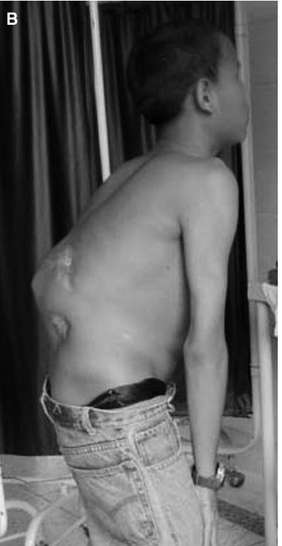
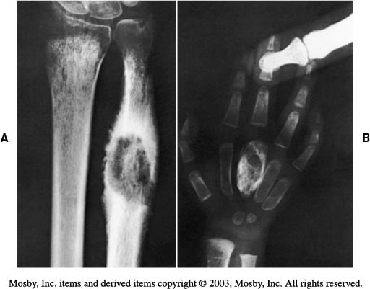
Operations applicable to bone and joint tuberculosis include (1) arthrotomy, including biopsy, synovectomy, and bone grafting of articular erosions, (2) curettage and bone grafting of extraarticular skeletal lesions, (3) resection of joints, (4) resection of bones, (5) evacuation or excision of soft tissue abscesses, (6) arthrodesis, (7) amputation.
8) Arthroplasty (Excision or Joint replacement

Slide 24
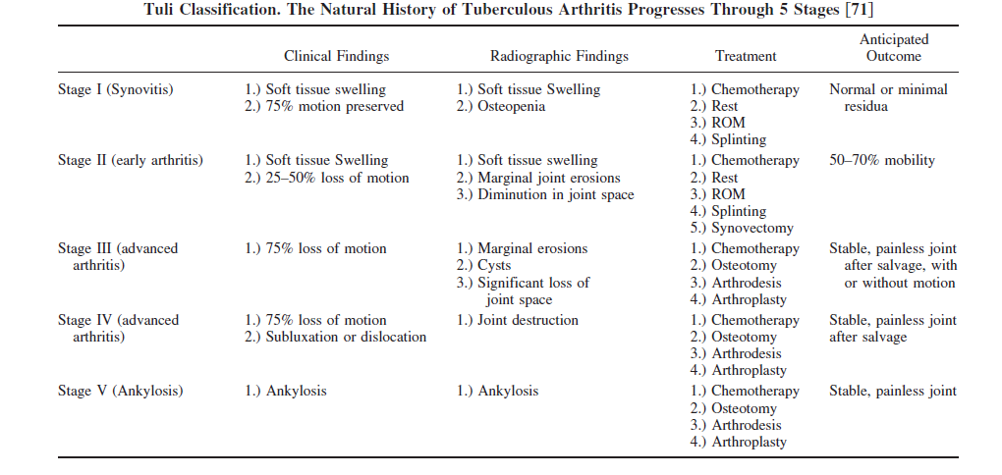

Slide 25
HIP
The infection may originate in the synovium, the proximal femur (epiphysis, metaphysis, femoral neck, or trochanters, the acetabulum, or the gluteal/ iliopsoas bursae.. Sinuses may occur in any of these locations.
The radiographic findings vary considerably. A lesion in the acetabular roof (“wandering acetabulum”) may result in subluxation, and there may be LLD. True pathologic dislocation may occur. Protrusio may be associated with acetabular floor lesions . Coxa magna may be confused with Perthes disease. Marked joint space narrowing without an osseous focus (“atrophic”) .
Treatment :Evacuation of abscess; Realignment osteotomy; buck traction; arthrodesis; excisional arthroplasty; synovectomy and debridement; joint replacement(late procedure); orthosis and Physiotherapy
KNEE
Radiographic findings may include irregularity of the joint space, osteoporosis, osteophytes, chondrocalcinosis, and loose bodies
During the early stages, traction and/or serial casting may be used to treat flexion contracture (with or without subluxation), and splinting in extension may help to prevent this complication. For those who present at a late stage without deformity, immobilization is recommended until the joint fuses. Osteotomy may be required to realign the joint, and surgical arthrodesis may be required if spontaneous fusion (or fibrous ankylosis) has not occurred. Prosthetic reconstruction is an option for a subset of patients, as a late procedure. Orthosis and Physiotherapy
Foot and ankle : Rare; calcaneus commonest. Cystic lesions with a well defined border and no sequestrae are most common; subperiosteal scalloping. Bone excision; curettage+/- toe amputation

Slide 26
UPPER LIMB : Uncommon; The shoulder: scapula, humerus, glenoid and clavicle. Periarticular soft tissue or bursae also may be involved. Drain abscess synovectomy curettage. The elbow(commonest in upper limb esp. olecranon), aspirate abscess, positioning, excisional arthroplasty may be preferable to arthrodesis for end stage. Wrist lesion is very rare and there may be dislocation of the carpus. Tenosynovitis of both the flexor and extensor tendons sheath may result, and consequently, carpal tunnel syndrome may occur. Synovectomy, cork-up splintage and arthrodesis.
Tuberculous osteomyelitis : Chemotherapy; Evacuate abscess; Sequestrectomy.
MONITORING WEIGHT GAIN; SYMPTOMATIC RELIEF; PAIN; MUSCLE BULK INC. IMPROVEMENT IN DEFORMITIES AND JOINT ROM; ABCESS RESOLUTION; SINUS &ULCER (HEALING); FUNCTIONAL RESTORATION; NEUROLOGICAL DEFICTS IMPROVEMENT OR COMPLETE RECOVERY(muscle;sensory;reflexes.etc)
FBC (differentials) / ESR/ TST/MANTOUX; IGRA(QUANTIFERON TEST)
SPUTUM CULTURE EXAMINATION/XPERT MTB/RIF ASSAY MONTHLY
BIOPSY/ASPIRATE AAFB; CULTURE AND XPERT MTB/RIF ASSAY
A sputum specimen should be collected by the end of treatment to document cure. If cultures are not practical, then monitoring by AFB smear/Gene expert examination should be undertaken at 2, 5, and 6 months. Smears positive after 5 months are indicative of treatment failure.
Bacteriologic & XPERT MTB/RIF monitoring of patients with MSK TB is more difficult & often not feasible. In these cases, response to treatment must be assessed clinically & radiographically. (X-RAYS; CT SCAN; MRI;IMMUNOLOGIC TEST; HEMATOLOGIC)
Radiographic changes may lag behind bacteriologic response & are not very sensitive
Monitor patient for drug toxicity. Most common adverse drug reaction is hepatitis.
Pyrazinamide can cause arthralgia and gouty arthritis

Slide 27
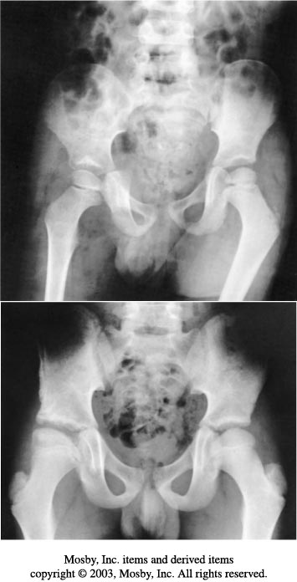
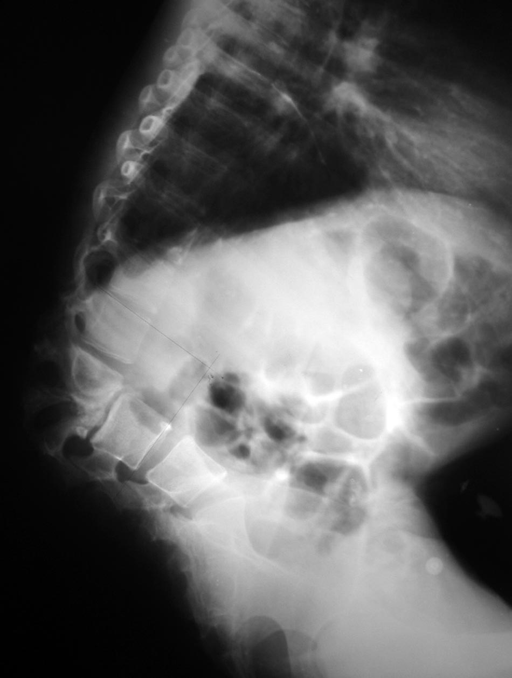

Slide 28
DIFFERENTIALS
Septic Arthritis; Osteoarthritis; Rheumatoid Arthritis; Pigmented villonodular synovitis; Perthes disease; HBSS
SPINE Brucellosis;Actinomycosis; Pyogenic Osteomyelitis; Osteosarcoma,Trauma;Paget disease; Hydatid cyst
Multiple myeloma; Aneurysmal bone cyst; Metastasis; Giant cell tumor
SUMMARY
Osteoarticular/musculoskeletal tuberculosis may be seen with some frequency by health care professionals working in various regions of the world, particularly in this enviroment(though not as commom as before). Chemotherapy is extremely effective as long as the appropriate regimen is prescribed, and patient compliance is ensured. Surgical intervention is most commonly required to establish the diagnosis, and to treat the musculoskeletal complications of the disease, especially in cases with delayed presentation. Outcomes may be maximized through early detection and treatment. Treatment response is best monitored/assessed through improvement in clinical parameters and reinforced by improvement in laboratory and radiological parameters.

Slide 29
THE WHO END TB STRATEGY

