Slide 1
HIV IN PREGNANCY
DR IO ADEBARA MPH, FMCOG
CONSULTANT DEPT OF OBGYN FETH IDO
ASSOCIATE LECTURER DEPT OF OBGYN ABUAD

Slide 2
INTRODUCTION
HIV is the virus that causes HIV infection.
Most people who are HIV-infected will develop AIDS after a period of time, which may be several months to more than 15 years.
AIDS is a group of serious illnesses and opportunistic infections that develop after a person is infected with HIV.
A diagnosis of AIDS is based on specific clinical criteria and laboratory test results.

Slide 3
BASIC FACTS: The normal immune system
T-cells regulate the immune system and kill cells that bear specific target antigens.
Each T-cell has a surface marker such as CD4, CD8.
CD4 cells are helper cells that activate B-cells, killer cells(CD8) and macrophages.
When the immune system is weakened or destroyed by a virus such as HIV, the body is vulnerable to opportunistic infections.
Infection with HIV causes a reversion in CD4:CD8 ratio

Slide 4
BASIC FACTS: The normal immune system…... II
The CD4+ count and viral load are two measures of the progression of HIV
The effects of HIV are measured by the decline in the number of CD4+ cells.
The normal count in a healthy adult is between 600 and 1,200 cells/mm3

Slide 5
Natural history: the chronology of HIV –induced disease.
Primary HIV infection
2-4 week period of intense viral replication before onset of an immune response.
1-2 weeks of acute illness in majority of cases. Clinical manifestations resolve as antibodies to virus become detectable in patient serum.
Sero-conversion: Process by which the body produce antibodies to HIV, these antibodies can be detected by lab tests.

Slide 6
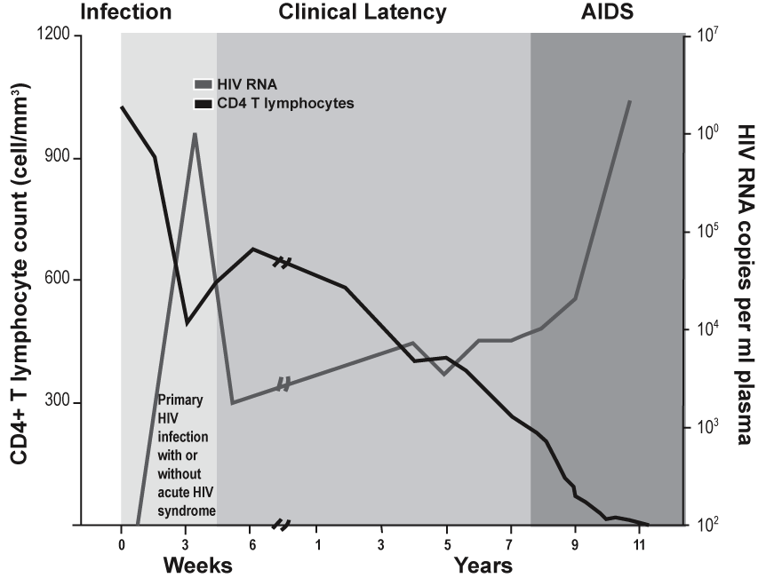
Natural History of HIV Infection

Slide 7
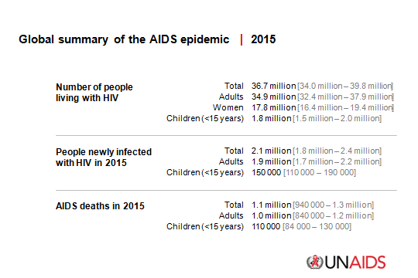
Epidemiology

Slide 8
HIV in Nigeria: Key Facts
National median prevalence | 3%
Estimated number of people living with HIV | 3,400,000
New HIV infection | 252,000
New HIV infection in children | 58,000
Total number of AIDS orphans | 1,800,000

Slide 9
HIV-1 and HIV-2
HIV-1 and HIV-2
Transmitted through the same routes
Associated with similar opportunistic infections
HIV-1 is more common worldwide.
HIV-2 is found predominantly in West Africa, Angola and Mozambique.
Differences between HIV-1 and HIV-2
HIV-2 is less pathogenic and progresses more slowly.
MTCT is relatively rare with HIV-2.
Some ARV drugs (NNRTIs) are ineffective against HIV-2

Slide 10
Transmission of HIV
HIV is transmitted by:
Sexual contact:
Unprotected sex (anal, vaginal, or oral)
Direct contact with HIV-infected body fluids such as semen and vaginal secretions
Blood to Blood transmission:
Transfusion with HIV-infected blood
Direct contact with HIV-infected blood
Re-use of unsterilized sharps (needles, surgical blades, razors used in scarification practices)
Needle stick injury
Injection of drugs with needles or syringes contaminated with HIV
MTCT: during pregnancy, delivery and breastfeeding

Slide 11
Laboratory Testing for HIV Diagnosis
Antibody based Assays:
Rapid tests
ELISA
Western Blot
Indirect Immunofluorescent Antibody Assay (IFA)
Nucleic Acid-based Test (Virologic tests)
Assays to detect HIV DNA
RNA (PCR)
Other tests:
1. Antigen detection test (p24 antigen)
2. Viral isolation
Notes:
EXPLAIN that there are various types of rapid tests, which will be covered in this session.
NOTE that the ELISA was the first test used, though it has drawbacks, particularly in developing countries. EXPLAIN the drawbacks of the ELISA test:
It is a complex diagnostic process that requires highly trained personnel, expensive equipment, and a high cost per test. Note that this high cost is not sustainable and will thus limit access to the test.
It is not suitable for point of care as testing is done in batches, meaning that test results cannot be made available on the same day.
ASK participants, “What does PCR mean?”
PCR = Polymerase Chain Reaction

Slide 12
Time from Infection to Detection of HIV-1 Markers
KEY:
NO DETECTION
EARLIEST POSSIBLE DETECTION OF HIV
Antibody assays
p24
DNA PCR
RNA PCR
5
10
15
20
25
30
35
Detection of HIV: Days after infection
Notes:
EXPLAIN that this chart does not imply an exact specificity for the detection of HIV, but rather the earliest possible time that HIV could possibly be detected.
NOTE that the window period can be reduced by:
Use Of Antigen Capture Technique: 8 days
Use of 4th generation kits: about 11-14 days
Early detection looking for IgM: about 10 days
Plasma HIV RNA: about 10 days
HIV DNA: about 1 week
EMPHASIZE the difference between HIV detection in antibody tests and antigen/PCR tests. For certain assays (e.g. PCR), the test becomes positive sooner after infection and before the antibody test becomes positive (thereby shortening the window period), making it useful in circumstances when a patient is suspected of having acute infection.
REMIND participants that the antibody test is the most widely available and most often used because it is the cheapest and most convenient.

Slide 13
SERIAL TESTING ALGORITHM

Slide 14
Pregnancy and HIV
EFFECTS OF HIV ON PREGNANCY OUTCOME
Spontaneous abortion
Ectopic pregnancy
Severe bacterial and parasitic infection including TB
Preterm labour
Low birth weight
Still births and early NND are more common
Puerperal sepsis
Infected fetus

Slide 15
FACTORS PERPETUATING HIV AMONG WOMEN
Biologic variables
Socio-cultural
High incidence of polygamy
Early age at marriage among girls
Social unrest and violence against women

Slide 16
Mother-to-Child Transmission of HIV (MTCT)
Vertical transmission encompasses MTCT during pregnancy, labour & delivery and breastfeeding period.
Risk factors for MTCT of HIV:
Viral load and characteristics
Maternal
Obstetrical
Foetal
Infant-related factors

Slide 17
Mother-to-Child Transmission
100 infants born to HIV-infected women who breastfeed, without any interventions
60 to 75% of all infants will not be HIV-infected
About 15% of all infants infected during labour and delivery
5–15 % of all infants infected during breast-feeding
5–10 % of all infants infected during pregnancy
25–40 infants will be HIV-infected

Slide 18
Risk Factors for MTCT
Pregnancy | Labour and Delivery | Breastfeeding
High maternal viral load | High maternal viral load | High maternal viral load
Infection | Prolonged rupture of membranes | Duration
STIs Malnutrition Haemorrhage | Chorioamnionitis Prolonged labour Invasive delivery procedures Instrumental delivery Episiotomy & genital lacerations | Early mixed feeding Breast fissures, infections Poor maternal nutrition
 | First infant in multiple birth Preterm birth Fetal genetic characteristics | Oral disease in infant

Slide 19
CLINICAL PRESENTATION & WHO CLINICAL STAGING
STAGE 1(Asymptomatic)
or only:
Persistent generalized lymphadenopathy
STAGE 2 (Mild Disease)
Weight loss 5-10%*
Sores or cracks around lips (angular cheilitis)
Itching rash (seborrhoea or prurigo)
Herpes zoster
Recurrent upper respiratory infections such as sinusitis or otitis
Recurrent mouth ulcers
STAGE 3 (Advanced Disease )
Weight loss > 10%
Oral thrush (or hairy leukoplakia)
More than 1 month: Diarrhoea or Unexplained fever
Severe bacterial infections (pneumonia, muscle infection, etc)
Pulmonary TB
Acute necrotizing ulcerative gingivitis/periodontitis

Slide 20
STAGE 4
Severe Disease (AIDS)
HIV wasting syndrome
Oesophageal thrush More than 1 month
Herpes simplex ulcerations
Recurrent severe pneumonia within 6 months
Lymphoma
Kaposi sarcoma
Invasive cervical cancer
CMV retinitis
Pneumocystis pneumonia
Extrapulmonary TB*
Toxoplasma*
Cryptococcal meningitis*
Visceral leishmaniasis*
HIV encephalopathy (Significant neurological impairment interfering with independent functioning and not due to other cause will often improve on ARV treatment)

Slide 21
MANAGEMENT PRINCIPLE
Early booking
Regular ANC attendance
Immunisation and IPT
Early commencement of ART
Repeat HIV testing in labour for all HIV –ve women
Modification of delivery process
Early commencement of infant prophylaxis
Exclusive breast feeding
Early infant diagnosis
Referal for ongoing care after pueperium

Slide 22
ANTENATAL MANAGEMENT
Provide information on HIV
Test and counsel for HIV
Diagnose and treat STIs
Promote safer sex practices
Discuss ARV options
Discuss delivery options
Provide infant-feeding counselling and support
Treat opportunistic infections including malaria

Slide 23
LABOUR AND DELIVERY
LABOUR
Provide ARVs as indicated based on the treatment strategy in place.
Minimise vaginal exams and invasive procedures.
Use partograph to monitor progress in labour.
Minimise risk of postpartum haemorrhage.
Use safe transfusion practices (blood screened for HIV, hepatitis B & C where possible).
Avoid:
Premature rupture of membranes
Prolonged rupture of membranes
Prolonged labour
Unnecessary trauma during childbirth

Slide 24
Elective Cesarean Section vs. Vaginal Delivery
Elective Cesarean section
For women with very high viral load and low CD4 count
Consider elective caesarean delivery when safe and feasible
Done before the onset of labour or membrane rupture
Vaginal delivery
On treatment
When the viral load is low
CD4 is high

Slide 25
POST PARTUM CARE
Patient Education
Information on receiving continued care
Newborn feeding
Symptoms of infection
Perineal and breast care
Disposal of blood-stained pads
Family Planning
Prevent unintended pregnancies.
Support child spacing.
Promote continuing safer sex practices.
Encourage the use of dual protection.
Continuing Care
Provide gynecologic care, including Pap smears.
Monitor for OIs, provide prophylaxis.
Prevent or treat TB and malaria.
Refer for ARV treatment, care and support.

Slide 26
Immediate Newborn Care of HIV-Exposed Infants
DO’s | DO NOT
Maintain universal precautions. Cut cord under cover of light gauze. Keep baby warm Wash baby with warm chlorhexidine solution or wipe dry with a towel Determine mother’s feeding choice. Administer Vitamin K. Commence ARV prophylaxis | Suction unless it is indicated. Use mouth-operated suction. Use mechanical suction at greater than 100 mm Hg pressure.

Slide 27
Immediate Postpartum Care of Women with HIV Infection
Signs and symptoms (S&S) of postnatal infection:
Pain during urination
Fever
Foul smelling lochia
Cough, sputum, shortness of breath
Redness, pain, pus or drainage from incision or episiotomy
Severe lower abdominal tenderness

Slide 28
Antiretroviral in pregnancy
No drug is without side effects
An ideal antiretroviral (ARV) drug must
Be able to interrupt HIV incorporation into human DNA
Excise all HIV proviruses from the cells DNA
Eliminate all HIV-infected cells
Safe
Affordable
Minimal side effects

Slide 29
ARV Drugs used for PMTCT
Two broad groups are used in PMTCT
Reverse transcriptase inhibitors (RTIs)
Nucleoside reverse transcriptase inhibitors (NRTIs)
Non-nucleoside reverse transcriptase inhibitors (NNRTIs)
Nucleotide reverse transcriptase inhibitors (NrRTIs)
Protease inhibitors (PIs)

Slide 30
Classes of ARVs commonly available in Nigeria.
Nucleoside Reverse Transcriptase Inhibitor NRTIs | Non-Nucleoside Reverse Transcriptase Inhibitors (NNRTIs) | Nucleotide Reverse Transcriptase Inhibitors (NrRTI) | Fusion Inhibitors | Protease Inhibitors (PIs)
Zidovudine (ZDV) Didanosine (ddl) Zalcitabine (ddc) Lamivudine (3TC) Abacavir (ABC) Emtricitabine (FTC) | Nevirapine (NVP) Efavirenz (EFV) Delavirdine (DLV) Rilpivirine | Tenofovir (TDF) | Enfuvirtide (T-20) | Saquinavir-ritonavir (SQV/r) Ritonavir (RTV) Indinavir (IDV) Nelfinavir (NFV) Amprenavir (APV) Lopinavir-ritonavir (LPV/r) Atazanavir-ritonavir (ATV/r) Tipranavir

Slide 31
ARVs Commonly Used in PMTCT
NRTIs
Zidovudine (ZDV) 300 mg tablets 12hrly
Lamivudine (3TC) 150 mg tablets 12hrly
Tenofovir (TDF) 300 mg tablets once daily
Emitricitabine (FTC) 300mg once daily
NNRTI
Nevirapine (NVP) 200 mg tablets, 12hrly
Efavirenz (EFV) 600 mg capsules daily
A FDC combining Tenofovir (300mg)+ EITHER Lamivudine (300mg) OR Emtricitabine (300mg) + Efevirenz (600mg)===ATRIPLA

Slide 32
FOR ALL HIV POSITIVE PREGNANT/BREASTFEEDING WOMEN
Newly diagnosed HIV positive pregnant woman in ANC not on ART | Start ART
Previously diagnosed HIV positive pregnant women not on ART | Start ART
Previously diagnosed HIV positive woman on ART | Continue ART*
Newly diagnosed HIV positive Pregnant woman in Labour | Start ART
Newly diagnosed HIV Positive woman in the Puerperium | Start ART
HIV positive pregnant woman with Tb co-infection(Tb and HBV) previously on ART | Continue ART*
* Modify ART in line with current preferred first line regimen if indicated

Slide 33
ARV Drug Toxicity
DRUG | TOXICITY | MINOR | MANAGEMENT
ZDV | Anaemia, neutropoenia, thrombocytopoenia, myopathy, intolerance | Blue or black discoloration of nails, nausea, headache | For severe anaemia, reduce dose or change to d4T
3TC | Pancreatitis, liver toxicity, mild peripheral neuropathy | Skin rash, headache | If serum amylase elevated, discontinue
NVP | Skin rash, Stevens-Johnson syndrome, hepatotoxicity |  | Do not give if CD4 >250 because of severe hepatotoxicity
EFV | Nightmares, rash, hepatitis,NTD | Dizziness | If hepatitis, discontinue
TDF | New or worsening kidney problem, Bone problem | Nausea, diarrhea, vomiting, and flatulence | If serum creatinine elevated, discontinue

Slide 34
Principles of ARV Use
Strict adherence is critical but a challenge in pregnancy.
ARVs have side effects that need clinical and lab monitoring.
Beware of drug interactions.
Resistance may develop if adherence is not excellent or if drug interactions affect drug levels.
Resistance may be spread to baby and to partner.
With excellent adherence and monitoring, risks of ART are minimised and benefits are maximised.

Slide 35
Co-Infection with Tuberculosis(TB)
Women infected with HIV can receive both antiretroviral and TB treatment at the same time with
Treatment of TB to start first (ART, 2 to 8 weeks later)
Careful drug selection, avoid rifampicin
Proper clinical management

Slide 36
Prophylaxis for PMTCT:The Infant
A. For breastfeeding infants with mother on triple ARV:
Commence daily NVP and continue for 6 weeks only
B. For non-breastfeeding infants:
Give daily NVP for 6 weeks only
C. For breastfeeding infants with mother not on triple ARV:
Commence daily NVP and continue until one week after cessation of all breastfeeding.
DOSAGES:
From birth to 6 weeks of age:
Birth weight < 2,500g : NVP 10mg(1ml) daily
Birth weight ≥ 2,500g : NVP 15mg(1.5ml) daily
From 6 weeks to 6 months of age:
NVP 20mg(2ml) daily
From 6 months to 9 months of age:
NVP 30mg(3ml) daily
From 9 months to 12 months of age:
NVP 40mg(4ml) daily

Slide 37
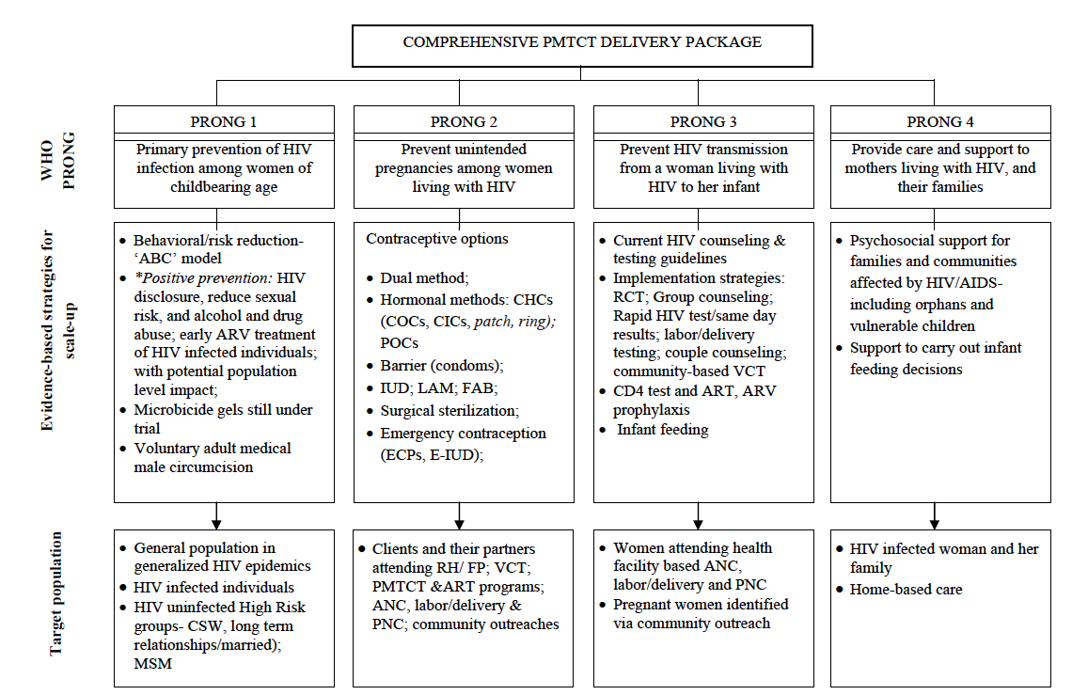
PREVENTION STRATEGIES
Notes:
SOURCE: Aizire J, Fowler MG, Coovadia HM. Operational issues and barriers to implementation of prevention of mother-to-child transmission of HIV (PMTCT) interventions in Sub-Saharan Africa. Curr HIV Res 2013;11(2):144–59.

Slide 38
Potential Intervention Approaches to Prevent HIV Transmission for all groups
Decrease Source
of HIV Infection
Decrease Host Susceptibility
to HIV Infection
Barrier protection
STI treatment
Blood screening
ART
Maternal-to-child transmission
Decrease partner’s viral load
Treatment of acute HIV infection
Barrier protection
STI treatment
Oral PEP
Oral PrEP
Topical microbicides
Vaccines
Infection control
Circumcision
Alter Risk-Taking Behavior
Condom promotion
Individual intervention
Couples intervention
Community based intervention
Structural intervention
Mayer KH, Mayer KH, Venkatesh KK. Antiretroviral therapy as HIV prevention: status and prospects. Am J Public Health. 2010;100:1867-1876.et al. Am J Public Health. 2010;100:1867-1876.
Notes:
Slide: Potential Intervention Approaches to Prevent HIV Transmission
There are a number of pathways that might prevent HIV transmission, focusing on decreasing the source of and host susceptibility to infection as well as approaches to alter risk-taking behavior. The use of antiretroviral therapy has emerged as a critical component to prevent and control the transmission of HIV.¹
Reference
Mayer KH, Venkatesh KK. Antiretroviral therapy as HIV prevention: status and prospects. Am J Public Health. 2010;100:1867-1876.

Slide 39
Recommended ARV regimens in pregnancy
1)TDF+FTC)+EFV
2)TDF +3TC(FTC)+ NVP
3)AZT + 3TC + EFV or NVP
4)AZT + 3TC (or FTC) + EFV
5) LPV/r +3TC+ AZT
6)AZT + 3TC + ABC
7)ZDV + 3TC + TDF

Slide 40
Points To Note;
*TDF + FTC + EFV as a fixed-dose combination(ATRIPLA) is the preferred option
-Less severe adverse events
- better virological and treatment response

