Slide 1
INFERTILITY AND ASSISTED CONCEPTION
DR. A.A. ADENIYI
MBBS,FWACS,FMCOG,MHS.

Slide 2
DEFINITIONS
Infertility/Subfertility: Failure of a couple to achieve pregnancy(conception) within one year (12 months) or more of regular (3-5times/wk), adequate and appropriate, unprotected coitus (sexual intercourse) and in absence of contraception.
Primary infertility : a couple who have never achieve pregnancy.
Secondary infertility: Previous pregnancy but failure to conceive subsequently.

Slide 3
DEFINITIONS
Fecundability: The probability that pregnancy will occur within a menstrual cycle of sexual exposure. (20-25% in a health young couple)
Fecundity: The probability of achieving a live birth within a single cycle.

Slide 4
Incidence of infertility
About 80% of couples achieve pregnancy within 12 months.
About 90% will achieve pregnancy at the end of 24 months (2 years)
Only about 10% remain infertile after 2 years.

Slide 5
AETIOLOGY OF INFERTILITY
Both male and female contribute to causes of infertility
The Male contributes about 30-40%
The female also contributes about 30-40%
Both are responsible about 10%
About 10% cannot be attributed to either male or female despite all investigations (Unexplained infertility)
40%(4 of 10) of unexplained infertility will achieve pregnancy within 3 years without any specific treatment.

Slide 6
Causes of Female infertility
Tubal and peritoneal factors: 25-35%
e.g peritubal adhesions, endosalpingeal damage, previous tubal surgery or sterilization,
Ovarian factors: 30-40% e.g. anovulation/oligo-ovulation, PCOS
Uterine factors: 10% ( fibroids, endometritis, congenital anomalies, adhesions)
Vaginal factors: e.g atresia, septum

Slide 7
Causes of Female infertility
Cervical factor: (5%) e.g ineffective sperm penetration due to cervicitis, antisperm antibodies.
Pelvic causes : Adhesion, endometriosis
Hormonal factor: Abnomalities of hypothatamo-pituitary-ovarian axis which may lead to anovulation, amenorrhoea etc

Slide 8
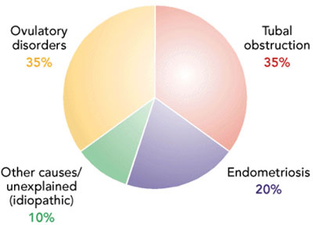

Slide 9
Male causes of infertility
Disorder of spermatogenesis
- Congenital: eg undescended testes
- Thermal factor: (scrotal temp is 1°C than the body temp) eg varicoecele, hot bath, tight underwears
- Infections: eg mump orhitis after puberty, bronchiectasis, prostitis etc.
- General factors : smoking, malnutrition, chronic illness, alcohol
- Endocrine:(testicular failure) gonadotrophin deficiency (Kallmann’ syndrome
- Genetic: chromosomal abnormality eg gene deletion Y chromosome
- Iatrogenic: Rdiation, cytotoxic drugs, antihypertensive drugs
- Immunological: anti sperm antibodies leading to clumping of spermtozoa.

Slide 10
Male causes of infertility
Disorder of sperm transport .
- Obstruction of the efferent ducts (surgical trauma,TB or gonococcal infection, Young syndrome (epididymal obstruction and bronchiectasis)
COITAL PROBLEMS
Erectile dysfunction
Ejaculatory defect- premature, retrograde or absence of ejaculation.
Hypospadias

Slide 11
Combined male and female factors
Age: more important in female than male
Infrequent intercourse, faulty coital techniques, poor knowledge of timing of coitus
Dyspareunia/ apareunia
Anxiety and apprehension

Slide 12
Management of infertility
History (both partners): Age, duration of infertility, previous pregnancy and outcome
Examination: weight, BMI, genitals, breasts etc.
Treatment

Slide 13
INVESTIGATIONS
Timing of investigation:
After a year in a young couple with no identified problem
Shorter time for older couple, women >35years or if there are identified problems
Extent of investigation:
Basic investigation: 1.seminal analysis(male)
2. Confirmation of ovulation (female)
3. Confirmation of tubal patency (female)

Slide 14
Investigations -Male
General- Urinalysis, blood ( eg sugar)
Basic: Semen analysis- ideally the 1st step.
SFA is usually performed after 2-4 days of abstinence
Sample is collected by masturbation ( coitus interruptus if masturbation fails)
Sample is examined within 1-2 hours of production.

Slide 15
SEMINAL ANALYSIS
SEMEN ANALYSIS | NORMAL REF. VALUES (LOWER LIMIT)
Abstinence | 2-4 days
Volume | 2.0 – 5.0 ml
pH | 7.2- 7.8
Viscosity | <3 (0-4 scale)
Liquefaction | Within 30 minutes
Sperm concentration | 20 million
Motility | >50% progressive motility
Morphology | > 30% normal form
White blood cell | < 1 million/ml

Slide 16
SEMINAL ANALYSIS
Two properly performed SFA, 2-4 weeks apart is usually required if one is abnormal.
NOMENCLATURE
- Normozoospermia- normal sperm count
- Oligozoospermia/oligospermia: sperm concentration below ref. Value
- Asthenozoospermia – abnormal motility

Slide 17
SEMINAL ANALYSIS
Teratozoospermia- abnormal sperm morphology
Oligoasthenoteratozoospermia (OAT): Abnormal sperm motility, morphology and concentration i.e all 3 parameters
Azoospermia- No spermatozoa in the ejaculate
- Aspermia- absent ejaculate
Necrozoosperm- immotile or dead spermatozoa
Polyzoospermia: sperm concentration above the refrence range
‘’Leucocytospermia’’ : Increased white blood cells in semen

Slide 18
INVESTIGATION- FEMALE
Tests of Ovulation:
Regularity of monthly Menstrual history
Basal body temperature (BBT)
Cervical mucus pattern

Slide 19
INVESTIGATION- FEMALE
Hormone estimation:
- Serum progestrone (day 21 level>30nmol/l)
- Serum LH (LH:FSH > 2 = PCOS
- Serum oestradiol
- Urine LH
- Serum prolactin (hyperprolactinaemia)
Endometrial biopsy
Sonography (transvaginal)
Laparoscopy
PREGNANCY (conclusive)

Slide 20
TUBAL PATENCY
Hysterosalpingography
Laparoscopy and dye test (chromopertubation)
Sonohysterosalpingography
Hysterocontrast sonography (Hycosy)
OTHERS
Falloposcopy

Slide 21
TREATMENT OF INFERTILITY- female
Ovulation induction (medical)
- clomiphene citrate
- Tamoxifen
- Gonogotrophin (hMG, recombinant FSH, (rFSH)
- Dopamine agonist (bromocriptine, carbagoline) in hyperprolactinaemia

Slide 22
Ovulation induction- Surgery
Laporoscopic ovarian drilling for PCOS
Wedge resection of the ovary

Slide 23
Complications of ovulation induction
Ovarian hyperstimulation syndrome
Mild
Moderate
Severe
Multiple pregnancy

Slide 24
Treatment of tubal disease
SURGERY
Salpingo- ovariolysis
Fimbrial surgery
Salpingoneostomy
Tubal anastomosis
ART (Assisted reproductive technique)

Slide 25
Treatment of infertility- Male
Improvement in general health: ceasation of smoking and alcohol, weight reduction.
Adjustment in medication that interfere with spermatogenesis

Slide 26
Male Factor
Hypogonadotrophism
hMG
GnRH
CC, hCG results poor
Varicocoele
Ligation? (no definitive data yet)
Retrograde ejaculation
Ephedrine, imipramine
AIH with recovered sperm

Slide 27
Male Factor
Idiopathic oligospermia
No effective treatment
?IVF
donor insemination

Slide 28
Unexplained Infertility
5-10% of couples
Review previous tests for validity
Empiric treatment:
Ovulation induction
IUI
Consider IVF and its variants
Adoption

Slide 29
ASSISSTED REPRODUCTIVE TECHNIQUES
Definition: All the procedures that involve the manipulation of gametes and embryo outside the body for the treatment of infertility
History of ART:
Birth of Louise Brown on July 25th 1978.(ivf-et)
Patrick Steptoe and Robert Edwards of England
Natural cycle to superovulation
Laparoscopy to (TVS) for ovum retrieval

Slide 30

HISTORY OF ART- Robert Edwards, Louise’s mother, Louise Brown and her son

Slide 31
TYPES OF ART
Intrauterine insemination (IUI): AIH and DI
Invitro fertilization and embryo transfer (IVF-ET)
Gamete intra-fallopian transfer- GIFT
Zygote intra-fallopian tube transfer- ZIFT
Subzonal insemination – SUZI
Intracytoplasmic sperm injection – ICSI
Testicular sperm aspiration –TESA
Percutaneous sperm aspiration – PESA
Microepidydimal sperm aspiration- MESA

Slide 32
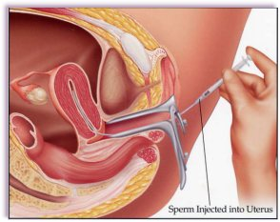
IUI

Slide 33
INDICATION FOR ART
Tubal damage
Unexplained infertility
Endometriosis
Male factor infertility
Ovarian failure
Genetic diseases
Polycystic ovarian disease

Slide 34
Major steps of an ART cycle
Consultation and evaluation
Pituitary down regulation
Controlled ovarian hyperstimulation (superovulation)
Monitoring of follicular growth
Human chorionic gonadotrophic (hCG) trigger
Oocyte retrieval or ovum collection
Sperm preparation
Fertilisation(insemination) invitro (IVF, ICSI,GIFT)
Embryo transfer (and cryopreservation)
Luteal support
Pregnancy Test

Slide 35
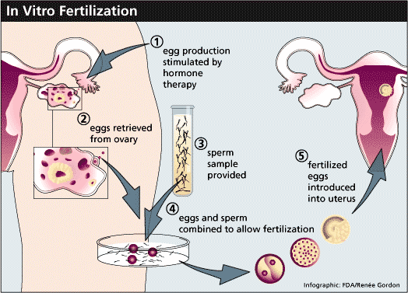

Slide 36
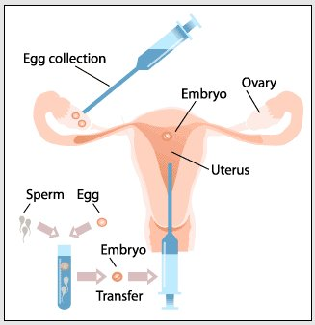
Major steps of an ART cycle

Slide 37
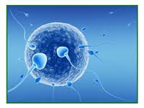
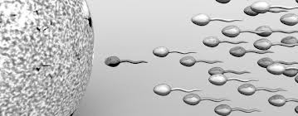

Slide 38
FERTILIZATION

Slide 39
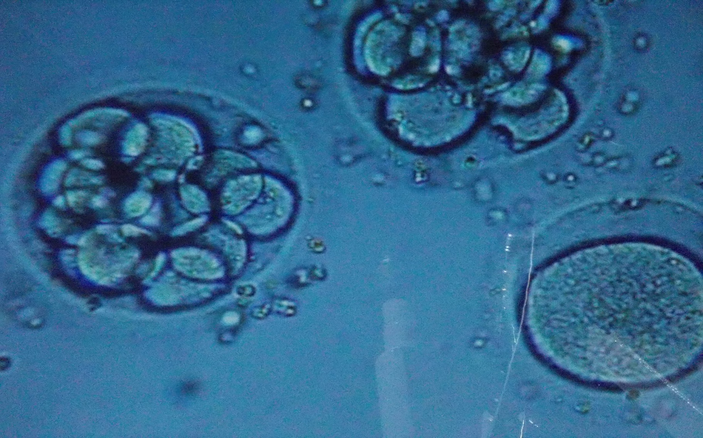
BLASTOCYST STAGE

Slide 40
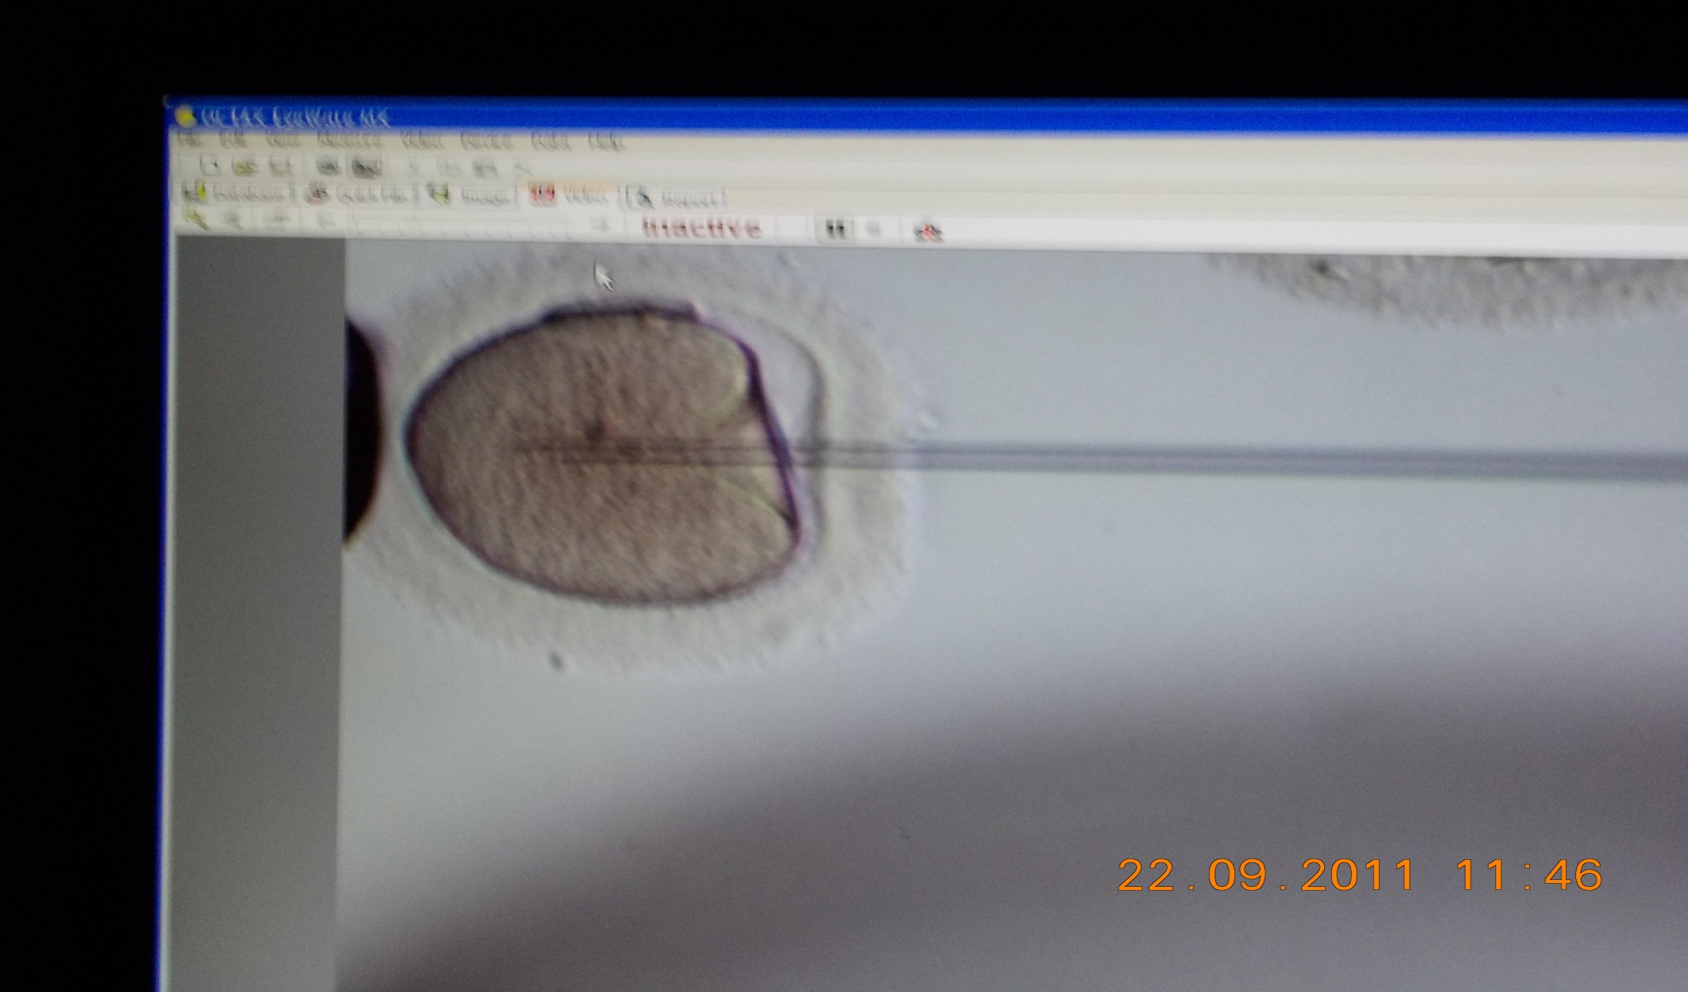
INTRACYTOPLASMIC SPERM INJECTION (ICSI)

Slide 41
OUTCOME/ SUCCESS OF ART
30-40%
Better results are being reported with improved techniques

Slide 42
Prognostic factors in ART
Maternal age
Ovarian reserve
Indication for ART.
Presence of hydrosalpinges
Uterine fibriods
Smoking

Slide 43
Complications of ART
Ovarian hyperstimulation syndrome (OHSS)
Multiple pregnancy
Psychological stress and anxiety
Fertility drugs and future ovarian cancers
COST!!!

Slide 44
