Slide 1
INTERSEX PART2
DR ADEJUBE FRANCIS

Slide 2
ii) MALE INTERSEX
Chromosomal intersex
-45x/46xy mosaic-abnormal testicular differentiation and thus anatomical testicular failure

Slide 3
MALE INTERSEX conts
Gonadal intersex
- Gonadal agenesis: anatomical failure with normal chromosomal make up; no testosterone, no MIF, little or no masculinisation of the external genitelia, uterus and vaginal are present.

Slide 4
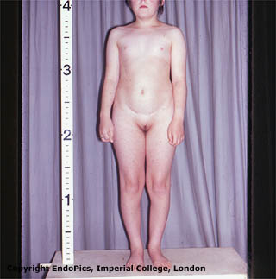
a) Swyers syndrome
XY chromosome
No SRY/ its receptors
Streak gonads
No testosterone/ MIF
Female internal and external genitalia

Slide 5
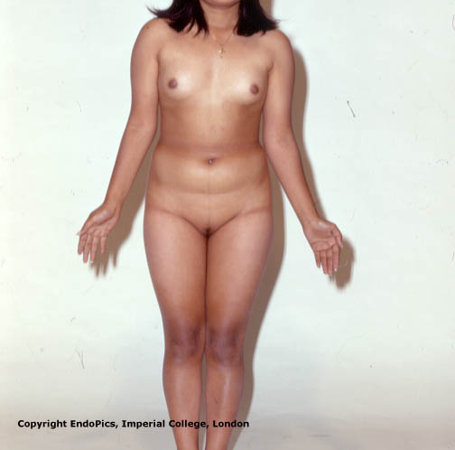
b) Leydig cell agenesis
46XY
SRY
Testes
Mullerian inhibiting factor
Partial or complete absence of leydig cells
No or reduced testosterone and DHT
Female / ambiguos external genitalia
Male internal genitalia

Slide 6
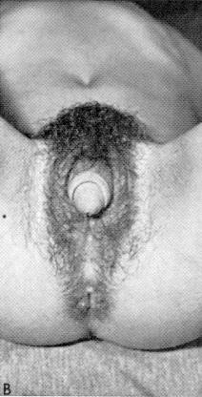
C) Testicular regression syndrome/congenital anorchia
46XY chromosome
SRY present
Testes and MIF are present
Self destruction of testes and MIF
Testosterone and DHT may or may not be present
Male internal genitalia
Female or ambiguous external genitalia

Slide 7
The gonad are streak and at risk of malignant transformation (30%) therefore they are to be removed at childhood.
Hormonal replacement therapy is given at the peri-pubertal age
Due to poor masculinisation of external genitelia the sex of rearing depends on the functionality of the external genitelia
Female gender is often assigned due to poor functionality of the penis
Surgical correction for cosmesis in line with chosen sex of rearing.

Slide 8
MALE INTERSEX conts
ENZYMATIC TESTICULAR FAILURE: deficiencies of enzymes involved in the synthesis of testosterone from cholesterol
The enzymatic failure is usually partial therefore there are some masculinisation of the external genitelia.
MIF is present therefore no uterus and no vaginal.

Slide 9
Enzymatic testicular failure
46XY and SRY
Testes and MIF
Defect in testosterone synthesis.
Increased testosterone precursors
Decreased DHT
Male internal gentalia
Ambiguous external genitalia

Slide 10
Enzymatic testicular failure
Autosomal recessive enzyme deficiency :
-20-22 desmolase
-3-ß-ol-dehydrogenase
-17- ∝ -hydroxylase -
17,20-desmolase -
17-ß –hydroxysteroid oxyreductase

Slide 11
Testicular enzymatic failure conts
The external genitelia is ambiguous due poor masculinisation due to little or no testosterone
Surgical correction is usually done to assign female gender.

Slide 12
MALE INTERSEX conts
4 END ORGANS INSENSITIVITY
-5alpha reductase deficiency
-androgen receptor deficiency

Slide 13
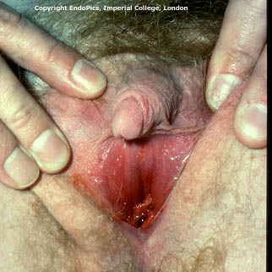
a) 5 alpha reductase deficiency
46XY and SRY
Testes and MIF
Testosterone
5 alpha reductase def.
Decreased DHT
Male internal genitalia
Ambiguous

Slide 14
There is ambiguous external genitelia
Female gender is assigned
If diagnosed at childhood, the testes should be removed to avoid further masculinisation at puberty.
Confirmation of diagnosis at birth is by measuring testosterone levels before and after 3days of gonanadotrophin challenge test, the testosterone level is at the normal range level of male.

Slide 15
b) Androgen insensitivity syndrome
46XY and SRY
Testis and MIF
Testosterone
5alpha reductase and DHT are normal
Absent androgen receptors/ insensitive
Male internal genitalia
Female external genitalia

Slide 16
Partial receptor deficiency will result to ambiguous genitelia
Complete receptor deficiency will lead female external genitelia and often presents at puberty due to primary amenorrhea, well developed breasts, scanty/absent pubic and axillary hair
Testosterone in the male range
Testes in the abdominal wall or inguinal hernia sac
Short vagina

Slide 17
partial receptor defect diagnosed at birth requires removal of the testes to prevent further masculinisation but if complete then wait till after puberty before the removal of the testes.
The testes are removed because of the associated risk of malignant transformation (5%).
Is a familiar disorder therefore check out other ‘’ sisters’’

Slide 18
iii) True hermaphroditism
• Gonads :
- ovary one side and testis on the other or
- ovotestis one side & ovary/testis on the other or
- bilateral ovotestis
• Karyotype :
46,XX most common(57%); XY(13%) and XX/XY(30%)
• Internal genitalia :
Both mullerian and wolffian derivates
• Phenotype is variable
• Gonadal biopsy is required for confirming diagnosis

Slide 19
True hermaphroditism conts
Incidence is very rare especially in USA and UK but appears to be relatively commoner in South Africa than other parts of the world.
Varying degrees of sexual ambiguity exist; predominant maleness or femaleness
Sex of rearing is determined by functional capacity of the external genitelia and the unwanted gonad is excised

Slide 20
General guidelines in management of intersex
Avoid immediate declaration of sex
Medical & Psychological Emergency
Goal is accurate diagnosis of intersex disorder
Assign proper sex of rearing:
Status of child’s anatomy
Functional potential of genitalia and reproductive tract
Proper counselling of the parents
Team management; obstetrician, neonatologist, paediatric endocrinolgist, genetist, family physician, paediatric surgeon,psychiatrist.

Slide 21
Diagnosis
Detailed history
Thorough physical examination
Investigations

Slide 22
Investigations
• Karyotype ( buccal smear; blood)
• Pelvic US and sometimes MRI
• Skin biopsy; genital skin fibroblast culture to measure 5alpha-reductase activity or dihydrotestosterone binding
Contrast study of Urogenital sinus
• Laparoscopy
Gonadal biopsy (laparotomy)
Rule out CAH: Serum electrolytes; 17-OHP level and urinary levels of 17-ketosteroids

Slide 23
Assigning sex
Federman’s rule: a palpable gonad below the inguinal ligament is testis until proven otherwise
Clitoral size: Measuring the clitoris is an effective method for determining the degree of androgen effect. The clitoral index can be determined by measuring the glans of clitoris in the anteroposterior and transverse diameters. A clitoral index greater than 35 mm² is evidence of increased androgen effect. A clitoral index greater than 100 mm² is evidence of virilization

Slide 24
Assigning sex
• Male gender :
- stretched phallus > 2 cm
- erectile tissue
- lack of severe hypospadias
• Female gender :
- inadequate phallus
- cervix and uterus present

Slide 25
DIFFICULT CASES
In difficult cases; sex assignment should be
to the sex which can be surgically made to be
adequate for coitus

Slide 26
Adolescence
Primary amenorrhea
- Complete androgen insensitivity
- Congenital anorchia
( early testicular regression syndrome)
- Complete leydig-cell agenesis
- Some forms of enzymatic testicular failure

Slide 27
Presentation in adolescence
Ambiguous genitalia
- Neglected CAH
- Mixed gonadal dysgenesis
- Partial androgen insensitivity
- Congenital anorchia ( Late )
- Testicular enzymatic failure
- Leydig cell agenesis
( incomplete)
- True hermaphrotidism

Slide 28
Management in adolescence
Gynecologists, endocrinologists, plastic surgeons, urologists and psychiatrists should be actively involved in the management of these patients

Slide 29
Management
Corrective surgery in drug induced clitoromegaly
Cortisol replacement therapy and Corrective surgery in CAH
Clitoral reduction
Removal of gonads in the presence of Y chromosome
XY female may have to maintain gender role regardless of diagnosis
Vaginal repair and construction

Slide 30
Assigning sex
• Sex assignment should be decided after detailed assessment, investigations and accurate diagnosis
• Complete gender assignment by 18 months

Slide 31
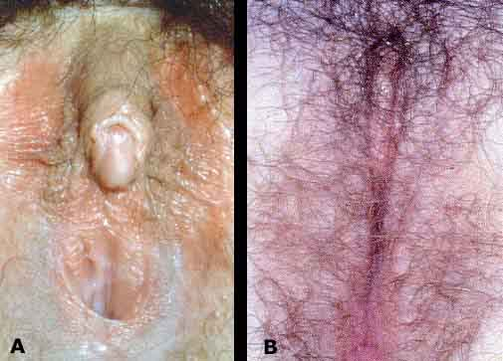
Clitoral reduction and vagina construction
f
Before surgery
After surgery

Slide 32
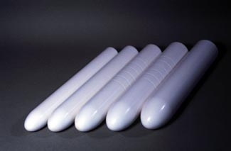
Vaginal dilation

Slide 33
Mc indoe reeds operation
A cavity is created at the supposed site of vagina by blunt dissection
The cavity is lined with split thickness skin graft, amnion, peritoneum or bowel to prevent closure
Has good functional and cosmetic result
Problems - postop pain/dyspareunia, contraction (irregular dilation), fistula, graft may not take.

Slide 34
Willams vaginoplasty
Creatsas modification of Williams vaginoplasty is a surgical technique in which vulval and perineal tissues are used for the creation of a functioning neovagina. A satisfactory sexual life was reported in 94.93% of the treated adolescents and an adequate sexual life in 3.79% in those treated.

Slide 35
Conclusion
With prompt correct diagnosis, and multidisciplinary approach in management a normal well adjusted and even fertile life is possible.

