Slide 1
OESOPHAGITIS
DR OGUNTOYE O.O.
MBBS(Ibadan),FWACP(Gastroenterol)

Slide 2
Oesophagitis
Oesophagitis is a general term for any inflammation, irritation, or swelling of the oesophagus.

Slide 3
Most common types of Oesophagitis
Reflux Esophagitis(GERD/NERD)
Infectious esophagitis
Candidiasis
HSV
CMV
Eosinophilic esophagitis
Pill Induced esophagitis
Radiation esophagitis
Caustic esophagitis
Esophageal cancer

Slide 4
ACID-PEPTIC DISORDERS
APD include a number of conditions whose pathophysiology is believed to be the result of damage from acid and peptic activity of gastric secretions.

Slide 5
APD DISEASE ENTITIES
APD covers ulcer and non-ulcer acid/pepsin-related GIT disorders
-reflux oesophagitis – GERD/NERD
-gastritis
-duodenitis
-gastroduodenitis
-gastric erosion
-gastric ulcer
-duodenal ulcer
-Zollinger-Ellison syndrome
-Stress-related ulcer

Slide 6
Clinical manifestations of diseases of the oesophagus
Dysphagia, heartburn, and odynophagia are symptoms with a high degree of specificity for the esophagus.
Chest pain, though common in esophageal disease, has a much longer differential diagnosis list.

Slide 7
Dysphagia
Dysphagia means difficulty swallowing.
an alarm symptom because it raises concern for the presence of a peptic stricture or adenocarcinoma arising in Barrett's esophagus

Slide 8
Heartburn
Heartburn is a symptom complex characterized by episodic substernal pain that is worse after meals and on reclining and is relieved, at least temporarily, by antacids.
Relief by antacids is especially important because it links the pain with acidity.
The quality of the discomfort is often burning, and it commonly radiates toward the mouth.
Heartburn is frequently accompanied by complaints of a bitter taste in the mouth (regurgitation) or a welling up in the mouth of a salty tasting (salivary derived) fluid (water brash).

Slide 9
Odynophagia
Odynophagia means painful swallowing and implies an acute and severe form of esophagitis, typically with mucosal ulceration.
Odynophagia is experienced substernally as an aching or stabbing pain that is aggravated by the act of swallowing, even swallowing saliva. It is common in esophagitis caused by infection, pills, and radiation but rare in esophagitis caused by reflux

Slide 10
GERD: Montreal Definition
A condition which develops when the reflux of stomach contents causes troublesome symptoms and/or complications
> 2 heartburn episodes/week
Adversely affect an individual’s well being
From Vakil N et al. Am J Gastroenterol 2006;101:1900-20.

Slide 11
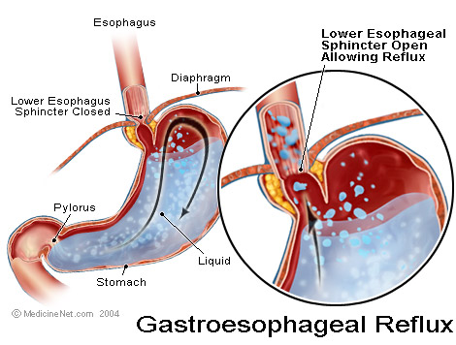
Definition
American College of Gastroenterology (ACG)
Symptoms OR mucosal damage produced by the abnormal reflux of gastric contents into the esophagus
Often chronic and relapsing
May see complications of GERD in patients who lack typical symptoms

Slide 12
GERD risk factors
The risk factors for reflux include
Hiatus hernia
Pregnancy
Scleroderma
Obesity
Cigarettes
Alcohol
Certain meds:
Anticholinergics
Beta blockers, CCB
Bronchodilators
Dopamine
Sedatives/anxiety meds, tricyclic antidepressants

Slide 13
Physiologic vs Pathologic
Physiologic GER
Postprandial
Short lived
Asymptomatic
No nocturnal sx
Pathologic GER
Symptoms
Mucosal injury
Nocturnal sx
Notes:
--distinction between normal and GERD is blurred because some degree of reflux is physiologic is all folks
Physiologic—postprandially, short lived, asymptomatic, not during sleep
Pathologic—symptoms or mucosal injury and often with nocturnal symptoms

Slide 14
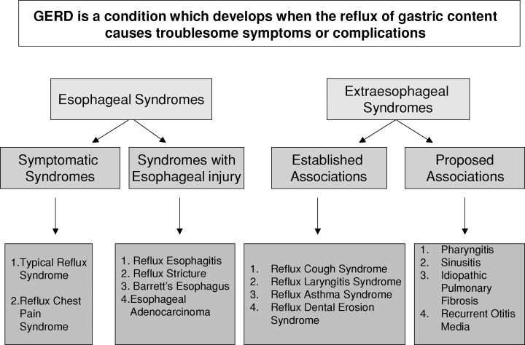
Montreal Classification of GERD
From Vakil N et al. Am J Gastroenterol 2006;101:1900-20.

Slide 15

Clinical Manifestations
Most common symptoms:
Heartburn—retrosternal burning discomfort
Regurgitation—effortless return of gastric contents into the pharynx without nausea, retching, or abdominal contractions
Notes:
1 -GERD related chest pain may mimic angina—squeezing/burning, substernal, radiates to back, neck, jaw, arms. Minutes to hours. After meals, awakens
patient from sleep, exacerbated by emotional stress
2 -water brash—hypersalivation—heartburn and regurg of sour fluid or tasteless saliva into mouth
3 -globus—lump in throat irrespective of swallowing
4 -odynophagia—esophageal ulcer
5 -nausea—infrequent
6 -hrt burn 70-85%//regurg 60%//dysphagi 15-20%//angina 33%//asthma 15-20%

Slide 16
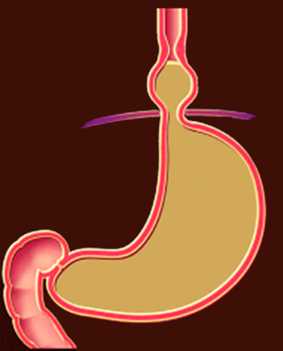
Pathogenesis of GERD
Decreased Salivation
LES
Impaired Tissue Resistance
Hiatal Hernia
Impaired Esophageal Clearance
Decreased LES Resting Tone
Duodenum
Delayed Gastric Emptying
Bile Reflux
Notes:
The main culprit in GERD is the movement of reflux, which is a mix of bile acid, pepsin, trypsin, and food, from the stomach back into the esophagus. In GERD, the antireflux barrier located at the gastroesophageal junction is no longer preventing reflux because of any of 3 reasons:
Transient relaxation of the LES (predominant in milder disease)
Hiatal hernia (predominant in more severe disease)
Hypotension of the LES (predominant in more severe disease)
Reflux involves a 2- to 3-fold increase in esophageal acid clearance time (time the esophageal mucosa is acidified to a pH of <4) of 2 to 3 times due to impairment in both esophageal emptying and salivary function
Prolonged exposure to acid damages the esophageal mucosa, compromising the ability of the epithelium to resist acid injury

Slide 17
Alternative Diagnosis in GERD
Coronary artery disease
Gallstones
Gastric /esophageal cancer
Peptic ulcer disease
Esophageal motility disorders
Pill induced esophagitis
Eosinophilic esophagitis
From Kahrilas PJ. N Engl J Med 2008;359:1700-7.

Slide 18
GERD Diagnosis
There is no single diagnostic gold standard for GERD

Slide 19
GERD Diagnostic Approach ACG Guidelines
If history typical for uncomplicated GERD, initial trial of empiric therapy with PPI (including lifestyle modification) is an appropriate starting point.
From DeVault KD et al. Am J Gastroenterol 2005;100:190-200.
Notes:
Empiric therapy, including lifestyle modification, is an appropriate starting point for patients with a history typical of uncomplicated GERD

Slide 20
AGA GERD Practice Guidelines: Diagnostic Testing
Endoscopy
pH testing
Manometry
From Kahrilas PJ et al. Gastroenterology 2008;135:1383-91.

Slide 21
Role of Endoscopy in Management of GERD: ASGE Guidelines
GERD despite therapy
Dysphagia
Odynophagia
GI bleeding/anemia
Mass, stricture or ulcer on imaging study
Recurrent symptoms after antireflux surgery
From Gastrointest Endosc 2007;66:219-24.

Slide 22
Role of Endoscopy in Management of GERD: ASGE Guidelines
Screening for Barrett’s in selected patients
Persistent vomiting
Suspected extraesophageal GERD
From Gastrointest Endosc 2007;66:219-24.

Slide 23
Goals in the management of GERD
Therapies that modify lifestyle
Increase Gastric pH
Acid Suppressive Medications (PPIs)
Increase esophageal clearance
Increase LES tone
Reduces duration and frequency of TLESR
Decrease gastric volume
Increase gastric emptying
Increase antro-duodenal coordination
Decrease acid reflux from stomach to esophagus
Decrease biliary reflux from duodenum to esophagus
That’s why it is mandatory to combine Prokinetics + PPIs Strategy of Treatment Of GERD
World J GE 2008
Prokinetics

Slide 24
Goals of therapy in symptomatic GERD
To provide satisfactory symptom control in the acute and maintenance management of symptomatic GERD.
To prevent symptom relapse.
To improve patient’s health-related quality of life.

Slide 25
AGA GERD Practice Guidelines: Lifestyle Modifications
Weight loss should be recommended in all patients (B)
Lifestyle modificatons should be tailored to individual circumstances (B)
Elevate HOB if nocturnal symptoms
Avoid precipitating foods
Broad lifestyle changes for all (vs. selected) not recommended
From Kahrilas PJ et al. Gastroenterology 2008;135:1383-91.

Slide 26
Lifestyle modifications
Elevate the head of the bed 6 inches
Stop smoking
Stop excessive alcohol consumption
Reduce dietary fat
Reduce meal size
Avoid bedtime snacks
Lose weight (if overweight)
Avoid:
chocolate,
carminatives (spearmint, peppermint),
coffee (caffeinated and decaffeinated),
tea,
cola beverages,
tomato juice,
citrus fruit juices

Slide 27
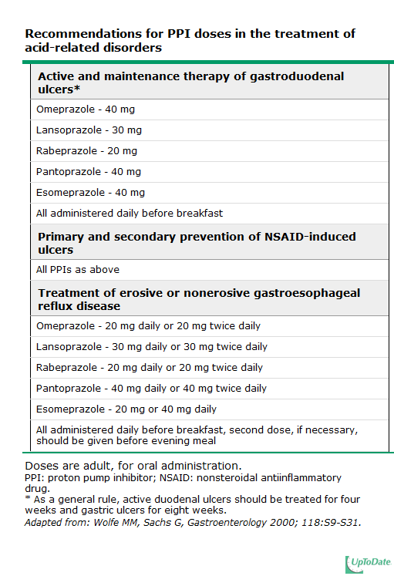

Slide 28
Medical treatment options:
Continuous maintenance therapy: once/ day.
On-demand therapy: consumption of medications when patient desire.
Intermittent therapy: short course of therapy from 1-2 weeks when symptoms recur.
Alternate therapy: every other day or every weekend.

Slide 29
Possible Causes For Failure of PPI Therapy
Compliance
Improper dosing time
Weakly acidic reflux
Visceral hypersensitivity
Psychologic comorbidities
Concomitant functional bowel disease
Delayed gastric emptying
Eosinophilic esophagitis
From Fass R. Clin Gastroenterol Hepatol 2008;6:393-400.

Slide 30
Causes of refractory GERD:
Wrong diagnosis: no reflux !!!
Extraesophageal symptoms of GERD.
Non-acid reflux or weak acid reflux.
Bile –induced reflux.
Nighttime GERD or nocturnal heartburn.
Suboptimal dose and dose timing.
Functional heart burn.

Slide 31
AGA GERD Practice Guidelines: Surgery
Patients with esophagitis who are well maintained on medical therapy have nothing to gain from surgery
Incur added risk
Should be advised against surgery
Patients likely to benefit from surgery:
PPI intolerance
Persistent symptoms especially regurgitation
From Kahrilas PJ et al. Gastroenterology 2008;135:1383-91.

Slide 32
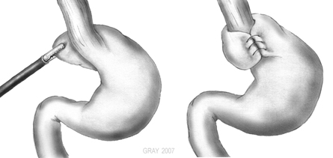
Nissen Fundoplication
When indicated, the operative procedure of choice is laparoscopic Nissen fundoplication, with a success rate of about 90%

Slide 33
Endoscopic treatment
Radiofrequency ablation of LES.
Stretta: endoscopic gastroplasty plication of the gastric folds immediately distal to the esophagogastric junction.
Endoscopic implantation of a bulking agent or polymer in the region of the LES.

Slide 34
Complication of GERD
Peptic stricture.
Barrett’s esophagus.
Bleeding and anaemia.
Adenocarcinoma.

Slide 35
Peptic Stricture
Peptic stricture is a lumen-narrowing lesion that occurs in erosive esophagitis secondary to edema, inflammation, or fibrosis of the distal end of the esophagus
Strictures produce dysphagia for solids
Diagnosis is by Ba swallow or EGD
Strictures may respond to medical therapy for GERD alone.
However, when strictures are fibrotic, dilation is typically required at various intervals.
PPI therapy is useful after dilation to reduce recurrent stricturing and the need for more frequent dilation.

Slide 36
Barrett’s esophagus
Barrett's esophagus is replacement of reflux-damaged squamous epithelium in the distal part of the esophagus by metaplastic, specialized columnar epithelium.
It is found in 10 to 15% of patients with GERD, principally in white individuals.
The lesion is suspected on endoscopy by the presence of reddish epithelium extending from the stomach into the tubular lumen of the esophagus

Slide 37
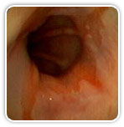
Barrett’s esophagus

Slide 38
Infectious Esophagitis
most commonly found in patients who are immunocompromised:
usually from cancer chemotherapy,
post-transplant antirejection medication,
and acquired immunodeficiency syndrome (AIDS) (especially with CD4 counts <200 mm3)
Candida albicans
herpes simplex virus type 1 (HSV-1)
CMV

Slide 39
Odynophagia
Odynophagia is characteristic and may be severe.
Dysphagia,
weight loss,
and gastrointestinal bleeding are common.
Complications are infrequent but may include tracheobronchial fistula, perforation, and hemorrhage.

Slide 40
Candida esophagitis
Multiple biopsies of ulcerated areas with routine histologic evaluation provide a definitive diagnosis.
Candida esophagitis is characterized on endoscopy by
numerous small white-yellow mucosal plaques containing microorganisms, inflammatory cells, and necrotic mucosa
biopsy demonstrate Candida pseudohyphae

Slide 41
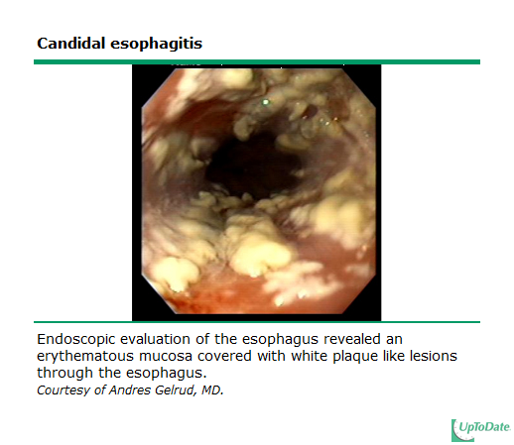

Slide 42
Tx Candida esophagitis
In non-AIDS patients, Candida esophagitis may be treated with
oral nystatin, 1 to 3 million units four times a day,
or clotrimazole (Mycelex troches), 100-mg tablets dissolved in the mouth three to five times a day,
but patients with AIDS require an azole antifungal such as
oral or intravenous fluconazole (Diflucan), 100 to 200 mg/day for 10 to 14 days

Slide 43
HSV esophagitis
HSV esophagitis on endoscopy
begins as numerous vesicles that ulcerate to yield small (<2 cm), shallow, volcano-shaped ulcers
A positive biopsy specimen from the ulcer edge demonstrates the characteristic cytopathic effect of HSV within squamous epithelial cells— eosinophilic intranuclear occlusions.

Slide 44
Tx HSV esophagitis
HSV esophagitis is treated with a nucleoside analogue such as
Acyclovir (Zovirax), 200 to 400 mg orally five times a day or 250 mg/m2 intravenously every 8 hours for 2 weeks.
Valacyclovir (Valtrex) and famciclovir (Famvir) are alternatives;
for resistant cases, intravenous foscarnet, 60 mg/kg every 8 hours for 2 to 4 weeks, is effective

Slide 45
CMV esophagitis
CMV esophagitis is characterized by
large (>2 cm), deep, often linear ulcers;
a positive biopsy specimen from the ulcer base demonstrates the characteristic cytopathic effect of CMV within fibroblasts and endothelial cells—basophilic intranuclear inclusions

Slide 46
Tx CMV esophagitis
CMV esophagitis is treated with
intravenous ganciclovir, 5 mg/kg every 12 hours for 2 to 4 weeks;
for resistant cases, foscarnet is administered intravenously at 60 mg/kg every 8 hours for 2 to 4 weeks.

Slide 47
Pill-Induced Esophagitis
commonly develops in patients, particularly the elderly, who are taking medication improperly (i.e., while supine or with too little liquid).
It also occurs in patients with a preexisting abnormality, such as a stricture, diverticulum, or motor disorder.
Pills adhere to the esophageal mucosa and cause necrosis and ulceration by the topical release of caustic medication

Slide 48
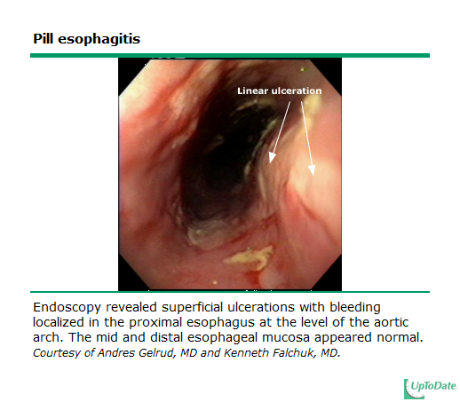

Slide 49
Tx Pill-Induced Esophagitis
Discontinuation of the offending medication and treatment with sucralfate suspension (1 g orally four times a day for 1 to 2 weeks) or a cocktail (equal parts viscous lidocaine, antacid, and diphenhydramine [Benadryl]) may control the symptoms.
Once-a-day PPI therapy is useful to prevent aggravation by reflux.
Education about the proper method of taking medication may prevent recurrence.

Slide 50
Radiation esophagitis
occurs after chest radiation therapy
severe esophagitis and ulceration can develop and lead to hemorrhage, perforation, or fistula.
Substernal pain, odynophagia, and dysphagia are typical.
Barium swallow and endoscopy can demonstrate the extent and severity of mucosal inflammation, ulceration, and luminal narrowing;
endoscopy has the added benefit of biopsy for exclusion of infectious esophagitis

Slide 51
A liquid diet or intravenous fluids plus the treatments described for pill-induced esophagitis are helpful.
Strictures may require dilation or even esophagectomy with colonic or jejunal interposition.

Slide 52
Eosinophilic esophagitis
uncommon, immunologically mediated entity
The disease is due to food allergy and can be manifested as chest pain or heartburn, but solid food dysphagia and food impaction are characteristic.
Skin testing and a radioallergosorbent assay (RAST) for allergy should be performed to identify and remove the offending agent or agents—the most common being seafood, nuts, milk, eggs, and soy. Dietary changes

Slide 53
In the past, eosinophilic esophagitis was abbreviated as "EE" but, because of confusion with erosive esophagitis, many prefer the abbreviation "EoE".
A panel of experts defined eosinophilic esophagitis as "a chronic, immune/antigen-mediated, esophageal disease characterized clinically by symptoms related to esophageal dysfunction and histologically by eosinophil-predominant inflammation"

Slide 54
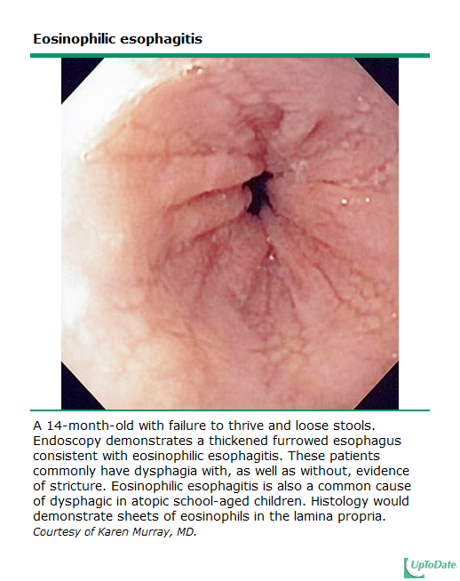

Slide 55
Caustic esophagitis
occurs from accidental ingestion in children and from suicidal attempts in adults.
Among the more common materials ingested are drain cleaners (sodium hydroxide), bleach (sodium hypochlorite), detergents (sodium tripolyphosphates), and disc batteries (sodium hydroxide).
has the potential to cause acute ulceration, perforation, and later stricture formation

Slide 56
When perforation is excluded by contrast (diatrizoate [Gastrografin] and, if negative, barium) swallows, endoscopy may be of value to assess the esophageal injury, but passage of the scope beyond an area of severe injury is not recommended to avoid perforation.
Emergency esophagogastrectomy is indicated for free perforation and mediastinitis

Slide 57
In the absence of these complications, esophagitis is treated supportively with intravenous fluids and prophylactic antibiotics.
Steroids in tapering dosage are often given but are without proven efficacy

Slide 58
Esophageal Cancer
Diagnostic evaluation starts with
Endoscopy (EGD)
Endoscopic ultrasound (EUS)
The two major treatment options for early esophageal cancer are surgical esophagectomy and endoscopic therapy.
The depth of tumor invasion into the wall of the esophagus is an important factor in selecting treatment.

Slide 59
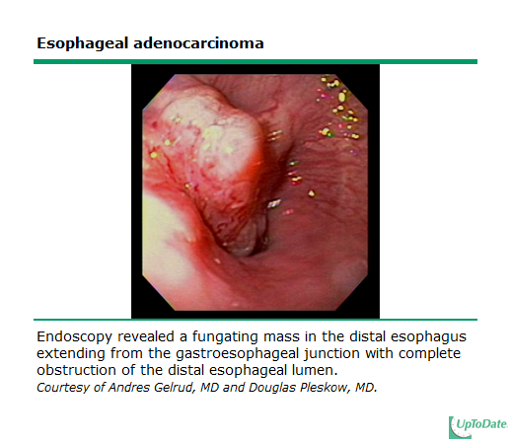

Slide 60
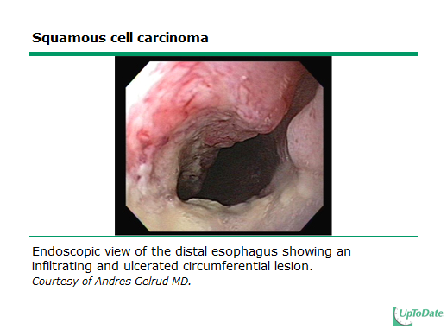

Slide 61
Learning Objectives
Recall the etiological findings of esophagitis
Describe and identify the varied clinical manifestations of esophagitis
Identify the various etiologies of and risk factors for esophagitis
Explain the appropriate diagnostic testing for esophagitis
Demonstrate knowledge of the treatment strategies of esophagitis
Restate the complications of esophagitis

Slide 62
THANK YOU

