Slide 1
UPPER GI BLEEDING
DR YUSUF MUSAH
Dept. of Internal Medicine
FETHI.

Slide 2
Outline
Introduction
Epidemiology
Aetiology
Mechanisms
Management
Resuscitation
History
Physical Examination
Investigations
Treatment
Indications for surgery.
Complications
Prognosis
Conclusion
References

Slide 3
Introduction
Acute GI Bleeding is a potentially life threatening abdominal emergency
Upper GI Bleeding (UGIB) is defined as bleeding in the GI tract from a source above the ligament of Treitz.
A major cause of morbidity & mortality with hospitalization

Slide 4
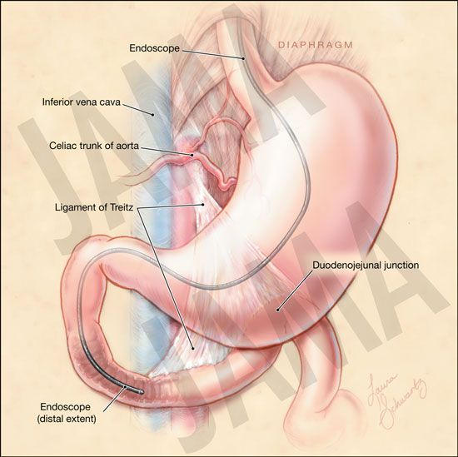
The Ligament of treitz

Slide 5
Epidermiology
UGIB accounts for about 80% of significant GI haemorrhage
Approx 100 cases per 100,000 population per year
Older population affected with Comorbidities
UITH Study
3o patients in 1year, 23males(76.7%) 7females(23.3%)
Malaena only(16-53.3%) Malaena+Hematemesis(11-36.7%)
Malaena+Hematemesis+Hematochezia(3-10.0%)

Slide 6
Aetiology
Non Variceal vs Variceal bleeds
Non variceal(80%)(PUD commonest)
Variceal(20%) portal hypertention mostly in liver cirrhosis(gastroesophageal, isolated gastric varices or Hypertensive portal gastropathy)
Non Variceal sources still account for UGIB in cirrhotic patients despite the high risk of Variceal bleeding

Slide 7
Aetiology
Non variceal
variceal
Peptic ulcer disease 35-50%
Mallory-weiss tears 15-20%
Gastritis or duodenitis 10-15%
Esophagitis 5-10%
AV malformations 5%
Tumors 2%
Gastroesophageal varices >90%
Hypertensive portal gastropathy <5%
Isolated gastric varices rare

Slide 8
cont’d
General causes
Blood dyscrasia
Hereditary telangiectasia
Leukaemia
Anticoagulants
Thrombocytopenia
Oesophagus
Varices
Oesophagitis
Mallory-weiss syndrome
Boerhaave syndrome
Para-oesophageal (rolling) hiatal hernia
Tumors: Benign&Malignant
Stomach
Gastric ulcers
Gastritis
Gastric erosions
Tumors: Ca, polyps, leomyomas, lymphomas, sarcomas
Dieulafoy lesion
Duodenum
Duodenal ulcers
Ampullary/Pancreatic tumour
Duodenal tumour
Ruptured aortic aneurysm/Aortoenteric fistula
Angiodysplasia

Slide 9
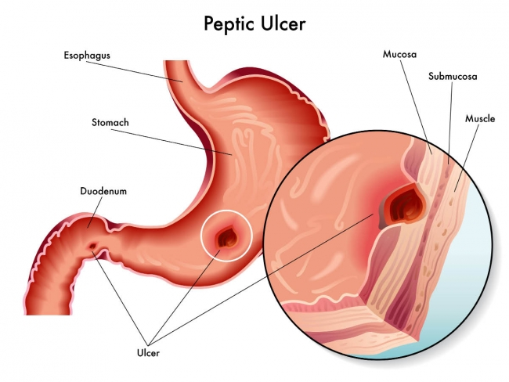
Peptic ulcer disease
Most frequent cause of UGIB
Consequence of acid-peptic erosion of mucosa
Mostly occurs from erosion into branches of gastroduodenal artery or left gastric artery.

Slide 10
Eradication of H pylori is demonstrated to reduce the risk of recurrent ulcers and thus recurrent ulcer hemorrhages after the initial episode
Duodenal ulcers are more common than gastric ulcers but the incidence of bleeding is same for both

Slide 11
Daily NSAID use causes an estimated 40-fold increase in gastric ulcer and an 8-fold increase in duodenal ulcer creation
Inhibits cyclooxygenase with decreased mucosal prostaglandin synthesis and impaired mucosal defences.
Long-term use is associated with a 20% incidence in the development of mucosal ulceration.

Slide 12
Mallory-Weiss tears
Account for 5% to 10% of cases of UGIB.
Mucosal & submucosal tears near the GEJ
Alcoholics after intense retching & vomiting, a history of repeated emesis
Forceful abdominal wall contraction against an unrelaxed cardia→ mucosal laceration of the proximal cardia from the increase in intragastric pressure.

Slide 13
Acute stress gastritis
Multiple superficial erosions of entire stomach, mostly the body.
Acid/pepsin injury and mucosal ischemia in hypo perfusion states
Critically ill patients with significant morbidity and mortality.
May follow multiple trauma, systemic respiratory distress syndrome, ARF & sepsis
Referred to as curling's ulcers in major burns.
Pts at risk are given prophylactic antacids, h₂-receptor antagonists, ppis

Slide 14
Esophagitis
Esophageal inflammation due to repeated exposure to acid secretion in GERD.
Infective agents esp in immunocompromised
Others include crohn’s dx, radiation,
Superficial mucosal ulcerations usually present with chronic anemia or occult stool blood

Slide 15
DIEULAFOY LESIONS
A vascular malformation usually within 6 cm of the GOJ along the lesser curvature .
Can occur anywhere along the GIT & accounts for 2-5% of acute UGIB episodes.
Rupturing of unusually large (1-3 mm) vessels found in the gastric submucosa.
Bleeding can be massive and brisk because of the large vessel size.
Mostly occurred in men and those in their third to tenth decade.
Notes:
Turtous arterioles in the stomach

Slide 16
Aortoenteric Fistula
Occurs in about 1% of aortic graft typically in a previous abdominal aortic aneurysm repair.
May also occur from an inflammatory or infectious aortitis.
Pseudoaneurysm develops at the proximal anastomotic suture line - fistulization into the overlying duodenum.
The interval between surgery & haemorrhage ranges from days to years (median of about 3 years).
A “sentinel bleed” often heralds the subsequent massive and often fatal hemorrhage.

Slide 17
Upper GI Malignancy
Often cause chronic anemia or occult bleeding
GI stromal tumor (GIST), leiomyomas and lymphomas may occasionally present as ulcerative lesions that bleed persistently

Slide 18
Gastric Antral Vascular Ectasia : GAVE
(watermelon stomach) –
A collection of dilated venules appearing as converging in a longitudinal, linear red streaks on the antrum gives watermelon appearance.
Most patients present with persistent, iron deficiency anemia from occult blood loss & acute severe hemorrhage is rare .

Slide 19
MECHANISMS
Ulcer-related UGIB
H pylori causes gastritis & duodenitis
alters PH
Ulcer burrows into the gastroduodenal mucosa
weakening & necrosis of the arterial wall (pseudoaneurysm)
wall ruptures.
Bleeding occurs

Slide 20
Vomiting-related UGIB
Forceful vomiting, retching, coughing or straining
rapid increase in the gradient between intragastric & intrathoracic pressures
a gastric mucosal tear from the forceful distention of the GEJ
Bleeding from tear

Slide 21
Portal HTN Related
Elevated portal pressure
Portal Pressure transmitted to point of Portosystemic Anastomosis
esophageal & gastric varices with portal gastropathy.
Bleeding

Slide 22
MANAGEMENT
PRINCIPLES
RESUSCITATION
IDENTIFY SOURCE & CAUSE OF BLEEDING
HISTORY
PHYSICAL EXAMINATION
INVESTIGATION
TREATMENT

Slide 23
Resuscitation
Elevate the limbs
Setup IV access on both upper limbs(wide bore IV canulae,size 16)
Start IVF infusion immediately, N/S 1L within 30 mins( 1ml:3ml) Crystalloids initially and replace soonest with blood
Take Urgent Samples: PCV, G&M, Clotting profile, E&U
IV Omeprazole 4omg bd for the next 48hrs
Urethral catheter to monitor urine output
NGT: Gastric lavage with normal saline
Monitoring vitals
Considering ICU admission is essential.
Empiric broad spectrum antibiotic may be necessary to combat underlying sepsis.

Slide 24
Indications for transfusion
Active bleeding with low BP and tachycardia’
Deteriorating clinical state.
Clinical judgment supersedes lab. Results

Slide 25
HISTORY
Age of patient: Occurs in all ages but older population are particularly prone with a concurrent increase in comorbidities & significant mortality.
Sex: UGIB is 2-fold greater in males than in females in all age groups but the death rate is similar in both sexes.
Hx of haematemesis &/or melaena
Hematochezia

Slide 26
HISTORY
There may be Hx of collapse
Dyspepsia & epigastric pain suggestive of PUD
Forceful vomiting, retching, coughing or straining
Drugs: Anticoagulants, NSAIDs & alcoholism
Yellow eyes & abd pain in CLD & oesophageal varices.
Hx of burns, sepsis, trauma, operation in stress ulceration

Slide 27
EXAMINATION
Gen Exm
Pallor,sweating, dehydration, Cold clammy ext restlessness, coma, stigmata of CLD , lymphadenopathies, petechial haemorrhages
Syst Exm
CVS(tarchycardia, hypotension)
RS(tachypnea)
GI(abdominal distention, ant abd veins, Epigastric tenderness (PUD), Ascitis, Hepato-slenomegaly (CLD & Varices), epigastric mass (Gastric Ca), Telangiectasia of lip &mouth in Hereditary telangiectasia.

Slide 28
Investigations
Serial Haematocrit level and
G&M
E,U,Cr
LFT
PT,INR
Platelet counts,
Bleeding time
Clotting time
CXR

Slide 29
UPPER GI ENDOSCOPY
Within 24hrs in a stable patient
Shows bleeding, oozing, visible vessels, clot
Dieulafoy lesions lesion appears as a large submucosal vessel that have become ulcerated.
Variceal haemorrhage have snakeskin-like appearance of stomach with cherry-red spots.
In aortoenteric fistula, evidence of bleeding in the distal duodenum (3rd or 4th portion) on OGD is considered diagnostic.

Slide 30
BARIUM/CONTRAST CT
Barium meal may show Ulcers – hiatal or peptic, varices, reflux oesophagitis,, gastric tumours.
IV Contrast CT scan in aortoenteric fistula will demonstrate air around the graft (suggestive of an infection),

Slide 31
Treatment
Proton pump Inhibitors
Prokinetics(metochlopromide)
Vasopressin- (Significant cardiac vasoconstriction→ MI. Reduce side effects with nitroglycerin)
Somatostatin (natural, very short half-life, no cardiac side effects
Octreotide a synthetic longer-acting analogue.

Slide 32
Balloon tamponade
Sengstaken-Blakemore tube : pts with massive hemorrhage ,has a gastric tube with esophageal and gastric balloons. The gastric balloon is inflated, and tension is applied to the gastroesophageal junction. If this does not control the hemorrhage, the esophageal balloon is inflated as well, compressing the venous plexus between them.
The Minnesota tube includes a proximal eosophageal lumen for aspirating swallowed secretions.

Slide 33
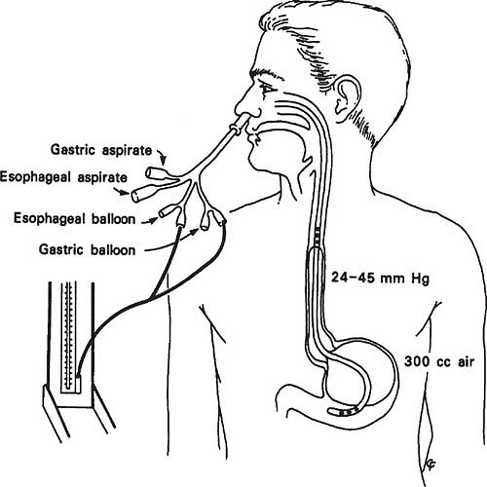
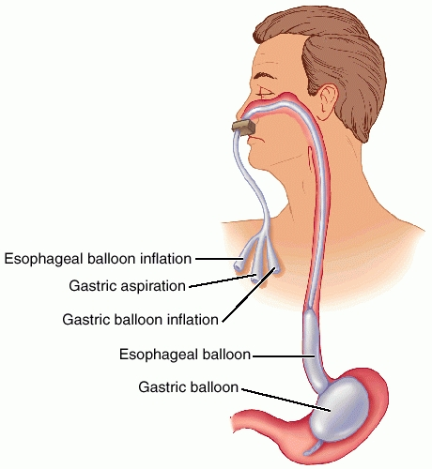

Slide 34
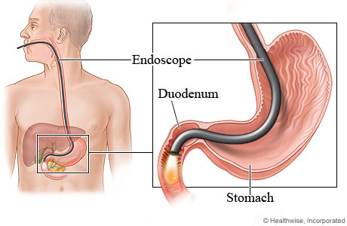
Endoscopy
is Gold Standard for treatment
Done within 24hrs of Stability
A variety of Endoscopic treatments modalities
Injection method
Cautery
Mechanical therapy

Slide 35
Injection
Tamponade effect(N/S solution, dilute epinephrine)
Tissue injury and thrombosis(Sclerosants like ethanol, ethanolamine,polidocanol
Primary tissue seal(thrombin, fibrin, cyanoacrylate glue)
Except Dilute epinephrine, injectables are rarelyused in Non variceal

Slide 36
Cautery
Electrocautery
Laser therapy
Mechanical
Clips
Rubber ligation

Slide 37
Indication for surgery in gi bleeding
Hemodynamic instability despite vigorous resuscitation (>6 units transfusion)
8- 10-unit loss in the younger population
Failure of endoscopic techniques to arrest haemorrhage
Recurrent haemorrhage after initial stabilization (≥ 2 attempts at obtaining endoscopic haemostasis)
Shock associated with recurrent haemorrhage
Continued slow bleeding requiring > 3units/ day

Slide 38
Complications
Anaemia
Shock
Acute Renal Failure
Syncope
Aspiration Pneumonitis

Slide 39
Prognosis
Risk factors with increased mortality
Age older than 60 years.
Severe comorbidity/ CVS disease, Pulmonary conditions and terminal malignancy.
Pulsatile bleeding (e.g. witnessed haematemesis, red blood per NG tube, fresh blood per rectum)
Shock on admission: mortality rate up to 30%.
RBC transfusion ≥ 6 units
Recurrent bleeding, the need for endoscopic haemostasis or surgery
In-patient at time of bleed.
Rockall score> eight

Slide 40
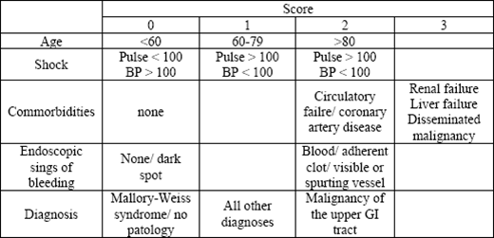
Rockall Score

Slide 41
CONCLUSION
In UGIB patients, comorbid illness, rather than actual bleeding is the major cause of death.
Rebleeding or continued bleeding is associated with increased mortality; differentiating patients with low probability of rebleeding and little comorbidity from those at high risk for rebleeding with serious comorbidities is therefore imperative.

Slide 42
THANK YOU

Slide 43
References
Nicholas A.B et al (2006)Davidson’s Principles and Practice of Medicine(20th ed)
Badoe E.A et al (2009) Principles and Practice of Surgery including Pathology in tropics(4thed)
emedicine.medscape.com/article/187857 (2015)

