Slide 1
WOUNDS & WOUND HEALING
DR SALAWU A .I (FWACS )

Slide 2
OUTLINE
Introduction
Wound healing phases
Cytokine activities in wound healing
Factors affecting wound healing
Aetiology & Classification of wounds
Principles of wound management
Fetal wound healing and special tissues
Abnormal wound healing
Complications of wound healing
Conclusion

Slide 3
Introduction
Wound can be defined as a distruption in the structural and functional integrity of a tissue
Wound healing is the process by which the living organism replaces damaged tissues with living tissues
Wound healing can also be defined as the series of stepwise overlapping physiological events that restores the structural and functional integrity of an injured tissue .
In lower animals it is by REGENERATION while in man it is imperfect with fibrous tissue replacement.

Slide 4
Historical perpective
Sumeriians 2000BC – used spiritual methods to heal wound
Egyptians 1650 BC – differentiated infected from non infected wound
Ebers papyrus 1550 BC – describes use of lints , ointments etc for wound treatment .
Greeks – described acute vs chronic wounds
Galen 120 -201 BC – described the importance of moist environment to wound healing
Others Ignas Simmelwiss , Louis Pasteur , Joseph Lister

Slide 5
Phases of wound healing
Broadly divided into 3 phases for convinence though they overlap
Inflammatory (lasts for 3days -1week )
Proliferative phase ( begins by 3rd day lasts for about 2- 4weeks)
Remodelling phase (begins 2 -4 weeks after injury )

Slide 6
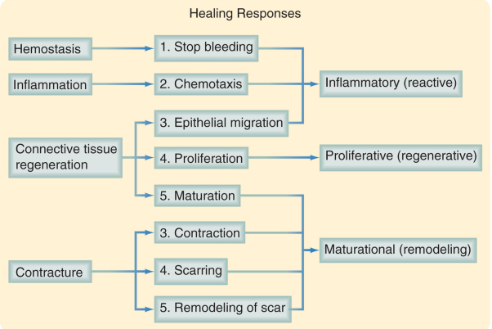
Wound healing phases

Slide 7
Inflammatory phase
It is initiated by stimulus such as physical injury , antigen antibody complexes ,infection
Haemostatic mechanism is triggered , initial vasoconstriction of vessels is followed by platelet adhesion and aggregation
Platelets then release vasodilatory agents to increase vascular permeability – serotonin ,histamine , bradykinin , prostagladins
Platelets also release growth factors like PDGF , TGF-B , IGF- 1, adhesive glycoproteins , fibronectins

Slide 8
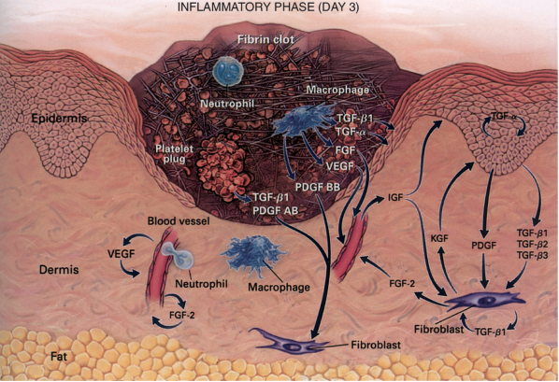
Diagram showing platelet plug

Slide 9
Inflammatory phase
The neutrophils are mobilized by chemoattractants to the site of the wound eg IL -1 ,proteases , hydrolases
The neutrohils perform phagocytic function and produce more cytokines that perpetuates the wound healing process ie KGF , IL-6 ,IL-8
The chief regulatory cell is the tissue macrophaghes which produce plethora of cytokines as shown in the tables below
Macrophages are attracted by monocyte chemoattractant protein 1 ( MCP-1 )
Note that Fibrin is the primary matrix at this stage

Slide 10
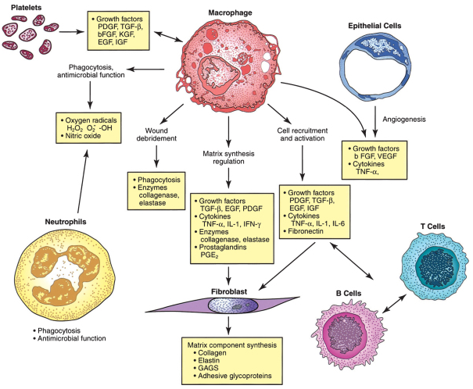
Illustration of the central role of macrophages in wound healing

Slide 11
Proliferative phase
Consists of 3 simultanous processes
Epithelization , Angiogenesis and Fibroplasia
Epithelization predominates in primary wound healing while angiogenesis and fibroplasia is more prominent in secondary wound healing
Epithelization process involves proliferation and differentiation of basal cells at the wound edges
Migration of the syncytial layer towards the centre of the wound by amoeboid movement due to loss of contact inhibition

Slide 12
There is also formation of epithelial spur which are columns of cells growing downward
Once the cells meet in the centre contact inhibition is restored
The epithelization process is facilitated by EGF , TGF ,KGF as well as interaction between the intergrin molecules and the extracellular matrix
The fibroplasia involves fibroblasts which are atttracted by macrophage secreted chemoattratants

Slide 13
Fibrobasts in turn secrete GAG, hyalouronic acid , laminin , fibronectin ,collagen with the subsequent formation of ground substance
Type 3 collagen production predorminates in the early phase of wound healing
Angiogenesis is the formation of new blood vessels
It involves the endothelial cells degrading the basement membrane , divison of the migration endothelial cells results in tubule or lumen formation .
These interactions are modulated by VCAM,PCAM ,metalloprotaenases , FGF , angiogenin , NO , lactic acid and tissue hypoxia .

Slide 14
Maturation/ remodelling phase
Wound contraction is mediated by activated fibroblasts called myofibroblast present throughout the wound
They initiate centripetal forces via interaction with the extracellular matrix
Fibroblast population decreases , dense capillary network regresses
Wound strength increase rapidly in 1-6weeks ,there is cross linking of the collagen fibres ,vitamin c is important in the hydroxylation of collagen monomers
Type 1 collagen production now predorminates

Slide 15
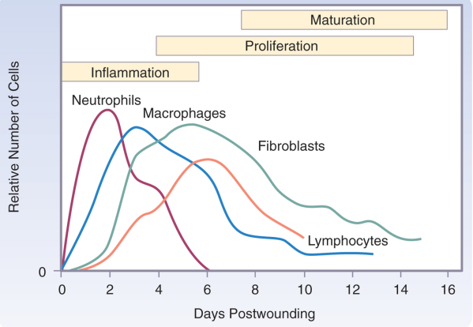
Temporal distribution of cells in wound healing

Slide 16
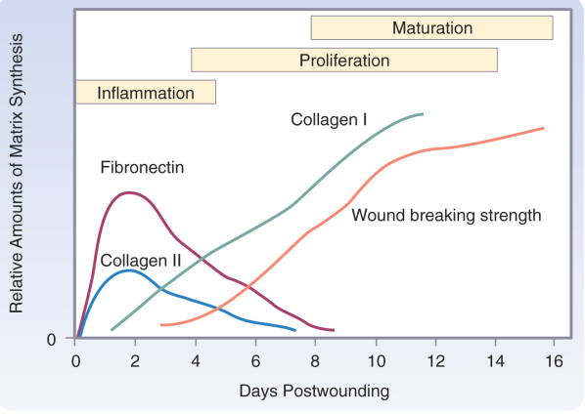
The content of the extracellular matrix

Slide 17
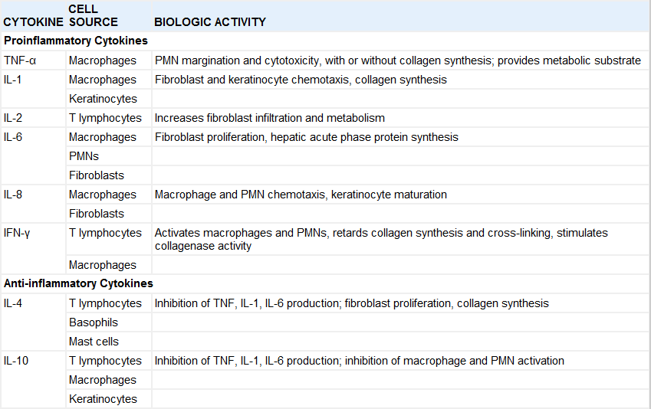
Important cytokines in wound healing

Slide 18
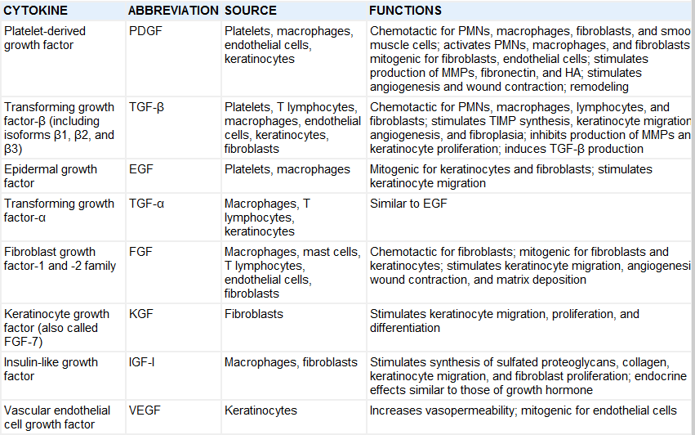
Important growth factors in wound healing

Slide 19
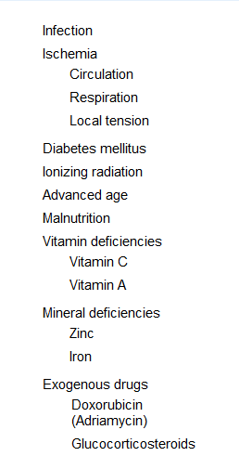
Factors affecting wound healing

Slide 20
LOCAL FACTORS
Radiation
Foreign bodies
Immobilization / trauma
Local infection
Blood supply

Slide 21
AETIOLOGY OF WOUNDS
MECHANICAL AGENTS
CHEMICAL AGENTS
RADIANT ENERGY
PATHOGENIC MICROORGANISMS

Slide 22
CLASSIFICATION OF WOUNDS
A) CLOSED WOUNDS (CONTUSION )
B) OPEN WOUNDS
1) Puncture wounds
2) laceration wounds
3) penetrating wounds
4) perforating wounds
5) Avulsion/Degloving wounds (complete or incomplete)

Slide 23
Classification of surgical wounds based on degree of contamination
The american college of surgeons determines four classes of wound based on level of contamination
CLASS I- CLEAN WOUNDS
CLASS II - CONTAMINATED WOUNDS
CLASS III - CONTAMINATED WOUNDS
CLASS IV - DIRTY WOUNDS

Slide 24
Classification of surgical wounds based on degree of contamination
Class I – clean wound with no sign of inflammation , no breach of hollow viscus eg simple herniotomy , skin lump excision .
Class II – surgery involving the gastrointestinal respiratory or genitourinary tracts , removal of pins or wires , gynaecologic procedures , as long as surgeries are uncomplicated .

Slide 25
Classification of surgical wounds based on degree of contamination
Class III – gunshot wounds , knife blade wound or large amount of spillage from GI tract into the wound . Highly inflammed or infected tissue around surgical wound .
Class IV – dirty infected wounds including those with foreign object lodged in the wound (bullet or debris ).farm yard wounds , wounds exposed to pus or feacal matter .

Slide 26
CLASSIFICATION OF WOUNDS BASED ON DURATION
ACUTE WOUNDS ( < 6WEEKS)
CHRONIC WOUNDS (> 6WEEKS )

Slide 27
CLASSIFICATION OF WOUNDS BASED ON DEGREE OF TISSUE DEVITALISATION
RANK AND WAKEFIELD CLASSIFICATION
A) TIDY WOUNDS
B) INDETERMINATE WOUNDS
C) UNTIDY WOUNDS

Slide 28
PRINCIPLES OF WOUND CARE
TIMELY DEBRIDEMENT
TETANUS PROPHYLAXIS / ANTIBIOTICS
ANALGESIA
ASEPSIS
GENTLE TISSUE HANDLING/ DRESSINGS
HEMOSTASIS
WOUND CLOSURE (PRIMARY CLOSURE , DELAYED PRIMARY CLOSURE , SECONDARY CLOSURE )
IMMOBILIZATION

Slide 29
Fetal wound healing
Classical in the first 3months of IUL
There is absence of scarring
Inflammation is reduced
Angiogenesis is reduced
Collagen deposition is rapid , organised and not excessive
More type 3 collagen is present than type 1
More water and hyalouronic acid content
There is absence of TGF B

Slide 30
Abnormal wound healing
Keloids &Hypertrophic scars – there is excessive deposition of collagen , collagen is haphzardly deposited , increased expression of mast cells within the wound.
Keloids are commoner in Blacks and Asians
Keloids grow beyond margin of the original wound .
Chronic non healing wounds – there is increased proteinases , increased MMP2,8 ,9, increased IL-1, IL-6 , TNF A.( pressure ulcers etc)

Slide 31
Healing in special tissues
Bones
Cartilage
Nerves
Liver

Slide 32
Complications of wound healing
Infection
Dyschromia
Implantation cyst
Neoplasia
Unstable scars
Contractures / Cicatrization

Slide 33
Conclusion
Wound healing in man is essentially by fibrous tissue replacement, however increase in the understanding of the physiological and molecular mechanisms underlying it will lead to better modulation of the healing process .

Slide 34
Bibilography
SABISTON TEXT BOOK OF SURGERY 17TH EDITION
PRINCIPLES AND PRACTICE OF SURGERY INCLUDING PATHOLOGY IN THE TROPICS 4TH EDITION .BADOE , ARCHAMPONG , ROCHA – AFODU .
GRABB AND SMITH PLASTIC SURGERY 6TH EDITION

