Slide 1
CUTANOUS ULCERS
DR SALAWU A.I (F.W.A.C.S )

Slide 2
Outline
Introduction
Classification
Principles of management
Complications of cutanous ulcers
conclusion

Slide 3
Introduction
An ulcer is the loss in the continuity of the surface of an epithelium
The immediate cause is the necrosis or death of cells
The underlying tissues may or may not be involved
Ulcers constitute a major source health problem globally

Slide 4
classification
This can be aetiopathological or clinicopathological
The causes of cutanous ulcers are numerous hence these classification schemes helps to simplify management protocols

Slide 5
Aetiopathological classification
A . Specific ulcers:
1) tropical ulcers
2) tuberculous ulcers
3) buruli ulcers
4) syphilitic ulcers
5) yaws ulcer

Slide 6
Aetiopathological classification
B .Non specific ulcers
1) Trauma
2) pyogenic /infections – strept spp , staph spp , tropical ulcers ,
3) vascular – venous , arterial , decubitus /pressure ulcers
4) Neurotrophic – diabetic neuropathy , leprosy , peripheral neuropathy ,cord lesions , syringomyelia
5) metabolic or systemic ulcers - diabetic ulcers , Hemoglobinopathies , Hereditary spherocytosis , ulcerative colitis

Slide 7
Aetiopathological classification cont’d
C. malignant ulcers :
1) squamous cell ca
2) basal cell ca (rodent ulcers )
3) malignant melanoma
4) kaposi sarcoma

Slide 8
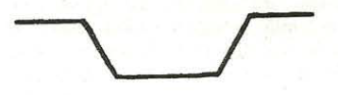
Clinicopathological classification
SLOPING
EXAMPLES
Traumatic
Infections /infestations
neurotropic
Metabolic
Heamoglobinopathic

Slide 9
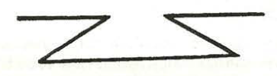
Clinicopathological classification
UNDERMINED
EXAMPLES
TUBERCULOSIS ULCER
BURULI ULCER

Slide 10
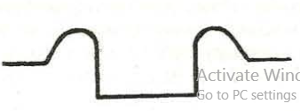
Clinicopathological classification
ROLLED EDGE OR ELEVATED EDGES
EXAMPLE
Malignant ulcer - basal cell ca or squamous cell ca

Slide 11
Venous ulcers
They are the commonest cause of chronic leg ulcers in the western world
The second commonest cause of leg ulceration in west africa
The result from chronic venous venous insufficiency leading to varicose veins
There may be previous history suggestive of DVT
Lipodermatosclerosis reduces oxygen tension locally leading to poor wound healing
Specific treatment includes use of pressure garments , Unna boot , venous stripping , sclerotherapy , ligation of perforators

Slide 12
Tropical ulcers
It is an acute ulcerative lesion
Caused by synergistic infection of anearobic Bacteroides fusiformis and aerobic Borrelia vincenti
Occurs in the tropics and subtropics
It is usually found in individuals with poor personal hygiene ,malnutrition and walking barefooted
Commonly located on the lower limb in the dorsum of the foot , pretibial area
It is thought to result from skin prick from thick foliage or insect bites , organism may also be introduced by flies

Slide 13
Tropical ulcers
It usually starts as a painful blister
The blister ruptures to release a serosanginous discharge
It may progress to diffuse inflammation and left untreated results in a yellowish brown , grey patch of foul smelling eschar involving the skin and subcutanous tissues

Slide 14
Buruli (Bairnsdale) ulcer
First described in Buruli district , a riverine district of Mengo Uganda
It is prevalent in several countries in Africa , Central America ,South America and Australia
Causative organism is acid alcohol fast bacterium mycobacterium ulcerans which grows at 30 -32 celsius with low oxygen tension < 2.5KPa and PH 5.4-7.4 .cultured in Lowestein Jenstein medium after 6-8weeks
Transmission is thought to be by direct inoculation or by acquatic insects Nicorius and Diplonychus

Slide 15
Buruli (Bairnsdale) ulcer
The organism produces a toxin called mycolactone a macrolide polyketide
Which is cytotoxic and immunosuppressive to fat and immune cells hence most of the the tissue damage occurs on the skin and subcutanous tissue
There is little or no immune response and it is initially painless
The disease progresses through phases of papule , nodule , plaque , oedematous phases and finally ulceration phase if allowed to progress
Specific treatment is with rifampicin ,clofazimin ,septrin

Slide 16
Tuberculosis of the skin
It may be associated with tuberculose adenitis of the groin
Clinically it appears as a dirty undermined ulcer with surrounding sinuses
Skin lesion of lupus vulgaris are made prominent by magnification
Specific treatment is with Rifampicin , Isoniacid , Ethambutol , Streptomycin ,

Slide 17
Arterial ulcers
Found in patients with preexisting chronic arterial disease
It may be atherosclerosis or Buergers disease
There is usually history of intermittent claudication in the lower limbs (pain on walking a predictable distance )
This may progress to rest pain , acropathy , trophic changes and eventually leg ulcers
Specific treatment includes transluminal angioplasty , endarterectomy , Bypass surgery

Slide 18
Principles of management of cutanous ulcers
HISTORY
Mode of onset
Duration
Presence or absence of pain
Progress of ulcer
Presence of painful regional lymph node
Presence of specific symptons : loss of sensation(neuropathy) , intermittent claudication (arterial ) , distented leg veins (venous ), night sweats associated with chronic cough( TB) , progressive weight loss ass. with polydisia (DM)

Slide 19
Physical examination
1)General physical examination
2)Ulcer
Number
Anatomical site
Size
Shape
Edge
Floor
Discharge

Slide 20
Comparism of unhealthy granulation tissue vs healthy granulation tissue
Unhealthy granulation tissue
Healthy granulation tissue
Pale granulation tissue
Cobblestoned or rough looking floor
Extensive slough
Extensive eschar
Excessive discharge usually purulent
Red granulation tissue
Smooth velvety appearance
No slough
No eschar
Minimal serous fluid collection
Sloppy healing edges

Slide 21
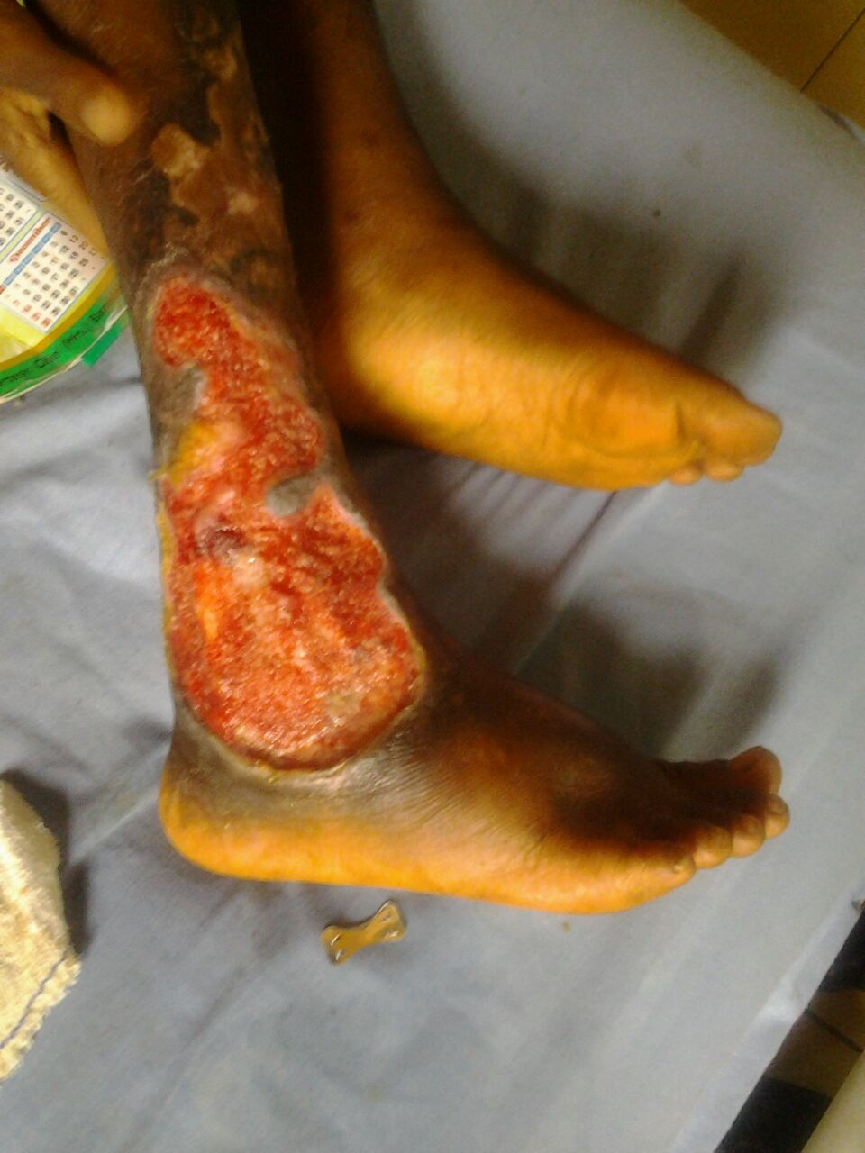
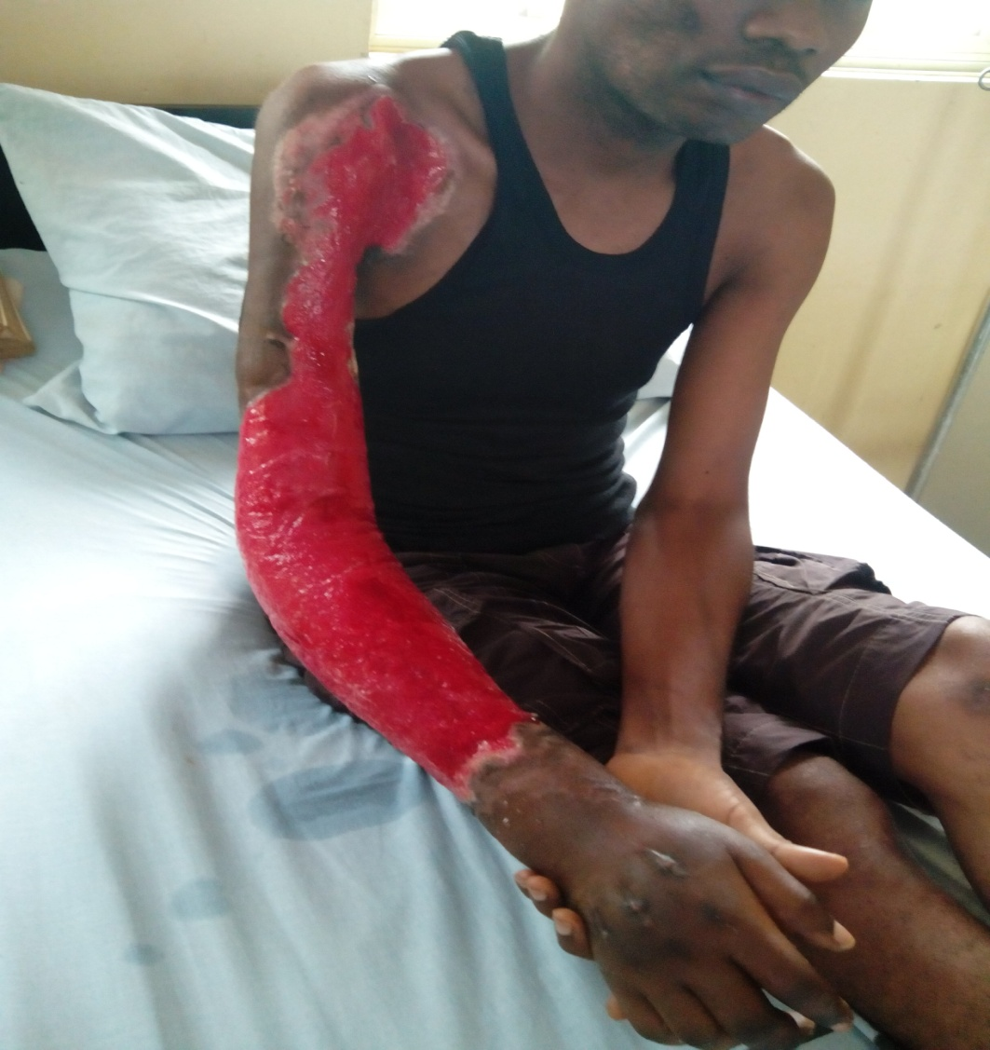
Comparism of unhealthy granulation tissue vs healthy granulation tissue
An Ulcer with unhealthy granulation tissue
An Ulcer with healthy granulation tissue

Slide 22
Physical examination
Local circulation
Arterial pulses
State of innervation
Regional lymph nodes

Slide 23
Investigations
1) urinalysis
2) Blood
Heamoglobin concentration
Full blood count
Electrolyte urea and creatinine
Heamoglobin genotype
3) Radiology
Plain films of adjacent bones
Duplex doppler studies
Arteriography
4 )Microscopy culture and sensitivity
5) Biopsy of ulcer

Slide 24
Treatment
1) Acute phase
Admit patient
Elevate the limbs or body part
Antitetanus prophylaxis
Analgesics
Antibiotics or specific antimicrobials or chemotherapeutic agents
DEBRIDEMENT
Wound care / dressings
2) Chronic phase
Skin graft
Local flaps
Distant or free flaps

Slide 25
Types of debridement
Autolytic
Biologic
Chemical
Surgical
Enzymatic

Slide 26
Wound dressing agents
Honey
Films
Foams
Hydrogels
Hydocolloids
Alginates

Slide 27
Complications of cutanous ulcers
LOCAL / REGIONAL
SYSTEMIC
Osteomyelitis
Septic arthritis
Lympheodema
Contractures
Marjolins ulcer
Lymphangitis /lymphadenitis
Gangrene of digits
Disuse muscular atrophy
Equinus deformity
Tetanus
Sepsis

Slide 28
Conclusion
Cutanous ulcers remain a common debilitating clinical condition in our environment , however health education , appropriate care by the specialist is capable of reducing the disease burden in the community .

Slide 29
Bibiliography
Badoe ,Archampong , Rocha – Afodu, principles and practice of surgery in the tropics including pathology 4th edition
Keynotes on plastic surgery by Adrian M. Richards

