Slide 1
Epilepsy and related Seizure disorders
AM ADEBIYI, FMCP
DEPARTMENT OF INTERNAL MEDICINE
FETHI/ABUAD
IDO-EKITI, EKITI STATE

Slide 2
OUTLINE
Definitions
History
Epidemiology
Classification
Clinical Features
Etiology
Differential diagnosis
Management
Prognosis
Conclusion

Slide 3
Definitions
Seizure : a transient occurrence of signs and/or symptoms due to abnormal excessive or synchronous neuronal activity in the brain. (ILAE/IBE Joint 2005 definition). Symptoms/signs may be sensory, motor, behavioural, autonomic e.t.c
Epilepsy: a disorder of the brain characterized by an enduring predisposition to generate epileptic seizures and by the neurobiologic , cognitive, psychological and social consequences of this condition (ILAE/IBE Joint 2005 definition).

Slide 4
Definitions
2014 operational definition of epilepsy (ILAE/IBE):
2 or more unprovoked seizures ≥ 24 hours apart.
1 unprovoked seizure with at least 60% chance of recurrence over the next 10 years.
A documented epilepsy syndrome.

Slide 5
Definitions
Epilepsy is said to be in remission when:
Patient has seizure freedom for 10 years, 5 of which must have been spent off-medications OR
Patient has passed the age of an age-dependent epilepsy syndrome.

Slide 6
Seizure disorders
Epilepsy
Single seizure
Febrile seizures
Reflex seizures
Drug-induced seizures
Epilepsia partialis continua
Status Epilepticus
Pseudoseizures
Seizures in Pregnancy/Catamenial Seizures

Slide 7
Febrile seizures
Age-related disorder (≤5 years)
Acute febrile illness in the absence of intracranial infection.
Mostly due to malaria, pneumonia, viral infections e.t.c
Predisposes to subsequent afebrile attacks if prolonged, focal or followed by neurologic deficit
Recurs in about 33% of patients (2nd febrile seizure)
May lead to mesial temporal lobe epilepsy later
Notes:
3rd febrile seizure occurs in 15% of patients. The younger the patient the greater the likelihood of recurrence.

Slide 8
Single seizures
Isolated event; NOT EPILEPSY.
Multiple attacks within 24 hours.
Could be due to alcohol intoxication, encephalitis, substance abuse.
Controversial role of therapy.
Ref. Hauser WA et al. Neurology 1990; 40: 1163-70
Notes:
Acute repetitive seizures

Slide 9
Epilepsia partialis continua
Continuous focal seizures
Common in the elderly, diabetics, hyperviscosity, ischaemic strokes
May result in Todd’s paralysis
High index of suspicion necessary

Slide 10
Drugs and Seizure
Drugs known to cause seizures:
Isoniazid, insulin, anticholinergics, antihistamines, antidepressants, chlorambucil, cycloserine, narcotic drugs, organophosphates, withdrawal of anticonvulsants

Slide 11
Seizures in Pregnancy
May be due to:
Eclampsia
Pregnancy in a known epileptic patient*
Antiphospholipid antibody syndrome
Systemic lupus erythemathosus
Tumors/AVMs that enlarge during pregnancy
Stroke/intracranial haemorrhage
Risk to mother and foetus.
Preconception counseling and monitoring very important.

Slide 12
Reflex Seizures:
Seizures provoked by certain events or activities:
Hot-water epilepsy in Southern India
Primary Reading Epilepsy
Photosensitivity (environmental flicker)
Musicogenic Seizures
Seizures induced by thinking (mental arithmetic)
Startle epilepsy (perirolandic lesion)
Eating epilepsy

Slide 13
Classification of epileptic seizures
Concept:
Generalized Seizures originate from neural networks in both hemispheres
Focal Seizures originate within networks limited to one hemisphere
Seizures classified as:
Generalized seizures
Focal/partial seizures
Unknown origin /unclassifiable

Slide 14
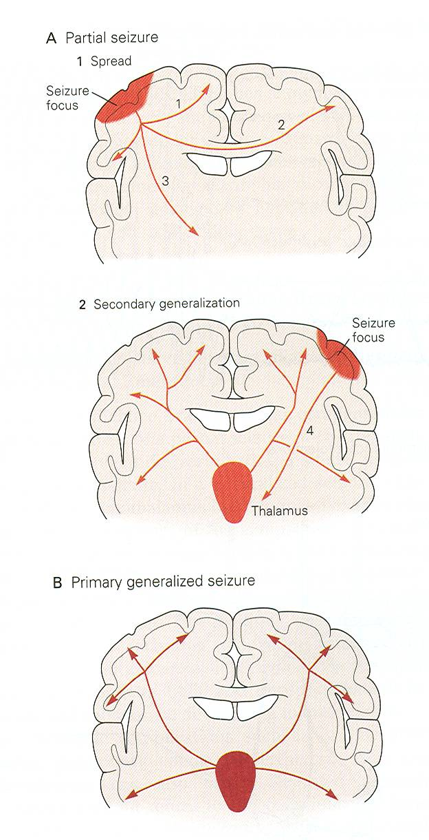

Slide 15
Classification of seizures
Generalized seizures
Focal seizures
Tonic-clonic
Absence (typical; atypical; absence with special features - myoclonic absence, eyelid myoclonus)
Myoclonic (myoclonic; myoclonic atonic; myoclonic tonic)
Clonic
Tonic
Atonic
Simple partial
Motor
Somatosensory
Psychic
Autonomic
Complex partial
With automatisms
Without automatisms
Secondary generalized

Slide 16
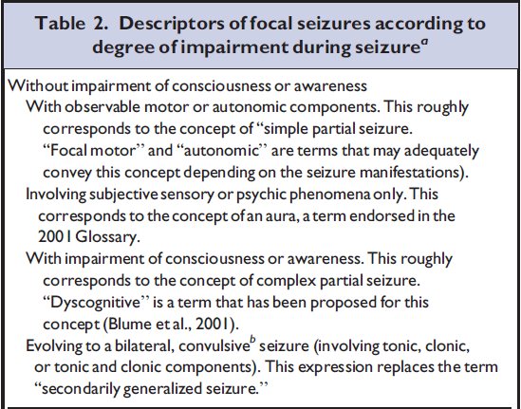
ILAE 2010 Revised terminology

Slide 17
CLASSIFICATION OF EPILEPSIES AND EPILEPTIC SYNDROMES 1989
1. Localization-related (focal/local/partial) epilepsies and syndromes
Idiopathic eg benign childhood epilepsy with centrotemporal spikes, primary reading epilepsy
Symptomatic eg Chronic progressive epilepsia partialis continua (Rasmussen’s) focal seizures, hemiparesis ; TLE, FLE, PLE,OLE*
Cryptogenic

Slide 18
CLASSIFICATION OF EPILEPSIES AND EPILEPTIC SYNDROMES 1989
2. Generalized epilepsies and syndromes
Idiopathic eg benign neonatal convulsions, juvenile absence epilepsy, juvenile myoclonic epilepsy
Cryptogenic or symptomatic eg West syndrome, Lennox Gastaut syndrome.
Symptomatic eg epileptic seizures complicating other disease states.
3. Epilepsies and syndromes undetermined as to whether they are focal or generalized e.g neonatal seizure, acquired epileptic aphasia
4. Special syndromes e.g febrile convulsions, isolated seizures

Slide 19
Aetiology of epilepsy
Genetic
Directly resulting from a known or presumed genetic defect(s) in which seizures are core symptom
Structural / metabolic
Epilepsy due to a distinct disease associated with substantially increased risk of epilepsy
Structural lesions may be inherited (e.g. tuberous sclerosis)or acquired (e.g. stroke, trauma, infection)
Unknown cause

Slide 20
Aetiology
Idiopathic 55-60% (65.5%)*
Vascular 20% (10.9%)
Infections 10-20% ( 2.5%)
Congenital ( 8.0%)
Trauma 4-12% ( 5.5%)
Neoplasm 3-10% ( 4.1%)
Degenerative ( 3.5%)
Others 1-2%
Osuntokun’s series and *Western studies

Slide 21
Aetiology by age-group
< 3 years of age
Perinatal injury
Metabolic defects
Congenital malformations
CNS infections
3-20 years
Genetic predisposition
Infections
Trauma
Congenital malformations
Metabolic defects

Slide 22
Aetiology by age-group
20 – 60 years
Brain tumors
Trauma
Vascular disease
Infections
Elderly (> 60 years)
Cerebrovascular disease
Brain Tumor
Degenerative diseases – AD
Non-ketotic hyperglycaemia
Post-cardiac arrest
Drugs

Slide 23
Epilepsy triggers
Sudden changes from light to dark/dark to light
Hormonal activity (particularly in women)
Changing or stopping anti-convulsant medications abruptly
Flashing lights
Loud noises
Stress
Fever
Lack of sleep
Low sugar levels

Slide 24
Epidemiology
Prevalence: 5.3 – 43 per 1000
Higher in developing countries (4-6X)
Higher in rural communities
37/1000 in Aiyete
5/1000 in Lagos
Higher in infancy and in the elderly
Incidence: 20-70/100,000/year

Slide 25
Epidemiology (Nigeria)
Largely a disease of children and young adults – 85% of patients under 30 years of age
Male preponderance (3:2)
Idiopathic epilepsy commonest
Symptomatic epilepsy common in the elderly
Epilepsy still a stigmatised disease

Slide 26
CLINICAL FEATURES OF EPILEPTIC SEIZURES
A. SIMPLE PARTIAL SEIZURES
♦ No alteration in consciousness
♦ No amnesia
♦ Focal symptoms and signs
♦ Sudden onset and cessation
♦ Due to focal cortical pathology
The focal symptoms / signs reflect the anatomical origin of seizure

Slide 27
Simple partial seizures: focal symptoms and signs
Motor manifestation: Jacksonian march, todd’s paresis
Somatosensory or special sensory: tingling or electric shock feeling; simple or complex visual hallucinations; simple or complex auditory hallucinations , olfactory or gustatory hallucination in form of unpleasant odor or taste.
Autonomic symptoms: epigastric sensation, flushing, sweating, pallor.

Slide 28
Focal symptoms and signs in simple partial seizures
Psychic manifestations
a. dysphasic symptoms: speech arrest
b. dysmnestic symptoms: flashback, déjà vu or jamais vu, panoramic experience
c. cognitive symptoms: dreamy states, sensation of unreality, detachment or depersonalization.
affective symptoms: fear, depression, anger, Elation, serenity, erotic thoughts, sexual arousal or orgasm.
Illusion eg macropsia
Structural hallucinations

Slide 29
COMPLEX PARTIAL SEIZURES
Clinical features
• Psychomotor triad :motor changes, automatism,
psychic changes
Aura (focal symptoms and signs as in simple partial seizures)
• Absence (altered consciousness)
• Automatism eg mimicry ( gelastic, dacrystic)
ambulatory, verbal, oro-alimentary.
• sudden onset and gradual recovery
• Complex partial seizures arise from temporal
lobe (60%), or frontal lobe (30%).

Slide 30
Generalised tonic-clonic seizures
Prodromal period of vague, ill defined feeling and sometimes increasing myoclonic jerking.
An aura preceding the seizure indicates focal onset*
Fall (with injury)
Tonic phase 10 -30 sec
Clonic phase 30 – 50 sec (jerking, amplitude increasing and frequency slowing Cyanosis, apnea, foaming, tongue biting, urinary incontinence, autonomic features
Post-ictal (1 to 10 minutes) confusion and drowsiness, sleep,headache, muscle pain
Sudden onset and gradual recovery

Slide 31
ABSENCE SEIZURES
Typical absence seizures
Sudden onset and cessation
Absence (blank stares)
Consciousness lost (with total amnesia)
Other signs-usually slight: minor tone changes, blinking , eye rolling,
• Duration is less than 10sec in >80%
• Precipitated by drowsiness, relaxation, hyperventilation, photic stimulation
• Typical 3-Hz spike.

Slide 32
ATYPICAL ABSENCE
Onset and cessation often gradual
Seizures may be prolonged
• Absence
• Consciousness may only be partially impaired and there may be partial responsiveness.
• Focal signs more prominent: tone changes, motor spasm, clonic jerking, automatism
Occur among patients with diffuse brain damage usually with mental retardation, other seizure types or neurological deficit .
Usually < 3-Hz spike.

Slide 33
MYOCLONIC SEIZURES
Rapid onset and cessation
• Brief jerk, singly or in series. May be induced by stimulus.
• Intensity varies from slight tremor to massive jerk.
•Distribution varies from single muscle to generalized jerking.
• Consciousness usually not altered
•Associated features depend on the clinical context of the myoclonus
• Occur as part of the syndrome of idiopathic generalized epilepsy or reflection of diffuse cerebral damage, retardation, other seizure types or neurological deficit.

Slide 34
TONIC SEIZURES
Fall with injury
• Can be brief, prolonged with fluctuating motor signs
• Sudden onset and cessation
• Post- ictal phase short
• Usually occurs in patients with diffuse cerebral
damage associated with mental retardation, other
seizure types or neurological handicap

Slide 35
ATONIC SEIZURES
Atonia with fall (astatic or drop attack)
Atonia may be more limited e.g. head nodding
Attack may progress in a stepwise fashion with increasing atonia

Slide 36
Pathogenesis: concepts
Seizure initiation
Seizure propagation
Epileptogenesis
Genetics of epilepsy
Mechanism of action of AEDs

Slide 37
Seizure initiation
The tendency of a neuron to discharge repetitively to a stimulus that normally causes a single action potential.
influx of extracellular calcium (Ca²⁺) causing prolonged membrane depolarization.
leads to opening of voltage-dependent sodium (Na⁺) channels, influx of Na⁺, and generation of repetitive action potentials.
Followed by hyperpolarizing afterpotential (mediated by GABA receptors or potassium (K⁺) channels.
Hyper-synchronization: the property of a population of neurons to discharge together independently.

Slide 38
Seizure propagation
Spread of activity is usually prevented by hyper-polarization and surrounding inhibition (by inhibitory neurons).
However, high level activation (repetitive discharges) leads to recruitment of surrounding neurons via several mechanisms:
Increased extracellular K⁺ (blunts hyperpolarization and depolarizes neighbouring neurons)
Accumulation of Ca²⁺ in presynaptic terminals (resulting in enhanced neurotransmitter release)
Activation of NMDA excitatory amino acid receptors, causing Ca²⁺ influx and neuronal activation
Recruitment of neurons with loss of surrounding inhibition and propagation of seizure activity into contiguous areas via local cortical connections, and distally via long commisural pathways (e.g. corpus callosum)

Slide 39
Mechanisms of action of AED
Mechanisms
Inhibition of Na⁺-dependent action potential (phenytoin, carbamazepine, lamotrigine, topiramate, zonisamide)
Inhibition of voltage-gated Ca²⁺ channels (phenytoin)
Decreased glutamate release (lamotrigine)
Potentiation of GABA receptor function (benzodiazepines and barbiturates)
Increased availability of GABA (valproic acid, gabapentin, tiagabine)
Inhibition of T-type Ca²⁺ channels in thalamic neurons (ethosuximide and valproic acid)

Slide 40
MANAGEMENT OF EPILEPSY
Differential diagnosis of epileptic seizures
Diagnosis
Clinical evaluation
investigations
Treatment
Pharmacological
Non-pharmacological
Surgical

Slide 41
DIFFERENTIAL DIAGNOSIS
Syncope (cardiac (e.g. arrhythmias; non-cardiac (e.g. vasovagal, orthostatism)
Sleep disorders (narcolepsy, OSA, parasomnias)
Transient ischaemic attacks
Dizziness/vertigo
Paroxysmal (intermittent) movement disorders
Metabolic (hypoglycaemia, alcohol) / delirium
Psychiatric disorders: panic/anxiety, conversion/psychogenic seizures, dissociative states, malingering, hyperventilation, etc).

Slide 42
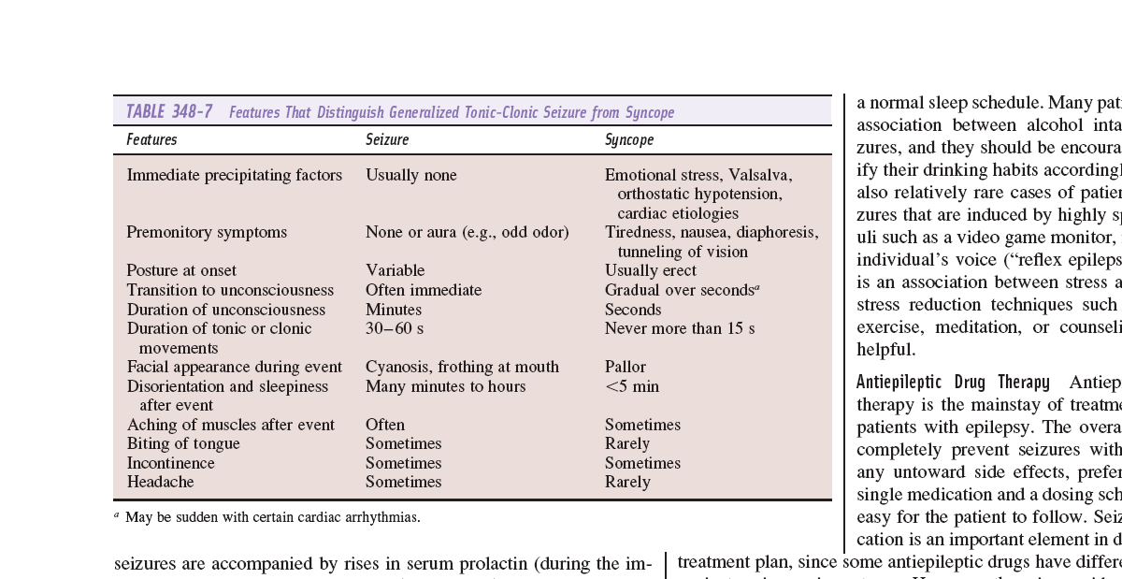

Slide 43
DIAGNOSTIC EVALUATION
History
Careful and detailed
Eye-witness account valuable
Exclude differentials
Risk factor evaluation
Seizure type: partial or generalized; type of generalized or partial seizure
Aura
Loss of consciousness or impairment
Sequence of events

Slide 44
DIAGNOSTIC EVALUATION
Electroencephalography
To identify electrical (potential) abnormalities
Ictal (during seizure) and interictal
Interictal EEG-May be normal (50%). 24 hour EEG, video EEG telemetry.
Neuroimaging
To identify structural lesions
MRI is superior to brain CT in seizure evaluation
Normal in idiopathic epilepsy
Abnormality is common in partial epilepsies e.g. TLE (hippocampal sclerosis)
Blood tests
Baseline biochemical and haematologic parameters

Slide 45
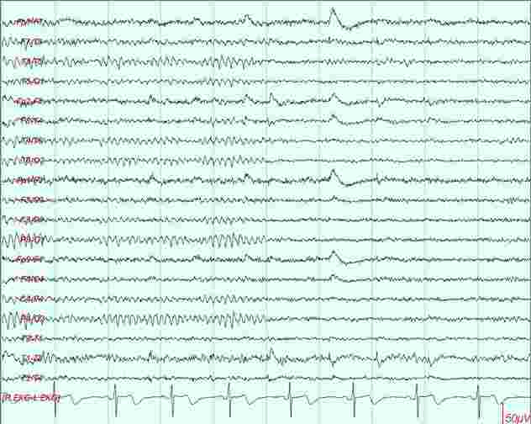
EEG– Normal

Slide 46
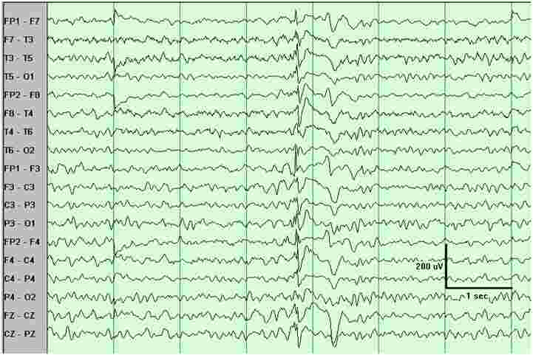
EEG – Generalized spike and SW

Slide 47
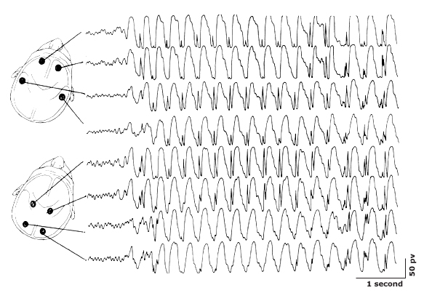
EEG – Absence seizures

Slide 48
TREATMENT
Early diagnosis and treatment
improves long-term quality of life
Reduces morbidity and mortality
Early referral
Decision to treat
Patient and physician interaction in decision making
Explain pros and cons of treatment
Offer treatment for epilepsy
Single seizures: consider risk of recurrence (abnormal neurological exam, abnormal imaging, abnormal EEG)

Slide 49
Principles of treatment
Monotherapy of appropriate drug
Increase dose gradually, adjusting with response
Monitor for side effects; check compliance
Watch out for interaction with other drugs
If response poor, introduce another drug while gradually withdrawing the first
Use poly-therapy as last resort

Slide 50
TREATMENT
Choice of AED should be rational
Monotherapy to maximal tolerable dose
Alternative monotherapy
Polytherapy (rational)
Use medications that are accessible to the patient on the long-term

Slide 51
TREATMENT
Important considerations
Treatment options
Pharmacological (first-line before second line)
Surgical (refractory seizures: resection, hemispherectomy, vagus nerve stimulation)
Women of child-bearing age: folic acid 5mg daily
Comorbidities: mood disorders, medical illness
Treatment duration: 2 years initially (relapse 11-14%)
Psychosocial and cultural issues: driving, marriage, employment, belief systems.

Slide 52
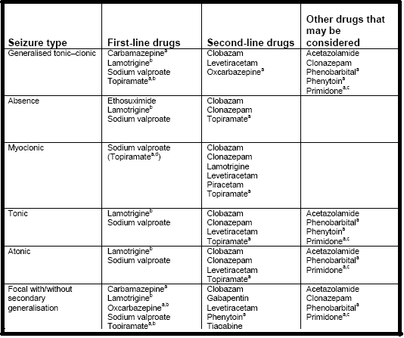
Drug options for seizure treatment (NICE)

Slide 53
OTHER TREATMENTS
SURGERY
- Temporal lobectomy
- Frontal lobectomy
- Lesionectomy
- Corpus callosotomy, hemispherectomy
VAGUS NERVE STIMULATION
KETOGENIC DIET

