Slide 1
HAND INJURIES
DR SALAWU A.I (FWACS )

Slide 2
outline
Introduction
Relevant anatomy
Common hand injuries
Principles of management of hand injury
Hand rehabilitation
Conclusion

Slide 3
Introduction
Hand injuries account for about 5 -10% of emergencies at the A/E
This is because the hand is a highly mobile structure of the body

Slide 4
Relevant anatomy
The hand comprise the anatomical region from the wrist to the finger tips
It is composed of multiple anatomic structures packed within a relatively tight space
1 ) covering structure – the skin is highly specialized with numerous sensory nerve ending
2) supporting structures – the bones consist of distal radius / ulna , 8 carpal bones , 5 metacarpal, 14 phalanges
3) feeding structures – radial &ulna arteries form the superficial and deep palmer arches

Slide 5
Relevant anatomy
4 ) restraining structures – palmer aponeurosis , fibrous flexor sheaths with pulleys
5 ) controlling structures – median nerve , ulna nerve ,radial nerve
6 ) moving structures – extrinsic and intrinsic musculotendinous units

Slide 6
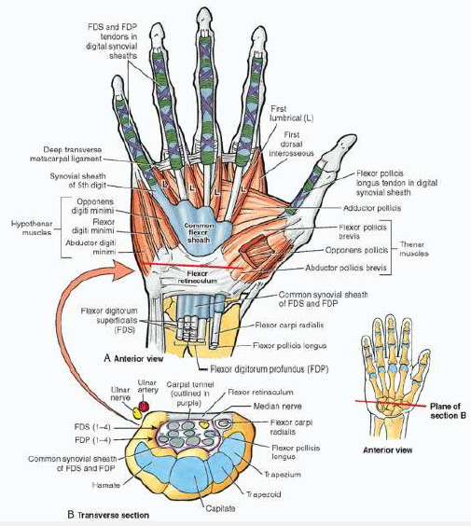
Tendons of the hand

Slide 7
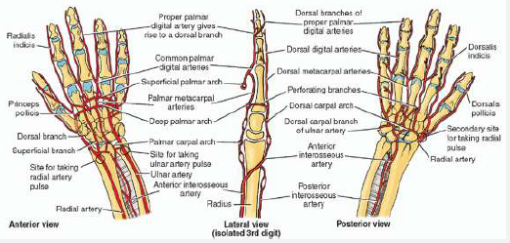
Blood supply of the hand

Slide 8
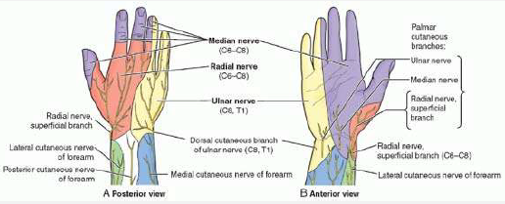
Distribution of the nerve supply to the hand

Slide 9
Common hand injuries
1) covering Skin:
Mechanism could be from avulsion /degloving , laceration , crush injuries , burns
Specific treatment entails debridement , prompt wound cover by primary or delayed primary wound closure , skin grafts or flaps cover to protect underlying structures

Slide 10
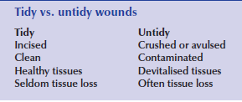
RANK AND WAKEFIELD CLASSIFICATION of WOUNDS

Slide 11
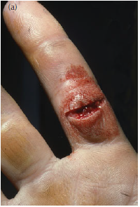
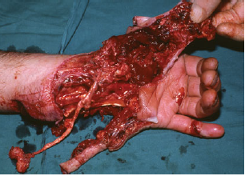
RANK AND WAKEFIELD CLASSIFICATION OF WOUNDS
TIDY HAND INJURY
UNTIDY HAND INJURY

Slide 12
Common hand injuries
2 ) supporting skeleton :
A Fracture is the break in the continuity of a bone
Fractures in the hand may coexist with other injuries or occur independently
It may be open or closed fractures
specific fractures worthy of note includes Scaphoid fracture , Bennet , Rolando , Boxer fracture
Specific treatment ranges from Buddy splinting , plaster of paris cast , to open reduction and internal fixation with implants

Slide 13
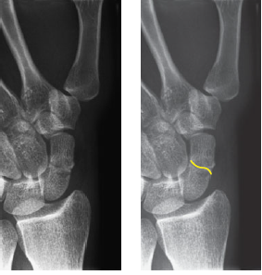
Plain radiograph showing a scaphoid fracture

Slide 14
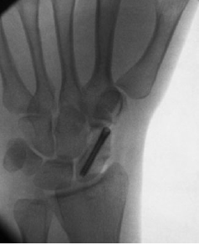
Fixation of the scaphoid fracture by internal fixation

Slide 15
Common hand injuries
3) controlling structures (nerves )
Nerve injuries are associated with loss of motor , sensory and autonomic functions
The degree of disability depends on the severity of the injury
Seddon Classification of nerve injury is based on severity of injury
NEUROPRAXIA – implies physiologic block of impulse without anatomic disruption of nerve fibre sheath recovery is usually within 6weeks
AXONETMESIS – axons are completely divided but neural tubes are intact

Slide 16
Common hand injuries
NEUROTMESIS – complete transection of the nerve fiber , it is the most severe form of injury
Injury is usually caused by a sharp object or violent traction force
recovery is only possible after end to end suturing of the transected nerve ends
TINEL SIGN – is used to evaluate recovery from nerve injury tingling sensation is felt by patient at the distal of the regenerating nerve

Slide 17
Common hand injuries
4 ) moving structures – the musculotendinous strutures are usually injured at the wrist , palm and dorsum of the hand by sharp objects
They present with loss of ability to move the joints of the hand
They classical are the flexor tendon and extensor tendon injuries
Injuries may coexist with other injuries
Treatment entails wound exploration and accurate repair followed by supervised hand therapy

Slide 18
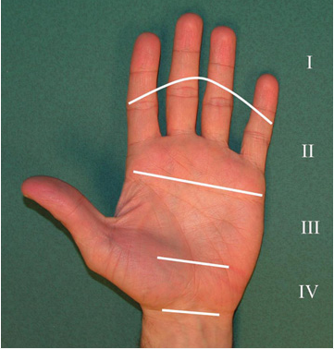
VERDAN ZONES OF FLEXOR TENDON INJURIES

Slide 19
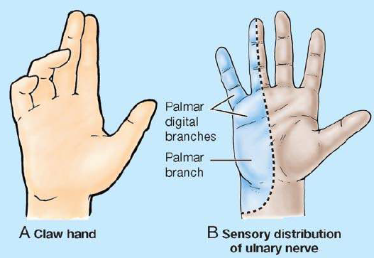
SIGNS ULNAR NERVE INJURY

Slide 20
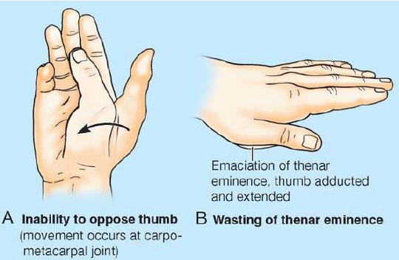
SIGNS OF MEDIAN NERVE INJURY

Slide 21
Common hand injuries
5) Arterial / vascular injuries-
They usually result from laceration from sharp objects other mechanism could be from thermal or chemical injuries
In the wrist they usually coexist with nerve injuries
Treatment entails rapid repair of the injured vessel by end to end anastomosis or vein grafts
Repair requires use of loupes or operating microscopes
ALLENS TEST

Slide 22
Principles of management of hand injuries
Patients presenting with hand injuries may present to the accident and emergency or they may present to the clinic , days after the injury
If patient presents in an emergent situation don’t forget the ATLS PROTOCOL , PRIMARY SURVEY (A,B,C,D,E of resuscitation )
This is to avoid missing life threatening injuries that may be coexisting as these should take priority

Slide 23
Principles of management of hand injuries
History of the dorminant hand used is important
Occupation of patient and hobby is important
The mechanism of injury should be enquired about
A detailed and systematic physical examination of the injured hand should be done
Common things to look out for includes deformities , inability to flex or extend tendons actively
Loss of sensation in the autonomous zones of the nerves
Capillary refill at the finger tips , radial and ulna artery pulsations

Slide 24
Principles of management of hand injuries
Document all the findings of examination thoroughly
Classify injury using Rank and Wakefield classification ( Tidy , Untidy and Indeterminate injuries )
Administer adequate analgesia usually via intravenous route in the acute phase
Administer tetanus prophylaxis as necessary
Cleanse and dress large wound in the A/E
Splint hand in position of Immobilization with P.O.P

Slide 25
Principles of management of hand injuries
Elevate the hand with drip stand to reduce swelling and pain
For untidy wounds , exploration and debridement will be necessary in the theatre
Choice of anaesthesia can be local , digital block , wrist block , Biers block , axillary , supraclavicular block or general anaesthesia
Prophylactic antibiotics with B- lactamase penicillin,

Slide 26
Principles of management of hand injuries
Investigations :
Should be tailored to the need of the patient
Base line hemoglobin concentration
Plain radiographs of the hand eg AP ,Lateral , oblique views
CT SCAN , MRI occassionally useful
Nerve conduction studies in nerve injuries

Slide 27
Principles of management of hand injuries
Intraoperatively
Good lightening should be available
Fine instruments should be utilized
Use tourniquet to achieve a bloodless field
Surgeon and assistant should be sitted
Loupe or microscope is essential in many situations
Padded dressings with splintage and elevation post operatively

Slide 28
Hand therapy
This is key
The overall aim of hand surgery is to restore function in the best possible way
Stiffness is the enemy of restoration of function
The Hand therapist or physiotherapy should institute regimens that are most suitable for the patient
To prevent stiffness and loss of function while maintaining the repair

Slide 29
conclusion
Hand injuries remain a common condition encountered in the accident and emergency units
Proper management of these conditions requires thorough understanding of the clinical anatomy of the hand
As well as early appropriate and timely intervention by skillful personnel

Slide 30
REFERENCES
SHORT PRACTICE OF SURGERY ; BAILEY & LOVE
KEITH MOORE CLINICAL ANATOMY ATLAS
SABISTON TEXT BOOK OF SURGERY

