Slide 1
Introduction to Plastic Surgery and Congenital Hand anomalies
Dr. O.F Babalola FMCS, FWACS, FAOCMF

Slide 2
Plastic surgery: subspecialty of Surgery responsible for repair of defects, correction of deformities and replacement of lost or missing body parts – Reconstruction
Recently added part: To surpass the normal body appearance - Aesthetic

Slide 3
Divisions of Plastic surgery
General Plastic Surgery
Burn Surgery
Hand Surgery
Craniofacial Surgery
Microvascular Surgery
Aesthetic Surgery

Slide 4
Congenital Hand Anomalies
Hand as an important cosmetic unit
Mixture of emotions attend hand anomalies; guilt, anger, disbelief, anxiety
Attitudes vary
Differing levels of disability occurs
Pertinent interest is functional independence
Expectations must be realistic

Slide 5
Incidence is 1 : 600 live births
Commonest is syndactyly
Next is polydactyly

Slide 6
embryology
Limb buds : 4th week of IUL, ventrolateral surface, opp. 8th -12th myotomes
Upper limb buds develop marginally in advance of lower limb buds
Musculature in the limb found in the 7th wk as a condensation of mesenchyme
As limb buds elongate, muscular tissue develops into central and dorsal components

Slide 7
Spinal nerves penetrate the base of the limb buds
Early contact of spinal nerves with differentiating muscle necessary for complete development
Differentiation occurs in proximodistal sequence from 4th week
End of fourth week – digital swellings

Slide 8
5th wk – hand plate with prominent digital swellings, clearly demarcated
End of 7th week- arm, forearm, hand have attained recognisable adult form
At birth, all structures fully differentiated except for nervous development.

Slide 9
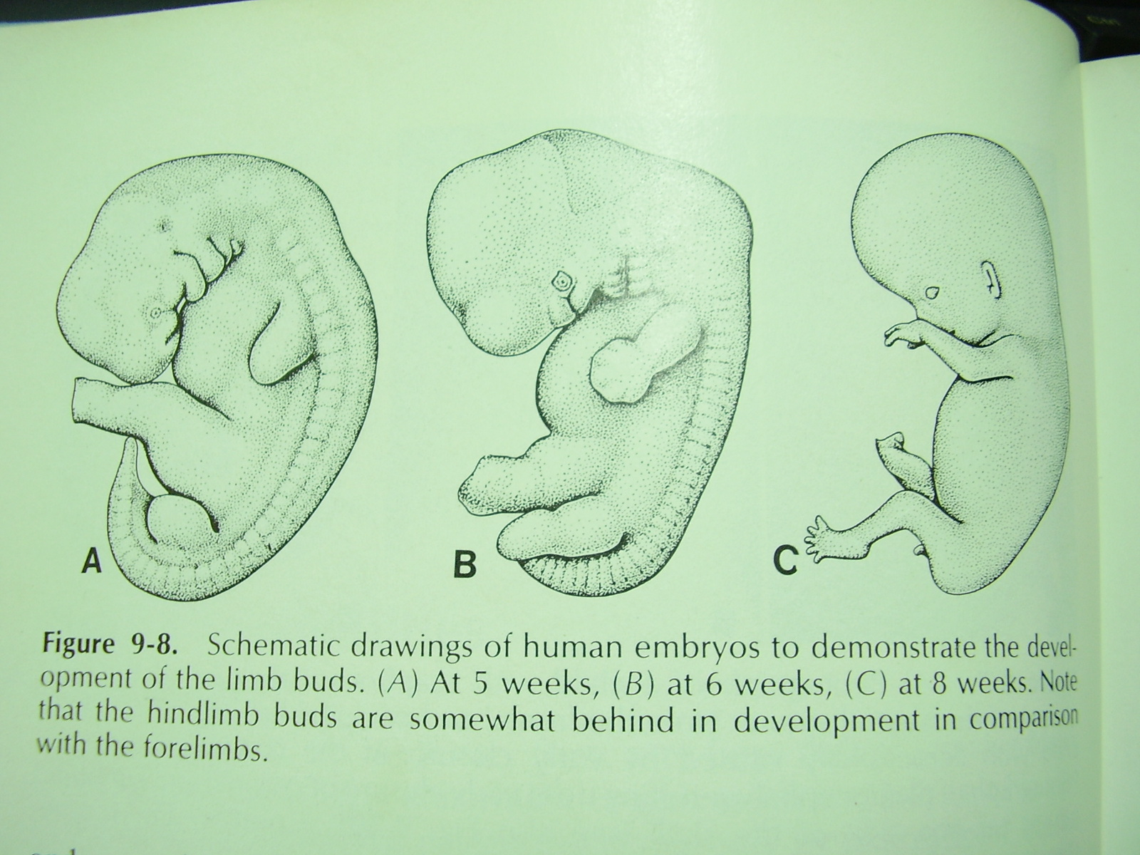

Slide 10
Aetiology
Genetic; Mendelian inheritance in syndactyly, polydactyly
Chromosomal; sex linked e.g Orofaciodigital syndrome type 1 ; Turner’s syndrome
Autosomal; Down’s syndrome
Enviromental -:
- Anoxia, irradiation, drugs, Hormones, Viral infections (TORCHES), Pressure.

Slide 11
Classification
Swansons Classification commonly used:
Failure of formation of parts
. Transverse defects:
amelia,
phocomelia
. Longitudinal defects:
Radial club hand, Ulna Club hand, cleft hand

Slide 12
Group 2
Failure of differentiation of parts
Syndactyly,
symphalangism,
radioulnar synostosis,
camptodactyly,
clinodactyly
congenital clasped thumb
congenital trigger thumb

Slide 13
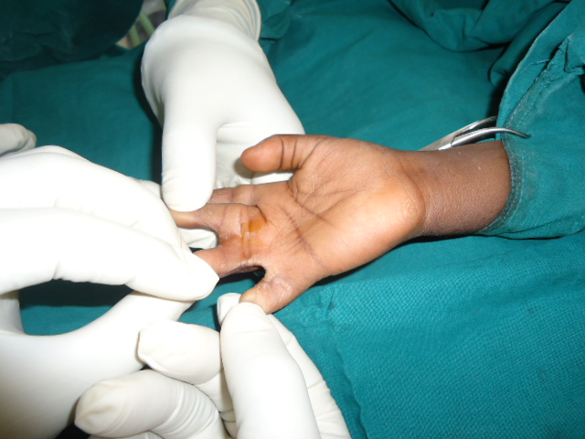
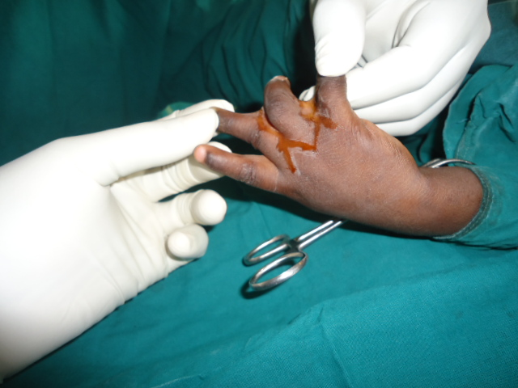

Slide 14
Group 3
Duplication
Polydactyly
Preaxial : Thumb polydactyly
Postaxial : Little finger polydactyly
Most common in American Negros (postaxial)
High as 1 : 300
Preaxial common in European
Association with numerous congenital
malformations

Slide 15
Three degrees:
Type 1: an extra soft tissue mass not attached to the skeleton
Type 2: an extra digit, or part thereof containing normal components articulating with a metacarpal or phalanx
Type 3: an extra digit with normal components articulating with extra metacarpal

Slide 16
Group 4
Overgrowth or Gigantism
-congenital localised pathological enlargement of skeletal and soft tissue. Rare , no association
Frequently unilateral, index finger commonest
Two clinical types:
Static

Slide 17
Group 5
Under growth or Hypoplasia
-Affects thumb commonly
-Short metacarpals seen in Turner’s syndrome
-Short phalanges (brachydactyly) affect borer digits commonly
Short functional digits should be preserved

Slide 18
Group 6
Congenital Constriction Band Syndrome
-1 in 15,000 live briths
Grooves running around the fingers perpendicular to the long axis
Distal portion may be hypoplastic, swollen or autoamputated
Other malformations e.g cleft lip, club feet, may be present

Slide 19
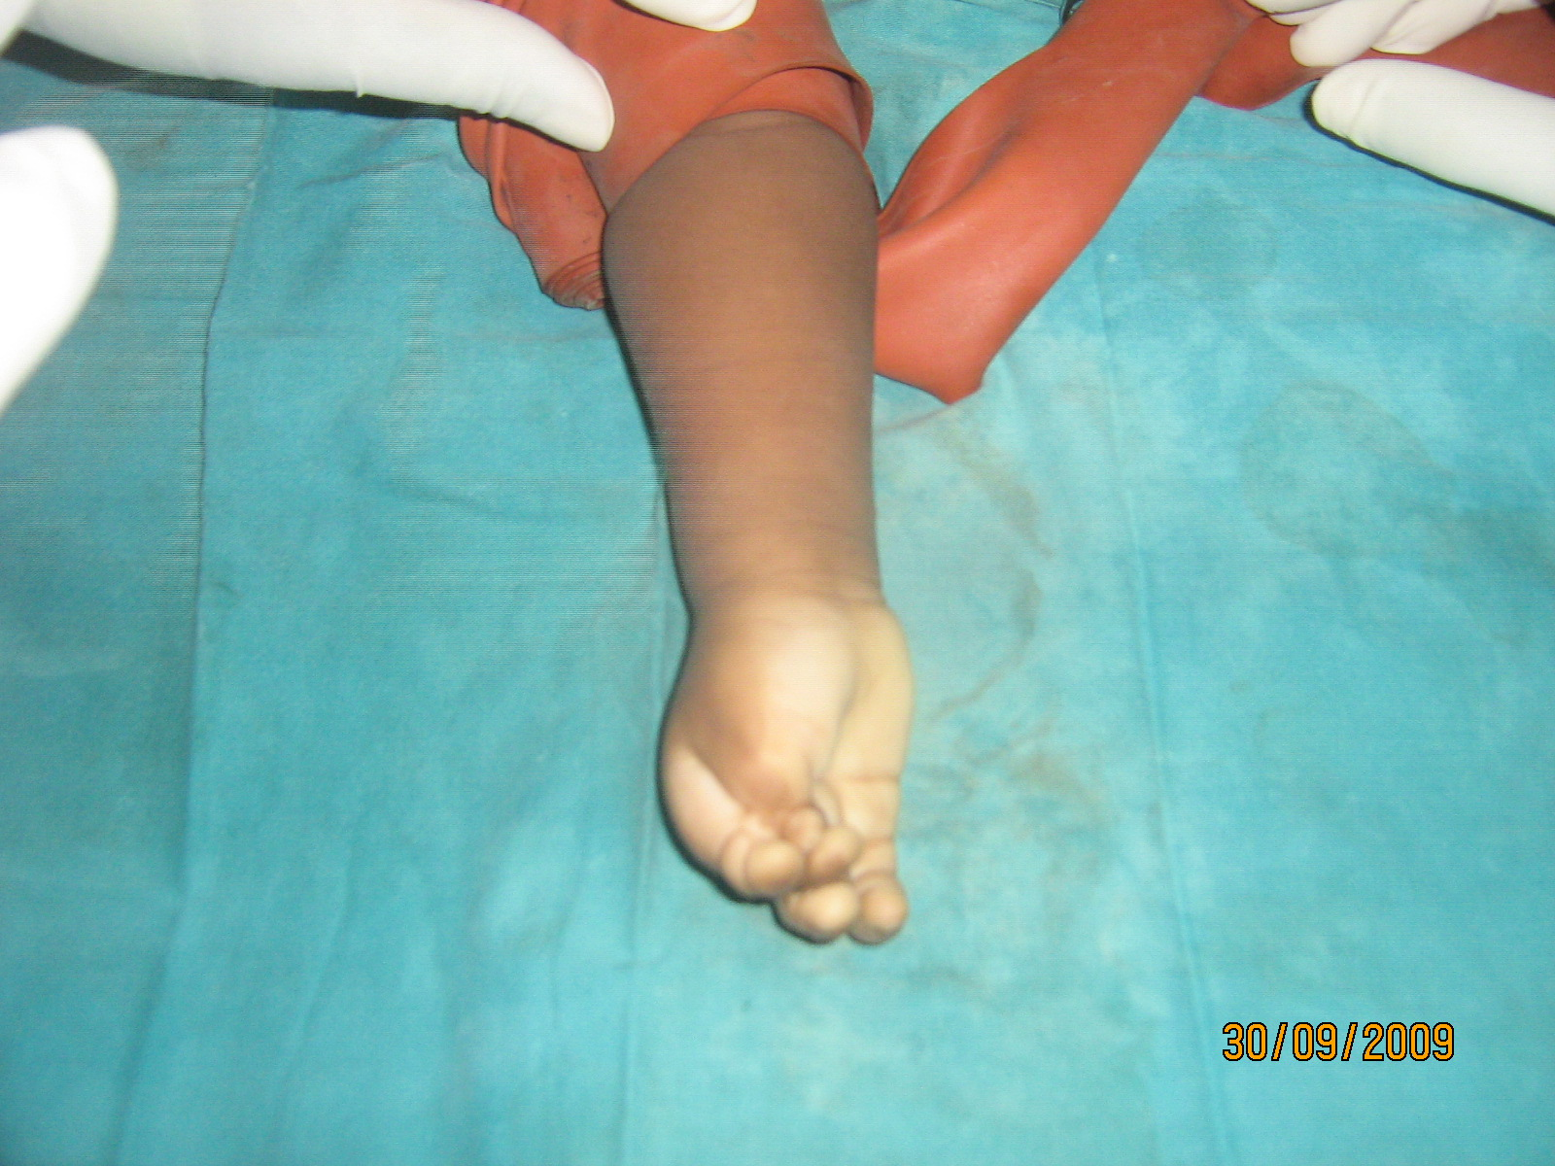

Slide 20
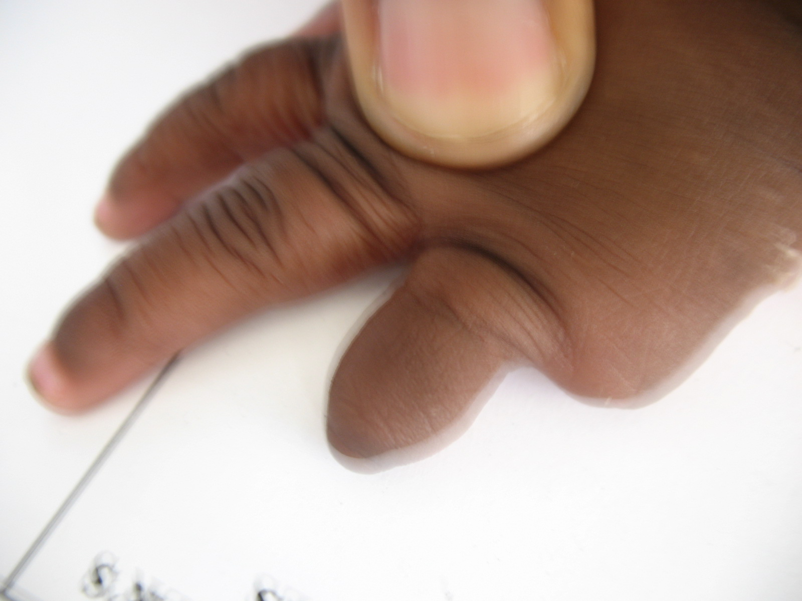

Slide 21
Group 7
Generalised skeletal anomalies e.g
-Arthrogryposis Multiplex Congenita
Involves anomalies of multiple joints, bones and muscles
-Madelung deformity

Slide 22
Summary
Plastic surgery involves Reconstruction & Aesthetics
Hand growth and anomalies start from 4th wk IUL
Syndactyly commonest worldwide, polydactyly among Negroes
Swanson’s classification widely used

Slide 23
Thank you for your attention

