Slide 1
MYASTHENIA GRAVIS
Dr Paul Olowoyo
MBBS(Ib), FWACP (Neurol.)

Slide 2
INTRODUCTION
Myasthenia gravis (MG) is an autoimmune neuromuscular disorder characterized by reduced skeletal muscle strength with repeated use and recovery following a period of rest.
The underlying defect is an antibody-mediated reduction in the number in Acetylcholinic postsynaptic receptors at the neuromuscular junction.
Treatment now available is highly effective
Specific cure has remained elusive.

Slide 3
PATHOPHYSIOLOGY
Autoantibodies develop against ACh nicotinic postsynaptic receptors.
Reduction of AChRs numbers by 3 mechanisms:
accelerated (2-3fold) turnover of AChRs
mechanical blockade
postsynaptic membrane damage
Symptoms when number ≈30% of normal
Pathogenic antibodies - T cell dependent IgG
Initiation & maintenance of autoimmune response not understood.

Slide 4
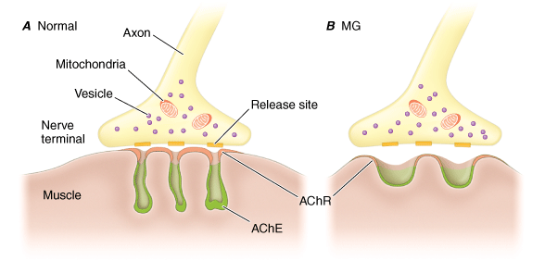
PATHOPHYSIOLOGY

Slide 5
PATHOLOGY
Antibodies to the acetylcholine receptor (AChR)
These bind to receptor and impair function
ACh is key transmitter for neuromuscular transmission
Blocking of receptor causes flaccid weakness

Slide 6
PATHOPHYSIOLOGY
The thymus appears to play a role
Abnormal in 75% of patients.
Hyperplasia in 65%, thymomas in 10-15%.
Clinical improvement following thymectomy.
The cholinergic receptors of smooth and cardiac muscles have a different antigenicity so, not affected.

Slide 7
EXACERBATING FACTORS
Antimicrobials:
Macrolides
Ampicillin
Tetracycline
Fluoroquinolones
Aminoglycosides
CQ.
Antidysrhythmics:
BBs, CCBs
Quinidine
Lidocaine
Procainamide & trimethaphan
Misc.:
Diphenylhydantoin
Lithium, CPZ
Muscle relaxants
Levothyroxine
Anticholinergics
ACTH
Corticosteroids

Slide 8
EPIDEMIOLOGY
Incidence:
US - 2/1,000,000 /year. Ibadan – 0.07/1000/ year
Prevalence: 0.5-14.2 cases per 100,000.
Sex:
M:F (<40years) = 2-3:1, (>40) = 3:2
Ibadan: 1:2
Age:
10% <10yrs
Peak: F= 20-30yrs, M= 50-60yrs
Race: Early onset commonner in Asians.
Thymoma: 50-60yrs, M>F

Slide 9
CLINICAL FEATURES
Hallmark: progressive weakness with repetitive or persistent activity & improvement with rest.
Onset: insidious, infrequently rapid.
Presentation and progression vary.
Ocular -> facial -> bulbar -> truncal
-> limb muscles.
Diaphragm, abdominal & intercostal muscles & external sphincters are involved in advanced cases.

Slide 10
CLINICAL FEATURES
Ocular palsies and ptosis - initial manifestation in ~50%, later in >90%.
Remains ocular in 16%. About 87% generalize within 13 months.
Proximal muscles are far more vulnerable.
Usually symmetric, but not often.
Sensory functions & reflexes are unaffected.
Little or no wasting.
Demonstrable evidence of coexisting autoimmune disorders

Slide 11
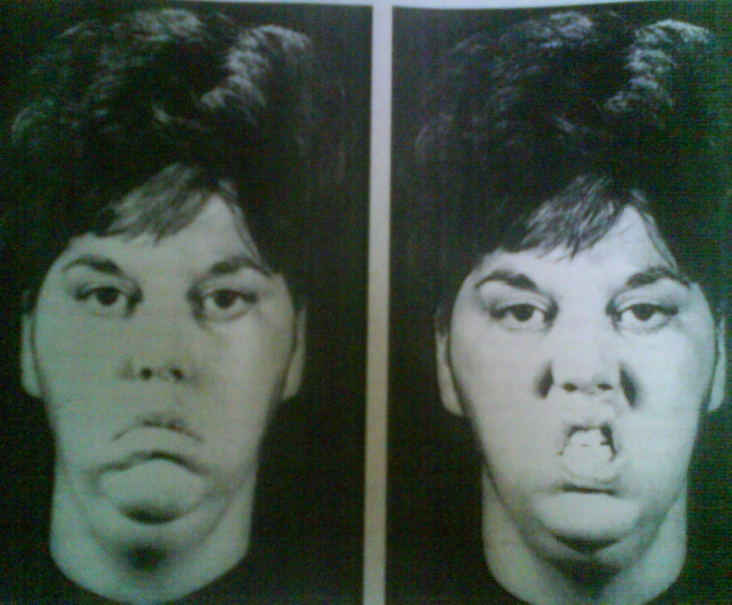
CHARACTERISTIC FACIAL APPEARANCE
At rest, bilateral ptosis, downward curve of corners of mouth, giving patient a sad appearance.
Smiling: myasthenic snarl – resulting from upward movement of medial portion of upper lip & horizontal contraction of corners of mouth.

Slide 12
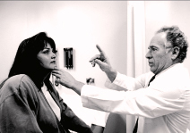


CLINICAL FEATURES

Slide 13
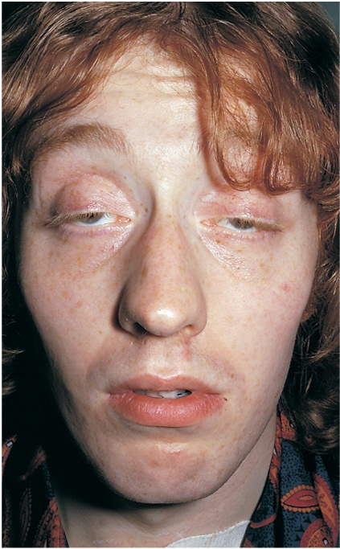
CLINICAL FEATURES
Weakness demonstrated by sustained activity, blinking, upward gaze

Slide 14
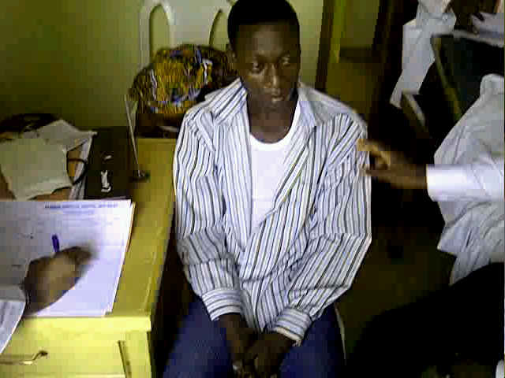
CLINICAL FEATURES

Slide 15
CLINICAL FEATURES
Demonstrable evidence of coexisting autoimmune disorders:
Hyperthyroidism (10-15%)
RA, scleroderma, and lupus.
Spontaneous remissions are rare.
Most improve with treatment, in the first 3 years.

Slide 16
OSSERMAN CLASSIFICATION
Class | Description | Relative incidence | AntiChErase response
R | Remission
I | Ocular only | 15-20%
IIa | Mild generalized | 30% | responsive
IIb | Moderate generalized | 25% | < satisfactory
III | Acute severe | 15% | poor response
IV | Chronic severe | 10%

Slide 17
DIFFERENTIAL DIAGNOSES
Lambert- Eaton Myasthenic Syndrome (LEMS)
Oculopharyngeal muscular dystrophy
Oculomotor nerve palsy
Horner’s syndrome
Brainstem stroke
Botulism
Diphtheria
Progressive external ophthalmoplegia
Thyroid disease

Slide 18
MYASTHENIA GRAVIS Vs LEMS
FEATURES | MYASTHENIA GRAVIS | LEMS
MALE : FEMALE | 2: 3 | 1:1
SITE OF LESION | POST SYNAPTIC | PRESYNAPTIC
ASSOCIATED TUMOR | THYMIC | OAT CELL CARCINOMA OF THE LUNG
MUSCLE POWER AFTER EXERTION | WORSENS | MAY IMPROVE AFTER FIRST FEW CONTRACTIONS OF MUSCLE
DEEP TENDON REFLEXES | PRESERVED | DIMINISHED OR ABSENT
REPETITIVE NERVE STIMULATION | DECREMENTAL | INCREMENTAL
AUTONOMIC CHANGES | NO CHANGES | PRESENT

Slide 19
INVESTIGATIONS
Tensilon (Edrophonium) test
0.1ml of 10mg/ml, if no response within 1minute, 0.9ml.
IV Atropine to hand
+ve in ALS, polio, & some peripheral neuropathies.
Ice pack test:
+ve test = clear resolution of ptosis in 2minutes.
+ve in ~80%.
Repetitive nerve stimulation (RNS)
Single-fiber electromyography (SFEMG)

Slide 20
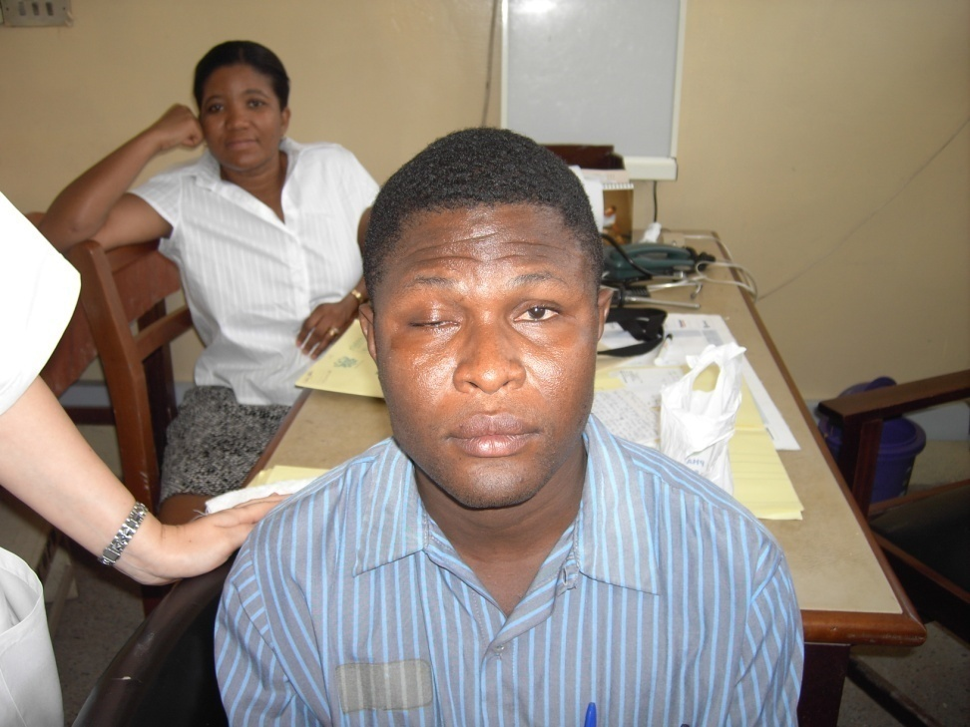
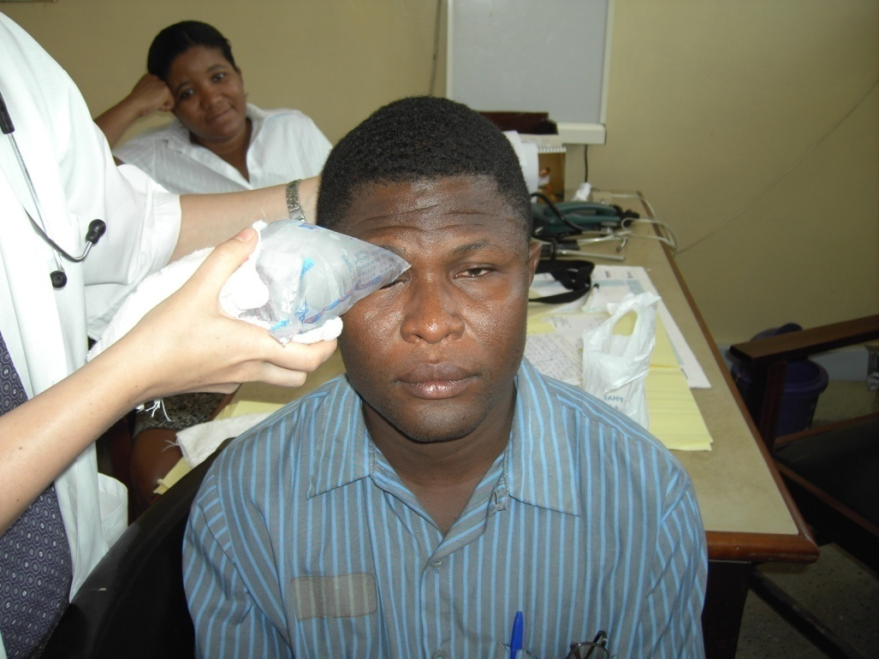
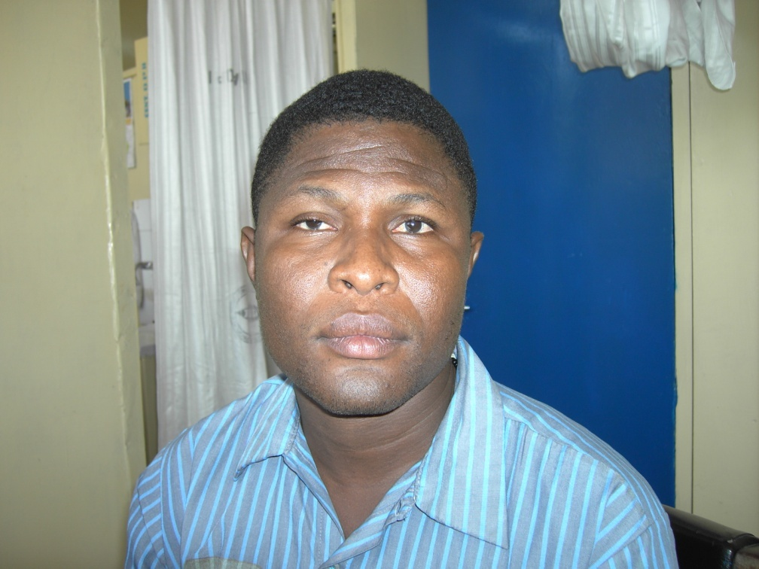

Slide 21
ANTIBODIES TO AChR , MUSK :
Anti-AChR Radioimmunoassay :
85 % positive in generalized MG
50 % positive in ocular MG
Presence of Anti-AChR antibodies is virtually diagnostic
But negative result does not rule out MG
Antibodies to MuSK – present in 40 % of AChR antibody negative patients with generalized MG.

Slide 22
INVESTIGATIONS
Anti Titin antibodies
Anti Ryanodine receptor antibodies
Anti-striated muscle (anti-SM) Ab
Chest x-ray
Chest CT scan
Thyroid function tests

Slide 23
TREATMENT
Approach is determined by severity, distribution, & rapidity progression.
AChE inhibitors & immunomodulating therapies are the mainstays of treatment.
Mild disease – AChE inhibitors initially.
Generalized – AChE inhibitors + immunomodulating therapy.

Slide 24
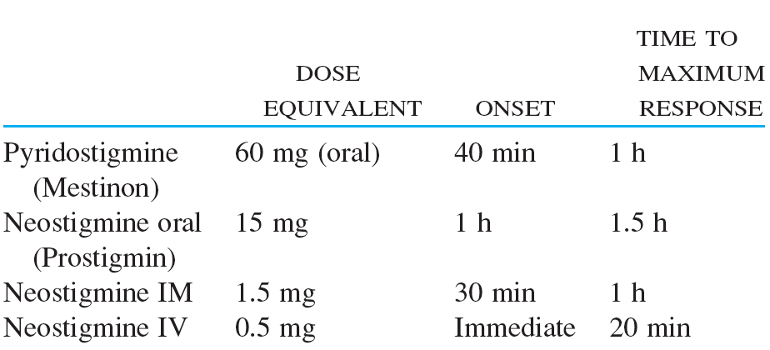
AChE INHIBITORS

Slide 25
TREATMENT
Corticosteroids (Prednisone)
Significant improvement/ remission with decreased Ab titer, in 1-4 mo.
No consensus on dosing schedule.
Weakness may worsen in the 1st 3 wks.
Trial of withdrawal may be attempted, most relapse.

Slide 26
TREATMENT
Azathioprine
Reserved for steroid failure or for its steroid-sparing effects.
Onset of action - 6-12 mo.
1 to 2-3mg/kg/d PO.
Side effects:, leukopenia, thrombocytopenia, macrocytic anemia; hypersensitivity, hepatotoxicity, risk of infections & neoplasia.

Slide 27
TREATMENT
High-dose IV immunoglobulin
Rapid onset of action, short duration of effects.
Best used in crisis management
2 g/kg slow IV infusion over 3-5 d.
SE: Allergy, renal insufficiency, aseptic meningitis, flu-like syndrome.
Plasma exchange (PE):
Removes circulating humoral factors
Improvement within days, lasts 6-8 weeks
An adjunct to immunomodulatory therapies and for crisis management.

Slide 28
TREATMENT
Thymectomy
Proposed as first-line therapy in most generalized MG.
Indications: Thymoma, Age 10-55 years with generalized MG.
May induce remission: young patients with a short duration of disease, hyperplastic thymus, & high antibody titer.
Remission rate increases with time: 40-60%, 7-10 years after surgery.

Slide 29
COMPLICATIONS
Aspiration pneumonia
Respiratory failure
Myasthenic crisis
Cholinergic crisis
Complications of long term immune suppression

Slide 30
MYASTHENIC CRISIS
Rapid and severe deterioration of myasthenia.
Severe generalized muscle weakness involving bulbar & respiratory muscles.
Respiratory infections, use of contraindicated drugs are common precipitating factors.
Management: ICU
Intubation & mechanical ventilation
Plasma exchange or IV immunoglobulin
Treat infection
Mortality: 13%

Slide 31
CHOLINERGIC CRISIS
Results from an excess of cholinesterase inhibitors
Clinically indistinguishable from weakness due to MG
CF: Miosis and the SLUDGE syndrome
Salivation, lacrimation, urinary incontinence, diarrhea, GI upset and hypermotility, emesis.
Bronchospasm, bronchorrhea, respiratory failure, & diaphoresis.
Tensilon worsens weakness
Treatment: Anticholinergic & Beta-agonist bronchodilators

Slide 32
Cholinergic crisis
One of the confusing factors in treating patients with MG is that insufficient medication (ie, myasthenic crisis) and excessive medication (ie, cholinergic crisis) can present in similar ways.

Slide 33
THANK YOU

