Slide 1
Skin grafts and introduction to flaps
DR SALAWU A.I (FWACS )

Slide 2
Outline
Introduction
Definition of skin graft
Classification of skin grafts
Mechanism of graft take
Causes of graft failure
Indications for skin grafts
Definition of a flap
Classification of flaps
Indications for flap
Causes of flap failure
conclusion

Slide 3
Introduction
The overall aim of plastic surgery is to restore form and function to damaged tissues
The plastic surgeon uses the reconstructive tool box or ladder to achieve this
Amongst which are skin grafts and tissue flap options
Hence a basic knowledge of skin grafts and flap is important to all practicing physicians

Slide 4
Skin grafts
A skin graft is a piece of skin which has been completely detached from its original location (donor site ) hence its blood supply and transplanted to another location (recipient site ) of the body devoid of skin cover.

Slide 5
Classification of skin graft
A. based on thickness
Split thickness skin graft
Full thickness skin graft
Composite graft
B. based on the donor tissue origin
Autograft – from the same individual
Allograft – from the same species but genetically non identical
Isograft – from identical twins
xenograft – from another species
C. based on the configuration
Sheet graft
Meshed graft

Slide 6
Split skin graft
The graft is composed of the whole epidermis and part of the dermis
Donor site includes most skin surfaces commonest donor site is the thigh
Suitable for large granulating wound
Healing of donor site is by re epithelization takes average of 2weeks
Harvesting requires use of humby knife or dermatone
It undergoes more secondary contracture
It can be meshed to increase surface area and survival

Slide 7
Full thickness skin graft
It is composed of the whole epidermis and dermis
Donor site are limited ie groin , pre / post auricular area , supraclavicular fossa
Used in the grafting of head and neck region and hand resurfacing
Harvesting is with the use of surgical knife
Donor wound is closed immediately
It undergoes more primary contracture
Gives better cosmetic appearance

Slide 8
Mechanism of skin graft take
Graft take implies all the processes that results in a graft attaching and surviving on its new recipient site
Adherence phase- here the graft attaches to the wound bed immediately by fibrin
Serum or plasmatic imbibition – (2-4 days )the graft imbibes serum from the wound bed and swells thought to provide nutrients to graft initially
Inosculation & revascularization – ( from 4days ) process by which blood supply is reestablished between the graft and wound bed
Remodeling – the graft returns to the normal skin architecture

Slide 9
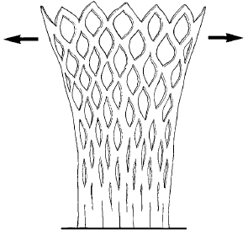
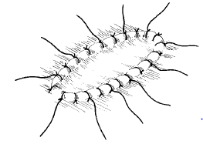
MESHED VS SHEET GRAFT
Expansion of meshed skin
Application of a sheet graft

Slide 10
Causes of graft loss
Hematoma –commonest cause of graft loss
Infection – organism count > 10^5/ml or group A beta hemolytic strept infection
Seroma
Shear force
Inappropriate bed – bone without periosteum , tendon without paratenon , nerve without epineurium
Technical factors – allowing graft to dessicate , reverse placement of skin graft

Slide 11
Indications for skin grafts
Traumatic wounds
Burn injuries
Coverage of extirpative wound ( post tumour resection )
For resurfacing post contracture release
Used with flaps for complex reconstructions
For resurfacing post congenital defect release (syndactyl )

Slide 12
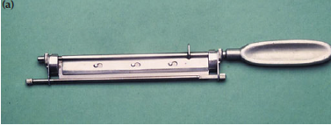
AN HUMBY KNIFE FOR HARVESTING SPLIT SKIN GRAFT

Slide 13
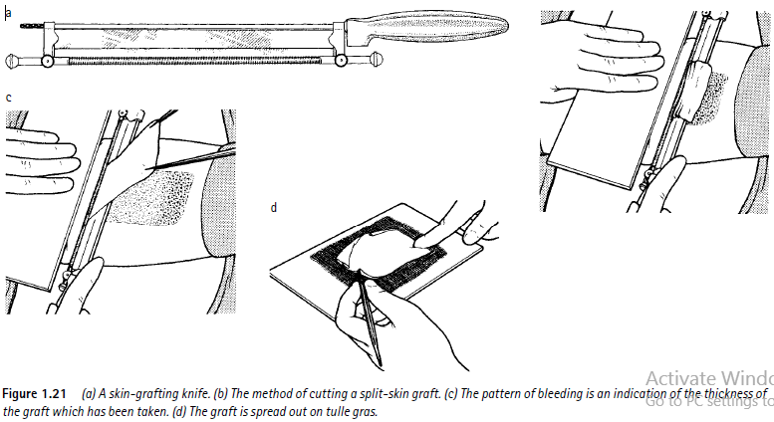
TECHNIQUE OF GRAFT HARVEST

Slide 14
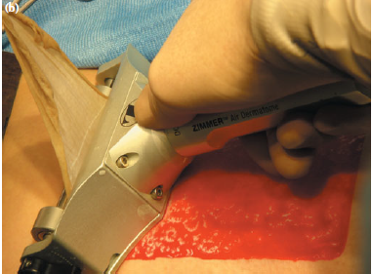
A POWERED DERMATONE USED FOR HARVESTING SPLIT SKIN GRAFT

Slide 15
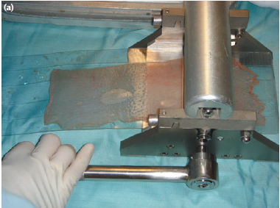
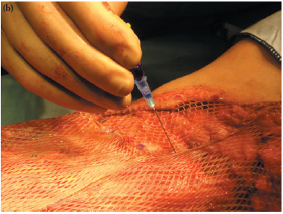
Skin graft
MESHER
MESHED SKIN GRAFT

Slide 16
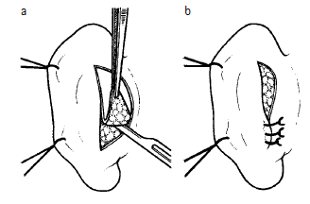
Post auricular full thickness graft harvest and primary wound closure

Slide 17
Flaps
A tongue of tissue raised from its original site (donor site) and transferred to a new site local or distance while maintaining its blood supply

Slide 18
classification of flaps
Flaps can be classified based on the 5 Cs
Circulation
Composition
Contiguity
Contour
Conditioning

Slide 19
Circulation
Flaps can be
Random pattern or Axial pattern flaps
Random pattern – has no named vessel , length to breadth ratio is 1 : 1
Axial pattern flaps – has recognized vessel
It could be direct eg Groin flap , fasciocutanous , musculocutanous , venous

Slide 20
Composition
It could be
Cutanous
Fasciocutanous
Fascial
Musculocutanous
Muscular
Osseocutanous
Osseous

Slide 21
Contiguity
By source of flap proximity to defect
Local flaps
Regional flaps
Distant flaps
Free flaps

Slide 22
Contour
Based on the method in which they are transferred
Advancement
Transposition
Rotation
Interpolation

Slide 23
Conditioning
This is based on whether the flap was delayed or undelayed
Delay is a technique through which flap survival is improved upon before definitive surgery
Hence a flap may be delayed or undelayed depending on how rubost it’s blood supply is considered

Slide 24
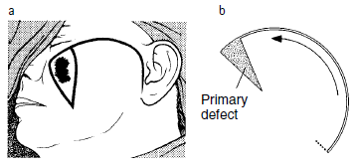
Cheek rotation flap

Slide 25
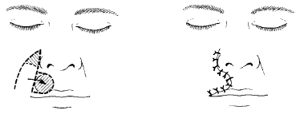
Nasolabial transposition flap

Slide 26
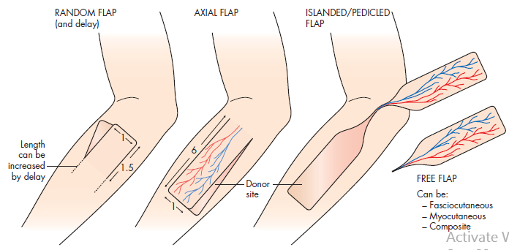
Skin flaps from simple to complex

Slide 27
Indications for use of flap
F – Filling of defects eg in contour defects due to bone loss
L – lining of epithelial surfaces eg in oral cavity head and neck reconstruction
A – augmentation of tissue volume eg in breast reconstruction
P – perfusion of tissues with better blood supply eg in lower limb reconstruction following sequestrectomy for osteomyelitis

Slide 28
Causes of flap failure
Numerous however common causes includes
Tension
Hematoma
Infection /local wound sepsis
Compression from external pressure
Poor surgical technique
Post operative vascular thrombosis and or venous congestion

Slide 29
Conclusion
Skin grafts and flaps are indispensible tools in the armamentarium of the reconstructive surgeon and an in-depth knowledge about them improves surgical outcome

Slide 30
Bibiliography
Badoe ,Archampong , Rocha – Afodu, principles and practice of surgery in the tropics including pathology 4th edition
Baily and Love short practice of surgery 25th edition
Keynotes on plastic surgery by Adrian M. Richards
Farquharson text book on operative general surgery 9th edition

