Slide 1
Spinal Cord Lesions
Dr Paul Olowoyo
MBBS(Ib), FWACP(Int.Med-Neurol.)
paulolowoyo

Slide 2
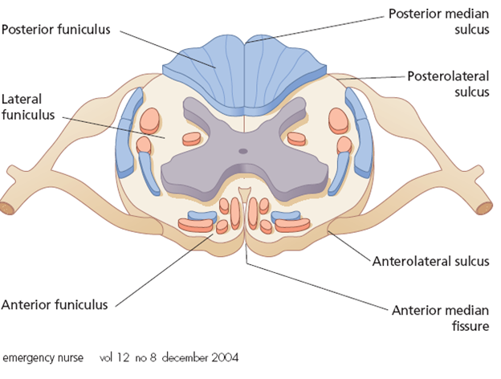
A Cross Section of the Spinal Cord
paulolowoyo

Slide 3
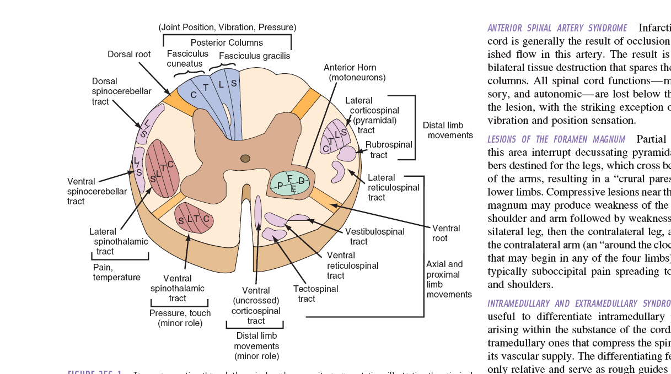
A Cross Section of the Spinal Cord
paulolowoyo

Slide 4
Spinal cord
Spinal segment Vertebrae
+ 1 C 5-7
+ 2 T 1-6
+3 T 7 –9
L 1-2 T 10
L 3-4 T 11
L 5 T 12
S1-Co L 1
paulolowoyo

Slide 5
SPINAL CORD COMPRESSION
Extra dural
Intra dural:
  Extramedullary
  Intramedullary
paulolowoyo

Slide 6
Etiology of Compressive Transverse Cord Lesions
Trauma
Infection (Acute, TB, Brucella, Fungal, Schisto, Norcardia)
Neoplasms ( primary, secondaries, lymphoma, multiple myeloma)
Abscesses
Degenerative disc disorders
Vascular (angioma, AVM)
paulolowoyo

Slide 7
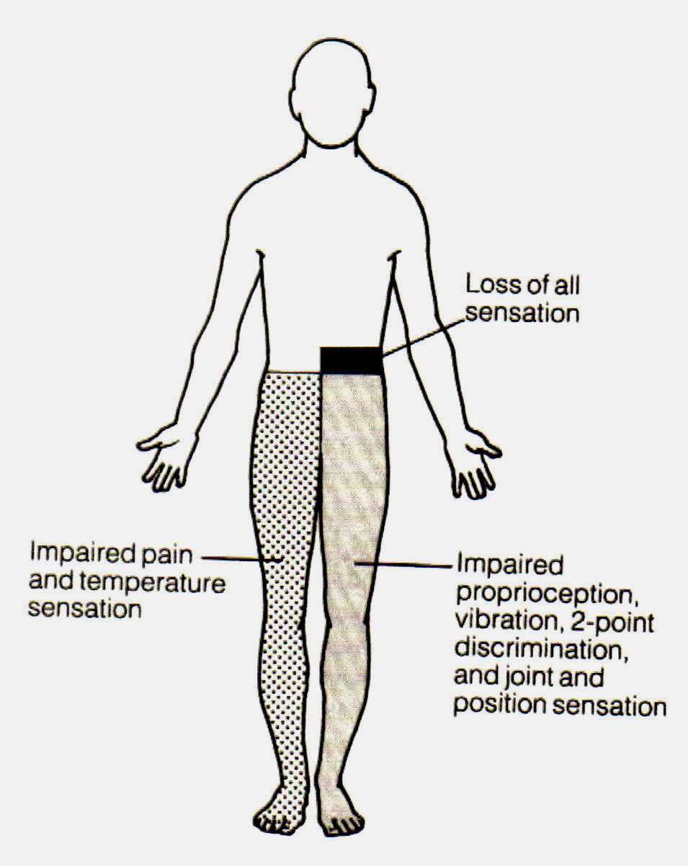
Brown- Sequard Syndrome
paulolowoyo

Slide 8
Central Cord Lesions
Etiology
  Syringomyelia, Hydromyelia, Hematomyelia
  Intramedullary tumors
Early Signs
  Suspended thermoanesthesia and analgesia
  Dissociated sensory loss, preserved proprioception and discriminative touch
Late signs, which follow extension of the lesion
  Segmental atrophy, paresis and areflexia
  Kyphoscoliosis following weakness of paraspinal muscles
  Loss of position and vibration sense
  Loss of sensation below lesion with sacral sparing
paulolowoyo

Slide 9
Posterior Cord Syndrome
Signs
  Impaired vibration and kinesthetic sense
  Impaired two point discrimination
  Sensory ataxia which is worse in the dark and Romberg sign is present.
paulolowoyo

Slide 10
Subacute combined degeneration of the spinal cord
Degeneration of the lateral and posterior columns of the spinal cord due to deficiency of vitamin B12
paulolowoyo

Slide 11
Subacute combined degeneration of the cord II
Clinical features
Initial symptoms usually symmetrical paraesthesiae of the feet or occasionally of the hands
Increasing difficulty in walking develop due to a combination of weakness and loss of postural sense
More widespread signs of VitB12 deficiency may be present including dementia, impairment of vision from optic nerve involvement
Anaemia is usually present but may be absent
Management
Parenteral doses of hyroxocobalamine
paulolowoyo

Slide 12
Cervical Spondylosis with Myelopathy
Most common form of myelopathy
Degenerative disease of the spine usually at mid and lower cervical spine vertebrae
  Narrowing of spinal canal and vertebral foramina
  Progressive injury of the spinal cord and spinal roots
paulolowoyo

Slide 13
Degenerative Disease of the Spine
Prevalence of cervical degenerative disease reaches 95 % at the age of 65 years
Cervical spondylosis is a non-specific degenerative process of the spine
There is stenosis of central spinal canal and root canals
Factors which contribute to narrowing
  Degenerate disc central, or posterolateral prolapse
  Osteophyte
  Hypertrophy of:
    lamina
    Articular facets
    Ligamentum flavum
    Posterior longitudinal ligaments
paulolowoyo

Slide 14
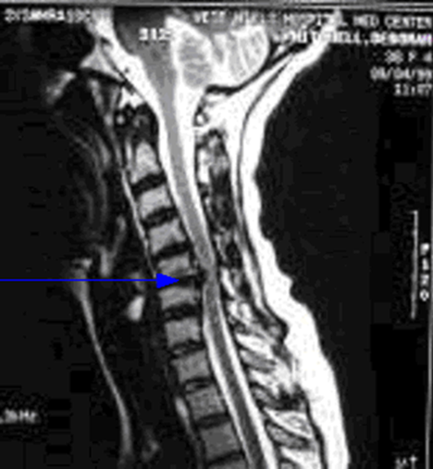
Cervical Spondylosis
paulolowoyo

Slide 15
Clinical Presentations
Radiculopathy
Spondylotic Myelopathy
Myeloradiculopathy
Rotational Vertebral Artery Occlusion (Vertebrobasilar Insufficiency)
Lhermitte’s sign
Spurling’s test
Intermittent neurogenic claudication
paulolowoyo

Slide 16
Cervical Spondylotic Radiculopathy
Referred pain in the arm from nerve root irritation
  Disc prolapse
  Osteophyte
  Unstable spinal segment
Pain
  Centered on back of the neck
  May radiate to the scapular, or anterior chest pain, or substernally
  May extend to the elbow, wrist, or fingers
  Burning sensation may be present
Pain may be monoradiculopathy or polyradiculopathy
Paresthesiae
paulolowoyo

Slide 17
Cervical Spondylotic Radiculopathy
Limitation of neck motion, extension or lateral rotation
Symptoms usually begin on waking
Symptoms worsen with Valsalva activities
Motor and reflex changes
C5/C6 disc herniation compresses C6 root
C6/C7 disc herniation compresses C7 root
paulolowoyo

Slide 18
Investigations
MRI is the investigation of choice
Cervical spine X – ray
  AP, lateral, oblique views
  Flexion and extension views if instability suspected
paulolowoyo

Slide 19
Management
Spontaneous recovery is common
Analgesics/anti-inflammatories
Cervical collar speeds recovery
Surgical decompression, discectomies
paulolowoyo

Slide 20
Cervical Spondylotic Myelopathy
Chronic disc degeneration with osteophytes is the most common cause of spinal cord compression in patients over 65 years of age
Modes of presentation
  Transverse cord syndrome
  Brown – Séquard syndrome
  Myeloradiculopathy
Numbness and paraesthesias
  Usually of distal limbs, especially hands
paulolowoyo

Slide 21
Cervical Spondylotic Myelopathy
Cough, straining, or turning the neck may induce electrical feelings down the spine, Lhermitte symptom
Bladder disturbance
Fingers may feel swollen or clumsy
Weakness of small muscles of the hand
Clumsiness
Weakness of the legs
  Spasticity is more than weakness
Quadriparesis
paulolowoyo

Slide 22
Cervical Spondylotic Myelopathy
Muscle stretch reflexes
  Loss of biceps reflex, but exaggerated triceps reflex
  Extensor plantar reflex
Sensory Changes
  Impaired vibration sense, joint position sense
  Romberg sign may be present
  Sensory gait ataxia in some subjects
paulolowoyo

Slide 23
Differential Diagnoses
Motor neurone disease
Cervical rib
Cervical sprain
Polyneuropathies
Rheumatoid arthritis
Syringomyelia
paulolowoyo

Slide 24
Investigations
Cervical X – rays
  Loss of disc height
  Prominent osteophytes
MRI
  Signal changes may be present within the spinal cord
paulolowoyo

Slide 25
Management
Cervical collar to prevent repetitive cord injury
Surgery to decompress
  Discectomy
  Resection of osteophytes
paulolowoyo

Slide 26
Treatment
Semi-rigid collar
Decompressive laminectomy
paulolowoyo

Slide 27
TB Spine/ Pott’s Disease
Extradural compression
Seven different types of radiological abnormalities:-
(i) disc space narrowing only
(ii) kissing lesions; half-moon
(iii) wedge collapse of vertebra;
(iv) vertebra plana;
(v) lesions localised in the vertebral body and/or its appendages;
paulolowoyo

Slide 28
TB Spine/ Pott’s Disease
(vi) para-spinal abscesses;
(vii) complete destruction of vertebral body.
Dorsolumbar region is the most frequently involved with D.11 vertebra being most often affected.
paulolowoyo

Slide 29
Intraspinal tumours
Most intraspinal tumours are benign
Effects are usually due to compression rather than infiltration
Anatomical groups
  Intramedullary
    Primary
    Metastasis
  Extramedullary
    Primary
    Metastasis
paulolowoyo

Slide 30
Intraspinal tumours
Primary neoplasms
  Intramedullary
    Astrocytomas, oligodendrogliomas, Ependymomas, lipomas, teratomas
  Extramedullary
    Neurofibromas, more intradural than extradural
    Meningiomas, sarcomas, vascular tumours, chordomas
paulolowoyo

Slide 31
Intraspinal Tumours
Compression of spinal cord by tumor reduces the CSF space arround the cord
Loculation of CSF below the lesion
  Increase protein and xanthochromia (Froin Syndrome)
paulolowoyo

Slide 32
Clinical Features of Spinal Tumours
Sensorimotor syndrome
Radicular-Spinal cord syndrome
Intramedullary syringomyelic syndrome
Foramen magnum syndrome
Conus medullaris syndrome
Cauda equina syndrome
paulolowoyo

Slide 33
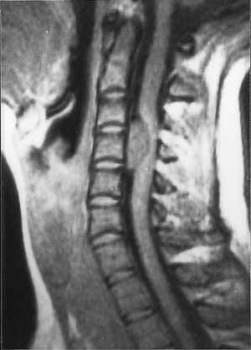
Spinal Meningioma
paulolowoyo

Slide 34
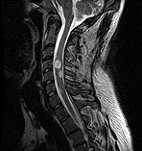
Spinal Astrocytoma
paulolowoyo

Slide 35
Clinical Features
Foramen magnum syndrome
  Pain
    Suboccipital
  Lhermitte symptoms
  Quadriparesis
  Neck stiffness
  Atrophy of the muscles of the hands and dorsal neck muscles
  Lower cranial nerve palsies, IX – XII
  Horner’s syndrome
  Papilledema
  Downbeat nystagmus
  Cerebellar ataxia
paulolowoyo

Slide 36
Clinical Features
Conus medullaris syndrome
  Early disturbance of bladder and bowel control, urine retention, constipation
  Erectile dysfunction
  Symmetrical saddle anesthesia
  Pain is not common, but may occur late
paulolowoyo

Slide 37
Clinical Features
Cauda equina syndrome
  Early radicular pain in the distribution of lumbosacral roots, usually asymmetric
  Pain
    May be unilateral
    Worse when lying down
  Flaccid paresis, glutei, posterior thigh muscles, anterolateral leg muscles, and foot
  Assymetric saddle anesthesia
  Loss of ankle jerk
  Sphincter disturbance
paulolowoyo

Slide 38
Summary
Compression may arise from lesions of:
Vertebral column – cervical spondylosis, myeloma, metastatic Ca (breast, prostate)
Spinal meninges – meningioma, neurofibroma, epidural abscess
Spinal cord – glioma, ependymoma
paulolowoyo

Slide 39
Summary
Management
Depends on nature of underlying lesion
Surgery usually required for benign tumours
Epidural abscess and TB spine require antibiotics and anti-TB drugs
paulolowoyo

Slide 40
THANK YOU
paulolowoyo

