Slide 1
VARICOSE VEINS
Dr. O.F BABALOLA FMCS, FWACS, FAOCMF

Slide 2
Dilated, elongated and tortuous veins which permit reverse flow through their faulty valves
Failure of the valves – common pathway
10 – 20% of adults in westernized countries
Low incidence in developing countries
Women affected more than men

Slide 3
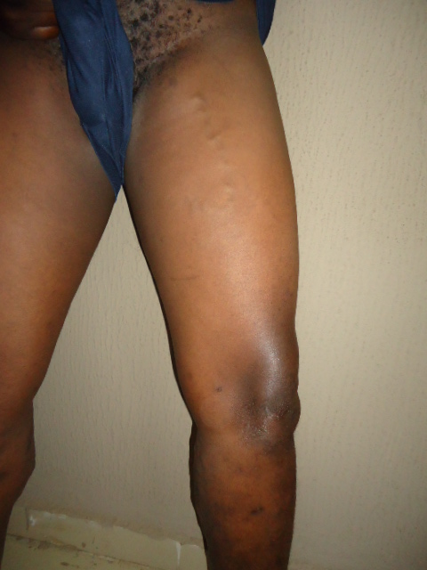

Slide 4
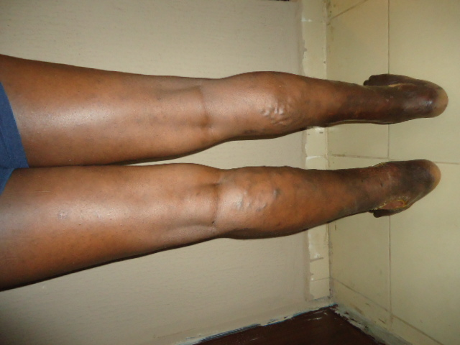

Slide 5
Relevant anatomy
Axial arteries accompanied by venae committantes: Deep veins
Veins superficial to the Muscle Fascia: Superficial Veins
Communicating veins between Deep & Superficial: Perforating Veins
10% of blood pass in the superficial veins of the leg
Junctions of SSV and GSV are perforators; SPJ, SFJ
All veins have valves

Slide 6
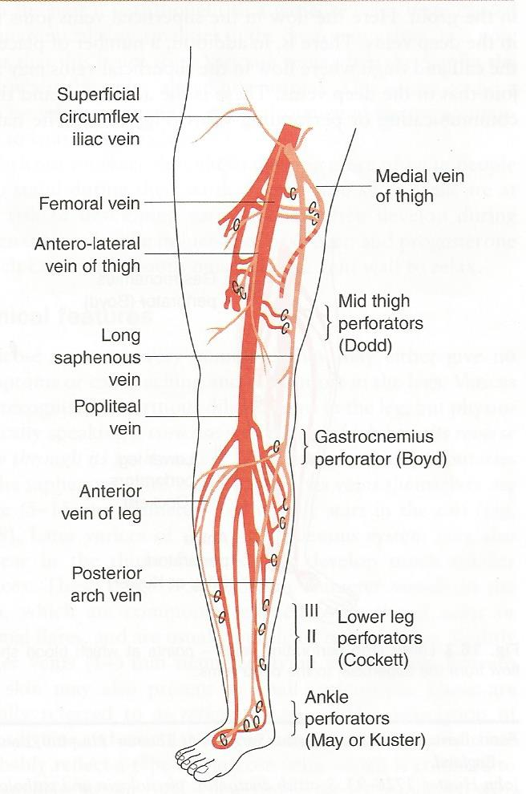

Slide 7
Valves prevent retrograde blood flow from deep to superficial and proximal to distal
Other perforating veins in the thigh, calf and ankle

Slide 8
Aetiological Factors
Diet: Western diet; Flour, Sugary, fiber deprived
Inheritance: Both parents – 80% risk,
Lack of exercise
Pregnancy

Slide 9
Physiology of blood flow through leg veins
At rest, upright position pressure in superficial & deep veins – 80 100mmHg
Venous flow maintained by the force of arterial pressure
Walking: contracting muscle empty deep veins within their compartments
Valveless calf plexuses contain app. 300ml which flow to d heart
Perforating venous valves prevent reflux to sup. veins

Slide 10
Muscular relaxation: blood is sucked into the empty deep veins from sup. And distal part of limbs
Superficial venous pressure drops below 30mmHg
Returns to resting value about 30 secs after

Slide 11
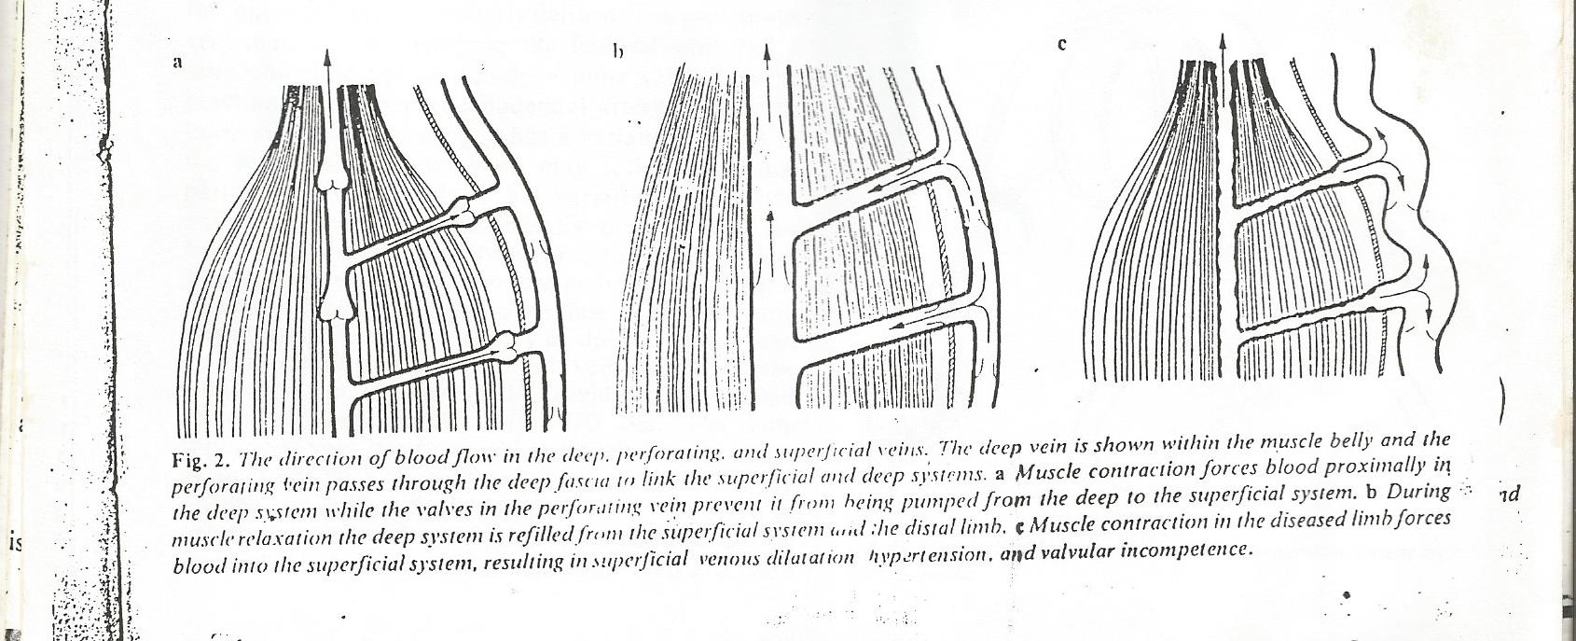

Slide 12
Pathophysiology
Not fully established
Gap between valves and vein walls first @ the commissure
Gap widens and reverse flow occurs
Valve cusps degenerate and hole develops
Reflux worsens and vein below valves dilate

Slide 13
Exercise does not reduce the Superficial venous pressure significantly
Resting pressure returns within a few secs. Of cessation of activity
Ambulatory venous hypertension develops and give rise to sequalae

Slide 14
Clinical Features: Symptoms
Asymtomatic
Unsightly appearance
Aching sensation
Discomfort in the leg
Itching
Ankle swelling
Paraesthesia

Slide 15
Clinical features: Signs
Full physical examination
Thread veins, Reticular veins
Brodie – Trendelenburg Test
Patey’s Test
Examinatiom of peripheral pulses
Abdominal examination

Slide 16
Note features of complications
Thrombosis
Haemorrhage
Ulceration
Lipodermatosclerosis

Slide 17
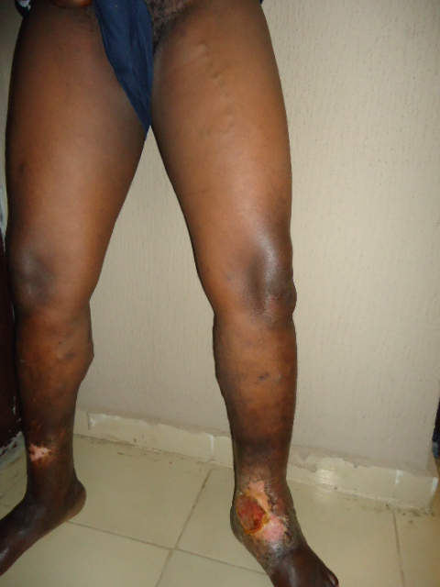

Slide 18
Investigation
Doppler USS
Duplex ultrasound imaging
Venography
Plethysmographic tech: Photo, air, light reflex, strain gauge
Exclude Arterial: ABPI, Arteriography
Ancilliary inv: FBC, Urinalysis, E&U, Group & Save

Slide 19
Treatment: Non Operative
Avoid prolonged standing, Elevation,
Compression bandaging
Compression stocking
Injection Sclerotherapy: 0.5% Sodium tetradecyl sulphate (STD)
Microsclerotherapy: STD, Polidocanol , dilute conc. – Thread, reticular veins

Slide 20
Treatment: Operative
Trendelenburg Procedure and Vein Stripping
Saphenopopliteal Junction ligation+/- stripping
Subfascial ligation of Perforators

Slide 21
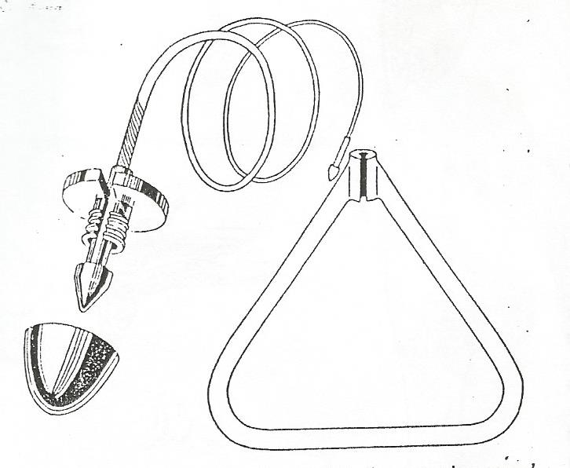
Myers Vein Stripper

Slide 22
Pre-op preparation
Discontinue Contraceptive pills for 2 months
D/C Warfarin
Mark veins with indelible ink
Mark perforator sites
Other routine prep: consent

Slide 23
Post-op Care
Routine post op care
Elevate leg to 10 degrees
Encourage walking 1st Post op day
Stitches removal 10 – 14days
Avoid prolonged standing, Elevate foot at inetrvals
Compression bandages for 4wks

Slide 24
Complications
Intraoperative
Damage to femora vein
Damage to femoral artery
False passage of stripper
Damage to sural and saphenous nerves

Slide 25
Post operative: early
-Reactionary haemorrhage
-Haematomas
-Wound Infection, Wound dehiscence
-Seroma
-Lymph cyst, lymphatic fistula
-DVT, Chest infection

Slide 26
Postoperative: Late
Adverse scars: painful, pigmentary, ugly
Recurrent varices
Residual varices

Slide 27
Summary
Varicose veins are common in legs, due to diseased valves
Diet, exercise lack, genetic, pregnancy are aetiological factors
Symtoms vary; Cosmetic disfigurement to Complicatons
Persistently high ambulatory venous pressure
Non-operative, operative treatment
Follow-up after treatment essential

Slide 28
Thank you for your attention

