Slide 1
CUTANOUS MALIGNANCIES
Dr. SALAWU A.I (FWACS)

Slide 2
Outline
Introduction
Malignant skin tumors
predisposing factors
Premalignant skin conditions
Prevention
conclusion

Slide 3
Introduction
Skin cancer is the commonest form of cancer noted in the western world
W.H.O estimates that > 65,000 world wide die from melanoma annually

Slide 4
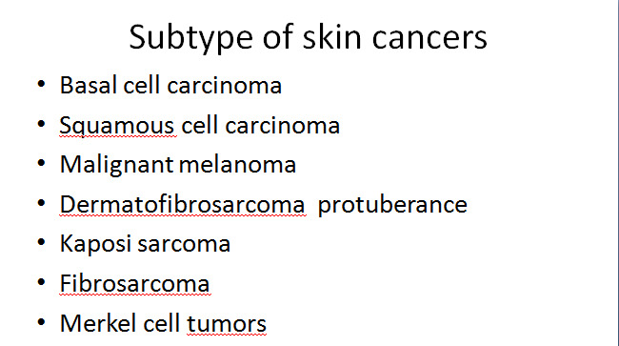
Malignant skin tumours

Slide 5
Predisposing factors to skin cancers
Exposure to UVB radiation
Immunodepressed states ( HIV , use of drugs following organ transplants eg cyclosporin A )
Genetic syndromes (congenital melanocytic nevus, xeroderma pigmentosa , Albinism )
Exposure to Ionizing radiations
Exposure to environmental carcinogens
Fair skin eg Fritztpatrick 1 , 2
Use of tobacco

Slide 6
Premalignant skin conditions
1 , Actinic keratosis
2 , Bowen’s disesase
3, Sebacious nevus
4 , Dysplastic nevus
5 , Lentigo maligna (Hutchinson’s melanocytic freckle)

Slide 7
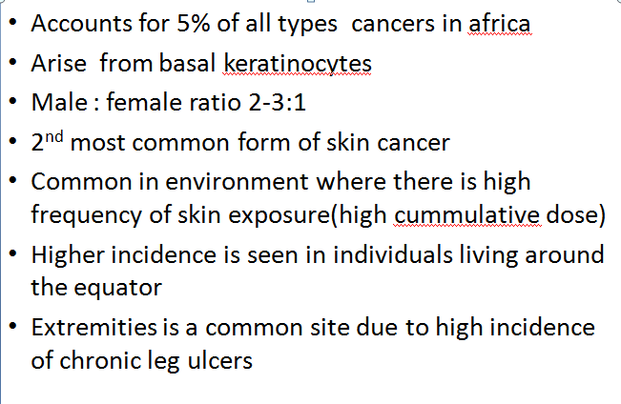
SQUAMOUS CELL CA

Slide 8
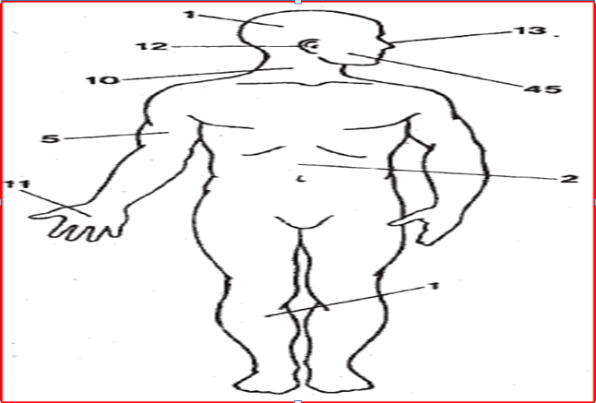
Distribution of squamous cell carcinoma

Slide 9
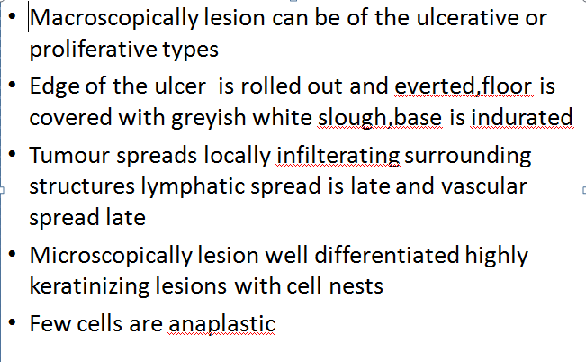
SQUAMOUS CELL CARCINOMA 3

Slide 10
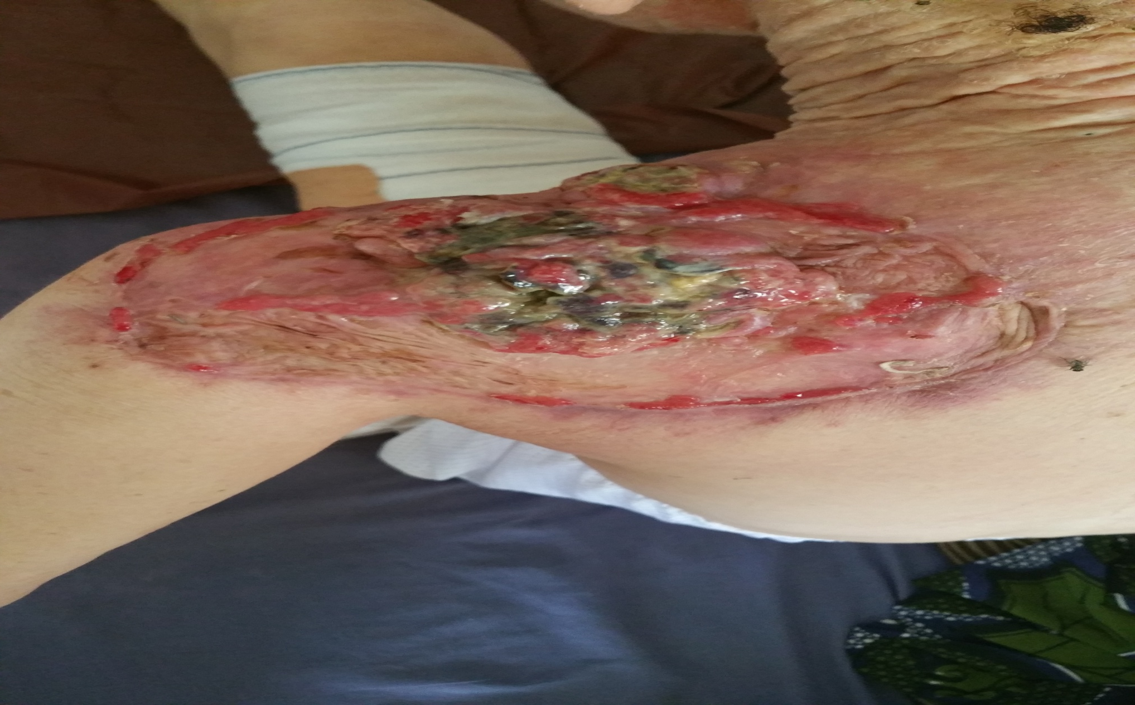
Recurrent squamous cell cancer on the shoulder

Slide 11
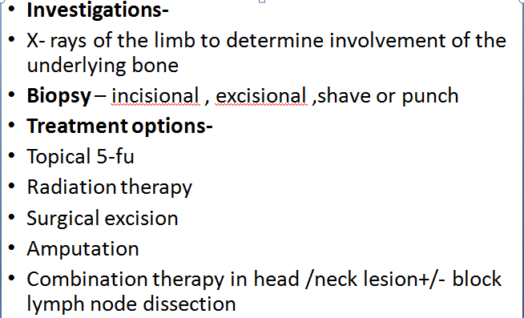
SQUAMOUS CELL CARCINOMA 4

Slide 12
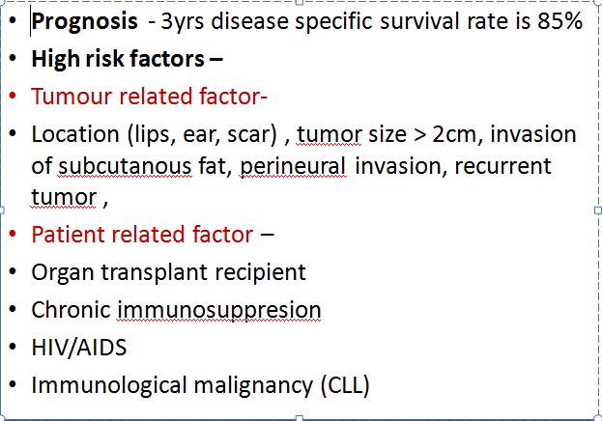
SQUAMOUS CELL CARCINOMA 5

Slide 13
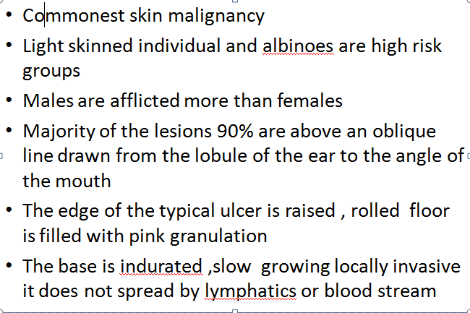
BASAL CELL CA

Slide 14
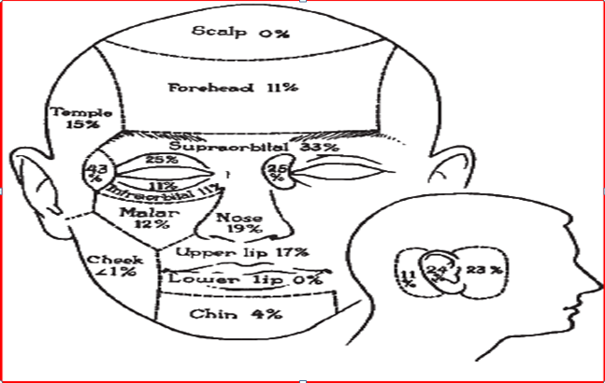
Distribution of new & recurrent basal cell carcinoma in the head/neck

Slide 15
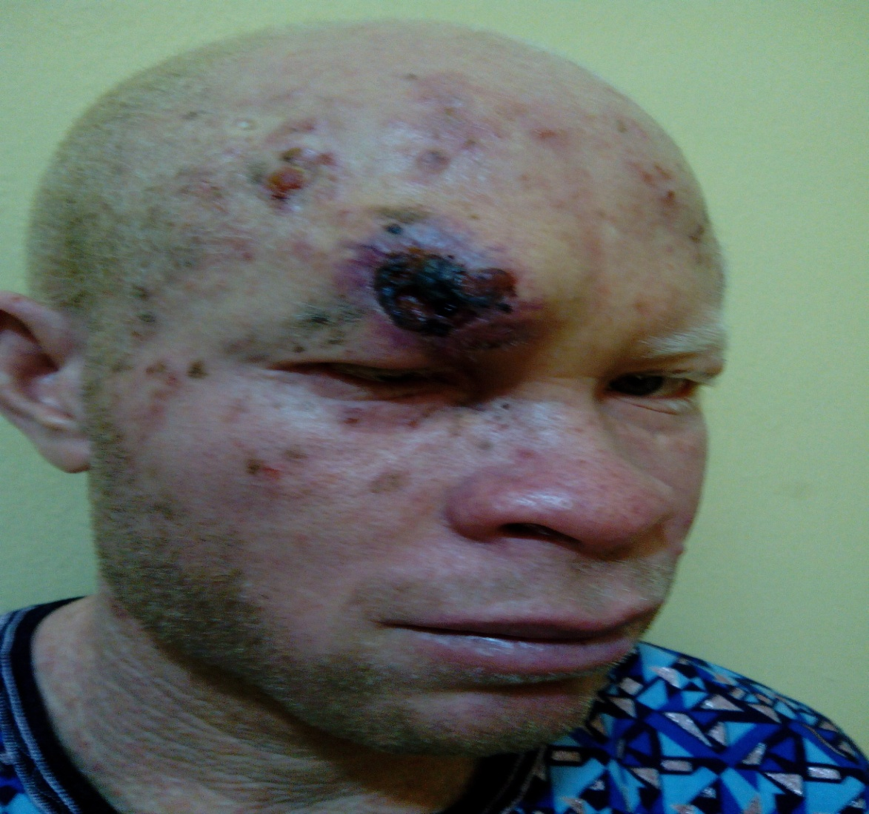
BASAL CELL CARCINOMA
Actinic / premalignant skin changes
Basal cell carcinoma

Slide 16
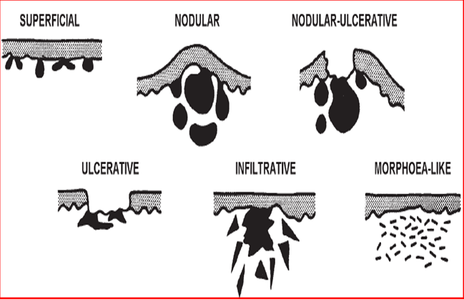
Histologic forms of basal cell ca

Slide 17
Treatment
Treatment modalities for Basal cell ca is similar those outlined for Squamous cell ca
They are both considered as non melanoma skin cancers
Surgical excision , radiotherapy , Topical 5 FU , Electrodessication and curretage

Slide 18
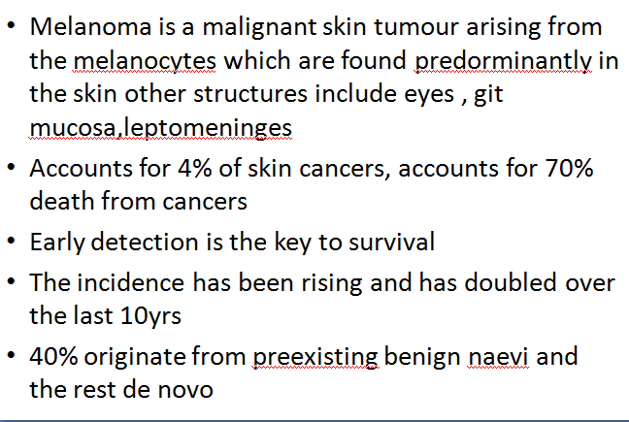
MELANOMA

Slide 19
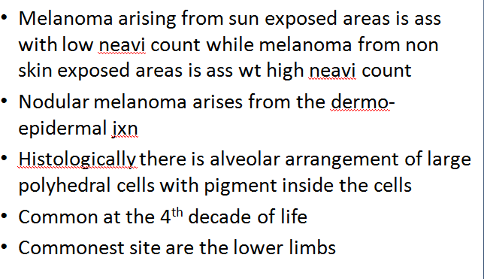
MELANOMA 2

Slide 20
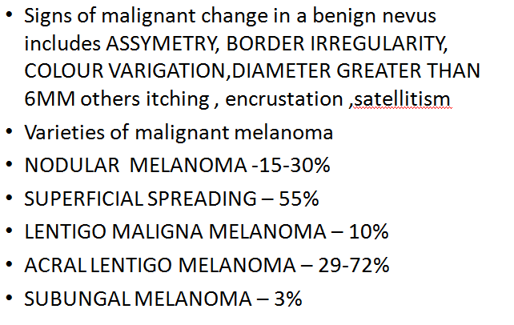
MELANOMA 3

Slide 21
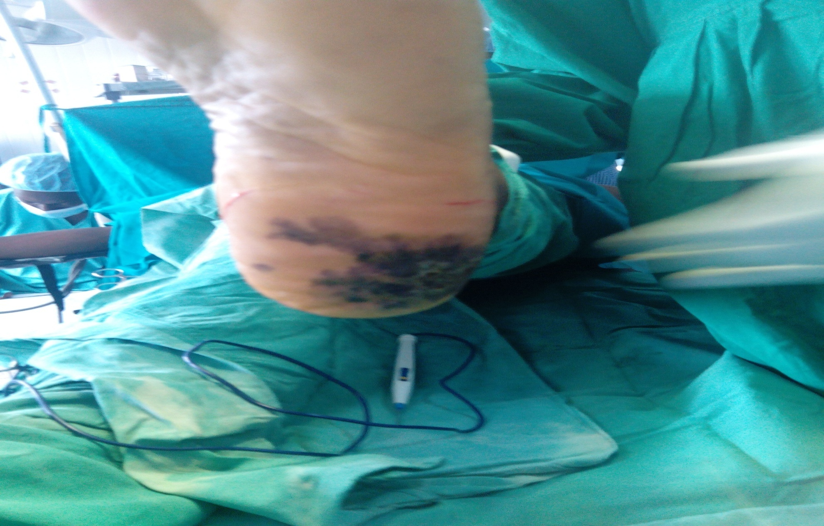
Melanoma on the heel

Slide 22
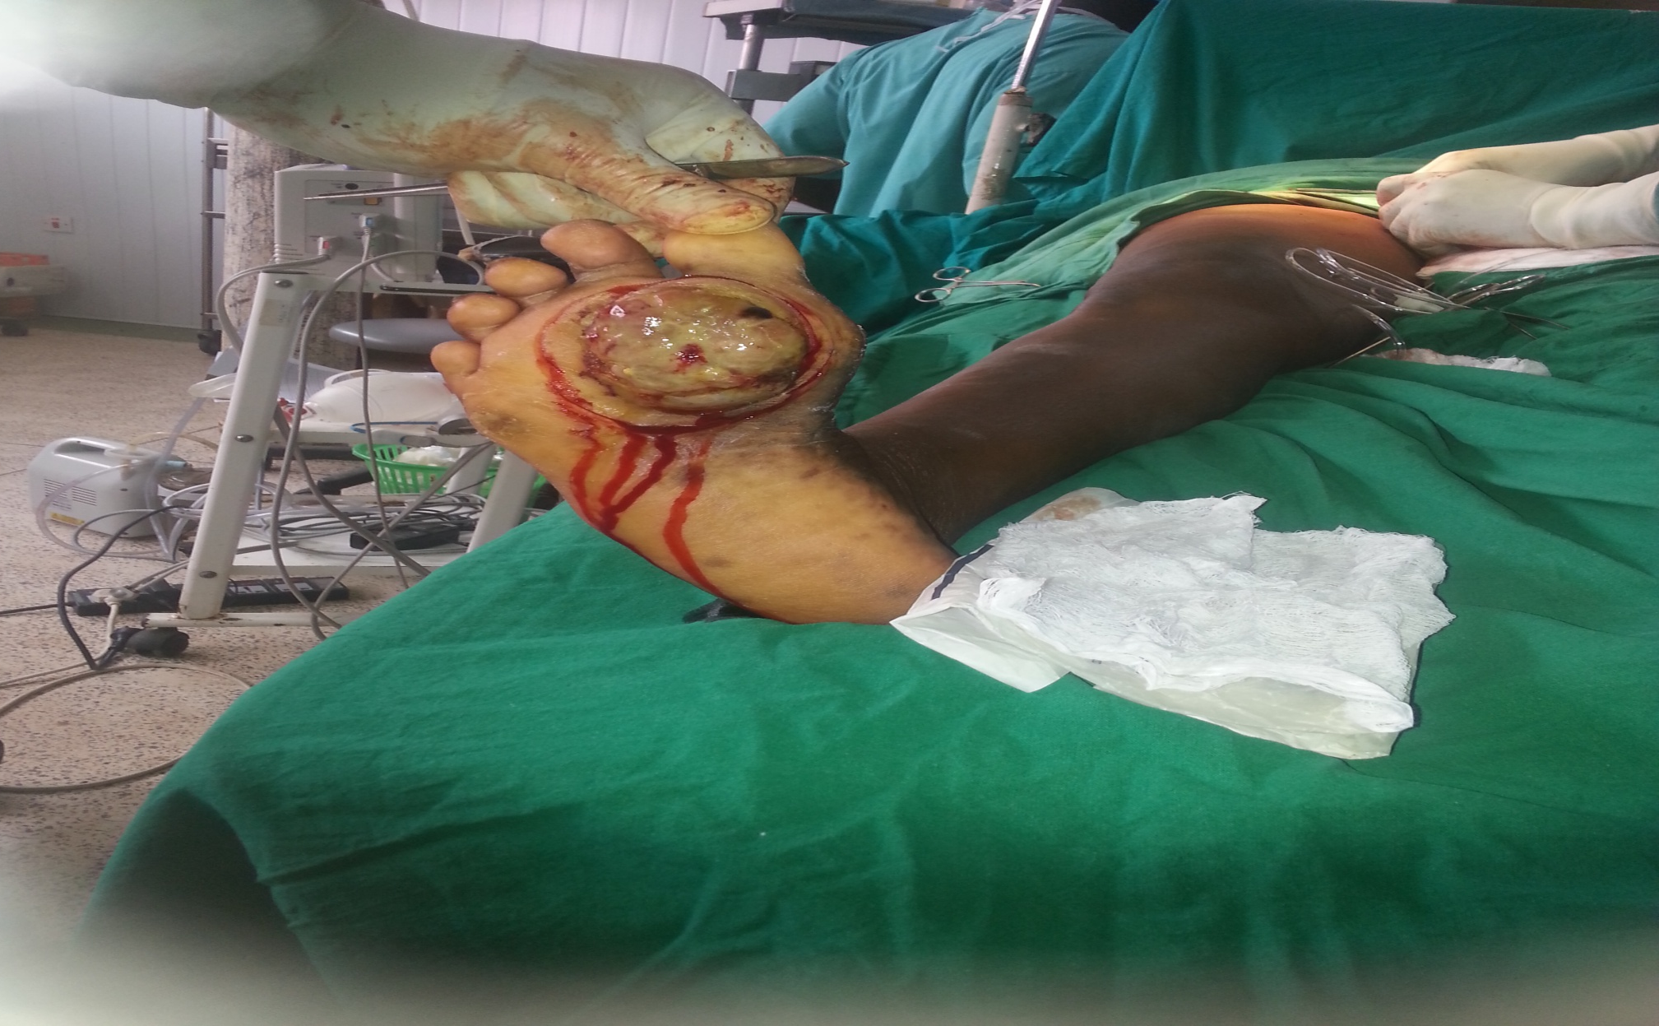
Melanoma of the sole

Slide 23
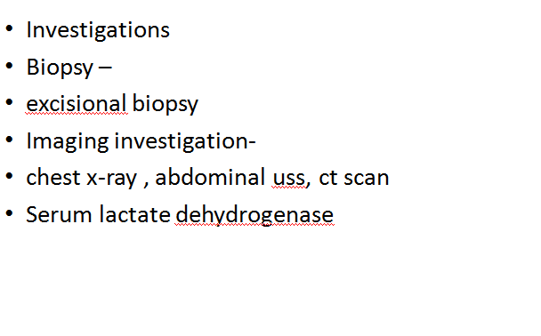
MELANOMA 4

Slide 24
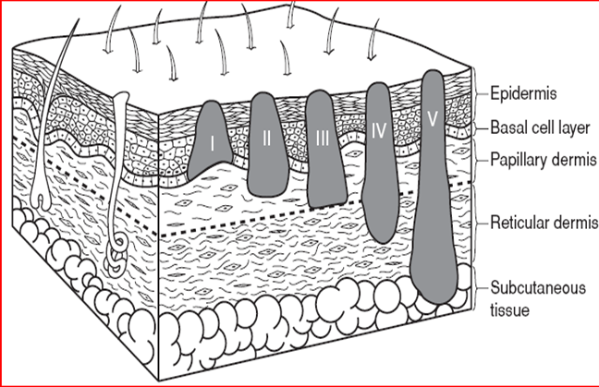
Clark’s staging/levels of melanoma

Slide 25
Breslow level /staging (1970)
Prognosticates based on the level thickness of the tumour invasion using the optical micrometre
The most important factor before nodal metastases
Level I : < 0.75mm
Level II : 0.76 – 1.75mm
Level III : 1.51 – 4.0mm
Level IV : > 4.0mm

Slide 26
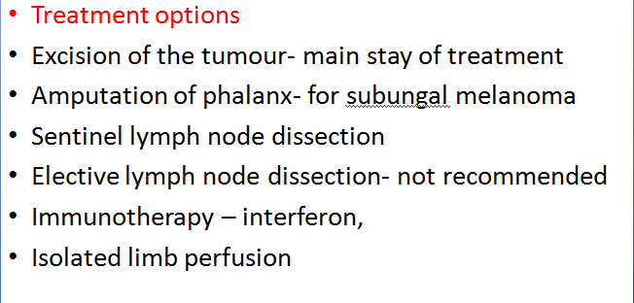
MELANOMA 5

Slide 27
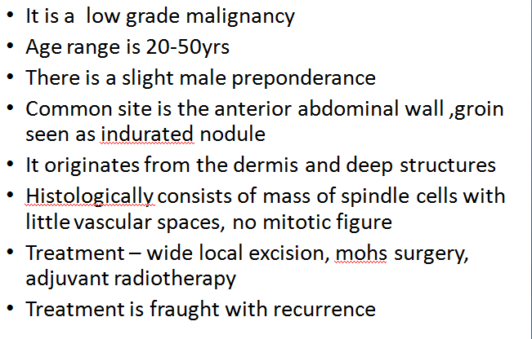
Dermatofibroma Protuberans

Slide 28
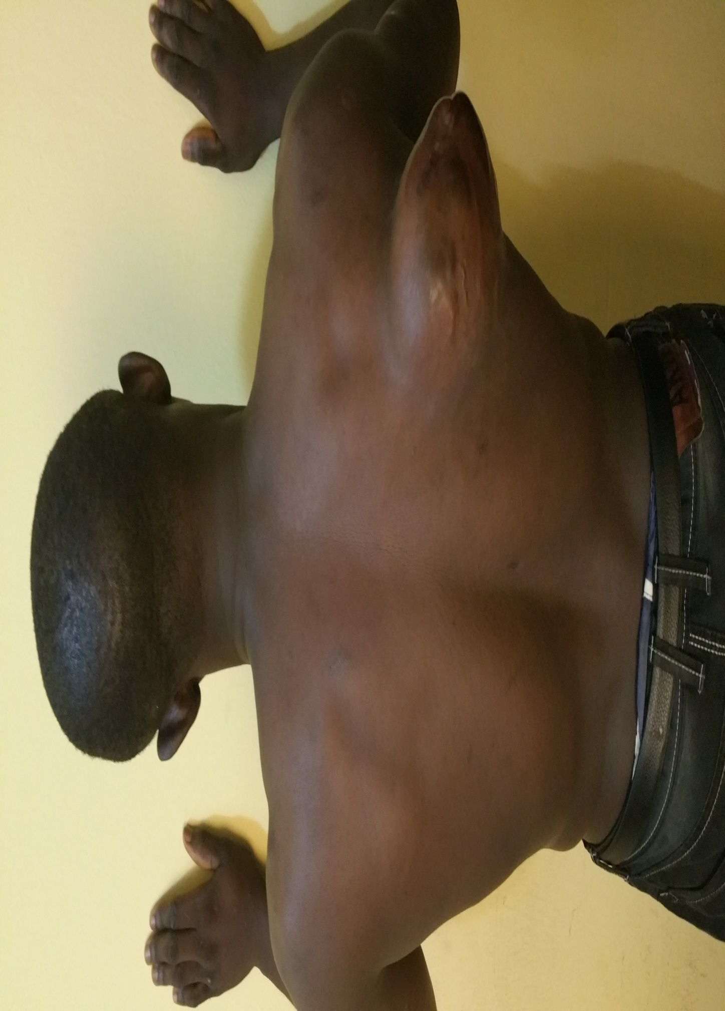
Recurrent dermatofibrosarcoma protuberans on the scapular

Slide 29
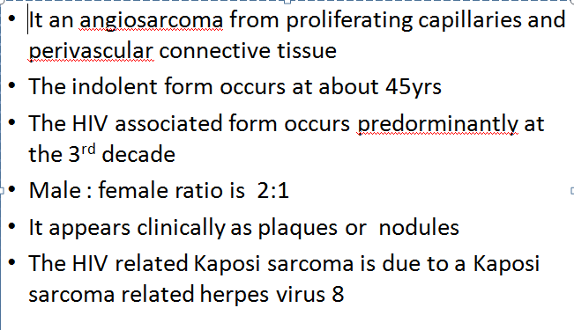
Kaposi sarcoma

Slide 30
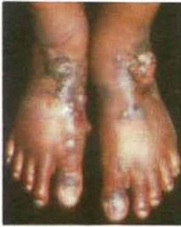
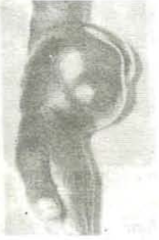
Presentations of Kaposi sarcoma
TYPE 1
TYPE 2

Slide 31
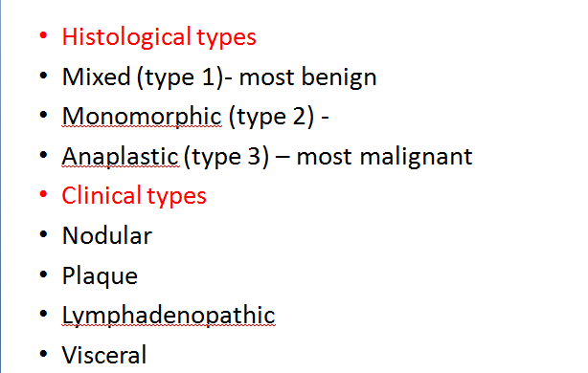
Kaposi sarcoma 2

Slide 32
Kaposi sarcoma 3
AIDS related kaposi sarcoma has an aggressive often involving multiple sites including the oral and the pharyngeal region
Fatal outcome occurs in 9- 12 months
Investigation
Chest x-ray
Stool microscopy
HIV screening
Needle biopsy

Slide 33
Kaposi sarcoma 4
Surgery is done for solitary lesions
To debulk the tumour
To obtain biopsy specimen and confirm diagnosis
Radiotherapy
Chemotherapy- paclitaxel ,docitaxcel
Biological agents- interferon alpha

Slide 34
FIBROSARCOMA
It is a neoplasm of young adults
It is common in the extremities and can occur along scar tissues
It is firm ,hard and has increased vascularity with dilated visible veins
It has varying degrees of differentatiation

Slide 35
MERKEL CELL CARCINOMA
They are also known as neuroendocrine tumours of the skin
Arise from merkel cells which modulate sensation of touch in the skin
They are very rare
Occur in sun exposed areas of the skin head /neck, arms ,leg and trunk
They appear as single painless nodule and metastasize at early stages to regional nodes and distant organs
Treatment includes wide local excision & radiotherapy

Slide 36
Prevention
Use of sun screens
Wearing protective clothing, sunglasses ,hats
Avoiding sun exposure or periods of peak exposure
The above are more important for albinos and the fair skin ( Fitzpatrick 1,2 )
Increase public awareness of the changes in benign nevus (A,B,C,D,E)

Slide 37
conclusion
Skin cancers are quiet common
Detailed understanding of the pathology permits early intervention
Which reduces its reduces morbidity and mortality .

