Slide 1
Overview of Diabetes Mellitus

Slide 2
Outline
Definition
Epidemiology
Insulin structure and function
Classification
Pathogenesis of Type 1 and Type 2 DM
Clinical features
Diagnosis of DM

Slide 3
What is Diabetes
Syndrome characterized by persistent hyperglycaemia due to disturbances in metabolism of carbohydrate, fat & protein as a result of defects in insulin secretion(absolute or relative), insulin action or both

Slide 4
What is Diabetes?
Diabetes is a chronic, multi-systemic disease that has become a world-wide pandemic affecting people of all ages, gender, the rich and poor.
Diabetes is caused by deficient insulin production, resistance to insulin action or a combination of both.

Slide 5
What is Diabetes?
It is a disorder of the very engine of life because when the body cannot utilize nutrients, including glucose, a number of vital mechanisms can breakdown with life-threatening consequences.

Slide 6
Epidemiology
DM is now one of the most common NCD globally. There is substantial evidence that it is epidemic in many low and middle income countries.
Type 2 DM constitutes about 85 to 95% of all diabetes in high-income countries and accounts for an even higher percentage in low and middle income countries like Nigeria

Slide 7
Epidemiology
382m (20-79yrs) had diabetes in 2013; 415m (8.8%) in 2015, projected 642m (10.4%) in 2040
The number of people with type 2 diabetes is increasing in every country
75% of people with diabetes live in low- and middle-income countries, largest in those transiting from low to middle
The greatest number of people with diabetes are between 40 and 59 years of age.

Slide 8
Epidemiology- 2016
1 in 11 adults have DM
1 in 2 adults with DM is undiagnosed
1 in 7 births is affected by Gestational DM
542,000 children have Type 1 DM
12% of global health expenditure is on DM

Slide 9
Insulin structure and function
Insulin is produced in the beta cells of the pancreatic islets.
Initially synthesized as a single-chain 86-amino-acid precursor polypeptide, preproinsulin
Insulin-A chain (21 AA) and B chain (30 AA) connected by disulfide bonds.
C- peptide

Slide 10
Types of Diabetes
Type 1 (5- 10%)- previously Juvenile, IDDM
1a (autoimmune) and 1b (Idiopathic)
Type 2- previously Adult onset, NIDDM
Secondary causes- pancreatic, Chromosomal, Inherited, Endocrinopathies
Gestational DM

Slide 11
Pathogenesis
Type 1 DM- result of interactions of genetic, environmental, and immunologic factors
Ultimately leads to the destruction of the pancreatic beta cells and insulin deficiency.
Type 1 DM results from autoimmune beta cell destruction
Most individuals with type 1 DM have the HLA DR3 and/or DR4

Slide 12
Pathogenesis
Auto- antibodies- to GAD- 65, Islet cell antibodies, Anti bodies to tyrosine phosphatase
T2DM pathogenesis is polygenic- genetic and environmental risk factors

Slide 13
Distinguishing Type 1 and Type 2
Age of onset
Family history
Body habitus (overweight, obese or not)
Medications required.. Insulin and Tab
Auto- immunity
C- peptide.. Absence in type 1

Slide 14
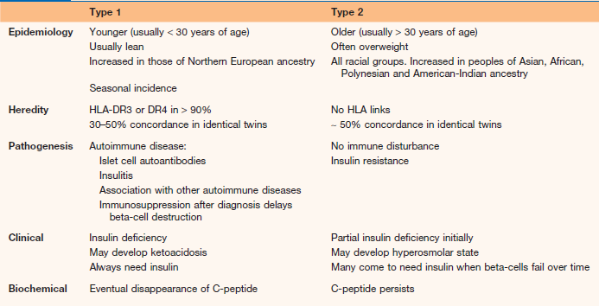

Slide 15
Risk factors for type 2 Diabetes
Age ≥ 45
Family history
Race
Overweight and Obesity
Hypertension
Blood Lipid disorders
Previous diabetes in pregnancy

Slide 16
Risk factors for type 2 Diabetes
Features of insulin resistance
Delivery of big baby >4kg
Polycystic ovary disease

Slide 17
What are the symptoms of Diabetes
Asymptomatic
Excessive urination, thirst and hunger
Weight loss
Recurrent skin infection
Discharge from private part
Complications- Acute hyperglycaemia, Chronic

Slide 18
Screening for DM- recommendations
Consider testing asymptomatic adults of any age who are overweight or obese (BMI ≥25 or ≥23 in Asians) and who have one or more additional risk factors for diabetes
For all other people, testing should begin at age 45 years.
If normal repeat every at least every 3yrs, or more if impaired

Slide 19
Diagnosis of DM
Fasting plasma glucose,
2-h plasma glucose after 75-g oral glucose tolerance test
Haemoglobin A1C
Random plasma glucose

Slide 20
Diagnosis of DM
FPG - ≥ 126 mg/dL (7.0 mmol/L).
(Fasting is defined as no caloric intake for at least 8 h)
OR
2-h PG - ≥ 200 mg/dL (11.1mmol/L) during an OGTT. The test should be performed as described by
the WHO, using a glucose load containing the equivalent of 75 g anhydrous glucose dissolved in
250- 300mls of water.

Slide 21
Diagnosis of DM
A1C - ≥ 6.5% (48 mmol/mol)
In the absence of classical symptoms of DM, results should be confirmed by repeat testing for 3 tests above
Random plasma glucose - ≥ 200 mg/dL (11.1 mmol/L).- in presence of symptoms

Slide 22
Pre- diabetes
Impaired fasting glucose- 6.1- 6.9 mmol/L
Impaired glucose tolerance- 7.8- 11mmol/L
Check during an OGGT

Slide 23
Thank You

