Slide 1
JAUNDICE
DR. YUSUF M
Internal Medicine
FTH, Ido-Ekiti

Slide 2
EVALUATION
Introduction
Physiology of bilirubin production
Classification
Clinical features

Slide 3
INTRODUCTION
Jaundice or icterus is the yellowish discoloration of tissues- sclera, skin, mucous membranes due to deposition of bile pigment (bilirubin)
It occurs in the presence of hyperbilirubinemia & clinically detected with serum bilirubin of 3.0mg/dl
This occurs when there is an imbalance between production and clearance

Slide 4
PHYSIOLOGY OF BILIRUBIN PRODUCTION
Bilirubin is a tetrapyrrole pigment
It is a product of heme breakdown
Sources of heme- RBCs, erythroid cells from bone marrow, haem proteins (catalase, myoglobins and cytochromes)
70-80% of the 250-300mg of bilirubin produced each day is derived from the breakdown of old RBCs

Slide 5
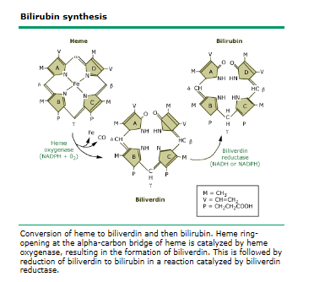

Slide 6
PHYSIOLOGY contd
1st reaction, heme oxygenase cleaves the porphyrin group opening the heme ring to form iron (Fe), equimolar quantities of carbon monoxide (CO) and biliverdin
2nd reaction, biliverdin oxidase reduces the methylene group of biliverdin and thus convert biliverdin to insoluble bilirubin
Unconjugated (insoluble) bilirubin is transported bound to albumin reversibly.

Slide 7
PHYSIOLOGY contd
Transported to the liver for conjugation where protein ligandin will transport it into endoplasmic reticulum
Bilirubin uridine diphosphate (UDP) glucuronosyltransferase catalyses the conjugation to water soluble bilirubin monoglucuronide and the more water soluble bilirubin diglucuronide.

Slide 8
PHYSIOLOGY contd
Transported into the bile canaliculi
Stored in gall bladder and released into the second part of duodenum
Bacteria beta glucurodases hydrolysed the conjugated bilirubin into unconjugated bilirubin in the ileum and colon (urobilinogens)
80% of this product is excreted in the faeces; remaining reabsorbed back through the portal vein to the liver (enterohepatic circulation) and into the blood for excretion in the kidney.

Slide 9
SUMMARY OF CAUSES OF HYPERBILIRUBINEMIA
Overproduction by reticuloendothelial system
Failure of hepatocyte uptake
Failure to conjugate bilirubin
Obstruction of biliary excretion into intestine

Slide 10
CLASSIFICATION OF JAUNDICE
A
Conjugated
Unconjugated
B
Prehepatic (hemolytic)- lemon yellow
Hepatic (hepatocellular)- orange yellow
Posthepatic (cholestastic)- greenish yellow

Slide 11
CLASSIFICATION contd
Most common causes of unconjugated hyperbilirubinemia are
bilirubin overproduction
Gilbert's syndrome
neonatal jaundice.

Slide 12
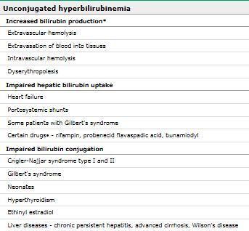

Slide 13
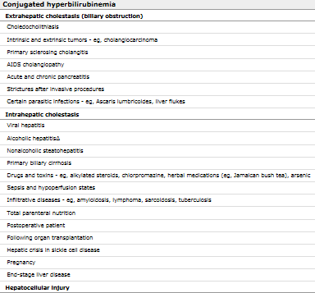

Slide 14
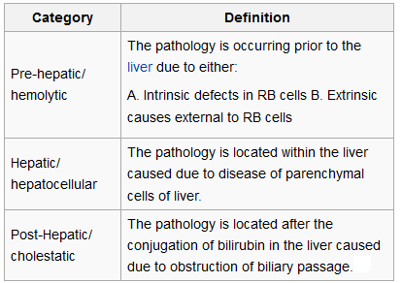

Slide 15
CLINICAL FEATURES
Jaundice is not a disease but a clinical features of an underlying disease, Other associated features include:
Pale colored stool
Dark-colored urine
Pruritus
Nausea, vomiting, diarrhea
Rectal bleeding
Fever and chills
Weakness
Weight loss
Loss of appetite
Confusion
Abdominal pain
Headache
Pedal/abdominal swelling

Slide 16
METHOD OF SERUM BILIRUBIN ESTIMATION
Van den Bergh method
Alkaline methanolysis
Dry reagent chemistry

Slide 17
VAN DEN BERGH METHOD
The technique involves the reaction of bilirubin with a diazo compound (diazotized sulfanilic acid), which creates two relatively stable dipyrryl azopigments. These fractions can be detected spectrophotometrically (their maximal absorption occurs at 540 nm). The indirect and direct fractions can be distinguished based upon their rate of production in the presence or absence of alcohol.
The fraction produced within one minute in the absence of alcohol represents the concentration of direct bilirubin; the total serum bilirubin is that amount that reacts in 30 minutes after the addition of alcohol; and the indirect fraction is the difference between the total and the direct bilirubin.
The fast reaction of direct (conjugated bilirubin) is due to the absence of internal hydrogen bonding and the fact that it is water soluble.

Slide 18
SUMMARY OF FINDINGS FROM SERUM BILIRUBIN ESTIMATION
Virtually 100 percent of the serum bilirubin in healthy people, including those with Gilbert's syndrome, is unconjugated.
Conjugated hyperbilirubinemia occurs only in hepatobiliary diseases.
The observation that jaundiced patients with hepatobiliary diseases have lower serum bilirubin concentrations measured by non-diazo than diazo based methods suggests that there are additional diazo-positive compounds distinct from bilirubin in their circulation
Monoglucuronides of bilirubin predominate over the diglucuronides in jaundiced patients with hepatobiliary disease.
Delta bilirubin —This albumin-linked bilirubin fraction is formed in the serum when hepatic excretion of bilirubin glucuronides is impaired; as a result, it represents a significant fraction of total serum bilirubin in patients with cholestasis and hepatobiliary disorders

Slide 19
MEASUREMENT OF URINARY BILIRUBIN
Unconjugated bilirubin is always bound to albumin in the serum
Not filtered by the kidney hence not found in the urine
Conjugated bilirubin is filtered in the kidney
Bilirubinuria implies the presence of liver disease

Slide 20
INHERITED CAUSES OF HYPERBILIRUBINEMIA
GILBERT’S SYNDROME
CRIGLER-NAJJAR SYNDROME TYPE I&II
DUBIN JOHNSON SYNDROME
ROTOR SYNDROME

Slide 21
GILBERT’S SYNDROME
Otherwise called "constitutional hepatic dysfunction" and "familial nonhemolytic jaundice“
Routine laboratory tests are usually normal in patients with Gilbert's syndrome, except for hyperbilirubinemia

Slide 22
FACTORS AFFECTING BIRUBIN LEVEL IN GILBERT’S SYNDROME
FACTOR INCREASING BILIRUBIN LEVEL
Fasting, hemolysis, intercurrent febrile illness, 3hrs post IV nicotinic acid administration
FACTOR DECREASING BILIRUBIN LEVEL
Steriod, enzyme inducers (phenobarbitone, clofibrate etc)

Slide 23
PATHOGENESIS OF GILBERT’S SYNDROME
Gilbert's syndrome is caused by a promoter abnormality. Normally, the TATAA element within the promoter upstream to exon 1A1 consists of A(TA)6TAA. In Gilbert's syndrome, two additional nucleotide residues (TA) are present in this element. Alleles containing the Gilbert-type promoter are termed UGT1A1*28.

Slide 24
CRIGLER-NAJJAR SYNDROME (CNS)
Also a nonhemolytic AR disorder forming unconjugated hyperbilirubinemia
Has 2 types- CNS 1 & 2 (Arias syndrome)
Rarer than Gilbert’s syndrome
Serum bilirubin usually greater than 345 in type 1 but less in type 2.
Type 2 can be treated wt phenobarbitone while exchange blood transfusion, phototherapy, liver transplantation, oral calcium PO4& CO3 are used in type 1

Slide 25
PATHOGENESIS OF CRIGLER-NAJJAR SYNDROME
In Crigler-Najjar I, the genetic lesions may result in a premature stop codon.
Crigler-Najjar type II is caused by point mutations that result in substitution of a single amino acid.

Slide 26
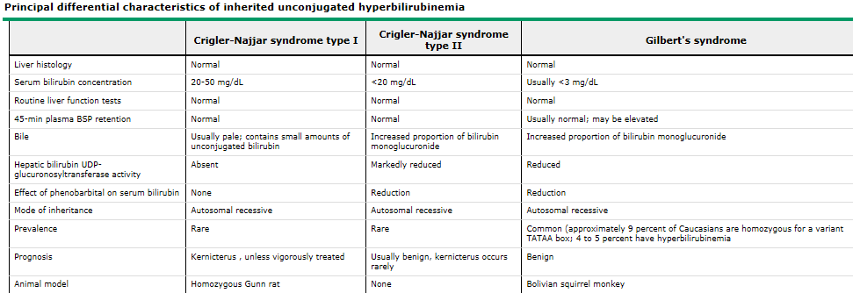

Slide 27
DUBIN JOHNSON AND ROTOR
Inherited conjugated hyperbilirubinemia
Impaired biliary excretion of bilirubin glucuronides is due to a mutation in the canalicular multiple drug-resistance protein 2 (MRP2).
A darkly pigmented liver is due to polymerized epinephrine metabolites, not bilirubin
DJS is due to a defect in the multiple drug-resistance protein 2 gene (ABCC2), located on chromosome 10
Hormonal contraceptives and pregnancy may lead to overt jaundice and icterus

Slide 28
DIAGNOSIS OF DJS
Unaffected subjects have a coproporphyrin III to coproporphyrin I ratio around 3–4:1.
DJS, this ratio is inverted, with coproporphyrin I being 3–4 times higher than coproporphyrin III. Analysis of urine porphyrins shows a normal level of coproporphyrin, but I isomer accounts for 80% of the total (normally 25%).

Slide 29
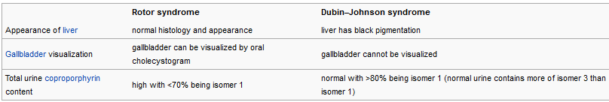

Slide 30
INVESTIGATION OF CAUSES OF JAUNDICE
LFT
FBC
Serology- antiHAV, HBsAg, AntiHCV, RVS
Autoimmune markers- AMA, AntiLKM
Abdominal US
Abdominal CT
MRCP
ERCP
Liver biopsy

Slide 31
DIFFERENTIAL DIAGNOSIS
Carotenemia
Quinacrine
Lycopeneamia

Slide 32
TREATMENT
Jaundice is not a disease hence treat the underlying pathology

Slide 33
CONCLUSION
Early diagnosis of the cause of jaundice and prompt treatment is the most important aspect of it management

Slide 34
THANK
YOU
FOR
LISTENING

