Slide 1
tuberculosis
DR KOLAWOLE.T.F
Consultant Chest Physician, department of Medicine,
Federal Teaching Hospital,
Ido Ekiti.

Slide 2
outline
Introduction
Properties/transmission
Pathogenesis/pathology
Classification
Risk factors
Clinical features
Management

Slide 3
introduction:Tuberculosis
1882 – Robert Koch – “one seventh of all human beings die of tuberculosis and… if one considers only the productive middle-age groups, tuberculosis carries away one-third and often more of these…”

Slide 4
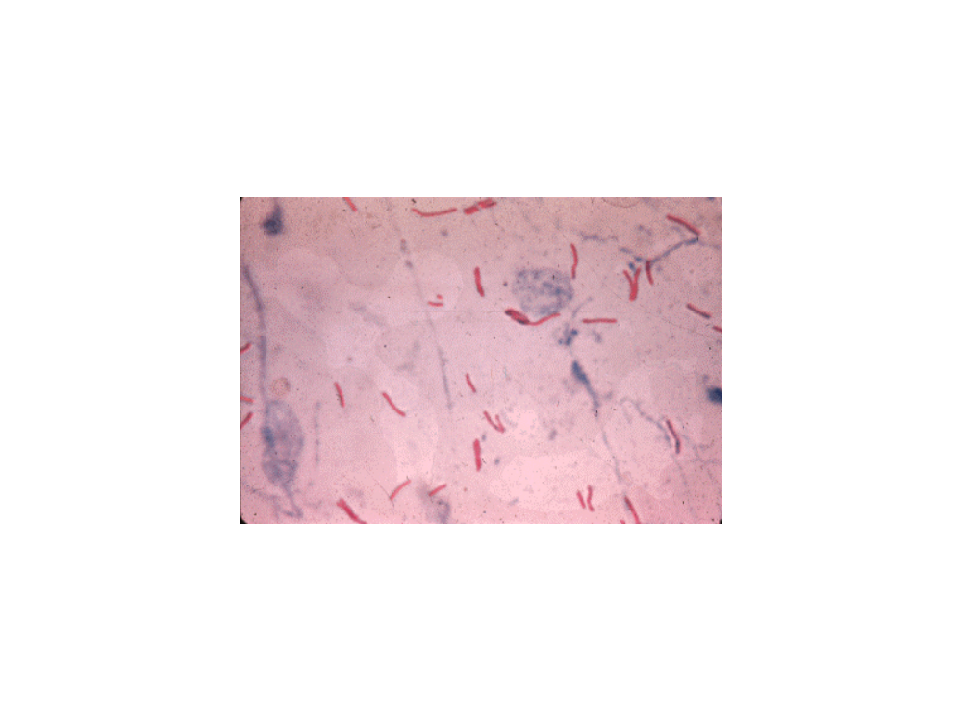
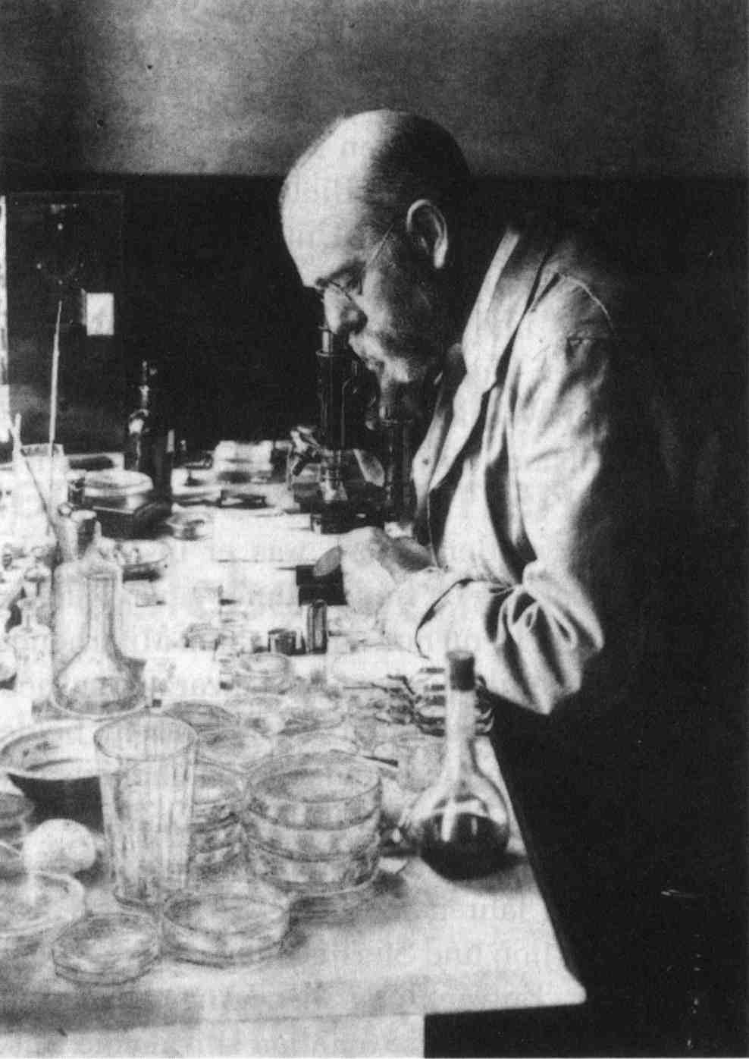
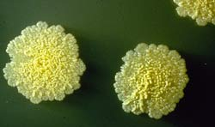
M tuberculosis as causative agent for tuberculosis
Robert Koch
1886

Slide 5
introduction
TB is caused by bacteria of the Mtb complex.
It affects the lungs majorly, but in up to one-third of cases other organs are involved.
If properly treated, TB is curable in all cases.
If untreated, the disease may be fatal within 5 years in more than half of cases.

Slide 6
MTB complex
MTB
M.bovis
M.bovis Calmette-Guerin
M.africanum
M.caprae
M.microti
M.pinnipedii
M.canetti

Slide 7
epidemiology
8 million new cases every year
1.3 billion infected
9 million have active disease
2 million die annually
Sub Saharan Africa 300/100,000
Fatality rate - 23%
Fatality rate (HIV+TB) - >50%

Slide 8
characteristics of MTB
M.tb is a rod-shaped, non-spore-forming, thin aerobic bacterium
It does not stain readily and are often neutral on Gram's staining.
Once stained, the bacilli cannot be decolorized by acid or alcohol, a characteristic justifying their classification as acid-alcohol fast bacilli (AFB).
Acid fastness is due mainly to the organisms' high content of mycolic acids, a long-chain cross-linked fatty acids, and other cell-wall lipids..

Slide 9
Survival strategies of MTB
M.tb has lipids; mycolic acids linked to underlying arabinogalactan and peptidoglycan in its cell wall.
This structure is responsible for the very low permeability of the cell wall and thus for the ineffectiveness of most antibiotics against the organism.
Another molecule in the mycobacterial cell wall, lipoarabinomannan, is involved in the pathogen-host interaction and facilitates the survival of M. tuberculosis within macrophages

Slide 10
Characteristics of MTB
Its cell wall prevents the fusion of the phagosome with a lysosome.
It also evade macrophage-killing by neutralizing reactive oxygen & nitrogen intermediates.
By these the bacteria multiply unchecked within the macrophage.

Slide 11
pathogenesis
Methods of aerosolization
Coughing-most effective
Speaking
Sneezing
Singing
laughing

Slide 12
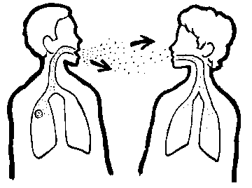
TB: Airborne Transmission

Slide 13
PATHOGENESIS OF TB
Primary TB- initial implant can occur any where in the lung.
Infectious droplet nuclei contain 1-5bacilli
About 30,000 of these are produced when sputum smear positive patient coughs/sneeze
When droplet nuclei are inhaled into alveoli they are attacked by alveolar macrophages
They release lysozymes/phagozymes that kill MTB- natural host defence at play

Slide 14
pathogenesis
Where macrophages cannot contain the bacilli because of overwhelming inoculum/weak immune defense system:
Macrophages will present the bacilli to higher level of immune defense system- T-cells (helper & suppressor- CD4 & CD8 T-cells.

Slide 15
pathogenesis
Both of these are stimulated to varying degree but one will prevail depending on the host and certain other factors
CD4-Th1 and Th2 cells produce different cytokines that have suppresive effect on each other.

Slide 16
pathogenesis
Th1 secrets IL-2, IL-12 & γ-interferon, which stimulate NK-cells, cytotoxic T-cells and activate macrophages to secret cytokines and hydrolytic enzymes that will kill bacilli and lead to CMI
Th2 stimulation secret IL-4, IL-5 & IL-10 & TNF-α all these will lead to caseation necrosis, cavity formation and progression to active disease- DTH

Slide 17
pathogenesis
1st exposure to TB bacilli results in a focus of caseation located anywhere on the periphery of the lung- Ghon focus; with the draining lymphatic and the lymph node- Ghon/primary complex.
Depending on the level of immunity- the complex can progress to active disease or may heal by fibrosis, calcification or complete clearing of the lesion.

Slide 18
pathogenesis
If CMI is not strong to control primary complex
TB bacilli will spread throughout the body by contiguos & hematogenous routes.

Slide 19
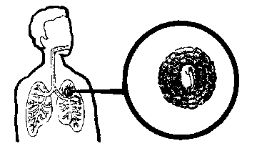
TB Invades/Infects the Lung
Effective immune
response
Infection limited
to small area of lung
Immune response
insufficient

Slide 20
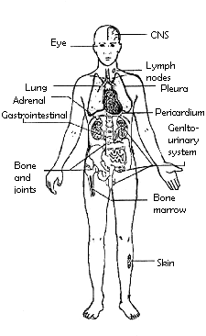
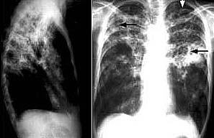
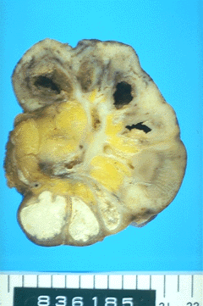
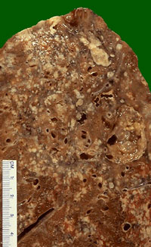
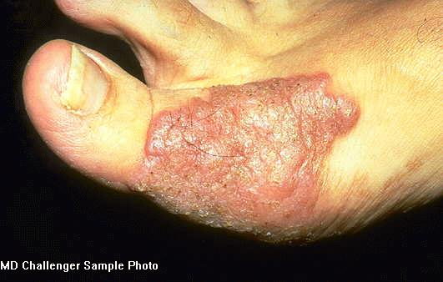
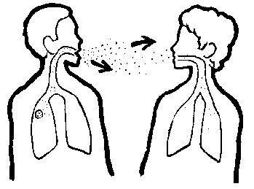
TB – A Multi-system Infection

Slide 21
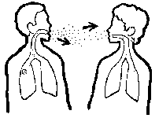


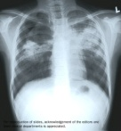
Natural History of TB Infection
Exposure to TB
No infection
(70-90%)
Infection
(10-30%)
Latent TB
(90%)
Active TB
(10%)
Never develop
Active disease
Untreated
Treated
Die within 2 years
Survive
Die
Cured

Slide 22
classification
Pulmonary TB(PTB) vs Extrapulmonary TB(EPTB)
Latent TB infection(LTBI) vs Active TB
EPTB vs Disseminated TB

Slide 23
classification
PTB
-primary PTB
-post primary PTB
EPTB
-multi-systemic manifestations

Slide 24
Primary PTB
Occurs soon after the initial infection
Middle & lower lung zones commonly involved
Lesions usually peripheral
  Hilar or paratracheal lymphadenopathy
Lesions healed spontaneously in majority of cases

Slide 25
Primary PTB
Primary PTB may progress rapidly to clinical illness if immunosuppressed
Hematogenous dissemination is common

Slide 26
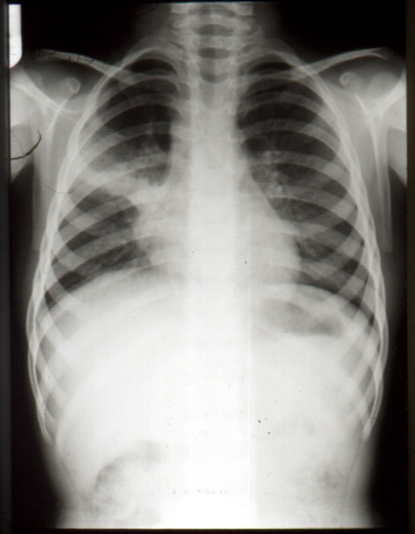
Primary
Disease

Slide 27
Post primary PTB
a.k.a adult-type, reactivation or secondary TB
Results from endogenous reactivation of latent infection
Usually localized to the apical & post segments of the upper lobes and superior segments of the lower lobes
Cavitations are present

Slide 28
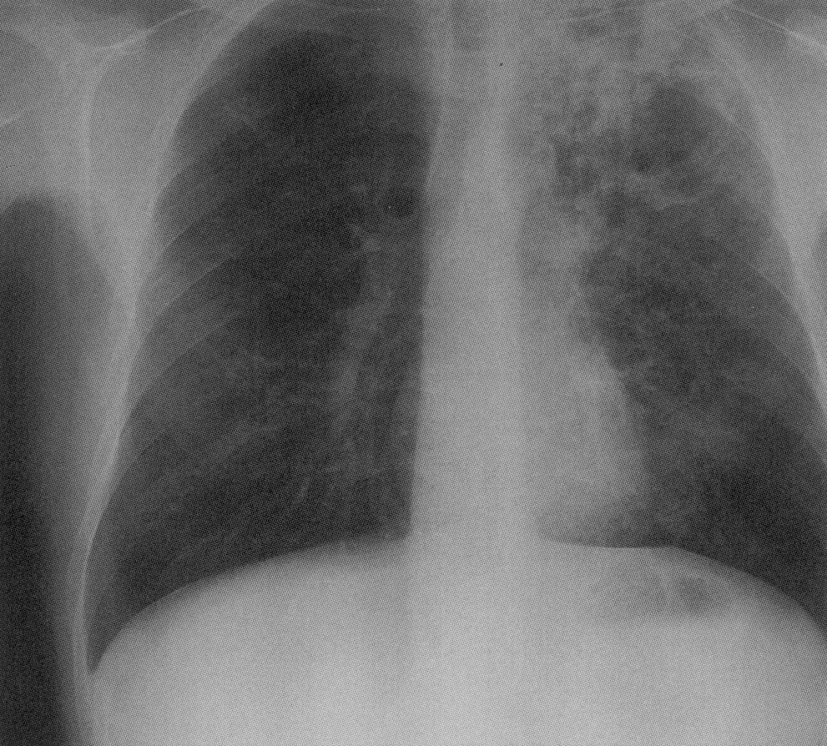
Upper lobe
cavitatory
disease

Slide 29
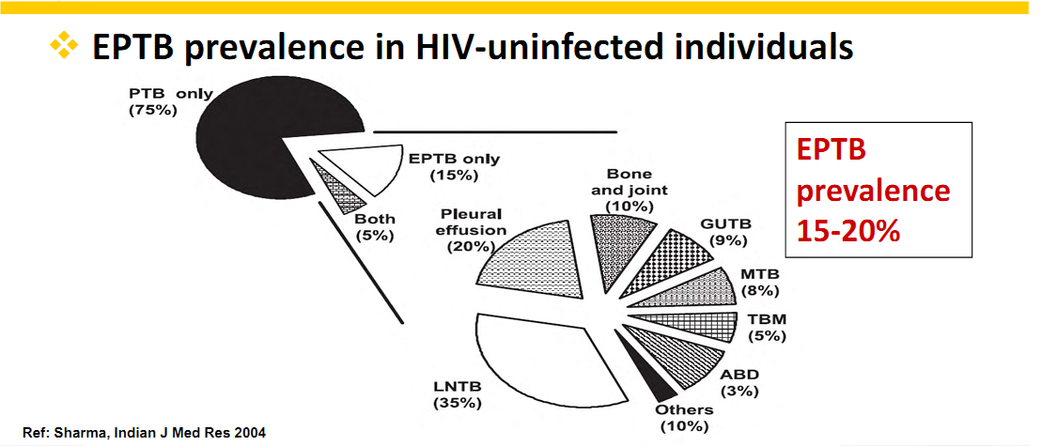

Slide 30
LTBI
Immune response limits the propagation of TBI resulting in:
-asymptomatic
-non infectious
-localized infection
that may remain in the body for many years

Slide 31
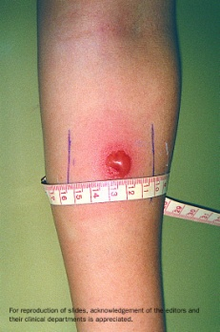


Latent TB vs. Active TB
Latent TB (LTBI) (Goal = prevent future active disease)
= TB Infection
= No Disease
= NOT SICK
= NOT INFECTIOUS
Active TB (Goal = treat to cure, prevent transmission)
= TB Infection which has
progressed to TB Disease
= SICK (usually)
= INFECTIOUS if PULMONARY (usually)
= NOT INFECTIOUS if not PULMONARY (usually)

Slide 32
TST
Diagnosis of latent TB infection depends on TST
A well-recognized limitation of the conventional TST is the lack of specificity of the purified protein derivative(PPD).
Attempts are been made to replace PPD with antigens (such as Early Secreted Antigenic Target-6(ESAT-6) & Culture Filtrate Protein-10(CFP-10) that are specific to MTB

Slide 33
TST
A standard dose is 5 tuberculin units
It is given as an intradermal injection of 2 tuberculin unit in 0.1 ml solution
It is read 48 to 72 hours later.
An exposed person is expected to mount an immune response in the skin containing the bacterial proteins.
The reaction is read by measuring the diameter of induration (palpable raised, hardened area) in millimetres.

Slide 34
Classification of TST
measurement of induration is determined to be positive depending on risk factors.
A +ve result indicates TB exposure.
5 mm or more is positive in:
  An HIV-positive person
  Persons with recent contacts with a TB patient
  Persons with nodular or fibrotic changes on chest X-ray consistent with old healed TB
  Patients with organ transplants, and other immunosuppressed patients

Slide 35
10 mm or more is positive in:
  Recent arrivals (< 5years) from high-prevalence countries
  Injection drug users
  Residents and workersof high-risk congregate settings (prisons, nursing homes, hospitals,
  Mycobacteriology lab personnel
  Persons with clinical conditions that place them at high risk (e.g., DM, Steroid therapy, leukemia, renal disease etc
  15 mm or more is positive in: Persons with no known risk factors for TB.

Slide 36
Interferon-Gamma Release Assays(IGRAs)
A recent time development is T-cell-based interferon-g release assays (IGRAs).
IGRAs are in vitro tests that are based on IFN-g release after T-cell stimulation by antigens such as early secreted antigenic target 6 [ESAT6] and culture filtrate protein 10 [CFP10])
These antigens are more specific to Mtb than the purified protein derivative.

Slide 37
IGRAs
Two IGRAs are currently available as :QuantiFERON- TB Gold (QFT) assay and the T-SPOT.TB Assay.
IGRAs have high specificity that is unaffected by BCG Vaccination.
TST, in contrast, has its specificity compromised by BCG vaccination and exposure to non-tuberculous mycobacteria

Slide 38
Determinants of case definitions of TB
Bacteriology
Site of disease
Previous
TB treatment
Smear
positive
Pulmonary
No
New Case
TB CASES
Smear
negative
RAD
Yes
Relapse
Extra-pulmonary
Transferred in
Failure
Others

Slide 39
Classification of TB cases by previous treatment
New TB cases
Re-treatment TB cases
TB patients
  never had treatment for TB
  or
  Have had < 4 weeks treatment for TB
TB patients
  Have had ≥ 4 weeks treatment for TB
  Once more smear positive and classified as one of these:
    Treatment failure
    Return after default
    Relapse
    Others

Slide 40
Classification of TB cases
New Case (N): A patient who has never had treatment for TB or who has taken anti-TB drugs for less than four weeks.
Relapse (R): A TB patient who previously received treatment and was declared cured or completed a full course of treatment and has once again developed sputum smear-positive TB
Treatment failure (F): A smear positive patient who while on Category 1 treatment remained, or became smear positive again five months or later after commencement of treatment

Slide 41
Classification of TB cases
Return after default (RAD): A TB patient who completed at least one month of Category 1 treatment and returned smear positive after at least 8 weeks of interruption of treatment
Transfer in (T.I.): A TB patient already registered for treatment in one LGA who is transferred to another LGA where s/he continues treatment

Slide 42
Classification of TB cases
Other (O): A TB patient who does not fit into one of the above case definitions:
  A patient who has been treated outside the TBLCP (net work)// for more than one month and is smear positive.
  A patient who previously received treatment and was declared cured or completed a full course of treatment and is again diagnosed by a Medical Officer as sputum smear negative TB.
  A patient who previously received treatment but outcome of treatment is un-known
  A patient who remains smear positive after completing re-treatment regimen is referred to as “chronic excretor”

Slide 43
Risk factors for TB
HIV infection
Injection drug use
Silicosis
DM
CRF
Lymphomas, leukemias
Cancers of the head, neck & lung

Slide 44
Risk factors(cont)
Malnutrition-weight loss<10% below ideal body weight
Gastrectomy/jejunoileal bypass
Contact with person with chronic cough
Immunosuppressive drugs e.g. prednisolone, TNF blocking agents

Slide 45
Identifying Pulmonary Tuberculosis (PTB) Suspects
Any person coughing for ≥3 weeks , with or without symptoms should be suspected of PTB.
Other associated symptoms include:
  Cough
  Chest pain
  hemoptysis
Other constitutional
/general symptoms:
  Weight loss
  Tiredness
  Low grade fever
  drenching night sweats
  Loss of appetite

Slide 46
Identifying Extra-pulmonary Tuberculosis (EPTB) Suspects
A person with EPTB will show features depending on the affected organ and some general symptoms
Symptoms specific to affected organ:
  Spinal TB = back swelling, difficulty or inability to walk
  Abdominal TB = Painless abdominal swelling
  TB adenitis = non-painful asymmetrical swollen node
  TB meningitis = signs & symptoms of meningeal irritation
Other constitutional /general symptoms:
  Weight loss
  Tiredness
  Low grade intermittent fever
  Night sweats
  Loss of appetite

Slide 47
investigations
AFB microscopy
Carbofuchsin based(Ziehl-Neesen, Kinyoun)
3 sputum samples
Mycobacterial culture
Lowenstein-Jensen
Middlebrook 7H10

Slide 48
IMPROVED AND NEWER CULTURE METHODS
New automated systems that are faster include the BACTEC 9000, and Mycobacterial Growth Indicator Tube (MGIT).
These are more sensitive than solid media for detecting Mtb
They also reduce delays in obtaining results to days rather than weeks. Their use for drug susceptibility results in even greater time savings.
Limitations: liquid systems are prone to contamination and require stringent quality assurance systems.
they are expensive and require equipment investments

Slide 49
Nucleic Acid Amplication
Radiographic studies
CXR(upper lobe infiltrates, cavities
CT(EPTB)
MRI( intracranial TB)
FBC+ESR
CSF, Pleural fluid, lymph nodes(EPTB)
RVS

Slide 50
investigations
Drug Susceptibility Testing
Mono-drug resistance TB
Poly-drug resistance TB
MDRTB
XDRTB
TDRTB
LFT
E/U/Cr
Notes:
Mono – resistance to only one first line drug.
Poly – resistance to 2 first line drugs except rifampicin and isoniazid.
Multi – resistance to isoniazid and rifampicin
Extensive – resistance to first line drugs, at least one second line injectable and at least one fluoroquinolone.
Total – resistance to all tb drugs.

Slide 51
Treatment
  Objectives of treatment
    To ensure cure without relapse.
    To prevent death
    To stop transmission.
    To prevent emergence of drug resistant cases.
  NB
    Treatment of active TB should never be attempted with a single drug
    Single drug should never be added to a failing regimen
    All recommended regimen have 2 phases (initiation and continuation)
    The initial intensive phase is designed to kill actively growing and semi-dormant bacilli.
    At least 2 bactericidal drug INH and rifampicin are necessary in the initiation phase
    Pyrazinamide giving in the initial intensive phase allow the duration of treatment to be reduced from 9 to 6 months.
    Addition of the ethambutol is of benefit when initial drug resistance is suspected or where the burden of organism is high.
    Continuation phase aims to eliminate most residual bacilli and reduces numbers if failures and relapse.

Slide 52
Grouping | Drugs/Codes
Group 1: First-line oral anti-TB drugs | Isoniazid (H); Rifampicin (R); Ethambutol (E); Pyrazinamide (Z).
Group 2: Injectable anti-TB drugs | Kanamycin (Km); Amikacin (Am); Capreomycin (Cm); Viomycin (Vi)
Group 3: Fluoroquinolones | Ciprofloxacin (Cfx); Ofloxacin (Ofx); Levofloxacin (Lfx); Moxifloxacin (Mfx); Gatifloxacin Gfx).
Group 4: Oral bacteriostatic second-line anti-TB drugs | Ethionamide (Eto); Prothionamide ((Pto); Cycloserine (Cs); Terizidone ((Trd); P-aminosalicylic acid (PAS); Thiacetazone (Th).
Group 5: Anti-TB drugs with uncertain efficacy | Clofazimine (Cfz); Amoxicillin/Clavulanate (Amx/Clv); Clarithromycin (Clr); Linezolid

Slide 53
ESSENTIAL ANTI-TB DRUGS
They have 3 main properties;
Bactericidal activity
Sterilizing activity
The ability to prevent resistance
The essential anti-TB drugs possess this properties to different extent
INH & Rifampicin –most powerful active against all populations
Rifampicin most potent
Pyrazinamide -active in acidic environment
Streptomycin- bactericidal against rapidly multiplying TB bacilli
Ethambutol and Thacetazone-to prevent resistance

Slide 54
Dosages of first line antituberculosis drugs and major adverse effects
Isoniazid |  | 5 mg/kg oral (maximum 300 mg) | 900 mg twice weekly 600 mg thrice weekly |  | Hepatitis, peripheral neuritis, drug induced lupus, seizures, and hypersensitivity with rash and fever. Drug interactions with dilantin and disulfiram
Rifampicin |  | 10 mg/kg oral (maximum 600 mg) | 10 mg/kg 600 mg twice weekly 600 mg thrice weekly |  | Orange body secretions, flu-like syndrome, hepatitis, thrombocytopenia, nausea, anorexia, diarrhoea, renal failure, and multiple drug interactions
Pyrazinamide |  | 25-30 mg/kg oral | 30-35 mg/kg |  | Hyperuricemia, hepatitis, rash, nausea, and anorexia
Ethambutol |  | 25 mg/kg initial 2 months, then 15 mg/kg oral | 50 mg/kg twice weekly 30 mg/kg thrice weekly |  | Optic neuritis and gastrointestinal discomfort
Streptomycin |  | 15 mg/kg intravenously or intramuscularly (maximum 1.0 g) 5 days a week | 15 mg/kg (maximum 1.5 g) twice weekly or thrice weekly |  | Ototoxicity, vestibular dysfunction, nephrotoxicity, rash, and hypersensitivity reactions
Dosage
Adverse effects
Drug
Twice or thrice weekly
Daily
Notes:
Rifampicin – red colouration of secretions
Isoniazid – peripheral neuritis
Pyrazinamide – hyperuricemia
Ethambutol – optic neuritis
Streptomycin - ototoxicity

Slide 55
Table 1. Current regimens for treatment of drug susceptible tuberculosis
Daily* | 2 months of isoniazid, rifampicin, and pyrazinamide, with or without ethambutol | 4 months of isoniazid and rifampicin
Intermittent | 2 weeks of daily isoniazid, rifampicin, pyrazinamide and streptomycin or ethambutol | 24 weeks of twice weekly isoniazid and rifampicin
 | 8 weeks of thrice weekly isoniazid, rifampicin, pyrazinamide and streptomycin or ethambutol§ | 18 weeks of thrice weekly isoniazid and rifampicin§
* The daily regimen is used when patients self administer their drugs. There is enough redundancy that, if patients miss some of their doses, the outcome will remain acceptable.
The intermittent regimens are intended for directly observed therapy.
Regimen
Initial phase
Continuation phase

Slide 56
RECOMMENDED STANDARDIZED TREATMENT REGIMENS FOR NEW CASES
Treatment regimens have an initial (intensive) phase- 2months & continuation phase usually lasting 4 or 6months
During the initial phase normally consisting INH,Rifampicin,Pyrazinamide & Ethambutol—the tubercle bacilli are killed rapidly,symptoms abate & sputum becomes negative
Continuation phase- fewer drugs,longer time & sterilizing effect of drugs eliminates remaining bacili and prevents relapse
Ethambutol may be omitted for patients with non-cavitatry ,smear negative PTB,HIV negative, patients with fully drug susceptible bacilli & young children with primary TB

Slide 57
RECOMMENDED STANDARDIZED TREATMENT REGIMENS FOR RE-TREATMENT CASES
Previously treated TB patients include those patients treated as new cases for more than 1 month who are now smear or culture positive(failure,relapse,return after default)
These category of px have higher likelihood of drug resistance esp. to INH
Re-treatment regimen consist of 5 drugs in initial phase & 3 drugs in the continuation (2SHRZE/1HRZE/5HRE)
This regime can cure px excreting bacilli resistant to INH and or streptomycin

Slide 58
MONITORING THE TREATMENT RESPONSE
Adults should have measurement of serum bilirubin, hepatic enzymes,urea nitrogen,creatinine,and complete blood count before starting chemotherapy for TB
Visual acuity and red-green colour test before initiation of ethambutol
Serum uric acid before initiation of pyrazinamide
Audiometry before streptomycin
Monthly follow up of patient is needed including sputum smear and cultures
Patient with negative smear after 2 months should have at least one sputum and culture test at the end of therapy
MDRTB Should have sputum cultures monthly

Slide 59
MANAGEMENT OF TB IN SPECIAL SITUATIONS
EXTRA PULMONARY TUBERCULOSIS
  In extra pulmonary TB there are fewer organisms but regimens used for pulmonary TB are effective.
  Can be classified into severe and non severe forms
  Severe forms include:
        Meningeal and central nervous system TB
        Spinal tuberculosis,
        Abdominal TB
        Bilateral pleural effusion
        Pericardial effusion
        Bone and join TB involving more than one site

Slide 60
LIVER DISEASE & TB
  The use of anti TB drug can be double-edged sword in patients with liver disease, since all major TB medication are associated with liver toxicity.
  Hepatic function monitoring is mandatory during treatment.
  Drug-induced hepatitis can be fatal.
  WHO recommend that pyrazinamide should not be used in patient with new chronic liver disease.
  In decompensated liver disease, a regimen without rifampicin appears to be safer.
  Streptomycin, ethambutol, and a reserve drug such as fluoroquiolone can be used in treatment in patient with fulminant liver disease.

Slide 61
Tuberculosis in patient with HIV infection
TB remains an important problem in px with HIV infection in the US
HIV infection and susceptibility to TB
HIV infected patient are at risks for primary or reactivation of TB and for second episode of TB from exogenous re-infection.
Susceptibility is related to pattern of cytokines produced by T-lymphocytes.
T₁ – lymphocytes which produces interferon-γ are central to anti-mycobacterial immune defenses
Fatal mycobacterial disease develop in children who lack interferon-γ receptors.
T₂ – lymphocytes which produce interleukin 4 and interleukin 10 do not contribute to antimycobacterial immunity.
Reduced T₁ response in HIV infected patient contribute to susceptibility to TB.

Slide 62
TB and course of HIV infection
Exposure of alveolar macrophages and lymphocyte from HIV infected patient to m-tuberculosis in-vitro up regulate retroviral replication.
Pleural fluid of patient with TB increase HIV replication in activated lymphocytes.
M-tuberculosis probably increase HIV replication by inducing macrophages to produce TNF-α, interleukin-1 and interleukin-6.
Risk of death in HIV infected patient with TB was reported to be twice that in HIV infected patient without TB independent of the CD4 cell count.
High mortality rate appeared to be due to progressive HIV infection.
Degree of immunosuppression is the most important predictor of survival in HIV infected patient with TB.
Immune restoration induced by HAART in developed countries may be responsible for the paradoxical worsening of TB manifestation-(Immune reconstruction inflammatory response)

Slide 63
Clinical presentation and Radiographic findings in HIV/PTB
  As the level of immunosuppression increases in HIV infected patient, myco bacteremia and extra pulmonary TB become progressively more common.
  In HIV infected patient with FUO, diagnostic studies for extra pulmonary should be undertaken.
  Clinical presentation of abdominal TB in HIV infected patient is characterized by visceral lesions and intra-abdominal lymphadenopathy with necrosis which is best seen with CT.
  In contrast ascites and omental thickening are characteristic of abdominal TB in HIV negative patient.
  Clinical presentation of TB – meningitis is similar in HIV positive and immunocompetent patient except that intra cerebral mass lesion are common in HIV infected patient
  In HIV patient with TB who have CD4 count of 200 or more per cubic millimeters-chest radiographic findings include upper lobe inflitration and cavitation similar to those in HIV negative patient withTB.
  In those with CD4 count < 200, mediastinal adenopathy is common similar to HIV negative children with primary TB.
  About 5% of HIV infected patient with TB have positive result on acid fast staining of sputum despite normal chest radiograph.

Slide 64
Treatment of TB in HIV pxs
  Recent guideline by CDC states that minimal duration of therapy is 6 months but if clinical or bacteriologic respond is slow, treatment should be given for a total of 9 months or for 4 months after cultures become negative.
  Standard 6 month regimen in HIV patient with drug susceptible TB result in prompt sterilization of sputum and low rates of treatment failure
  However, studies have shown higher rate of relapse in HIV infected patient who received 6 months therapy as compare to 9 or 12 months therapy.
  DOT therapy is strongly recommended

Slide 65
  New anti-retroviral combination regimen have dramatically improve the prognosis for HIV infected patient with TB.
  Rifampicin induces activities of cytochrome P-450 CYP3A which reduces the concentration of HIV Protease inhibitors(Pis) and NNRTI to subtherapeutic levels leading to incomplete viral suppression and emergence of drug resistance
  Concomitant administration of rifampicin with PIs and NNRTI is not recommended.
  Rifabutin - less potent inducer of cytochrome P-450 CYP3A can be administered in combination with PI-indinavir or nelfinavir or amprenavir which is still under development.
  Rifabutin should not be used with hard gel formulation of saquinavir because of decrease drug levels
  Indinavir can be given in increase dose of 1000 mg every 8 hrs in patient receiving rifabutin- this reduces a likelihood of drug resistant HIV mutant.
  PIs inhibit metabolism of rifabutin with increased likelihood of developing uveitis- a reduce dose of rifabutin, 150mg daily is recommended.

Slide 66
  Use of rifabutin with NNRTI e.g. nevirapine and efavirenz should be approached with caution since resistance of HIV to both of them is conferred by a single mutation.
  PIs are recommended as part of initial therapy in patient with > 5000 copies of HIV RNA per ml
  Thiacetazone should never be used, since it is associated with increased risk of severe and in some cases fatal skin reactions.

Slide 67
Immune Reconstitution Inflammatory Syndrome(IRIS)
Paradoxical reaction characterized by fever, worsening chest infiltration on radiography and peripheral and mediastinal lymphadenopathy have been noticed in patient with HIV during anti TB therapy.
A marked reduction of HIV burden and marked increase in reactivity in tuberculin skin test can accompany this reaction-suggesting stronger immune response to M.tuberculosis after retroviral therapy.
Paradoxical reaction are self limiting and generally last 10 to 40 days but may require treatment with glucocorticoid in severe reactions

Slide 68
PROGNOSIS
Almost all properly treated patients with TB can be cured
Relapse rates are less than 5% with current regimens
Main cause of treatment failure is non adherence to therapy

