Slide 1
Layout of User Forms in the Input Tools
About the placement of each control and the object name

Slide 2
About this file
This file lists the placement of the various controls used in the input tool and the names of the objects. Use it as a reference when reading the code on the user form.
There are some exceptions, but basically ufSet1 makes labels (lbl) to have a height of 10 points and a width of 90 points, text boxes (txt) to have a height of 15 points and a width of 90 points, combo boxes (cmb) to have a height of 15 points and a width of 140 points, and check boxes (chk) to have a height of 15 points and a width of 90 points. (1 point corresponds to about 1/72 inch).
The object names shown on this slide are only the initial state. Some of the object names change depending on the input data. Please check the code for details.
The red lines in the user form layout are marked with numbers at the top, bottom, left, and right ends of the slide, which are measured from the top or right (unit: points).

Slide 3
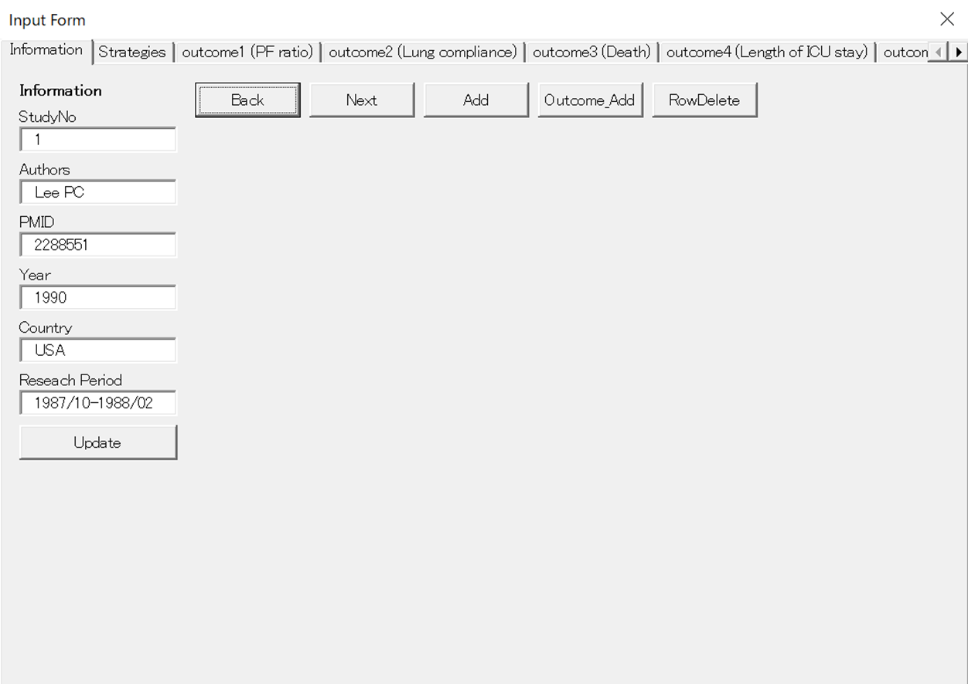
Layout of ufSet1 (Information tab)

Slide 4
Layout of ufSet1 (Information tab)
₁₀
₁₀
₁₀₀
₁₁₀
₁₇₀
₁₇₅
₂₃₅
₂₄₀
₃₀₀
₃₀₅
₃₆₅
₃₇₀
₄₂₀
₁₀
₂₀
₂₀
₂₅
₂₅
₃₅
₃₅
₅₀
₅₀
₅₅
₅₅
₆₅
₆₅
₈₀
₈₀
₈₅
₈₅
₉₅
₉₅
₁₁₀
₁₁₀
₁₁₅
₁₁₅
₁₂₅
₁₂₅
₁₄₀
₁₄₀
₁₄₅
₁₄₅
₁₅₅
₁₅₅
₁₇₀
₁₇₀
₁₇₅
₁₇₅
₁₈₅
₁₈₅
₂₀₀
₂₀₀
₂₀₅
₂₀₅
₂₃₅
₂₃₅
₁₀
₁₀₀
₁₁₀
₁₇₀
₁₇₅
₂₃₅
₂₄₀
₃₀₀
₃₀₅
₃₆₅
₃₇₀
₄₂₀

Slide 5
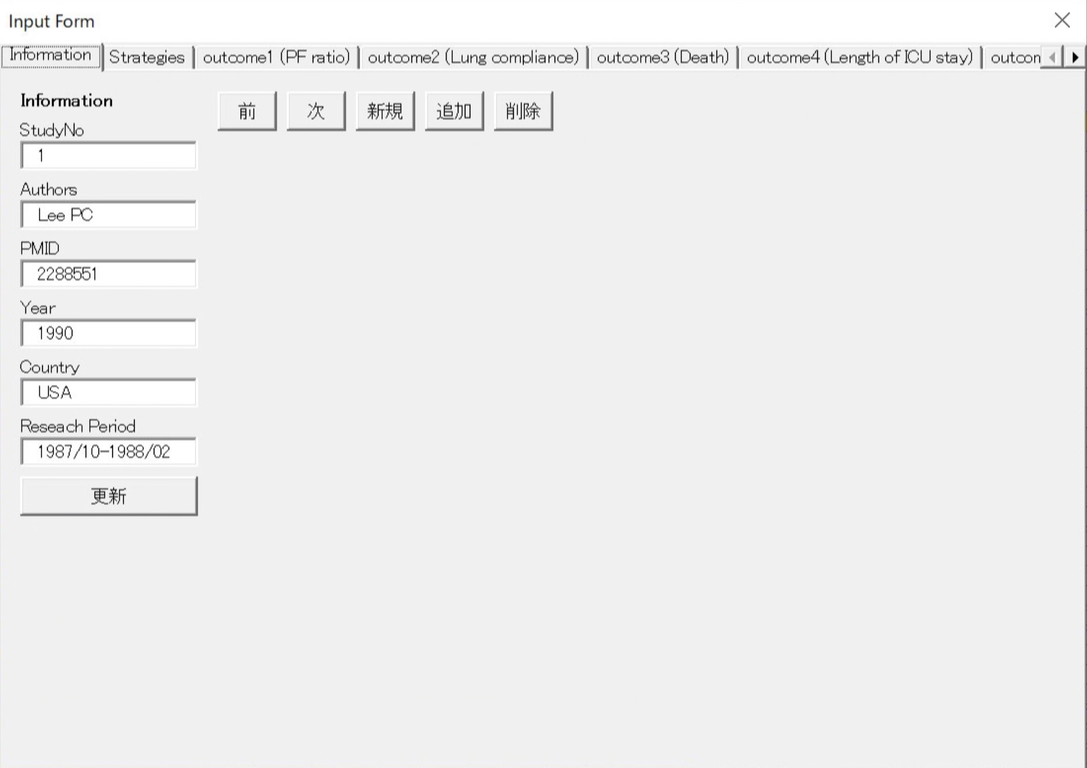
Layout of ufSet1 (Information tab)
_{pageinformation}
_{pagestrategies}
_{pageout1}
_{pageout2}
_{pageout3}
_{pageout4}
_{lblinformation}
_{btnBack}
_{btnNext}
_{btnAdd}
_{btnOutcome} _{_Add}
_{btnRowDelete}
_{lblStudyNo}
_{txtStudyNo}
_{lblAuthors}
_{txtAuthors}
_{lblPMID}
_{txtPMID}
_{lblYear}
_{txtYear}
_{lblCountry}
_{txtCountry}
_{lblResearhPeriod}
_{txtResearchPeriod}
_{btnUpdate}

Slide 6
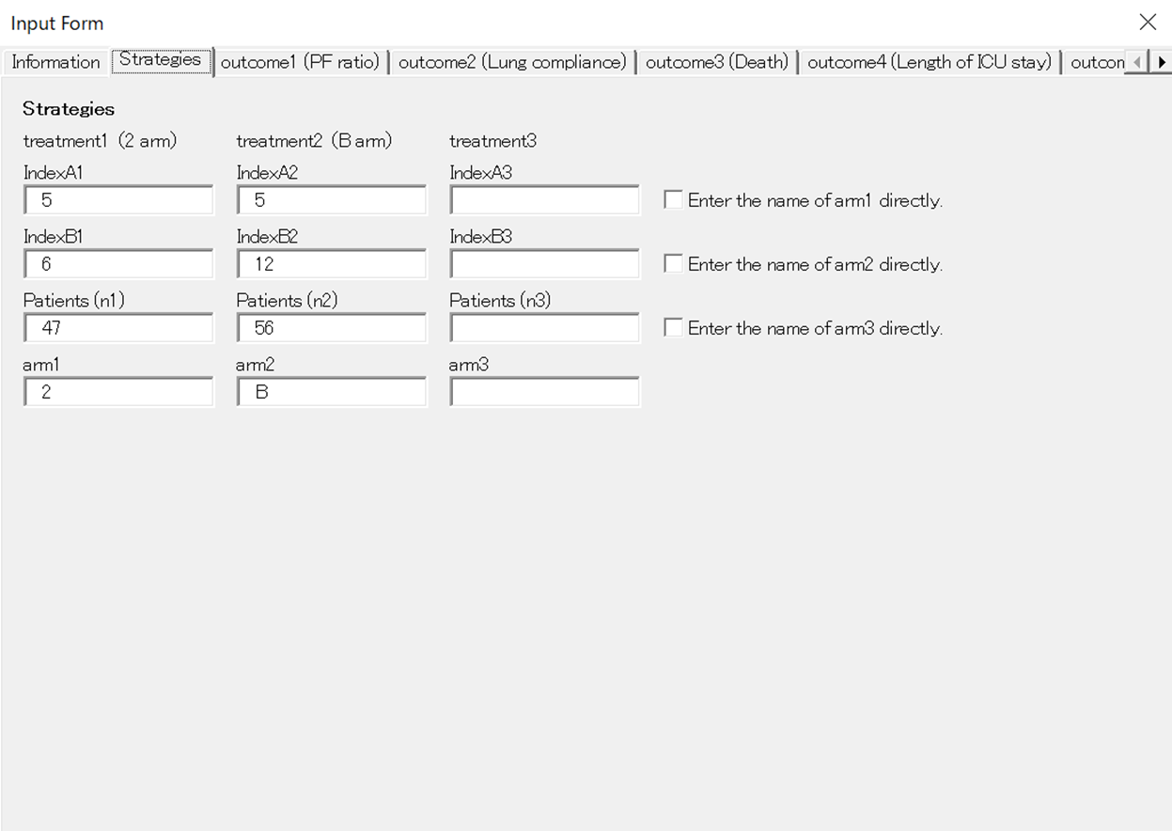
Layout of ufSet1 (Strategies tab)

Slide 7

Layout of ufSet1 (Strategies tab)
₁₀
₁₀
₁₀₀
₁₁₀
₂₀₀
₂₁₀
₃₀₀
₃₁₀
₄₀₀
₁₀
₂₀
₂₀
₂₅
₂₅
₃₅
₃₅
₄₀
₄₀
₅₀
₅₀
₆₅
₆₅
₇₀
₇₀
₈₀
₈₀
₉₅
₉₅
₁₀₀
₁₀₀
₁₁₀
₁₁₀
₁₂₅
₁₂₅
₁₃₀
₁₃₀
₁₄₀
₁₄₀
₁₅₅
₁₅₅
₁₀
₁₀₀
₁₁₀
₂₀₀
₂₁₀
₃₀₀
₃₁₀
₄₀₀

Slide 8
Layout of ufSet1 (Strategies tab)
_{pageinformation}
_{pagestrategies}
_{pageout1}
_{pageout2}
_{pageout3}
_{pageout4}
_{lblmaintitle}
_{lbltr1}
_{lbltr2}
_{lbltr3}
_{lblIndexAtr1}
_{lblIndexAtr2}
_{lblIndexAtr3}
_{txtIndexAtr1}
_{txtIndexAtr2}
_{txtIndexAtr3}
_{chkarm1}
_{lblIndexBtr1}
_{lblIndexBtr2}
_{lblIndexBtr3}
_{txtIndexBtr1}
_{txtIndexBtr2}
_{txtIndexBtr3}
_{chkarm2}
_{lblntr1}
_{lblntr2}
_{lblntr3}
_{txtntr1}
_{txtntr2}
_{txtntr3}
_{chkarm3}
_{lblarm1}
_{lblarm2}
_{lblarm3}
_{txtarm1}
_{txtarm2}
_{txtarm3}

Slide 9
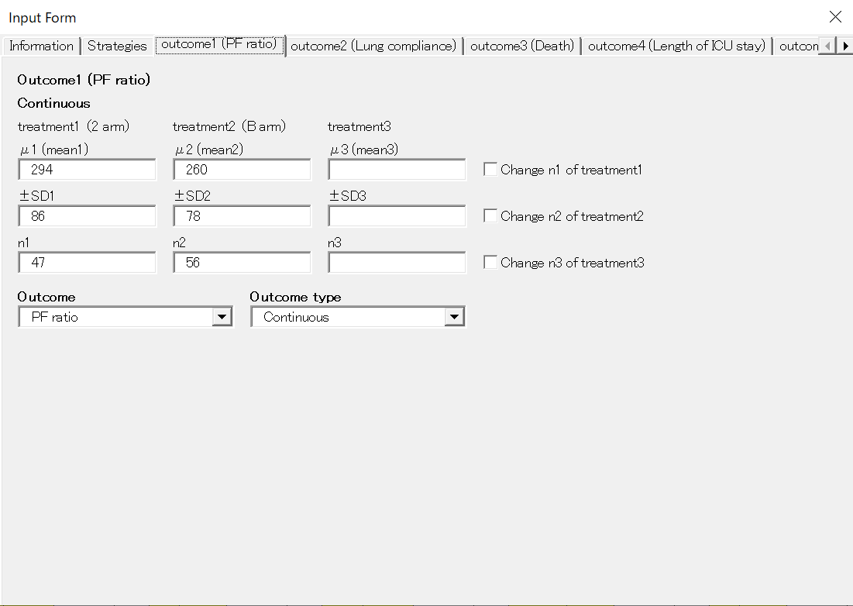
Layout of ufSet1 (Outcome tab: Continuous)

Slide 10

Layout of ufSet1 (Outcome tab: Continuous)
₁₀
₁₀
₁₀₀
₁₁₀
₂₀₀
₂₁₀
₃₀₀
₃₁₀
₄₀₀
₁₀
₂₀
₂₀
₂₅
₂₅
₃₅
₃₅
₄₀
₄₀
₅₀
₅₀
₅₅
₅₅
₆₅
₆₅
₈₀
₈₀
₈₅
₈₅
₉₅
₉₅
₁₁₀
₁₁₀
₁₁₅
₁₁₅
₁₂₅
₁₂₅
₁₄₀
₁₄₀
₁₅₀
₁₅₀
₁₆₀
₁₆₀
₁₇₅
₁₇₅
₁₀
₁₅₀
₁₆₀
₃₀₀
₃₁₀
₄₀₀

Slide 11
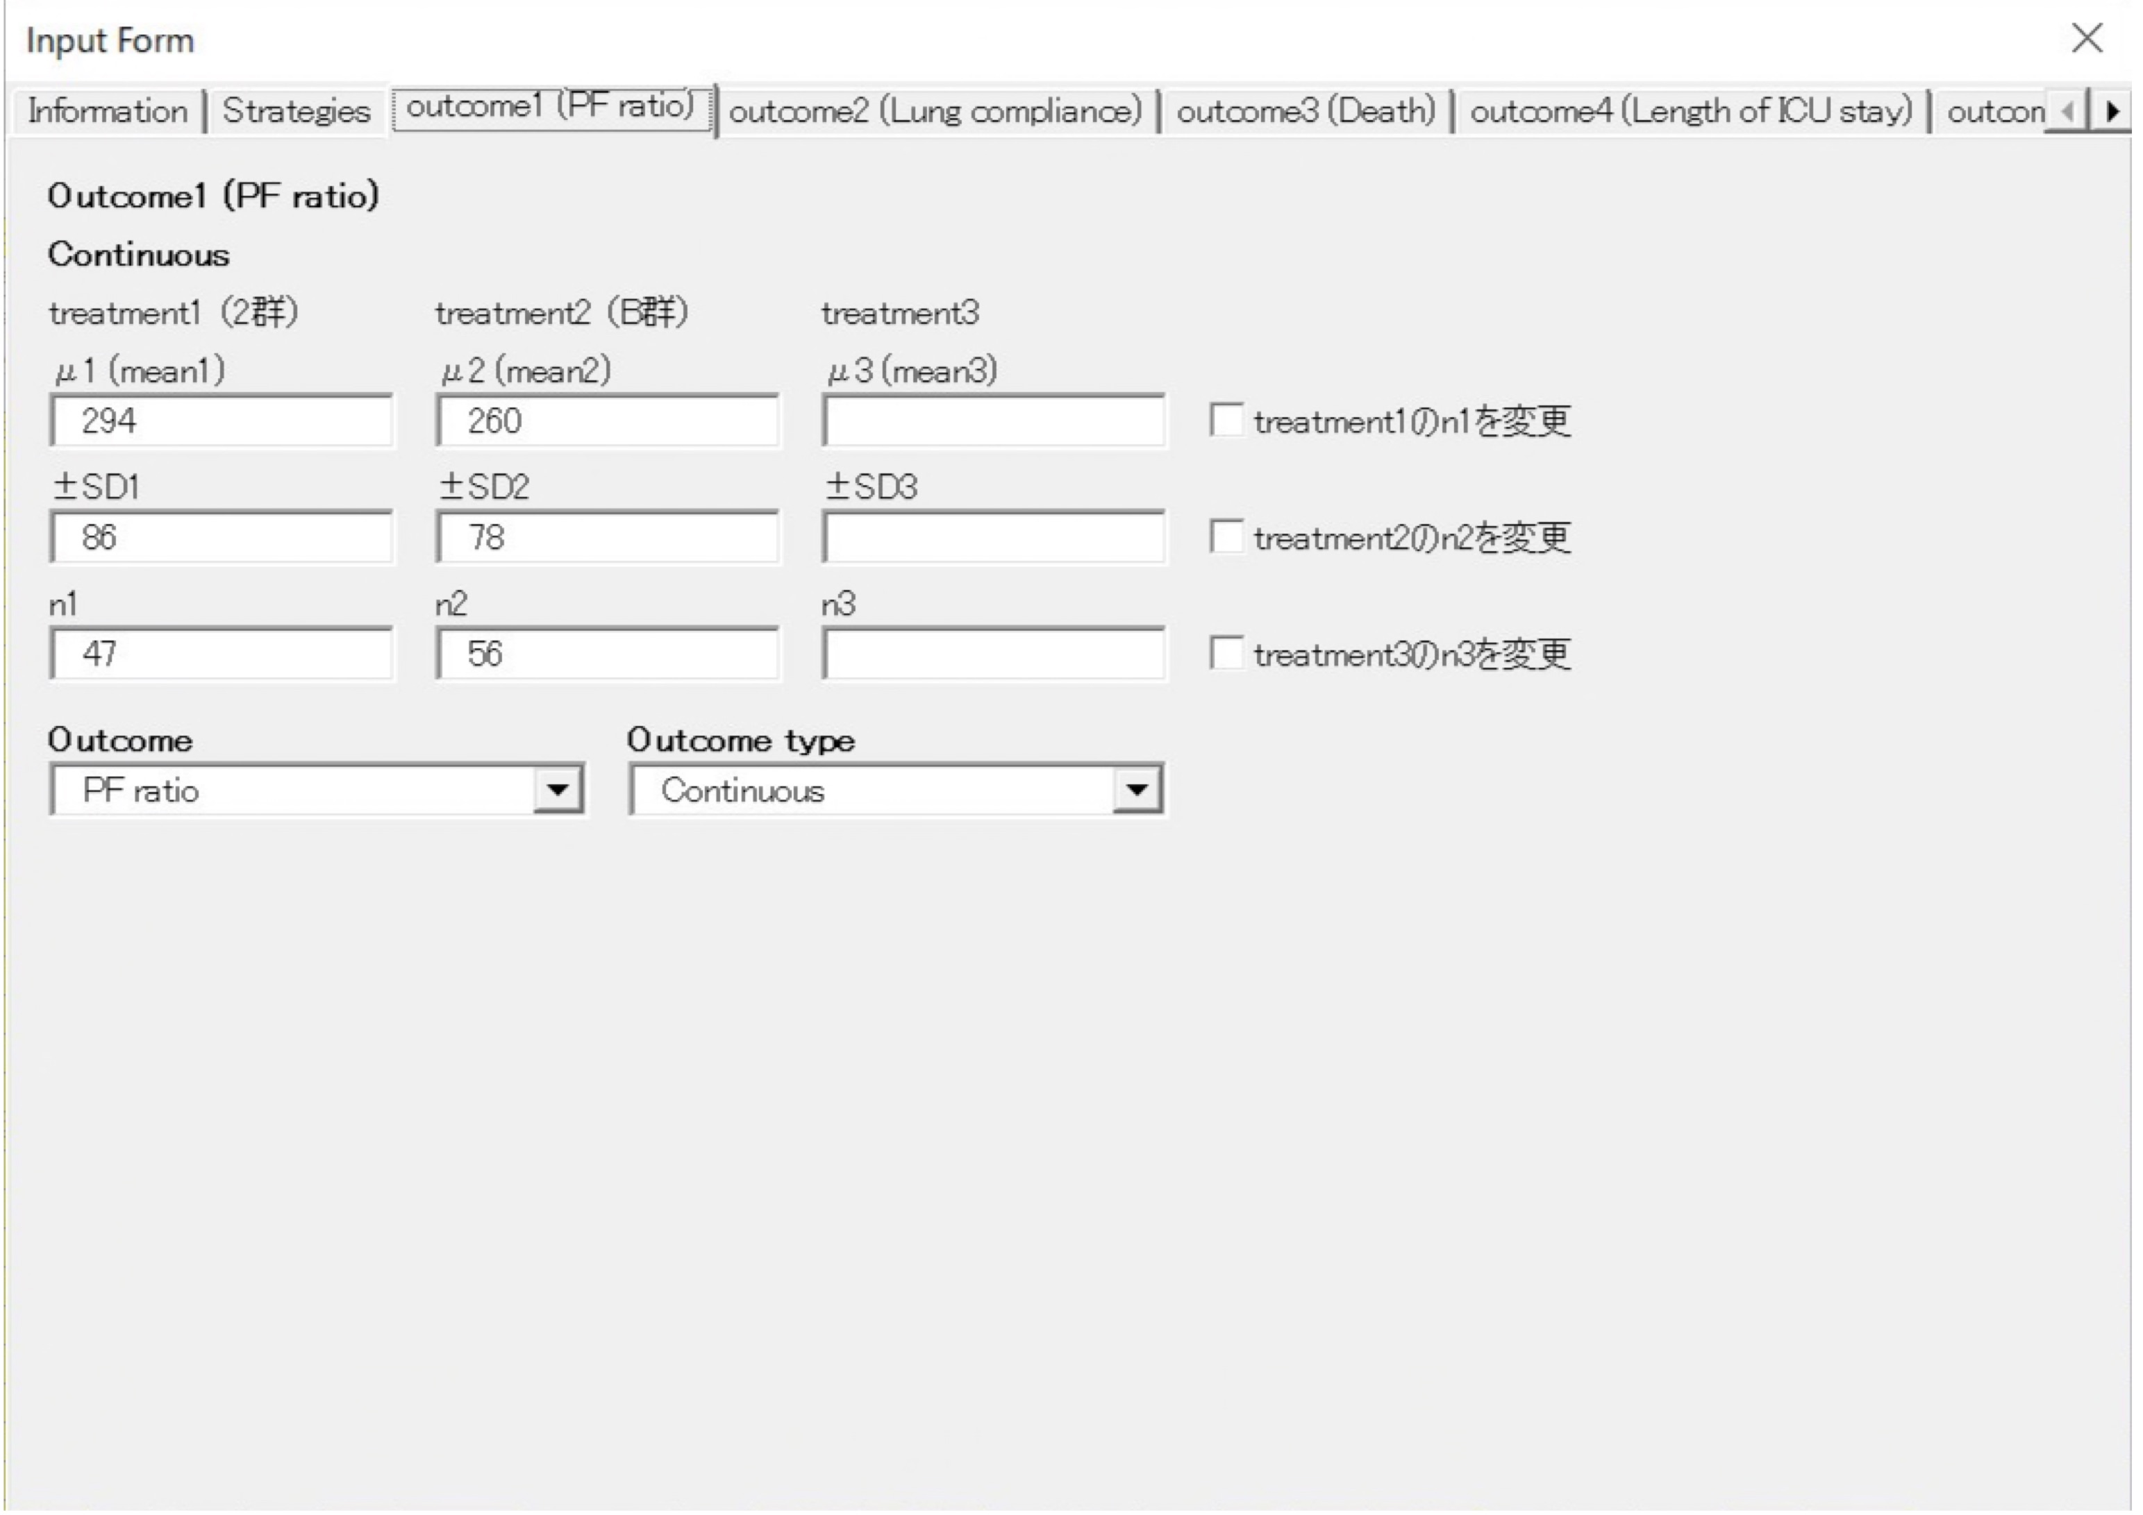
ufSet1 (Outcome tab: sub1 if Continuous)
_{pageinformation}
_{pagestrategies}
_{pageout1}
_{pageout2}
_{pageout3}
_{pageout4}
_{lblout1maintitle}
_{lblout1subtitle1}
_{lblout1sub1tr1}
_{lblout1sub1tr2}
_{lblout1sub1tr3}
_{lblout1meantr1}
_{lblout1meantr2}
_{lblout1meantr3}
_{txtout1meantr1}
_{txtout1meantr2}
_{txtout1meantr3}
_{chkout1sub1tr1}
_{lblout1sdtr1}
_{lblout1sdtr2}
_{lblout1sdtr3}
_{txtout1sdtr1}
_{txtout1sdtr2}
_{txtout1sdtr3}
_{chkout1sub1tr2}
_{lblout1sub1ntr1}
_{lblout1sub1ntr2}
_{lblout1sub1ntr3}
_{txtout1sub1ntr1}
_{txtout1sub1ntr2}
_{txtout1sub1ntr3}
_{chkout1sub1tr3}
_{lblcmb1}
_{lbltype1}
_{cmb1}
_{cmbtype1}

Slide 12
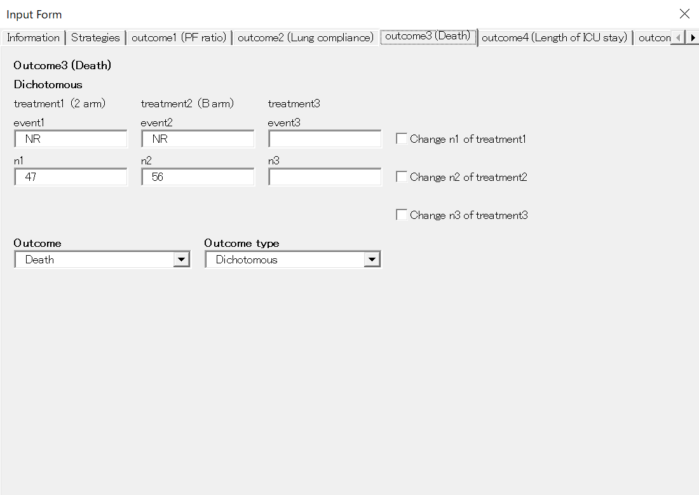
Layout of ufSet1 (Outcome tab: Dichotomous)

Slide 13

Layout of ufSet1 (Outcome tab: Dichotomous)
₁₀
₁₀₀
₁₁₀
₂₀₀
₂₁₀
₃₀₀
₃₁₀
₄₀₀
₁₀
₁₀
₂₀
₂₀
₂₅
₂₅
₃₅
₃₅
₄₀
₄₀
₅₀
₅₀
₅₅
₅₅
₆₅
₆₅
₈₀
₈₀
₈₅
₈₅
₉₅
₉₅
₁₁₀
₁₁₀
₁₂₅
₁₂₅
₁₄₀
₁₄₀
₁₅₀
₁₅₀
₁₆₀
₁₆₀
₁₇₅
₁₇₅
₁₀
₁₅₀
₁₆₀
₃₀₀
₃₁₀
₄₀₀

Slide 14
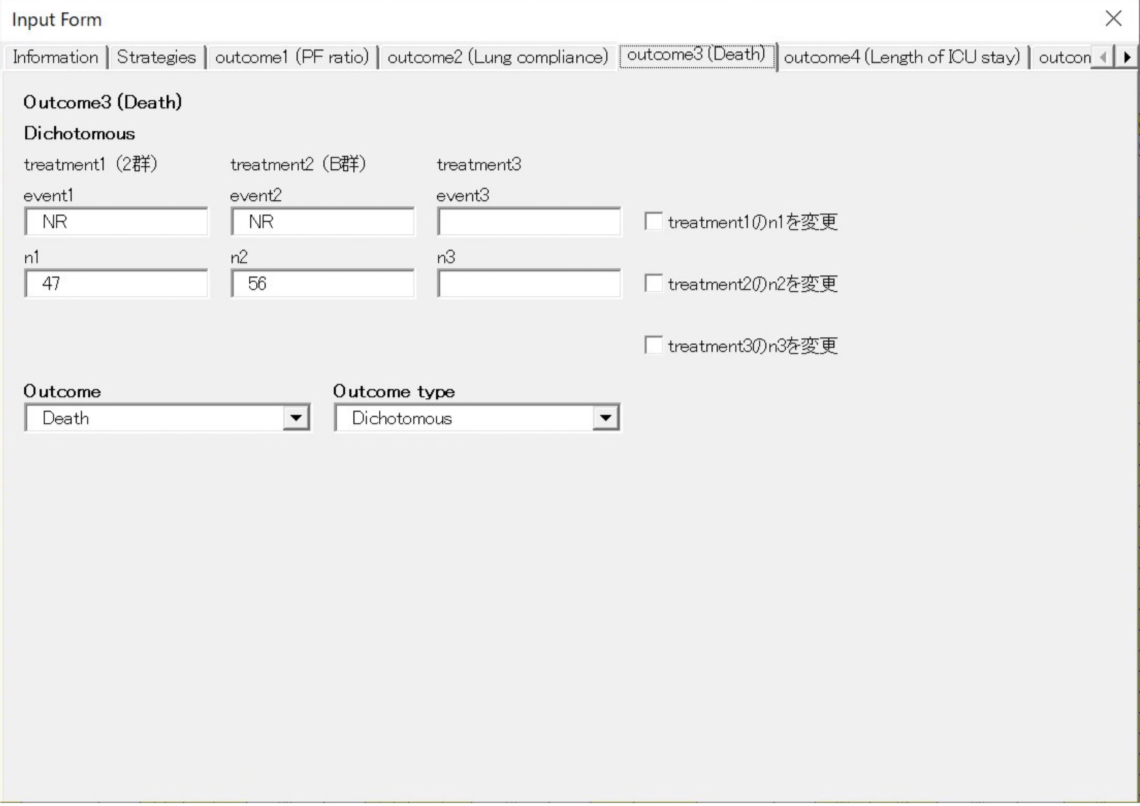
ufSet1 (Outcome tab: sub2 if Dichotomous)
_{pageinformation}
_{pagestrategies}
_{pageout1}
_{pageout2}
_{pageout3}
_{pageout4}
_{lblout3maintitle}
_{lblout3subtitle2}
_{lblout3sub2tr1}
_{lblout3sub2tr2}
_{lblout3sub2tr3}
_{lblout3eventtr1}
_{lblout3eventtr2}
_{lblout3eventtr3}
_{txtout3eventtr1}
_{txtout3eventtr2}
_{txtout3eventtr3}
_{chkout3sub2tr1}
_{lblout3sub2ntr1}
_{lblout3sub2ntr2}
_{lblout3sub2ntr3}
_{txtout3sub2ntr1}
_{txtout3sub2ntr2}
_{txtout3sub2ntr3}
_{chkout3sub2tr2}
_{chkout3sub2tr3}
_{lblcmb3}
_{lbltype3}
_{cmb3}
_{cmbtype3}

Slide 15
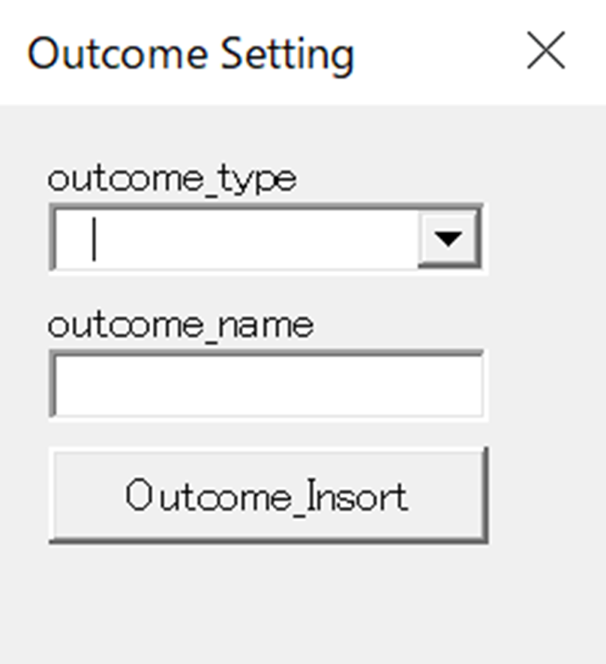
Layout of ufSet2

Slide 16
Layout of ufSet2
₁₀
₁₀₀
₁₀
₁₀
₂₀
₂₀
₃₅
₃₅
₄₀
₄₀
₅₀
₅₀
₆₅
₆₅
₇₀
₇₀
₉₀
₉₀
₁₀
₁₀₀

Slide 17
Layout of ufSet2
_{lbloutcome_type}
_{cmboutcome_type}
_{lbloutcome_name}
_{txtoutcome_name}
_{btnOutcome_Insort}

Slide 18
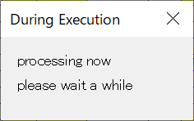
Layout of ufSet4

Slide 19
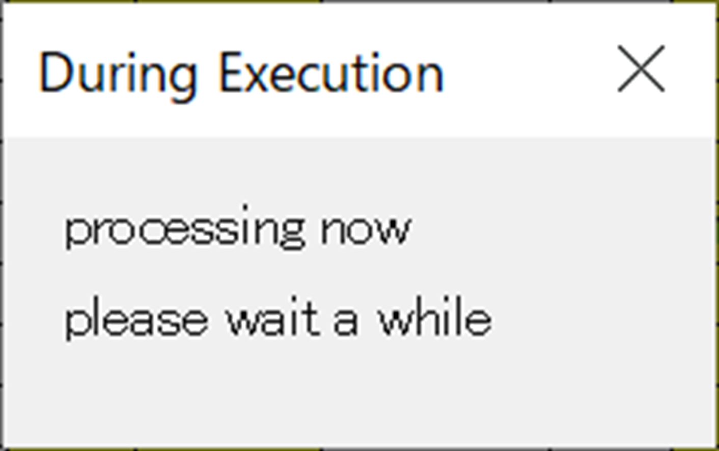
Layout of ufSet4
₁₀
₁₀₀
₁₀
₁₀
₂₀
₂₀
₂₅
₂₅
₃₅
₃₅
₁₀
₁₀₀

Slide 20
Layout of ufSet4
_{lblprocess}
_{lblwait}

Slide 21
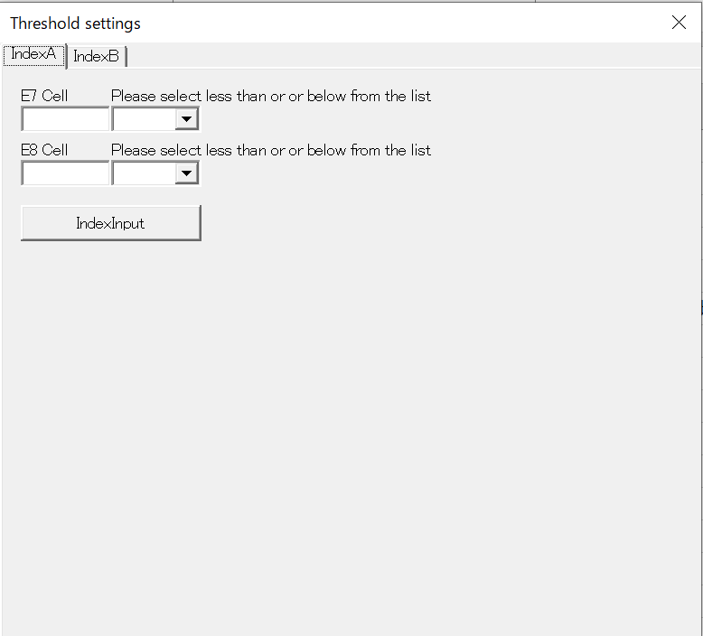
Layout of ufSet5 (IndexA tab)

Slide 22

Layout of ufSet5 (IndexA tab)
₁₀
₆₀
₁₁₀
₂₄₀
₁₀
₁₀
₂₀
₂₀
₃₅
₃₅
₄₀
₄₀
₅₀
₅₀
₆₅
₆₅
₇₅
₇₅
₉₅
₉₅
₁₀
₁₁₀
₂₄₀

Slide 23
Layout of ufSet5 (IndexA tab)
_{Pages(0)}
_{.Pages(1)}
_{lblIndexALow_max_value}
_{lblIndexAsign1}
_{txtIndexALow_max_value}
_{cmbIndexAsign1}
lblIndexAIntermediate_max_value
_{lblIndexAsign2}
txtIndexAIntermediate_max_value
_{cmbIndexAsign2}
_{btnIndexAinput}

Slide 24
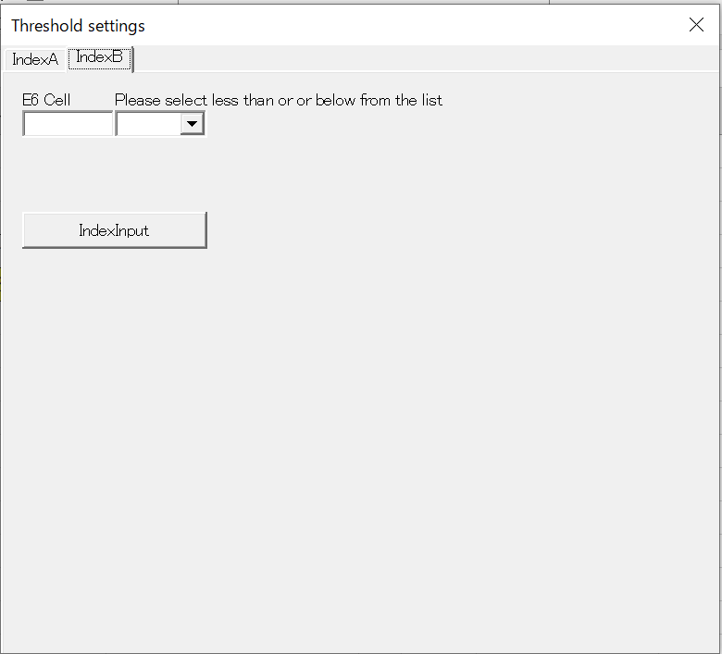
Layout of ufSet5 (IndexB tab)

Slide 25

Layout of ufSet5 (IndexB tab)
₁₀
₁₀
₆₀
₁₁₀
₂₄₀
₁₀
₂₀
₂₀
₃₅
₃₅
₇₅
₇₅
₉₅
₉₅
₁₀
₁₁₀
₂₄₀

Slide 26
Layout of ufSet5 (IndexB tab)
_{Pages(0)}
_{.Pages(1)}
_{lblIndexBLow_max_value}
_{lblIndexBsign1}
_{txtIndexBLow_max_value}
_{cmbIndexBsign1}
_{btnIndexBinput}

