Slide 1

Board of Zoning Appeals
August 27, 2026
5:30 PM
Council Chambers and Zoom

Slide 2

Requests
Conditional Use: A request at 412 E. Wylie Street for Conditional Use approval to allow for the use "Dwelling, Duplex" in the Residential Small Lot (R3) zoning district by Kevin Spicer.
Variances: The petitioner is also requesting variances from the maximum vehicle parking allowance and the vehicle parking location and design standards.

Slide 3
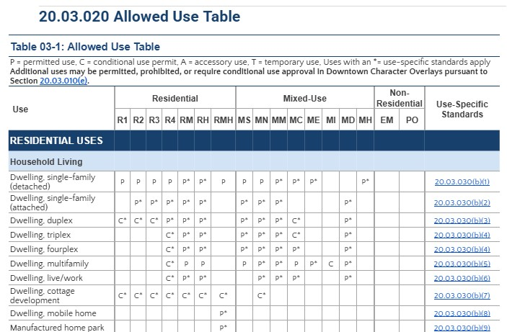

Slide 4
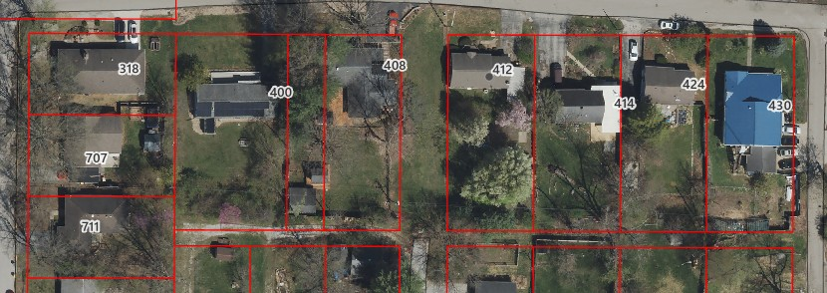
Location
S. Grant St
S. Palmer Ave
S. Dunn St

Slide 5
Site Overview
Area: 0.23 acres
Current Zoning: Residential Small Lot (R3)
Existing Land Use: Dwelling, single-family (detached)
Proposed Land Use: Dwelling, duplex

Slide 6
Site Overview
Located in Bryan Park neighborhood
No historic regulations
No closed canopy on site
Petition presented to Bryan Park and Elm Heights Neighborhood Associations on May 7, 2026

Slide 7
Use-Specific Standards
20.03.030(b)(3)(A)(i): No Notices of Violations on file with the Planning and Transportation Department at filing
20.03.030(b)(3)(B): UDO’s definition for “Family” limits no more than 3 unrelated adults living together per unit
20.03.030(b)(3)(C)(i): Each duplex unit has a separate exterior entrance both facing E. Wylie Street to the north

Slide 8
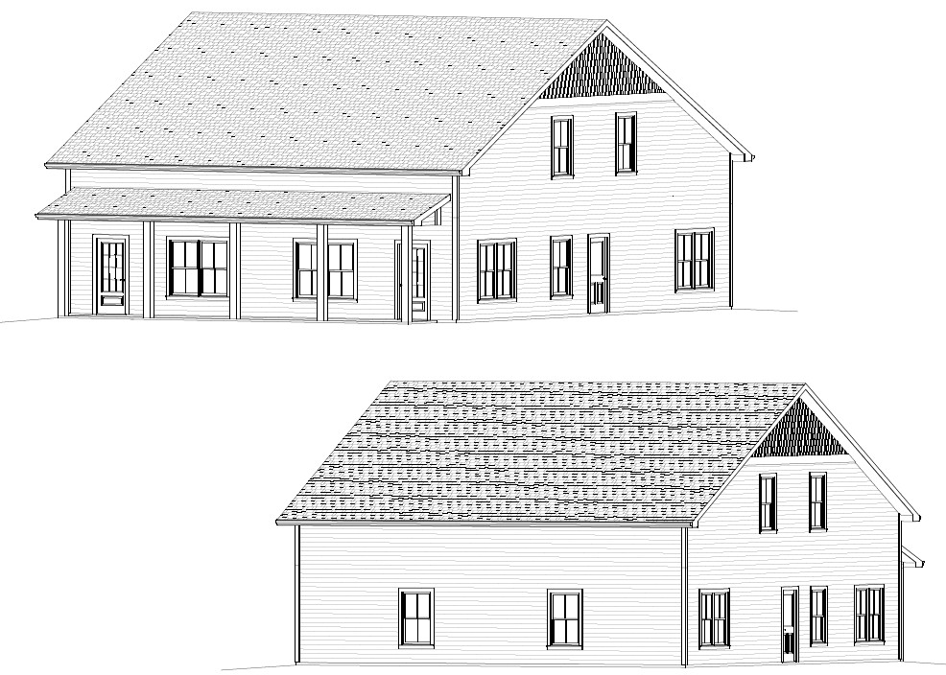
Current
Elevations

Slide 9
Use-Specific Standards
20.03.030(b)(3)(C)(ii): Four design elements are similar in general shape, size, and design with the majority of existing structure on the same block face
Roof Pitch
Front Porch Width and Depth
Front Building Setback
Vehicle Parking Access

Slide 10
Block Face
S. Grant St
S. Dunn St

Slide 11
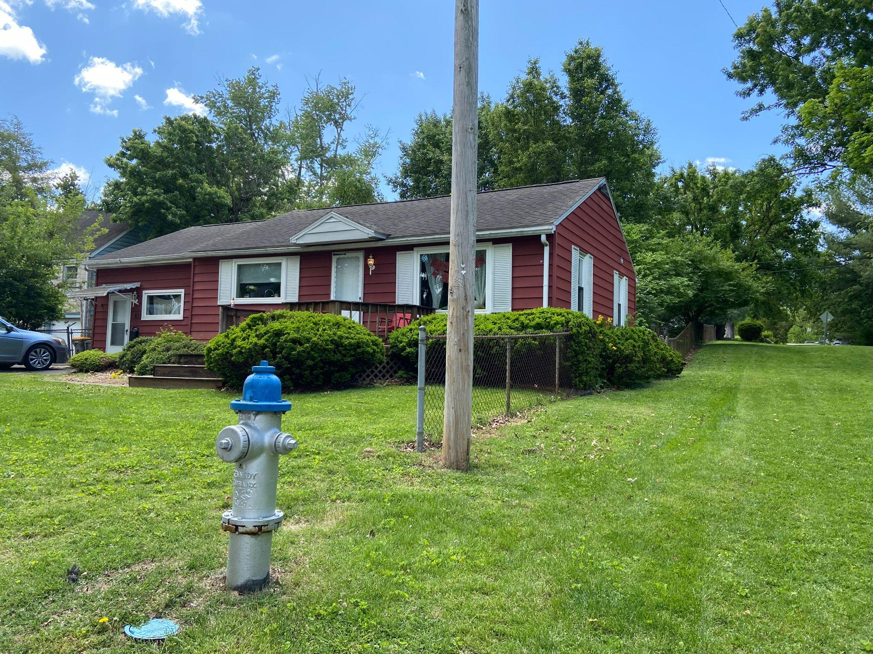
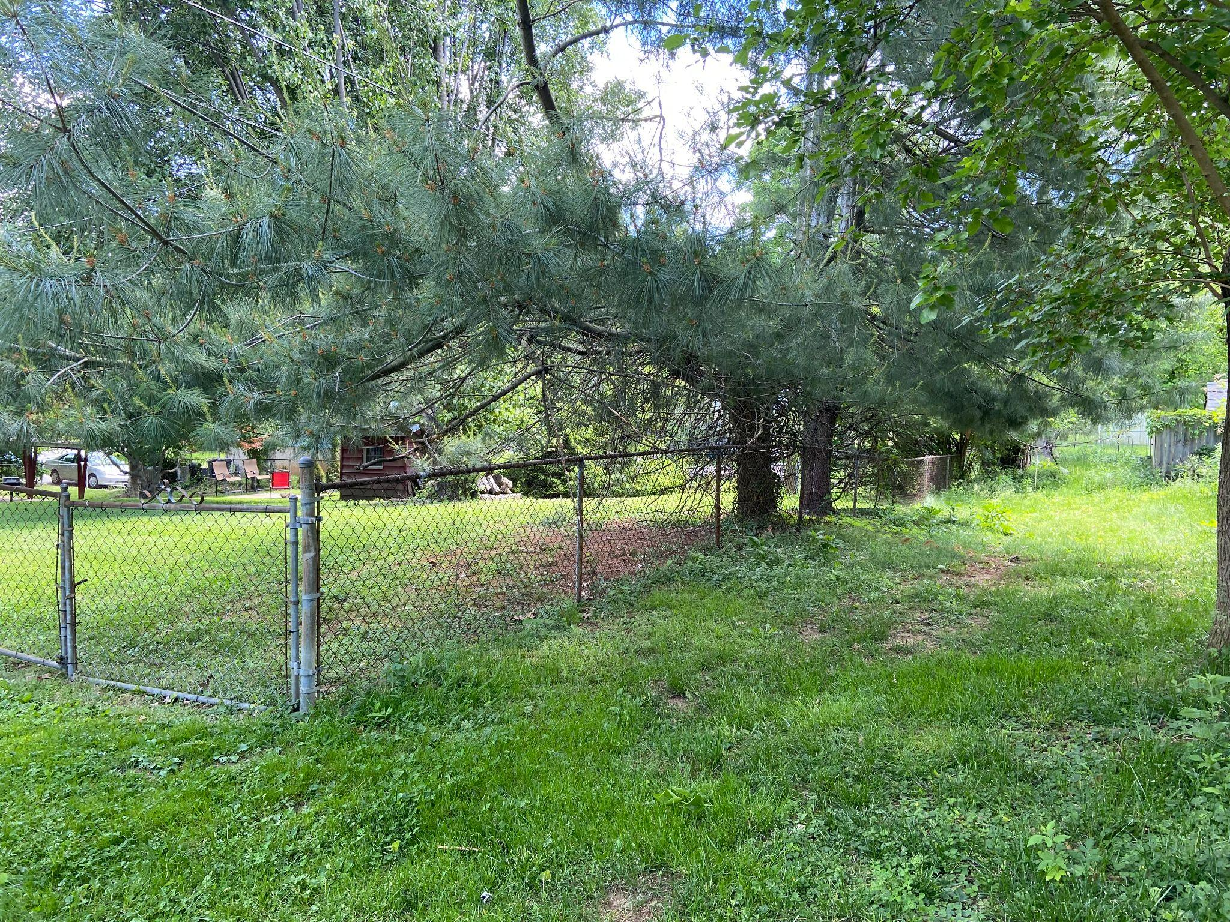
Existing Conditions
View from E Wylie St
View of undeveloped alley

Slide 12
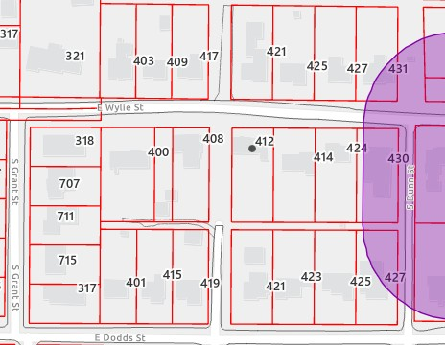
Use-Specific Standards
20.03.030(b)(3)(C)(iii): Six bedrooms maximum
20.03.030(b)(3)(D): Not within the 150 foot buffer limit
20.03.030(b)(3)(E): Maximum number of 15 allowed duplexes per year not exceeded

Slide 13
Criteria and Findings for Conditional Use Permit
20.06.040(d)(6)(B) General Compliance Criteria
Proposed Finding: There are Use-Specific Standards outlined in UDO Section 20.03.030(b)(3) that apply to the use “Dwelling, Duplex” within the R3 zoning district, and this petition meets those standards as described above. At the time of their application, the property owner did not have any Notices of Violation on file in the Planning and Transportation Department, and occupancy of each dwelling unit is subject to the definition of “Family” in the UDO. Each duplex unit has a separate exterior entrance with both entrances facing E. Wylie Street to the north. The four design elements were evaluated by staff and found to be similar in general shape, size, and design with the majority of existing single-family or duplex structures on the same block face. Each dwelling unit has 3 bedrooms, which meets the maximum 6 bedroom limitation, and there are no other duplexes within a 150 foot buffer of the site. The petitioner did attend the joint Bryan Park and Elm Heights Neighborhood Associations meeting on May 7, 2026 and presented this petition as required. There are no known other applicable regulations for this petition. Water service and sanitary connection will need to be coordinated with City of Bloomington Utilities, and electrical service will need to be coordinated with Duke Energy. There is adequate capacity in the City’s water and sewer systems to serve the location, and there are no known prior land use approvals for this site.

Slide 14
Criteria and Findings for Conditional Use Permit
20.06.040(d)(6)(C) Additional Criteria Applicable to Conditional Uses
i. Consistency with Comprehensive Plan and Other Applicable Plans
Proposed Finding: This proposal is in line with the goals of the Comprehensive Plan. In the Future Land Use Map, this area is identified as the “Mixed Urban Residential” land use category. The Comprehensive Plan states that the Mixed Urban Residential land use category “refers to older neighborhoods that were developed using a traditional block and grid-like street pattern.” Additionally, Policy 5.3.1 encourages opportunities for infill and redevelopment across the City of Bloomington with consideration for increased residential densities and underutilized housing types such as duplexes. The construction of a duplex at this location accomplishes many of the goals within the Comprehensive Plan including infill development and the incorporation of a mix of housing types within the community.

Slide 15
Criteria and Findings for Conditional Use Permit
20.06.040(d)(6)(C) Additional Criteria Applicable to Conditional Uses
ii. Provides Adequate Public Services and Facilities
Proposed Finding: As stated by the City of Bloomington Utilities (CBU) Department, there is adequate water and sewer capacity in the City’s systems to serve the development. On the site plan, new concrete walkways are shown to connect the proposed duplex to E. Wylie Street to the north, which provides pedestrian connections to the site and is required by UDO Section 20.04.050(d)(4)(C). The petitioner has modified the proposed parking arrangement to remove the previously shown drivecut on E. Wylie Street. The revised site plan is now showing a new parking area off the alley along the south side of the property. The new parking area will be accessed from a newly improved alley that derives access from the existing stub of S. Palmer Avenue.

Slide 16
Criteria and Findings for Conditional Use Permit
20.06.040(d)(6)(C) Additional Criteria Applicable to Conditional Uses
iii. Minimizes or Mitigates Adverse Impacts
Proposed Finding: There are no known regulated natural or scenic features that will be impacted. The City’s Senior Environmental Planner visited the site and determined that there is no closed canopy present on the site, so the regulations of UDO Section 20.04.030(h) are not applicable in this case. The property is not designated as a historic site nor is it subject to any historic regulations. No significant adverse impacts are expected from the creation of the proposed duplex. No changes to trash and waste collection service are expected. This petition was presented to the Bryan Park and Elm Heights Neighborhood Associations during a joint meeting on May 7, 2026. In response to feedback received at the neighborhood meeting, the petitioner revised the site plan to include a proposed 6’ tall opaque privacy fence on the east side of the lot to help buffer this property from the adjacent use; a condition of approval has been included for that aspect.

Slide 17
Criteria and Findings for Conditional Use Permit
20.06.040(d)(6)(C) Additional Criteria Applicable to Conditional Uses
iv. Rational Phasing Plan
Proposed Finding: No phasing is proposed with this plan.

Slide 18
Development Standards Variance Requests
Maximum Vehicle Parking: A variance is being requested to increase the maximum number of parking spaces allowed for a “Dwelling, Duplex” use from 4 to 5 parking spaces. 20.04.060(e)
Vehicle Parking Location and Design: UDO Section 20.04.060(i)(2)(B)(ii) allows for a 20’ by 20’ parking area. The petitioner is requesting a variance from that restriction to allow the 20’ by 40’ parking area as proposed.

Slide 19
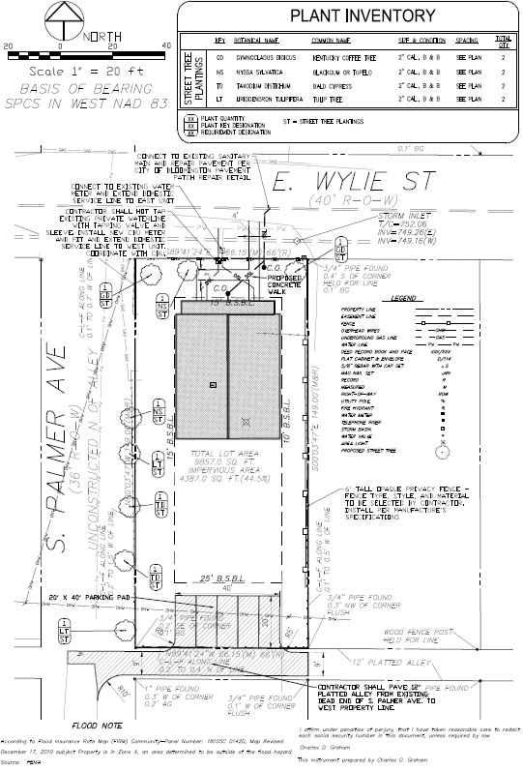
Current Site Plan

Slide 20
Criteria and Findings for Development Standards Variance
1. The approval will not be injurious to the public health, safety, morals, and general welfare of the community.
Proposed Finding - Maximum Vehicle Parking: The granting of this variance is not expected to be injurious to the public health, safety, morals, or general welfare of the community. While the maximum parking standards for this use were highly contested and vetted, one additional parking space that otherwise meets the design standards of the property would have no impact on the community, at large.

Slide 21
Criteria and Findings for Development Standards Variance
2. The use and value of the area adjacent to the property included in the Development Standards Variance will not be affected in a substantially adverse manner.
Proposed Finding - Maximum Vehicle Parking: Adverse impacts to the use and value of surrounding properties as a result of the requested variance are not found. While the maximum parking standards for this use were highly contested and vetted, one additional parking space that otherwise meets the design standards of the property would have no impact on the community, at large.

Slide 22
Criteria and Findings for Development Standards Variance
3. The strict application of the terms of the Unified Development Ordinance will result in practical difficulties in the use of the property; that the practical difficulties are peculiar to the property in question; that the Development Standards Variance will relieve the practical difficulties.
Proposed Finding - Maximum Vehicle Parking: The strict application of the terms of the UDO will not result in practical difficulties in the use of the property. This property can be developed with a duplex with 4 parking spaces maximum as permitted by the UDO. There are not practical difficulties peculiar to the property in question that prevent the petitioner from meeting the parking maximum of 4 spaces.

Slide 23
Criteria and Findings for Development Standards Variance
1. The approval will not be injurious to the public health, safety, morals, and general welfare of the community.
Proposed Finding - Vehicle Parking Location and Design: The granting of this variance is expected to be injurious to the public health, safety, morals, or general welfare of the community. The petitioner is requesting double the size permitted by UDO Section 20.04.060(i)(2)(B)(ii) for parking areas accessed via an improved alley in this zoning district. A wider interface between the private and public spaces can create increased safety issues in the event that the alley is used by anyone on foot whether it is improved to the east or not.

Slide 24
Criteria and Findings for Development Standards Variance
2. The use and value of the area adjacent to the property included in the Development Standards Variance will not be affected in a substantially adverse manner.
Proposed Finding - Vehicle Parking Location and Design: Adverse impacts to the use and value of surrounding properties as a result of the requested variance are found. The purpose of limiting the size of the allowed parking area off an improved alley is to manage vehicular access in the community and prevent vehicles from blocking alley traffic. Safe alley access is important to the use and value of surrounding properties, and doubling the size of the allowed parking pad increases risk to pedestrians and to future vehicular users in the event the alley is expanded to the east. A 40-foot drivecut allowing direct access for five vehicles is not comparable to the design of vehicle access in the surrounding properties.

Slide 25
Criteria and Findings for Development Standards Variance
3. The strict application of the terms of the Unified Development Ordinance will result in practical difficulties in the use of the property; that the practical difficulties are peculiar to the property in question; that the Development Standards Variance will relieve the practical difficulties.
Proposed Finding - Vehicle Parking Location and Design: The strict application of the terms of the UDO will not result in practical difficulties in the use of the property. Since the alley to the south of the subject property is not currently improved, the petitioner has the option to access the property via E. Wylie Street with a compliant driveway as previously shown or to improve the alley for access purposes. There are not practical difficulties peculiar to the property in question that prevent the petitioner from meeting the regulations of UDO Section 20.04.060(i)(2)(B)(ii) which limits the parking pad size to 20 feet by 20 feet or 400 square feet in size. The site can be developed with a compliant driveway off E. Wylie Street to the north or a compliant parking pad via an improved alley to the south of the property and meet the minimum and maximum parking regulations for the proposed use.

Slide 26
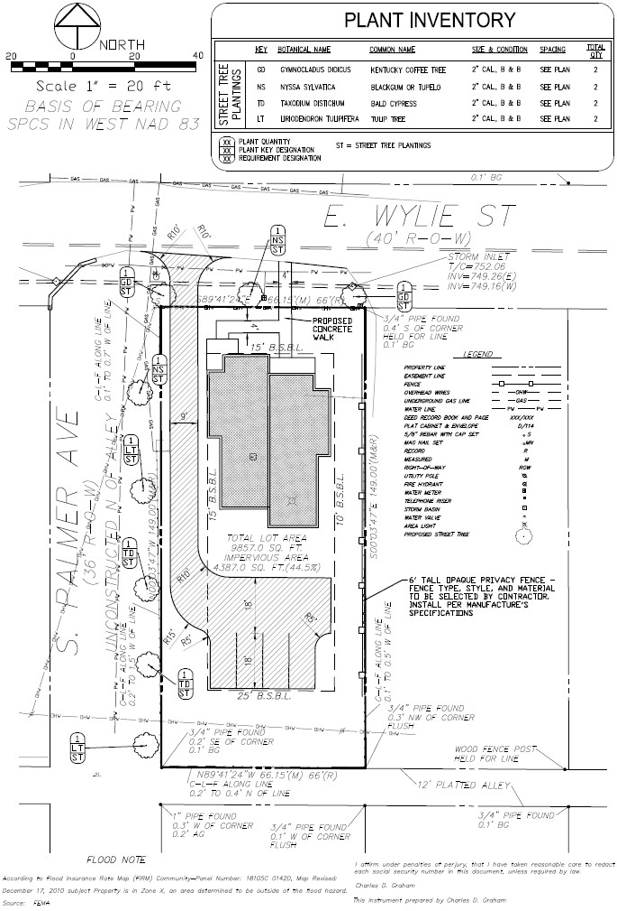
Previous Site Plan

Slide 27
Current Site Plan

Slide 28
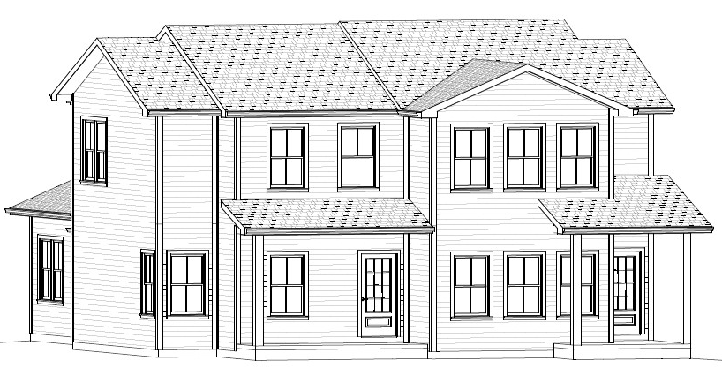
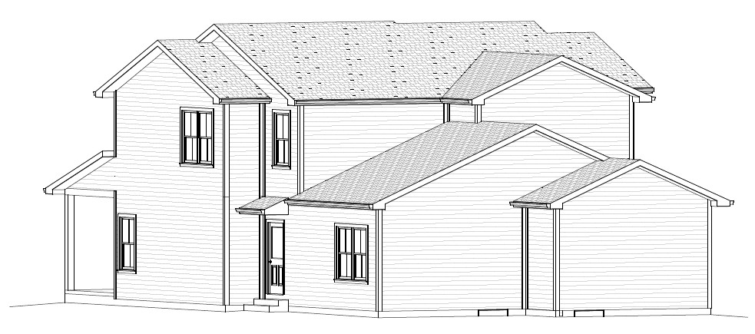
Previous
Elevations

Slide 29
Current
Elevations

Slide 30
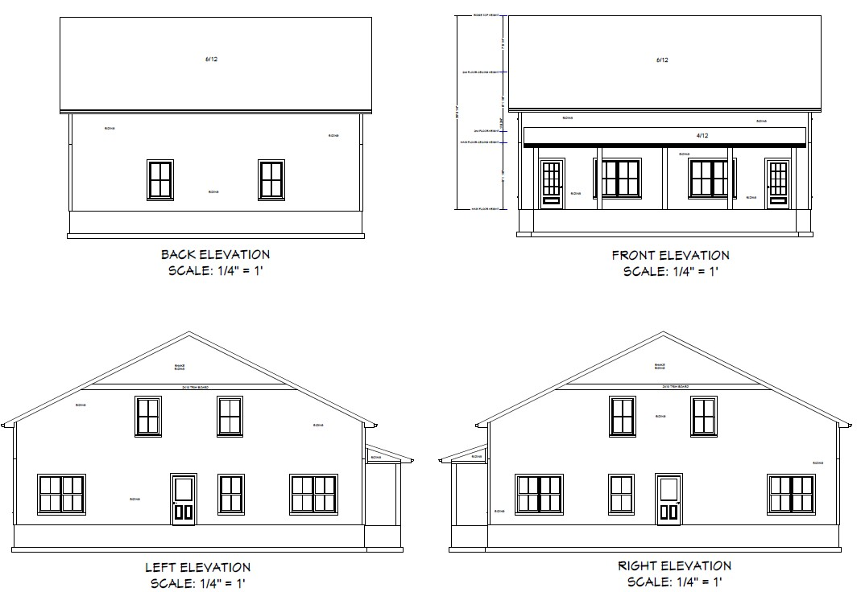
Current Elevations

Slide 31
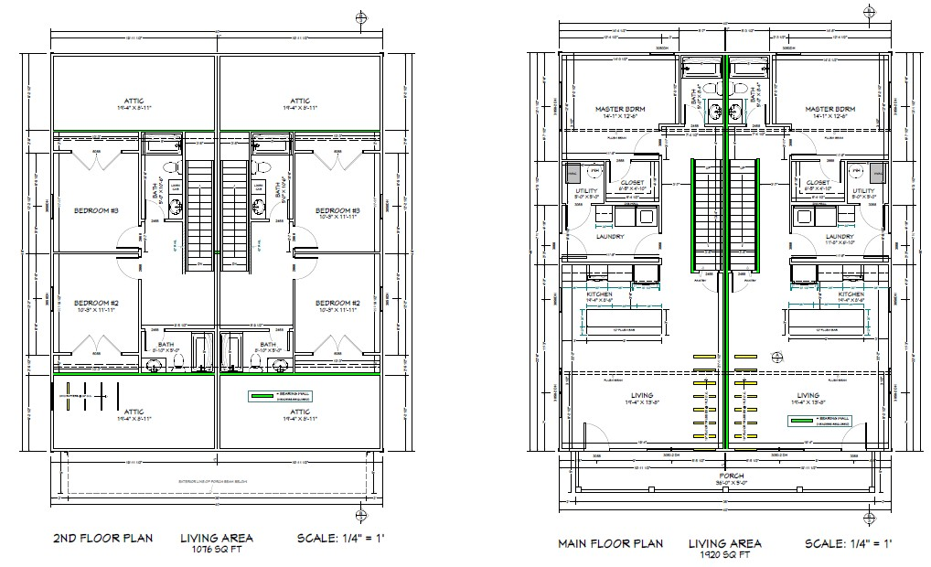
Current Floor Plan

Slide 32

Siding Color

Slide 33
Recommendation
The Department recommends that the BZA adopt the proposed findings, approve the Conditional Use request, and deny the variance requests with the following conditions:
The conditional use approval is limited to the design shown and discussed in the packet.
A right-of-way use permit is required prior to any work in the public right-of-way.
Per the submitted site plan, a 6’ tall opaque fence is required along the east property line.

