Slide 1
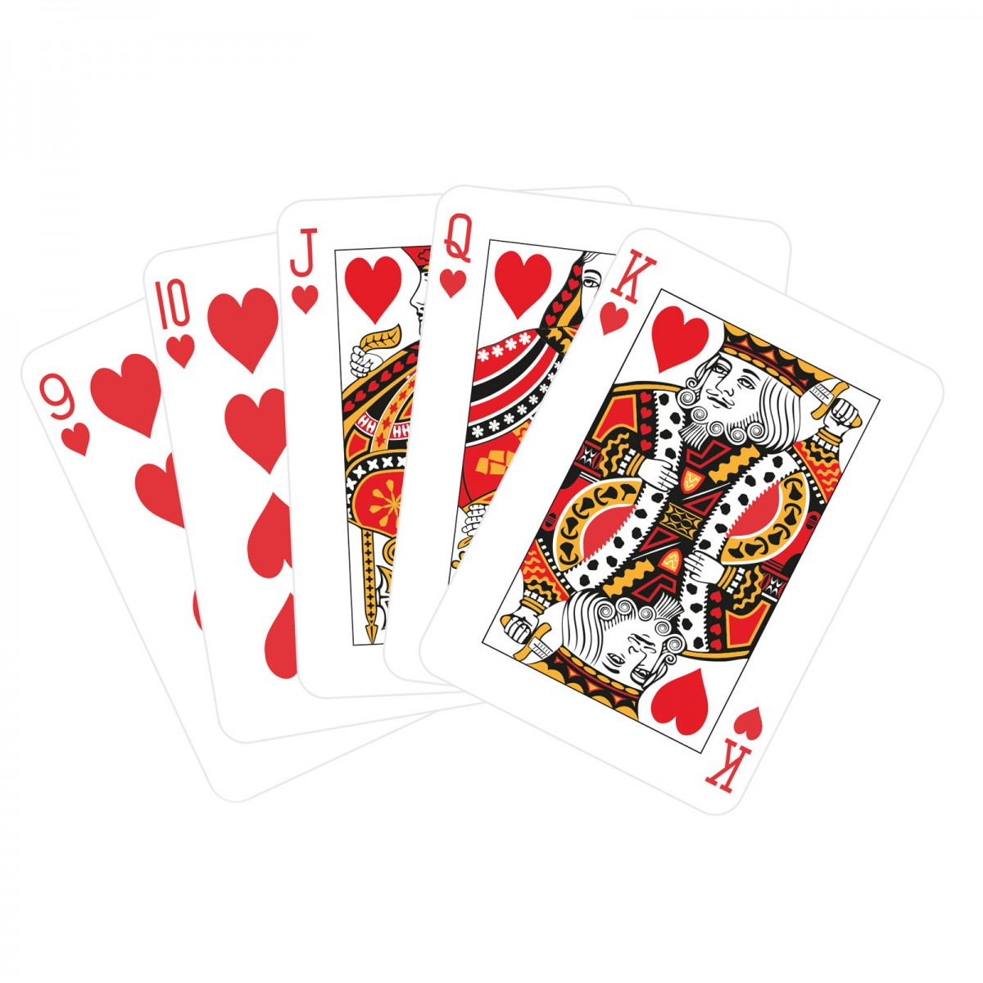
Final Project
Using only the code in your tool box (or your head) Create a program that allows the user to virtually deal a hand of cards.
Your program should:
Allow the user to ask to be dealt a hand of cards over and over until the user makes the decision to stop playing.
Extra Credit for:
Size of hand is a property not hard coded
Ability to deal more than 1 hand at a time
Display the cards as pictures not text (you will get credit for text output but not as much) note: I have not specified a specific card game or the number of cards in a deck, you can define that to your advantage, but you must have at least 5 cards.
Count the number of times the user has played (and output this information)
Provide statistics to the user including number of times and percentage each possible outcome has occurred (ex: You have drawn a 2 of clubs four times or 10% of your rolls.) This should output each time the user plays the game.

Slide 2

You will define and use functions in your program. While this program screams for multiple functions, you can get away with writing just 1 as long as it works.
You can call the variables whatever you want, no prefix is required.
When complete, name your program with your_name.html, your_name.css and your_name.js and call me to copy it to the final disk
Remember 50% of the score for this assignment is in the comments !!!!!!!!!! (If you turn something in with no comments you cannot get higher than a 50%)

