Slide 1
Ballwall „3D – Flappy Bird“
Samardzic Nuris, 01611855
Tosun Begüm, 11719058

Slide 2
Contents
Basic Idea
Libraries
Code

Slide 3
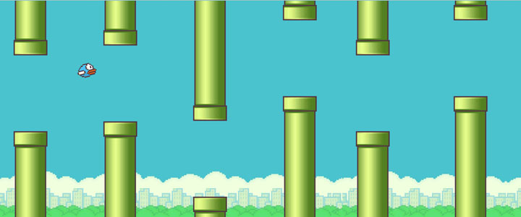

Slide 4



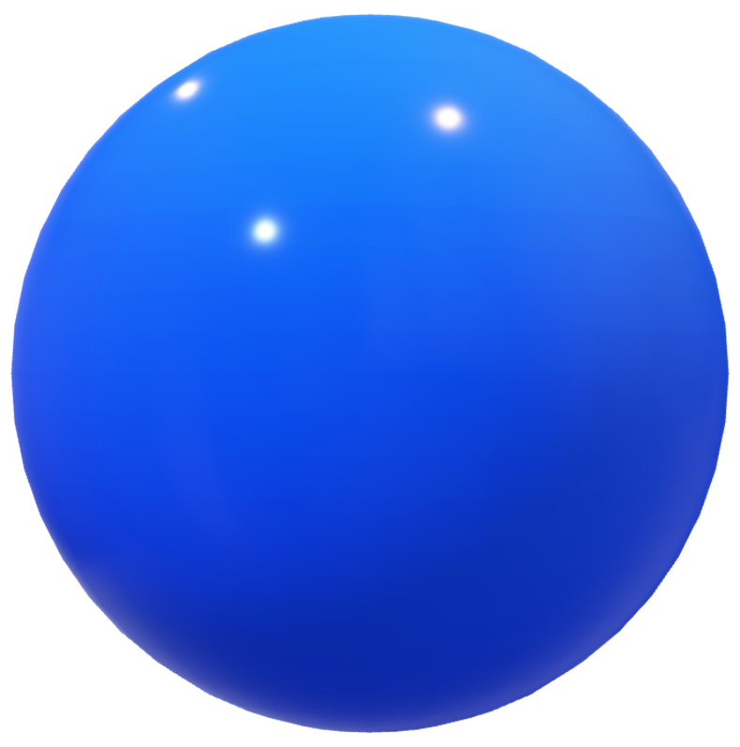

Slide 5
Libraries
glew v2.2.0 OpenGL Extension Wrangler Library (GLEW) :
a cross-platform open-source C/C++ extension loading library
provides efficient run-time mechanisms for determining which OpenGL extensions are supported on the target platform
currently maintained by Nigel Stewart with bug fixes, new OpenGL extension support and new releases
was developed by Milan Ikits and Marcelo Magallon
Aaron Lefohn, Joe Kniss, and Chris Wyman were the first users and also assisted with the design and debugging process

Slide 6
Libraries
freeglut v3.0.0 free GL Utility Toolkit:
GLUT vs freeglut:
GLUT is getting old and really needs improvement
its license does not allow anyone to distribute modified library code
freeglut is a free-software/open-source alternative to the GLUT library
originally written by Pawel W. Olszta with contributions from Andreas Umbach and Steve Baker
John F. Fay, John Tsiombikas, and Diederick C. Niehorster are the current maintainers of the freeglut project

Slide 7
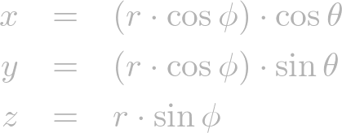
Sphere
3D closed surface where every point on the sphere is same distance (radius) from a given point
x² + y² + z² = r²
we cannot draw all the points on a sphere
sample a limited amount of points by dividing the sphere by sectors and stacks
an arbitrary point (x, y, z) on a sphere can be computed with the corresponding sector angle θ and stack angle ϕ

Slide 8
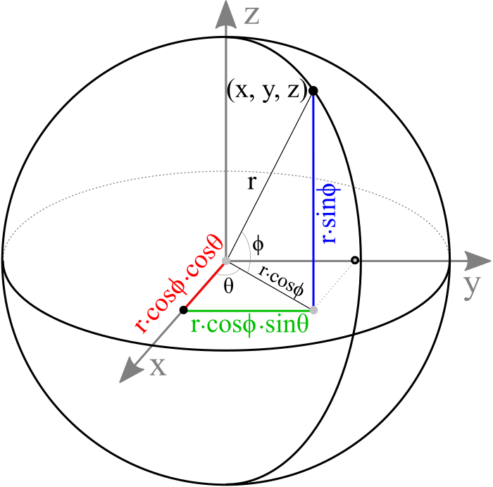
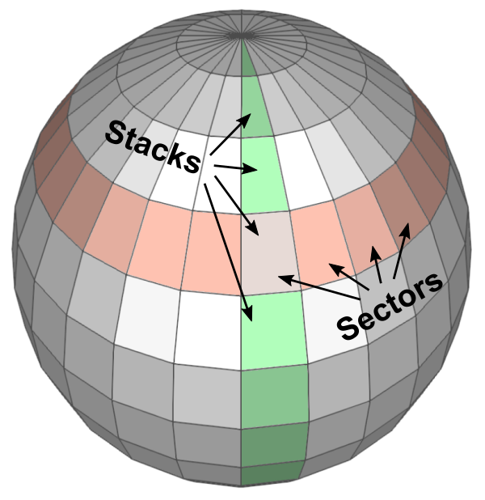

Slide 9
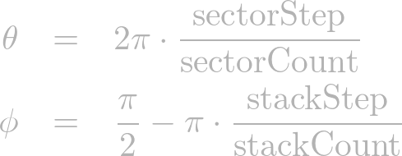
Sphere
range of sector angles is from 0 to 360 degrees
stack angles are from 90 (top) to -90 degrees (bottom)

Slide 10
Creating the sphere
adapted from http://www.songho.ca/opengl/gl_sphere.html
done in three main steps

Slide 11
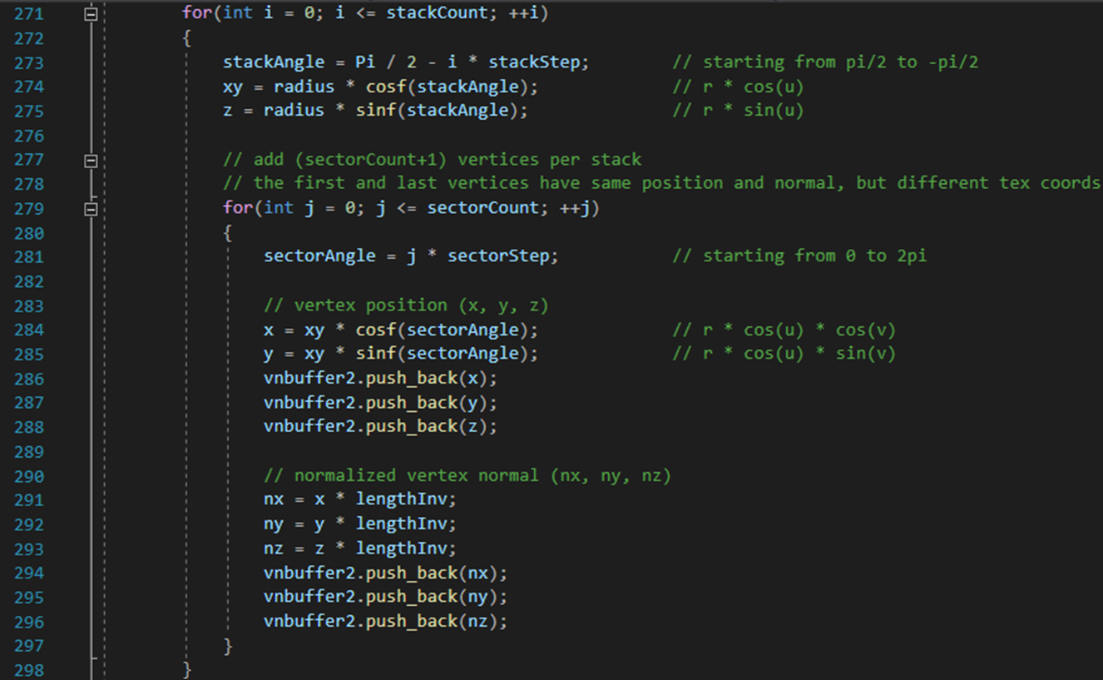
Creating the sphere: 1.step

Slide 12
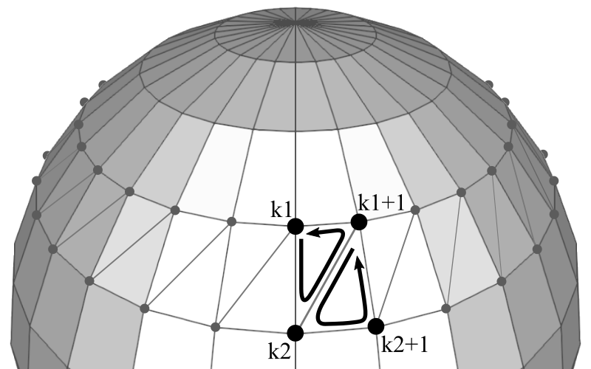
Sphere
to draw the surface of a sphere in OpenGL, you must triangulate adjacent vertices to form polygons
Each sector in a stack requires 2 triangles
If the first vertex index in the current stack is k1 and the next stack is k2, then the counterclockwise orders of vertex indices of 2 triangles are;
k1 ⟶ k2 ⟶ k1+1
k1+1 ⟶ k2 ⟶ k2+1

Slide 13
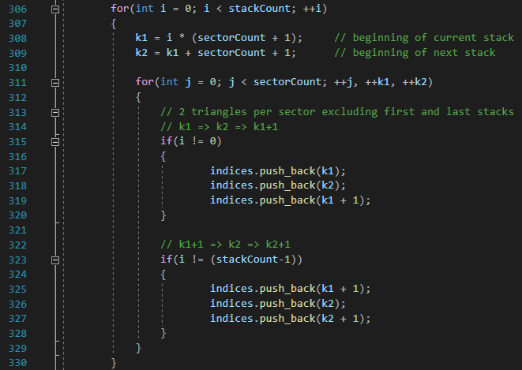
Creating the sphere: 2.step

Slide 14
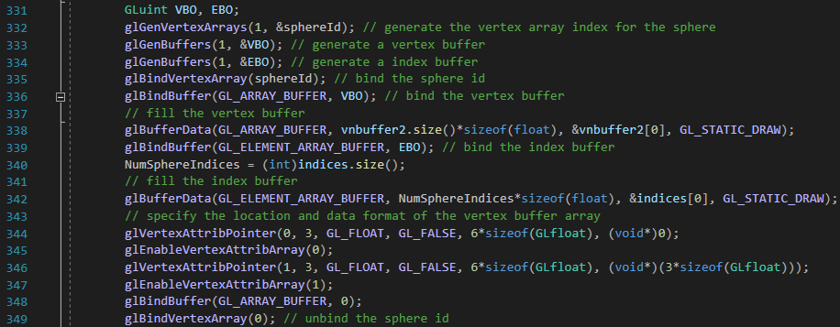
Creating the sphere: 3.step

Slide 15




Slide 16
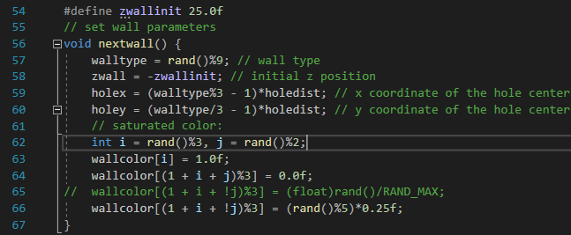
Creating walls

Slide 17
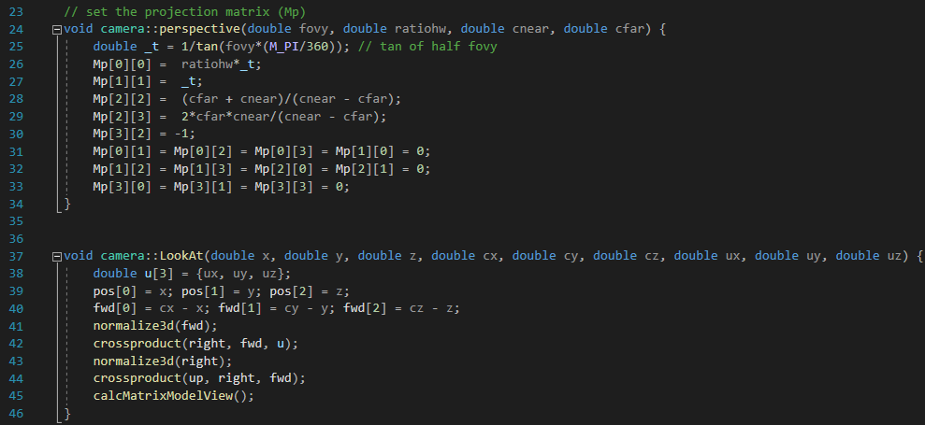
Perspective / View

Slide 18
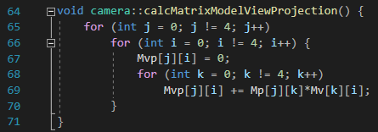
Perspective / View

Slide 19
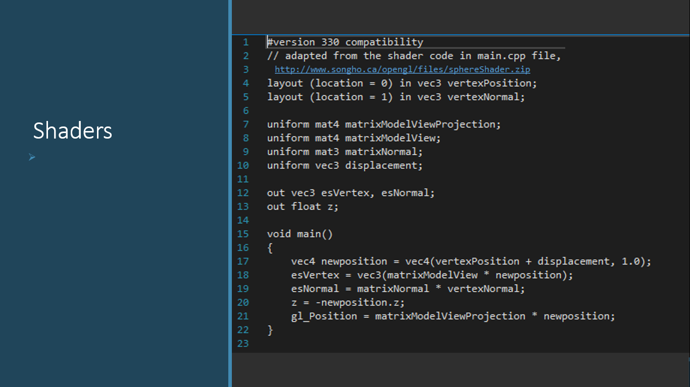
Shaders

Slide 20
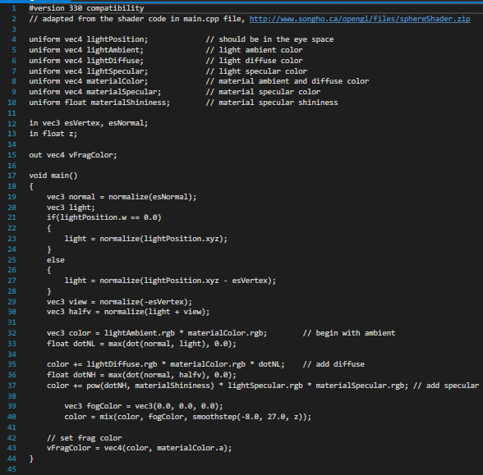
Shaders

Slide 21
Demo

Slide 22


