Slide 1
Ballwall „3D – Flappy Bird“
Samardzic Nuris, 01611855
Tosun Begüm, 11719058

Slide 2
Contents
Basic Idea
Libraries
Code

Slide 3
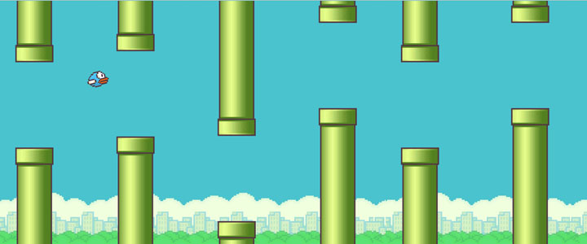

Slide 4



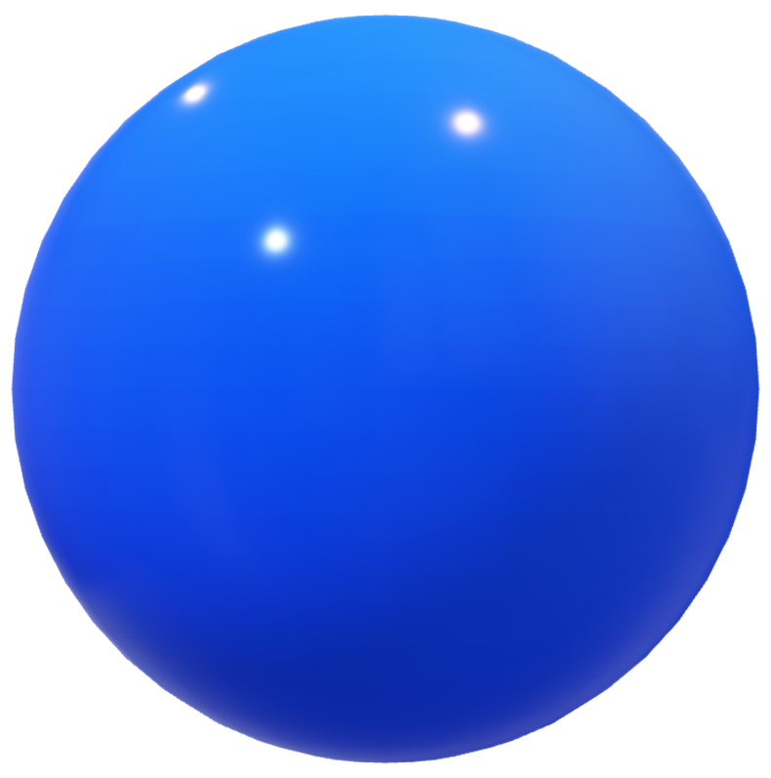

Slide 5




Slide 6
Demo

Slide 7
Libraries
OpenGL extensions: implementations to provide new or expanded functionality that the core of OpenGL does not provide
glew v2.2.0 OpenGL Extension Wrangler Library (GLEW) :
a cross-platform open-source C/C++ extension loading library
provides efficient run-time mechanisms for determining which OpenGL extensions are supported on the target platform
currently maintained by Nigel Stewart with bug fixes, new OpenGL extension support and new releases
was developed by Milan Ikits and Marcelo Magallon
Aaron Lefohn, Joe Kniss, and Chris Wyman were the first users and also assisted with the design and debugging process

Slide 8
Libraries
freeglut v3.0.0 free GL Utility Toolkit:
GLUT vs freeglut:
GLUT is getting old and really needs improvement
its license does not allow anyone to distribute modified library code
freeglut is a free-software/open-source alternative to the GLUT library
originally written by Pawel W. Olszta with contributions from Andreas Umbach and Steve Baker
John F. Fay, John Tsiombikas, and Diederick C. Niehorster are the current maintainers of the freeglut project

Slide 9
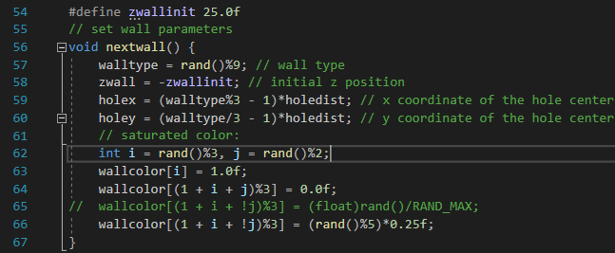
Creating walls

Slide 10
Creating the sphere
adapted from http://www.songho.ca/opengl/gl_sphere.html
done in three main steps

Slide 11
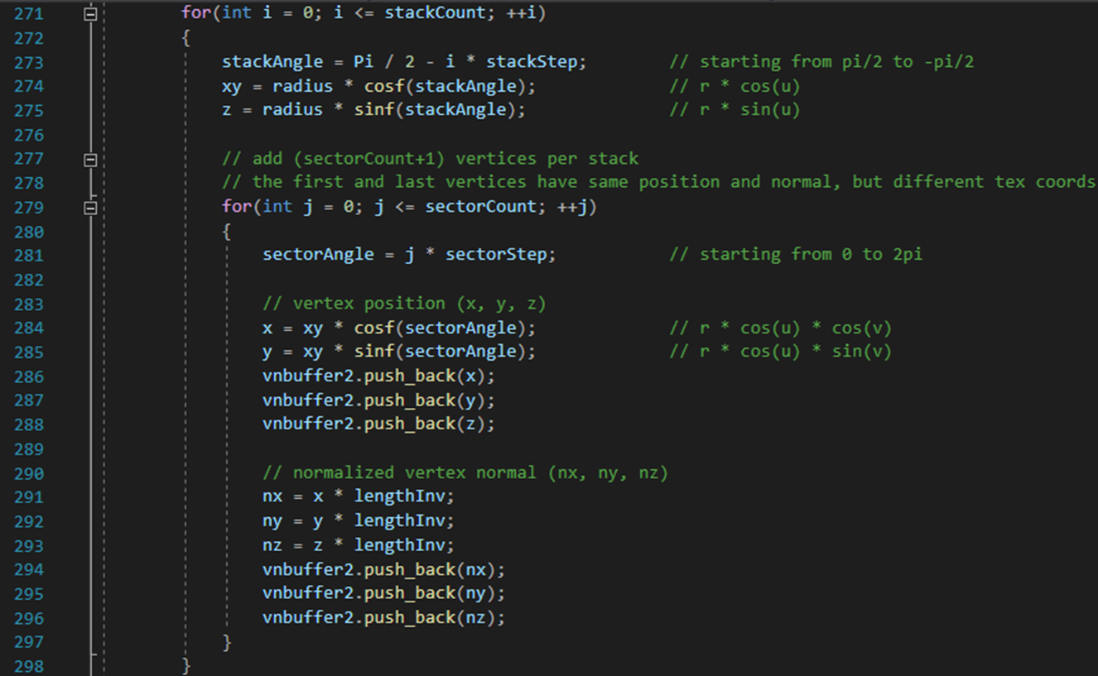
Creating the sphere: 1.step

Slide 12
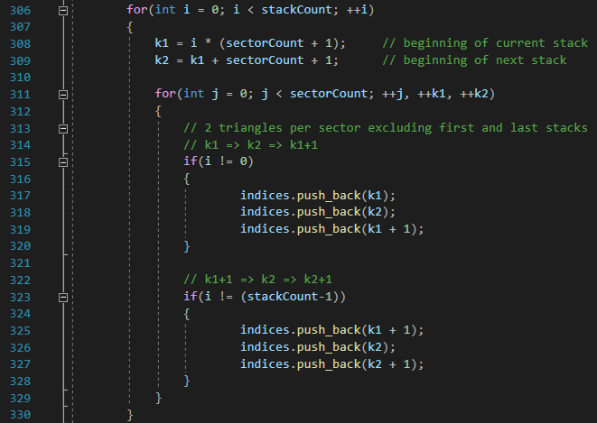
Creating the sphere: 2.step

Slide 13
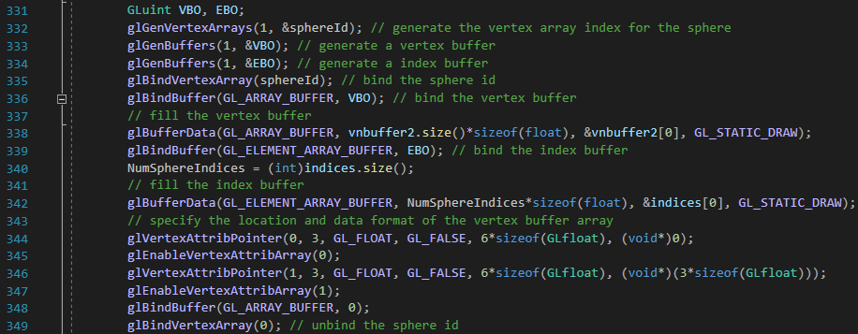
Creating the sphere: 3.step

Slide 14
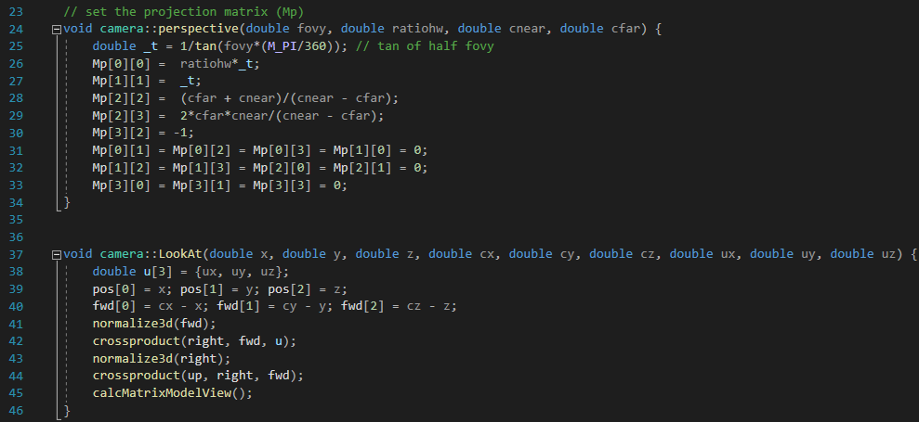
Perspective / View

Slide 15
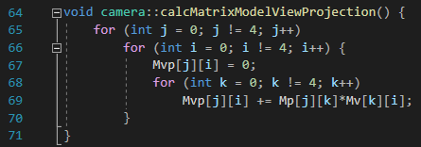
Perspective / View

Slide 16
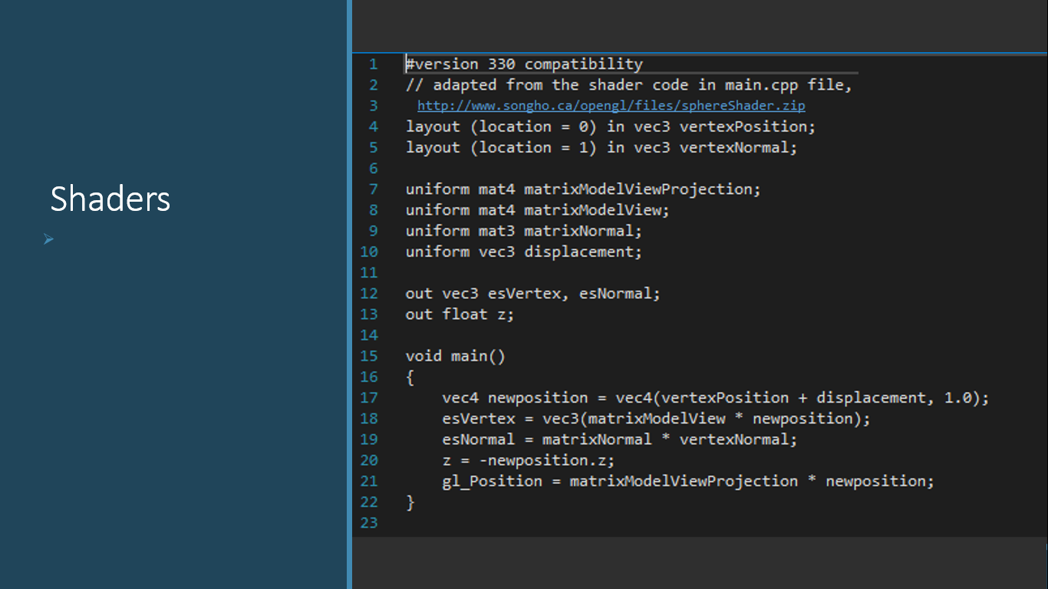
Shaders

Slide 17
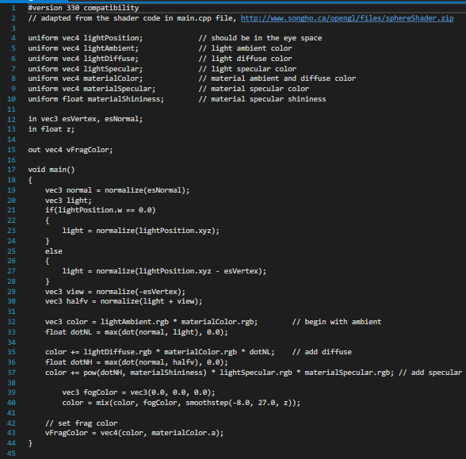
Shaders

