Slide 1

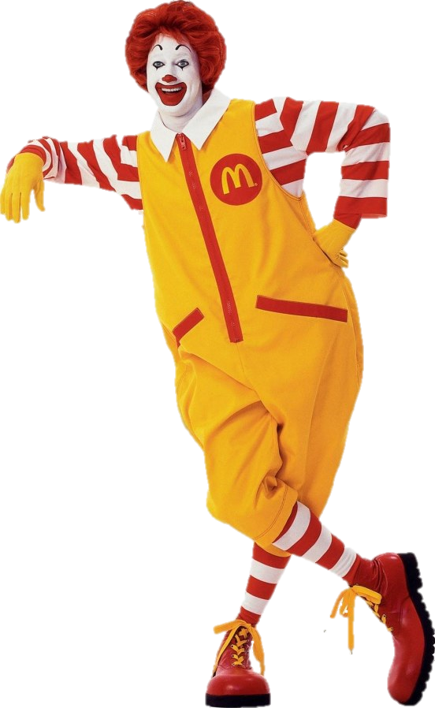
FFL RANKINGS
Week 13!
Team | W | L | T | Pct
Coffin Corner Gunners | 88 | 43 | 1 | .670
+/- 1 PSI | 82 | 48 | 2 | .629
Screw you, Goodell | 74 | 52 | 6 | .583
Down w/the Confederacaaaa! | 73 | 54 | 5 | .572
FU Roadshow Winnebago | 71 | 60 | 1 | .542
Boston Bobcatz | 68 | 60 | 4 | .530
Wilfork Island | 62 | 70 | 0 | .470
A Gronking To Forget | 71 | 61 | 0 | .538
Richmond Confederates | 54 | 76 | 2 | .417
The Peasemakers | 52 | 78 | 2 | .402
What Would Jameis Do? | 42 | 88 | 2 | .326
$1 All Stars | 42 | 89 | 1 | .322

Slide 2
FFL RANKINGS

Slide 3
Week 6!

