Slide 1
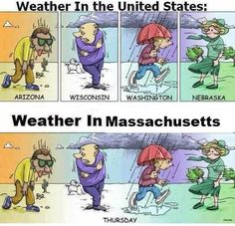
Credit - Pinterest

Slide 2
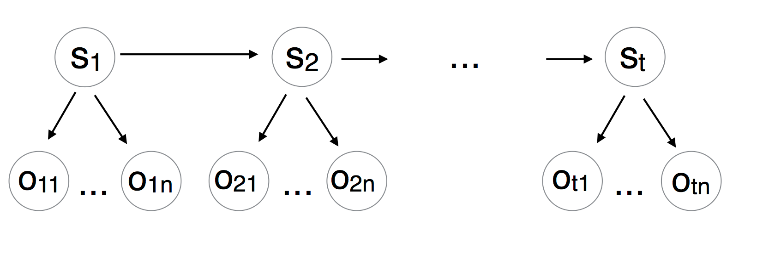
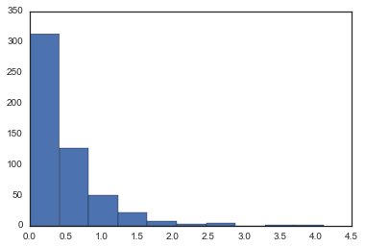
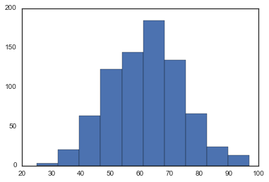
Hidden Markov Model
Hidden States
Normal | Fog-Rain | Snow
Fog-Snow | Fog | Rain-Snow
Fog-Rain-Snow | Rain | Thunderstorm
Precipitation –
Log Normal
Observations
Humidity –
Gaussian
Mean Temperature | Mean Dew Point
Mean Humidity | Mean Wind Speed
Precipitation | Mean Visibility
Mean Sea Level Pressure
Notes:
- Weather is often very hard to predict even when we have a sense of the weather measures
We have attempted to model weather events based on weather measures using a second order HMM
9 hidden states representing weather events
7 continuous real-valued weather measures are our observations (all seven observed for each weather event)

Slide 3
Data
55 years of of daily weather data for Boston
Training set – 1st Jan 1960 to 31st Dec 2010
Test Set – 1st Jan 2011 to 31st Dec 2015
Notes:
Dataset – Weather measure data for Boston over the past 55 years
Training – first 50 years, test on the next 5 years
TP – tracked over the entire training period – studied its stationarity
EP – for each state – multivariate normal represents EP for the 7 observations made
The multivariate normal constructed from underlying gaussian and log-normal distributions representing each of the 7 real-valued weather measures
Results – overall inference accuracy of 65%
Specifically, inferred normal days, extreme events like thunderstorms and specific events like Fog
Model did less well on highly overlapping events like Rain, Rain-Snow, Fog-Snow etc. However, still considerable better than a naïve baseline.
Confusion matrix to represent nature of error (not all labels are equidistant; ordering exists)
Further improve with - a third order model, better/more parameters, better EP/TP

