Slide 1
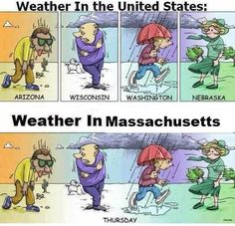
Credit - Pinterest
Notes:
Weather is often very hard to predict even when we have reliable instrumentation, especially in Boston!

Slide 2
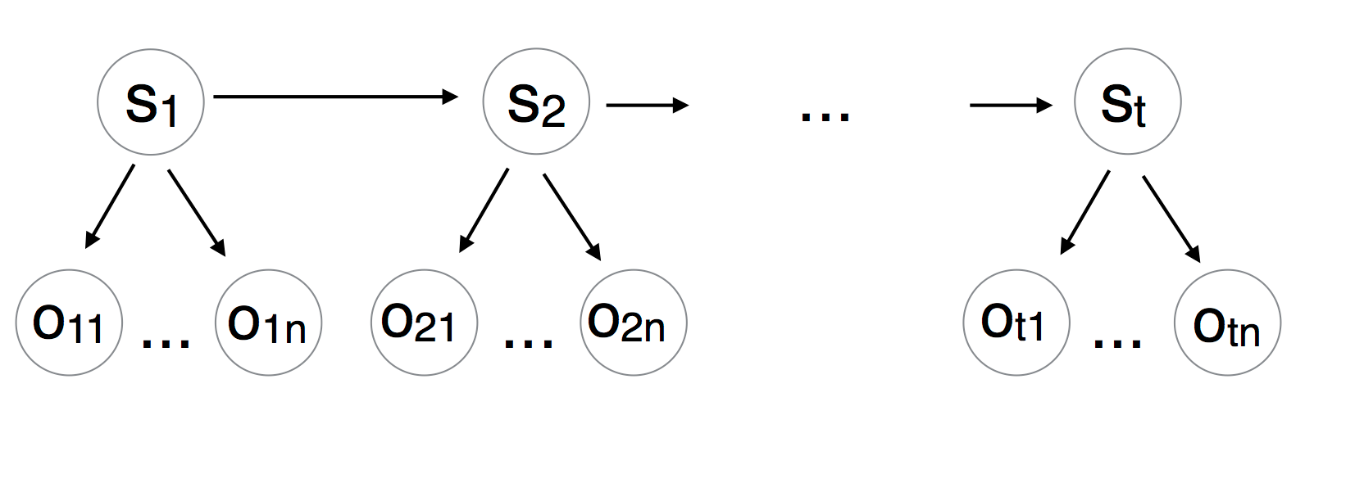
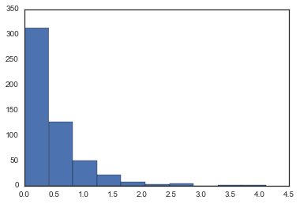
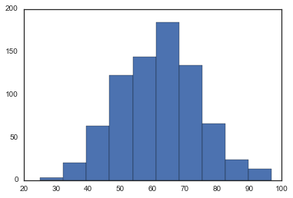
Hidden Markov Model
Hidden States
Normal | Fog-Rain | Snow
Fog-Snow | Fog | Rain-Snow
Fog-Rain-Snow | Rain | Thunderstorm
Precipitation –
Log Normal
Observations
Humidity –
Gaussian
Mean Temperature | Mean Dew Point
Mean Humidity | Mean Wind Speed
Precipitation | Mean Visibility
Mean Sea Level Pressure
Notes:
Nevertheless, we have attempted to model weather events using a second order Hidden Markov Model. Our model has 9 hidden states representing weather events and 7 continuous real-valued weather measures as observations. The observations have been modeled using Gaussian and Log-Normal distributions and the emissions probability is derived from a multivariate Gaussian.

Slide 3
Data
55 years of of daily weather data for Boston
Training set – 1st Jan 1960 to 31st Dec 2010
Test Set – 1st Jan 2011 to 31st Dec 2015
Notes:
The model was trained on 50 years of data and tested on the next five years and produced an average inference accuracy of 65%. It did especially well to infer extreme events like thunderstorms and specific events like fog days.

