Slide 1
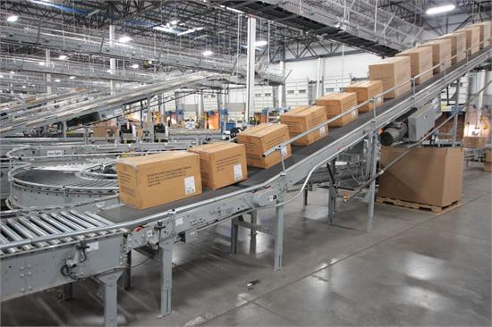
Continuous Integration – Continuous Delivery (CI/CD) Tool Chain
Notes:
Abstract: Do you: - Have your code compiling in a clean environment - Run all of your unit tests before deploying to a testing environment - all the while having your feet kicked up on the desk sipping your coffee
If not, come join us in a thought-provoking talk about Application Lifecycle Management (ALM). We will demonstrate ways of orchestrating continuous integration and continuous deployment toolchains (CI/CD). See how this toolchain allows development teams to shorten their lead times (Time to market) by quickly and efficiently delivering new features and enhancements into the hands of your customers.
More frequent releases? What?!? Why is that a good thing? - smaller changes (easier to identify when things go boom!) - improved velocity to get things to the customer (revenue!!!) - reduces code conflicts reduced errors and stress - no down time = more revenue

Slide 2
Who is this dude
Started life as a sysadmin of 5000 servers (physicals)
Used programming to aid in managing those servers
Started the path of application delivery
Last 8 years focused on release engineering and the DevOps philosophy.
Notes:
a little classic asp, a bunch of vbscript, and ms-sql
Over a decade of c#

Slide 3
CI vs CD
Continuous Integration (CI) is a development practice that requires developers to integrate code into a shared repository several times a day. Each check-in is then verified by an automated build, allowing teams to detect problems early. (ThoughtWorks)
Continuous delivery (CD) is a software engineering approach in which teams produce software in short cycles, ensuring that the software can be reliably released at any time. It aims at building, testing, and releasing software faster and more frequently.

Slide 4
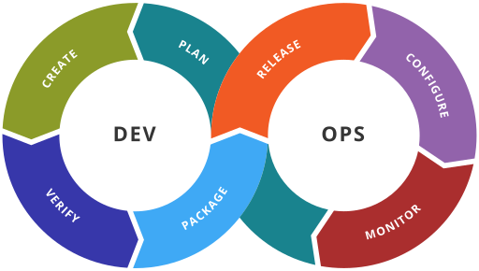
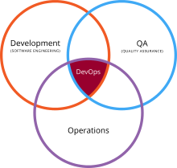
Devops?
DevOps is a cultural shift and collaboration (between development, operations, testing, security, compliance and other business groups) - Wikipedia

Slide 5
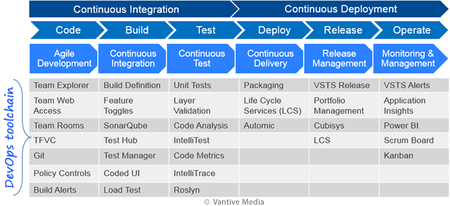
Devops Role in the Application Lifecycle Management (ALM)

Slide 6



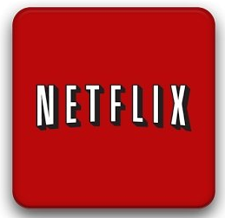
Crazy Deployments – large scale environments
Amazon – 11.6 sec Mean time between deployments
Netflix – hundreds times per day
Facebook – phased deployments fully automated 1.5gb executable 30 min to deploy
Etsy – 50/day
Notes:
Amazon May Deployment Stats (2010)
(production hosts & environments only)
11.6 seconds Mean time between deployments (weekday)
1,079 Max # of deployments in a single hour
10,000 Mean # of hosts simultaneously receiving a deployment
30,000 Max # of hosts simultaneously receiving a deployment
http://assets.en.oreilly.com/1/event/60/Velocity%20Culture%20Presentation.pdf
Netflix, the popular movie streaming site, deploys a hundred times per day, without the use of Chef or Puppet, without a quality assurance department and without release engineers.
Deployment at Netflix is completely automated. When a service needs to be deployed, the developer first pushes the code to a source code repository. The code push is picked up by Jenkins, which subsequently performs a build producing an application package. Then, a fresh VM image (AMI) is produced based on a base image (containing a Linux distribution) and software that all Netflix servers run, including a JVM and Tomcat, possibly further customized by the team. On top of this base install, the application package is installed. From this, an AMI is produced and registered with the system.
https://www.infoq.com/news/2013/06/netflix
Facebook:
entire code base is compiled down to a single binary executable 1.5 gb in size
Rolling out a Facebook update takes an average of 30 minutes—15 minutes to generate the binary executable and another 15 minutes to push the executable to most of Facebook's servers via BitTorrent.
Facebook typically rolls out a minor update on every single business day.
Major updates are issued once a week, generally on Tuesday afternoons
https://arstechnica.com/information-technology/2012/04/exclusive-a-behind-the-scenes-look-at-facebook-release-engineering/
Feature toggles
phased deployments
https://www.forbes.com/sites/quora/2013/08/12/how-do-facebook-and-google-manage-software-releases-without-causing-major-problems/#5bd00e165b29
Quora, every commit is pushed to production immediately unless a line in the commit message explicitly disables it.
https://www.quora.com/How-often-do-major-software-companies-such-as-Github-Facebook-Google-Quora-Pinterest-etc-push-code-to-production-Is-there-any-standard-pattern-of-release-cycle-which-any-company-can-follow
Etsy
renowned for its DevOps and Continuous Delivery practices, does 50 deploys/day. A fully automated deployment pipeline,
https://www.infoq.com/news/2014/03/etsy-deploy-50-times-a-day

Slide 7
Toolchain
Code — Source Code Management (SCM) - Code development and review, version control tools, code merging, pull requests (code reviews)
Build — Continuous integration tools, build status
Test — Continuous testing tools that provide feedback on business risks
Package — Artifact repository, application pre-deployment staging
Configure — Infrastructure configuration and management, Infrastructure as Code tools
Release — Change management, release approvals, release automation
Feature Enablement – Use feature toggles for A/B testing, canary releases, fail fast and recover faster.
Monitor — Applications performance monitoring, end–user experience

Slide 8
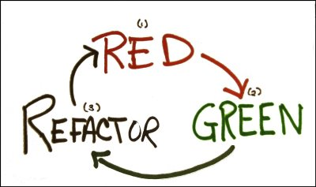
CODE And Unit Tests
Source code Management (SCM)
Unit tests
Branch policies
Pull requests
Notes:
Unit Tests
Exercise the code
Documents the requirements
MsTest/VsTest; Xunit, Nunit
Code coverage > 80%
Branch policies
Do they help, or just get in the way?
Pull Requests
What are the best practices for Pull Requests?
Download the code – does it compile
Run the tests
Does the functionality it is supposed to accomplish really accomplished
Style
Optimizations

Slide 9
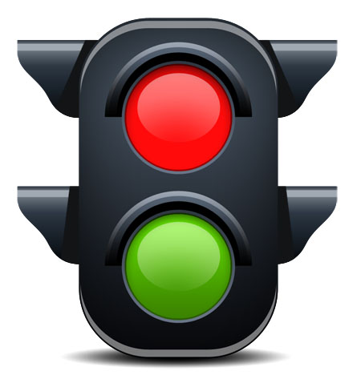
Build and Unit test – the CI
Always want to build in a clean environment that matches where the code is going to be deployed too. - Build Server!
Find issues faster and closer to the source code check in
Notes:
MSBuild, DotNet build
Mstest, vstest, xunit

Slide 10
Configuration
Build Time Transforms
Deployment Time Transforms
Environment changes Test/Prod/Datacenters
Environment Variables – override at the instance level
Notes:
Build Time
From laptop to server side
Deployment time
Connection strings
Endpoint urls
User/password info

Slide 11
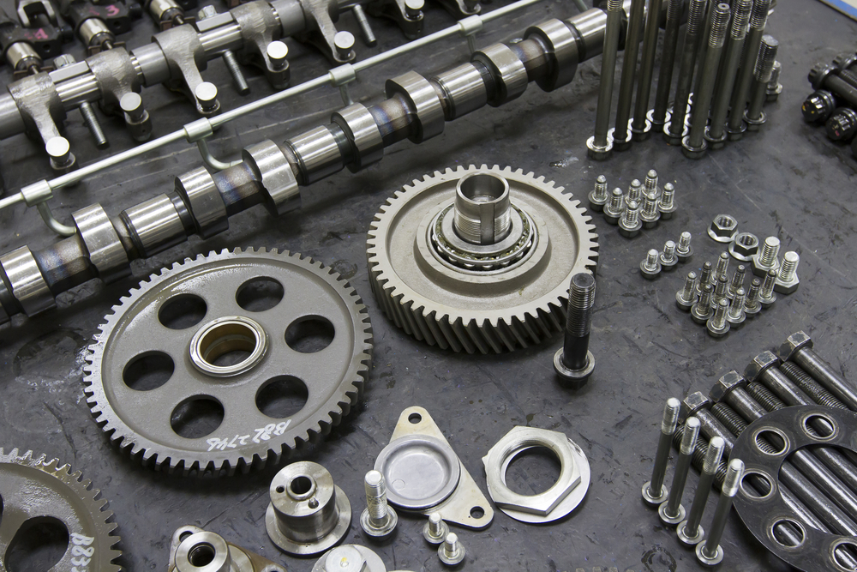

Packaging of binaries
Store the artifacts of the compilation and packaging process
Test/Prod debug/release versions if config is different
Re deployable units, dev can pull down and see exact bits that are on the server
Rollback deployments are easy
Notes:
Msdeploy – package.zip
Dotnet pack
Artifactory/Nuget/Chocolatey/Nexus

Slide 12

Automated Tests
Security tests
Functional/Integration tests
Performance Tests
Stress Tests
UI testing
Notes:
Security – sql injection, cross site scripting attacks
Minimal static code analysis, better is full web app scanning
Owasp, sonarQube, checkmarx, fortify, appscan
PROVE THE DATA IS SAFE before you do anything with it this should also be in unit test level!
Functional
Key business Flows
3rd party integrations
Perf tests
Baseline
Stress
How far until it gives up the ghost
Ui Testing
Most fragile of the testing (ui changes a lot)

Slide 13
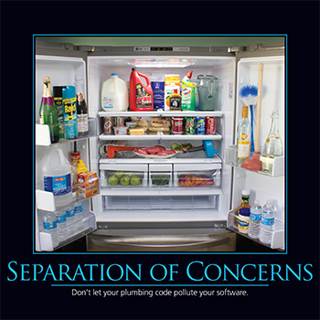
Release – Begin the CD
Separation of concerns
Code release != Customer has feature
Zero Downtime Deployments
load balancers,
Azure – Deployment slots
Notes:
Build, Test, Package, Deployment of Code
Azure built in Code deployment
Jenkins
VSTS

Slide 14

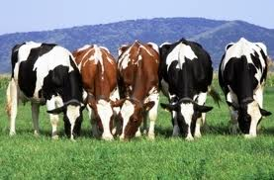
Plucky VS Longhorn
Pets are given names like pussinboots.cern.ch
They are unique, lovingly hand raised and cared for. When they get ill, you nurse them back to health
Cattle are given numbers like vm0042.cern.ch
They are almost identical to other cattle
When they get ill, you get another one

Slide 15
Environments
Ideal is testing environment = production environment
Testing in production
Infrastructure is treated as “cattle” rather than pets.
Notes:
Configuration is the only difference Facebook and google
Allows us to give more attention to our cute and furry applications

Slide 16
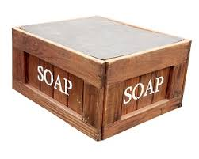
Application Automation – our Pets/Our Concerns
Fault tolerance - route around failure, avoid single points of failure
Apps manage their own data, abstract other data sources, and never trust data until proven safe.
Apps acquire infrastructure themselves based on load
Apps auto heal
Notes:
Scaling issues
Session data
Queue processing
Identifying which instance is bad
Fault Tolerance
Queues, persistence layers (in-memory cache, redis) and datastores

Slide 17
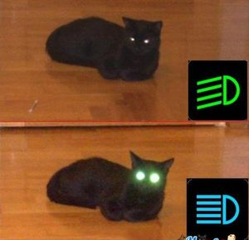
Features Toggles – continuous delivery
Dynamic toggle vs Releasing code to turn feature on.
Allows to Fail Fast - kill switch
Allows for A/B testing
Allows for Canary releases
Dark releases (code is there for internal only)
Short lived
Notes:
Configuration service
Environment overrides
Deployment slots
App settings
Traffic management
Group authorizations

Slide 18
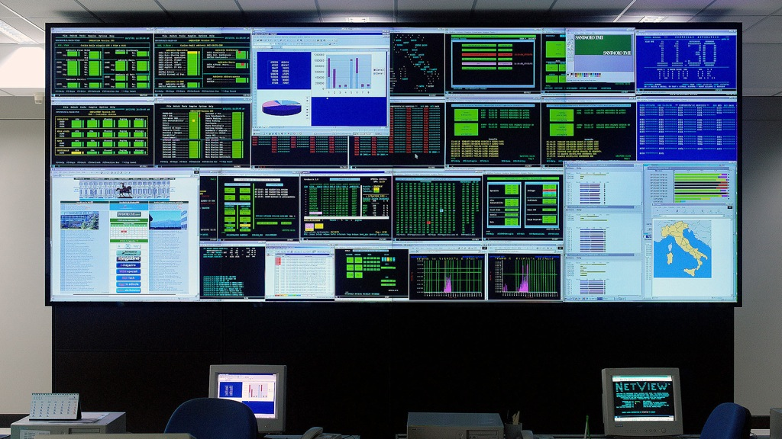
Monitor – all the things!
Performance
Response Time
Transaction time
Alerting
Exceptions
Errors
Scaling
Real User Monitoring
Bounce rate
Landing/exit pages
Business Primary Key Indicators
Orders/sec
Customer signups
Server
CPU
Memory
Network traffic
Reporting
Availability
Deployments
Time To Market
System Outages
Notes:
Excpetionless Pingdom DataDog Google Anayltics
Serilog – plugin nature, How do you monitor key business flows?

Slide 19
CI/CD
Continuous Integration - keep feedback loop small and fast
Continuous Deployment – get the code into production
Continuous Delivery – constantly add value by getting feature to customer quickly
Notes:
Current client when first arrived they had no automation
Dev Manager was manually merging through 4 source code branches (dev, test, stage, prod)
Manually building on local laptop, deploying from laptop from each of the branches.
Taking nearly 6 weeks for code to get out the door to prod.
3 months later, we migrated to Git, each application had a master branch that we had automated build and deploy to test, stage, and 1 button push to prod for 5 apps.
6 months later all apps were CD to test, first unit tests projects created and integrated. We had decom’ed the staging environment (saving 200k) as

Slide 20
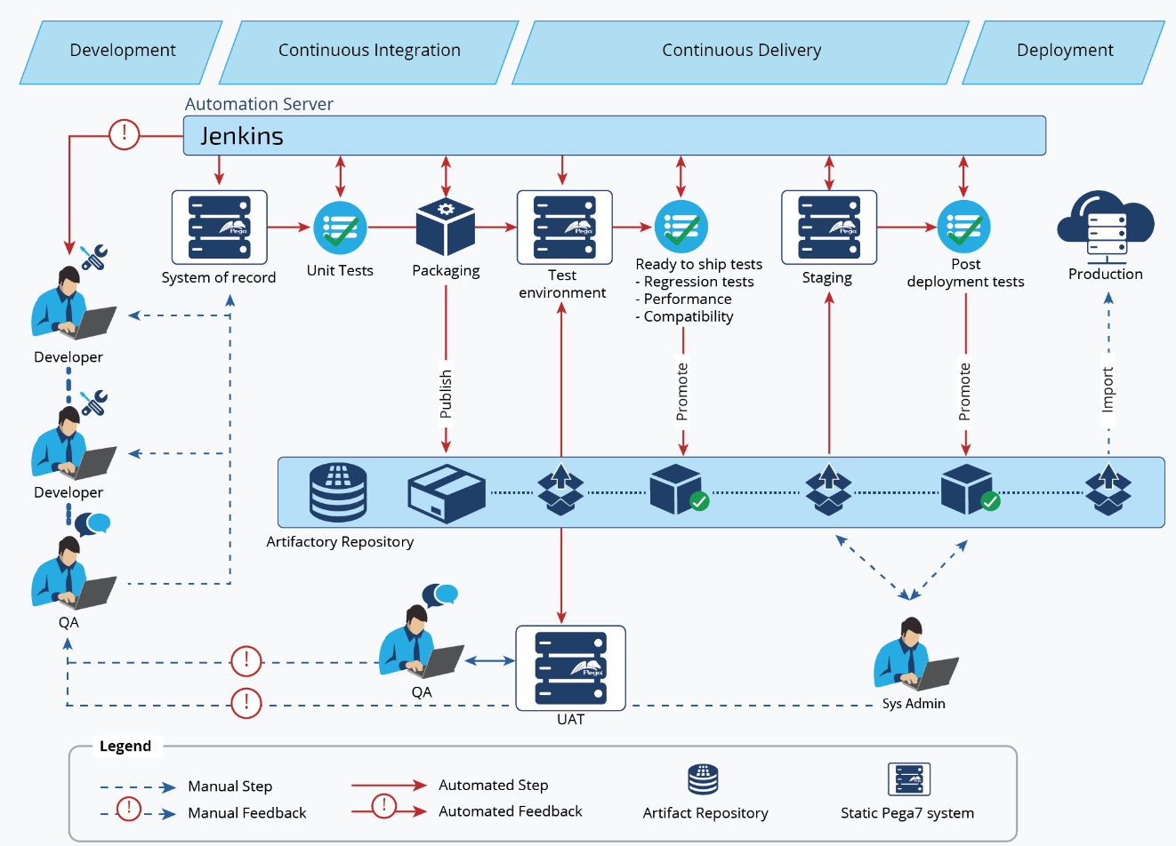
PIPELINE - Summary

Slide 21
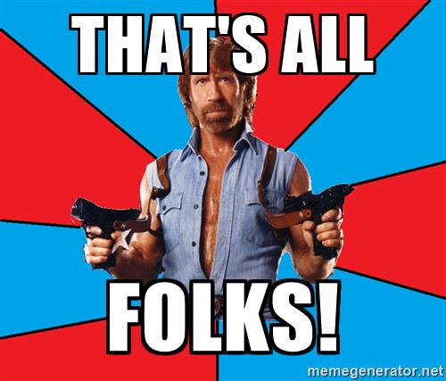
Questions?

Slide 22
References
Application Automation
Devops
CERN Infrastructure Evolution
DevOps Toolchain for Microsoft Dynamics 365
The Lean Startup, Eric Ries
Testing in production - Seth Eliot

