Slide 1
Mission Critical High -Customer Value
DO IT
Not Critical
High -Customer value
Partner with 3rd party – Microsoft methodology
Not Critical
Low/no customer value
STOP NOW
Mission Critical
Low Customer Value
Find a cheap off the shelf solution if possible, change process to use solution

Slide 2
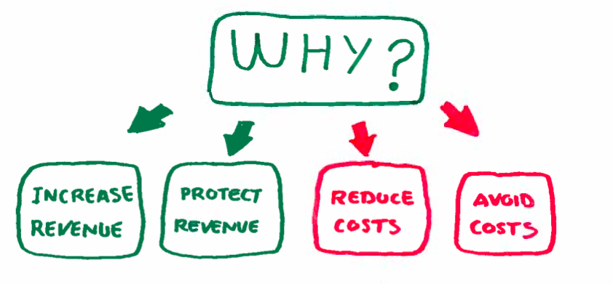
Business Value

Slide 3
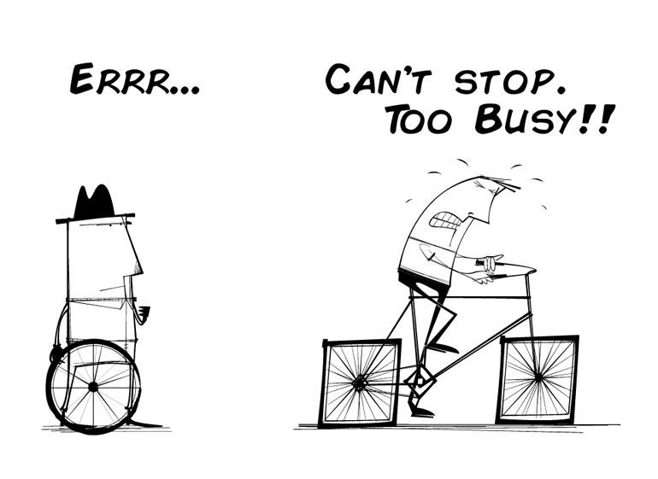
Too busy…

Slide 4

Who trusts inputs

Slide 5
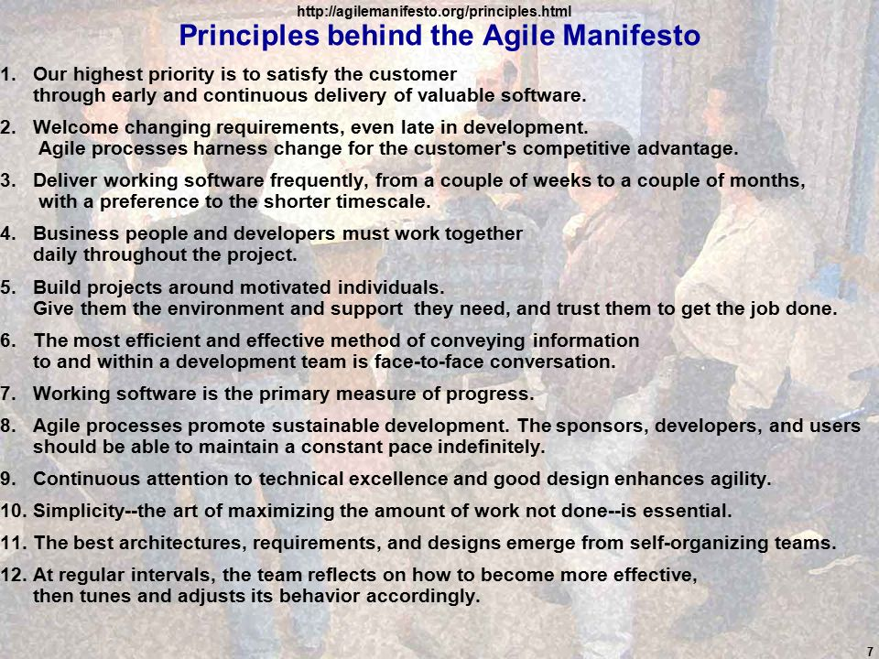

Slide 6
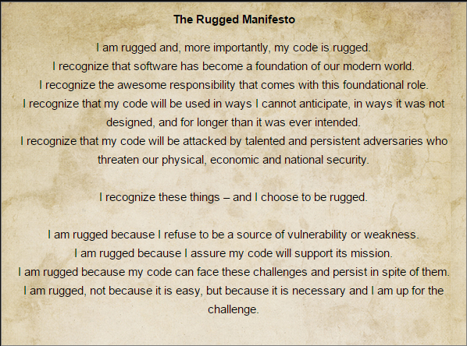

Slide 7
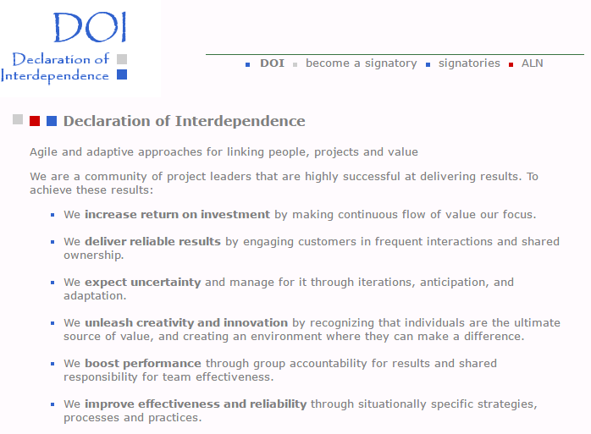

Slide 8
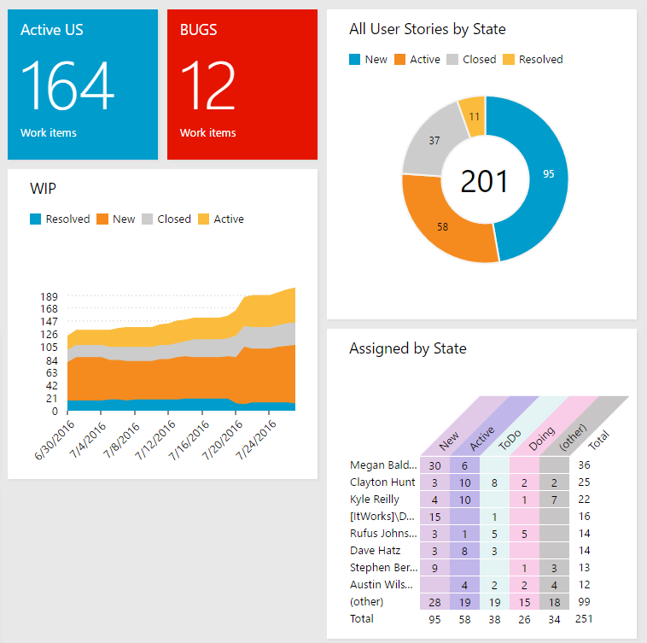
July

