Slide 1
Examining the Influence and Reach of the Russian Troll Factory
Rob Chudzik
Springboard Capstone 2 Project
March, 2019

Slide 2
Problem Statement
In the lead up to the 2016 US Election, and for a short time afterwards, social media users in he US were targeted by a disinformation campaign by a Russian “troll factory,” designed to “sow disinformation and discord into American politics via social media.”¹
1. FiveThirtyEight.com, Why We’re Sharing 3 Million Russian Troll Tweets, July 31, 2018

Slide 3
Project Objective
I will use the Tweets to explore questions about the nature of the disinformation campaign, such as:
Did the tweets increase in frequency or volume around the time of major events?
Did other trolls retweet and amplify troll tweets?
Can clusters be made of Twitter handles/’users’ grouped with similar features?
Can common topics or themes be identified?
What were the most-used hashtags?
Did the tweets predominantly support one candidate or political party, or seek to undermine the other?

Slide 4
Project Objective
By exploring the patterns, topics and methods of the disinformation campaign, I will seek to create insight into these efforts and understand how to recognize, identify and potentially avoid future disinformation attacks.

Slide 5
Client
My client for this project is the American voter, and I intend to provide analysis to aid them in discerning manufactured disinformation from “real” opinion and information.

Slide 6
Data Sources
The data I will be using for this project is data that has been made available to the public by Five Thirty Eight, on their GitHub.
The data was originally gathered by two professors at Clemson University; Darren Linvill and Patrick Warren, and shared with FiveThirtyEight.
“Using advanced social media tracking software, they pulled the tweets from thousands of accounts that Twitter has acknowledged as being associated with the IRA. The professors shared their data with FiveThirtyEight in the hope that other researchers, and the broader public, will explore it and share what they find.”
FiveThirtyEight.com, Why We’re Sharing 3 Million Russian Troll Tweets, July 31, 2018)

Slide 7
NLP Analysis Process
Data Wrangling
EDA
Text Pre-processing
Analysis
NLP
The roughly 3 million-row data set results in a file size of 1.16 GB, far exceeding GitHub’s file size limit,

Slide 8
Data Wrangling
The roughly 3 million-row data set results in a file size of 1.16 GB, far exceeding GitHub’s file size limit,
As a result, the data was split into 13 separate CSV files.
Code was written to iterate over each CSV file in the directory, and append each file into one CSV file. The single file was then read into a single dataframe containing all ~ 3 million rows of data.

Slide 9
EDA
Exploratory Data Analysis (EDA) was undertaken to examine the structure of the data and extract any initial findings and patterns in the data.
2,843 unique trolls, accounting for 2.94 million tweets
Ten most active authors were responsible for ~350,000 tweets, (only 14% of the total Troll tweets)
Indicates a more widespread use of trolls with tweets distributed across many users

Slide 10
EDA – Activity Timeline
A primary area of interest was the timing of troll activity and how it aligned with major events in the election cycle.
Focused on a time window beginning in June, 2015 (Trump announces candidacy) and ending in January 2018 (when the troll accounts were identified).
Significant events in the 2016 election cycle were annotated on the timeline: party debates, presidential debates, and the Charlottesville white supremacist rally.

Slide 11
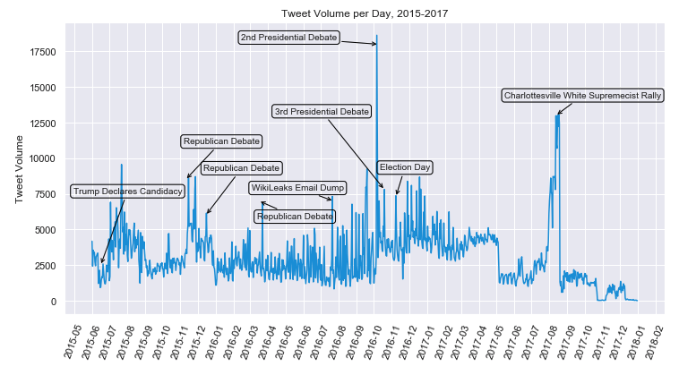
EDA – Activity Timeline
Clear spikes in troll activity aligning with significant 2016 Election Events

Slide 12
Text Pre-processing
Before any form of NLP can be undertaken, text pre-processing must be performed to prepare the data to be machine-readable
Text pre-processing consists of :
Noise Removal
Tokenization
Normalization (i.e., stemming or lemmatization)
Tokenization is the process of converting a text into tokens – words or entities present in the text.

Slide 13
Text Pre-processing
Text normalization includes:
converting all letters to lower or upper case
converting numbers into words or removing numbers
removing punctuations and accent marks
removing white spaces
removing stop words, sparse terms, and particular words
Lemmatization
Reducing multiple forms of a word to a common base form
For the words “studying” and “studies”, lemmatization would reduce to the base word (known as a lemma) “study”

Slide 14
Pre-NLP Analysis
Hashtag Analysis
Analysis of the trolls’ most-used hashtags provided limited amount of insight into the content posted by the trolls and the methods they used.
The top hashtags reflected “hot” issues during the 2016 election, like “MAGA” or “BlackLivesMatter”
But many of the hashtags are simply noise – like “local” and “news”.

Slide 15
NLP - Latent Dirichlet Allocation
Latent Dirichlet Allocation (LDA) is the topic modeling algorithm that was used
Used to classify text in a document and assign it to a particular topic.
Builds a “topic per document” model and “words per topic” model, modeled as Dirichlet distributions.
Requires a sparse vector
Created a bag-of-words document representation
Used Gensim NLP Library

Slide 16
LDA Topic Modeling Results
Sample output:
1 --- (1, '0.041*"trump" + 0.013*"obama" + 0.013*"hillary" + 0.013*"clinton" + 0.011*"president" + 0.009*"say" + 0.009*"american" + 0.008*"donald" + 0.007*"vote" + 0.007*"state"')
First digit is the topic number (i.e., 1)
Top 10 keywords that contribute to this topic are listed (i.e., "trump”, "obama”)
Preceded by the weight of keyword on the topic (i.e., 0.041)

Slide 17
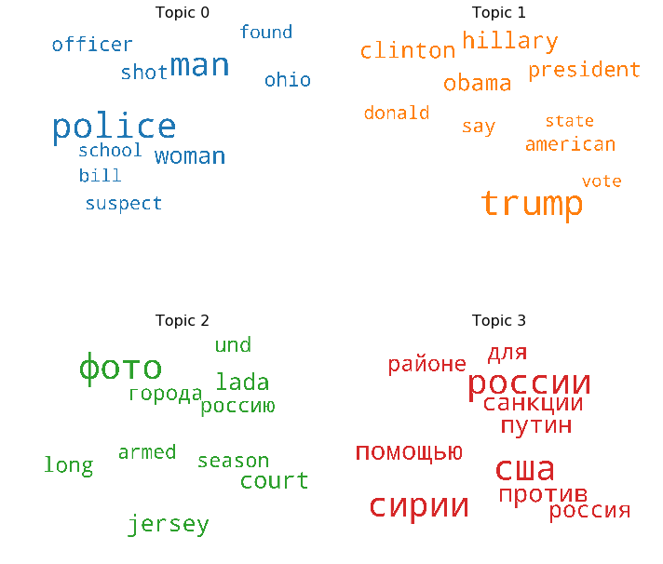
LDA Output Word Cloud
Visualization of the topic modeling results can help understanding

Slide 18
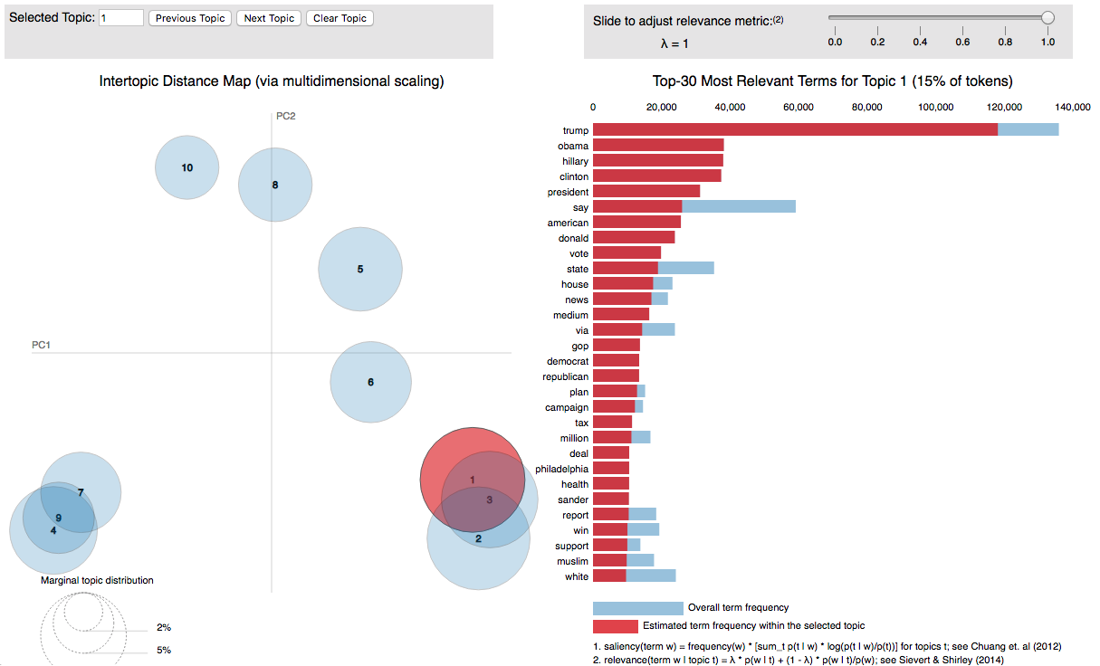
PyLDAvis
Better, interactive way to visualize LDA output

Slide 19
Troll Groups
Clemson University researchers Darren Linvill and Patrick Warren classified trolls into five groups, each with unique patterns of behaviors
Focused on the Right Troll and Left Troll groups
Right Troll, spreading nativist and right-leaning populist messages. It supported the candidacy and Presidency of Donald Trump and denigrated the Democratic Party.
Left Troll, sending socially liberal messages and discussing gender, sexual, religious, and -especially- racial identity.
Analyzed hashtags, mentions, and topics of each group

Slide 20
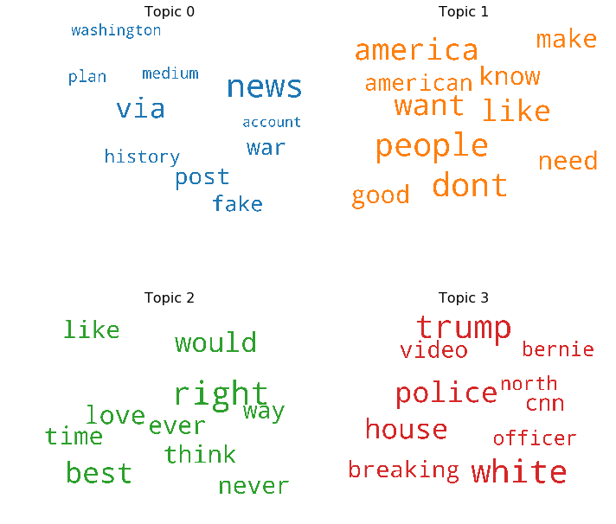
Right Troll Group
The Right Troll group appears to be strongly right-wing in their hashtag and topical themes, attacking Democrats, Barack Obama, Hillary Clinton, and their supporters.
Echo Donald Trump’s themes of #MAGA (Make America Great Again) and #2a (Second Amendment).
However, the Right Troll group members also sometimes tweeted divisive messages about the Republican party as well.

Slide 21
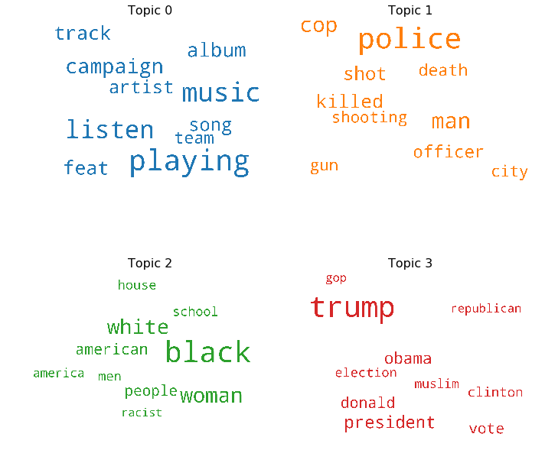
Left Troll Group
The Left Troll group played the foil to the Right Troll group, focusing on identity politics and the issues related to identity politics that were designed to provoke and inflame.
The hashtags reflect the strategy of this group, with common hashtags like #BlackLivesMatter and #BlackSkinIsNotACrime. Topical themes focused on #PoliceBrutality, which was a central issues during this time period.

Slide 22
Conclusions
The conclusions drawn from this analysis are less definitive than I had hoped, but several findings contradicted the assumptions held at the start of this analysis project.
Expected a much larger “echo chamber” of trolls amplifying other trolls’ messages
only 1,739 trolls amplifying other troll users

Slide 23
Conclusions
Russian trolls didn’t appear to be supporting any one candidate
More intent on sowing confusion, disinformation and divisiveness
Both Left Trolls and Right Trolls communicated messages intended to divide within that Left or Right audience
As it became clear that Donald Trump was the Republican nominee, Russian Trolls aligned behind Trump and against Clinton.
Aligns with intelligence reporting
ISSUE: #RacialJustice SOLUTION: #BernieSanders http://t.co/eumRjEvxrC

