Slide 1
GPSC_LIM food web
Part 3: Network Indices

Slide 2
Network Indices
To better understand the structural properties and transformations that occur in ecosystems from the micro- to the macro-scopic level
A robust estimators of food web functioning, even in the face of inherent uncertainty in the exact value of food web flows
The R-package NetIndices (Kones, Soetaert & van Oevelen, 2009) can be used to estimate network indices

Slide 3
General idea to calculate network indices
j
Get solutions of flows value in the food web
Turn it into a matrix in the form:
Flow: i → j
predefined
With a value (or 0 = no flow)
Solutions from Parsimonious/LA
Define some compartment as:
Import
Export/ Dissipation: export(=usable, e.g. OC); dissipation(=unusable, e.g. IC)
Dead
！ These external compartments which function as in/output for the food web, are often big and vague compartments that are not quantified
Select which index to calculate
The R-package NetIndices (Kones, Soetaert & van Oevelen, 2009)
 | Compartment 1 | Compartment 2 | …
Compartment 1 | 0 or flow value | 0 or flow value | …
Compartment 2 | 0 or flow value | 0 or flow value | …
… | … | … | …
i

Slide 4
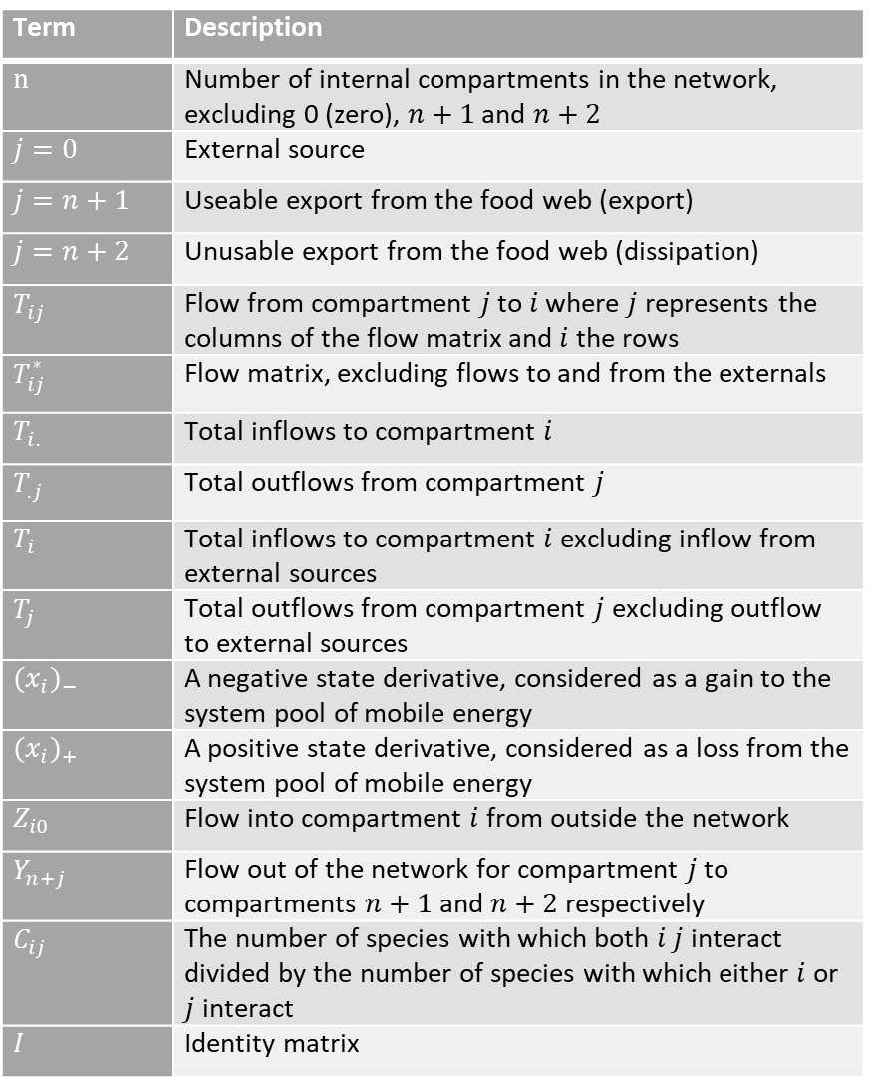
Term | Description
$n$ | Number of internal compartments in the network, excluding 0 (zero), $n+1$ and $n+2$
$j=0$ | External source
$j=n+1$ | Useable export from the food web (export)
$j=n+2$ | Unusable export from the food web (dissipation)
$T_{ij}$ | Flow from compartment $j$ to $i$ where $j$ represents the columns of the flow matrix and $i$ the rows
$T_{ij}^{∗}$ | Flow matrix, excluding flows to and from the externals
$T_{i.}$ | Total inflows to compartment $i$
$T_{.j}$ | Total outflows from compartment $j$
$T_{i}$ | Total inflows to compartment $i$ excluding inflow from external sources
$T_{j}$ | Total outflows from compartment $j$ excluding outflow to external sources
${(x_{i})}_{−}$ | A negative state derivative, considered as a gain to the system pool of mobile energy
${(x_{i})}_{+}$ | A positive state derivative, considered as a loss from the system pool of mobile energy
$Z_{i0}$ | Flow into compartment $i$ from outside the network
$Y_{n+j}$ | Flow out of the network for compartment $j$ to compartments $n+1$ and $n+2$ respectively
$C_{ij}$ | The number of species with which both $i$ $j$ interact divided by the number of species with which either $i$ or $j$ interact
$I$ | Identity matrix

Slide 5
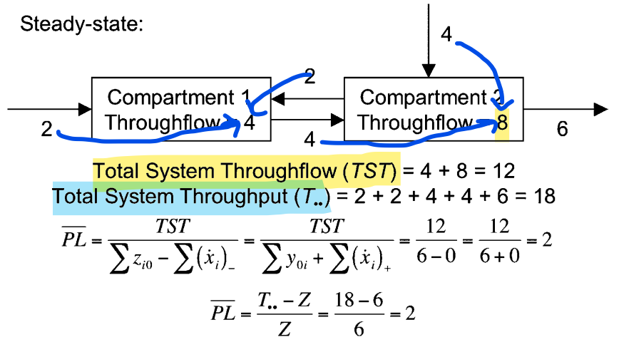
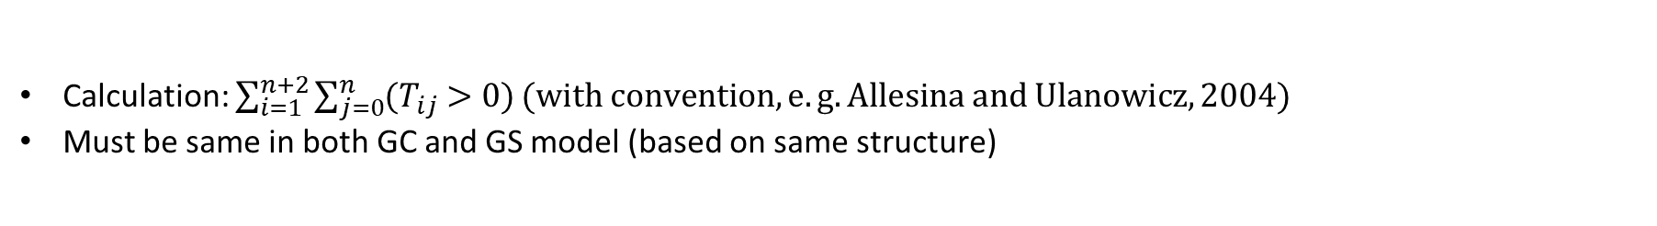
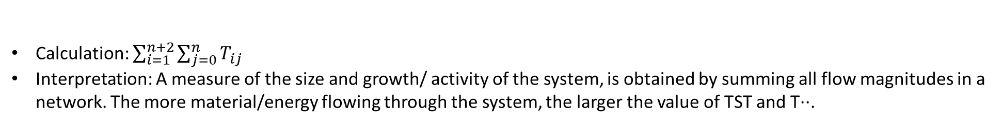
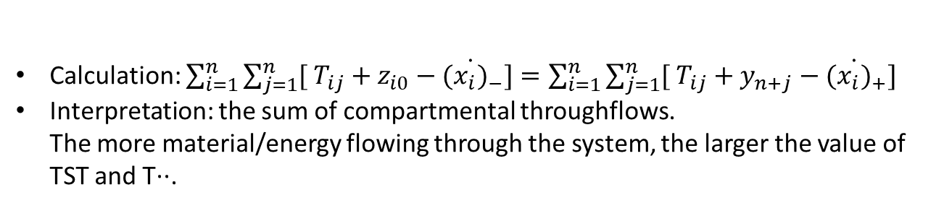
General indices:
Total system throughput (T..)
Calculation: $\sum_{i=1}^{n+2}{\sum_{j=0}^{n}{T_{ij}}}$
Interpretation: A measure of the size and growth/ activity of the system, is obtained by summing all flow magnitudes in a network. The more material/energy flowing through the system, the larger the value of TST and T··.
Total system throughflow (TST)
Calculation: $\sum_{i=1}^{n}{\sum_{j=1}^{n}{[ T_{ij}+z_{i0}−{(\dot{x_{i})}}_{−}}]=\sum_{i=1}^{n}{\sum_{j=1}^{n}{[ T_{ij}+y_{n+j}−{(\dot{x_{i})}}_{+}}] }}$
Interpretation: the sum of compartmental throughflows. The more material/energy flowing through the system, the larger the value of TST and T··.
Number of links (Ltot)
Calculation: $\sum_{i=1}^{n+2}{\sum_{j=0}^{n}{{(T}_{ij} >0)}}(with convention,e.g. Allesina and Ulanowicz, 2004)$
Must be same in both GC and GS model (based on same structure)
Average link weight (Tij)
Calculation:$T../L_{tot}$

Slide 6
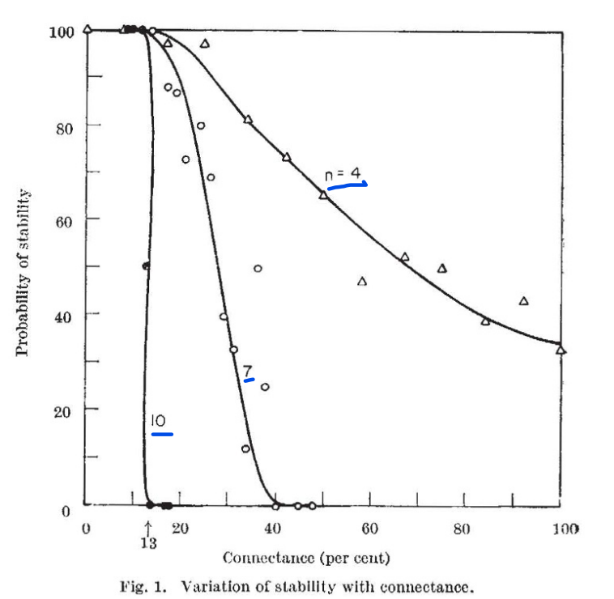
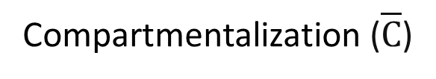
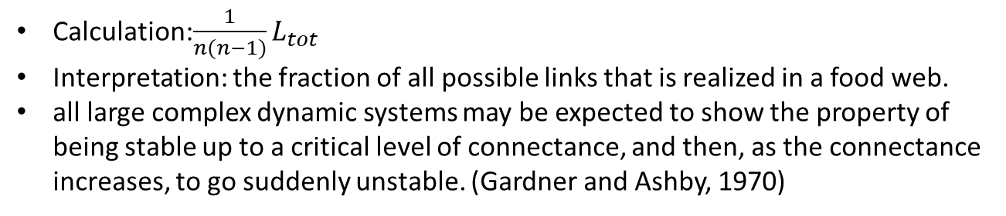
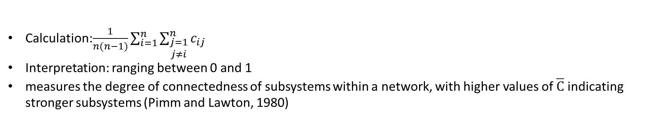
General indices:
Connectance (C)
Calculation:$\frac{1}{n(n−1)}L_{tot}$
Interpretation: the fraction of all possible links that is realized in a food web.
all large complex dynamic systems may be expected to show the property of being stable up to a critical level of connectance, and then, as the connectance increases, to go suddenly unstable. (Gardner and Ashby, 1970)
Compartmentalization ($\overline{C}$)
Calculation:$\frac{1}{n(n−1)}\sum_{i=1}^{n}{\sum_{\begin{aligned}j=1 \\ j≠i\end{aligned}}^{n}{c_{ij}}}$
Interpretation: ranging between 0 and 1
measures the degree of connectedness of subsystems within a network, with higher values of $\overline{C}$ indicating stronger subsystems (Pimm and Lawton, 1980)

Slide 7
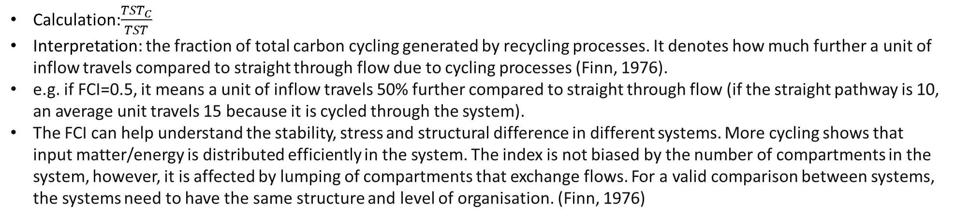
Pathway analysis
The average path length (PL)
Calculation:$\frac{TST}{\sum{z_{i0}−\sum{{(\dot{x_{i})}}_{−}}}}=\frac{TST}{\sum{y_{n+j}+\sum{{(\dot{x_{i})}}_{+}}}}$
Interpretation: mean number of compartments through which each inflow passes, weighted by the sizes of the inflows
Total system of cycled throughflow (TSTc)
Calculation:$\sum_{j=1}^{n}{\left(1−\frac{1}{q_{ij}}\right)T_{j}，where Q={(I−G′)}^{−1}，where G^{′}=[T_{ji}^{∗}/max⁡(T_{i},T_{j})]}$
Finn Cycling index (FCI)
Calculation:$\frac{{TST}_{C}}{TST}$
Interpretation: the fraction of total carbon cycling generated by recycling processes. It denotes how much further a unit of inflow travels compared to straight through flow due to cycling processes (Finn, 1976).
e.g. if FCI=0.5, it means a unit of inflow travels 50% further compared to straight through flow (if the straight pathway is 10, an average unit travels 15 because it is cycled through the system).
The FCI can help understand the stability, stress and structural difference in different systems. More cycling shows that input matter/energy is distributed efficiently in the system. The index is not biased by the number of compartments in the system, however, it is affected by lumping of compartments that exchange flows. For a valid comparison between systems, the systems need to have the same structure and level of organisation. (Finn, 1976)

Slide 8
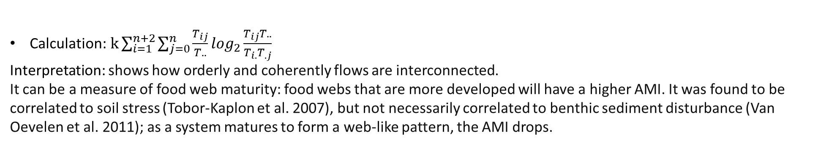
Network uncertainty
Average mutual information (AMI)
Calculation:$k\sum_{i=1}^{n+2}{\sum_{j=0}^{n}{\frac{T_{ij}}{T..}}}\log_{2}\frac{T_{ij}T..}{T_{i.}T_{.j}}$
Interpretation: shows how orderly and coherently flows are interconnected.
It can be a measure of food web maturity: food webs that are more developed will have a higher AMI. It was found to be correlated to soil stress (Tobor-Kaplon et al. 2007), but not necessarily correlated to benthic sediment disturbance (Van Oevelen et al. 2011); as a system matures to form a web-like pattern, the AMI drops.
Check: Latham and Scully (2002)

Slide 9
Indices used in LIM studies:
van Oevelen et al., 2016
T..
FCI
AMI
The network indices were compared between canyon sections by calculating the fraction of which the randomized set of indices of one canyon section is larger than that of another section.
For example, when this fraction is 0.90, this implies that 90% of the values of section 1 are larger than the ones of section 2 (and consequently 10% of the values are lower). We define differences of > 90% and < 10% as significant difference and > 95% and < 5% as highly significant difference

Slide 10
Indices used in LIM studies:
De Smet et al., 2016
Total system throughput(T..): the sum of all flow magnitudes in a network
Total number of links (Ltot)
The average link weight (Tij)
The connectance (C)
The average mutual information index (AMI): the average amount of constraint placed upon an arbitrary flow anywhere in the network.
Stratmann et al., 2018
The network index T.. fraction was compared:
T..(side A)/T..(side B)
When this fraction is > 0.95, the difference in “total system throughput” between the two food webs from the same sampling event is considered significantly different (van Oevelen et al., 2011), indicating that carbon flows in the food web from that specific sampling event have not recovered from the experimental disturbance.

Slide 11
Indices used in LIM studies:
De Jonge et al., 2020
The topological size and complexity:
The number of links (L),
linkage density (LD): the average number of links per compartments
connectance (C): the proportion of realised links (Gardner and Ashby, 1970).
Trophic level (TL): signifies the position of a trophic compartment in the food chain and is related to resource availability and transfer efficiency (Post, 2002).
C cycling:
Total system throughput (T..): the sum of all C flows in the food web, reflecting the ‘ecological’ size of the system (Latham, 2006)
Finn’s Cycling Index (FCI): the proportion of C cycling due to recycling processes, reflecting structural differences and the efficiency of C usage in a system (Finn, 1976).
Network indices are robust to a fair extent of variation in input data and network structure (Kones et al., 2009, Heymans et al., 2014). This underlines their suitability for analysing models that cannot be fully parameterized with empirical data, like the food-web model from the remote DISCOL experimental area where direct measurements are limited.

Slide 12
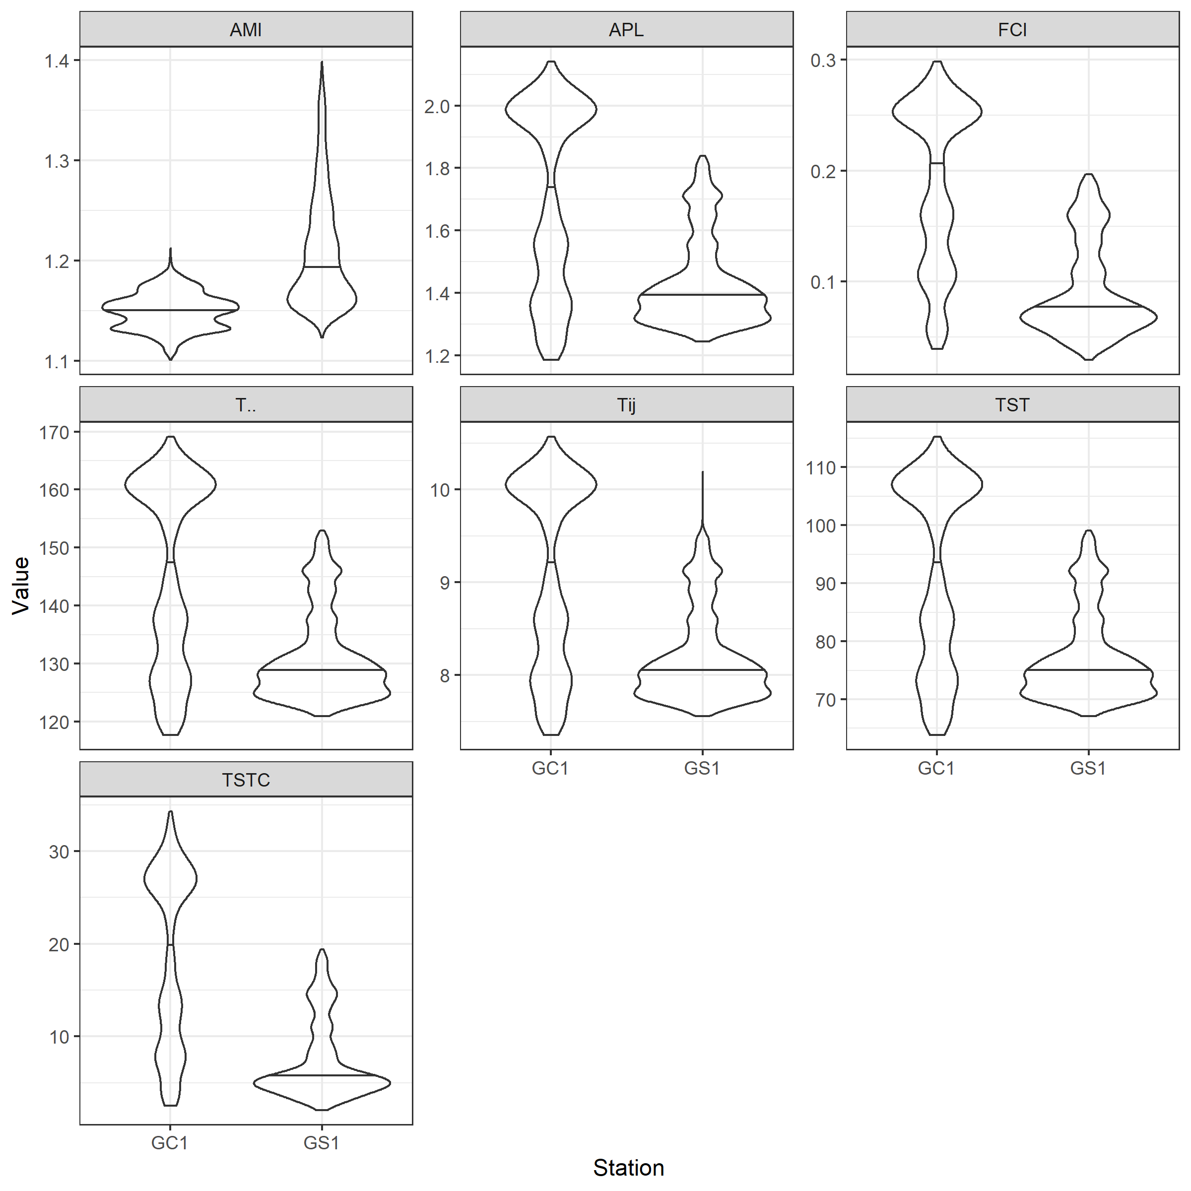
After calculating the network indices
What do these network features tell you about the ecological system?
Is the interpretation of your measures dependent on the quality of your data?
→ How trustworthy and robust are the indices you calculated?
General indices: GC1 > GS1
The more material/energy flowing through the system, the larger the value of TST and T··
Pathway analysis: GC1 > GS1
The fraction of total carbon cycling generated by recycling processes. More cycling= input matter/energy is distributed efficiently in the system
Network uncertainty: GC1 < GS1
lower = more stable (Rutledge et al. 1976)
Higher= well-development (Ulanowicz 1980; 1986; 1997)
Number of links (Ltot): GC1=GS1=16
Connectance (C): GC1=GS1=0.75
Same value based on same structure

Slide 13
Foundation in communication theory
Developed from the study of electrical communication: the telegraph, Morse Code fame.
The principal foundations of communication theory
A Mathematical Theory of Communication (Shannon, 1948).
Concerned with the coding and efficient transmission of information over noisy channels, including telegraph, telephone, television, and radio (Pierce, 1980).
Information: a measurable quantity expressing the degree of uncertainty about what message will be produced by a message source.
The more that is known about a message source, the less information and the less uncertainty there is in what message will be produced.
Entropy= the uncertainty
Information= the freedom of choice of the source to produce messages.
The more uncertain you are about what message the source will produce, the more information content a message from that source will contain.
The capacity to discover what signal a source will produce

Slide 14

Foundation in communication theory
The uncertainty, or information measure
a statistical measure of the uncertainty of the message source.
H is related to the number of binary decisions that must be made to account for all of the possible messages that may be produced. [Network analysis interpretation using a base of logs equal to 2, which is consistent with the concept of binary decisions.]
Pi: probability of flow over the ith link
Based on the frequency of signals in sequences that a message source produces, we are able to describe the source with this general measure of uncertainty

Slide 15
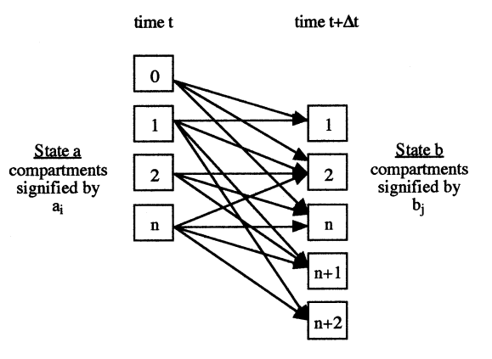
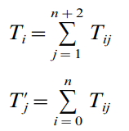
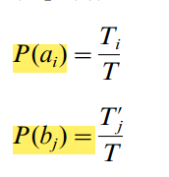
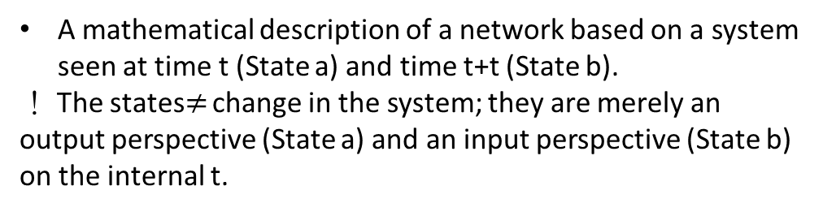
The average mutual information (AMI)
A mathematical description of a network based on a system seen at time t (State a) and time t+t (State b).
！ The states$≠$ change in the system; they are merely an output perspective (State a) and an input perspective (State b) on the internal t.
input
Formula Derivation
: The total flow out of compartment i at time t
Usable output
: The total flow into compartment j at time t+$∆$t; (‘)=input
Unusable output
: The probability that any given quantum of flow in the network will leave i at time t
: The probability that flow will enter compartment j at time t+ $∆$t

Slide 16





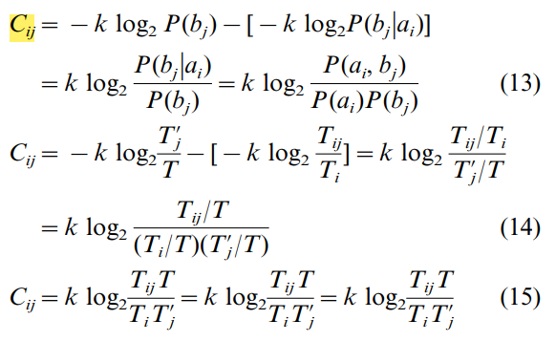
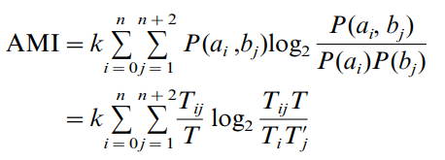
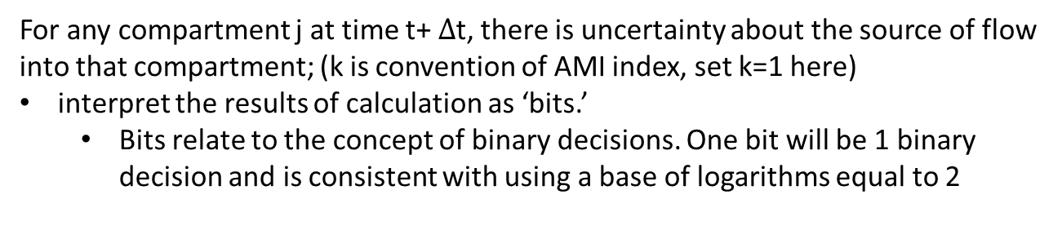
Formula Derivation
‘joint probability’: any given quantum of flow will both leave i at time t and enter j at time t+t.
‘conditional’ probability: flow leaving i at time t will arrive at j at time t+ $∆$t
From Bayes’ Theorem
For any compartment j at time t+ $∆$t, there is uncertainty about the source of flow into that compartment; (k is convention of AMI index, set k=1 here)
interpret the results of calculation as ‘bits.’
Bits relate to the concept of binary decisions. One bit will be 1 binary decision and is consistent with using a base of logarithms equal to 2
conditional probability
Hj
Cij: a measure of constraint away from completely arbitrary flow
Each Cij is weighed by the joint probability of that flow
weighted constraints are summed over all combinations of i and j in the network.
The result is the AMI

Slide 17
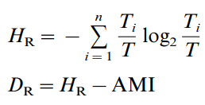
The average mutual information (AMI)
Interpretation
Diversity, the effective number of choices for energy flow
Rutledge et al. (1976)
defined the statistical uncertainty (HR) as an upper bound on the AMI.
defined the HR – AMI = DR, the conditional uncertainty
As the AMI falls(= less constraints) in a system with increasing ‘choice’ (i.e. web-like structure; mature; complex structure), the stability (DR) has increased
Ulanowicz (1980, 1986, 1997)
held the opposite view: the AMI should increase with development
AMI would indicate a refining of the network to distinctly constrained flow patterns.

Slide 18
BAC = 30% TOU (ref)
以30%TOU的結果跟DOU比較(大約=20-25%)
if BAC=DOU?
把我們的TOU% * huh 的sedimentation rate = OC content -> 跟model 的值比較
不設POC的上限(直接讓model決定)
反證sediment trap的flux是不是有問題?
Sedimentation rate : 維持
! Check the part of POC part! 20220311

