Slide 1
Date | Season | Cruise | Station | Longitude | Latitude | Depth (m) | Measurement | Gear
2014/11 | AU | OR1_1096 | GC1
 |  |  | GS1
2015/03 | SP | OR1_1099 | GC1
 |  |  | GS1
2015/04 | SP | OR1_1102 | GC1
 |  |  | GS1
2015/08 | SU | OR1_1114 | GC1
 |  |  | GS1
2015/11 | AU | OR1_1126 | GC1
 |  |  | GS1
2016/02 | SP | OR1_1128 | GC1
2016/03 | SP | OR1_1132 | GS1
2016/10 | AU | OR1_1151 | GC1
 |  |  | GS1
2018/03-04 | SP | OR1_1190 | GC1
 |  |  | GS1
2019/03-04 | SP | OR1_1219 | GC1
 |  |  | GS1
2019/10 | AU | OR1_1242 | GC1
 |  |  | GS1
2020/11 | AU | NOR_T004 | GC1

Slide 2
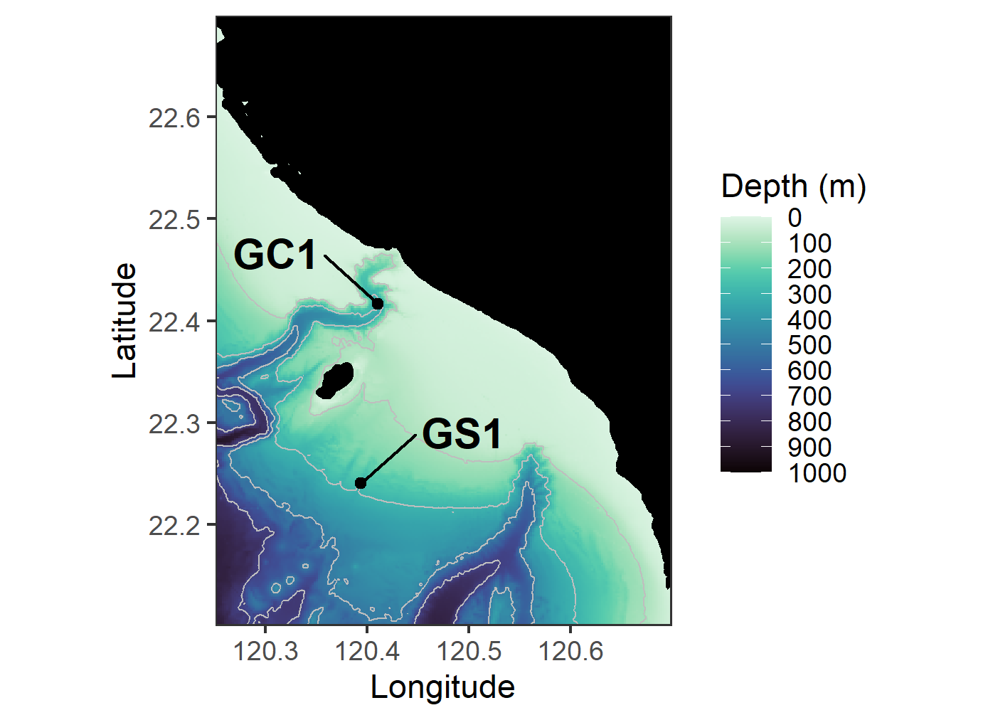
Figure.1 The map of sampling stations of the upper Gaoping Submarine Canyon (GC1) and Gaoping Slope (GS1).

Slide 3
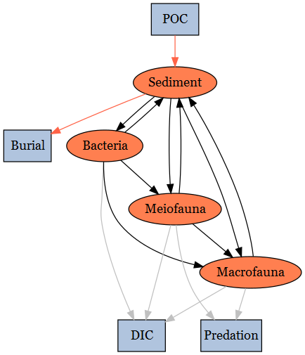
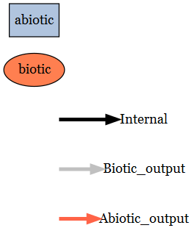
Figure.2 conceptual model of the food web structure which formed the basis of our linear inverse model (LIM). See section “Structure” for description.

Slide 4
Inequality description | Calculation | GC1 | GS1 | Unit | Reference
Temperature limitation (Tlim) | Q10* exp((T-20)/10), with Q10 = 2 | 1.05 | 1.09 | -
Bacteria growth efficiency |  | [0.02, 0.61] | [0.02, 0.61] | - | del Giorgio and Cole (1998)
DOU (Bacteria -> DIC) | Maximum DOU= 30% TOU | [0.0, 21.77] | [0.0, 16.01] | mg C/m²/d | Mahaut et al. (1995)
Maintenance respiration of meiofauna |  | Tlim * 0.01 * Stock | Tlim * 0.01 * Stock | mg C/m²/d | van Oevelen et al. (2011)
Maintenance respiration of macrofauna |  | Tlim * 0.01 * Stock | Tlim * 0.01 * Stock | mg C/m²/d
Assimilation efficiency of meiofauna |  | [0.456, 0.699] | [0.456, 0.699] | - | Conover (1966)
Assimilation efficiency of macrofauna |  | [0.6 0.7] | [0.6 0.7] | - | Loo and Rosenberg (1996)
P/B ratio of meiofauna |  | [0.0090, 0.0493] | [0.0090, 0.0493] | - | Fenchel (1982); Fleeger and Palmer (1982)
P/B ratio of macrofauna |  | [0.0008, 0.0048] | [0.0008, 0.0048] | - | Stratmann et al. (2018)
Net growth efficiency of meiofauna |  | [0.3, 0.5] | [0.3, 0.5] | - | Herman and Heip (1985); Banse and Mosher (1980); Herman et al. (1983; 1984)
Net growth efficiency of macrofauna |  | [0.6, 0.72] | [0.6, 0.72] | - | Navarro et al., 1994; Nielsen et al., 1995
Sedimentation rate |  | [75.93, 137.92] | [57.18, 66.80] | mg C/m²/d | Huh et al. (2009)
Sediment burial efficiency |  | [0.24, 1] | [0.24, 1] | - | Hsu et al. (2014)
Table. 2 Equality and inequality constraints implemented in the LIM models of GC1 and GS1. Values given as single number implied that the data were equalities, whereas the values designated in [ minimum value, maximum value ] represented the inequalities.

Slide 5
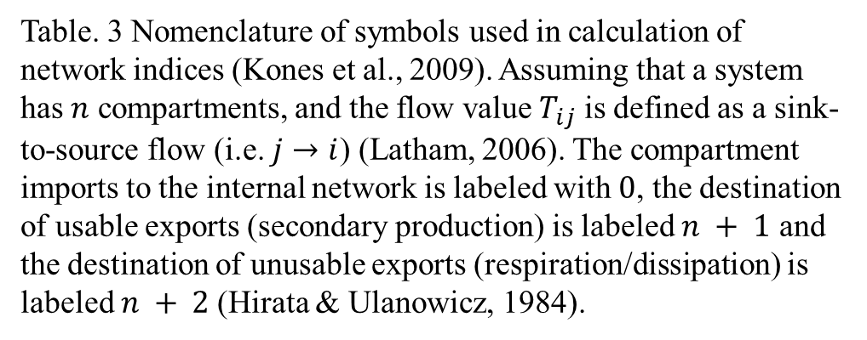
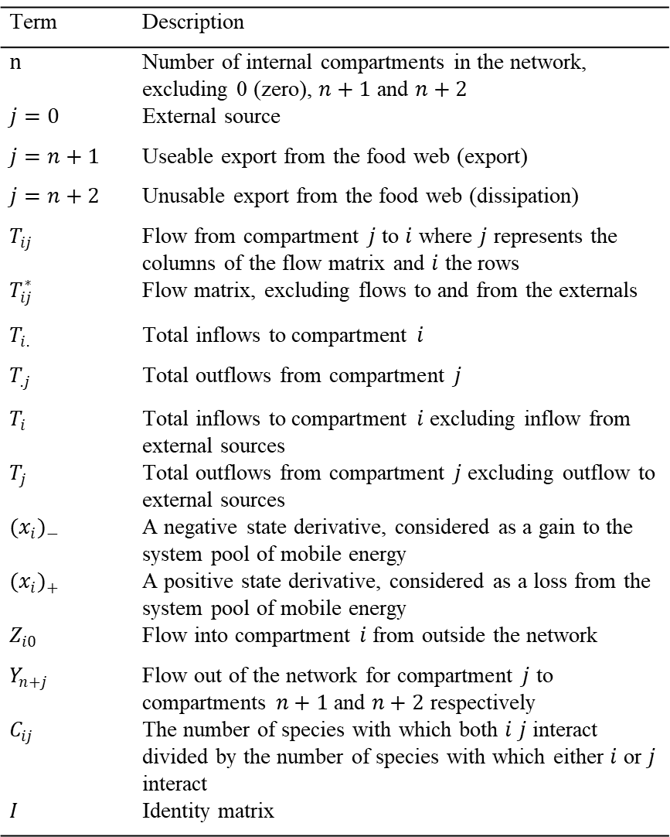
Term | Description
$n$ | Number of internal compartments in the network, excluding 0 (zero), $n+1$ and $n+2$
$j=0$ | External source
$j=n+1$ | Useable export from the food web (export)
$j=n+2$ | Unusable export from the food web (dissipation)
$T_{ij}$ | Flow from compartment $j$ to $i$ where $j$ represents the columns of the flow matrix and $i$ the rows
$T_{ij}^{∗}$ | Flow matrix, excluding flows to and from the externals
$T_{i.}$ | Total inflows to compartment $i$
$T_{.j}$ | Total outflows from compartment $j$
$T_{i}$ | Total inflows to compartment $i$ excluding inflow from external sources
$T_{j}$ | Total outflows from compartment $j$ excluding outflow to external sources
${(x_{i})}_{−}$ | A negative state derivative, considered as a gain to the system pool of mobile energy
${(x_{i})}_{+}$ | A positive state derivative, considered as a loss from the system pool of mobile energy
$Z_{i0}$ | Flow into compartment $i$ from outside the network
$Y_{n+j}$ | Flow out of the network for compartment $j$ to compartments $n+1$ and $n+2$ respectively
$C_{ij}$ | The number of species with which both $i$ $j$ interact divided by the number of species with which either $i$ or $j$ interact
$I$ | Identity matrix
Table. 3 Nomenclature of symbols used in calculation of network indices (Kones et al., 2009). Assuming that a system has $n$ compartments, and the flow value $T_{ij}$ is defined as a sink-to-source flow (i.e. $j→i$) (Latham, 2006). The compartment imports to the internal network is labeled with $0$, the destination of usable exports (secondary production) is labeled $n + 1$ and the destination of unusable exports (respiration/dissipation) is labeled $n + 2$(Hirata & Ulanowicz, 1984).

Slide 6
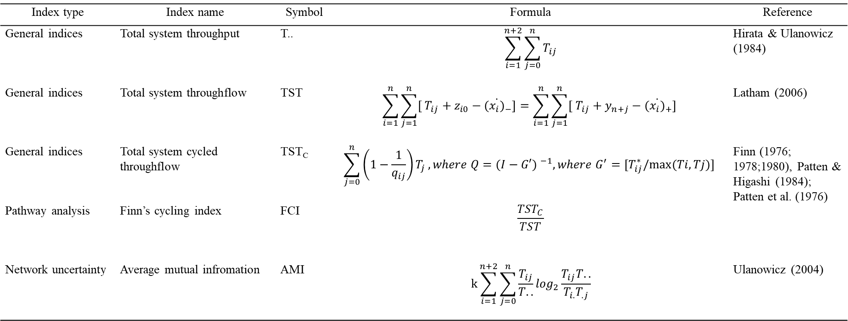
Index type | Index name | Symbol | Formula | Reference
General indices | Total system throughput | T.. | $$\sum_{i=1}^{n+2}{\sum_{j=0}^{n}{T_{ij}}}$$ | Hirata & Ulanowicz (1984)
General indices | Total system throughflow | TST | $$\sum_{i=1}^{n}{\sum_{j=1}^{n}{[ T_{ij}+z_{i0}−{(\dot{x_{i})}}_{−}}]=\sum_{i=1}^{n}{\sum_{j=1}^{n}{[ T_{ij}+y_{n+j}−{(\dot{x_{i})}}_{+}}] }}$$ | Latham (2006)
General indices | Total system cycled throughflow | TST_{C} | $$\sum_{j=0}^{n}{\left(1−\frac{1}{q_{ij}}\right)T_{j}}, where Q={(I−G′) }^{−1},where G^{′}=[T_{ij}^{∗}/max⁡(Ti,Tj)]$$ | Finn (1976; 1978;1980), Patten & Higashi (1984); Patten et al. (1976)
Pathway analysis | Finn’s cycling index | FCI | $$\frac{{TST}_{C}}{TST}$$
Network uncertainty | Average mutual infromation | AMI | $$k\sum_{i=1}^{n+2}{\sum_{j=0}^{n}{\frac{T_{ij}}{T..}}}\log_{2}\frac{T_{ij}T..}{T_{i.}T_{.j}}$$ | Ulanowicz (2004)
Table. 4 Algorithms for the calculation of the network indices; see Table. 3 for symbols.

Slide 7
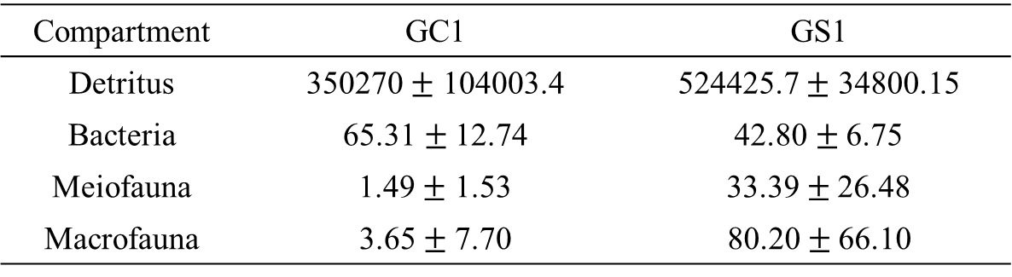
Compartment | GC1 | GS1
Detritus | 350270 $±$ 104003.4 | 524425.7 $±$ 34800.15
Bacteria | 65.31$±$12.74 | 42.80$±$6.75
Meiofauna | 1.49 $±$ 1.53 | 33.39 $±$26.48
Macrofauna | 3.65$±$7.70 | 80.20 $± \text{66.}\text{10}$
Table. 1 Standing stocks (in mg C/ m²) as mean$±$standard deviation of the food web compartments for GC1 and GS1.
Station | Averaged bottom water temperature(°C) | Tlim
GC1 | 13.54 | 1.05
GS1 | 13.90 | 1.09

Slide 8
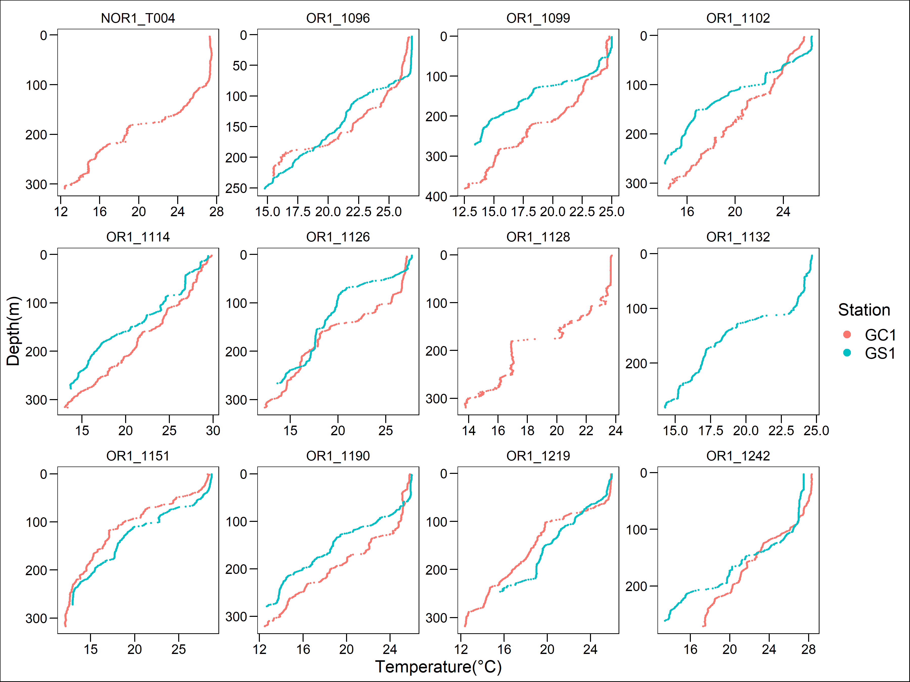
CTD plot_temp

Slide 9
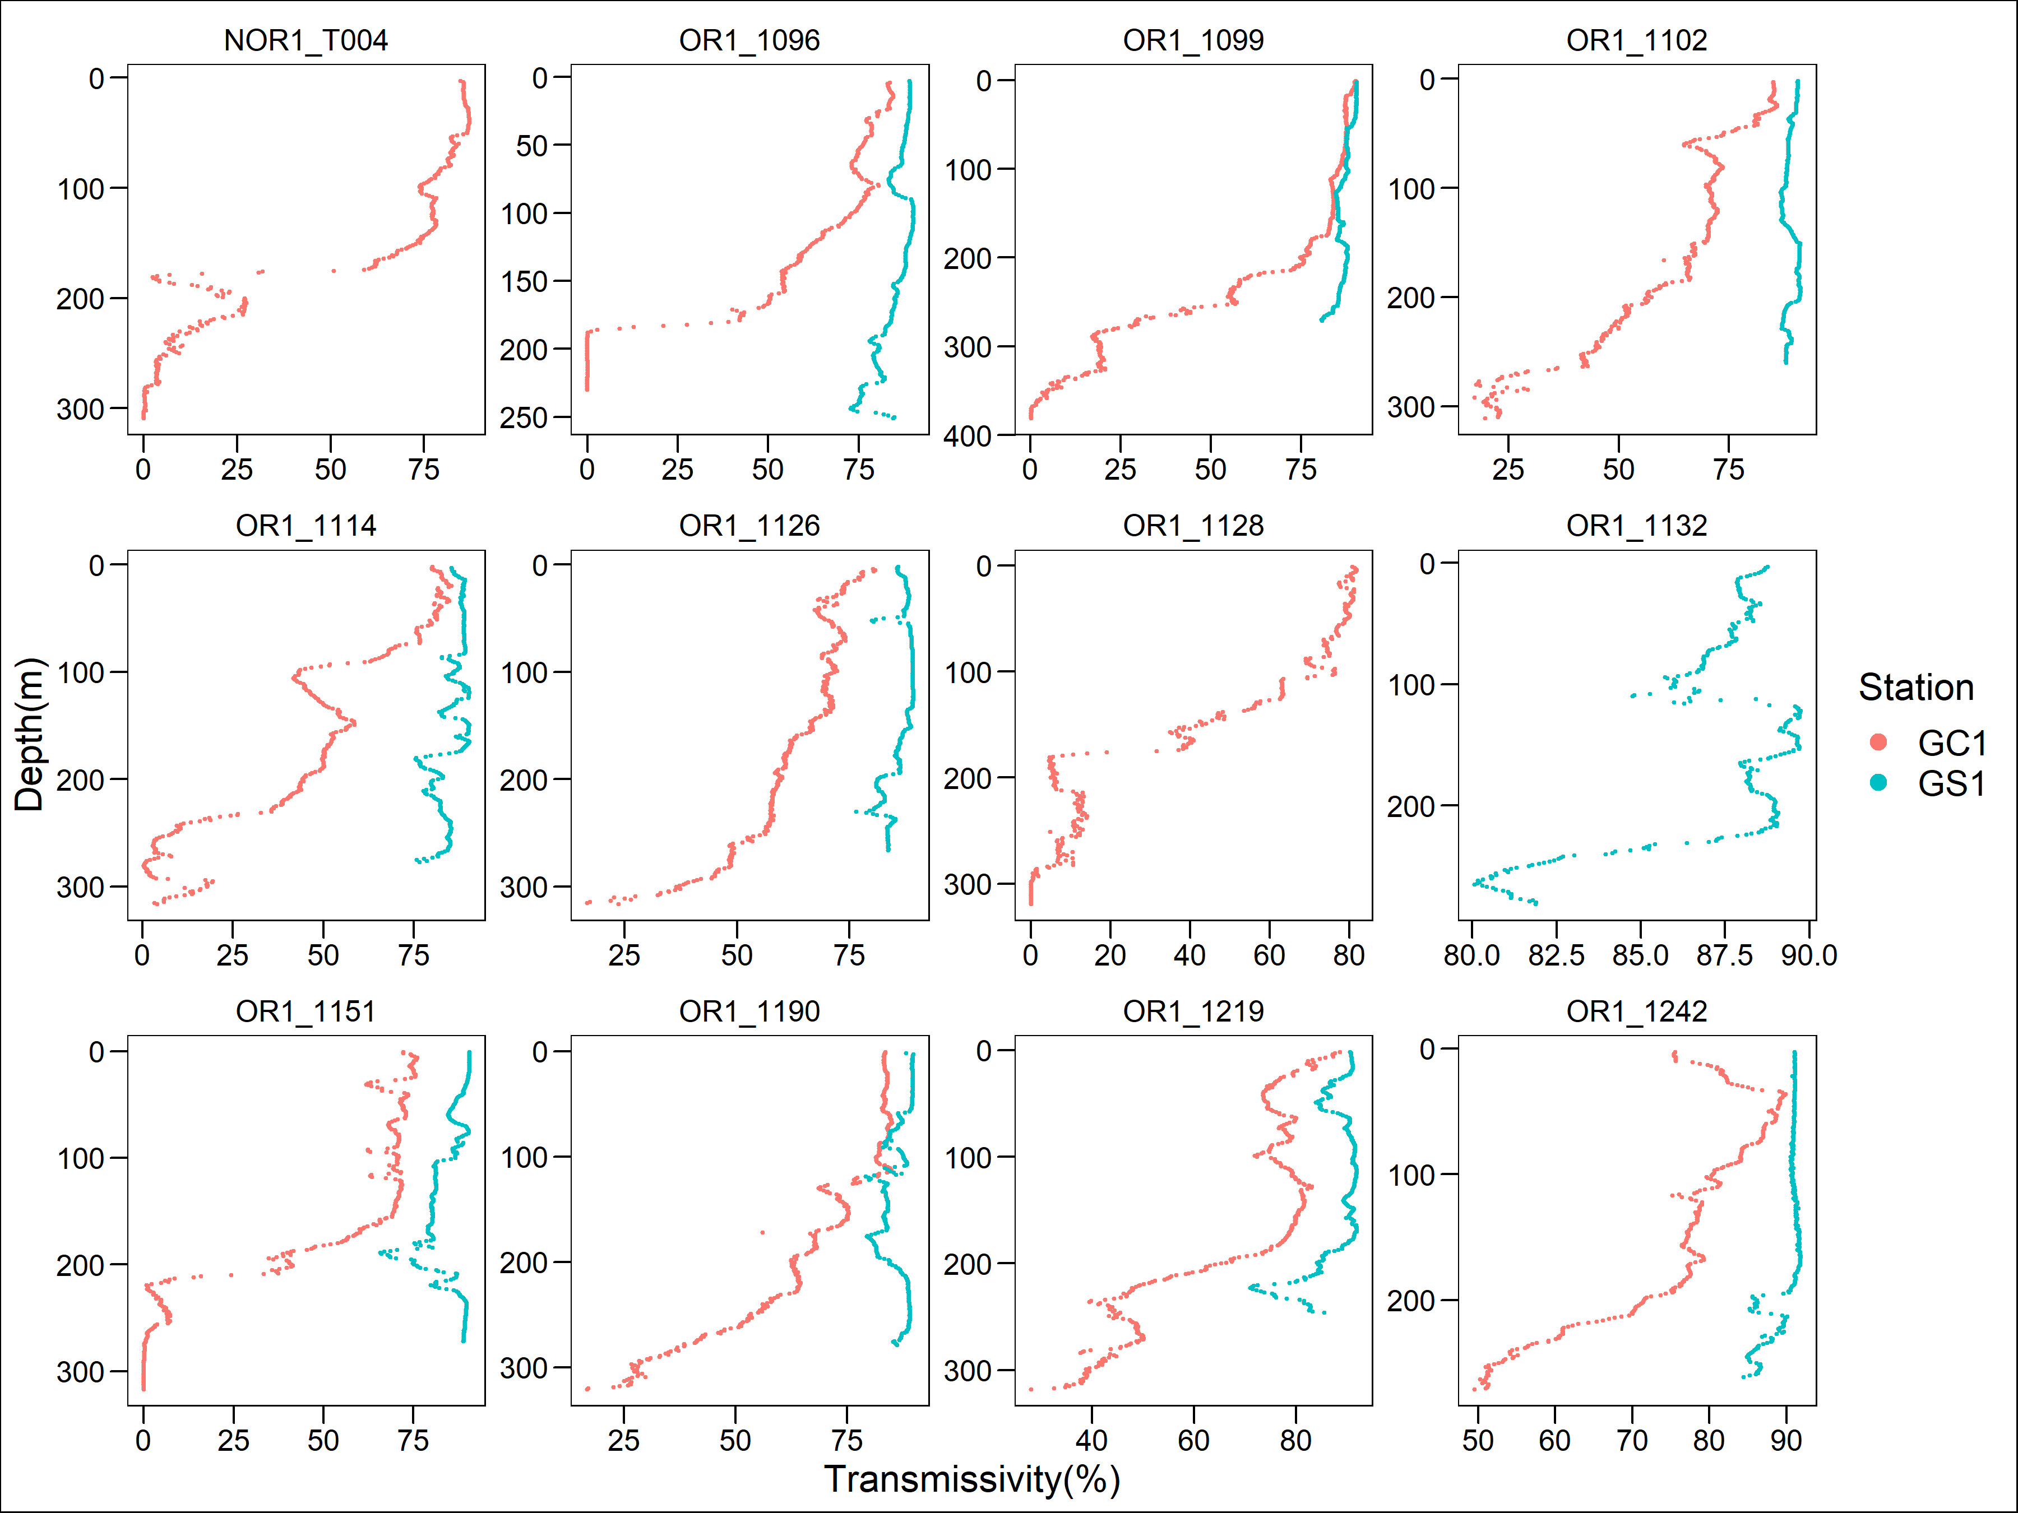
CTD plot_trans

Slide 10
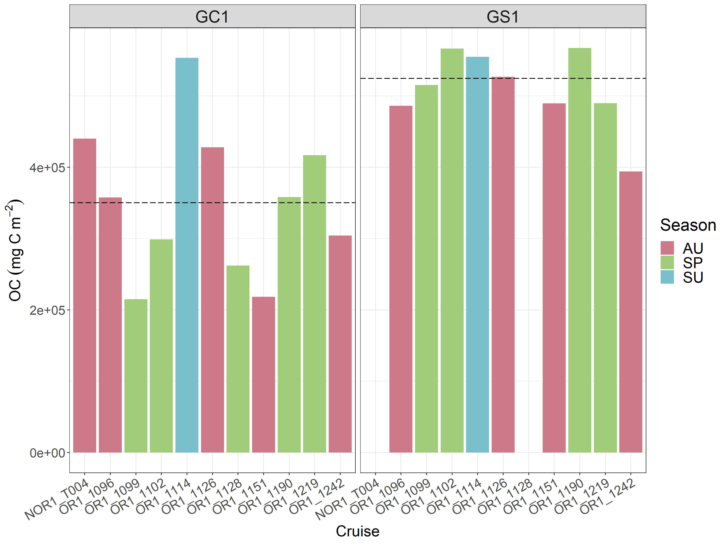
Sediment OC

Slide 11
Sediment_ statistics(OC)
PERMDISP
 | Df | Sum of squares | Mean squares | F-value | Pr (>F)
Habitat | 1 | 4.2034e+09 | 4203409008 | 3.0159 | 0.1051
Residuals | 16 | 2.2300e+10 | 1393745915
Season | 1 | 6.2729e+09 | 6272856607 | 1.6005 | 0.2263
Residuals | 16 | 6.2709e+10 | 3919334785
PERMANOVA
 | Df | Sum of squares | R2 | F-value | Pr (>F)
Habitat | 1 | 1.3517e+11 | 0.61649 | 25.9645 | 0.0003***
Season | 1 | 1.1106e+08 | 0.00051 | 0.0213 | 0.8816
Habitat:Season | 1 | 1.1092e+10 | 0.05059 | 2.1306 | 0.1673
Residual | 14 | 7.2883e+10 | 0.33241
Total | 17 | 2.1926e+11 | 1.00000

Slide 12
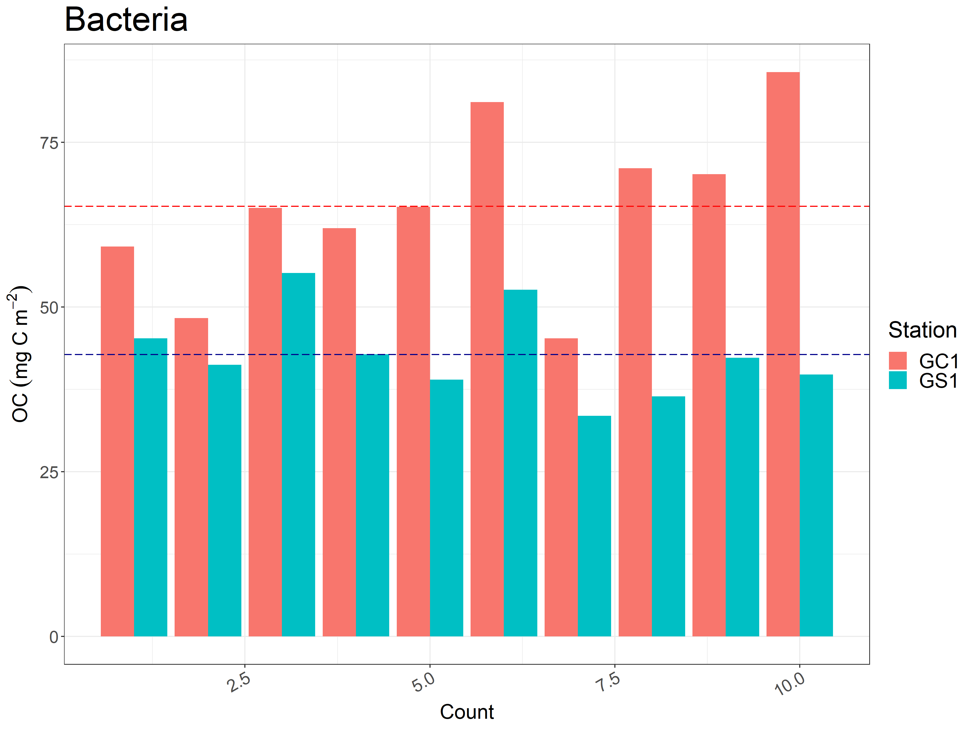
Anova_seasonal difference?
Bacteria

Slide 13
Bacteria_ statistics(OC)
Welch Two Sample t-test
 | Df | GC1 Mean | GS1 Mean | t | p-value
 | 13.677 | 65.30876 | 42.80281 | 4.9356 | 0.0002347***

Slide 14
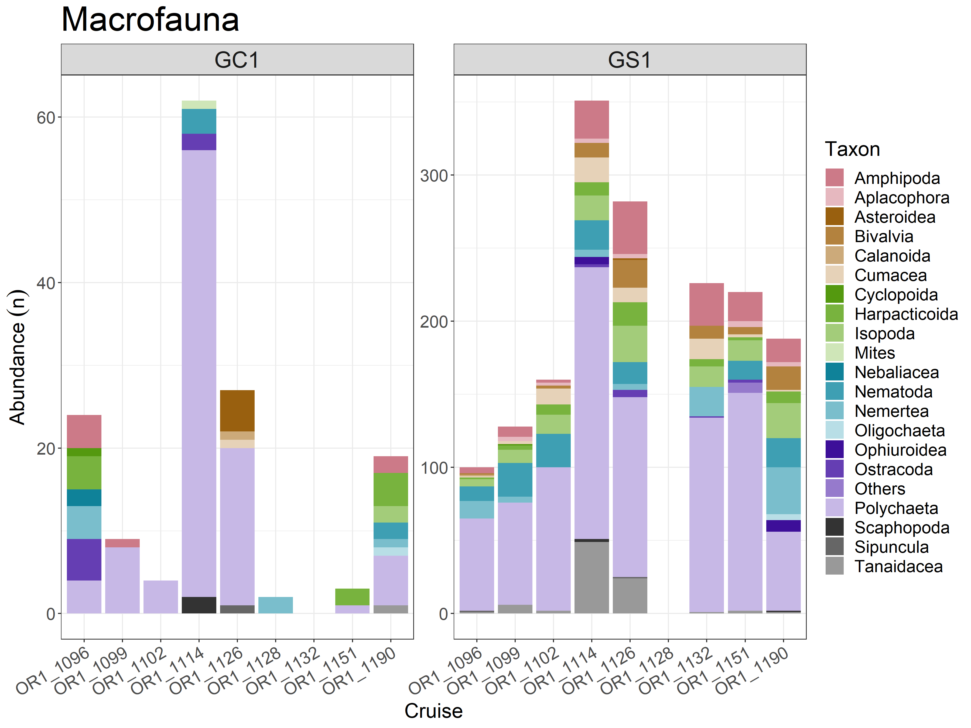
Macrofauna_abundance

Slide 15
Macrofauna_ statistics(OC)
PERMDISP
 | Df | Sum of squares | Mean squares | F-value | Pr (>F)
Habitat | 1 | 2.4262 | 2.42623 | 37.932 | 0.0001 ***
Residuals | 40 | 2.5585 | 0.06396
Season | 1 | 0.3203 | 0.32031 | 1.1371 | 0.298
Residuals | 40 | 11.2673 | 0.28168
PERMANOVA
 | Df | Sum of squares | R2 | F-value | Pr (>F)
Habitat | 1 | 0.3649373 | 0.02803441 | 1.793473 | 0.1906
Season | 1 | 4.6696224 | 0.35871952 | 22.9487 | 0.0001 ***
Habitat:Season | 1 | 0.2506460 | 0.01925458 | 1.2318 | 0.2816
Residual | 38 | 7.7322695 | 0.59399149
Total | 41 | 13.0174751 | 1.00000

Slide 16
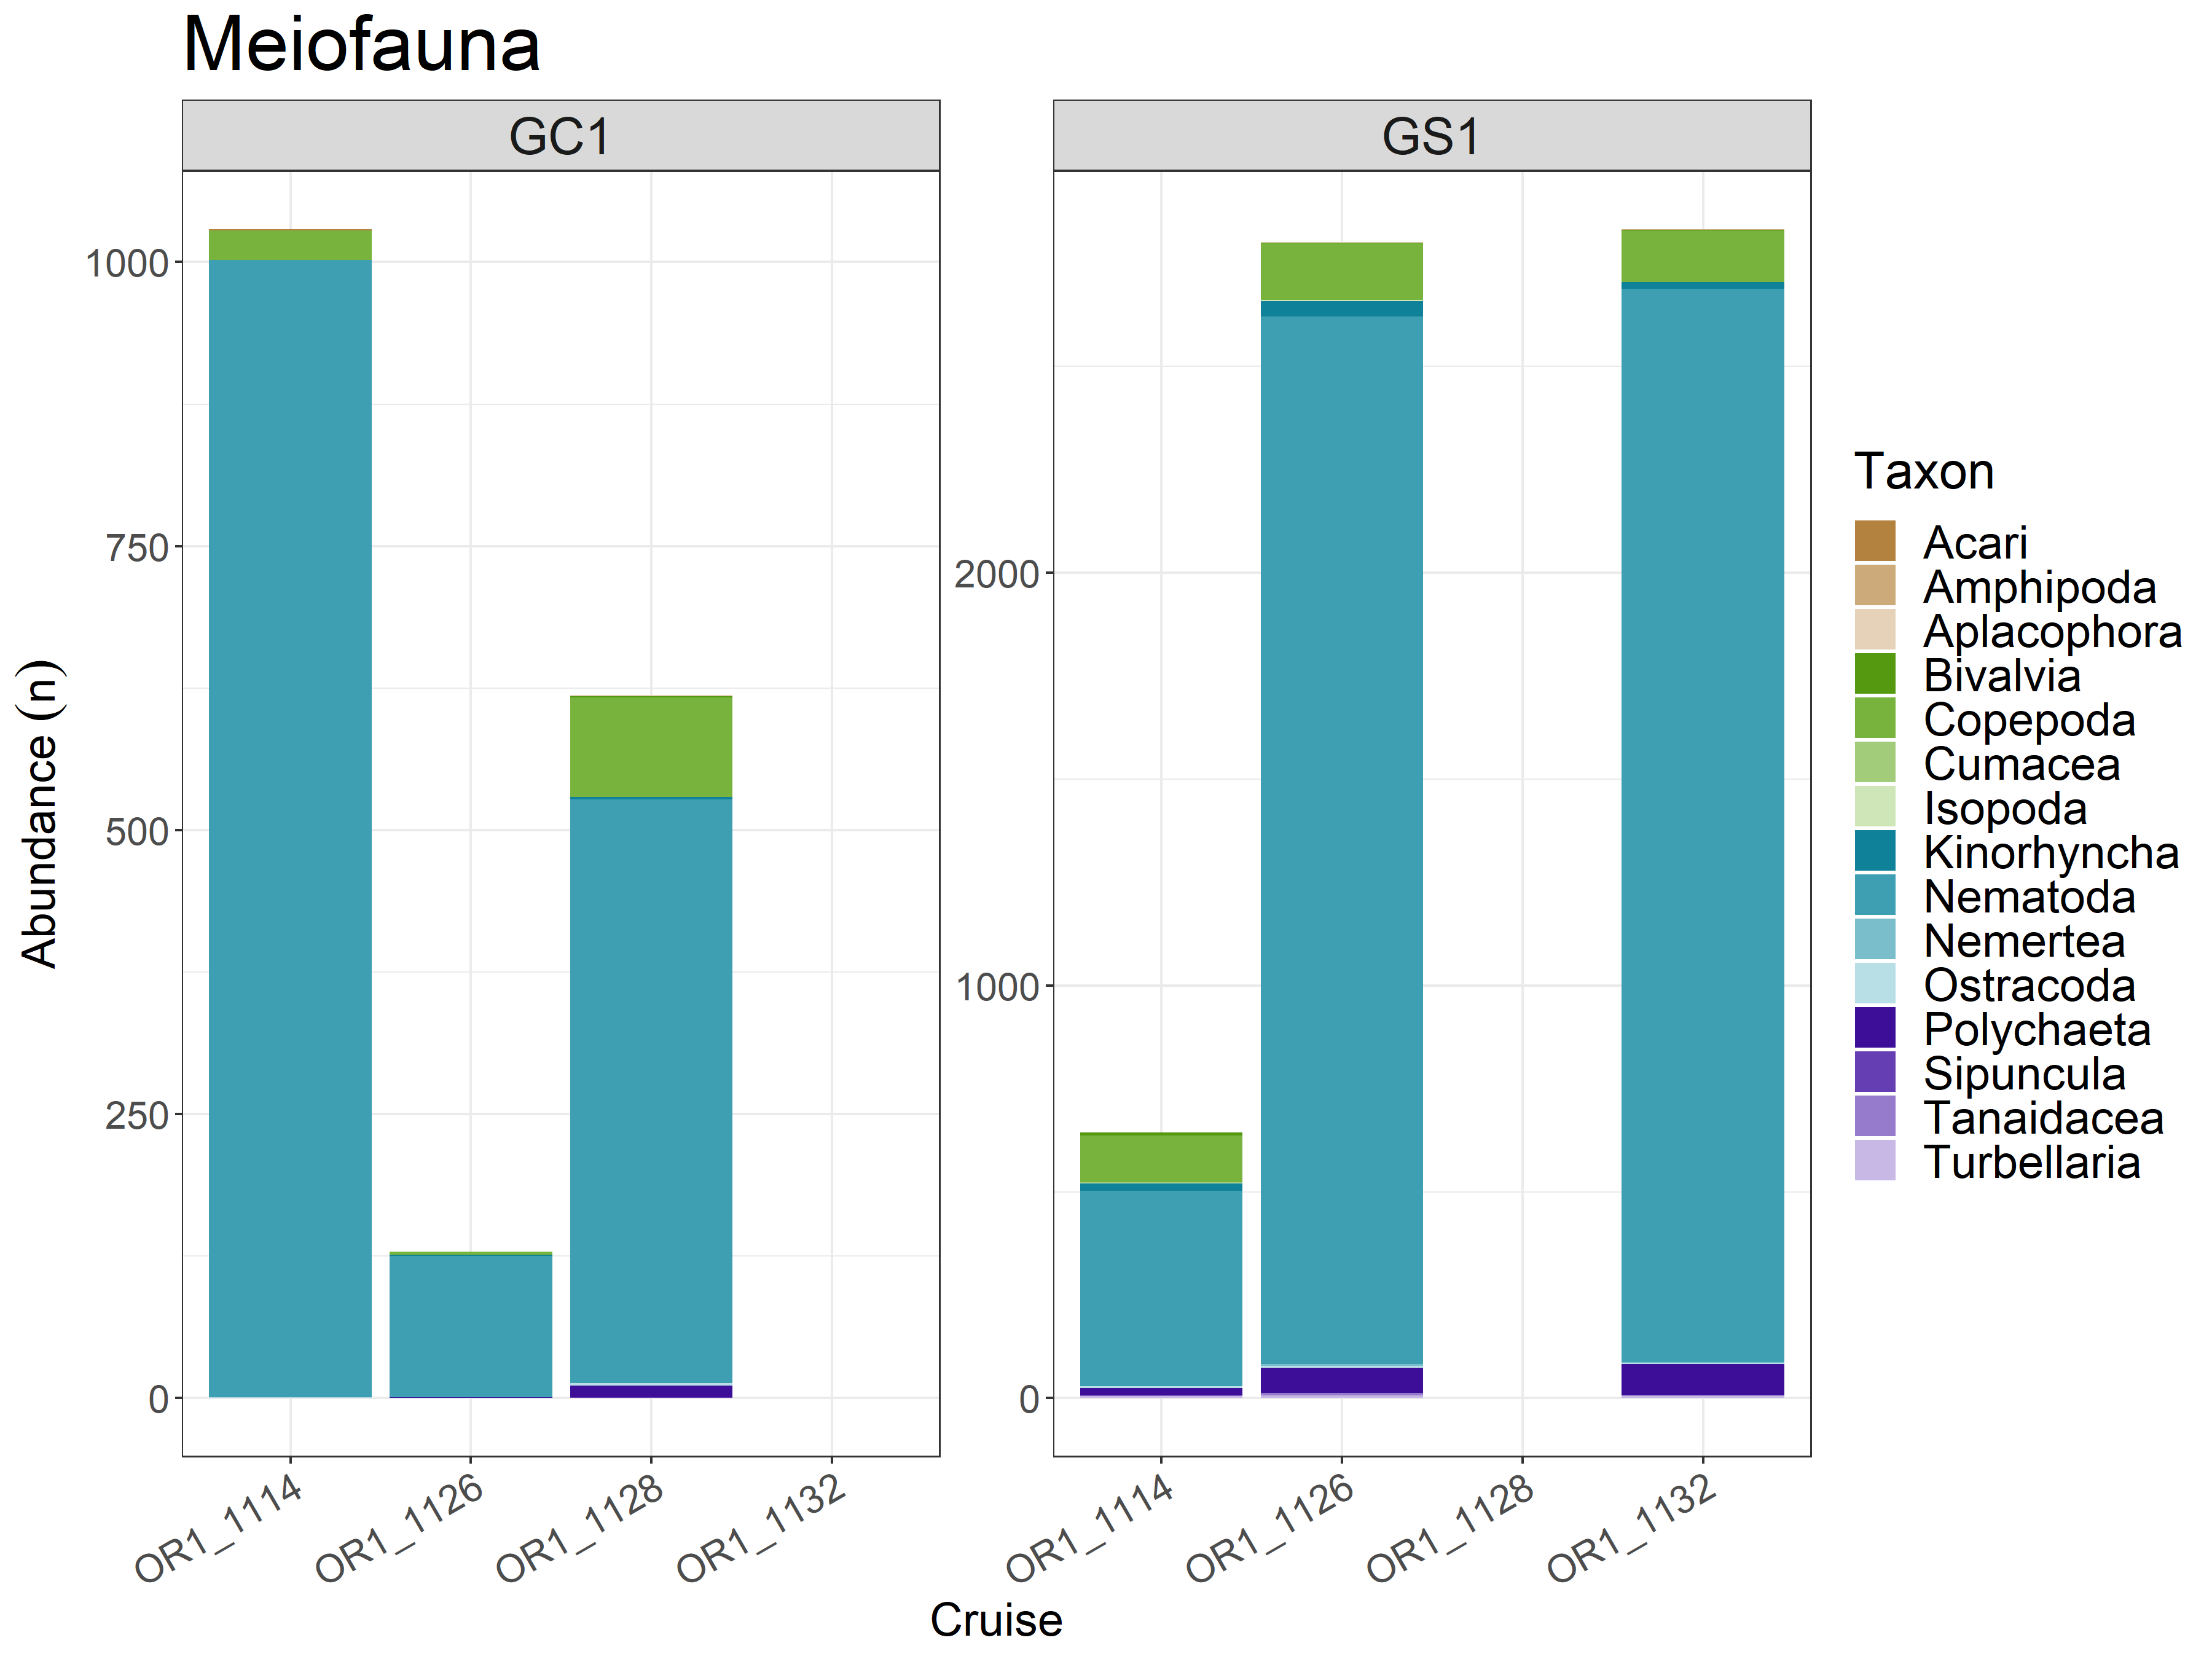
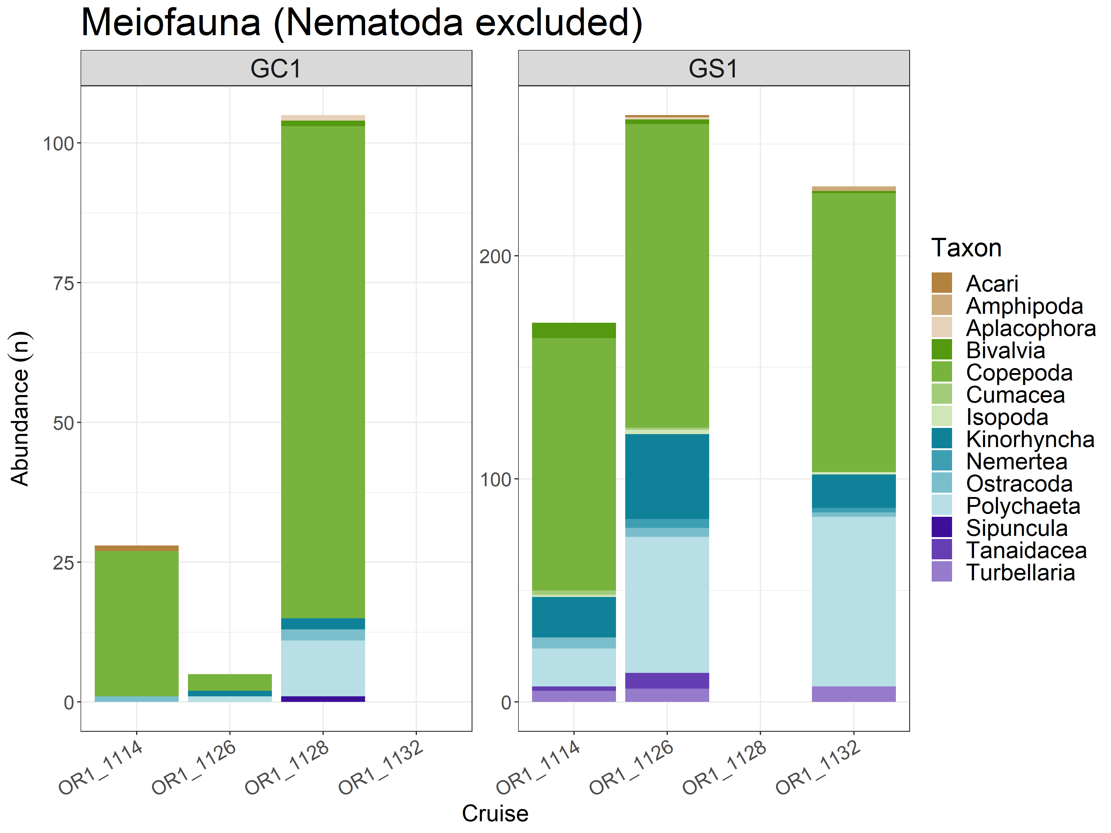
Meiofauna_abundance

Slide 17
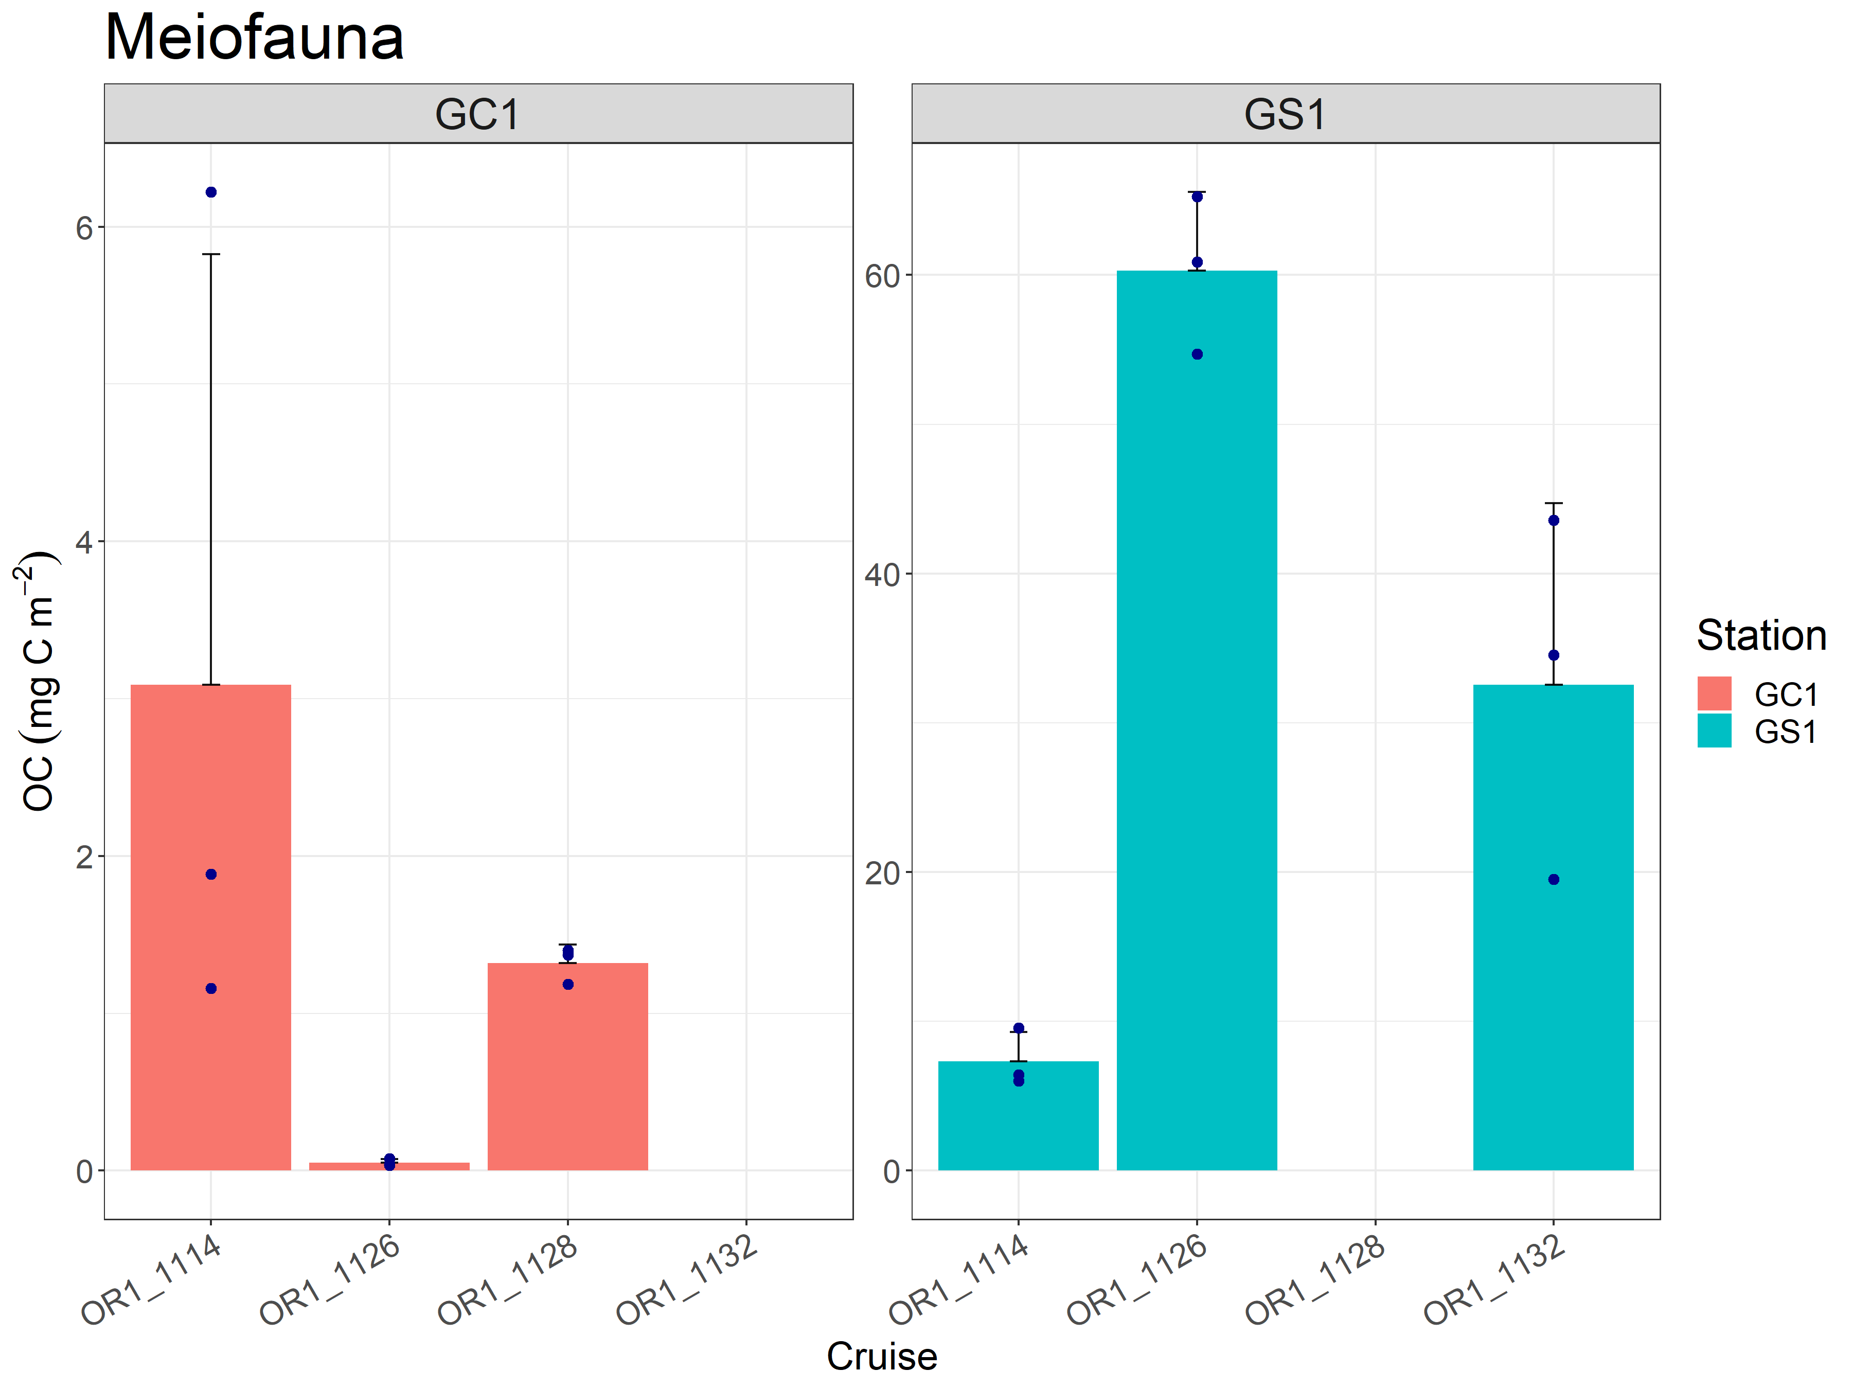
Meiofauna_biomass

Slide 18
Meiofauna_statistics (OC)
PERMDISP
 | Df | Sum of squares | Mean squares | F-value | Pr (>F)
Habitat | 1 | 0.00083406 | 0.00083406 | 30.284 | 0.0001 ***
Residuals | 16 | 0.00044066 | 0.00002754
Season | 2 | 0.00116895 | 0.00058448 | 25.979 | 0.0001 ***
Residuals | 15 | 0.00033748 | 0.00002250
PERMANOVA
 | Df | Sum of squares | R2 | F-value | Pr (>F)
Habitat | 1 | 0.00047162 | 0.42492 | 23.711 | 0.0005 ***
Season | 1 | 0.00020614 | 0.18573 | 10.364 | 0.0171 *
Habitat:Season | 1 | 0.00027301 | 0.24598 | 13.726 | 0.0089 **
Residual | 8 | 0.00015912 | 0.14337
Total | 11 | 0.00110989 | 1.00000

Slide 19
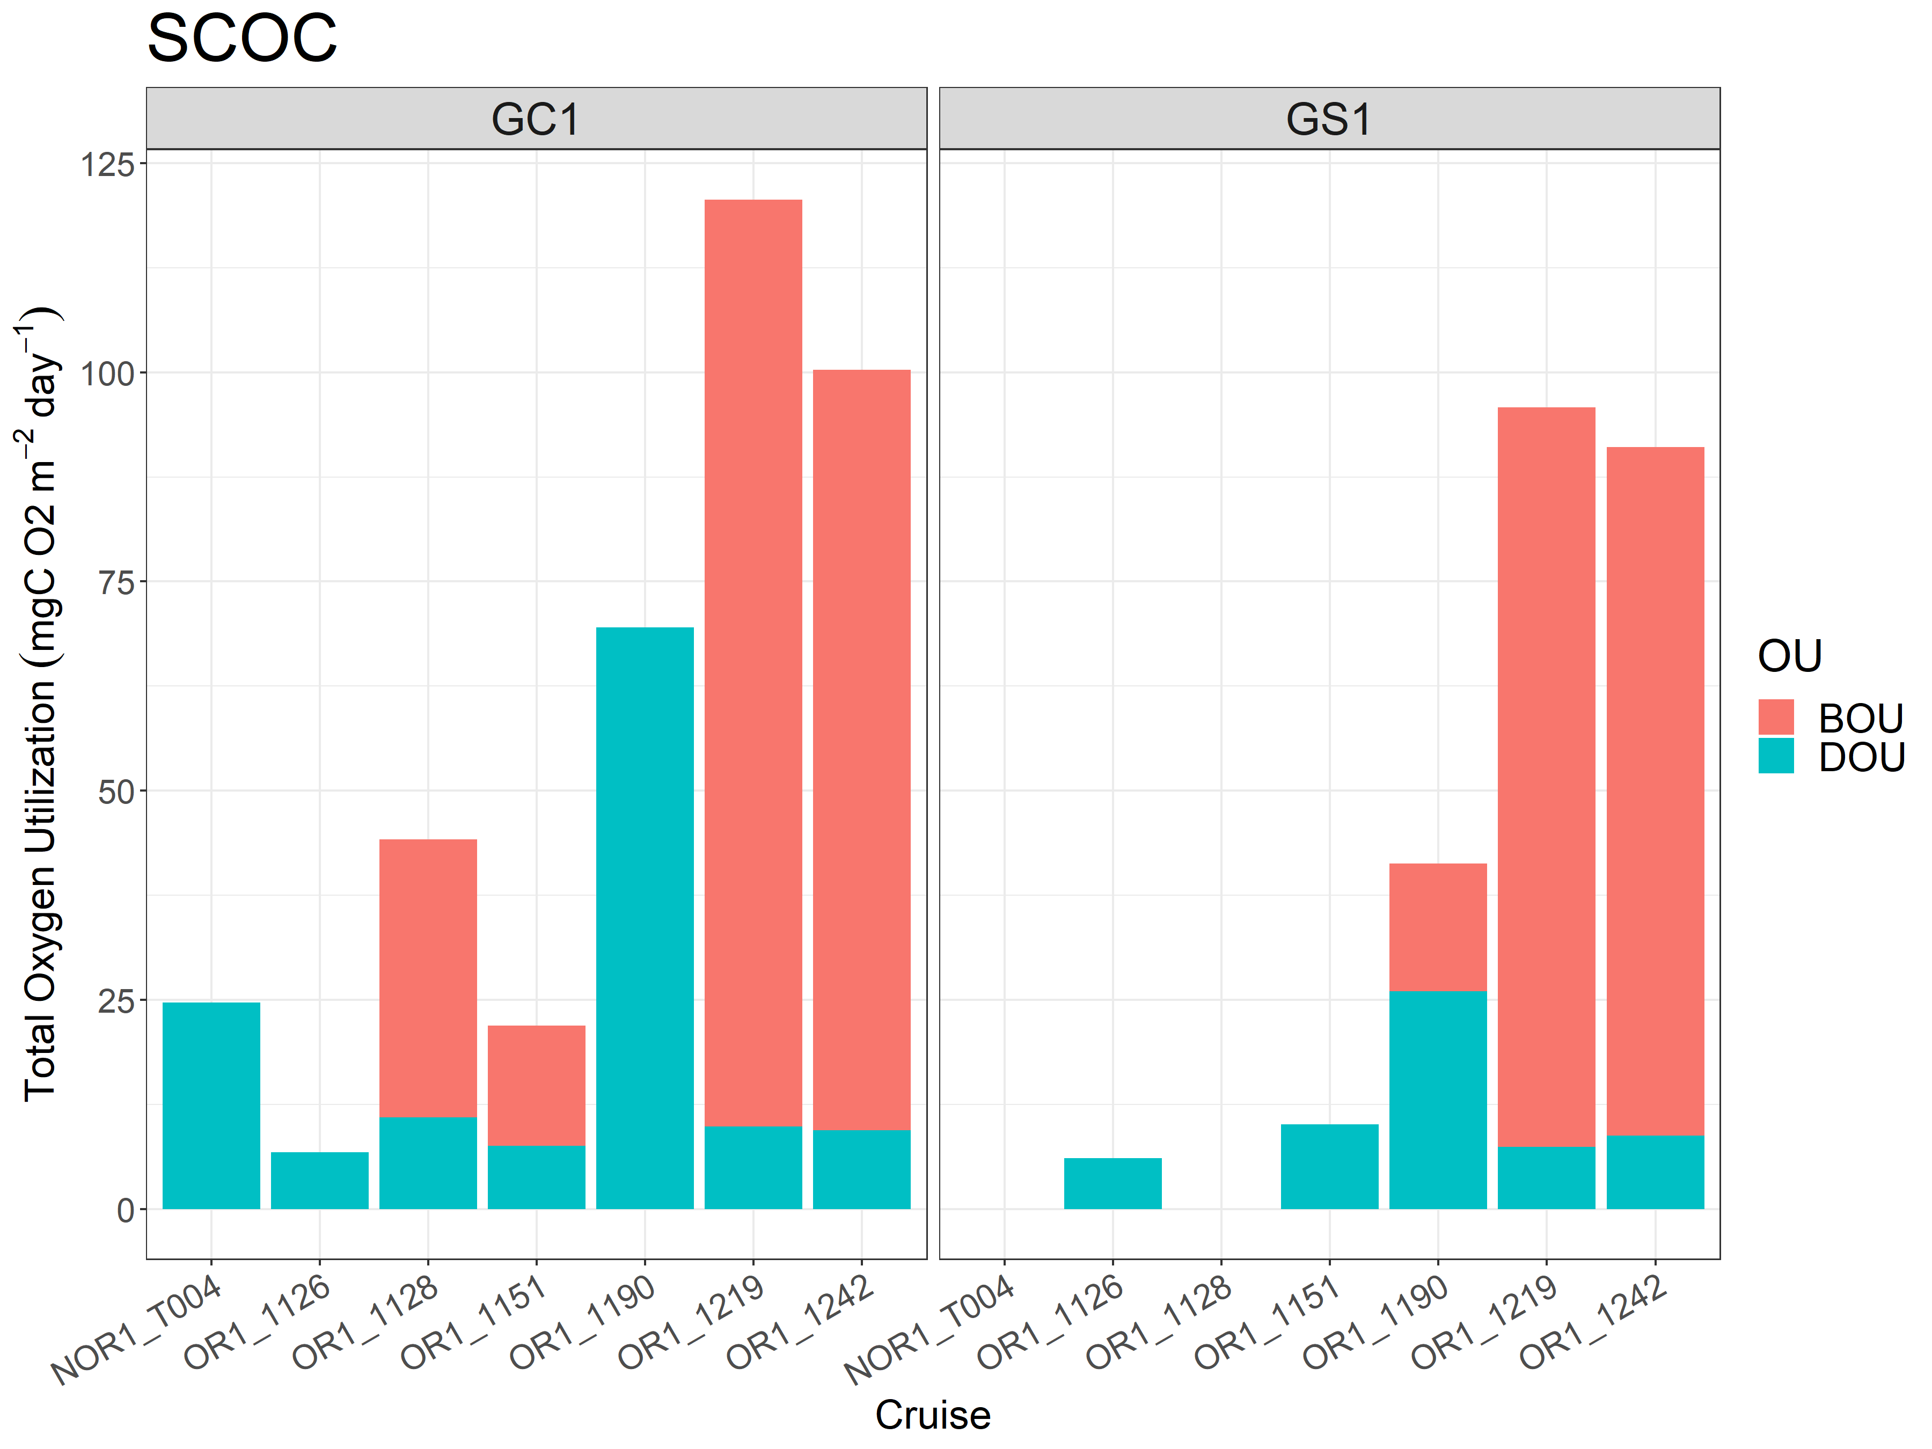
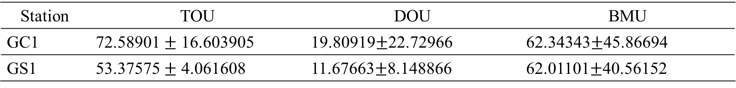
SCOC
Station | TOU | DOU | BMU
GC1 | 72.58901 $±$ 16.603905 | 19.80919$±$22.72966 | 62.34343$±$45.86694
GS1 | 53.37575 $±$ 4.061608 | 11.67663$±$8.148866 | 62.01101$±$40.56152

Slide 20
TOU
PERMDISP
 | Df | Sum of squares | Mean squares | F-value | Pr (>F)
Habitat | 1 | 0.00083406 | 0.00083406 | 30.284 | 0.0001 ***
Residuals | 16 | 0.00044066 | 0.00002754
Season | 2 | 0.00116895 | 0.00058448 | 25.979 | 0.0001 ***
Residuals | 15 | 0.00033748 | 0.00002250
PERMANOVA
 | Df | Sum of squares | R2 | F-value | Pr (>F)
Habitat | 1 | 0.00047162 | 0.42492 | 23.711 | 0.0005 ***
Season | 1 | 0.00020614 | 0.18573 | 10.364 | 0.0171 *
Habitat:Season | 1 | 0.00027301 | 0.24598 | 13.726 | 0.0089 **
Residual | 8 | 0.00015912 | 0.14337
Total | 11 | 0.00110989 | 1.00000

Slide 21
DOU
PERMDISP
 | Df | Sum of squares | Mean squares | F-value | Pr (>F)
Habitat | 1 | 0.00083406 | 0.00083406 | 30.284 | 0.0001 ***
Residuals | 16 | 0.00044066 | 0.00002754
Season | 2 | 0.00116895 | 0.00058448 | 25.979 | 0.0001 ***
Residuals | 15 | 0.00033748 | 0.00002250
PERMANOVA
 | Df | Sum of squares | R2 | F-value | Pr (>F)
Habitat | 1 | 0.00047162 | 0.42492 | 23.711 | 0.0005 ***
Season | 1 | 0.00020614 | 0.18573 | 10.364 | 0.0171 *
Habitat:Season | 1 | 0.00027301 | 0.24598 | 13.726 | 0.0089 **
Residual | 8 | 0.00015912 | 0.14337
Total | 11 | 0.00110989 | 1.00000

Slide 22
BOU
PERMDISP
 | Df | Sum of squares | Mean squares | F-value | Pr (>F)
Habitat | 1 | 0.00083406 | 0.00083406 | 30.284 | 0.0001 ***
Residuals | 16 | 0.00044066 | 0.00002754
Season | 2 | 0.00116895 | 0.00058448 | 25.979 | 0.0001 ***
Residuals | 15 | 0.00033748 | 0.00002250
PERMANOVA
 | Df | Sum of squares | R2 | F-value | Pr (>F)
Habitat | 1 | 0.00047162 | 0.42492 | 23.711 | 0.0005 ***
Season | 1 | 0.00020614 | 0.18573 | 10.364 | 0.0171 *
Habitat:Season | 1 | 0.00027301 | 0.24598 | 13.726 | 0.0089 **
Residual | 8 | 0.00015912 | 0.14337
Total | 11 | 0.00110989 | 1.00000

Slide 23
A table for turnover rate
Station | TOU/OC_{total} | DOU/OC_{bacteria} | BOU/OC_{(meiofauna+macrofauna)} | Method
GC1 | 0.0002 | 0.3033 | 12.1291 | Direct measurement
 | 0.000044 | 0.231722 | 0.022400 | Model results
GS1 | 0.0001 | 0.2728 | 0.5459 | Direct measurement
 | 0.000027 | 0.269328 | 0.023773 | Model results

Slide 24
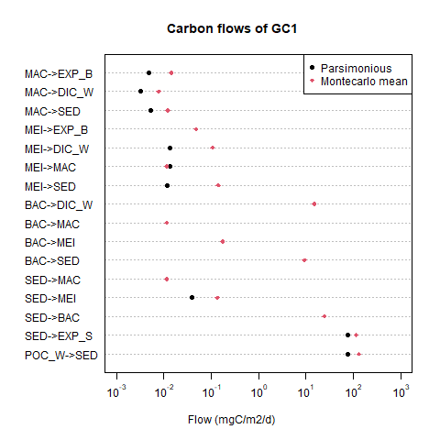
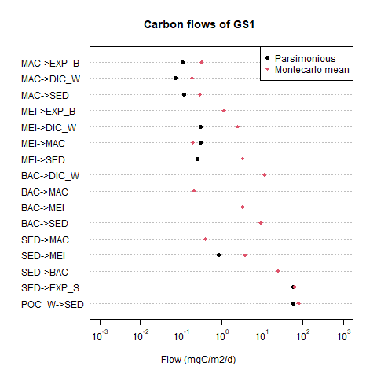

Slide 25
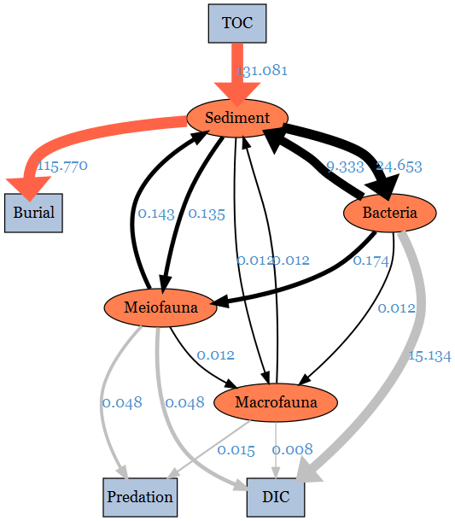
LIM result for GC1

Slide 26
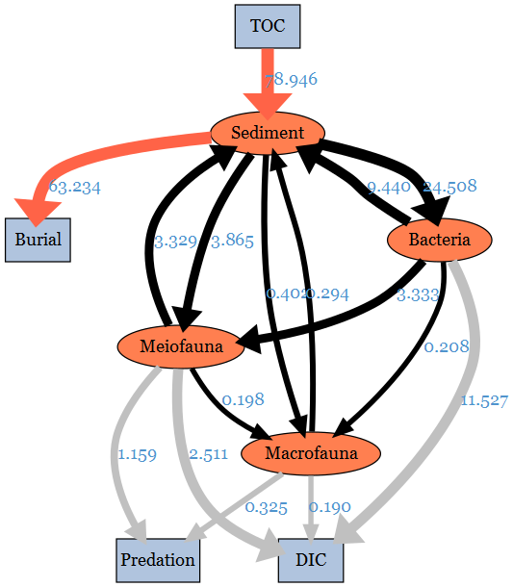
LIM result for GS1

Slide 27
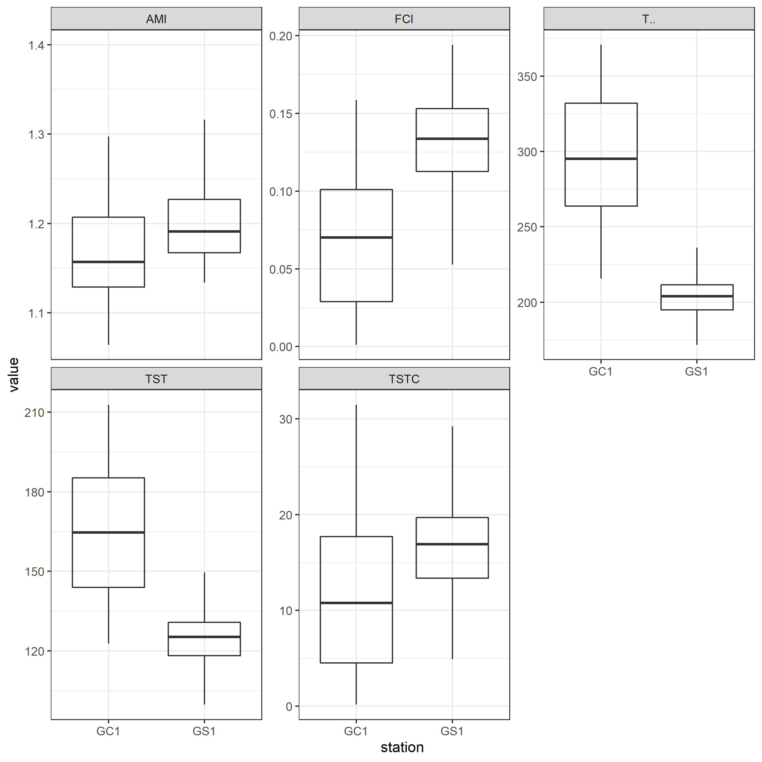
Network indices | Fraction | Significance
T.. | 0.9987 | *** (GC1>GS1)
TST | 0.9623 | *** (GC1>GS1)
TSTC | 0.2926
FCI | 0.1034
AMI | 0.2963

Slide 28
0?
0.001
0.01
0.1
1

Slide 29
5/5討論
Method:
改動統計方法(maybe無母數多factor)->需補上考慮seasonality 的原因
2. turnover rate->可做看看但不一定要放
SCOC/OC (Rowe)
做法:比較實測跟model值
DOU/細菌; BOU/(macro+meio); TOU/(OC全部)
圖:
1. TOC改回POC
2. 改segment plot 0->0+很小的值，用虛線表示是0
Discussion:
!!!跟結果有關的東西先討論
1. model output (在OU部分) 沒有不合理
-TOU相加還是同個magnitude
-DOU看起來合理(跟實際測量吻合)
-BMU可能低估/物理性擾動/生物擾動/化學性消耗
2. 文獻中POC (53多)不夠用可能是
-因為文獻只考慮POC忽略DOC才會是細菌首先用掉的
-忽略了直接沉降的chla (去看文獻裡C來源)
!!! model並沒有考慮到export (真正的POC應該要更高; 呼應文獻)
3. network indices 值代表的意義(最主要控制的flow)+延伸
4. predation flow(的意義) + 跟生物10%efficiency 比較
5.比較parsimonious的差別
6.跟blue carbon (海草床or紅樹林)的burial efficiency 比較 (林幸助P)
Introduction:
(aim of this study)
1.從生物+沉積物的角度看碳的流量(給了最低的TOC; 進入system, burial%, 回到水層)
2.深海的POC<SCOC(很多sediment trap研究)但不合->看看introduction怎麼插進採樣工具給的bias(e.g. sediment trap)

Slide 30
