Slide 1
GC1_LIM food web
12/27 discussion

Slide 2
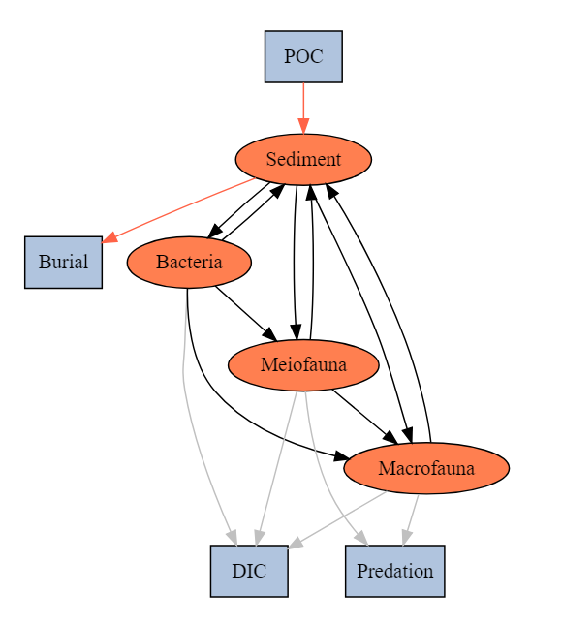
Topological food web structure
SYM | MEANING
POC->SED | Organic matter derived from the water column
SED->EXP_S | Sediment export(e.g. downslope, burial…)
SED->BAC | Bacteria feed on detritus OC
BAC->SED | Bacteria feces deposit on sediment
SED->MEI | Meiofauna feed on detritus OC
MEI->SED | Meiofauna feces deposit on sediment
SED->MAC | Macrofauna feed on detritus OC
MAC->SED | Macrofauna feces deposit on sediment
BAC->MEI | Meiofauna feed on bacteria
BAC->MAC | Macrofauna feed on bacteria
MEI->MAC | Macrofauna feed on meiofauna
MEI->EXP_B | Meiofauna predated by other benthopelagic/pelagic predators
MAC->EXP_B | Macrofauna predated by other benthopelagic/pelagic predators
BAC->DIC | Bacteria respiration
MEI->DIC | Meiofauna respiration
MAC->DIC | Macrofauna respiration
abiotic
biotic
Internal flows
Exchange with external

Slide 3
Compartment | Standing stock (mgC m⁻²)
Detritus | 2504.94
Bacteria | 4.62
Meiofauna | 0.69
Macrofauna | 3.65
Problem 1
Sampling season
Cruise | OR1_1096 | OR1_1099 | OR1_1102 | OR1_1114 | OR1_1126 | OR1_1128 | OR1_1151 | OR1_1190
Date | 2014/11 | 2015/03 | 2015/04 | 2015/08 | 2015/11 | 2016/02 | 2016/10 | 2018/03-04
Detritus | √ | √ | √ | √ | √ | √ | √ | √
Bacteria |  |  |  |  |  |  |  | √
Meiofauna |  |  |  | √ | √ | √
Macrofauna | √ | √ | √ | √ | √ | √ | √ | √

Slide 4
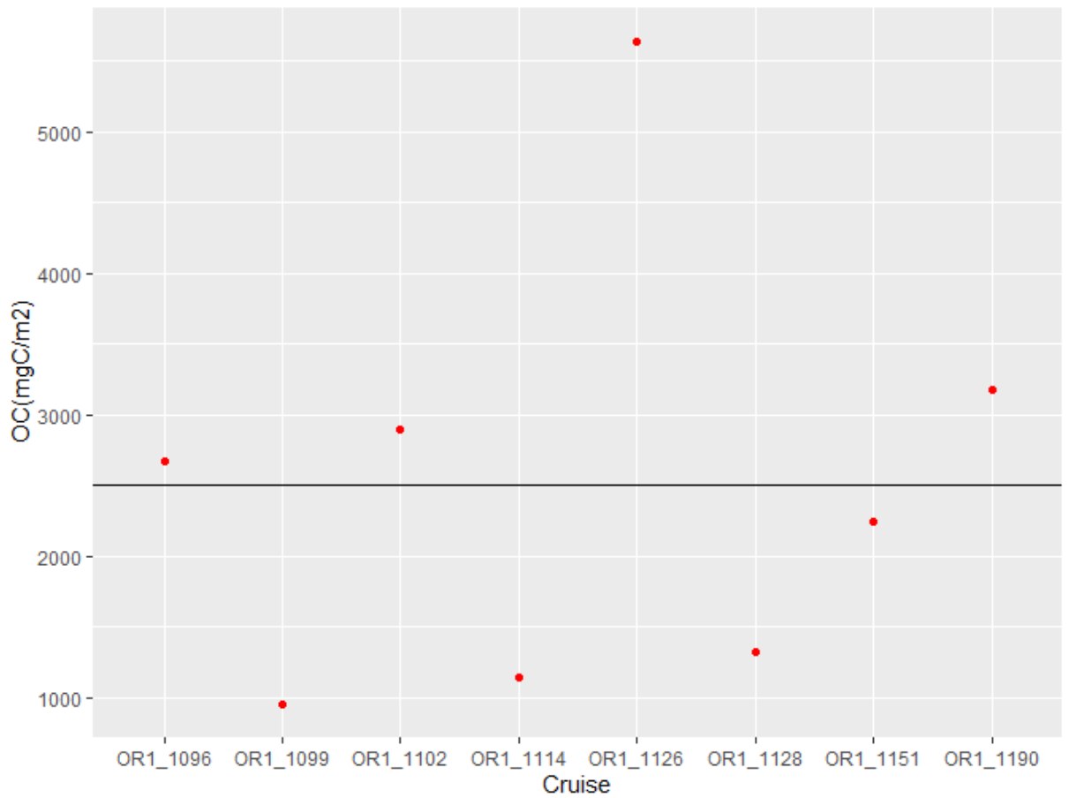
Detritus

Slide 5
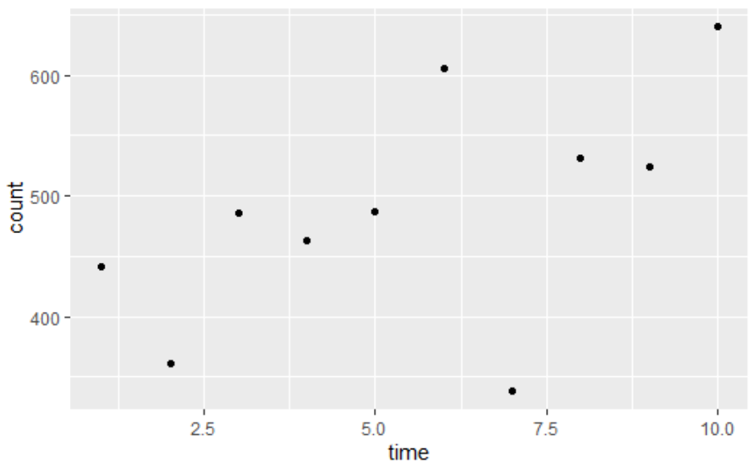
Bacteria
Code:
A<-9^2*pi #well area (mm^2)
a<-0.11^2*pi #view area (mm^2)
V<-0.1/2 #sample volume (ml)
GC1_bac_num <- mean(GC1_bac_count*A/a/V)
#count* A/a/V = # bac/ ml
area<-pi*(3/2)^2/10000#m2
# Convert to biomass (assuming 10 fgC cell-1, Deming & Capenter 2008)
GC1_bac_biomass<-GC1_bac_num*10*V/1E-12/area #fgC/ml*V(ml)/core area(m2)/1E-12=mgC/m2
Problem 2
Vertical sediment depth:
For meio & bac: quantity/syringe area; ignored depth?
For detritus: 0-1 cm
For macro: 0-10 cm

Slide 6
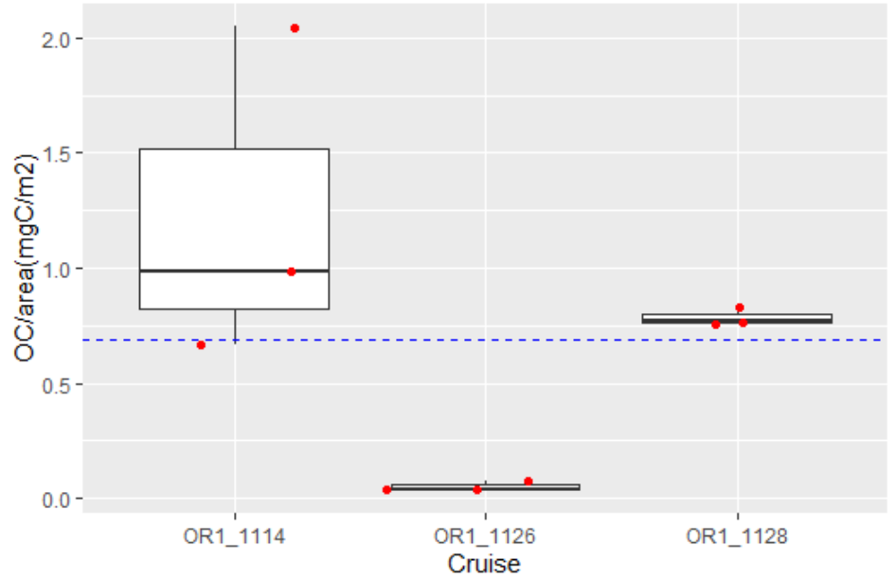
Meiofauna
Problem 3
Should foraminifera be included?

Slide 7
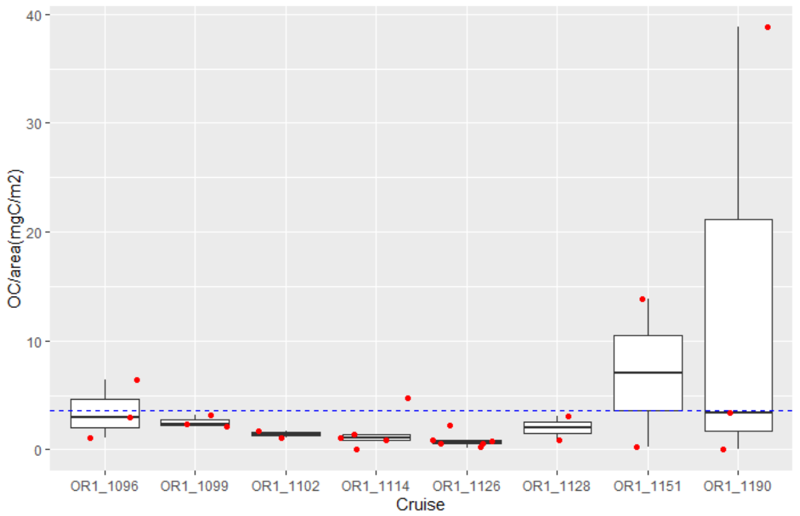
Macrofauna

Slide 9
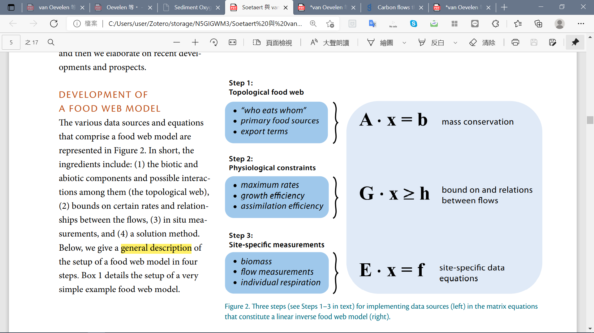
Development of a linear inverse model

Slide 10
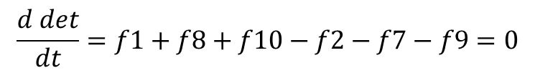
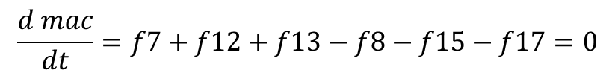
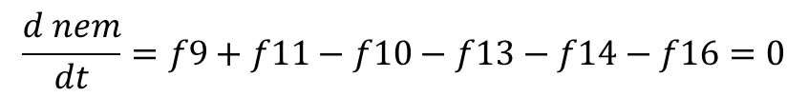
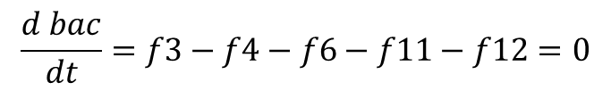
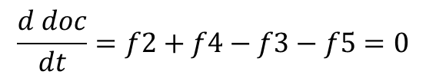
Development of a linear inverse model
det_w
doc_w
dic_w
f1
f5
f6
f15
det
f14
$$\frac{d det}{dt}=f1+f8+f10−f2−f7−f9=0$$
f10
f2
f9
f7
$$\frac{d doc}{dt}=f2+f4−f3−f5=0$$
doc
nem
f16
exp
$$\frac{d bac}{dt}=f3−f4−f6−f11−f12=0$$
f4
f3
f13
f17
f11
f8
$$\frac{d nem}{dt}=f9+f11−f10−f13−f14−f16=0$$
bac
mac
f12
$$\frac{d mac}{dt}=f7+f12+f13−f8−f15−f17=0$$
All mass balances are assumed to be in steady state

Slide 11






Development of a linear inverse model
$$\frac{d det}{dt}=f1+f8+f10−f2−f7−f9=0$$
$$\frac{d doc}{dt}=f2+f4−f3−f5=0$$
$$\frac{d bac}{dt}=f3−f4−f6−f11−f12=0$$
x
$$\frac{d nem}{dt}=f9+f11−f10−f13−f14−f16=0$$
$$\left[\begin{matrix}\begin{matrix}\begin{matrix}\begin{aligned}1 \\ 0 \\ 0 \\ 0 \\ 0\end{aligned} & \begin{aligned}−1 \\ 1 \\ 0 \\ 0 \\ 0\end{aligned} & \begin{aligned}0 \\ −1 \\ 1 \\ 0 \\ 0\end{aligned}\end{matrix} & \begin{aligned}0 \\ 1 \\ −1 \\ 0 \\ 0\end{aligned} & \begin{aligned}0 \\ −1 \\ 0 \\ 0 \\ 0\end{aligned}\end{matrix} & \begin{matrix}\begin{aligned}0 \\ 0 \\ −1 \\ 0 \\ 0\end{aligned} & \begin{aligned}−1 \\ 0 \\ 0 \\ 0 \\ 1\end{aligned} & \begin{aligned}1 \\ 0 \\ 0 \\ 0 \\ −1\end{aligned}\end{matrix} & \begin{matrix}\begin{aligned}−1 \\ 0 \\ 0 \\ 1 \\ 0\end{aligned} & \begin{aligned}1 \\ 0 \\ 0 \\ −1 \\ 0\end{aligned} & \begin{matrix}\begin{aligned}0 \\ 0 \\ −1 \\ 1 \\ 0\end{aligned} & \begin{aligned}0 \\ 0 \\ −1 \\ 0 \\ 1\end{aligned} & \begin{matrix}\begin{aligned}0 \\ 0 \\ 0 \\ −1 \\ 1\end{aligned} & \begin{aligned}0 \\ 0 \\ 0 \\ −1 \\ 0\end{aligned} & \begin{matrix}\begin{aligned}0 \\ 0 \\ 0 \\ 0 \\ −1\end{aligned} & \begin{aligned}0 \\ 0 \\ 0 \\ −1 \\ 0\end{aligned} & \begin{aligned}0 \\ 0 \\ 0 \\ 0 \\ −1\end{aligned}\end{matrix}\end{matrix}\end{matrix}\end{matrix}\end{matrix}\right]∙\left[\begin{aligned}f1 \\ f2 \\ f3 \\ f4 \\ f5 \\ f6 \\ f7 \\ f8 \\ f9 \\ f10 \\ f11 \\ f12 \\ f13 \\ f14 \\ f15 \\ f16 \\ f17\end{aligned}\right]=0$$
$$\frac{d mac}{dt}=f7+f12+f13−f8−f15−f17=0$$
A
b
All mass balances are assumed to be in steady state (i.e. b=0)

Slide 12
細分食性:改structure
Assume:
influx POC as a complex assemblage of, while a portion of sediment flows out the system through the process of burial and/or export (orange flows). Then, it is assumed that bacteria feed only on detrital OC; meiofauna feeds on bacteria and detrital OC; macrofauna feeds on meiofauna, bacteria and detrital OC. Then, the meiofauna will be further divided into selective deposit feeders, non-selective deposit feeders, epigrowth feeders, and omnivores/predators (Liao et al., 2020), and the macrofauna stocks will be divided into surface deposit-feeders, deposit-feeders, suspension-feeders, and predators+scavengers (Chen, 2018). Moreover, it is presumed that the predators of each size class prey on organisms of the same and smaller size classes. The grey flows indicate the loss of carbon as the feces and as consumed by benthopelagic/pelagic predators (fig. 12). In this LIM model, the compartments with orange color are part of the food web model, whereas compartments with blue color were only considered as carbon influx or efflux, but were not directly modeled.

