Slide 1
Date | Season | Cruise | Station | Long (°E) | Lat (°N) | Depth (m) | Measurement | Gear
2014/11 | AU | OR1_1096 | GC1 | 120.4170 | 22.4170 | 222 | Sediment TOC, Macrofauna | CTD, Boxcorer
 |  |  | GS1 | 120.4006 | 22.2349 | 270 | Sediment TOC, Macrofauna | CTD, Boxcorer
2015/03 | SP | OR1_1099 | GC1 | 120.3768 | 22.4017 | 395 | Sediment TOC, Macrofauna | CTD, Multicorer
 |  |  | GS1 | 120.4002 | 22.2328 | 277 | Sediment TOC, Macrofauna | CTD, Multicorer
2015/04 | SP | OR1_1102 | GC1 | 120.4114 | 22.4173 | 323 | Sediment TOC, Macrofauna | CTD, Boxcorer
 |  |  | GS1 | 120.4006 | 22.2329 | 279 | Sediment TOC, Macrofauna | CTD, Boxcorer
2015/08 | SU | OR1_1114 | GC1 | 120.4114 | 22.4172 | 320 | Sediment TOC, Meiofauna, Macrofauna | CTD, Multicorer
 |  |  | GS1 | 120.3998 | 22.2322 | 279 | Sediment TOC, Meiofauna, Macrofauna | CTD, Multicorer
2015/11 | AU | OR1_1126 | GC1 | 120.4112 | 22.4175 | 318 | Sediment TOC, Meiofauna, Macrofauna, DOU | CTD, Multicorer
 |  |  | GS1 | 120.3995 | 22.2329 | 277 | Sediment TOC, Meiofauna, Macrofauna, DOU | CTD, Multicorer
2016/02 | SP | OR1_1128 | GC1 | 120.4108 | 22.4171 | 319 | Sediment TOC, Meiofauna, Macrofauna, TOU, DOU | CTD, Multicorer
2016/03 | SP | OR1_1132 | GS1 | 120.4008 | 22.2296 | 281 | Meiofauna, Macrofauna | CTD, Multicorer
2016/10 | AU | OR1_1151 | GC1 | 120.4110 | 22.4176 | 317 | Sediment TOC, Macrofauna, TOU, DOU | CTD, Multicorer
 |  |  | GS1 | 120.4004 | 22.2315 | 272 | Sediment TOC, Macrofauna, DOU | CTD, Multicorer
2018/03-04 | SP | OR1_1190 | GC1 | 120.4104 | 22.4172 | 321 | Sediment TOC, Bacteria, Macrofauna, TOU, DOU | CTD, Multicorer
 |  |  | GS1 | 120.3977 | 22.2309 | 279 | Sediment TOC, Bacteria, Macrofauna, TOU, DOU | CTD, Multicorer
2019/03-04 | SP | OR1_1219 | GC1 | 120.4092 | 22.4179 | 318 | Sediment TOC, TOU, DOU | CTD, Multicorer
 |  |  | GS1 | 120.3772 | 22.2538 | 246 | Sediment TOC, TOU, DOU | CTD, Multicorer
2019/10 | AU | OR1_1242 | GC1 | 120.4082 | 22.4168 | 271 | Sediment TOC, TOU, DOU | CTD, Multicorer
 |  |  | GS1 | 120.3776 | 22.2531 | 261 | Sediment TOC, TOU, DOU | CTD, Multicorer
2020/11 | AU | NOR1_T004 | GC1 | 120.4121 | 22.4140 | 309 | Sediment TOC, TOU, DOU | CTD, Multicorer
Table 1. Sampling cruises including dates, coordinates, and water depths of two sites. Different gears were used to collect sediment and benthic fauna samples. Cruises were assigned to the corresponding seasons to test the seasonal effect.

Slide 2
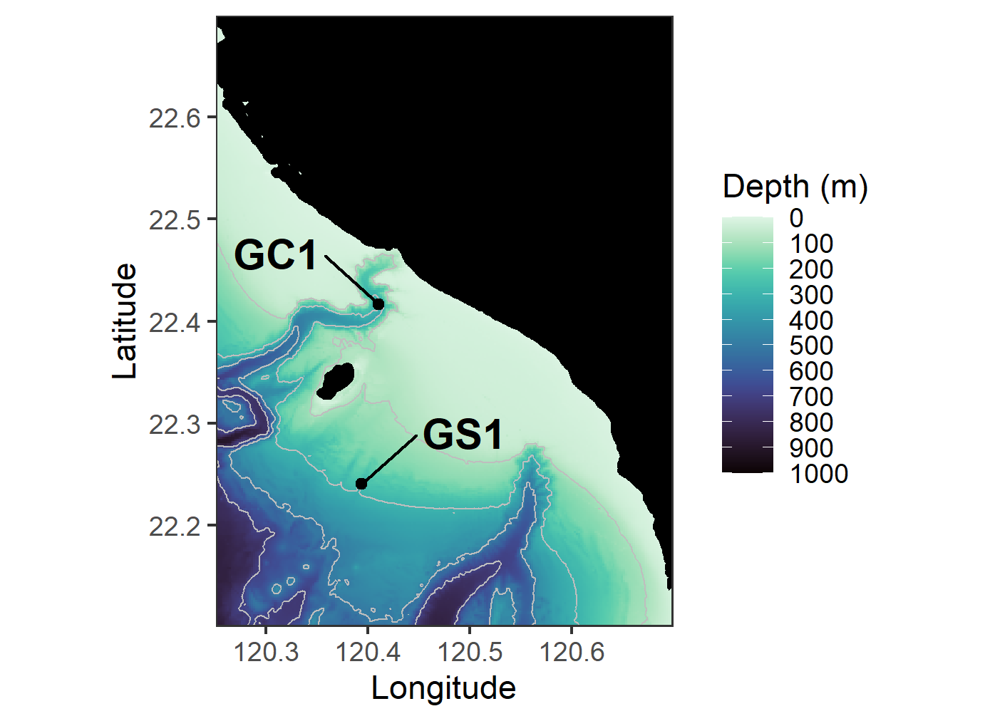
Figure 1. The map of sampling stations of the upper Gaoping Submarine Canyon (GC1) and Gaoping Slope (GS1).

Slide 3
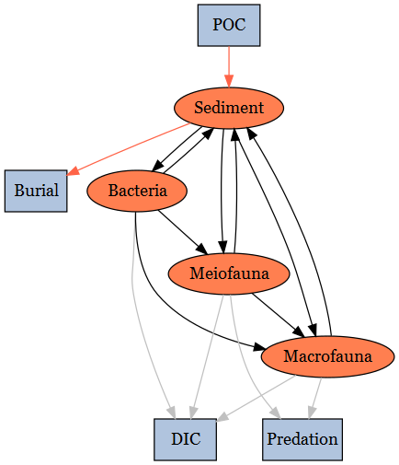
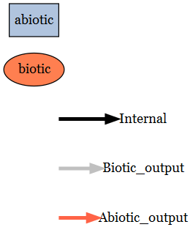
Figure 2. Conceptual model of the food web structure which formed the basis of our linear inverse model (LIM). See section “Structure” for description.

Slide 4
Flow | Meaning
POC->SED | Organic carbon derived from the water column
SED->EXP_S | Sediment export(e.g. downslope, burial…)
SED->BAC | Bacteria feed on detritus OC
BAC->SED | Bacteria feces deposit on sediment
SED->MEI | Meiofauna feed on detritus OC
MEI->SED | Meiofauna feces deposit on sediment
SED->MAC | Macrofauna feed on detritus OC
MAC->SED | Macrofauna feces deposit on sediment
BAC->MEI | Meiofauna feed on bacteria
BAC->MAC | Macrofauna feed on bacteria
MEI->MAC | Macrofauna feed on meiofauna
MEI->EXP_B | Meiofauna predated by other benthopelagic/pelagic predators
MAC->EXP_B | Macrofauna predated by other benthopelagic/pelagic predators
BAC->DIC | Bacteria respiration
MEI->DIC | Meiofauna respiration
MAC->DIC | Macrofauna respiration
Table 13. Definition of each flow in Fig. 2. The flows are with direction, for example, “SED->BAC” represents carbon flow from the detritus stock to bacteria stock.

Slide 5
Inequality description | Calculation | GC1 | GS1 | Unit | Reference
Temperature limitation (Tlim) | Q10* exp((T-20)/10), with Q10 = 2 | 1.05 | 1.09 | -
Bacteria growth efficiency |  | [0.02, 0.61] | [0.02, 0.61] | - | del Giorgio and Cole (1998)
DOU (Bacteria -> DIC) | Maximum DOU= 30% TOU | [0.0, 21.77] | [0.0, 16.01] | mg C/m²/d | Mahaut et al. (1995)
Maintenance respiration of meiofauna |  | Tlim * 0.01 * Stock | Tlim * 0.01 * Stock | mg C/m²/d | van Oevelen et al. (2011)
Maintenance respiration of macrofauna |  | Tlim * 0.01 * Stock | Tlim * 0.01 * Stock | mg C/m²/d | van Oevelen et al. (2011)
Assimilation efficiency of meiofauna |  | [0.456, 0.699] | [0.456, 0.699] | - | Conover (1966)
Assimilation efficiency of macrofauna |  | [0.6 0.7] | [0.6 0.7] | - | Loo and Rosenberg (1996)
P/B ratio of meiofauna |  | [0.0090, 0.0493] | [0.0090, 0.0493] | - | Fenchel (1982); Fleeger and Palmer (1982)
P/B ratio of macrofauna |  | [0.0008, 0.0048] | [0.0008, 0.0048] | - | Stratmann et al. (2018)
Net growth efficiency of meiofauna |  | [0.3, 0.5] | [0.3, 0.5] | - | Herman and Heip (1985); Banse and Mosher (1980); Herman et al. (1983; 1984)
Net growth efficiency of macrofauna |  | [0.6, 0.72] | [0.6, 0.72] | - | Navarro et al., 1994; Nielsen et al., 1995
Sedimentation rate |  | [75.93, 137.92] | [57.18, 66.80] | mg C/m²/d | Huh et al. (2009)
Sediment burial efficiency |  | [0.24, 1] | [0.24, 1] | - | Hsu et al. (2014)
Table 2. Equality and inequality constraints implemented in the LIM models of GC1 and GS1. Values given as single number implied that the data were equalities, whereas the values designated in [ minimum value, maximum value ] represented the inequalities.

Slide 6
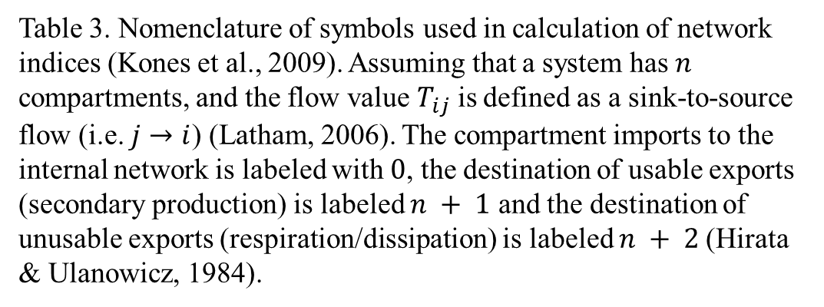
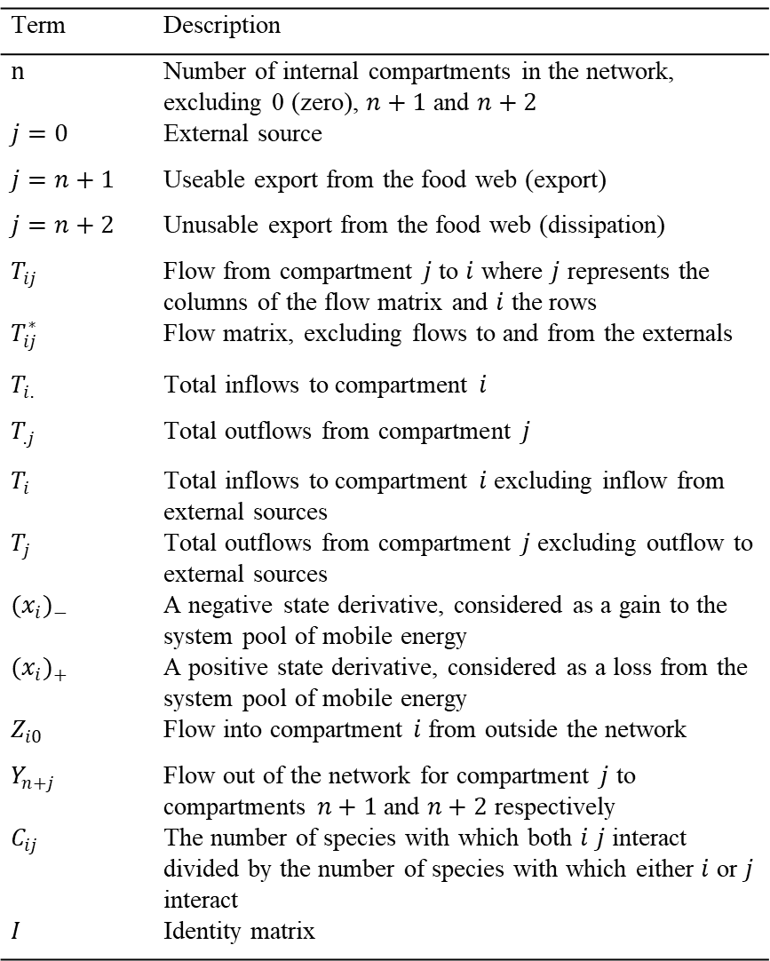
Term | Description
$n$ | Number of internal compartments in the network, excluding 0 (zero), $n+1$ and $n+2$
$j=0$ | External source
$j=n+1$ | Useable export from the food web (export)
$j=n+2$ | Unusable export from the food web (dissipation)
$T_{ij}$ | Flow from compartment $j$ to $i$ where $j$ represents the columns of the flow matrix and $i$ the rows
$T_{ij}^{∗}$ | Flow matrix, excluding flows to and from the externals
$T_{i.}$ | Total inflows to compartment $i$
$T_{.j}$ | Total outflows from compartment $j$
$T_{i}$ | Total inflows to compartment $i$ excluding inflow from external sources
$T_{j}$ | Total outflows from compartment $j$ excluding outflow to external sources
${(x_{i})}_{−}$ | A negative state derivative, considered as a gain to the system pool of mobile energy
${(x_{i})}_{+}$ | A positive state derivative, considered as a loss from the system pool of mobile energy
$Z_{i0}$ | Flow into compartment $i$ from outside the network
$Y_{n+j}$ | Flow out of the network for compartment $j$ to compartments $n+1$ and $n+2$ respectively
$C_{ij}$ | The number of species with which both $i$ $j$ interact divided by the number of species with which either $i$ or $j$ interact
$I$ | Identity matrix
Table 3. Nomenclature of symbols used in calculation of network indices (Kones et al., 2009). Assuming that a system has $n$ compartments, and the flow value $T_{ij}$ is defined as a sink-to-source flow (i.e. $j→i$) (Latham, 2006). The compartment imports to the internal network is labeled with $0$, the destination of usable exports (secondary production) is labeled $n + 1$ and the destination of unusable exports (respiration/dissipation) is labeled $n + 2$(Hirata & Ulanowicz, 1984).

Slide 7
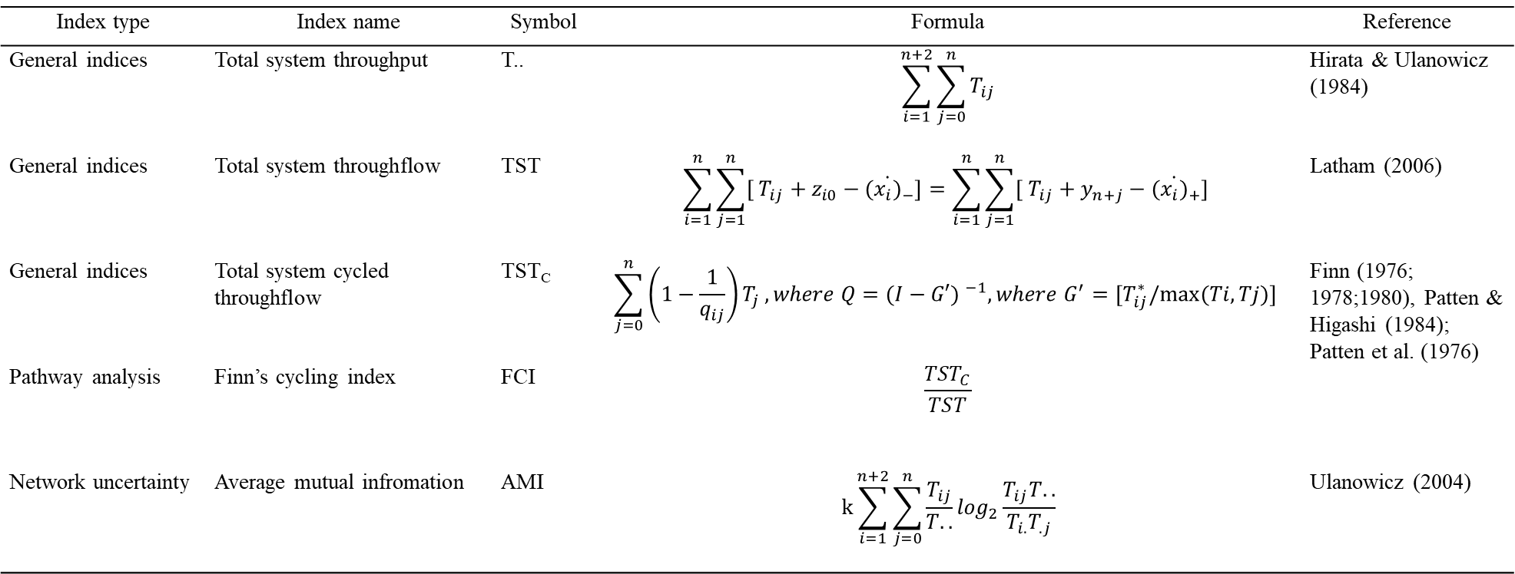
Index type | Index name | Symbol | Formula | Reference
General indices | Total system throughput | T.. | $$\sum_{i=1}^{n+2}{\sum_{j=0}^{n}{T_{ij}}}$$ | Hirata & Ulanowicz (1984)
General indices | Total system throughflow | TST | $$\sum_{i=1}^{n}{\sum_{j=1}^{n}{[ T_{ij}+z_{i0}−{(\dot{x_{i})}}_{−}}]=\sum_{i=1}^{n}{\sum_{j=1}^{n}{[ T_{ij}+y_{n+j}−{(\dot{x_{i})}}_{+}}] }}$$ | Latham (2006)
General indices | Total system cycled throughflow | TST_{C} | $$\sum_{j=0}^{n}{\left(1−\frac{1}{q_{ij}}\right)T_{j}}, where Q={(I−G′) }^{−1},where G^{′}=[T_{ij}^{∗}/max⁡(Ti,Tj)]$$ | Finn (1976; 1978;1980), Patten & Higashi (1984); Patten et al. (1976)
Pathway analysis | Finn’s cycling index | FCI | $$\frac{{TST}_{C}}{TST}$$
Network uncertainty | Average mutual infromation | AMI | $$k\sum_{i=1}^{n+2}{\sum_{j=0}^{n}{\frac{T_{ij}}{T..}}}\log_{2}\frac{T_{ij}T..}{T_{i.}T_{.j}}$$ | Ulanowicz (2004)
Table 4. Formula of the network indices; see Table 3. for the symbols.

Slide 8
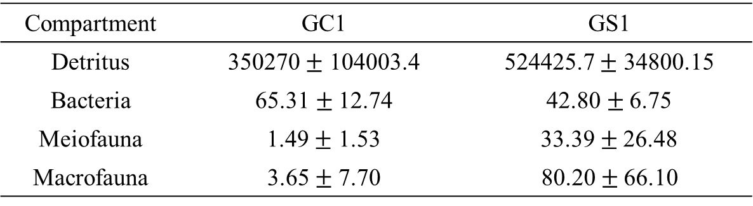
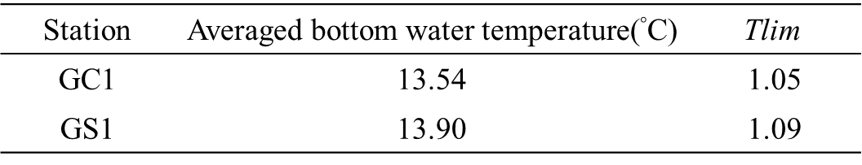
Compartment | GC1 | GS1
Detritus | 350270 $±$ 104003.4 | 524425.7 $±$ 34800.15
Bacteria | 65.31$±$12.74 | 42.80$±$6.75
Meiofauna | 1.49 $±$ 1.53 | 33.39 $±$26.48
Macrofauna | 3.65$±$7.70 | 80.20 $± \text{66.}\text{10}$
Table 5. Standing stocks (in mg C/ m²) as mean$±$standard deviation of the food web compartments for GC1 and GS1.
Station | Averaged bottom water temperature(°C) | $$\text{Tlim}$$
GC1 | 13.54 | 1.05
GS1 | 13.90 | 1.09
Table 6. Average bottom water temperature and the calculated $\text{Tlim}$ of GC1 and GS1.

Slide 9
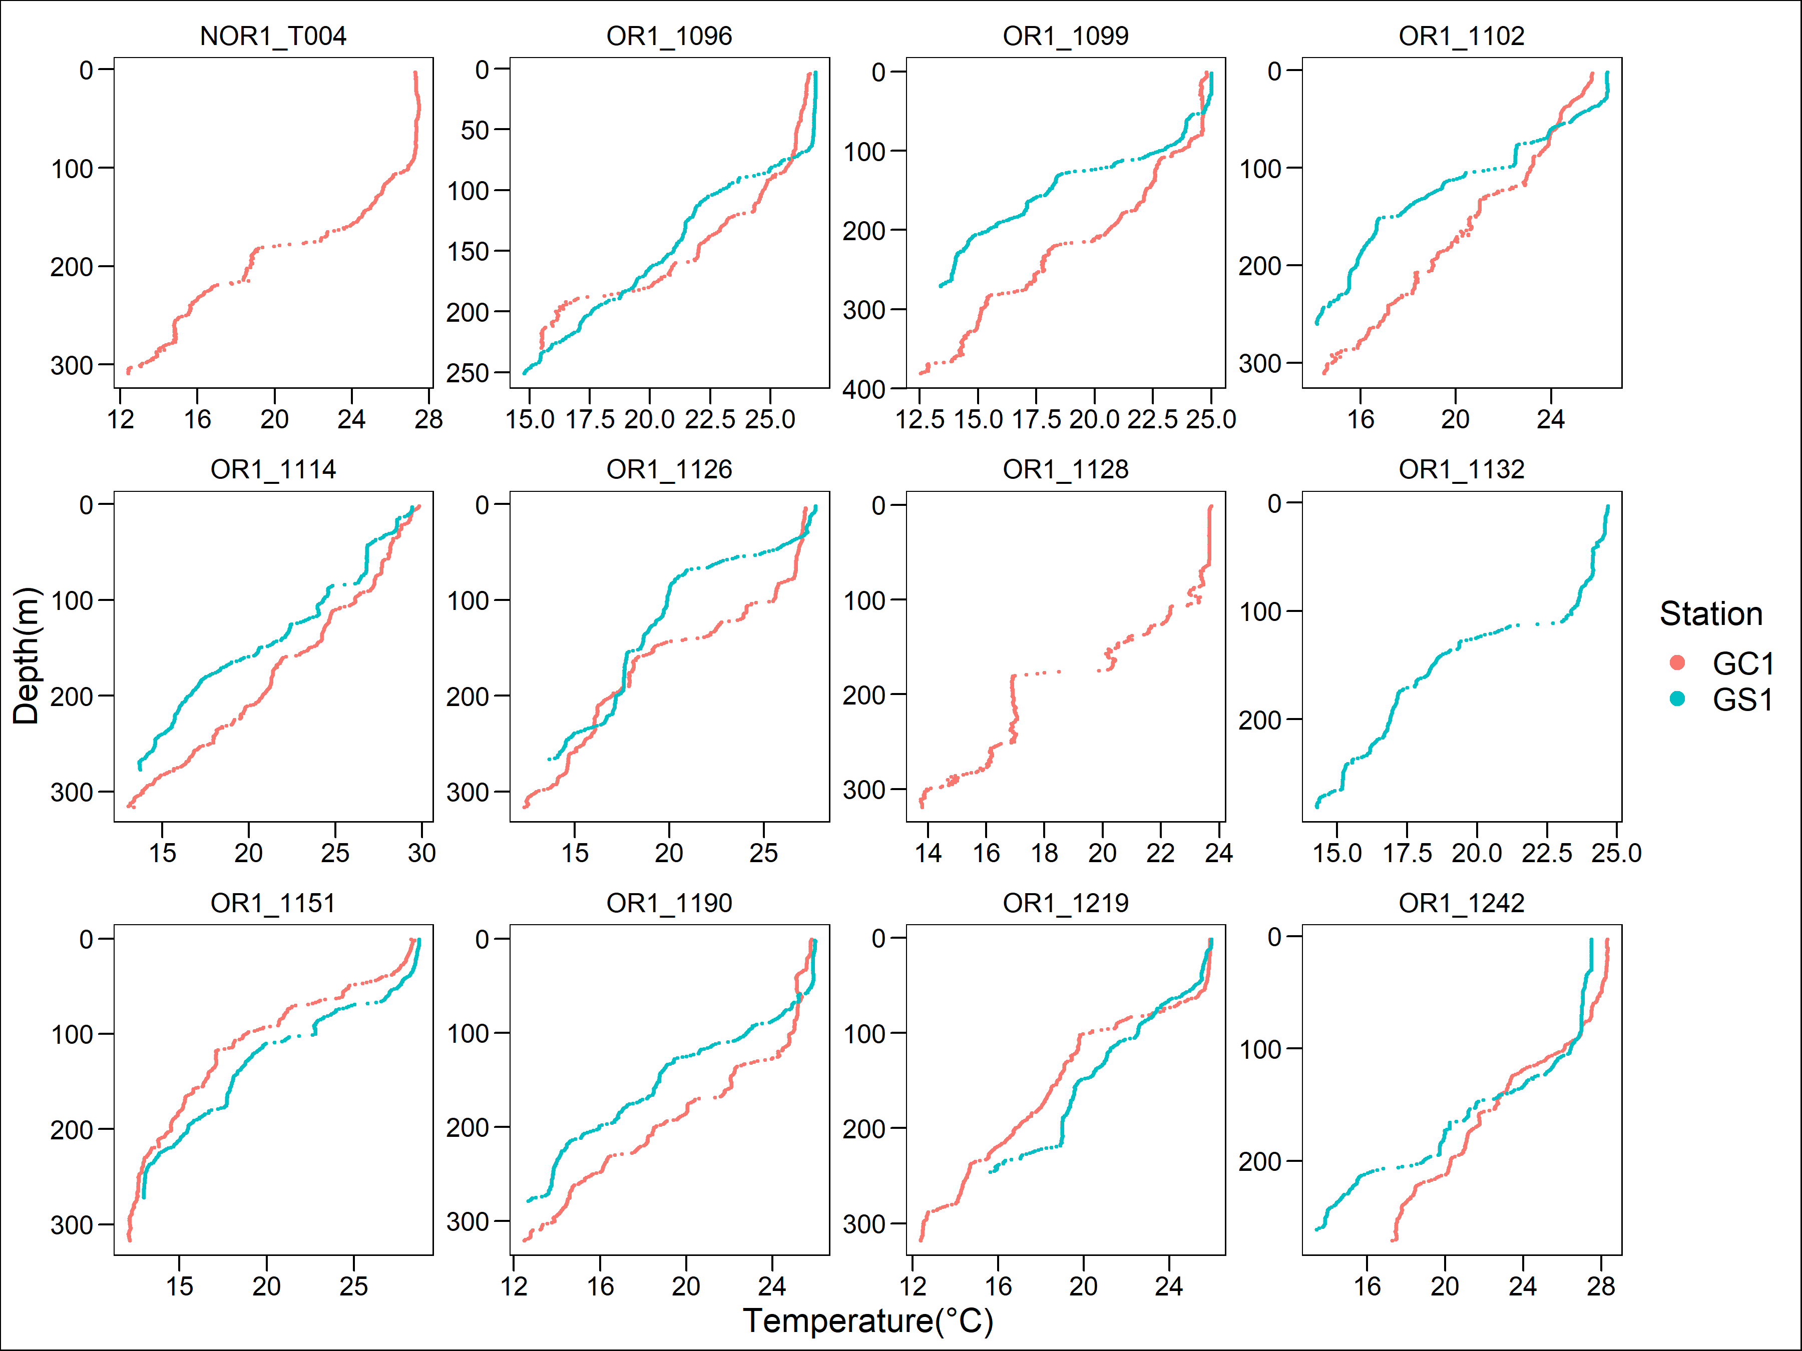
Figure 3. Water temperature profile for each cruise of the two sites.

Slide 10
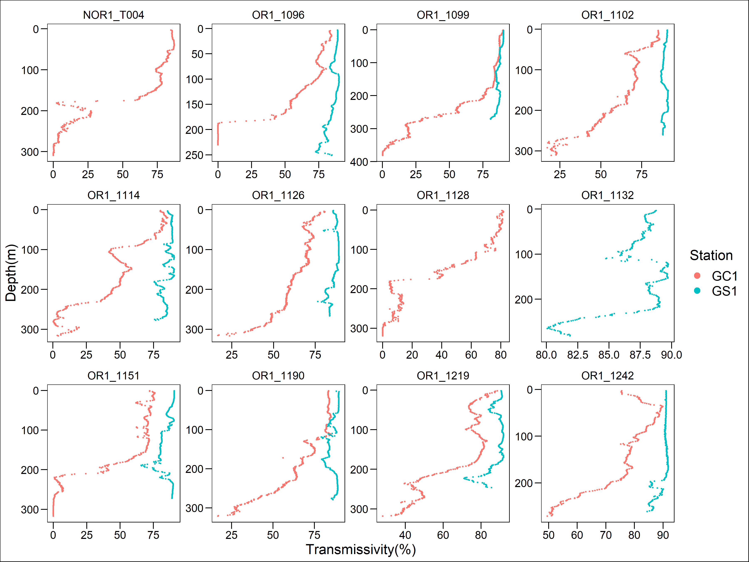
Figure 4. Light transmission profile for each cruise of the two sites. Note that GC1 has a very low light transmission below 200 meter depth in almost all the sampling cruises.

Slide 11
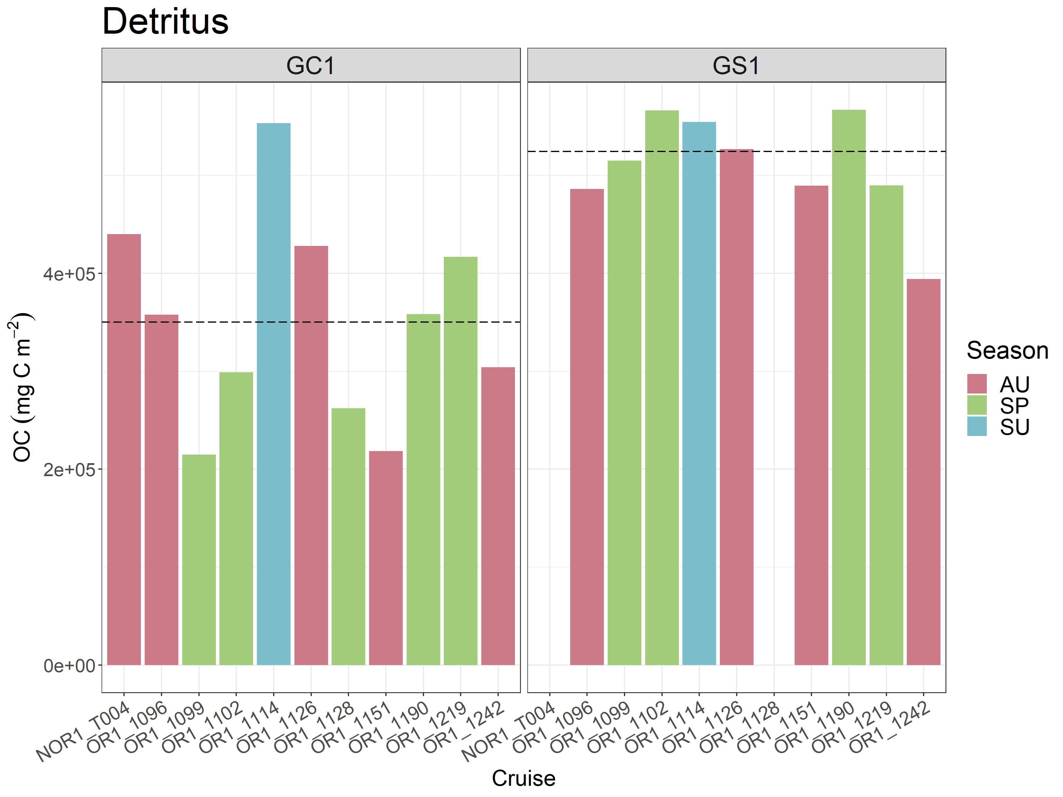
Figure 5. Carbon stocks of sediment of GC1 and GS1. The Cruises were labeled different colors as different seasons. Note that there was no sampling in NOR1-T004 and OR1-1128 for GS1.The dotted lines represent the mean values of the stocks.

Slide 12
PERMDISP
 | Df | Sum of squares | Mean squares | F-value | Pr (>F)
Habitat | 1 | 4.2034e+09 | 4203409008 | 3.0159 | 0.1051
Residuals | 16 | 2.2300e+10 | 1393745915
Season | 1 | 6.2729e+09 | 6272856607 | 1.6005 | 0.2263
Residuals | 16 | 6.2709e+10 | 3919334785
PERMANOVA
 | Df | Sum of squares | R2 | F-value | Pr (>F)
Habitat | 1 | 1.3517e+11 | 0.61649 | 25.9645 | 0.0003***
Season | 1 | 1.1106e+08 | 0.00051 | 0.0213 | 0.8816
Habitat:Season | 1 | 1.1092e+10 | 0.05059 | 2.1306 | 0.1673
Residual | 14 | 7.2883e+10 | 0.33241
Total | 17 | 2.1926e+11 | 1.00000
Table 7. PERMDISP and PERMANOVA on sediment carbon stock GC1 and GS1.

Slide 13
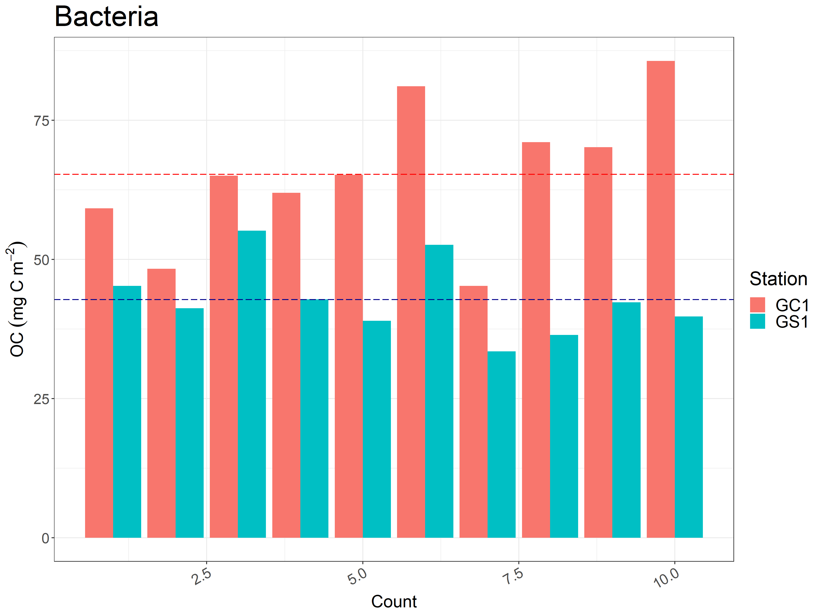
Figure 6. Carbon stocks of bacteria of GC1 and GS1. Note that bacteria were only collected in cruise OR1-1190. The dotted line represent the mean value of each count.

Slide 14
Welch Two Sample t-test
 | Df | GC1 Mean | GS1 Mean | t | p-value
 | 13.677 | 65.30876 | 42.80281 | 4.9356 | 0.0002347***
Table 8. T-test on bacteria carbon stock of GC1 and GS1.

Slide 15
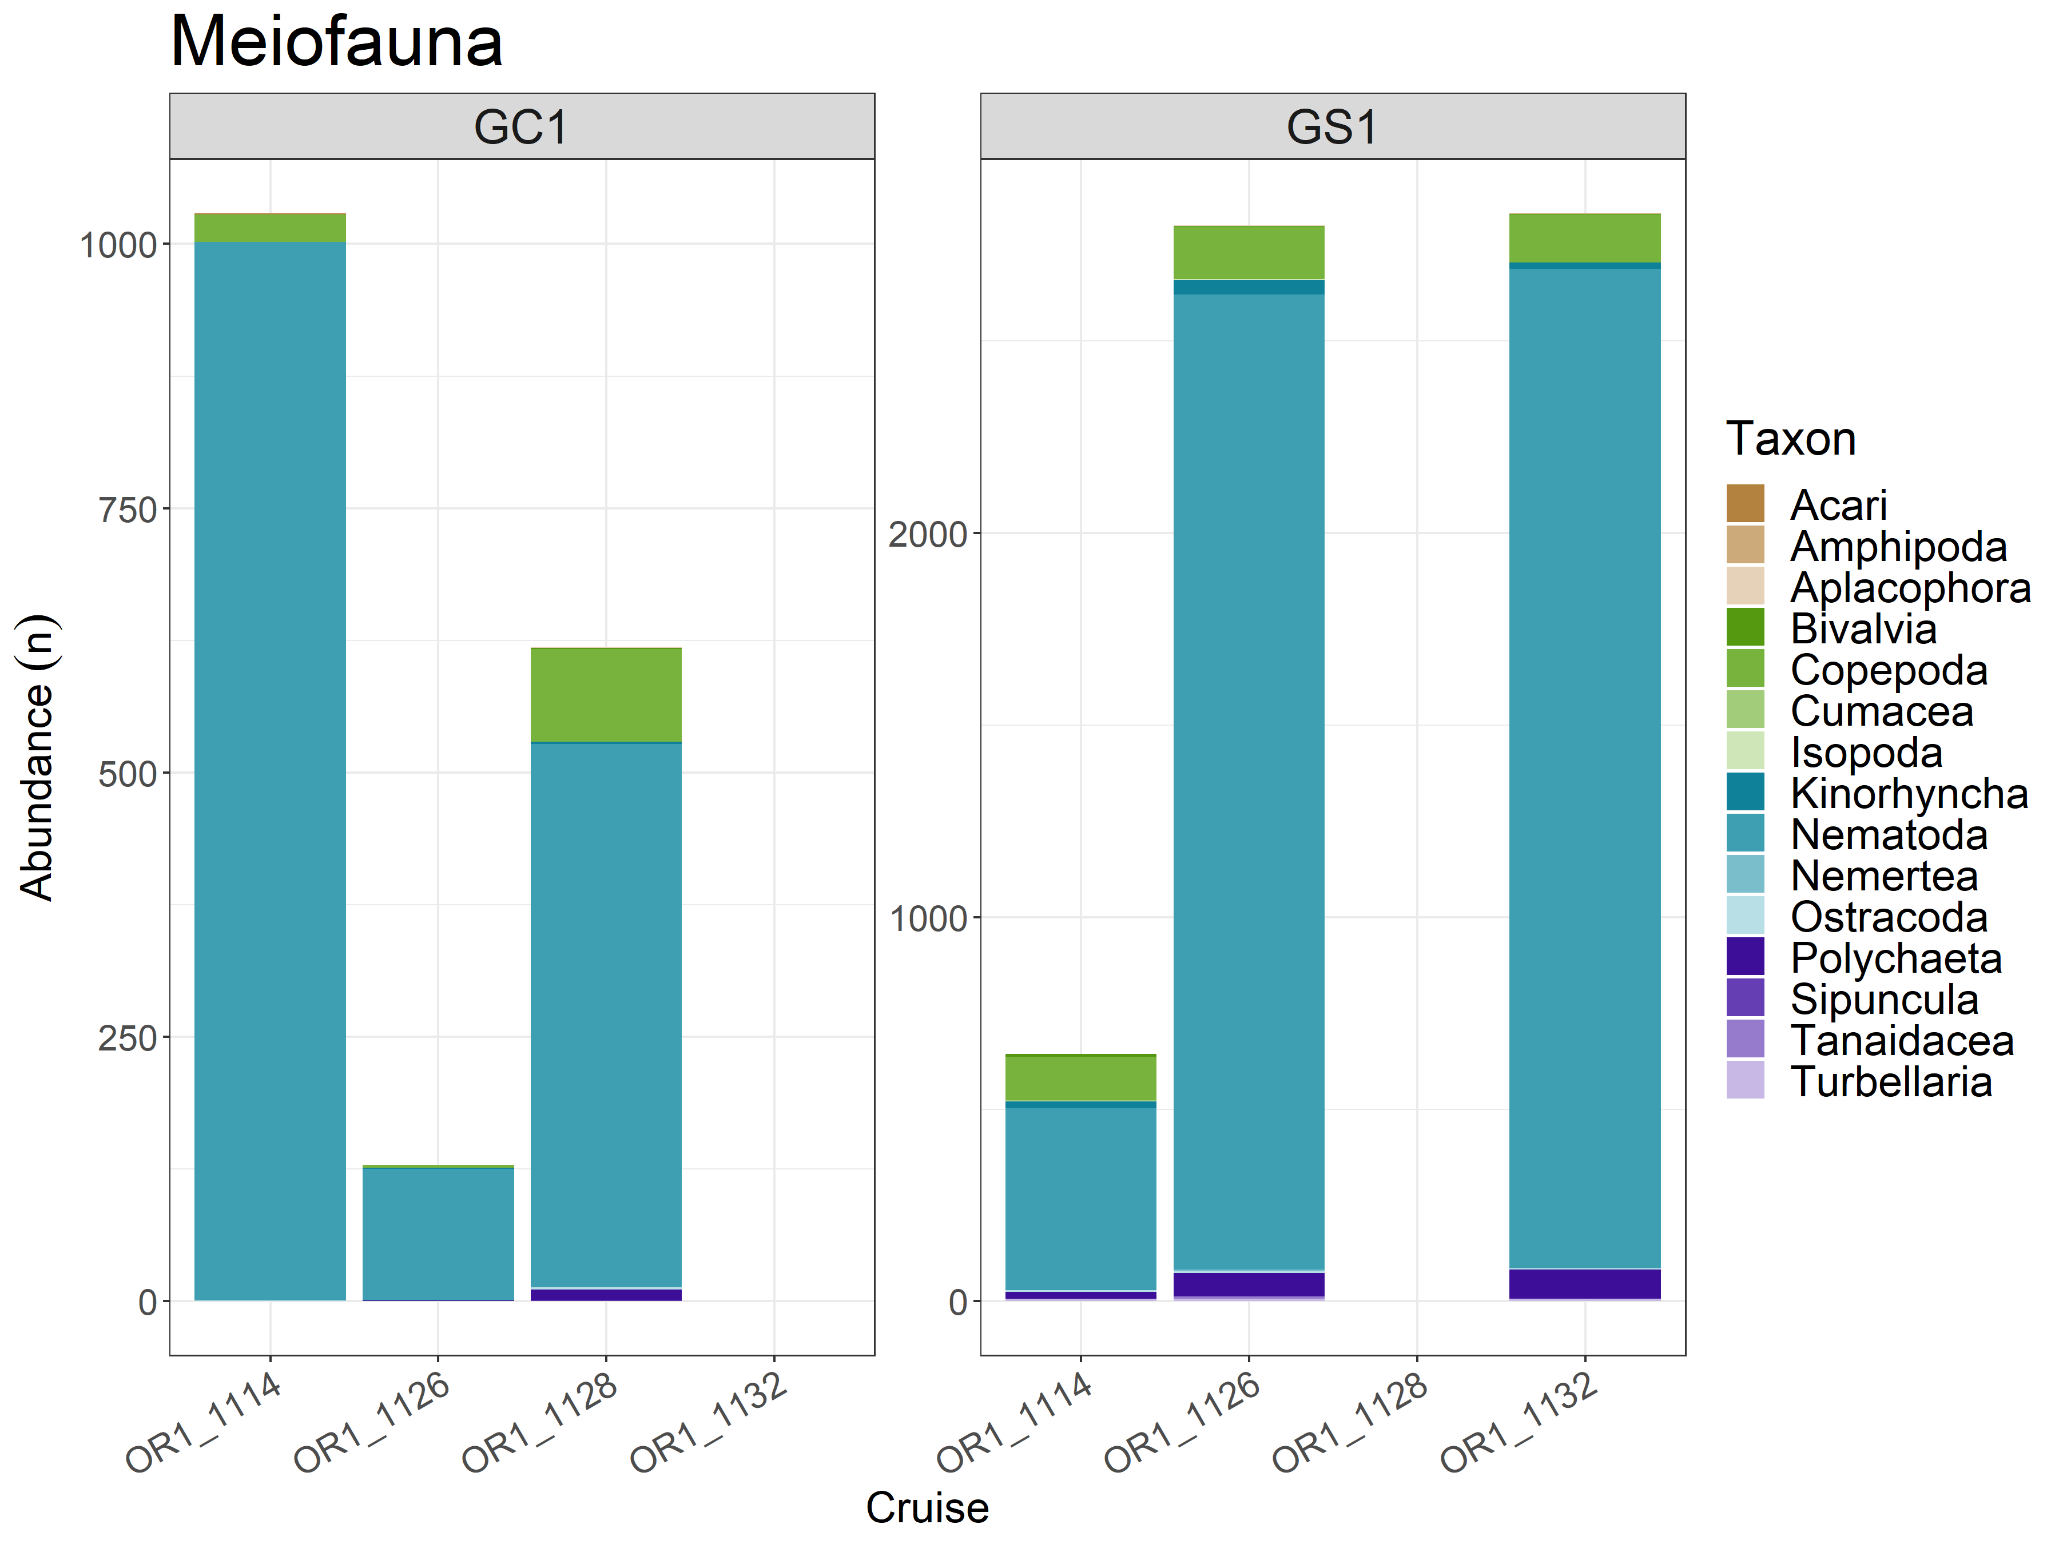
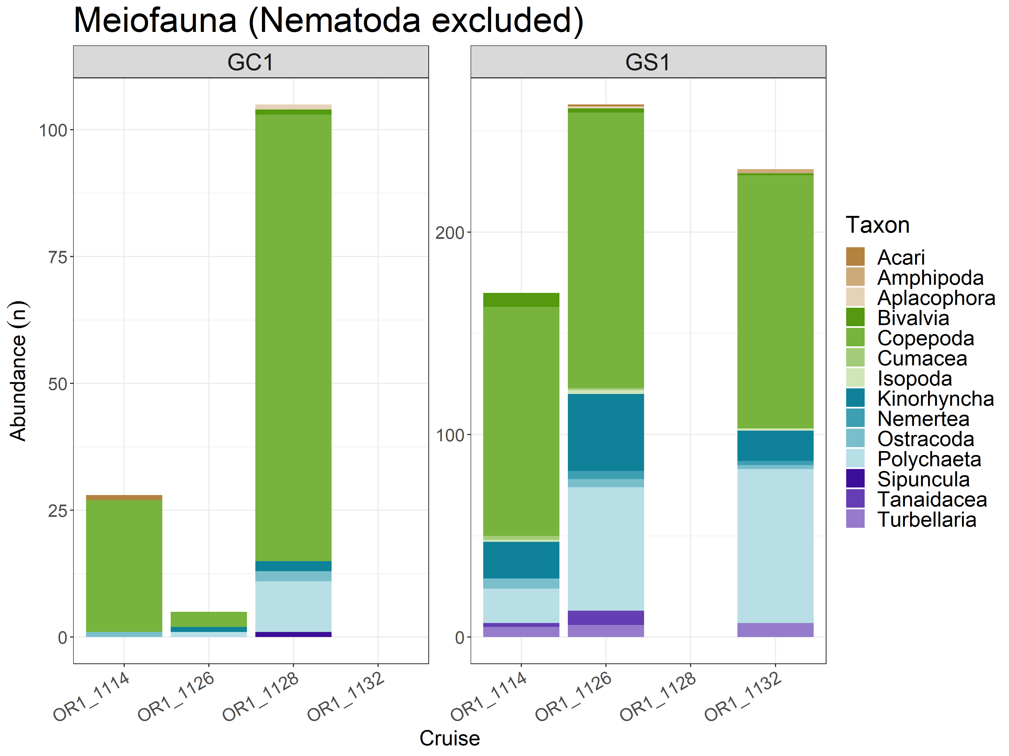
Figure 7. The abundance of meiofauna in each cruise of GC1 and GS1. Note that there was no sampling in OR1-1132 for GC1 and OR1-1128 for GS1. The left figure included all the taxa, which was dominated by Nematodes. The right one showed the composition without Nematodes.

Slide 16
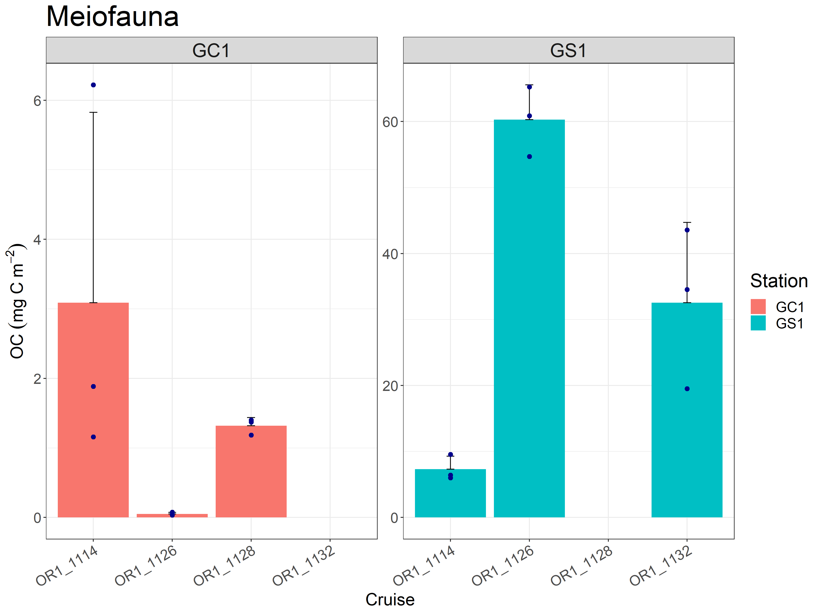
Figure 8. Carbon stocks of meiofauna of GC1 and GS1. Note that meiofauna was only collected in three cruises for each site. The dot represent the sum of fauna biomass for each replicate. The bar represent the mean value of three replicates.

Slide 17
PERMDISP
 | Df | Sum of squares | Mean squares | F-value | Pr (>F)
Habitat | 1 | 0.00083406 | 0.00083406 | 30.284 | 0.0001 ***
Residuals | 16 | 0.00044066 | 0.00002754
Season | 2 | 0.00116895 | 0.00058448 | 25.979 | 0.0001 ***
Residuals | 15 | 0.00033748 | 0.00002250
PERMANOVA
 | Df | Sum of squares | R2 | F-value | Pr (>F)
Habitat | 1 | 0.0022880 | 0.49908 | 15.941 | 0.0002 ***
Residual | 16 | 0.0022965 | 0.50092
Total | 17 | 0.0045845 | 1.00000
Table 9. PERMDISP and PERMANOVA on meiofaunal carbon stock of GC1 and GS1.

Slide 18
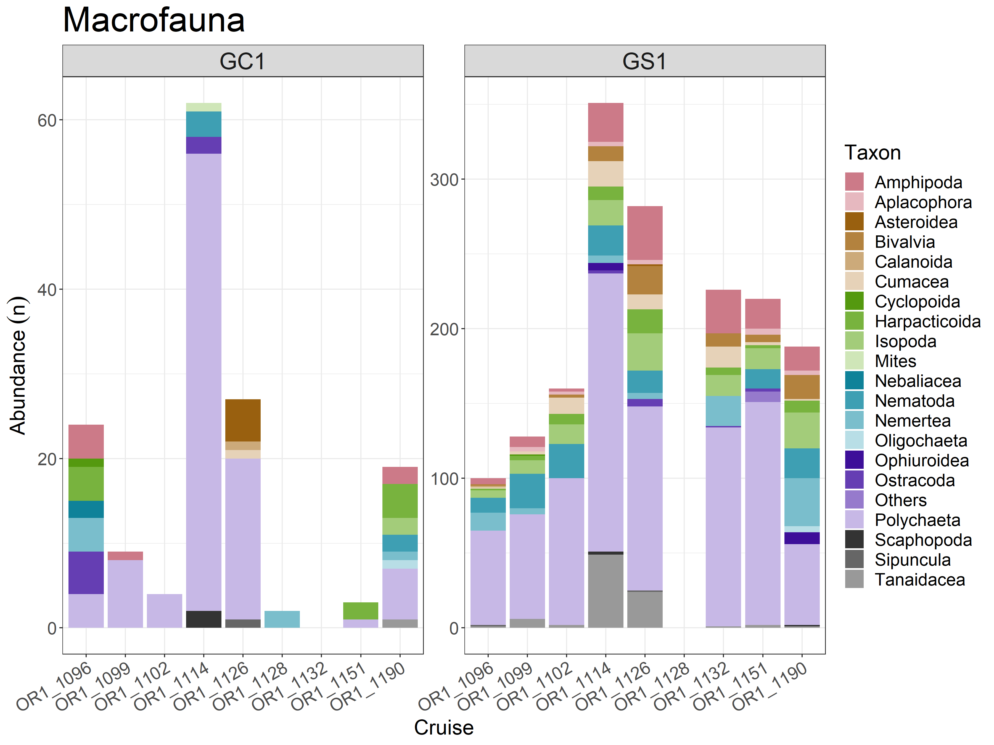
Figure 9. The abundance of macrofauna in each cruise of GC1 and GS1. Note that there was no sampling in OR1-1132 for GC1 and OR1-1128 for GS1.

Slide 19
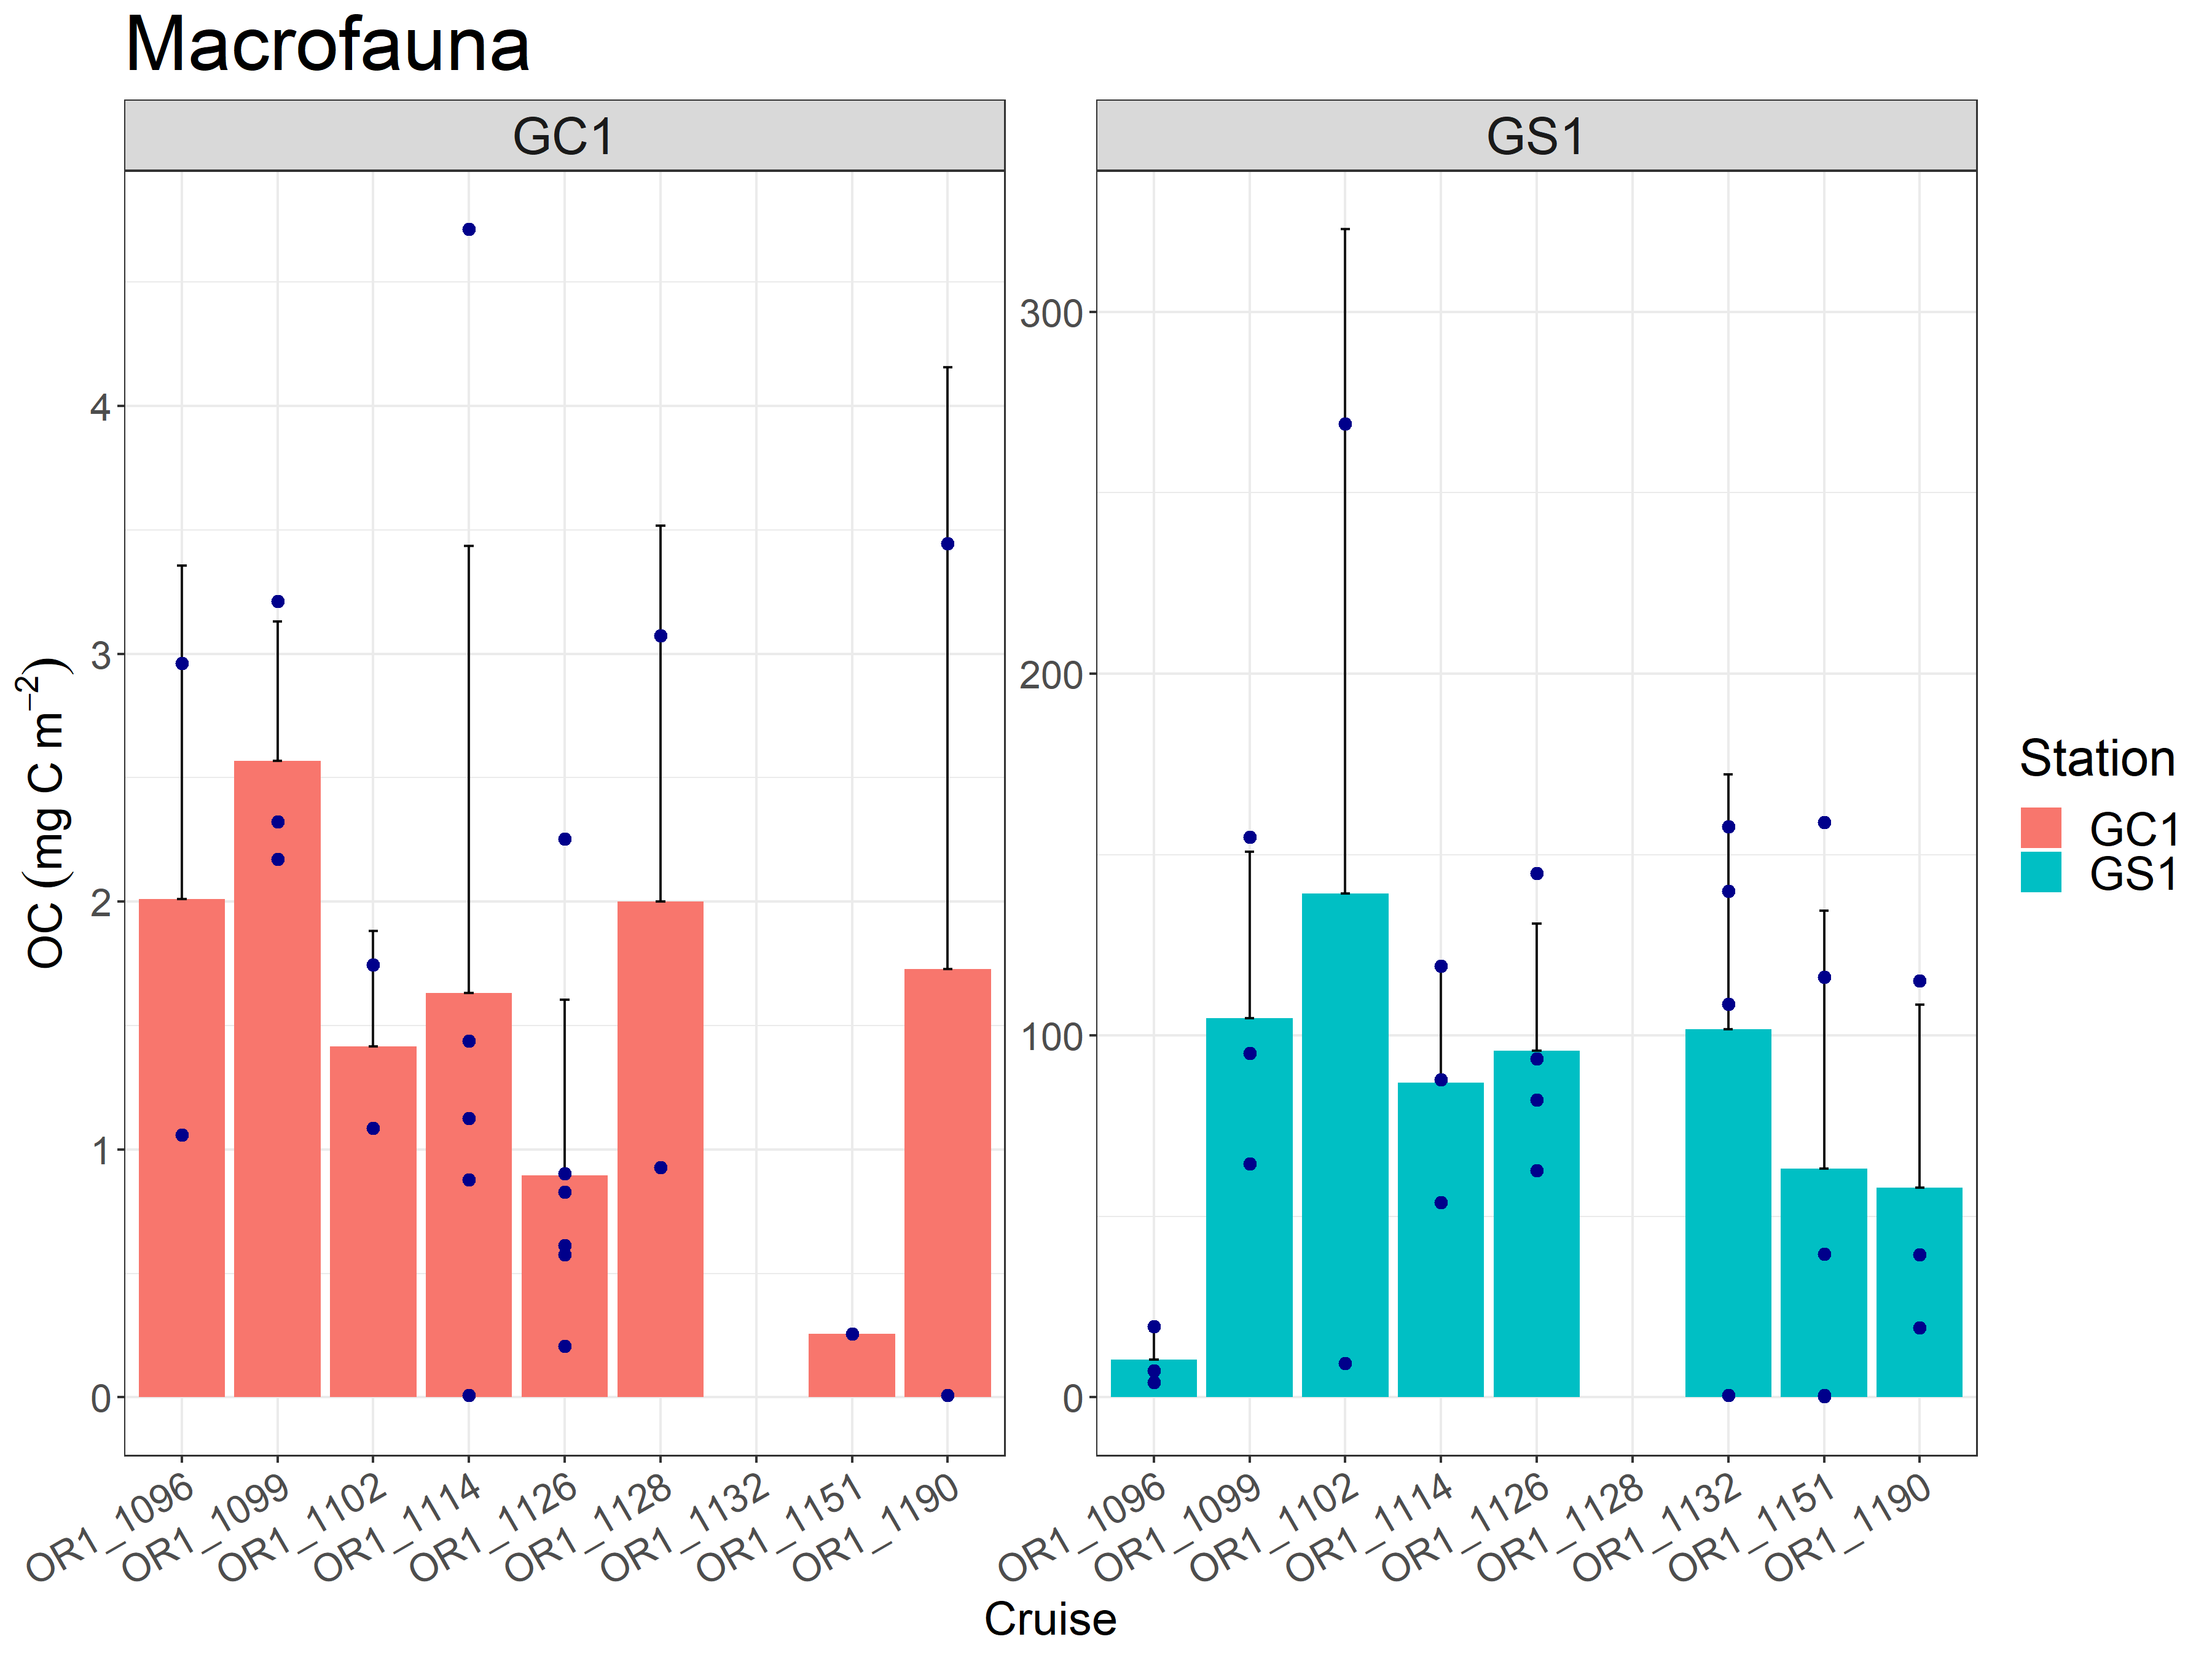
Figure 10. Carbon stocks of macrofauna of GC1 and GS1. Note that there was no sampling in OR1-1132 for GC1 and OR1-1128 for GS1. The dot represent the sum of fauna biomass for each replicate. The bar represent the mean value of three replicates.

Slide 20
PERMDISP
 | Df | Sum of squares | Mean squares | F-value | Pr (>F)
Habitat | 1 | 2.4262 | 2.42623 | 37.932 | 0.0001 ***
Residuals | 40 | 2.5585 | 0.06396
Season | 1 | 0.3203 | 0.32031 | 1.1371 | 0.298
Residuals | 40 | 11.2673 | 0.28168
PERMANOVA
 | Df | Sum of squares | R2 | F-value | Pr (>F)
Habitat | 1 | 4.6696224 | 0.35871952 | 22.9487 | 0.0001 ***
Season | 1 | 0.3649373 | 0.02803441 | 1.793473 | 0.1906
Habitat:Season | 1 | 0.2506460 | 0.01925458 | 1.2318 | 0.2816
Residual | 38 | 7.7322695 | 0.59399149
Total | 41 | 13.0174751 | 1.00000
Table 10. PERMDISP and PERMANOVA on macrofaunal carbon stock of GC1 and GS1.

Slide 21
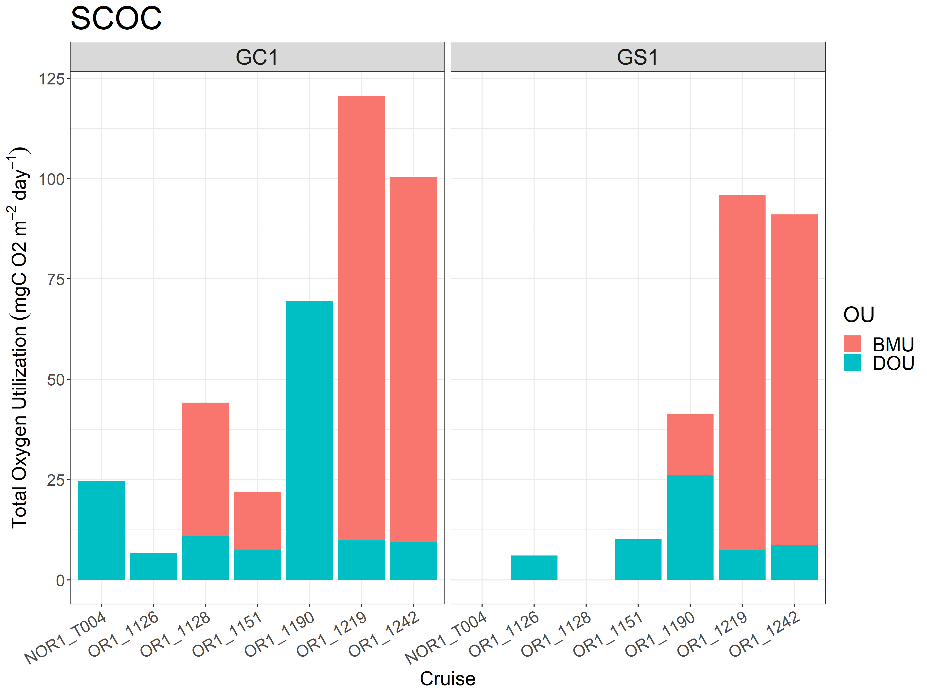
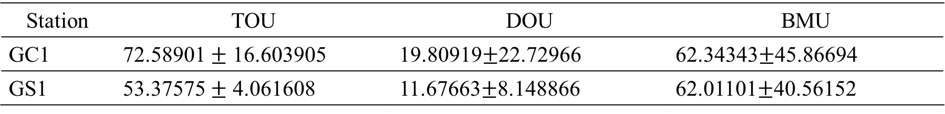
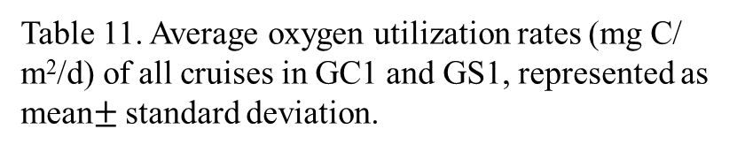
Figure 11. Average total oxygen utilization (TOU) for each cruise of GC1 and GS1. TOU was further divided into DOU and BOU. Note that there was no measurement in NOR1-T004 and OR1-1128 for GS1.
Table 11. Average oxygen utilization rates (mg C/ m²/d) of all cruises in GC1 and GS1, represented as mean$±$standard deviation.
Station | TOU | DOU | BMU
GC1 | 72.58901 $±$ 16.603905 | 19.80919$±$22.72966 | 62.34343$±$45.86694
GS1 | 53.37575 $±$ 4.061608 | 11.67663$±$8.148866 | 62.01101$±$40.56152

Slide 22
PERMDISP
 | Df | Sum of squares | Mean squares | F-value | Pr (>F)
Habitat | 1 | 1818.9 | 1818.92 | 3.3882 | 0.0763
Residuals | 25 | 13420.9 | 536.84
Season | 1 | 196.5 | 196.50 | 0.3012 | 0.5893
Residuals | 25 | 16310.9 | 652.43
PERMANOVA
 | Df | Sum of squares | R2 | F-value | Pr (>F)
Habitat | 1 | 1675 | 0.04973 | 1.2060 | 0.2867
Season | 1 | 20 | 0.00059 | 0.0143 | 0.9095
Habitat:Season | 1 | 41 | 0.00122 | 0.0295 | 0.8687
Residual | 23 | 31946 | 0.94846
Total | 26 | 33682 | 1.00000
Table 12. PERMDISP and PERMANOVA on TOU of GC1 and GS1.

Slide 23
DOU
PERMDISP
 | Df | Sum of squares | Mean squares | F-value | Pr (>F)
Habitat | 1 | 63.7 | 63.71 | 0.4053 | 0.5425
Residuals | 65 | 10216.8 | 157.18
Season | 1 | 23 | 22.984 | 0.1453 | 0.7412
Residuals | 65 | 10282 | 158.186
PERMANOVA
 | Df | Sum of squares | R2 | F-value | Pr (>F)
Habitat | 1 | 375.8 | 0.02769 | 1.8035 | 0.1925
Season | 1 | 69.9 | 0.00515 | 0.3355 | 0.5836
Habitat:Season | 1 | 0.0 | 0.00000 | 0.0001 | 0.9935
Residual | 63 | 13128.0 | 0.96716
Total | 66 | 13573.7 | 1.00000
Table 13. PERMDISP and PERMANOVA on DOU of GC1 and GS1.

Slide 24
PERMDISP
 | Df | Sum of squares | Mean squares | F-value | Pr (>F)
Habitat | 1 | 3.2609 | 3.2609 | 0.5498 | 0.554
Residuals | 5 | 29.6562 | 5.9312
Season | 1 | 2.4125 | 2.4125 | 0.4027 | 0.596
Residuals | 5 | 29.9550 | 5.9910
PERMANOVA
 | Df | Sum of squares | R2 | F-value | Pr (>F)
Habitat | 1 | 0.001 | 0.00001 | 0.0000 | 0.999
Season | 1 | 0.005 | 0.00006 | 0.0002 | 0.974
Habitat:Season | 1 | 9.440 | 0.10341 | 0.3461 | 0.614
Residual | 3 | 81.839 | 0.89652
Total | 6 | 91.286 | 1.00000
Table 14. PERMDISP and PERMANOVA on BMU of GC1 and GS1. Note that the Number of permutation was only 999.

Slide 25
Station | OC_{total}/TOU (yr) | OC_{bacteria}/DOU (d) | OC_{(meiofauna+macrofauna)} /BMU (d) | Method
GC1 | 13.22 | 3.2970 | 0.0824 | Direct measurement
 | 62.94 | 4.3155 | 44.6422 | Model results
GS1 | 19.80 | 3.6654 | 1.8318 | Direct measurement
 | 101.02 | 3.7129 | 42.0642 | Model results
Table 15. Stock turnover (unit: year or day) calculated with the two different estimations of oxygen utilization rates.

Slide 26
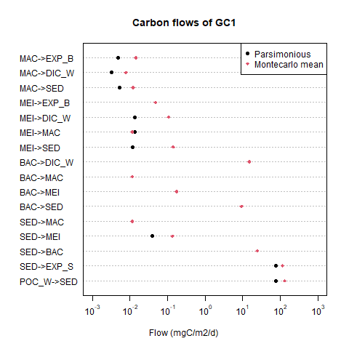
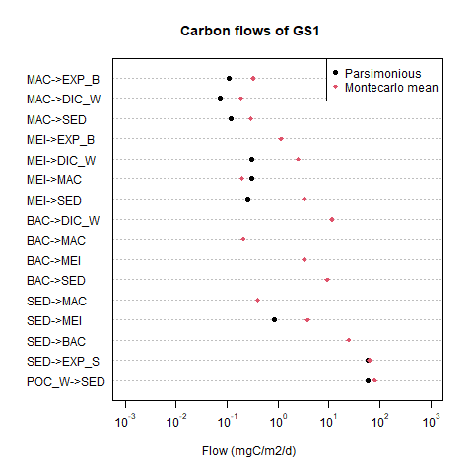
Figure 12. LIM results for each flow in the food web by the two different methods. Note that the value of some flows calculated with the parsimonious method was zero, which cannot be log-transformed. Thus these flows remain no black dot on the figure.

Slide 27
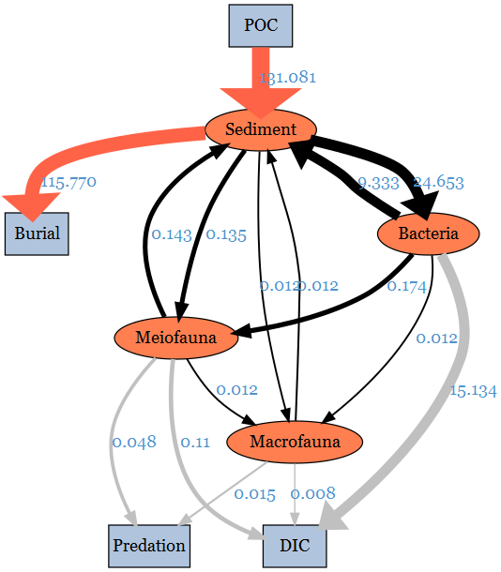
Figure 13. The conceptual model plotted with LIM results of GC1 processed with the MCMC algorithm. The flows were drawn to scale.

Slide 28
Flow | Mean | SD (±2%)
POC->SED | 131.0813 | 15.718839894
SED->EXP_S | 115.7699 | 12.745327433
SED->BAC | 24.65287 | 7.984219083
BAC->SED | 9.333087 | 6.129441886
SED->MEI | 0.1351685 | 0.094398395
MEI->SED | 0.1427569 | 0.052851363
SED->MAC | 0.01158626 | 0.008464554
MAC->SED | 0.01237802 | 0.002703155
BAC->MEI | 0.1743825 | 0.113613234
BAC->MAC | 0.01161126 | 0.008529056
MEI->MAC | 0.01152755 | 0.008494257
MEI->EXP_B | 0.04797334 | 0.014436516
MAC->EXP_B | 0.01.450261 | 0.002452046
BAC->DIC | 15.13379e | 4.724027779
MEI->DIC | 0.1072931 | 0.031537262
MAC->DIC | 0.007844448 | 0.001781753
Table 13. Mean and standard deviation of the food web flows (mgC/ m2/ d) of the GC1 processed with the MCMC algorithm.

Slide 29
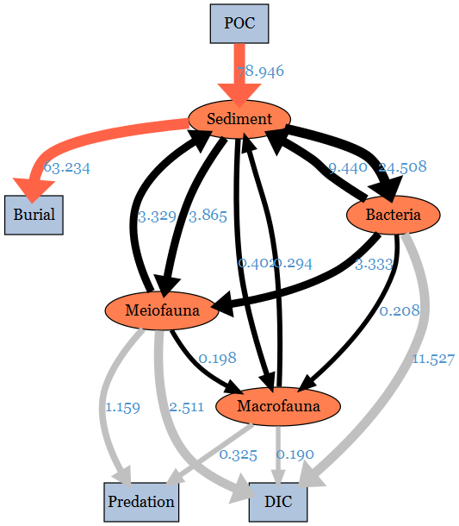
Figure 14. The conceptual model plotted with LIM results of GS1 processed with the MCMC algorithm. The flows were drawn to scale.

Slide 30
Flow | Mean | SD (±2%)
POC->SED | 78.9461651 | 3.37455051
SED->EXP_S | 63.2342462 | 2.02409975
SED->BAC | 24.5079327 | 4.21209840
BAC->SED | 9.4396541 | 3.47065352
SED->MEI | 3.8648229 | 2.01270266
MEI->SED | 3.3291330 | 1.15358193
SED->MAC | 0.4016262 | 0.25919974
MAC->SED | 0.2936759 | 0.07290954
BAC->MEI | 3.3326240 | 2.10875051
BAC->MAC | 0.2084190 | 0.17275121
MEI->MAC | 0.1984801 | 0.16944190
MEI->EXP_B | 1.1590011 | 0.29228201
MAC->EXP_B | 0.3252832 | 0.05975403
BAC->DIC | 11.5272356 | 2.03033542
MEI->DIC | 2.5108326 | 0.66658793
MAC->DIC | 0.1895663 | 0.04661137
Table 13. Mean and standard deviation of the food web flows (mgC/ m2/ d) of the GS1 processed with the MCMC algorithm.

Slide 31
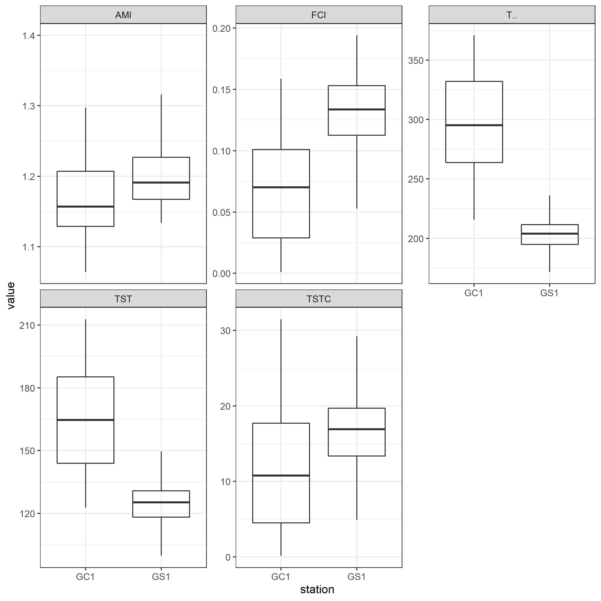
Network indices | Fraction | Significance
T.. | 0.9987 | *** (GC1>GS1)
TST | 0.9623 | *** (GC1>GS1)
TSTC | 0.2926
FCI | 0.1034 | Marginally GC1<GS1
AMI | 0.2963
Table 16. Comparison of network indices calculated for GC1 and GS1.The number indicates the fraction of network values that are higher in GC1.
Figure 15. The selected network indices of GC1 and GS1. The indices were calculated from 10,000 solutions of the LIM, as a result, there were also 10,000 values for each index. Therefore, they were presented as box plots.

