Slide 1
Date | Season | Cruise | Station | Longitude | Latitude | Depth (m) | Measurement | Gear
2014/11 | AU | OR1_1096 | GC1
 |  |  | GS1
2015/03 | SP | OR1_1099 | GC1
 |  |  | GS1
2015/04 | SP | OR1_1102 | GC1
 |  |  | GS1
2015/08 | SU | OR1_1114 | GC1
 |  |  | GS1
2015/11 | AU | OR1_1126 | GC1
 |  |  | GS1
2016/02 | SP | OR1_1128 | GC1
2016/03 | SP | OR1_1132 | GS1
2016/10 | AU | OR1_1151 | GC1
 |  |  | GS1
2018/03-04 | SP | OR1_1190 | GC1
 |  |  | GS1
2019/03-04 | SP | OR1_1219 | GC1
 |  |  | GS1
2019/10 | AU | OR1_1242 | GC1
 |  |  | GS1
2020/11 | AU | NOR_T004 | GC1

Slide 2
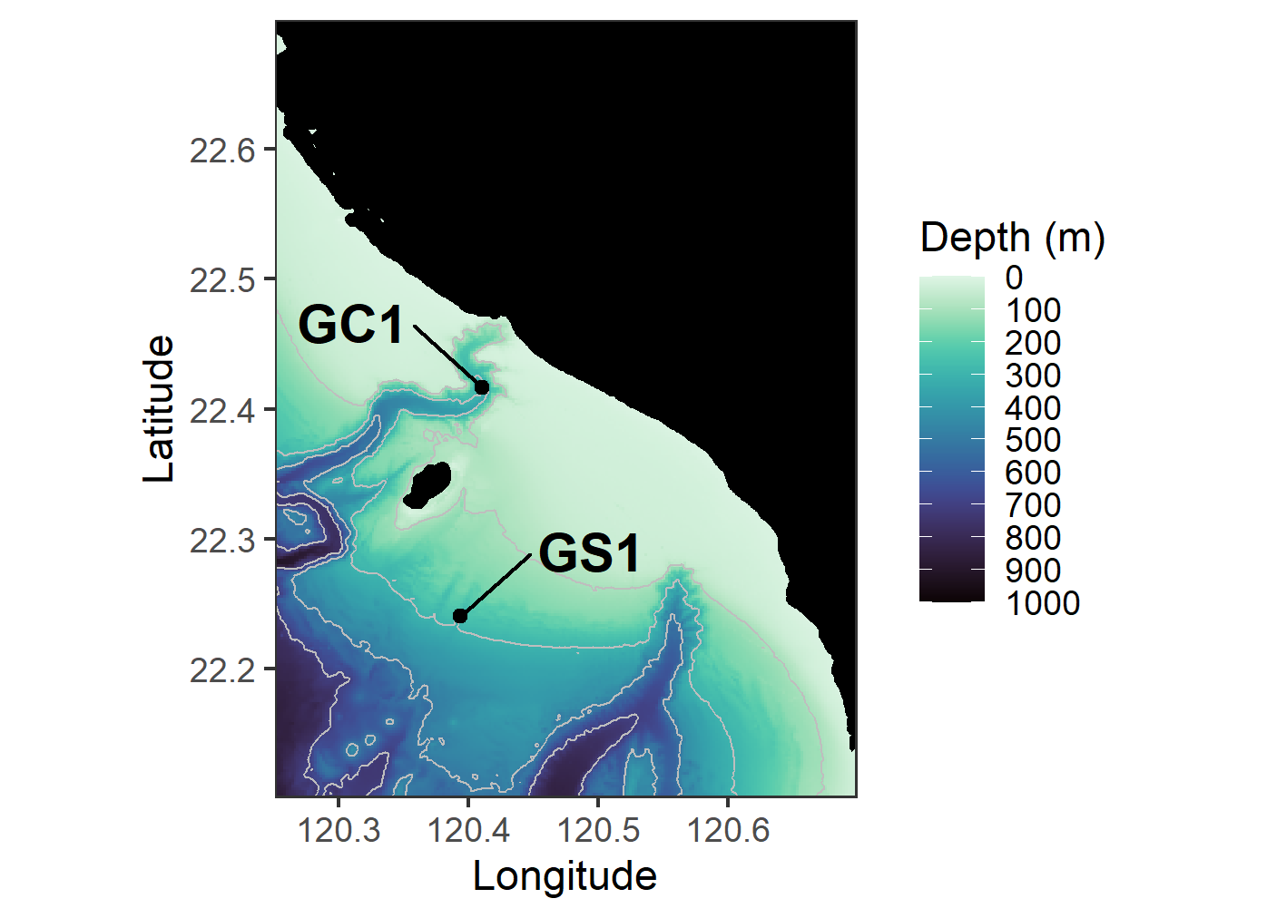
Figure.1 The map of sampling stations of the upper Gaoping Submarine Canyon (GC1) and Gaoping Slope (GS1).

Slide 3
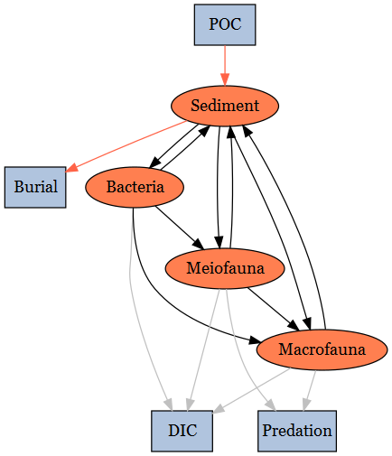
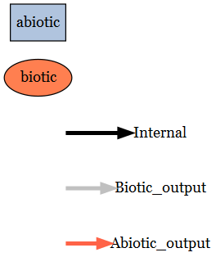
Figure.2 conceptual model of the food web structure which formed the basis of our linear inverse model (LIM). See section “Structure” for description.

Slide 4
Inequality description | Calculation | GC1 | GS1 | Unit | Reference
Temperature limitation (Tlim) | Q10* exp((T-20)/10), with Q10 = 2 | 1.05 | 1.09 | -
Bacteria growth efficiency |  | [0.02, 0.61] | [0.02, 0.61] | - | del Giorgio and Cole (1998)
DOU (Bacteria -> DIC) | Maximum DOU= 30% TOU | [0.0, 21.77] | [0.0, 16.01] | mg C/m²/d | Mahaut et al. (1995)
Maintenance respiration of meiofauna |  | Tlim * 0.01 * Stock | Tlim * 0.01 * Stock | mg C/m²/d | van Oevelen et al. (2011)
Maintenance respiration of macrofauna |  | Tlim * 0.01 * Stock | Tlim * 0.01 * Stock | mg C/m²/d
Assimilation efficiency of meiofauna |  | [0.456, 0.699] | [0.456, 0.699] | - | Conover (1966)
Assimilation efficiency of macrofauna |  | [0.6 0.7] | [0.6 0.7] | - | Loo and Rosenberg (1996)
P/B ratio of meiofauna |  | [0.0090, 0.0493] | [0.0090, 0.0493] | - | Fenchel (1982); Fleeger and Palmer (1982)
P/B ratio of macrofauna |  | [0.0008, 0.0048] | [0.0008, 0.0048] | - | Stratmann et al. (2018)
Net growth efficiency of meiofauna |  | [0.3, 0.5] | [0.3, 0.5] | - | Herman and Heip (1985); Banse and Mosher (1980); Herman et al. (1983; 1984)
Net growth efficiency of macrofauna |  | [0.6, 0.72] | [0.6, 0.72] | - | Navarro et al., 1994; Nielsen et al., 1995
Sedimentation rate |  | [75.93, 137.92] | [57.18, 66.80] | mg C/m²/d | Huh et al. (2009)
Sediment burial efficiency |  | [0.24, 1] | [0.24, 1] | - | Hsu et al. (2014)
Table. 2 Equality and inequality constraints implemented in the LIM models of GC1 and GS1. Values given as single number implied that the data were equalities, whereas the values designated in [ minimum value, maximum value ] represented the inequalities.

Slide 5
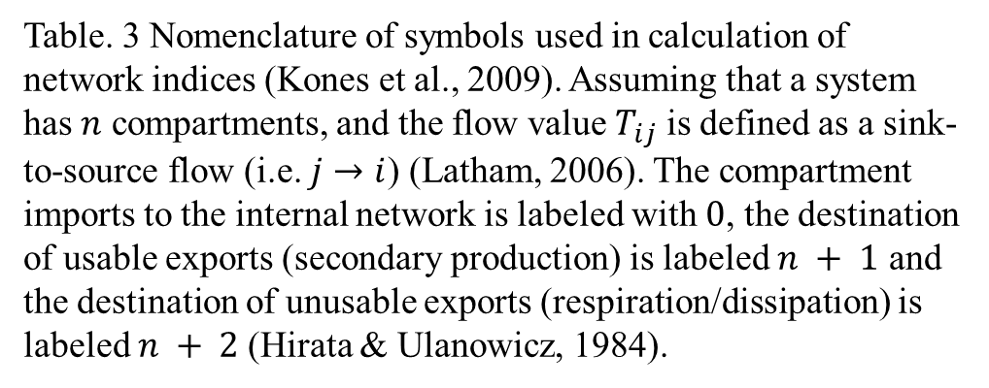
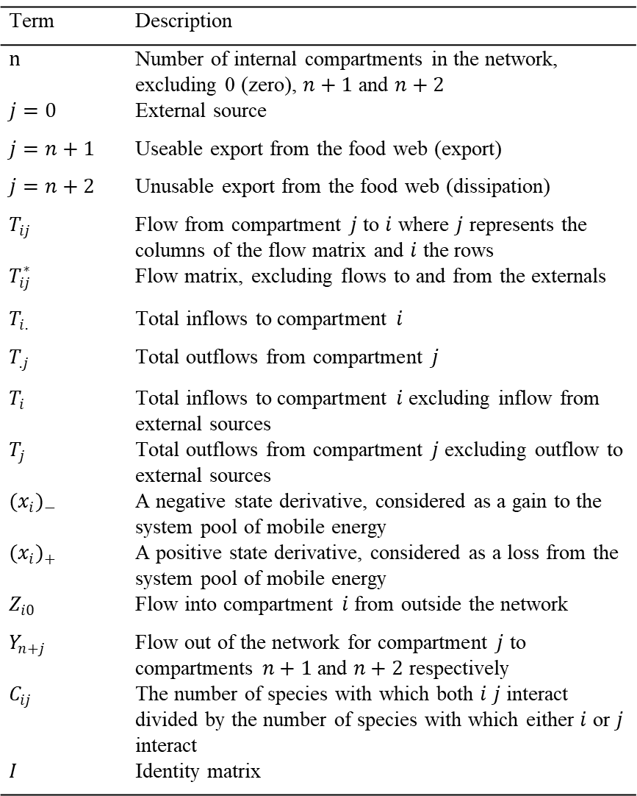
Term | Description
$n$ | Number of internal compartments in the network, excluding 0 (zero), $n+1$ and $n+2$
$j=0$ | External source
$j=n+1$ | Useable export from the food web (export)
$j=n+2$ | Unusable export from the food web (dissipation)
$T_{ij}$ | Flow from compartment $j$ to $i$ where $j$ represents the columns of the flow matrix and $i$ the rows
$T_{ij}^{∗}$ | Flow matrix, excluding flows to and from the externals
$T_{i.}$ | Total inflows to compartment $i$
$T_{.j}$ | Total outflows from compartment $j$
$T_{i}$ | Total inflows to compartment $i$ excluding inflow from external sources
$T_{j}$ | Total outflows from compartment $j$ excluding outflow to external sources
${(x_{i})}_{−}$ | A negative state derivative, considered as a gain to the system pool of mobile energy
${(x_{i})}_{+}$ | A positive state derivative, considered as a loss from the system pool of mobile energy
$Z_{i0}$ | Flow into compartment $i$ from outside the network
$Y_{n+j}$ | Flow out of the network for compartment $j$ to compartments $n+1$ and $n+2$ respectively
$C_{ij}$ | The number of species with which both $i$ $j$ interact divided by the number of species with which either $i$ or $j$ interact
$I$ | Identity matrix
Table. 3 Nomenclature of symbols used in calculation of network indices (Kones et al., 2009). Assuming that a system has $n$ compartments, and the flow value $T_{ij}$ is defined as a sink-to-source flow (i.e. $j→i$) (Latham, 2006). The compartment imports to the internal network is labeled with $0$, the destination of usable exports (secondary production) is labeled $n + 1$ and the destination of unusable exports (respiration/dissipation) is labeled $n + 2$(Hirata & Ulanowicz, 1984).

Slide 6
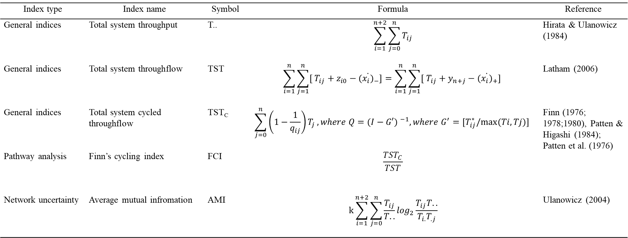
Index type | Index name | Symbol | Formula | Reference
General indices | Total system throughput | T.. | $$\sum_{i=1}^{n+2}{\sum_{j=0}^{n}{T_{ij}}}$$ | Hirata & Ulanowicz (1984)
General indices | Total system throughflow | TST | $$\sum_{i=1}^{n}{\sum_{j=1}^{n}{[ T_{ij}+z_{i0}−{(\dot{x_{i})}}_{−}}]=\sum_{i=1}^{n}{\sum_{j=1}^{n}{[ T_{ij}+y_{n+j}−{(\dot{x_{i})}}_{+}}] }}$$ | Latham (2006)
General indices | Total system cycled throughflow | TST_{C} | $$\sum_{j=0}^{n}{\left(1−\frac{1}{q_{ij}}\right)T_{j}}, where Q={(I−G′) }^{−1},where G^{′}=[T_{ij}^{∗}/max⁡(Ti,Tj)]$$ | Finn (1976; 1978;1980), Patten & Higashi (1984); Patten et al. (1976)
Pathway analysis | Finn’s cycling index | FCI | $$\frac{{TST}_{C}}{TST}$$
Network uncertainty | Average mutual infromation | AMI | $$k\sum_{i=1}^{n+2}{\sum_{j=0}^{n}{\frac{T_{ij}}{T..}}}\log_{2}\frac{T_{ij}T..}{T_{i.}T_{.j}}$$ | Ulanowicz (2004)
Table. 4 Algorithms for the calculation of the network indices; see Table. 3 for symbols.

Slide 7
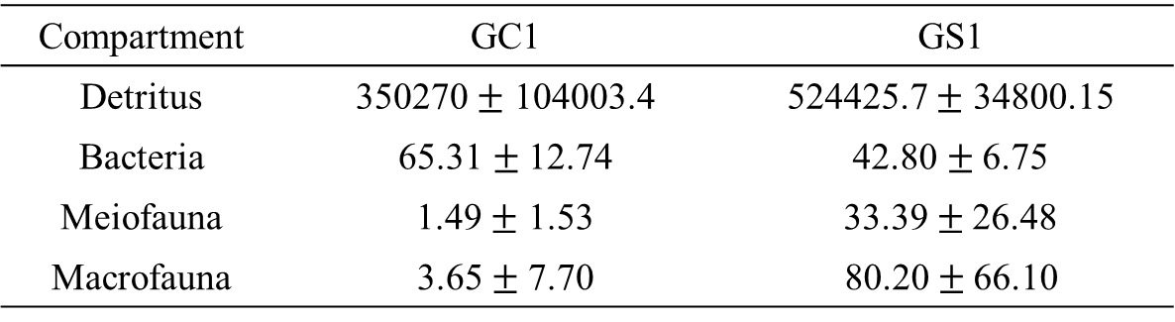
Compartment | GC1 | GS1
Detritus | 350270 $±$ 104003.4 | 524425.7 $±$ 34800.15
Bacteria | 65.31$±$12.74 | 42.80$±$6.75
Meiofauna | 1.49 $±$ 1.53 | 33.39 $±$26.48
Macrofauna | 3.65$±$7.70 | 80.20 $± \text{66.}\text{10}$
Table. 1 Standing stocks (in mg C/ m²) as mean$±$standard deviation of the food web compartments for GC1 and GS1.
Station | Averaged bottom water temperature(°C) | Tlim
GC1 | 13.54 | 1.05
GS1 | 13.90 | 1.09

Slide 8
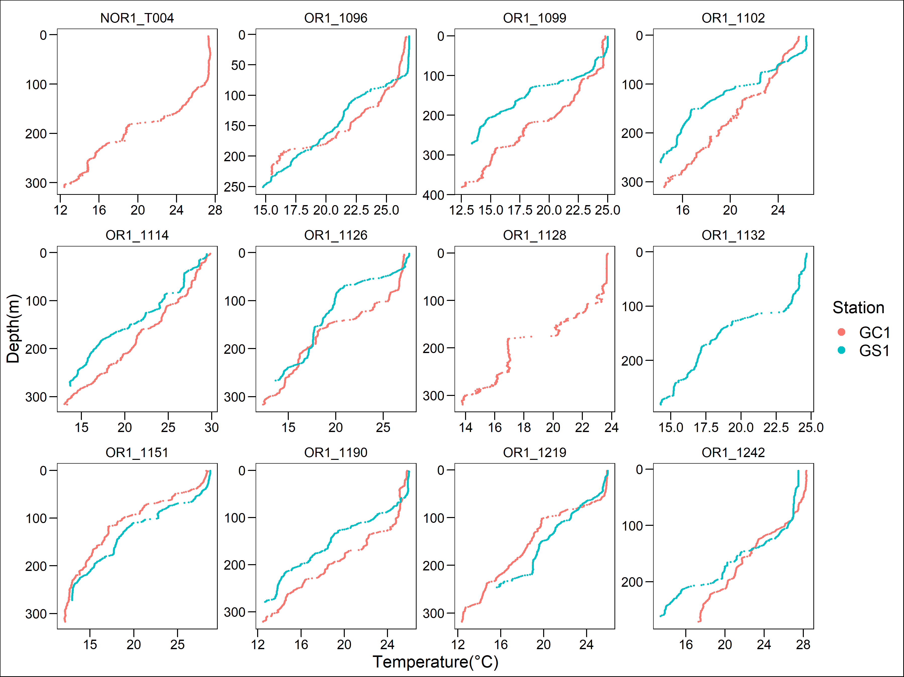
CTD plot_temp

Slide 9
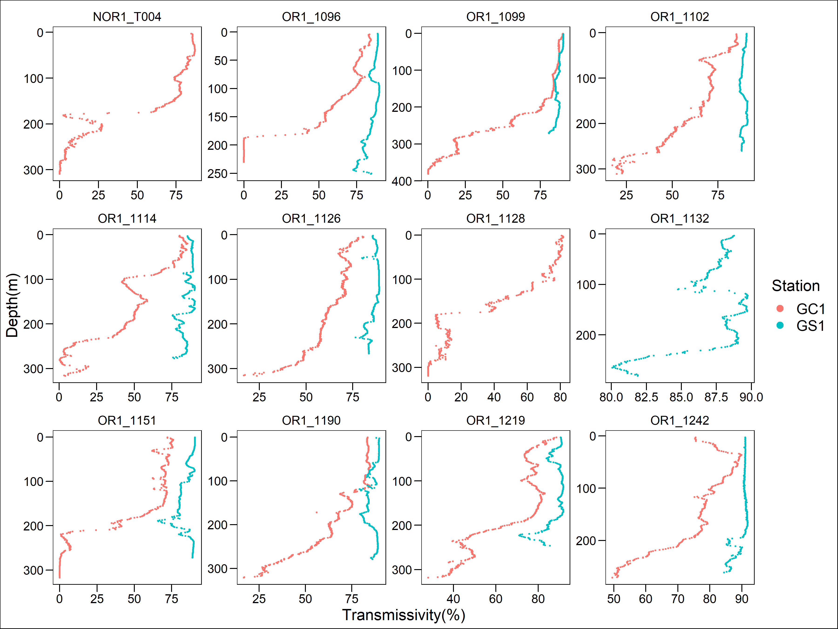
CTD plot_trans

Slide 10
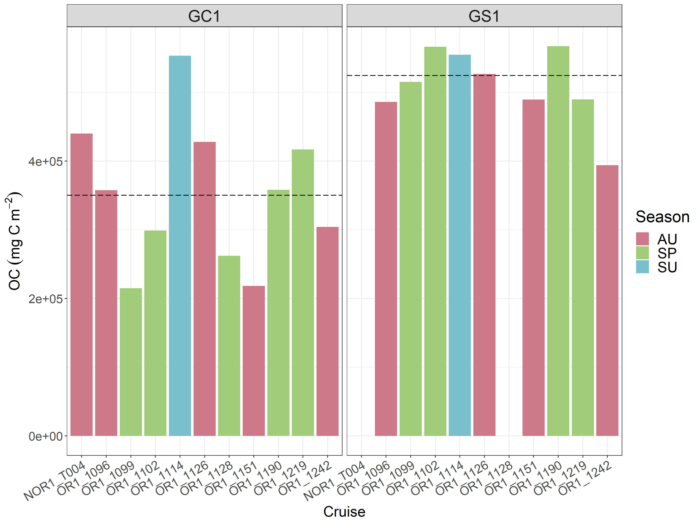
Sediment OC

Slide 11
Sediment_ statistics(OC)
One-way ANOVA
Source | Df | Sum of squares |  | Mean squares | F-value | Pr (>F)
Season | 2 | 3.880e+10 |  | 1.940e+10 | 1.505 | 0.25
Residuals | 17 | 2.191e+11 |  | 1.289e+10
Welch Two Sample t-test
 | Df |  | GC1 Mean | GS1 Mean | t | p-value
 | 15.603 |  | 350270.0 | 509952.4 | -4.4109 | 0.0004626

Slide 12
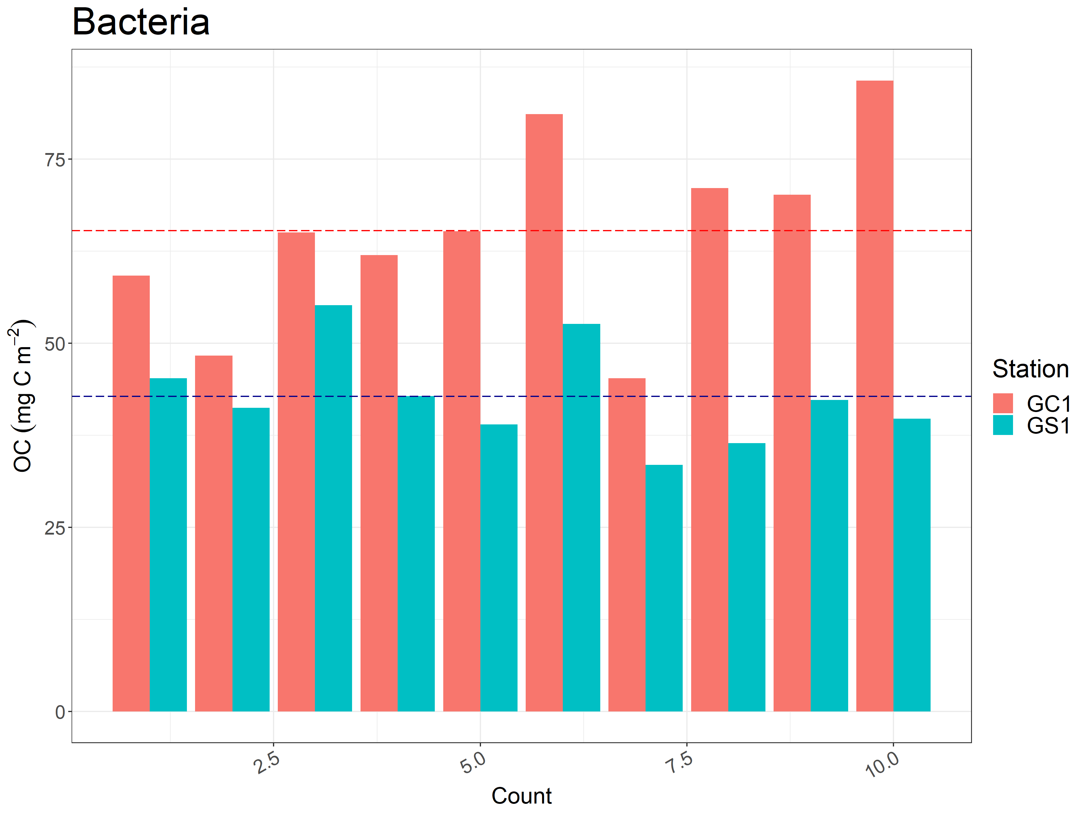
Anova_seasonal difference?
Bacteria

Slide 13
Bacteria_ statistics(OC)
Welch Two Sample t-test
 | Df | GC1 Mean | GS1 Mean | t | p-value
 | 13.677 | 65.30876 | 42.80281 | 4.9356 | 0.0002347

Slide 14
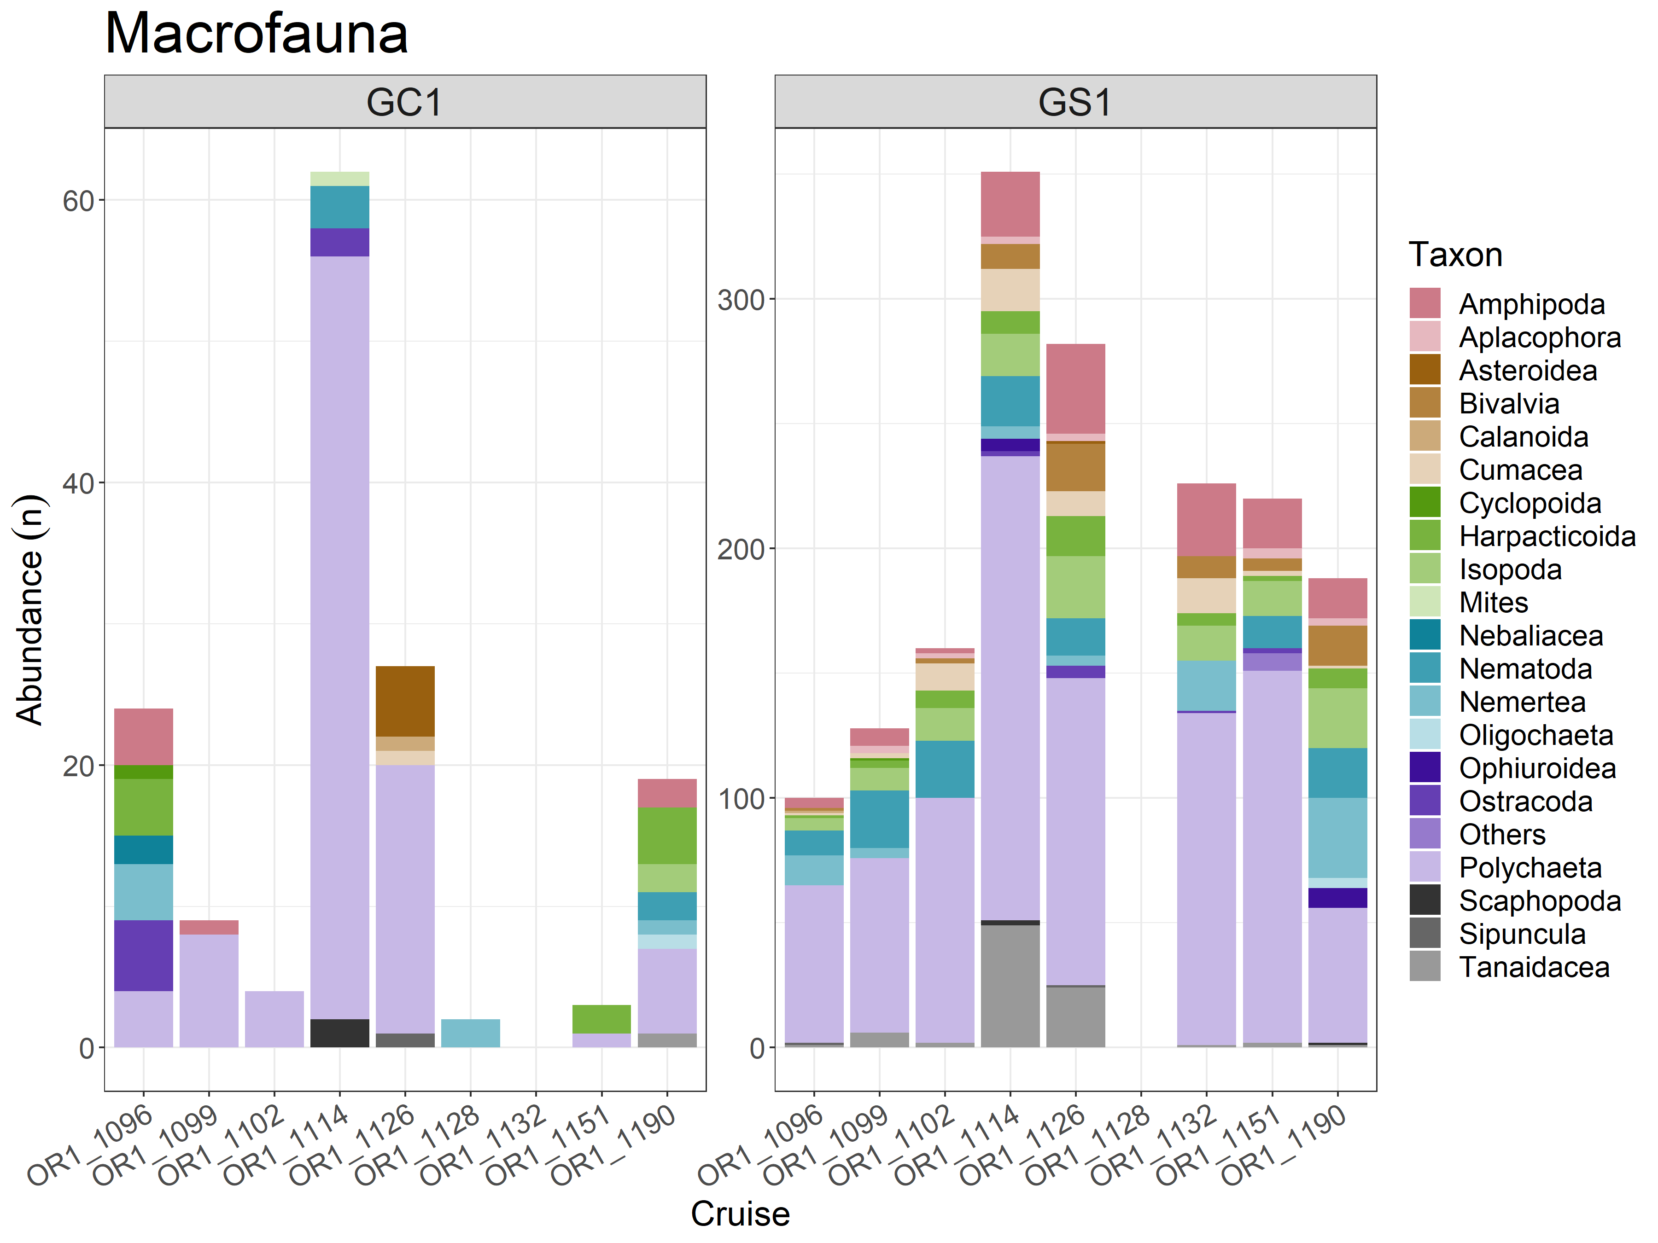
Macrofauna_abundance

Slide 15
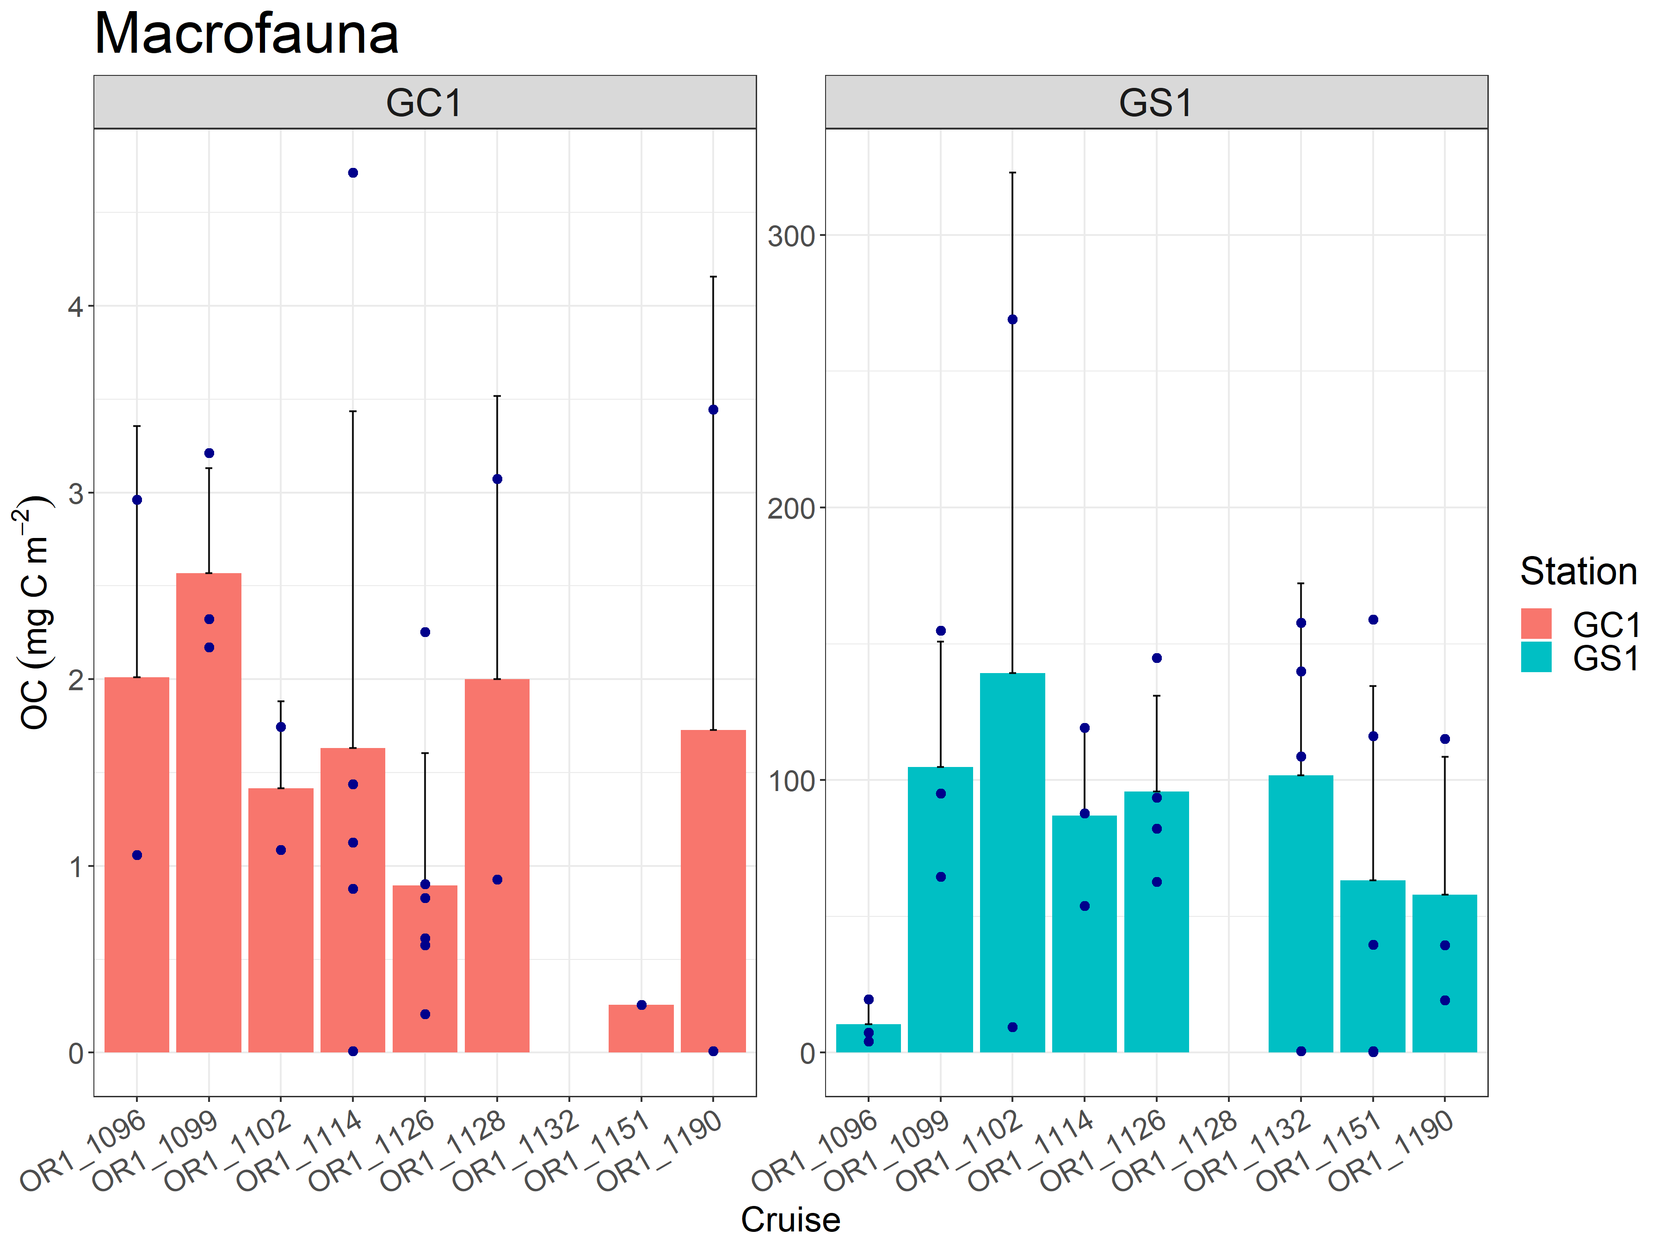
Macrofauna

Slide 16
Macrofauna_ statistics(OC)
One-way ANOVA
Station | Source | Df | Sum of squares | Mean squares | F-value | Pr (>F)
GC1 | Season | 2 | 0.0002926 | 0.0001463 | 1.268 | 0.303
 | Residuals | 20 | 0.0023074 | 0.0001154
Kruskal-Wallis rank sum test
Station | Source | Df | Kruskal-Wallis chi-squared |  |  | P-value
GS1 | Season | 2 | 1.6098 |  |  | 0.4471
Wilcoxon rank sum exact test
 | Source | W |  |  |  | P-value
 | Habitat | 55 |  |  |  | <0.0001

Slide 17
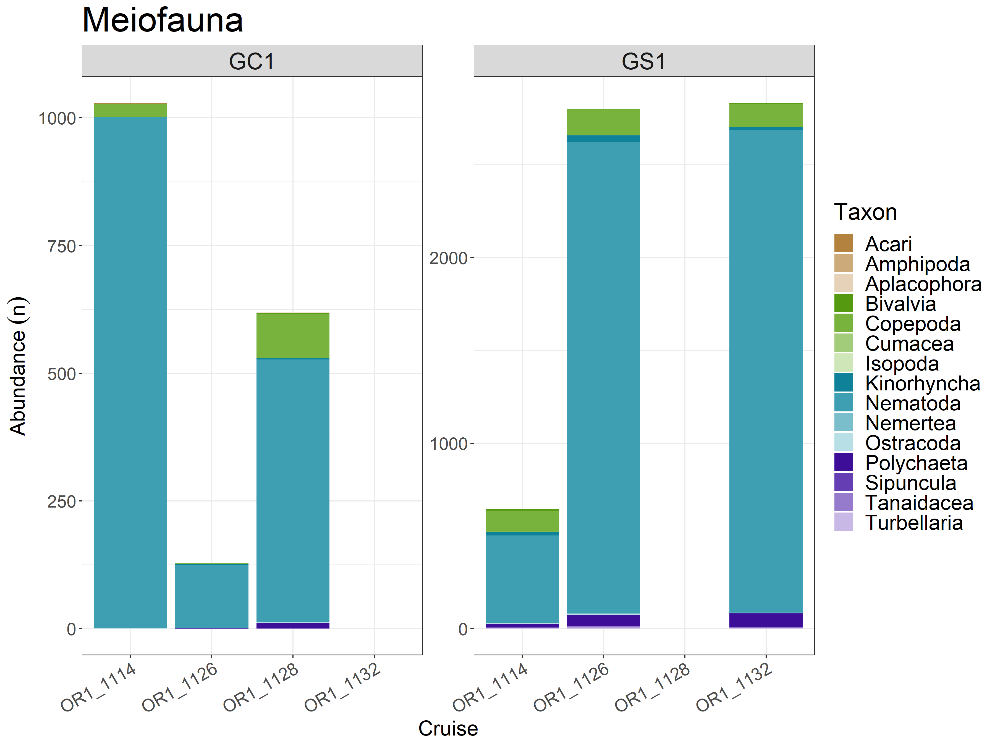
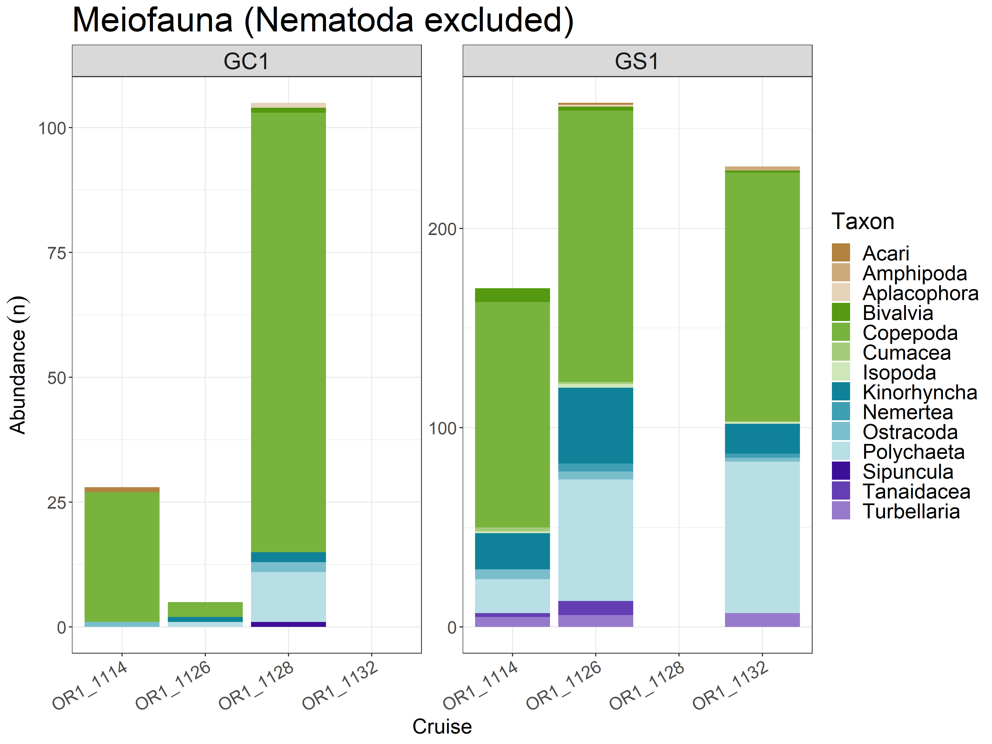
Meiofauna_abundance

Slide 18
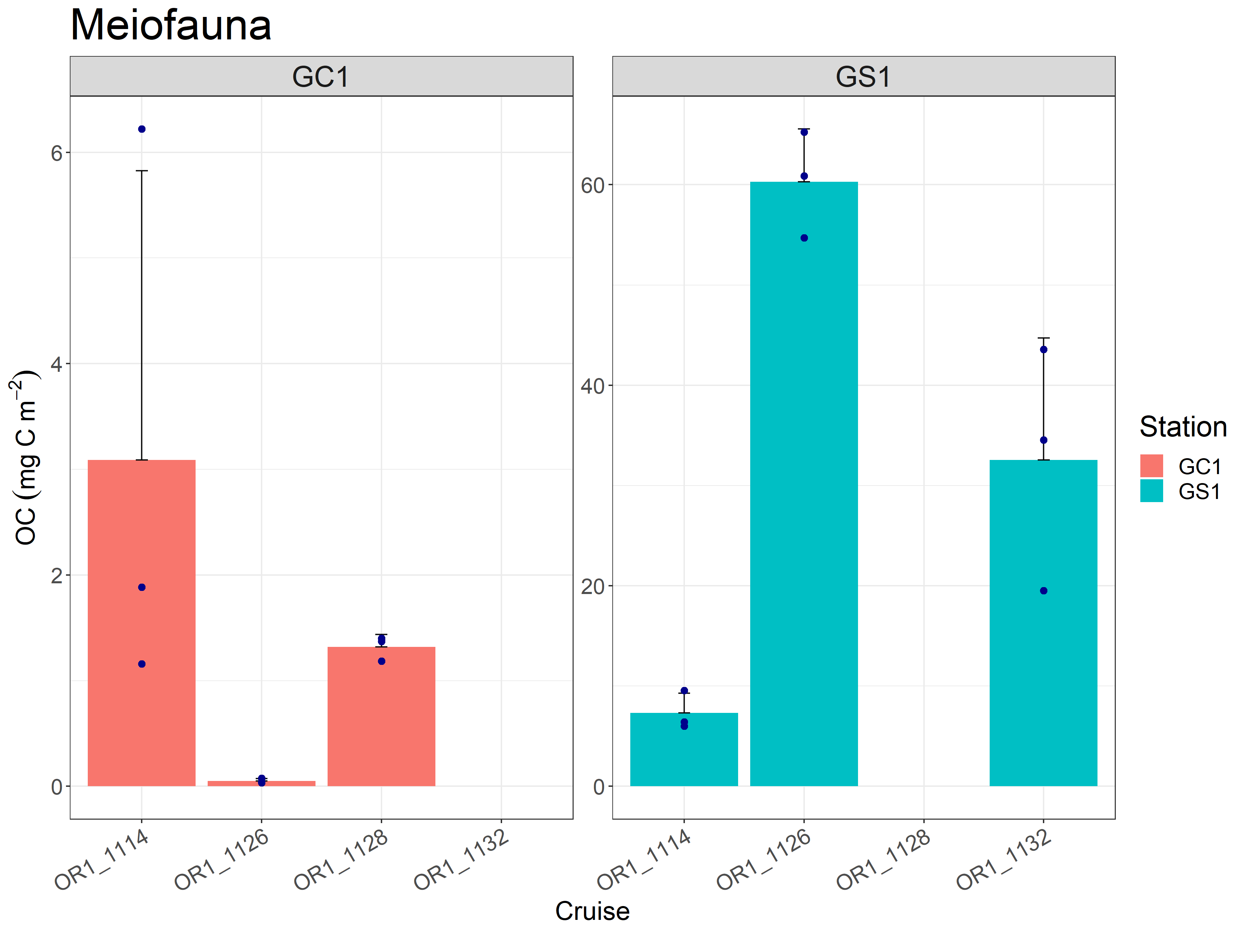
Meiofauna_biomass

Slide 19
Meiofauna_statistics (OC)
Kruskal-Wallis rank sum test
Station |  | Source |  | Df | Kruskal-Wallis chi-squared |  |  |  |  |  |  | P-value
GC1 |  | Season |  | 2 | 5.6 |  |  |  |  |  |  | 0.06081
One-way ANOVA
Station |  | Source |  | Df | Sum of squares |  | Mean squares |  | F-value |  |  | Pr (>F)
GS1 |  | Season |  | 2 | 4208 |  | 2103.9 |  | 35.12 |  |  | 0.000488
 |  | Residuals |  | 6 | 359 |  | 59.9
Tukey multiple comparisons of means (95% family-wise confidence level)
Fit: aov(formula = OC ~ Season, data = GS1)
 | Season |  | diff |  |  | lwr |  | upr |  | p adj
 | SP-AU |  | -27.72138 |  |  | -47.11245 |  | -8.330313 |  | 0.0109958
 | SU-AU |  | -52.94432 |  |  | -72.33539 |  | -33.553251 |  | 0.0003863
 | SU-SP |  | -25.22294 |  |  | -44.61401 |  | -5.831869 |  | 0.0169050
Wilcoxon rank sum exact test
Source |  |  | W |  |  |  |  |  |  |  | P-value
Habitat |  |  | 1 |  |  |  |  |  |  |  | <0.0001

Slide 20
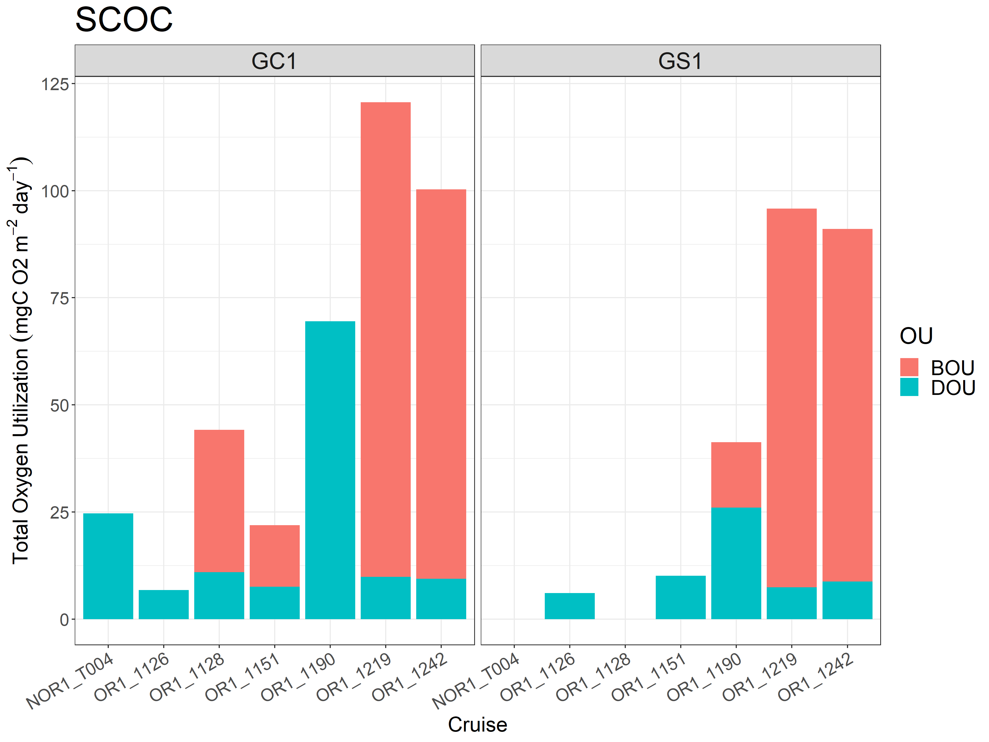
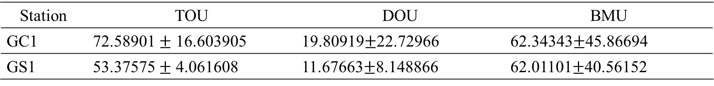
SCOC
Station | TOU | DOU | BMU
GC1 | 72.58901 $±$ 16.603905 | 19.80919$±$22.72966 | 62.34343$±$45.86694
GS1 | 53.37575 $±$ 4.061608 | 11.67663$±$8.148866 | 62.01101$±$40.56152

Slide 21
Welch Two Sample t-test
OU | Df | GC1 Mean |  | GS1 Mean | t | p-value | Df
TOU | 24.612 | 69.95451 |  | 52.03684 | 1.6779 | 0.106 | 13.677
Wilcoxon rank sum exact test
OU | Source |  | W |  |  |  | P-value
DOU | Habitat |  | 658 |  |  |  | 0.0175

Slide 22
A table for turnover rate

Slide 23
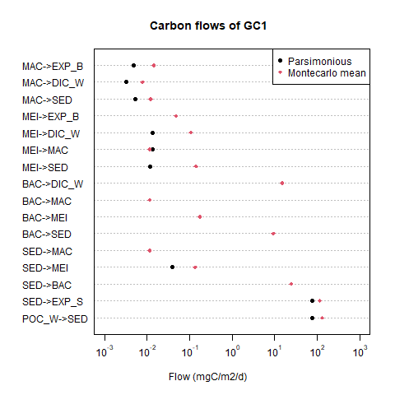
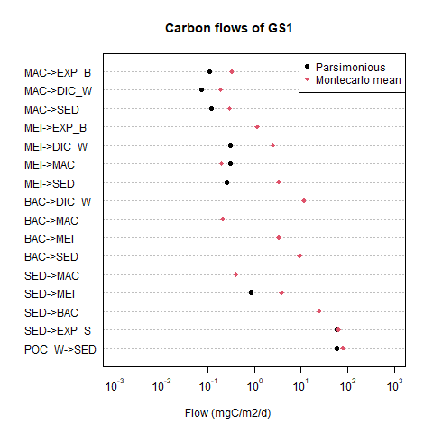

Slide 25
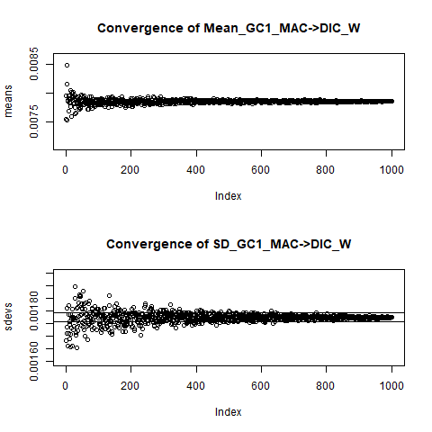
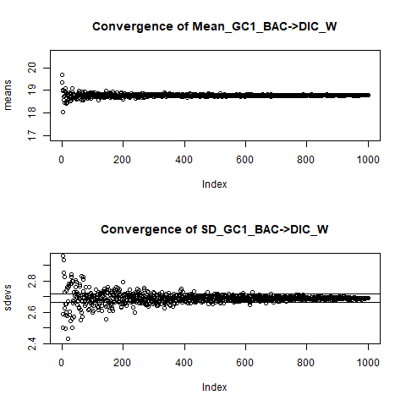
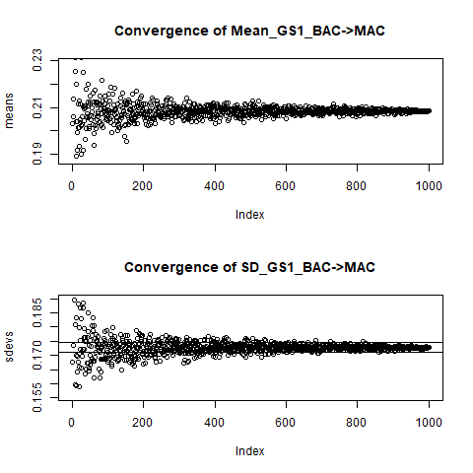

Slide 26
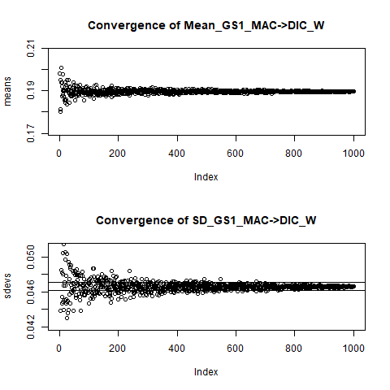
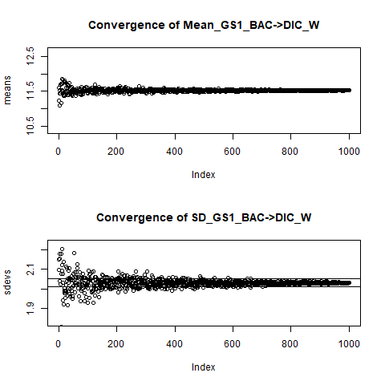
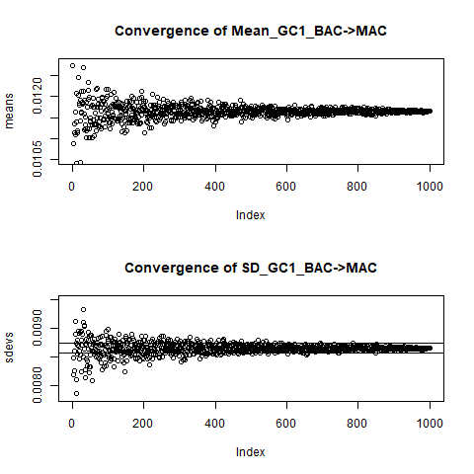

Slide 27
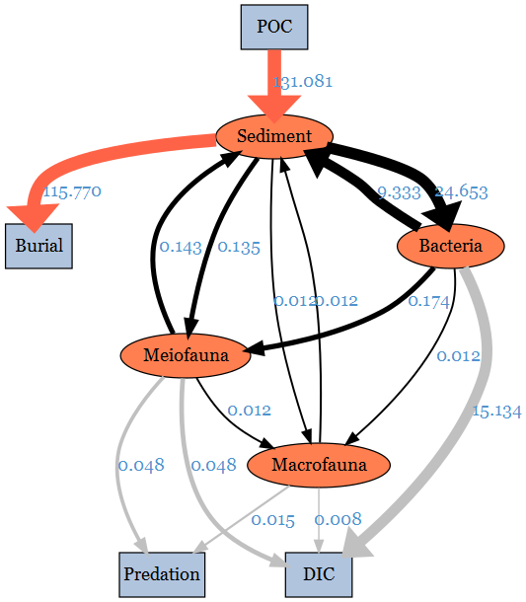

Slide 28
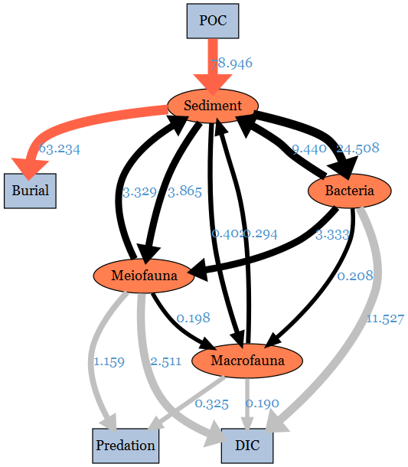

Slide 29
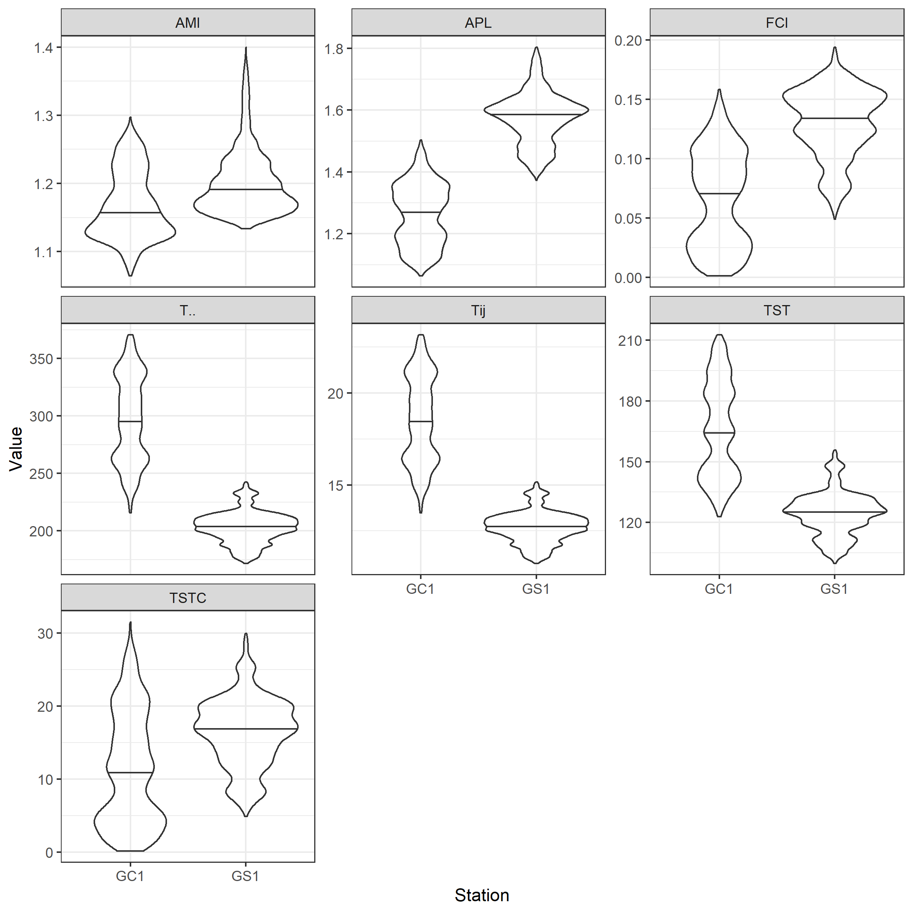

Slide 30
把model的POC改成TOC (=POC+DOC)
文獻中POC (53多)不夠用可能是
-因為文獻只考慮POC忽略DOC才會是細菌首先用掉的
-忽略了直接沉降的chla (去看文獻裡C來源)

