Slide 1
GPSC_LIM food web
Part 3: Network Indices

Slide 2
Network Indices
To better understand the structural properties and transformations that occur in ecosystems from the micro- to the macro-scopic level
A robust estimators of food web functioning, even in the face of inherent uncertainty in the exact value of food web flows
The R-package NetIndices (Kones, Soetaert & van Oevelen, 2009) can be used to estimate network indices

Slide 3
General idea to calculate network indices
j
Get solutions of flows value in the food web
Turn it into a matrix in the form:
Flow: i → j
predefined
With a value (or 0 = no flow)
Solutions from Parsimonious/LA
Define some compartment as:
Import
Export/ Dissipation: export(=usable, e.g. OC); dissipation(=unusable, e.g. IC)
Dead
！ These external compartments which function as in/output for the food web, are often big and vague compartments that are not quantified
Select which index to calculate
The R-package NetIndices (Kones, Soetaert & van Oevelen, 2009)
 | Compartment 1 | Compartment 2 | …
Compartment 1 | 0 or flow value | 0 or flow value | …
Compartment 2 | 0 or flow value | 0 or flow value | …
… | … | … | …
i

Slide 4
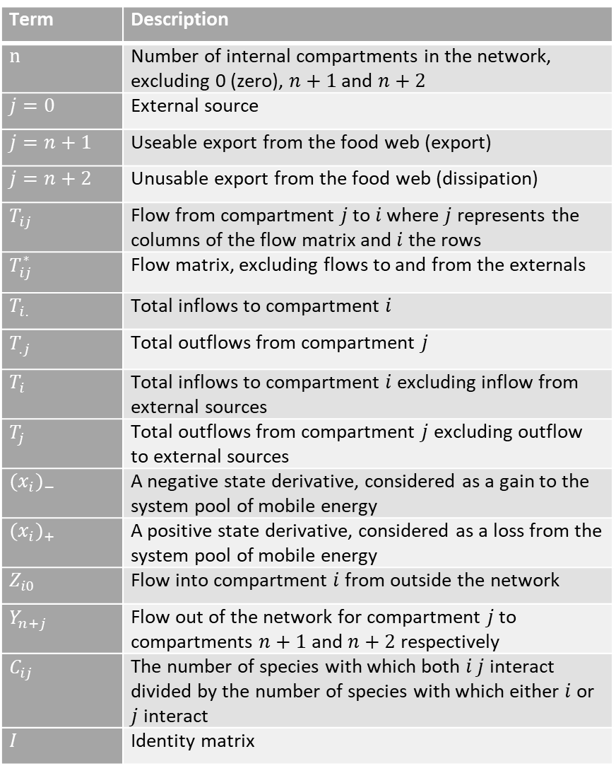
Term | Description
$n$ | Number of internal compartments in the network, excluding 0 (zero), $n+1$ and $n+2$
$j=0$ | External source
$j=n+1$ | Useable export from the food web (export)
$j=n+2$ | Unusable export from the food web (dissipation)
$T_{ij}$ | Flow from compartment $j$ to $i$ where $j$ represents the columns of the flow matrix and $i$ the rows
$T_{ij}^{∗}$ | Flow matrix, excluding flows to and from the externals
$T_{i.}$ | Total inflows to compartment $i$
$T_{.j}$ | Total outflows from compartment $j$
$T_{i}$ | Total inflows to compartment $i$ excluding inflow from external sources
$T_{j}$ | Total outflows from compartment $j$ excluding outflow to external sources
${(x_{i})}_{−}$ | A negative state derivative, considered as a gain to the system pool of mobile energy
${(x_{i})}_{+}$ | A positive state derivative, considered as a loss from the system pool of mobile energy
$Z_{i0}$ | Flow into compartment $i$ from outside the network
$Y_{n+j}$ | Flow out of the network for compartment $j$ to compartments $n+1$ and $n+2$ respectively
$C_{ij}$ | The number of species with which both $i$ $j$ interact divided by the number of species with which either $i$ or $j$ interact
$I$ | Identity matrix

Slide 5
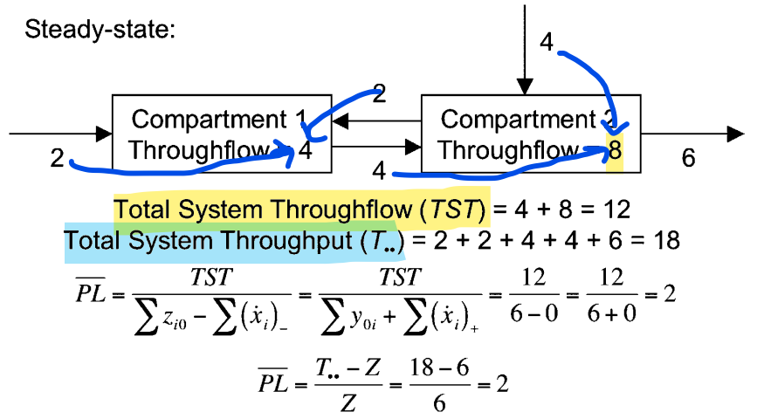
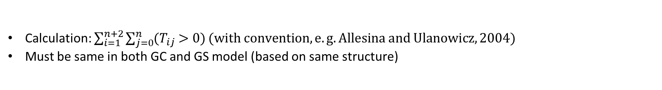
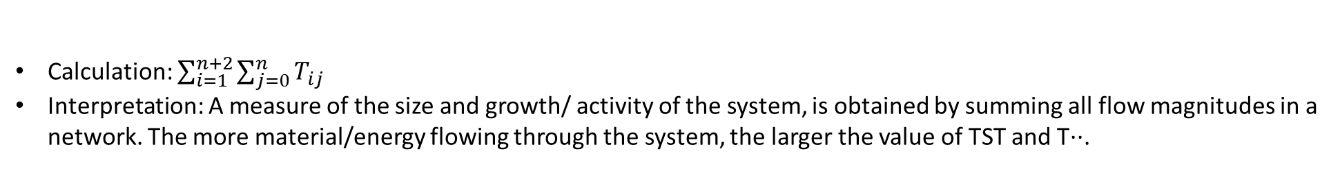
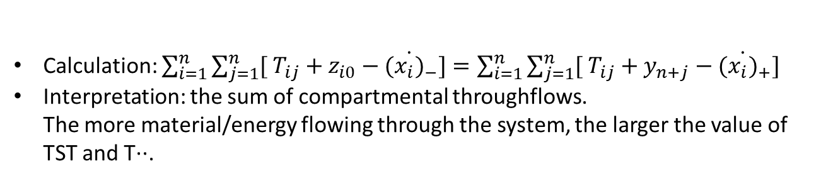
General indices:
Total system throughput (T..)
Calculation: $\sum_{i=1}^{n+2}{\sum_{j=0}^{n}{T_{ij}}}$
Interpretation: A measure of the size and growth/ activity of the system, is obtained by summing all flow magnitudes in a network. The more material/energy flowing through the system, the larger the value of TST and T··.
Total system throughflow (TST)
Calculation: $\sum_{i=1}^{n}{\sum_{j=1}^{n}{[ T_{ij}+z_{i0}−{(\dot{x_{i})}}_{−}}]=\sum_{i=1}^{n}{\sum_{j=1}^{n}{[ T_{ij}+y_{n+j}−{(\dot{x_{i})}}_{+}}] }}$
Interpretation: the sum of compartmental throughflows. The more material/energy flowing through the system, the larger the value of TST and T··.
Number of links (Ltot)
Calculation: $\sum_{i=1}^{n+2}{\sum_{j=0}^{n}{{(T}_{ij} >0)}}(with convention,e.g. Allesina and Ulanowicz, 2004)$
Must be same in both GC and GS model (based on same structure)
Average link weight (Tij)
Calculation:$T../L_{tot}$
Interpretation:

Slide 6
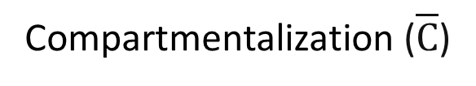
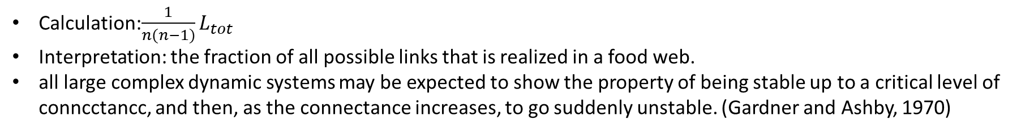
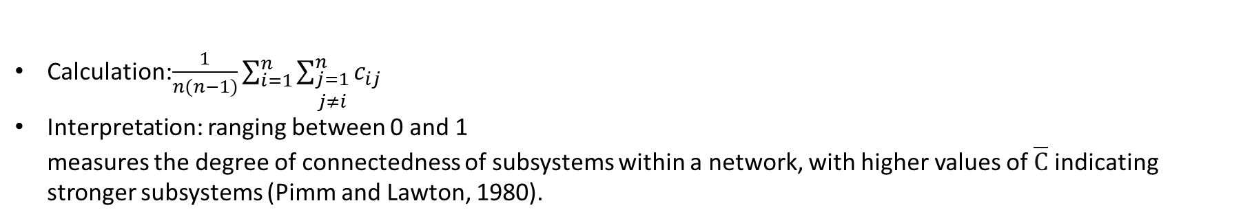
General indices:
Connectance (C)
Calculation:$\frac{1}{n(n−1)}L_{tot}$
Interpretation: the fraction of all possible links that is realized in a food web.
all large complex dynamic systems may be expected to show the property of being stable up to a critical level of conncctancc, and then, as the connectance increases, to go suddenly unstable. (Gardner and Ashby, 1970)
Compartmentalization ($\overline{C}$)
Calculation:$\frac{1}{n(n−1)}\sum_{i=1}^{n}{\sum_{\begin{aligned}j=1 \\ j≠i\end{aligned}}^{n}{c_{ij}}}$
Interpretation: ranging between 0 and 1 measures the degree of connectedness of subsystems within a network, with higher values of $\overline{C}$ indicating stronger subsystems (Pimm and Lawton, 1980).

Slide 7
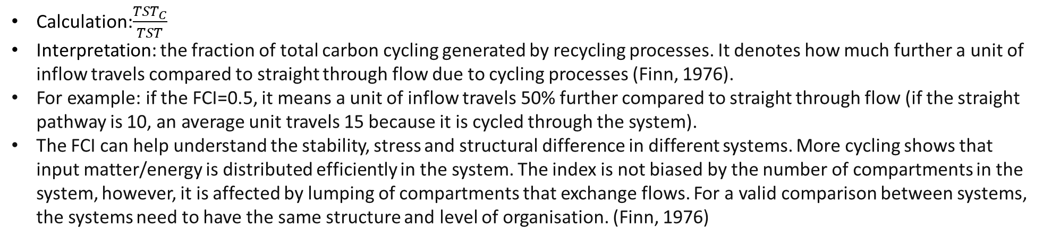
Pathway analysis
The average path length (PL)
Calculation:$\frac{TST}{\sum{z_{i0}−\sum{{(\dot{x_{i})}}_{−}}}}=\frac{TST}{\sum{y_{n+j}+\sum{{(\dot{x_{i})}}_{+}}}}$
Interpretation: mean number of compartments through which each inflow passes, weighted by the sizes of the inflows
Total system of cycled throughflow (TSTc)
Calculation:$\sum_{j=1}^{n}{\left(1−\frac{1}{q_{ij}}\right)T_{j}，where Q={(I−G′)}^{−1}，where G^{′}=[T_{ji}^{∗}/max⁡(T_{i},T_{j})]}$
Interpretation:
Finn Cycling index (FCI)
Calculation:$\frac{{TST}_{C}}{TST}$
Interpretation: the fraction of total carbon cycling generated by recycling processes. It denotes how much further a unit of inflow travels compared to straight through flow due to cycling processes (Finn, 1976).
For example: if the FCI=0.5, it means a unit of inflow travels 50% further compared to straight through flow (if the straight pathway is 10, an average unit travels 15 because it is cycled through the system).
The FCI can help understand the stability, stress and structural difference in different systems. More cycling shows that input matter/energy is distributed efficiently in the system. The index is not biased by the number of compartments in the system, however, it is affected by lumping of compartments that exchange flows. For a valid comparison between systems, the systems need to have the same structure and level of organisation. (Finn, 1976)

Slide 8
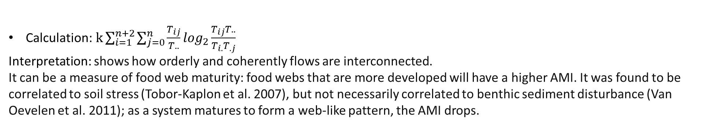
Network uncertainty
Average mutual information (AMI)
Calculation:$k\sum_{i=1}^{n+2}{\sum_{j=0}^{n}{\frac{T_{ij}}{T..}}}\log_{2}\frac{T_{ij}T..}{T_{i.}T_{.j}}$
Interpretation: shows how orderly and coherently flows are interconnected.
It can be a measure of food web maturity: food webs that are more developed will have a higher AMI. It was found to be correlated to soil stress (Tobor-Kaplon et al. 2007), but not necessarily correlated to benthic sediment disturbance (Van Oevelen et al. 2011); as a system matures to form a web-like pattern, the AMI drops.
Latham and Scully (2002)

Slide 9
The topological size and complexity:
the number of links (L),
linkage density (LD): the average number of links per compartments
connectance (C): the proportion of realised links (Gardner and Ashby, 1970).
Trophic level (TL): signifies the position of a trophic compartment in the food chain and is related to resource availability and transfer efficiency (Post, 2002).
C cycling:
total system throughput (T..): the sum of all C flows in the food web, reflecting the ‘ecological’ size of the system (Latham, 2006)
Finn’s Cycling Index (FCI): the proportion of C cycling due to recycling processes, reflecting structural differences and the efficiency of C usage in a system (Finn, 1976).
Network indices are robust to a fair extent of variation in input data and network structure (Kones et al., 2009, Heymans et al., 2014). This underlines their suitability for analysing models that cannot be fully parameterized with empirical data, like the food-web model from the remote DISCOL experimental area where direct measurements are limited.

Slide 10
After calculating the network indices
What do these network features tell you about the ecological system?
Is the interpretation of your measures dependent on the quality of your data?
→ How trustworthy and robust are the indices you calculated?

