Slide 2
Schematic food web (simplified)
det_w
doc_w
dic_w
Compartment
det: detritus in the sediment
doc: dissolved organic carbon
bac: bacteria
meio: meiofauna
mac: macrobenthos
det_w: detritus in the water column
dic_w: dissolved inorganic carbon in the water column
doc_w:dissolved organic carbon in the water column
exp:export (e.g., predation by megabenthos)
Internal flows
exchange with external
det
doc
meio
exp
bac
mac

Slide 3
Schematic food web of the (simplified)
det_w
doc_w
dic_w
f1
f5
f6
Detritus from the water column (det_w) adds to the sedimentary detritus compartment (det, f1)
Detritus is taken up directly by meiofauna (meio, f9) and macrobenthos (mac, f7), and dissolves to become dissolved organic carbon (doc, f2)
Part of the dissolved organic carbon is taken up by bacteria (bac, f3), and the other part effluxes to the water column (doc_w, f5). Viral lysis of bacteria is implemented as a flux from bacteria to DOC (f4)
Bacteria are grazed upon by meiofauna (f11) and macrobenthos(f12)
Respiration by the biotic compartments induces a flux to the dissolved inorganic carbon pool in the water column (dic_w; f6+f14+f15).
Meiofauna and macrobenthos produce feces that add to the detritus compartment (f10, f8).
Meiofauna are preyed upon by macrobenthos (f13).
Finally, meiofauna and macrobenthos are preyed upon by megabenthic predators(considered as export fluxes from the food web) (f16, f17).
f15
det
f14
f10
f2
f9
f7
doc
meio
f16
exp
f4
f3
f13
f17
f11
f8
bac
mac
f12

Slide 4
Schematic food web of the (simplified)
det_w
doc_w
dic_w
f1
f5
f6
f15
Compartment | Standing stock (mgC m⁻²) | Reference
Detritus
Dissolved organic carbon
Bacteria
Meiofauna
Macrobenthos
det
f14
f10
f2
f9
f7
doc
nem
f16
exp
f4
f3
f13
f17
f11
f8
bac
mac
f12

Slide 5
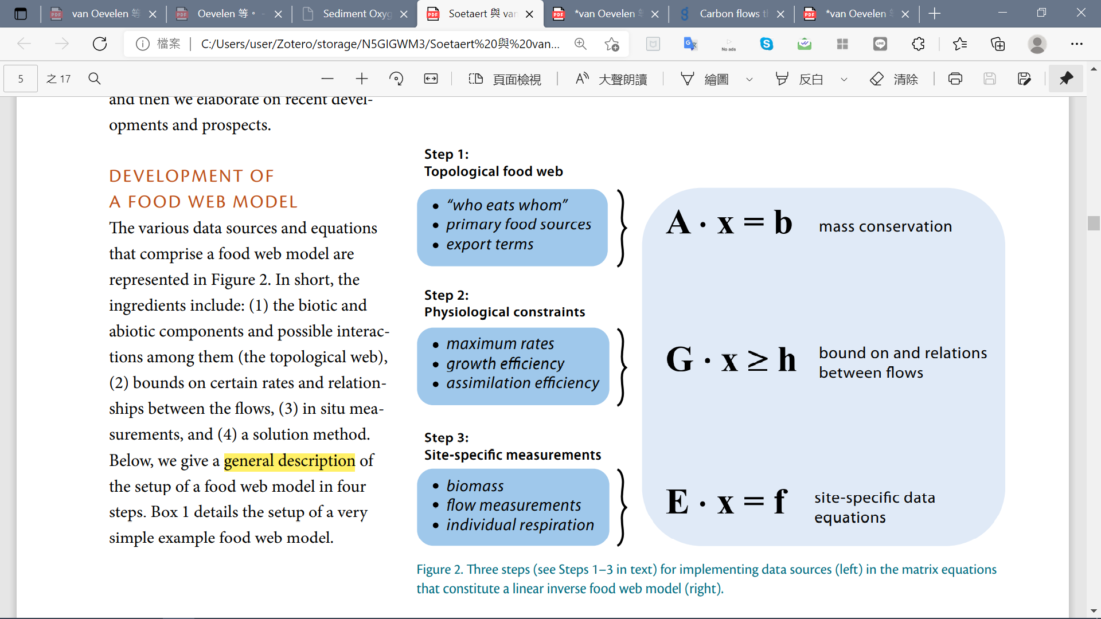
Development of a linear inverse model

Slide 6
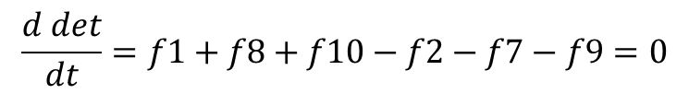
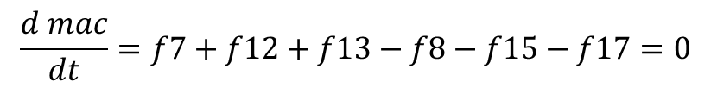
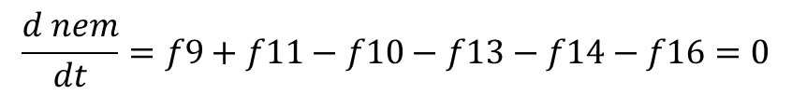
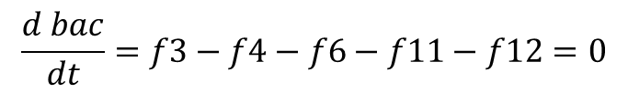
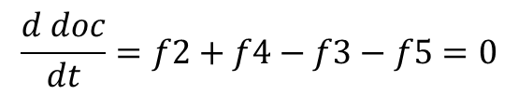
Development of a linear inverse model
det_w
doc_w
dic_w
f1
f5
f6
f15
det
f14
$$\frac{d det}{dt}=f1+f8+f10−f2−f7−f9=0$$
f10
f2
f9
f7
$$\frac{d doc}{dt}=f2+f4−f3−f5=0$$
doc
nem
f16
exp
$$\frac{d bac}{dt}=f3−f4−f6−f11−f12=0$$
f4
f3
f13
f17
f11
f8
$$\frac{d nem}{dt}=f9+f11−f10−f13−f14−f16=0$$
bac
mac
f12
$$\frac{d mac}{dt}=f7+f12+f13−f8−f15−f17=0$$
All mass balances are assumed to be in steady state

Slide 7






Development of a linear inverse model
$$\frac{d det}{dt}=f1+f8+f10−f2−f7−f9=0$$
$$\frac{d doc}{dt}=f2+f4−f3−f5=0$$
$$\frac{d bac}{dt}=f3−f4−f6−f11−f12=0$$
x
$$\frac{d nem}{dt}=f9+f11−f10−f13−f14−f16=0$$
$$\left[\begin{matrix}\begin{matrix}\begin{matrix}\begin{aligned}1 \\ 0 \\ 0 \\ 0 \\ 0\end{aligned} & \begin{aligned}−1 \\ 1 \\ 0 \\ 0 \\ 0\end{aligned} & \begin{aligned}0 \\ −1 \\ 1 \\ 0 \\ 0\end{aligned}\end{matrix} & \begin{aligned}0 \\ 1 \\ −1 \\ 0 \\ 0\end{aligned} & \begin{aligned}0 \\ −1 \\ 0 \\ 0 \\ 0\end{aligned}\end{matrix} & \begin{matrix}\begin{aligned}0 \\ 0 \\ −1 \\ 0 \\ 0\end{aligned} & \begin{aligned}−1 \\ 0 \\ 0 \\ 0 \\ 1\end{aligned} & \begin{aligned}1 \\ 0 \\ 0 \\ 0 \\ −1\end{aligned}\end{matrix} & \begin{matrix}\begin{aligned}−1 \\ 0 \\ 0 \\ 1 \\ 0\end{aligned} & \begin{aligned}1 \\ 0 \\ 0 \\ −1 \\ 0\end{aligned} & \begin{matrix}\begin{aligned}0 \\ 0 \\ −1 \\ 1 \\ 0\end{aligned} & \begin{aligned}0 \\ 0 \\ −1 \\ 0 \\ 1\end{aligned} & \begin{matrix}\begin{aligned}0 \\ 0 \\ 0 \\ −1 \\ 1\end{aligned} & \begin{aligned}0 \\ 0 \\ 0 \\ −1 \\ 0\end{aligned} & \begin{matrix}\begin{aligned}0 \\ 0 \\ 0 \\ 0 \\ −1\end{aligned} & \begin{aligned}0 \\ 0 \\ 0 \\ −1 \\ 0\end{aligned} & \begin{aligned}0 \\ 0 \\ 0 \\ 0 \\ −1\end{aligned}\end{matrix}\end{matrix}\end{matrix}\end{matrix}\end{matrix}\right]∙\left[\begin{aligned}f1 \\ f2 \\ f3 \\ f4 \\ f5 \\ f6 \\ f7 \\ f8 \\ f9 \\ f10 \\ f11 \\ f12 \\ f13 \\ f14 \\ f15 \\ f16 \\ f17\end{aligned}\right]=0$$
$$\frac{d mac}{dt}=f7+f12+f13−f8−f15−f17=0$$
A
b
All mass balances are assumed to be in steady state (i.e. b=0)

