Slide 1
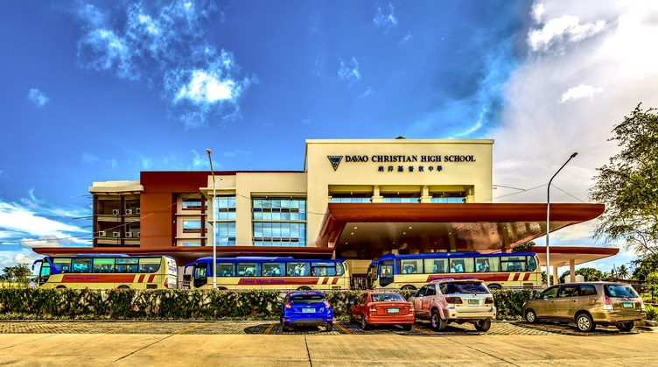
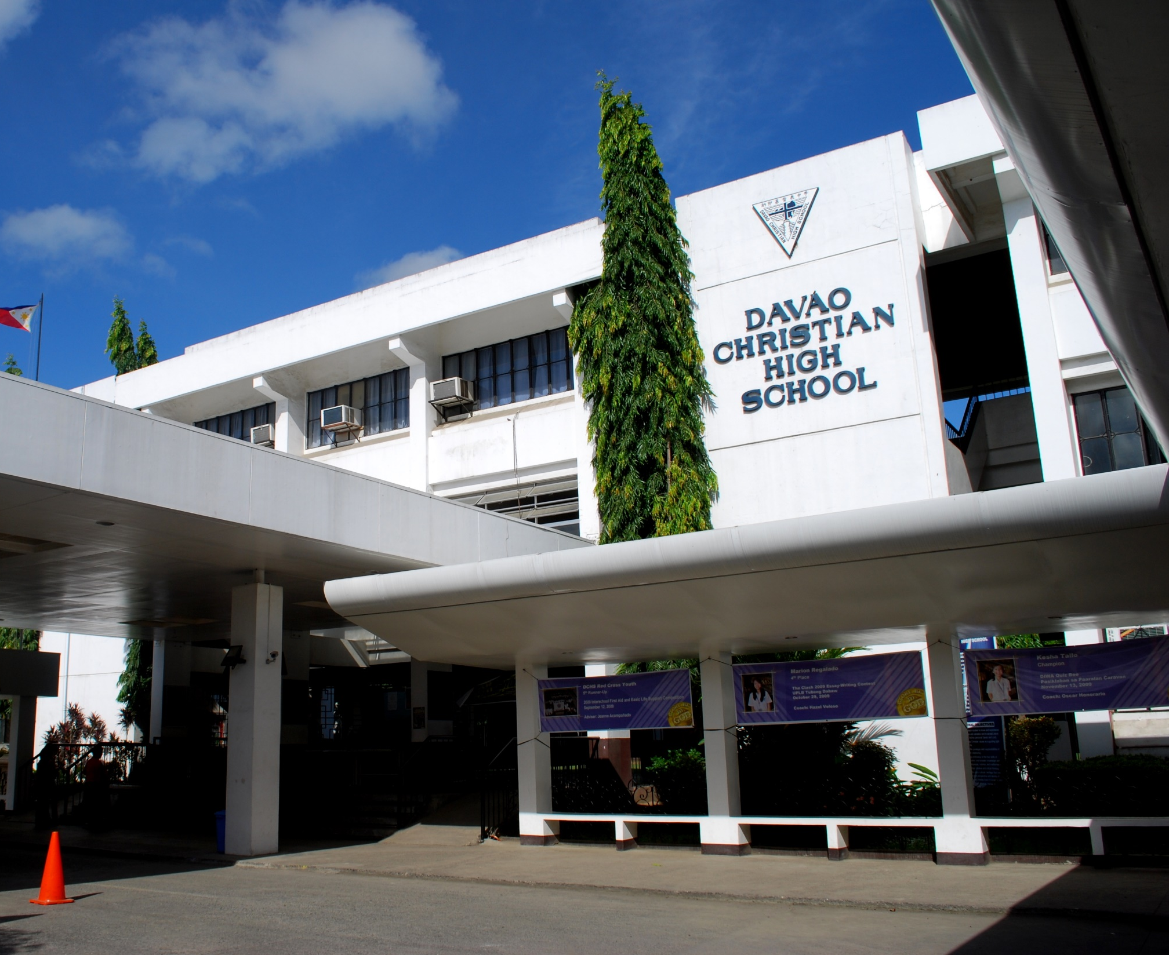
DIFFERENT CAMPUSES | SAME EMPHASES

Slide 2

DIFFERENT CAMPUSES, THE SAME EMPHASES
V. MAPA CAMPUS
Preschool
Elementary
Junior High School
Senior High School
C.P. GARCIA CAMPUS
Preschool
Elementary
Grade 7

