Slide 1


Slide 2
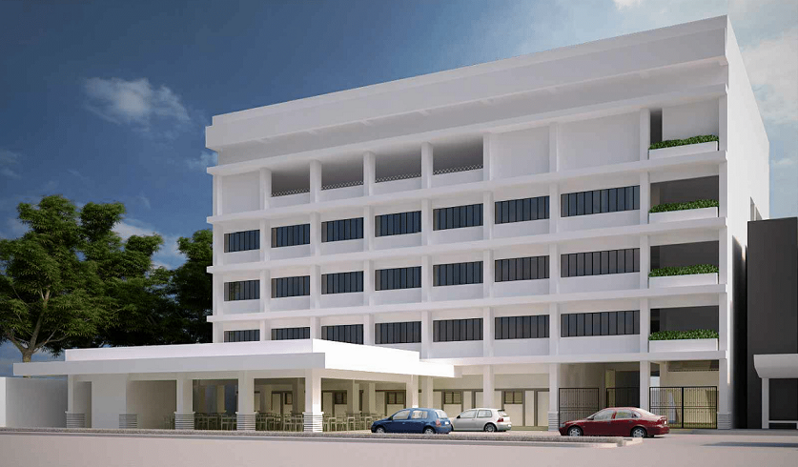

DAVAO CHRISTIAN HIGH SCHOOL
SENIOR HIGH SCHOOL BUILDING
Architect’s Perspective
FEATURES:
1st Floor: Canteen
2nd - 4th Floor: Classrooms, Laboratories, & Offices
5th Floor: Open Roof Deck
ACCEPTING DONATIONS

