Slide 1
Affine transformation
林鼎然 製作
1

Slide 2
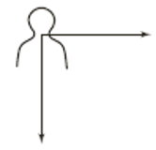
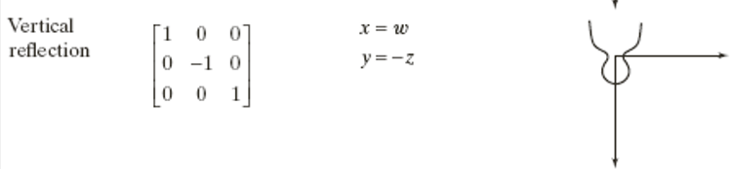


2D signal Affine transform: Reflection
(w,z)是舊訊號的某點位置，(x,y)是新訊號對應(w,z)的位置
$$, T=\left[\begin{matrix}a_{11} & a_{12} & 0 \\ a_{21} & a_{22} & 0 \\ b_{1} & b_{2} & 1\end{matrix}\right]$$
$$\left[x y 1\right]=[w z 1]T$$
寫上新舊數學座標關係式
帶入特例的T
帶入特例座標 (手寫p1-2)
學生練習

Slide 3
Matlab coding (上次的code)
clear all
close all
% horizontal reflection (try other factor)
T=[1 0 0;
0 -1 0;
0 0 1];
% vertical reflection (try other factor)
T=[-1 0 0;
0 1 0;
0 0 1];
% horizontal and vertical reflection (try other factor)
T=[-1 0 0;
0 -1 0;
0 0 1];
A=imread('cameraman.tif');
clear A_new;
for i=1:size(A,1)
for j=1:size(A,2)
orig_coord=[i j];
new_coord_1=[orig_coord 1]*T;
new_coord=new_coord_1(1:2);
A_new(round(new_coord(1)),round(new_coord(2)))=A(i,j);
end
end
figure; imshow(A)
hold on
plot([257 257], [0 257], 'r', 'LineWidth', 2)
hold off
@注意負座標
@手寫畫欲改之座標偏移

Slide 4
Matlab coding (請嘗試其他倍數參數、正負號、xy軸同時組合)
clear all
close all
% horizontal reflection (try other factor)
T=[1 0 0;
0 -1 0;
0 0 1];
% vertical reflection (try other factor)
T=[-1 0 0;
0 1 0;
0 0 1];
% horizontal and vertical reflection (try other factor)
T=[-1 0 0;
0 -1 0;
0 0 1];
A=imread('cameraman.tif');
clear A_new;
for i=1:size(A,1)
for j=1:size(A,2)
orig_coord=[i j];
new_coord_1=[orig_coord 1]*T;
new_coord=new_coord_1(1:2);
A_new(round(new_coord(1)+257),round(new_coord(2)+257))=A(i,j);
end
end
figure; imshow(A)
hold on
plot([257 257], [0 257], 'r', 'LineWidth', 2)
hold off
figure; imshow(A_new)
hold on
@水平翻，垂直翻，兩者翻。

Slide 5
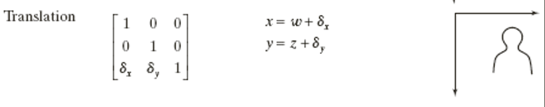
2D signal Affine transform: Translation (shift)
(w,z)是舊訊號的某點位置，(x,y)是新訊號對應(w,z)的位置
$$, T=\left[\begin{matrix}a_{11} & a_{12} & 0 \\ a_{21} & a_{22} & 0 \\ b_{1} & b_{2} & 1\end{matrix}\right]$$
$$\left[x y 1\right]=[w z 1]T$$
寫上新舊數學座標關係式
帶入特例的T
帶入特例座標 (手寫p3)
學生練習

Slide 6
Matlab coding (請嘗試其他倍數參數、正負號、xy軸同時組合)
clear all
close all
% Translation
T=[1 0 0;
0 1 0;
30 10 1];
% Translation
T=[1 0 0;
0 1 0;
15 -20 1];
A=imread('cameraman.tif');
clear A_new;
for i=1:size(A,1)
for j=1:size(A,2)
orig_coord=[i j];
new_coord_1=[orig_coord 1]*T;
new_coord=new_coord_1(1:2);
A_new(round(new_coord(1)+257),round(new_coord(2)+257))=A(i,j);
end
end
figure; imshow(A)
hold on
plot([257 257], [0 257], 'r', 'LineWidth', 2)
hold off
figure; imshow(A_new)
hold on
plot([257 257], [0 512], 'r', 'LineWidth', 2);
plot([0 512],[257 257], 'r', 'LineWidth', 2)
hold off
畫個基準，僅供參考

Slide 7
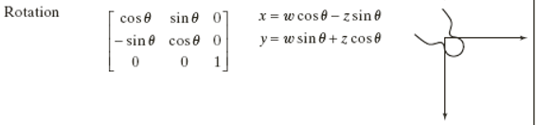
2D signal Affine transform: Rotation
(w,z)是舊訊號的某點位置，(x,y)是新訊號對應(w,z)的位置
$$, T=\left[\begin{matrix}a_{11} & a_{12} & 0 \\ a_{21} & a_{22} & 0 \\ b_{1} & b_{2} & 1\end{matrix}\right]$$
$$\left[x y 1\right]=[w z 1]T$$
1. Iphone旋轉
2. 先跑matlab，再推導
學生練習

Slide 8
Matlab coding (請嘗試其他倍數參數、正負號、xy軸同時組合)
clear all
close all
% Rotation
theta=pi/4;
T=[cos(theta) sin(theta) 0;
-sin(theta) cos(theta) 0;
0 0 1];
A=imread('cameraman.tif');
clear A_new;
for i=1:size(A,1)
for j=1:size(A,2)
orig_coord=[i j];
new_coord_1=[orig_coord 1]*T;
new_coord=new_coord_1(1:2);
% if(new_coord(1)>=1)&&(new_coord(2)>=1)
A_new(round(new_coord(1)+257),round(new_coord(2)+257))=A(i,j);
% end
end
end
figure; imshow(A)
hold on
plot([257 257], [0 257], 'r', 'LineWidth', 2)
hold off
figure; imshow(A_new)
hold on
plot([257 257], [0 512], 'r', 'LineWidth', 2);
plot([0 512],[257 257], 'r', 'LineWidth', 2)
hold off
@For迴圈內的平移效應可以融入到T的平移中!!!
@黑點，0對1，多對1b

Slide 9
EO1

Slide 10


2D signal Affine transform: Rotation
(w,z)是舊訊號的某點位置，(x,y)是新訊號對應(w,z)的位置
$$, T=\left[\begin{matrix}a_{11} & a_{12} & 0 \\ a_{21} & a_{22} & 0 \\ b_{1} & b_{2} & 1\end{matrix}\right]$$
$$\left[x y 1\right]=[w z 1]T$$
1. Iphone旋轉
2. 先跑matlab，再推導
寫上新舊數學座標關係式
帶入特例的T
帶入特例座標 (手寫p4)

Slide 11
學生練習時間
1. Try other factors
2. Combine all techniques
學生練習

Slide 12
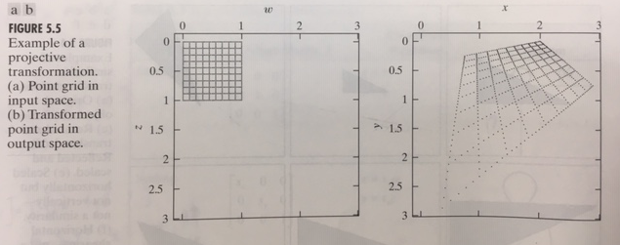
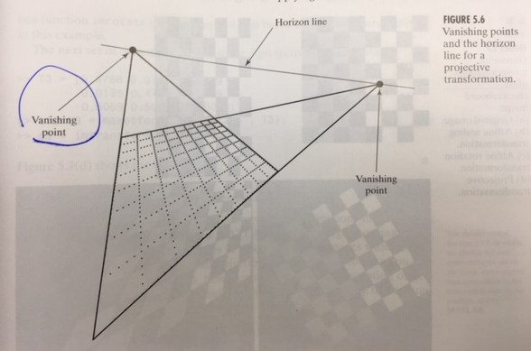


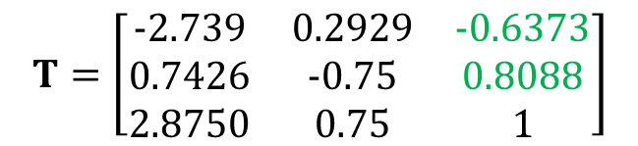
Projective transformation
例
$$, T=\left[\begin{matrix}a_{11} & a_{12} & a_{13} \\ a_{21} & a_{22} & a_{23} \\ b_{1} & b_{2} & 1\end{matrix}\right]$$
$$\left[x y h\right]=[w z 1]T$$
$$T=\left[\begin{matrix}−2.739 & 0.2929 & −0.6373 \\ 0.7426 & −0.75 & 0.8088 \\ 2.8750 & 0.75 & 1\end{matrix}\right]$$

Slide 13
Interpolation
林鼎然 製作
13

Slide 14
內插—interpolation —針對留空的點
Scaling
Shear (vertical)
Shear (horizontal)
Rotation

Slide 15
Scaling(請嘗試其他倍數參數、正負號、xy軸同時組合)
clear all
close all
% scaling (half size) (try other factor)
T=[0.5 0 0;
0 0.5 0;
0 0 1];
% scaling (double size) (try other factor)
T=[2 0 0;
0 2 0;
0 0 1];
% routine
A=imread('cameraman.tif');
clear A_new;
for i=1:size(A,1)
for j=1:size(A,2)
orig_coord=[i j];
new_coord_1=[orig_coord 1]*T;
new_coord=new_coord_1(1:2);
A_new(round(new_coord(1)),round(new_coord(2)))=A(i,j);
end
end
figure; imshow(A)
figure; imshow(A_new)

Slide 16
Shear (vertical)(請嘗試其他倍數參數、正負號、xy軸同時組合)
@注意出界
clear all
close all
% shear (vertical, right down) (try other factor)
T=[1 0 0;
0.5 1 0;
0 0 1];
% shear (vertical, right up) (try other factor)
T=[1 0 0;
-0.5 1 0;
0 0 1];
A=imread('cameraman.tif');
clear A_new;
for i=1:size(A,1)
for j=1:size(A,2)
orig_coord=[i j];
new_coord_1=[orig_coord 1]*T;
new_coord=new_coord_1(1:2);
if(new_coord(1)>=1)&&(new_coord(2)>=1)
A_new(round(new_coord(1)),round(new_coord(2)))=A(i,j);
end
end
end
figure; imshow(A)
figure; imshow(A_new)

Slide 17
Shear (horizontal)(請嘗試其他倍數參數、正負號、xy軸同時組合)
@注意出界
clear all
close all
% shear (horizontal, down right) (try other factor)
T=[1 0.5 0;
0 1 0;
0 0 1];
% shear (horizontal, down left) (try other factor)
T=[1 -0.5 0;
0 1 0;
0 0 1];
A=imread('cameraman.tif');
clear A_new;
for i=1:size(A,1)
for j=1:size(A,2)
orig_coord=[i j];
new_coord_1=[orig_coord 1]*T;
new_coord=new_coord_1(1:2);
if(new_coord(1)>=1)&&(new_coord(2)>=1)
A_new(round(new_coord(1)),round(new_coord(2)))=A(i,j);
end
end
end
figure; imshow(A)
figure; imshow(A_new)

Slide 18
Rotation(請嘗試其他倍數參數、正負號、xy軸同時組合)
clear all
close all
% Rotation
theta=pi/4;
T=[cos(theta) sin(theta) 0;
-sin(theta) cos(theta) 0;
0 0 1];
A=imread('cameraman.tif');
clear A_new;
for i=1:size(A,1)
for j=1:size(A,2)
orig_coord=[i j];
new_coord_1=[orig_coord 1]*T;
new_coord=new_coord_1(1:2);
% if(new_coord(1)>=1)&&(new_coord(2)>=1)
A_new(round(new_coord(1)+257),round(new_coord(2)+257))=A(i,j);
% end
end
end
figure; imshow(A)
hold on
plot([257 257], [0 257], 'r', 'LineWidth', 2)
hold off
figure; imshow(A_new)
hold on
plot([257 257], [0 512], 'r', 'LineWidth', 2);
plot([0 512],[257 257], 'r', 'LineWidth', 2)
hold off

Slide 19
Interpolation

Slide 20
內插—interpolation —針對留空的點 (手寫p5)
1-D interpolation: 以Scaling，2倍為例
1-D interpolation filter
h=[1/4 1/2 1/4]
(自己取1/2份量，兩旁各取1/4份量)
Convolution
正規化
2-D interpolation: 以Scaling，2倍為例
兩次一維：水平→垂直
正規化
x=[0 4 0 8 0 12]
h=[0.25 0.5 0.25]
y=conv(x,h)
學生練習：1. 練習不同係數。2. 練習不同個數

Slide 21
EO2

Slide 22
內插—interpolation —針對留空的點 (手寫p5)
1-D interpolation: 以Scaling，2倍為例
1-D interpolation filter
h=[1/4 1/2 1/4]
(自己取1/2份量，兩旁各取1/4份量)
Convolution
正規化
2-D interpolation: 以Scaling，2倍為例
兩次一維：水平→垂直
正規化
用2倍的圖講解，先每一列。學生練習
看結果。再每一行。學生練習
@自己改改別的數字和個數和說法!!
@試著去補rotation的洞!!

Slide 23
Matlab coding -- interpolation
clear all
close all
% scaling (double size) (try other factor)
T=[2 0 0;
0 2 0;
0 0 1];
% routine
A=imread('cameraman.tif');
clear A_new;
for i=1:size(A,1)
for j=1:size(A,2)
orig_coord=[i j];
new_coord=[orig_coord 1]*T;
A_new(round(new_coord(1)),round(new_coord(2)))=A(i,j);
end
end
figure; imshow(A)
figure; imshow(A_new)
%%
h=[1/4 1/2 1/4];
A_new=double(A_new);
for k=1:size(A_new,1)
B_new(k,:)=conv(A_new(k,:),h);
end
figure;imshow(uint8(B_new*2))
for k=1:size(B_new,1)
C_new(:,k)=conv(B_new(:,k),h);
end
figure;imshow(uint8(C_new*4))

Slide 24
EO3

Slide 25
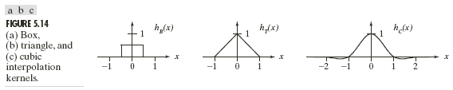
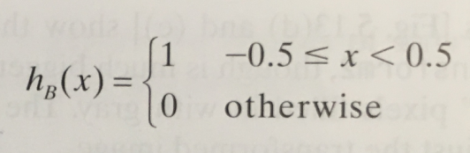
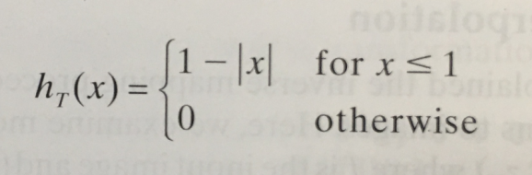
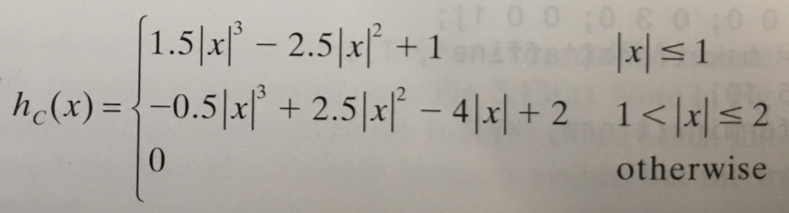
可嘗試其他interpolation filter
box
Triangle又叫linear
cubic
@畫出我們的filter與此數學式之差別
@h=[0 ½ 1 ½ 0]➔ h=[0 1/4 1/2 1/4 0]
@h=[1/4 1/2 1/4]
@記得要做正規化
@手寫cubic一維 (手寫2)

Slide 26
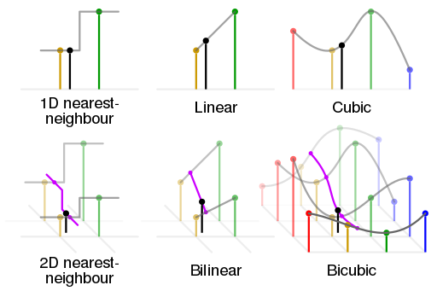
2-D版本

Slide 27
剛剛是2倍
3倍怎麼辦? 4倍?

Slide 28
Notes:
NOTE: There is only one slide for Chapter 1.

Slide 29
Notes:
NOTE: There is only one slide for Chapter 1.

Slide 30
Matlab內建function-- imresize
A=imread('cameraman.tif');
figure;imshow(A);
B=imresize(A,2);
figure;imshow(B);
C=imresize(A,0.5);
figure;imshow(C);

Slide 31
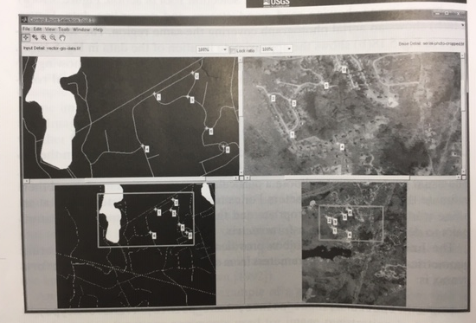
Registration

Slide 32
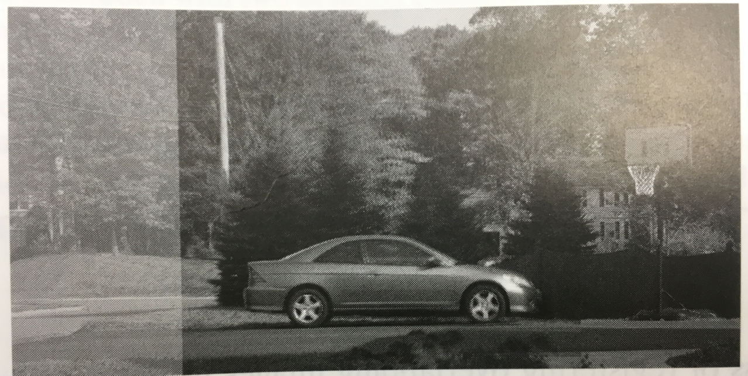
Registration-stich
Template matching process

