Slide 1
Growth Kinetics of Ferrite
on an Austenite Grain Boundary Face
Seong Gyoon Kim, Kunsan National University
POSCO (2007. 9. 7.)

Slide 2
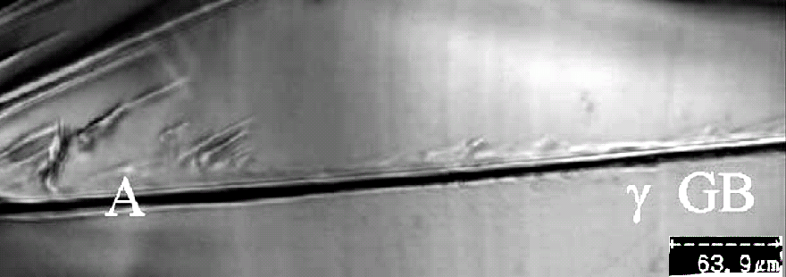
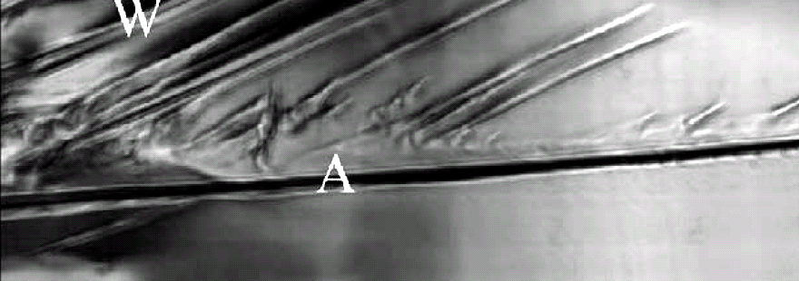
Growth of ferrite allotriomorph: In situ observation
646 C°
4
sec.
640 C°
D. Phelan, Mater. Sci. & Eng. (2005)
In situ laser-scanning confocal microscopy study

Slide 3
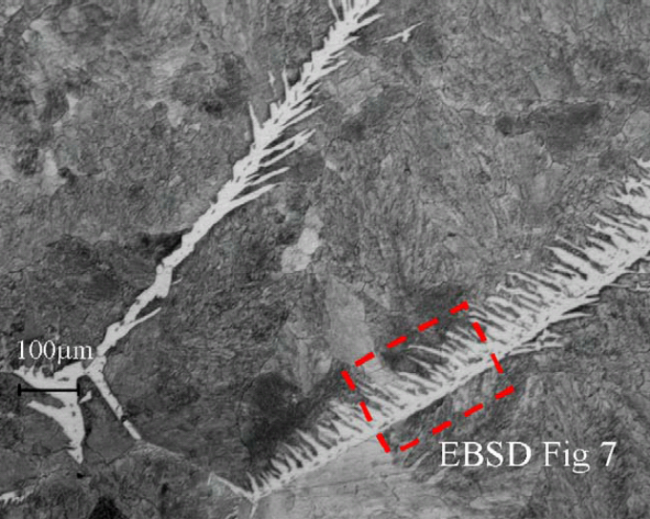
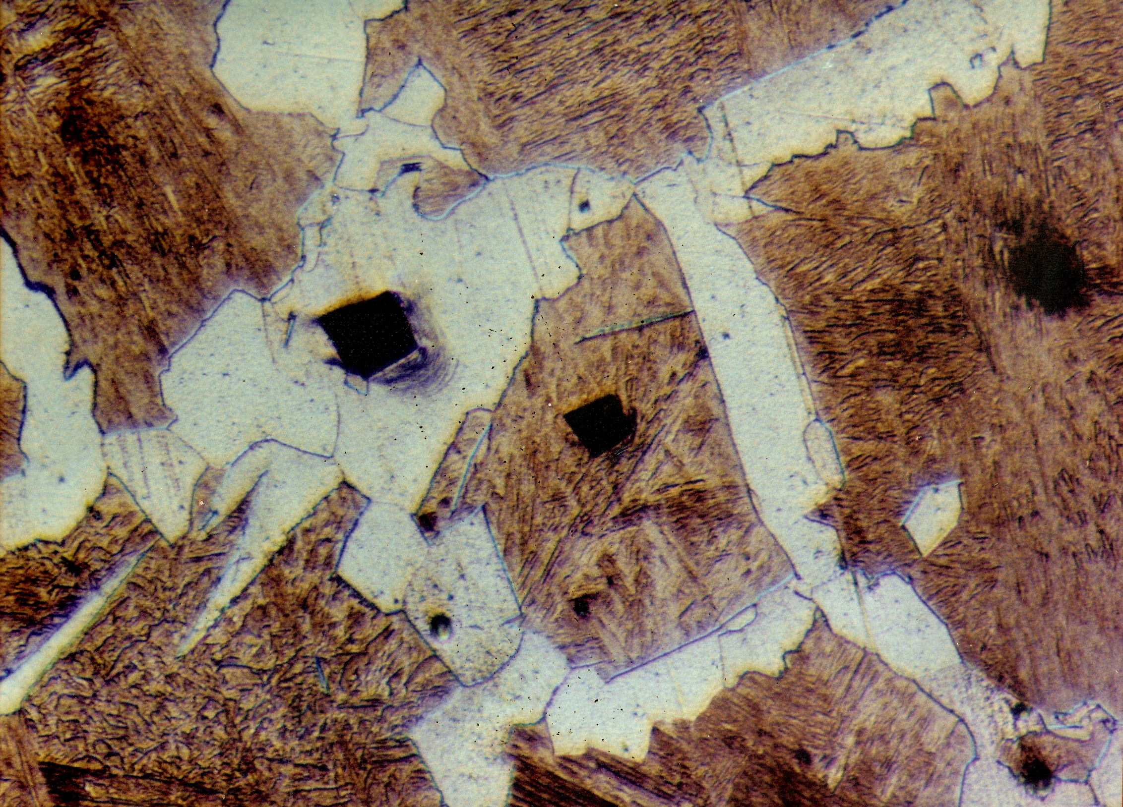
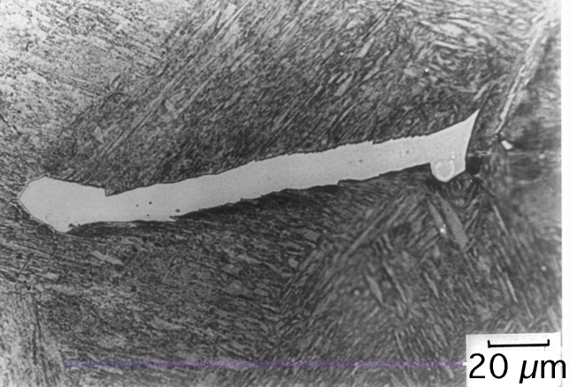
Growth of ferrite allotriomorph: Optical microscopy
D. Phelan, Mater. Sci. & Eng. (2005)
S.G. Kim (1990)
H. Bhadeshia
Prog. Mater. Sci. (1985)

Slide 4
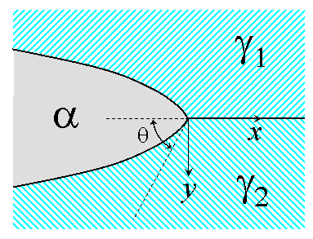
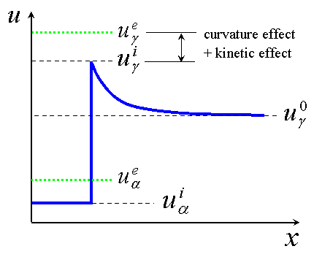


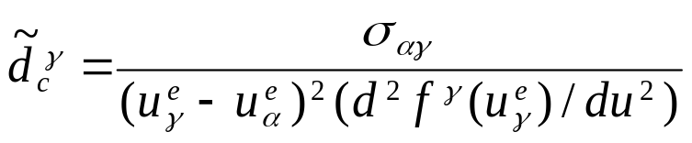

Diffusional growth of ferrite on austenite GB
equil. comp.
alloy comp.
equil. comp.
Growth rate of ferrite is a function of
wetting angle,
dimensionless supersaturation,
capillary length,
carbon diffusivity,

Slide 5
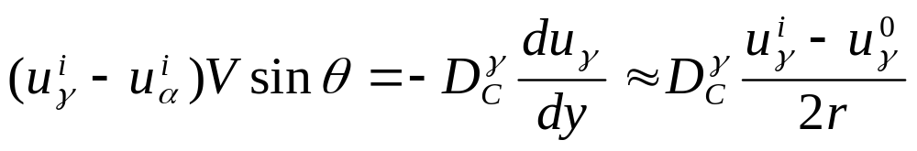
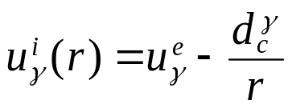
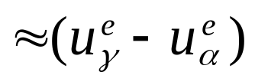
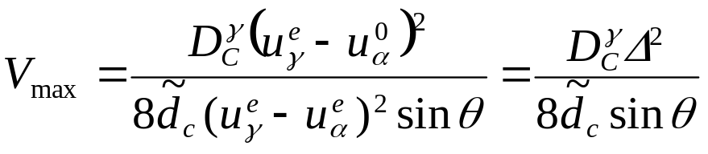

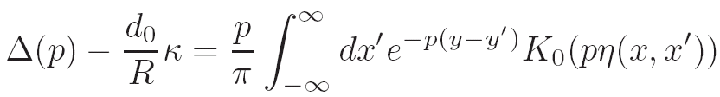
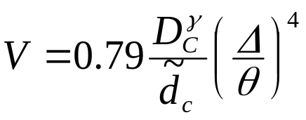
Theory of ferrite growth on austenite GB
Zener-Hillert theory (1957, Jernkontorets Ann.)
maximum velocity
Brener theory (in Press, 2007, Phys. Rev. Lett.)
For small Δ, θ and p/θ ² :

Slide 6

Phase-field simulation of ferrite growth on austenite GB
1. Adoption of full thermodynamic database
2. Wetting angle control by boundary condition
3. Simulation parameters
Ferrite/austenite interface energy:
J/m²
Ferrite/austenite interface mobility: m
Local equilibrium: m = ∞
Hillert: m = 0.035 exp(-147,000/RT) m⁴/Js
Hillert & Hoglund Scripta Mater. (2006) 1259
Wits: m = 1.7x10⁻⁵ exp(-140,000/RT)
Krielaart: m = 4.x10⁻⁷ exp(-140,000/RT)
Carbon concentration: 0.1 wt%
Temperature: 869~700 °C (ΔT = 0~170 K, Δ=0~0.92 )
Wetting angle: 15~50 degree

Slide 7
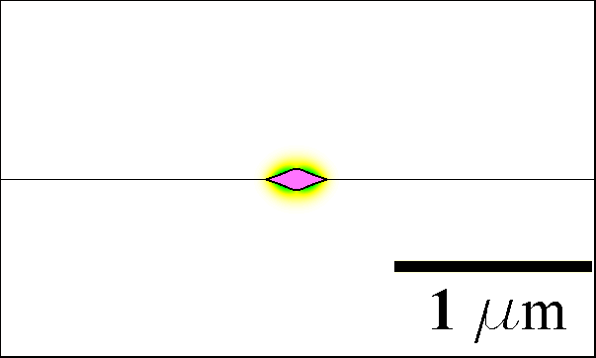
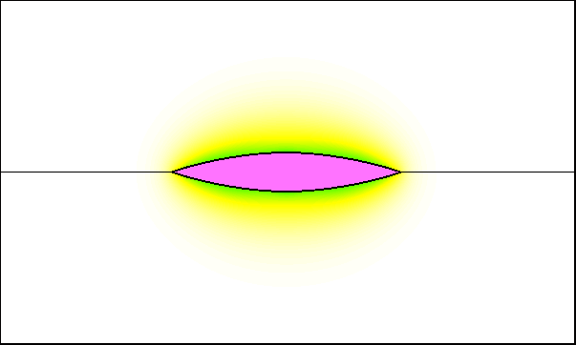
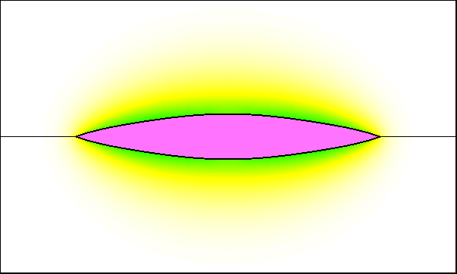
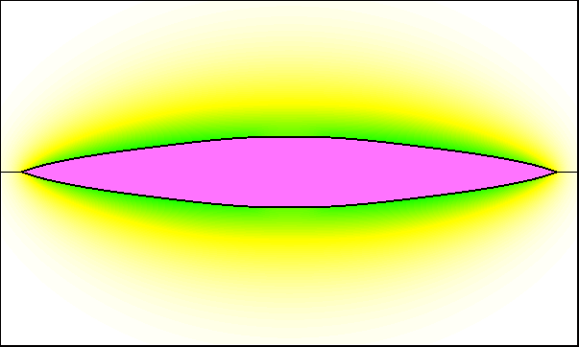
Simulation example: morphology
t = 3.6x10⁻⁴ s
t = 9.1x10⁻³ s
t = 0.018 s
t = 0.027 s
ΔT = 20 K, θ = 20º

Slide 8
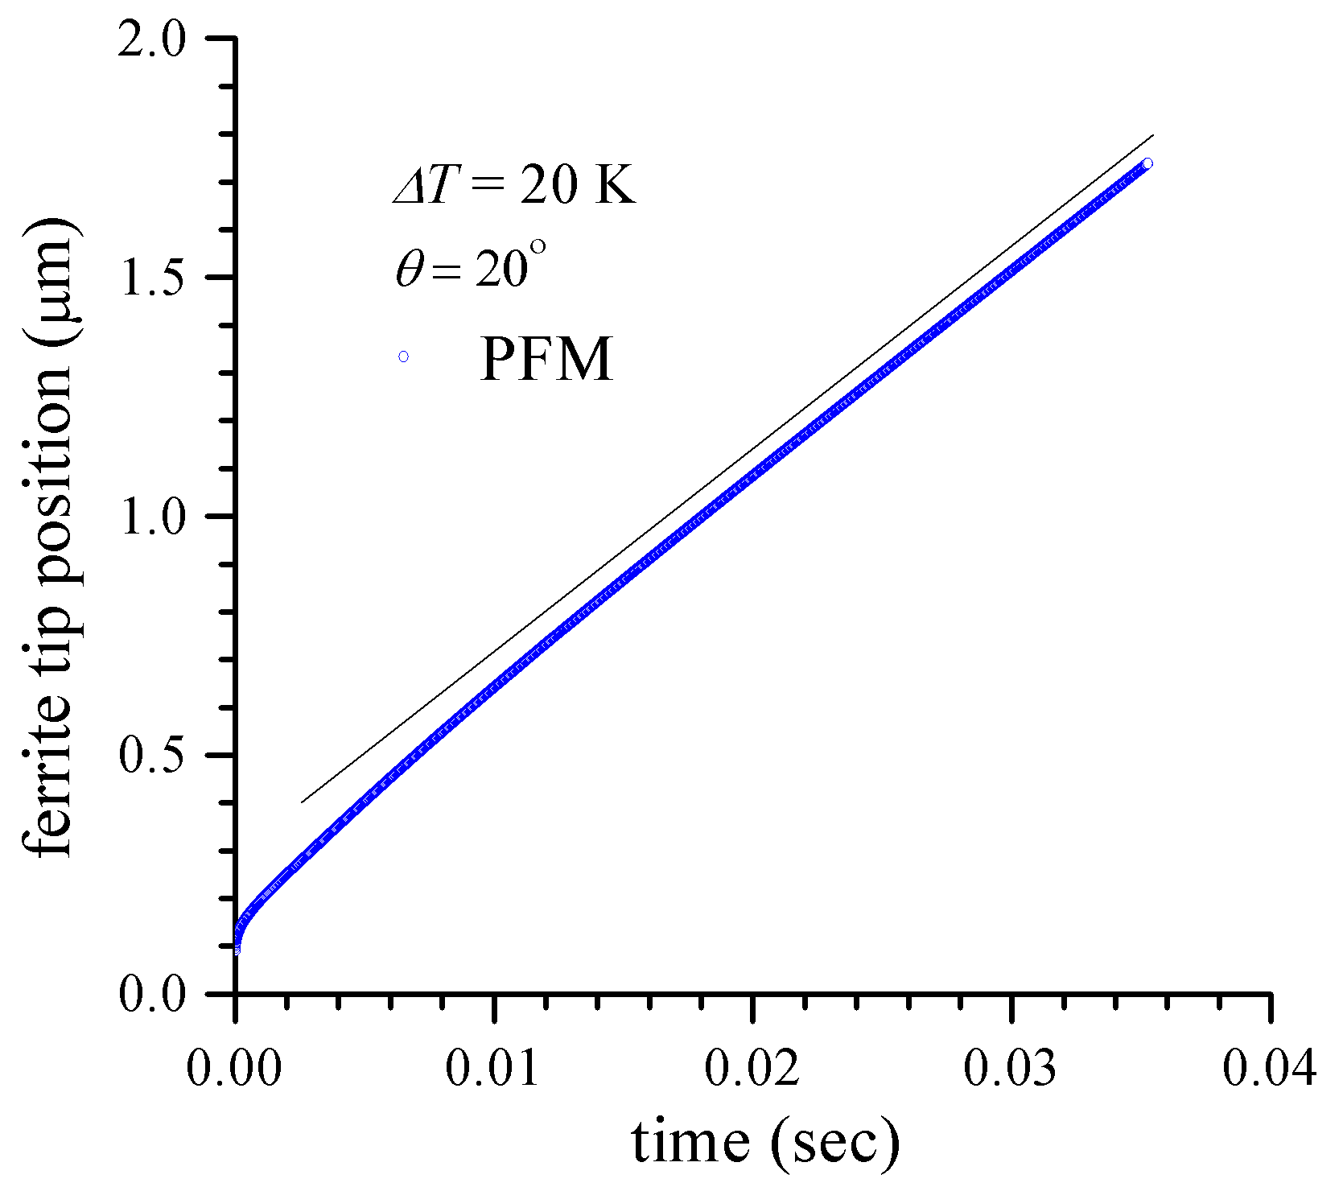
Simulation example: growth rate

Slide 9
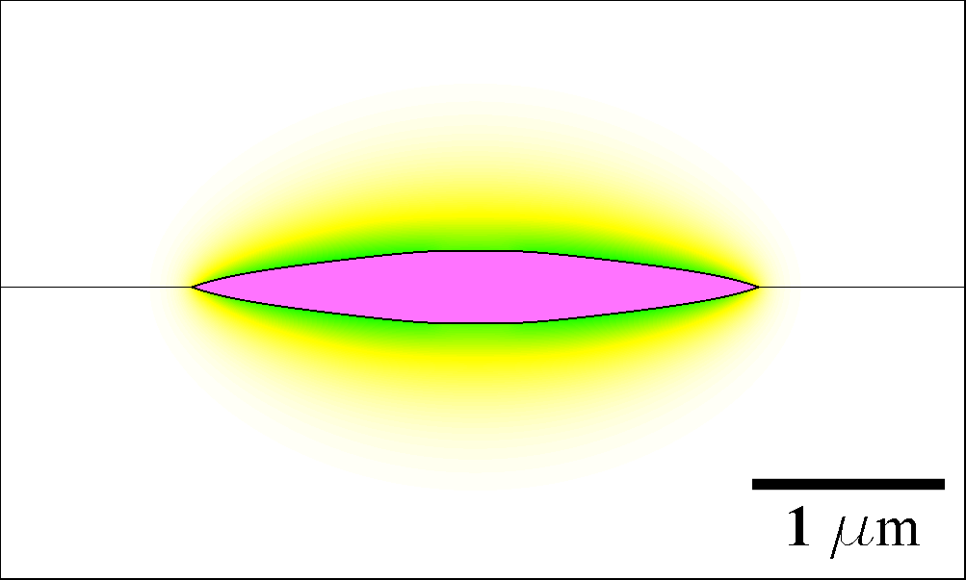
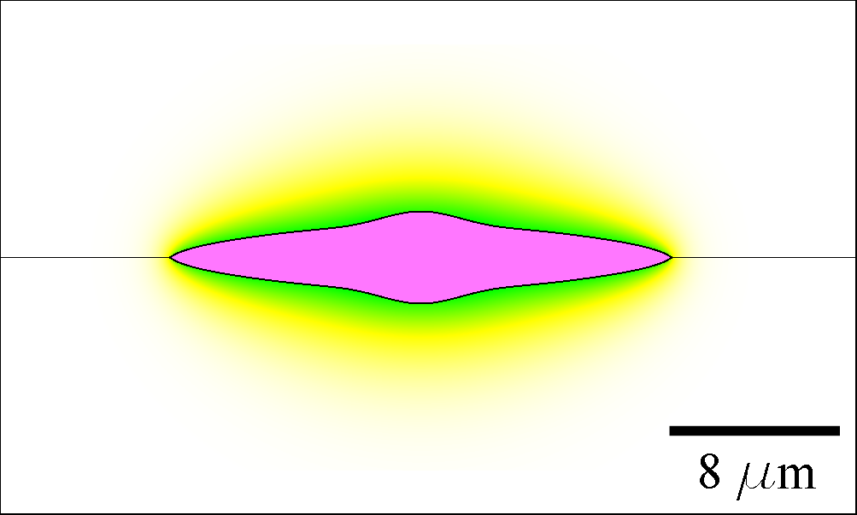
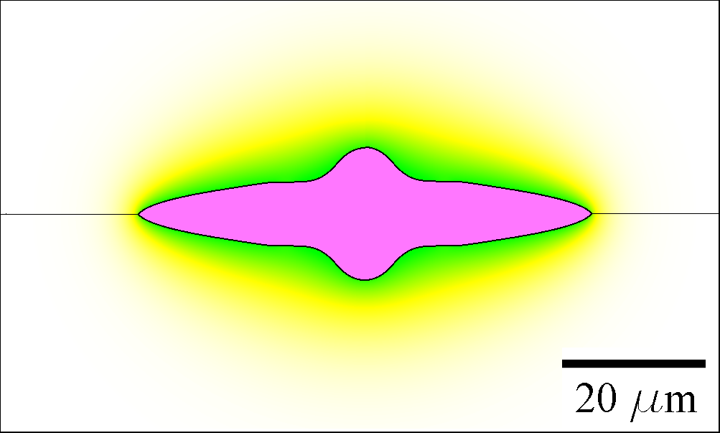


Morphological change with wetting angle
ΔT = 20 K
θ = 20º
θ = 35º
t = 0.029 s
t = 2.23 s
θ = 50º
t = 23.2 s
θ = 20º
θ = 50º

Slide 10
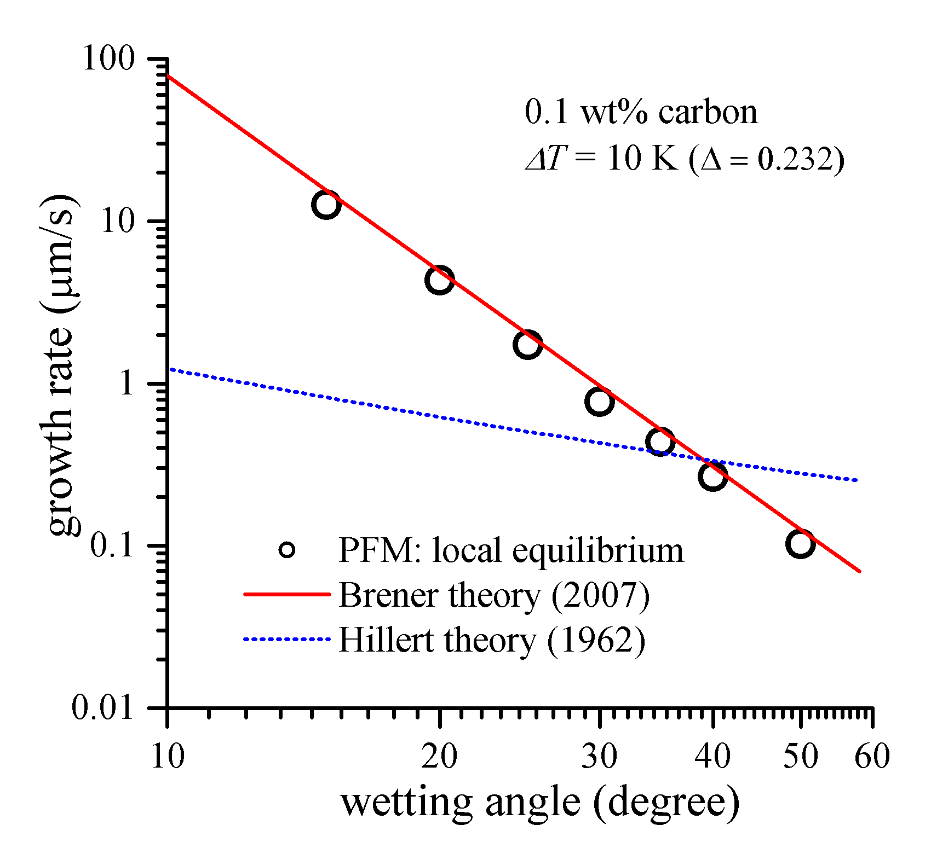
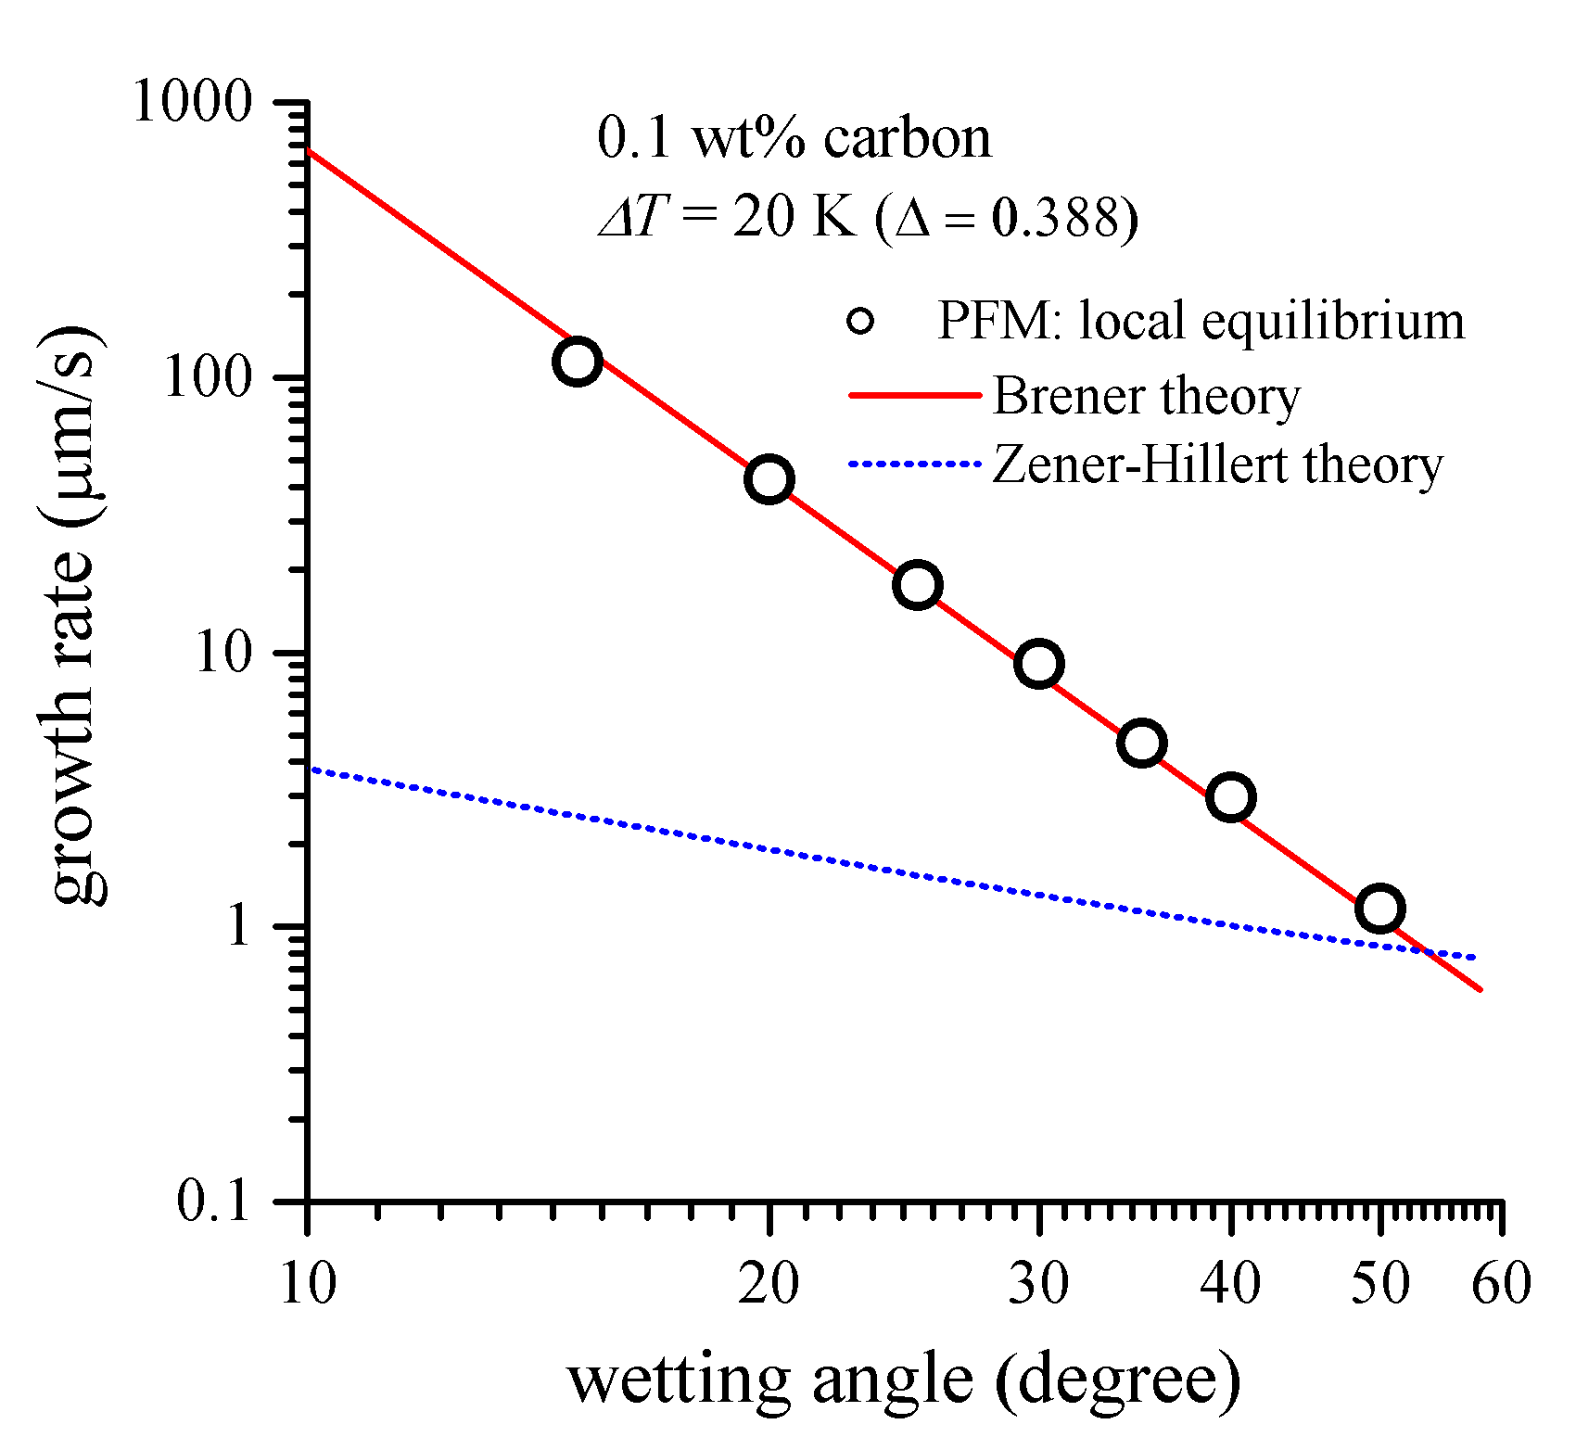
Effect of wetting angle
ΔT = 10 K
ΔT = 20 K
V ~ 1/θ ⁴
for even large θ !

Slide 11
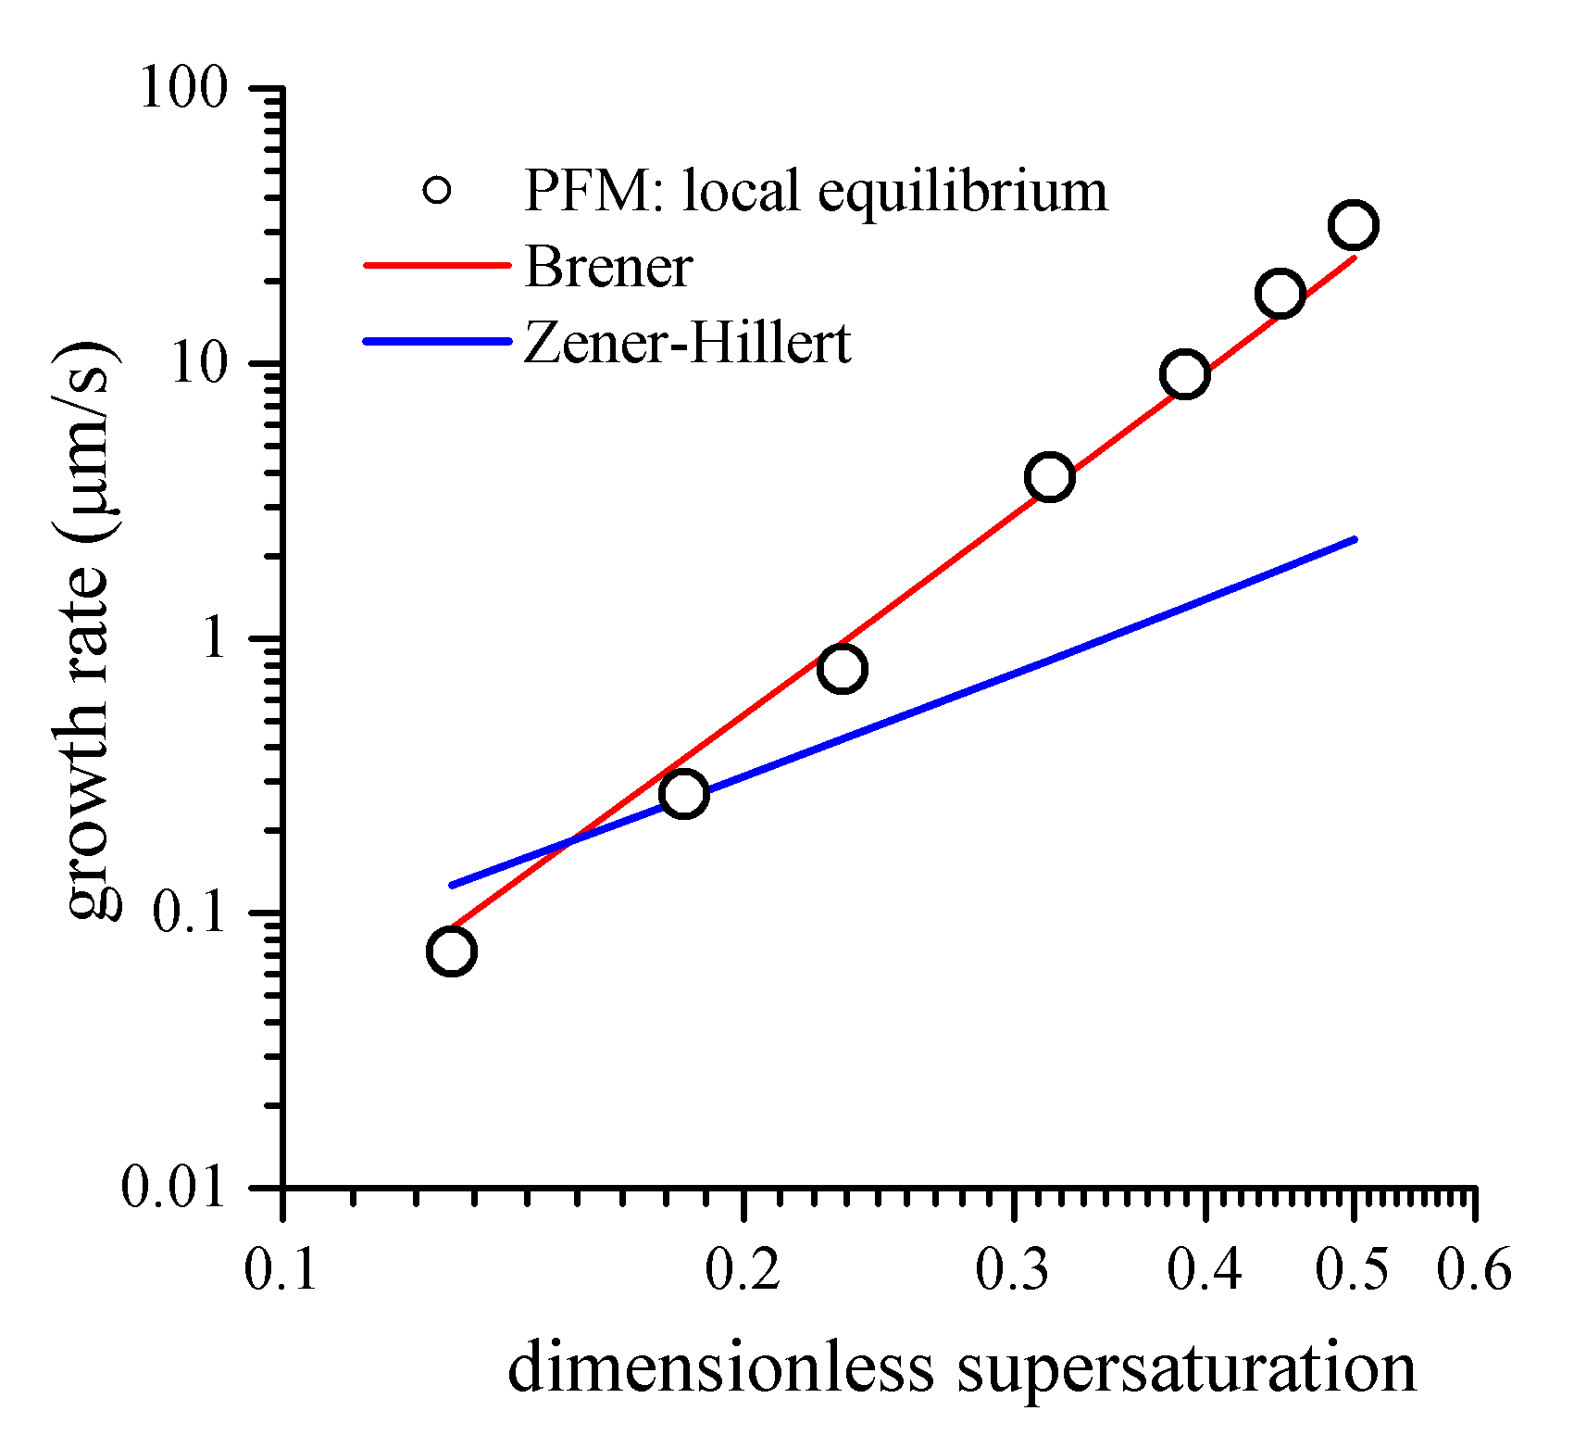
Effect of supersaturation
Θ = 30º
V ~ Δ⁴
for Δ < 0.5

Slide 12
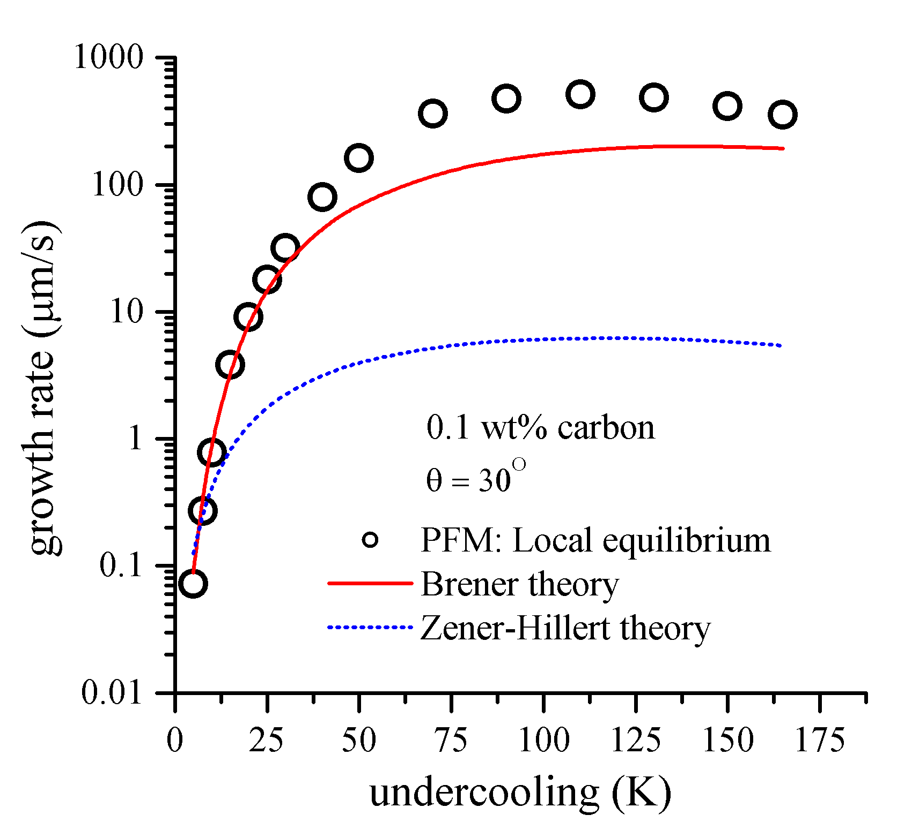
Effect of supersaturation

Slide 13
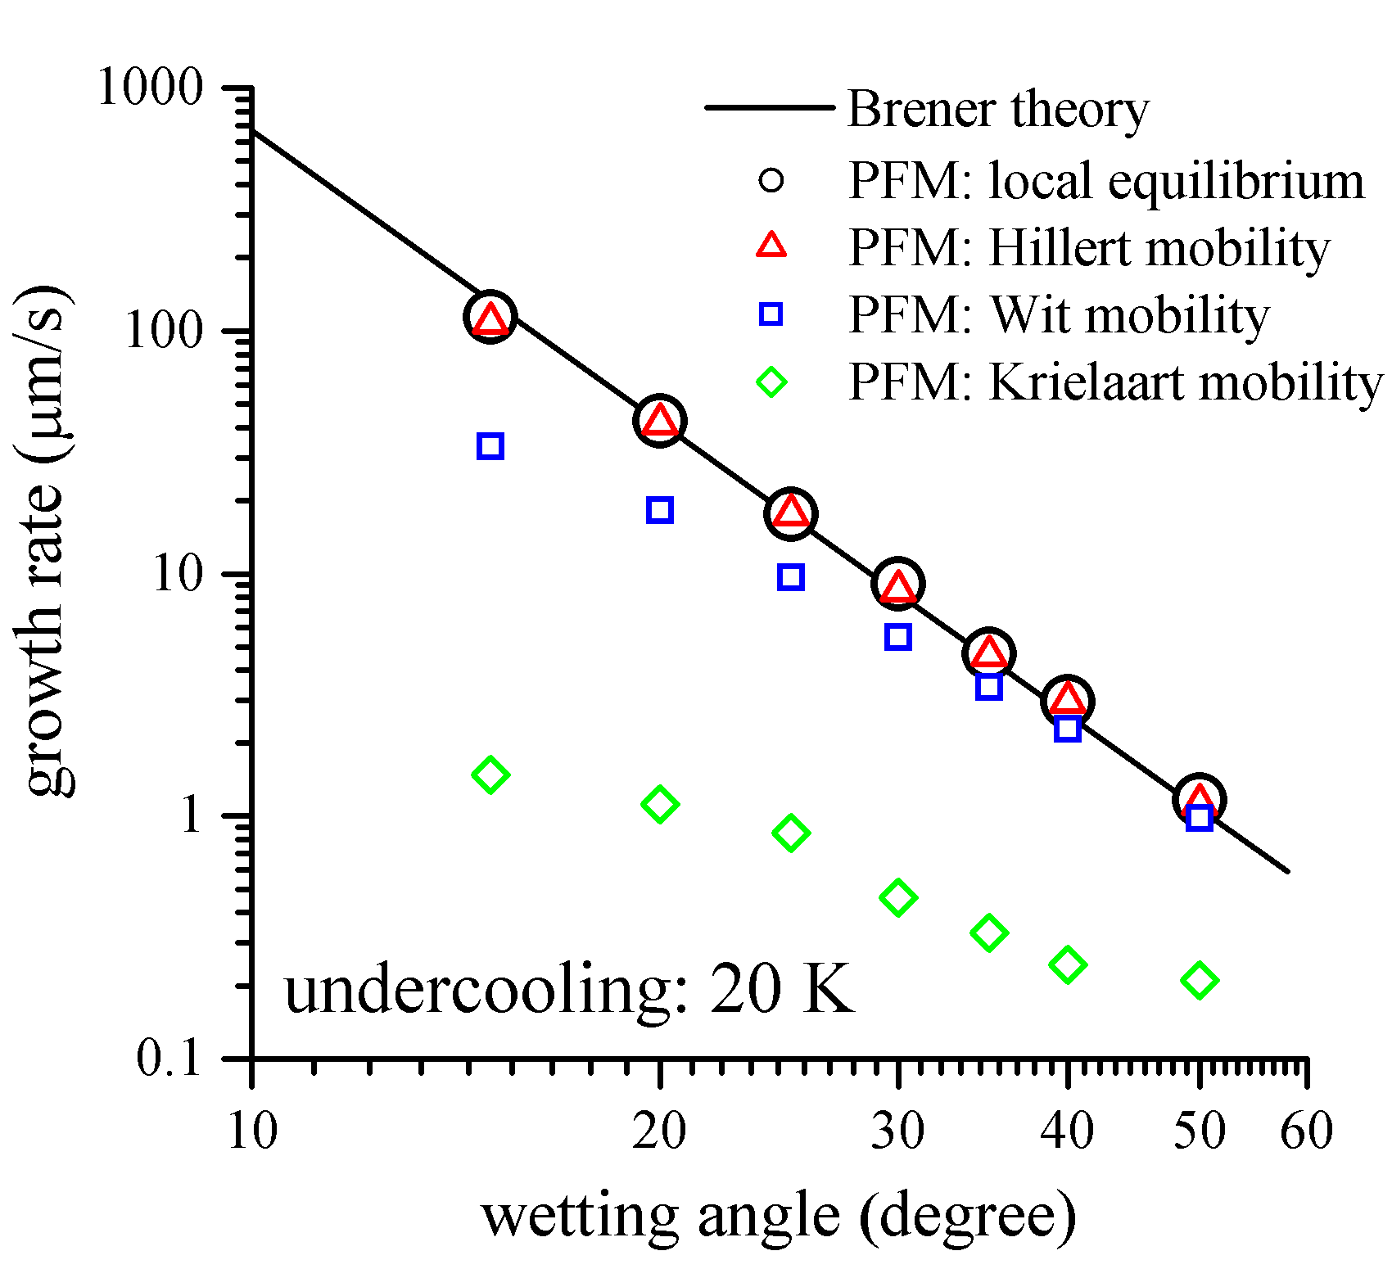
Effect of interface mobility

Slide 14
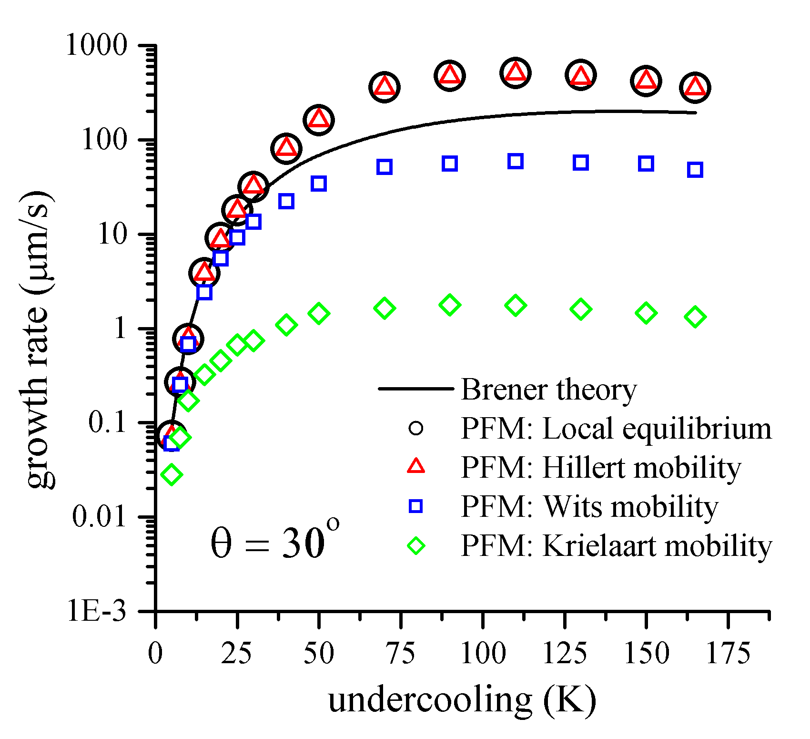
Effect of interface mobility

Slide 15
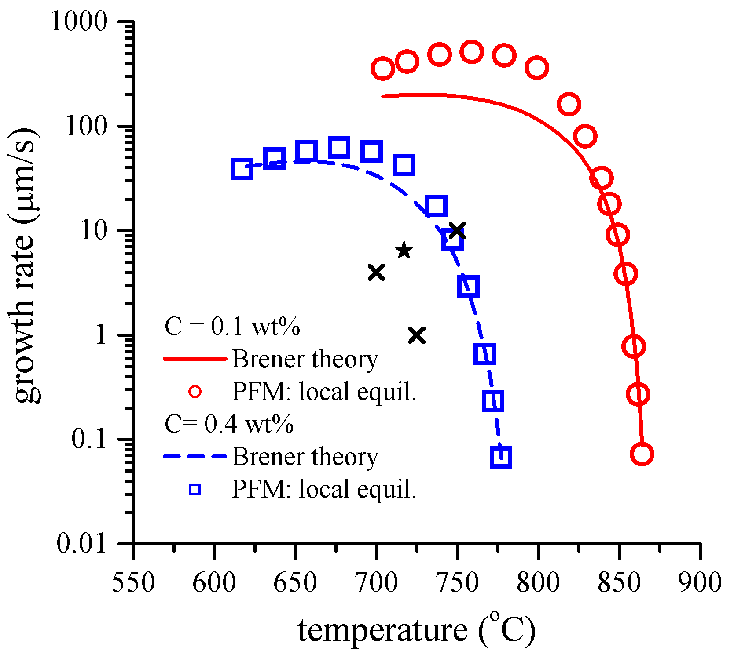
Effect of carbon concentration
Θ = 30º
0.4 wt% C
0.1 wt% C

Slide 16
Conclusion
For ferrite growth on austenite GB, we now have the correct theory; Brener solution
2. Phase-field simulation results are in excellent agreement with Brener solution
3. Importance of the interface mobility effect
4. Urgent necessity of reanalysis of the experimental results
5. Implication on the initial stage of ferrite growth: Possibility of orientation selection by growth competition

